Slide 1
Using Accelerator Directives to Adapt Science Applications for State-of-the-Art HPC Architectures
John E. Stone
Theoretical and Computational Biophysics Group
Beckman Institute for Advanced Science and Technology
University of Illinois at Urbana-Champaign
http://www.ks.uiuc.edu/Research/gpu/
WACCPD 2017: Fourth Workshop on Accelerator Programming Using Directives
9:15am-10:00am, Room 710-712, Colorado Convention Center,
Denver, CO, Monday Nov 13th, 2017

Slide 2
Overview
My perspective about directive-based accelerator programming today and in the near-term ramp up to exascale computing
Based on our ongoing work developing VMD and NAMD molecular modeling tools supported by our NIH-funded center since the mid-90’s
What is a person like me doing using directives? I’m the same guy that likes to give talks about CUDA and OpenCL, x86 intrinsics, and similarly lower level programming techniques. Why am I here?

Slide 3
Spoilers:
Directives are a key solution in the “all options on the table” type of approach that I believe is required as we work toward exascale computing
There aren’t enough HPC developers in the world to write everything entirely in low level APIs fast enough to keep pace
Science is an ever changing landscape – significant methodological developments come every few years in active fields like biomolecular modeling…
Code gets (re)written for new science methodologies before you’ve finished optimizing the old code for the previous science method!?!?!?!
Hardware is still changing very rapidly, and more disruptively than during the blissful heyday of “Peak Moore’s Law”

Slide 4
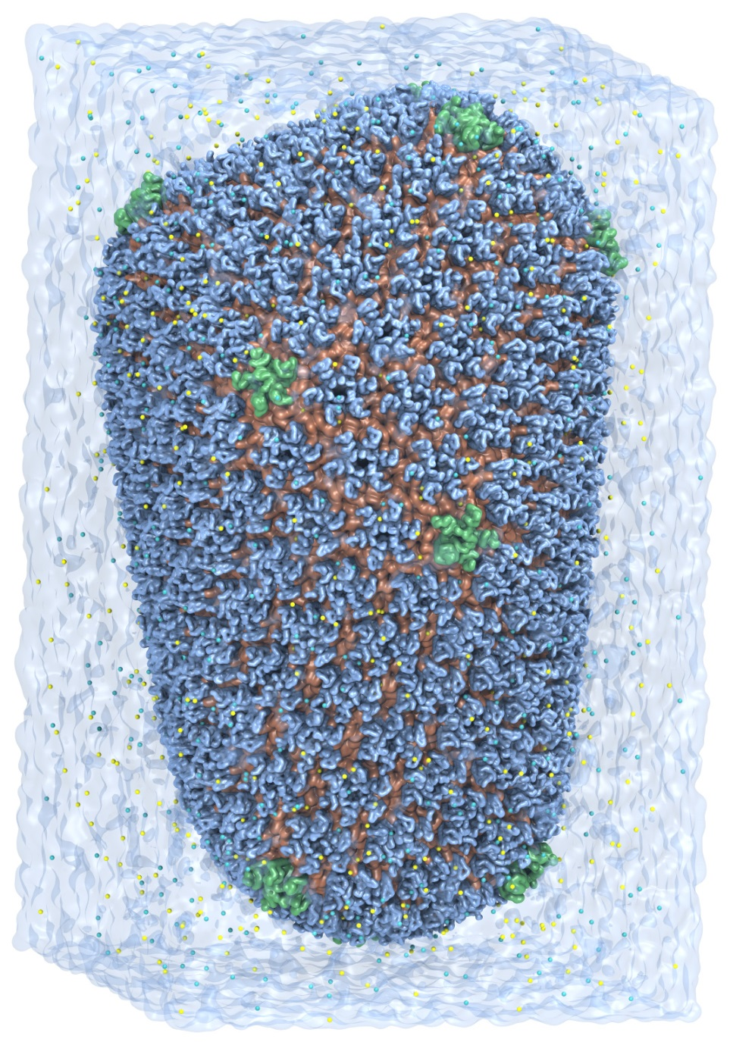
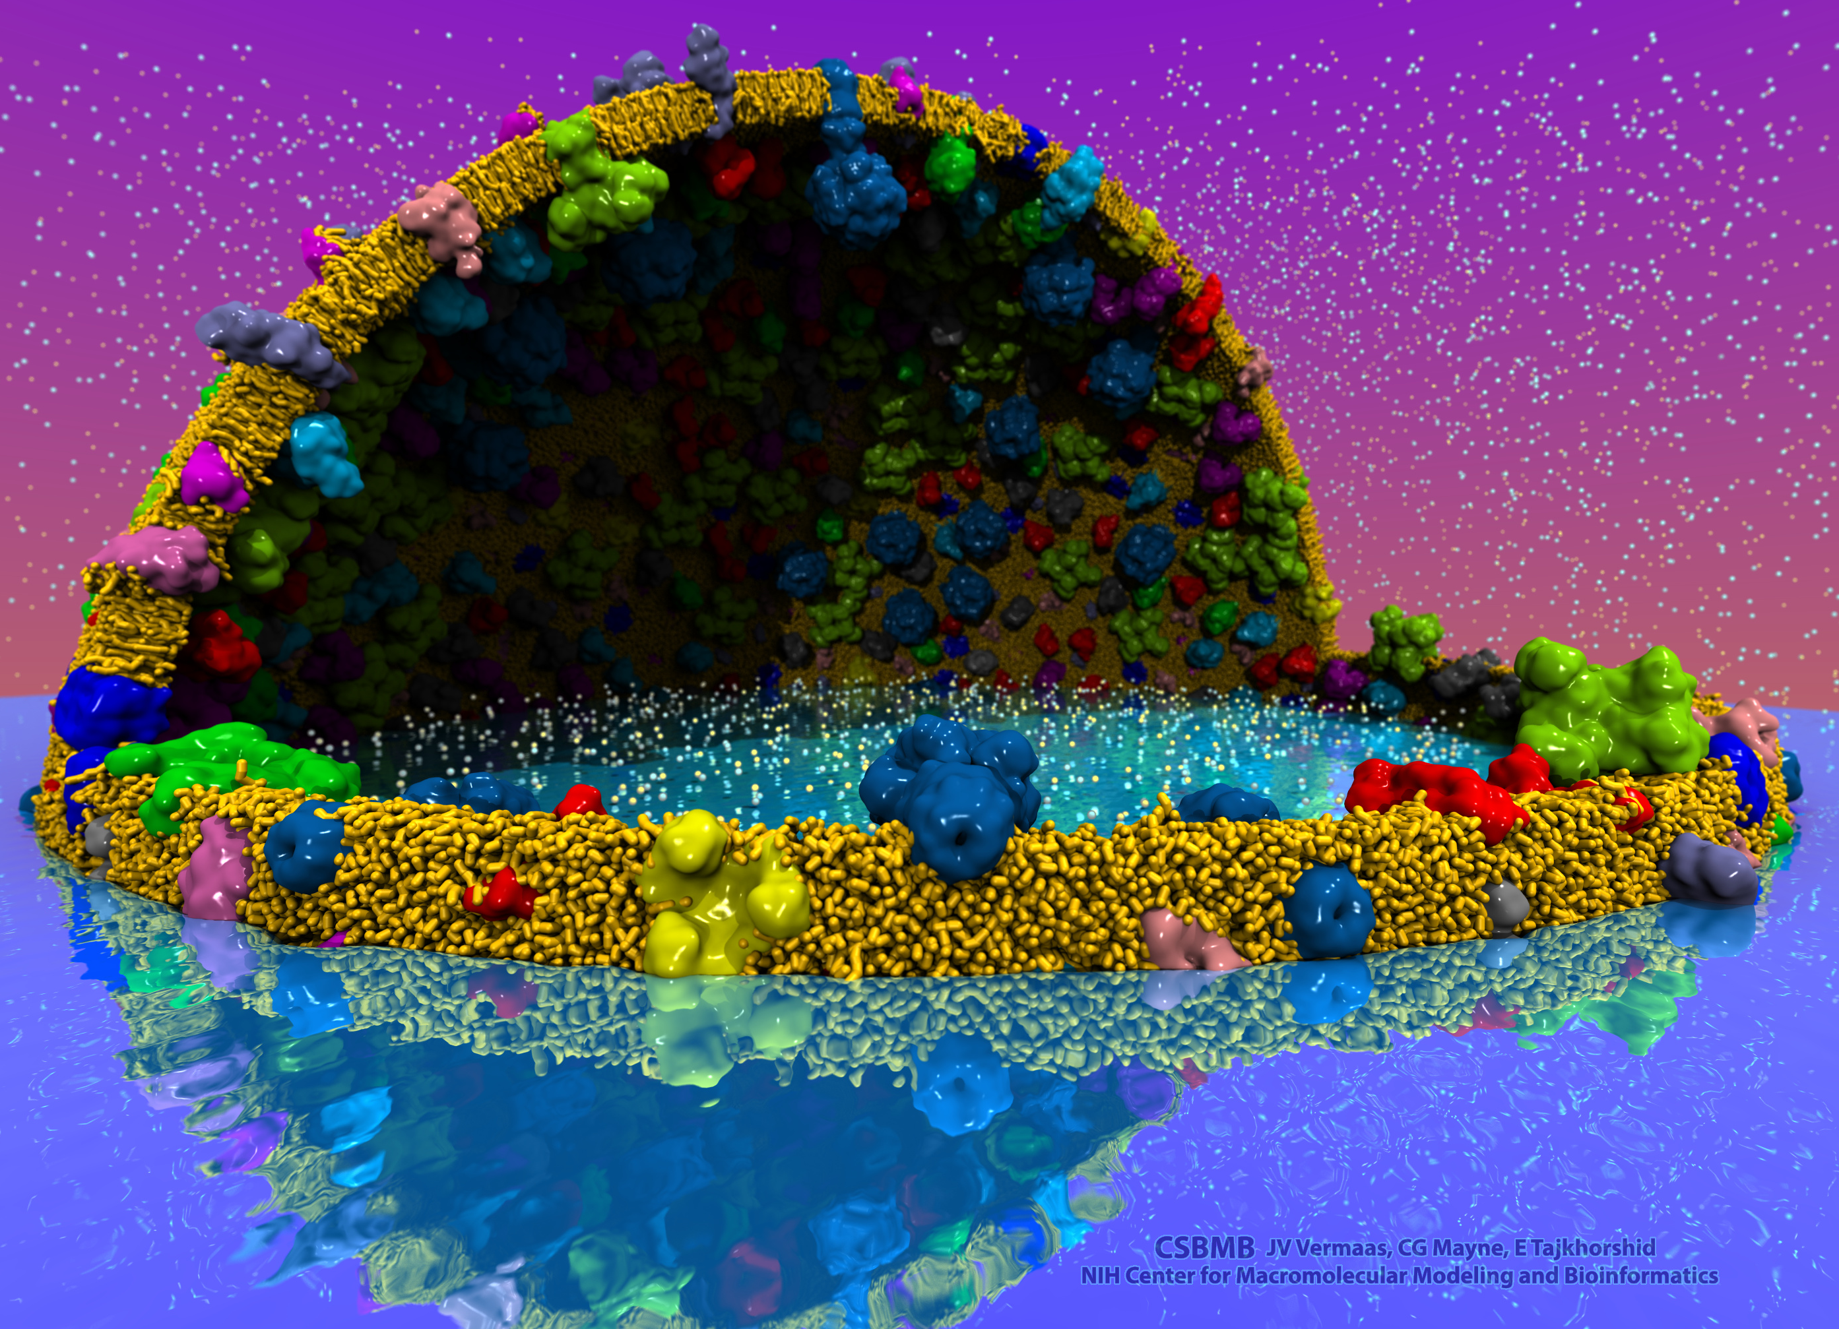
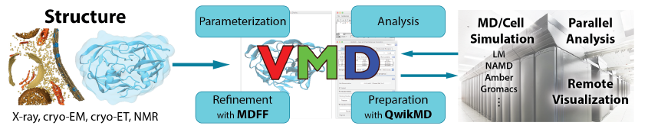
VMD – “Visual Molecular Dynamics”
Visualization and analysis of:
  Molecular dynamics simulations
  Lattice cell simulations
  Quantum chemistry calculations
  Sequence information
User extensible scripting and plugins
http://www.ks.uiuc.edu/Research/vmd/
Cell-Scale Modeling
MD Simulation

Slide 5
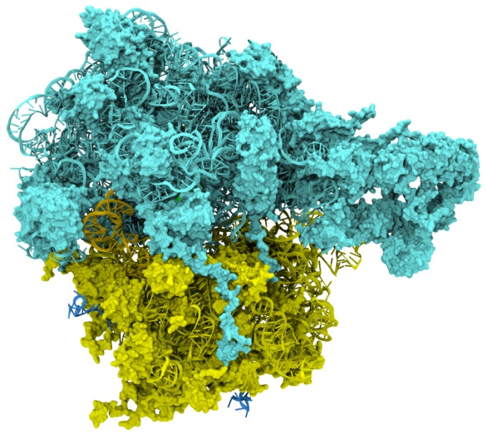
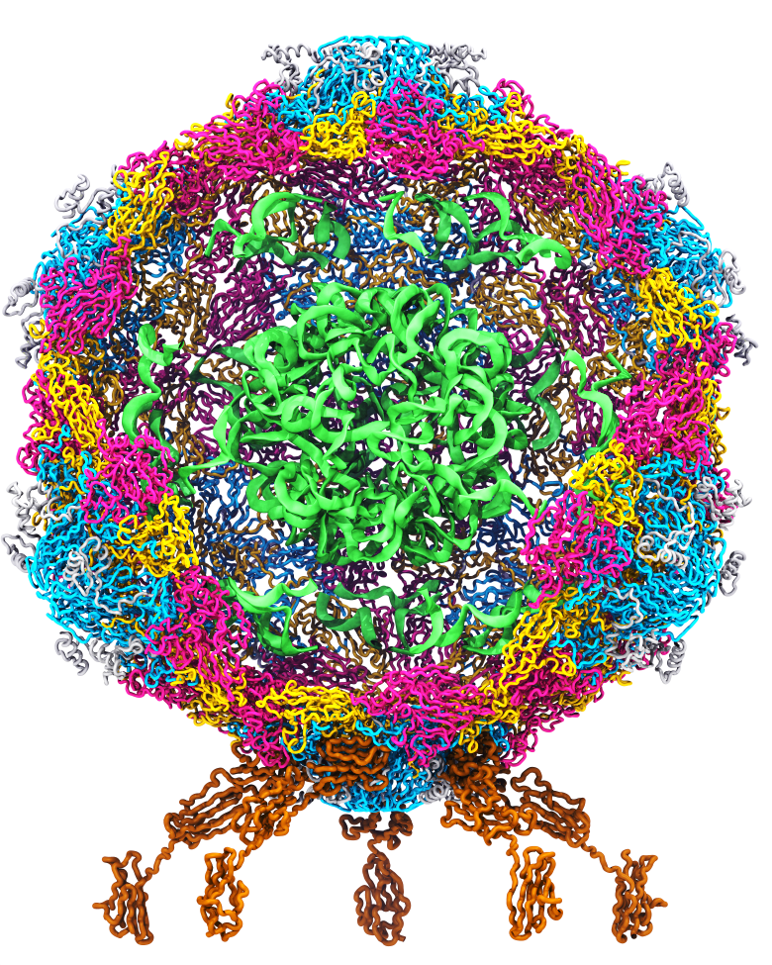
Goal: A Computational Microscope
Study the molecular machines in living cells
Ribosome: target for antibiotics
Poliovirus
Notes:
Ribosomes synthesize new proteins from genetic information
Bacterial ribosome is a target for antibiotics, which interfere with its ability to function by binding to sites on the structure, preventing proteins from being synthesized
Ribosome simulations are extremely computationally challenging due to the size of the structure and its natural environment (solvent, ions, etc, large box, 3 million atoms or so)
Bionanodevice for sequencing DNA efficiently
Knowledge of an individual’s genetic makeup can lead to the prediction and treatment of many diseases by the means of personal genomic medicine and pharmacogenomics. In order for genome sequencing to become practical for common medical use, an inexpensive high throughput genome sequencing technique is required. NIH has set a goal of reducing the cost of genome sequencing by a factor of 10,000, to less than $1,000 within ten years.
The computer is the best microscope to guide the development of bionanodevices, for example to sequence DNA. While experiments can measure DNA electrostatic potentials, they cannot visualize the DNA’s location and conformation at the time of measurement.

Slide 6
Exemplary Hetereogeneous
Computing Challenges
Tuning, adapting, or developing software for multiple processor types
Decomposition of problem(s) and load balancing work across heterogeneous resources for best overall performance and work-efficiency
Managing data placement in disjoint memory systems with varying performance attributes
Transferring data between processors, memory systems, interconnect, and I/O devices

Slide 7
Major Approaches For Programming Hybrid Architectures
Use drop-in libraries in place of CPU-only libraries
  Little or no code development
  Examples: MAGMA, BLAS-variants, FFT libraries, etc.
  Speedups limited by Amdahl’s Law and overheads associated with data movement between CPUs and GPU accelerators
Generate accelerator code as a variant of CPU source, e.g. using OpenMP and OpenACC directives, and similar
Write lower-level accelerator-specific code, e.g. using CUDA, OpenCL, other approaches

Slide 8
Challenges Adapting Large Software Systems for State-of-the-Art Hardware Platforms
Initial focus on key computational kernels eventually gives way to the need to optimize an ocean of less critical routines, due to observance of Amdahl’s Law
Even though these less critical routines might be easily ported to CUDA or similar, the sheer number of routines often poses a challenge
Need a low-cost approach for getting “some” speedup out of these second-tier routines
In many cases, it is completely sufficient to achieve memory-bandwidth-bound GPU performance with an existing algorithm

Slide 9
Amdahl’s Law and Role of Directives
Initial partitioning of algorithm(s) between host CPUs and accelerators is typically based on initial performance balance point
Time passes and accelerators get MUCH faster…
Formerly harmless CPU code ends up limiting overall performance!
Need to address bottlenecks in increasing fraction of code
Directives provide low cost, low burden, approach to improve incrementally vs. status quo
Directives are complementary to lower level approaches such as CPU intrinsics, CUDA, OpenCL, and they all need to coexist and interoperate very gracefully alongside each other

Slide 10
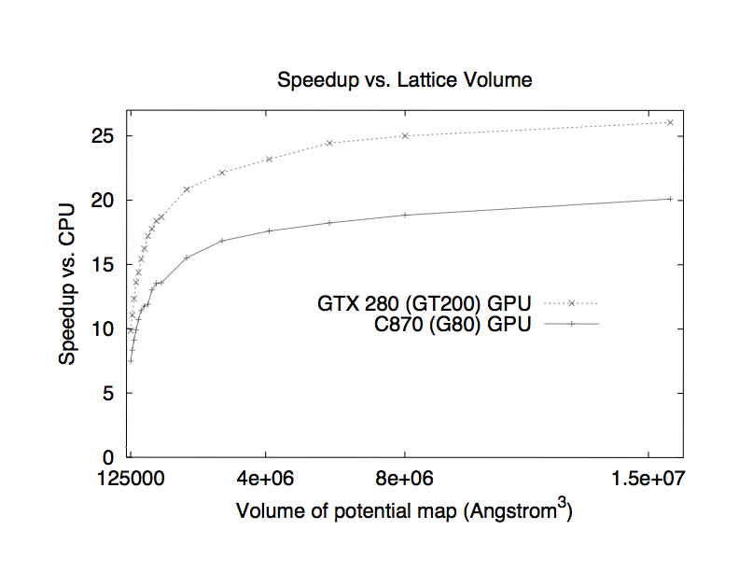
Multilevel Summation on the GPU:
An Amdahl’s Law Example From Our Previous Work
Accelerate short-range cutoff and lattice cutoff parts
Performance profile for 0.5 Å map of potential for 1.5 M atoms.
Hardware platform is Intel QX6700 CPU and NVIDIA GTX 280.
Computational steps | CPU (s) | w/ GPU (s) | Speedup
Short-range cutoff | 480.07 | 14.87 | 32.3
Long-range anterpolation | 0.18
restriction | 0.16
lattice cutoff | 49.47 | 1.36 | 36.4
prolongation | 0.17
interpolation | 3.47
Total | 533.52 | 20.21 | 26.4
Multilevel summation of electrostatic potentials using graphics processing units. D. Hardy, J. Stone, K. Schulten. J. Parallel Computing, 35:164-177, 2009.
Notes:
The short-range cutoff and lattice cutoff calculations are the most computationally demanding parts of multilevel summation and have the most data-parallelism to exploit.
The short-range part is just cutoff summation on the GPU, using a switching function particular to multilevel summation.
For the lattice cutoff part, the pairwise distances between lattice points are precomputed.
The calculation simplifies to accumulating at each lattice point a sum of the “weighted” surrounding charges.
We accelerate this by streaming blocks of lattice charges from global memory into shared memory and reading the fixed weights from the GPU constant memory.

Slide 11
How Do Directives Fit In?
Single code base is typically maintained
Almost “deceptively” simple to use
Easy route for incremental, “gradual buy in”
Rapid development cycle, but success often follows minor refactoring and/or changes to data structure layout
Higher abstraction level than other techniques for programming accelerators
In many cases, performance can be “good enough” due to memory-bandwidth limits, or based on return on developer time or some other metric

Slide 12
Why Not Use Directives Exclusively?
Some projects do…but:
  Back-end runtimes for compiler directives sometimes have unexpected extra overheads that could be a showstopper in critical algorithm steps
  High abstraction level may mean lack of access to hardware features exposed only via CUDA or other lower level APIs
  Fortunately, interoperability APIs enable directive-based approaches to be used side-by-side with hand-coded kernels, libraries, etc.
  Presently, sometimes-important capabilities like JIT compilation of runtime-generated kernels only exist within lower level APIs such as CUDA and OpenCL

Slide 13
What Do Existing Accelerated Applications Look Like?
I’ll provide examples from digging into modern versions of VMD and NAMD that both have already incorporated acceleration in a deep way.
Questions:
How much code needs to be “fast”
What fraction runs on accelerator now?
Using directives, how much more coverage can be achieved, and with what speedup?
Do I lose access to any points of execution or resource control that are critical for the application’s performance?

Slide 14
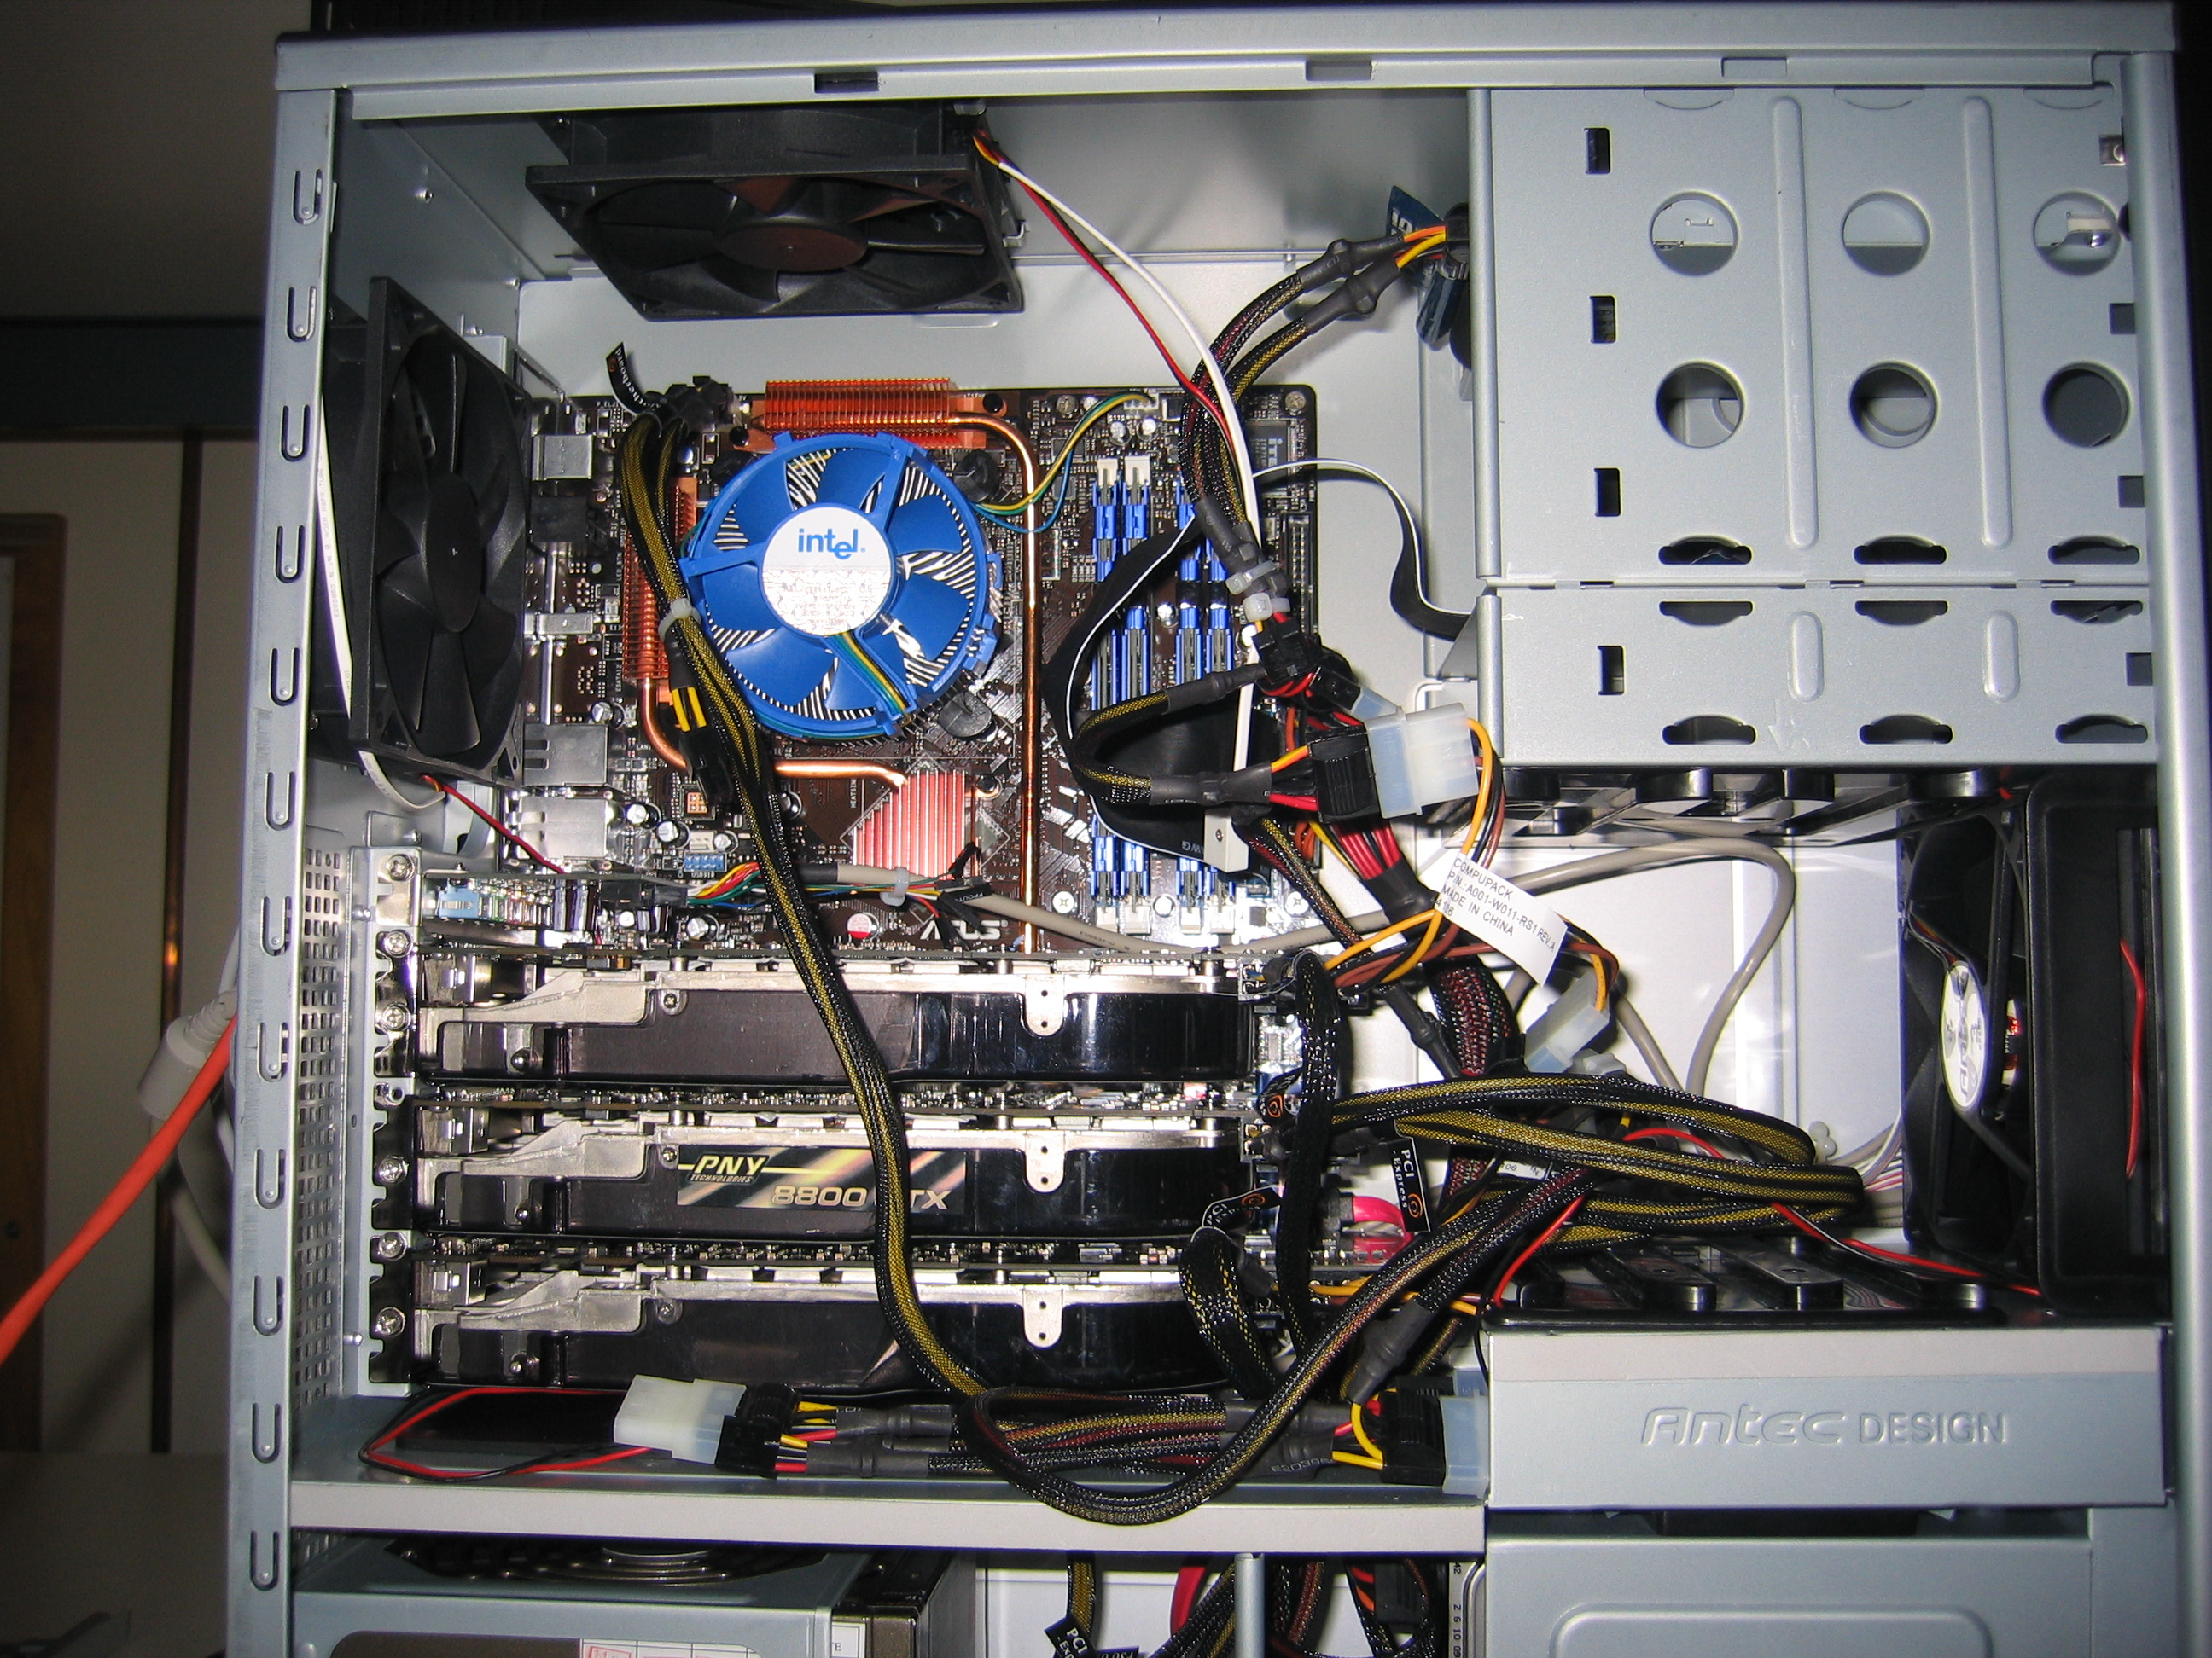
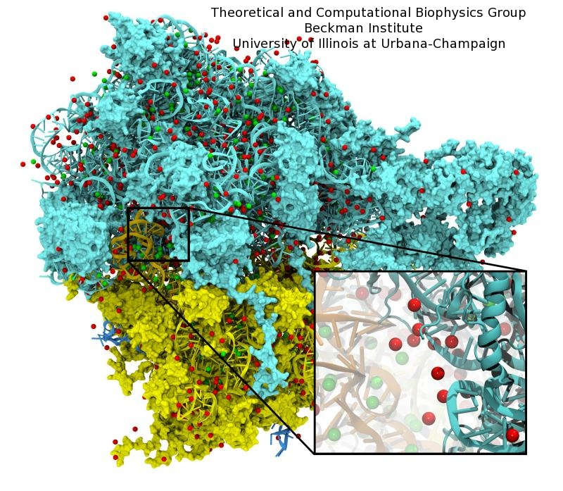
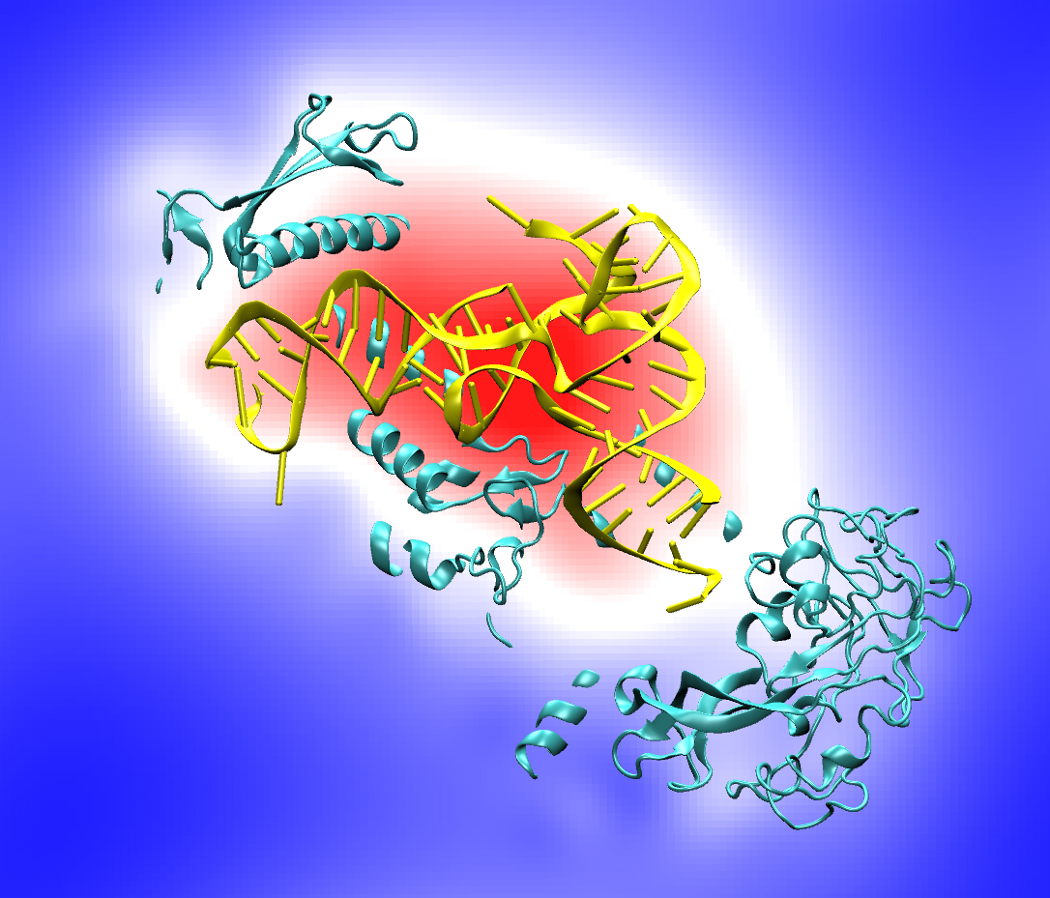
VMD: 10 Years of GPU-Accelerated Computing
Has stood the test of time
Modeling, Visualization, Rendering, and Analysis
Blast from the past:
CUDA starting with version 0.7 !!!
Quad core Intel QX6700, three NVIDIA GeForce 8800GTX GPUs, RHEL4 Linux
Accelerating molecular modeling applications with graphics processors. J. Stone, J. Phillips, P. Freddolino, D. Hardy, L. Trabuco, K. Schulten. J. Comp. Chem., 28:2618-2640, 2007.

Slide 15
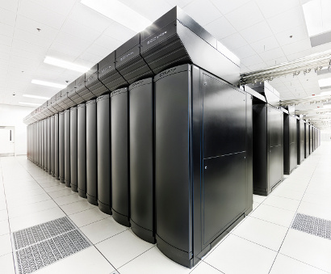
VMD Petascale Visualization and Analysis
Analyze/visualize large trajectories too large to transfer off-site:
  User-defined parallel analysis operations, data types
  Parallel rendering, movie making
Supports GPU-accelerated Cray XK7 nodes for both visualization and analysis:
  GPU accelerated trajectory analysis w/ CUDA
  OpenGL and GPU ray tracing for visualization and movie rendering
Parallel I/O rates up to 275 GB/sec on 8192 Cray XE6 nodes – can read in 231 TB in 15 minutes!
Parallel VMD currently available on:
ORNL Titan, NCSA Blue Waters, Indiana Big Red II, CSCS Piz Daint, and similar systems
NCSA Blue Waters Hybrid Cray XE6 / XK7
22,640 XE6 dual-Opteron CPU nodes
4,224 XK7 nodes w/ Telsa K20X GPUs

Slide 16
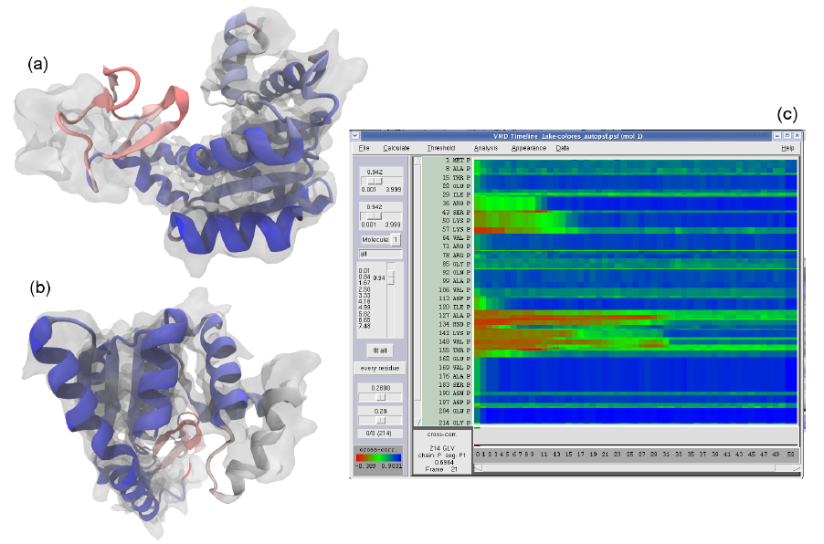
GPUs Can Reduce MDFF Trajectory Analysis Runtimes from Hours to Minutes
GPUs enable laptops and desktop workstations to handle tasks that would have previously required a cluster, or a very long wait…
GPU-accelerated petascale supercomputers enable analyses that were previously impractical, allowing detailed study of very large structures such as viruses
GPU-accelerated MDFF Cross Correlation Timeline
Regions with poor fit Regions with good fit

Slide 17
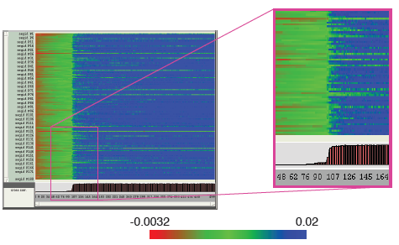
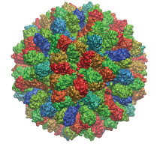
Parallel MDFF Cross Correlation Analysis on Cray XK7
Relative CC
Rabbit Hemorrhagic Disease Virus (RHDV)
Traj. frames | 10,000
Structure component selections | 720
Single-node XK7 (projected) | 336 hours (14 days)
128-node XK7 | 3.2 hours 105x speedup
2048-node XK7 | 19.5 minutes 1035x speedup
Structure
RHDV colored by relative CC
Time
Calculation of 7M CCs would take 5 years using serial CPU algorithm!
Stone et al., Faraday Discuss., 169:265-283, 2014.

Slide 18
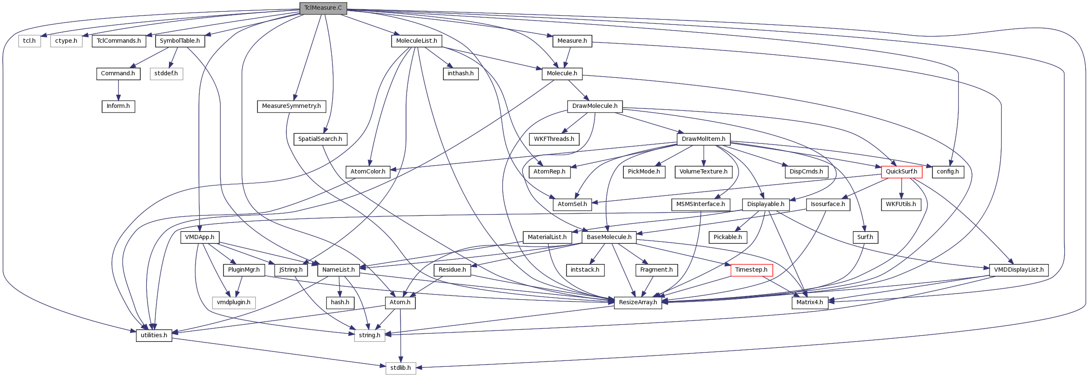
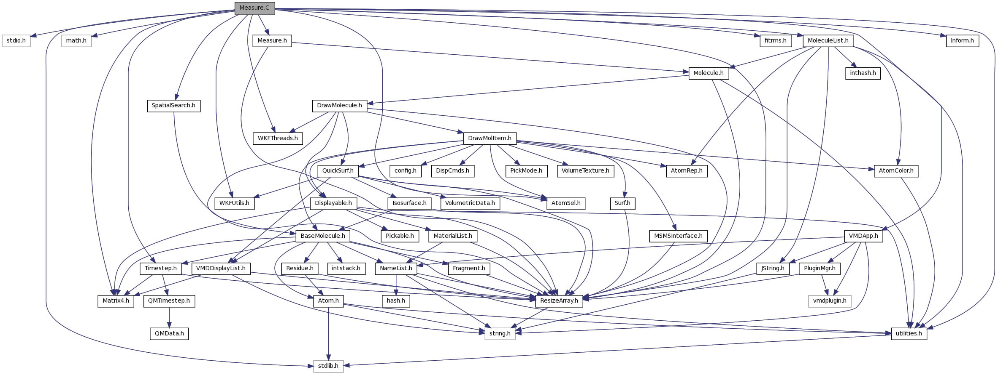
Example of VMD Module Connectivity
Early progress focused acceleration efforts on handful of high level analysis routines that were the most computationally demanding
Future hardware requires pervasive acceleration
Top image shows script interface links to top level analytical routines
Bottom image shows links among subset of data analytics algorithms to leaf-node functions

Slide 19
VMD Software Decomposition
Externally developed collective variables module:
C++: 20,000 LOC
Headers: 11,000 LOC
Internally+externally developed scripts
Tcl / Python scripts: 284,000 LoC
VMD “plugin” shared lib modules:
C: 102,000 LoC
C++: 36,000 LoC
Headers: 17,000 LoC
CUDA: 5,000 LoC
VMD Core (~230,000 LoC)
C++: 140,000 LoC
Headers: 36,000 LoC
C: 14,000 LoC
Tcl bindings: 12,000 LoC
Python bindings: 8,000 LoC
Hand-coded accelerator and vectorization:
CUDA: 17,000 LoC
Intel x86 intrinsics: 2,500 LoC
IBM POWER intrinsics: 500 LoC
ARM NEON intrinsics: 100 LoC

Slide 20
VMD Software Decomposition
All hand-written accelerated or vectorized code (CUDA + CPU intrinsics) represents only 9% of core VMD source code
Percent coverage of leaf-node analytical functions is lower yet
Need to evolve VMD toward high coverage of performance-critical analysis code with fine-grained parallelism on accelerators and vectorization

Slide 21
Directive-Based Parallel Programming with OpenACC
Annotate loop nests in existing code with #pragma compiler directives:
  Annotate opportunities for parallelism
  Annotate points where host-GPU memory transfers are best performed, indicate propagation of data
Evolve original code structure to improve efficacy of parallelization
  Eliminate false dependencies between loop iterations
  Revise algorithms or constructs that create excess data movement
How well does this work if we stick with “low cost, low burden” philosophy I claim to support?

Slide 22
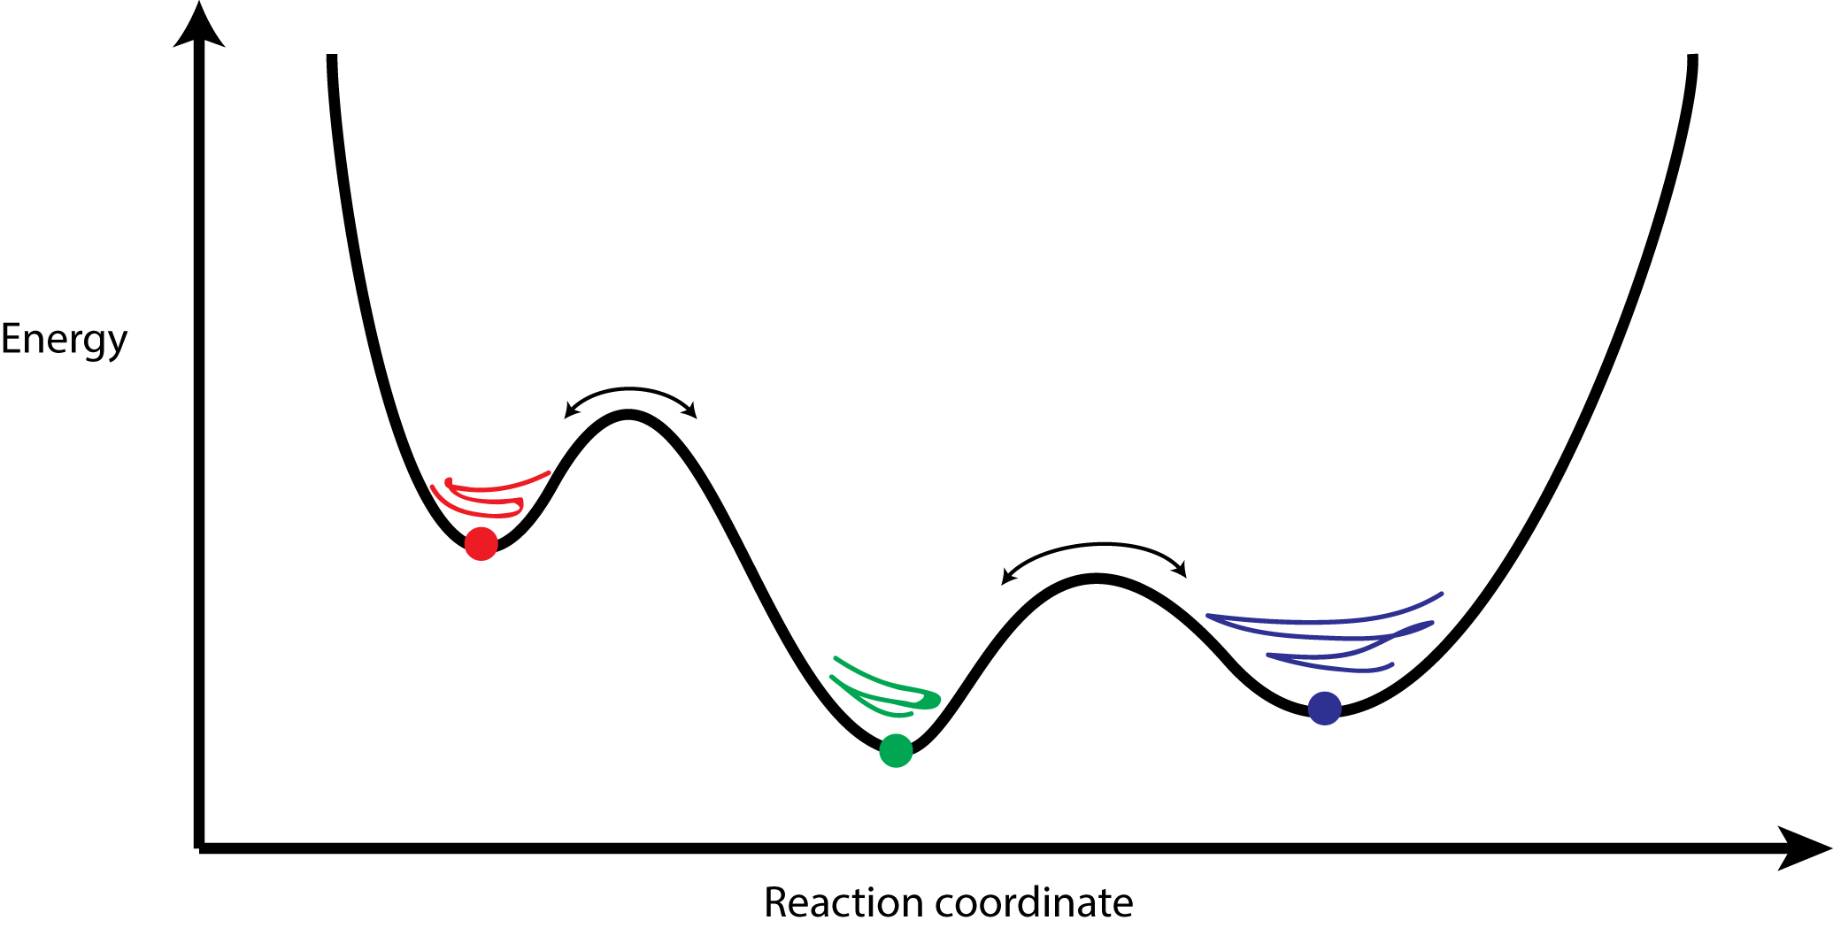
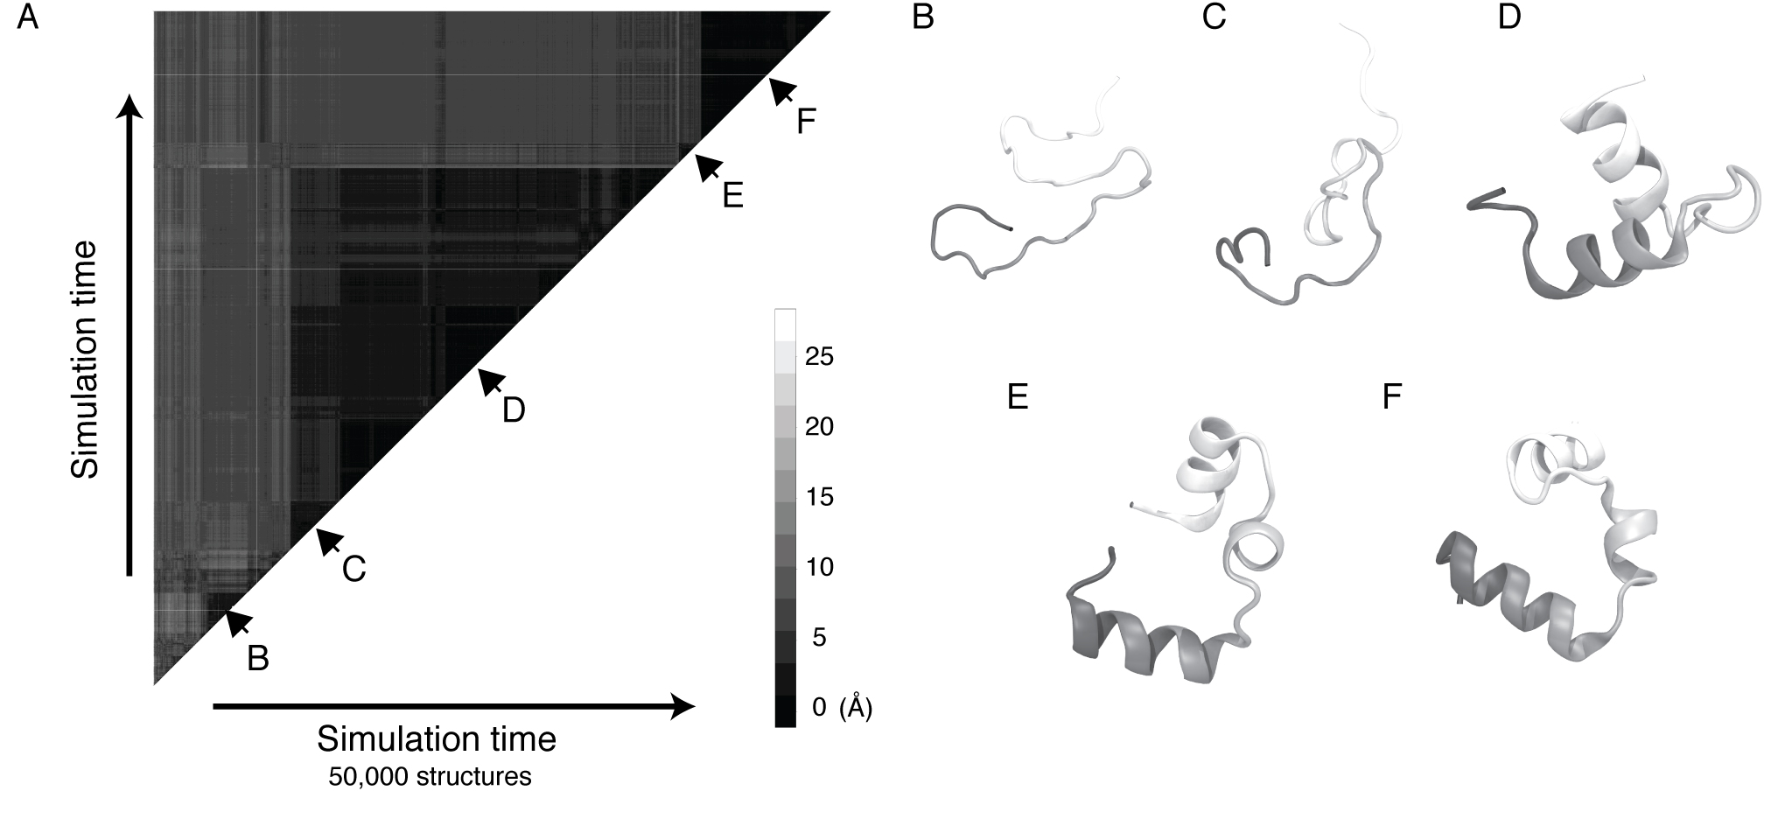
Clustering Analysis of Molecular Dynamics Trajectories
GPU-Accelerated Molecular Dynamics Clustering Analysis with OpenACC. J.E. Stone, J.R. Perilla, C. K. Cassidy, and K. Schulten. In, Robert Farber, ed., Parallel Programming with OpenACC, Morgan Kaufmann, Chapter 11, pp. 215-240, 2016.

Slide 23
Serial QCP RMSD Inner Product Loop
for (int l=0; l<cnt; l++) {
double x1, x2, y1, y2, z1, z2;
x1 = crdx1[l];
y1 = crdy1[l];
z1 = crdz1[l];
G1 += x1*x1 + y1*y1 + z1*z1;
x2 = crdx2[l];
y2 = crdy2[l];
z2 = crdz2[l];
G2 += x2*x2 + y2*y2 + z2*z2;
a0 += x1 * x2;
a1 += x1 * y2;
a2 += x1 * z2;
a3 += y1 * x2;
a4 += y1 * y2;
a5 += y1 * z2;
a6 += z1 * x2;
a7 += z1 * y2;
a8 += z1 * z2;
}
Simple example where directive based parallelism can be applied easily and effectively
Such a loop is inherently a memory-bandwidth-bound algorithm, so that’s the goal for acceleration

Slide 24
OpenACC QCP RMSD Inner Product Loop
Simple example where directive based parallelism can be applied easily and effectively
Such a loop is inherently a memory-bandwidth-bound algorithm, so that’s the goal for acceleration
// excerpted code that has been abridged for brevity…
void rmsdmat_qcp_acc(int cnt, int padcnt, int framecrdsz,
int framecount, const float * restrict crds,
long i, j, k;
#pragma acc kernels copyin(crds[0:tsz]), copy(rmsdmat[0:msz])
for (k=0; k<(framecount*(framecount-1))/2; k++) {
// compute triangular matrix index ‘k’ in a helper function
// to ensure that the compiler doesn’t think that we have
// conflicts or dependencies between loop iterations
acc_idx2sub_tril(long(framecount-1), k, &i, &j);
long x1addr = j * 3L * framecrdsz;
long x2addr = i * 3L * framecrdsz;
#pragma acc loop vector(256)
for (long l=0; l<cnt; l++) {
// abridged for brevity ...
rmsdmat[k]=rmsd; // store linearized triangular matrix
}
}

Slide 25
OpenACC QCP RMSD Inner Product Loop
Performance Results
Xeon 2867W v3, w/ hand-coded AVX and FMA intrinsics: 20.7s
Tesla K80 w/ OpenACC: 6.5s (3.2x speedup)
OpenACC on K80 achieved 65% of theoretical peak memory bandwidth, with 2016 compiler and just a few lines of #pragma directives. Excellent speedup for minimal changes to code.
Future OpenACC compiler revs should provide higher performance yet

Slide 26
Caveat Emptor
Compilers are not all equal…
…sometimes they make me want to scream…
…but they all improve with time
If we begin using directives now to close the gap on impending doom arising from Amdahl’s Law, the compilers should be robust and performant when it really counts

Slide 27
Directives and Hardware Evolution
Ongoing hardware advancements are addressing ease-of-use gaps that remained a problem for both directives and hand-coded kernels
Unified memory: eliminate many cases where programmer used to have to hand-code memory transfers explicitly, blurs CPU/GPU boundary
What about distributing data structures across multiple NVLink-connected GPUs?

Slide 28
Performance Tuning, Profiling Wish List
Some simple examples on my wish list:
  Make directive runtimes more composable with external resource management, tasking frameworks, and runtime systems, interop APIs are already a start, to build more commonality there.
  Help profiling tools to clearly identify functions, call chains, and resources associated with code produced by compiler directives and their runtime system(s), to clearly differentiate from hand-coded kernels, and resources used by other runtimes
  Allow directive-based programming systems support things like application-determined hardware scheduling priorities that encompass both hand-coded and directive-generated kernels
  Allow programmer oversight about what resources directive kernels are allowed to use, CPU affinity, etc

Slide 29
Using CPUs to Optimize Accelerator Performance
Optimization strategy:
  Use the CPU to “regularize” the GPU workload
  Use optimal/fixed-size data structures, idealize layout for GPU traversal
  Handle exceptional or irregular work units on the CPUs; GPUs processes the bulk of the work concurrently
  On average, the GPUs are kept highly occupied, attaining a high fraction of peak performance

Slide 30
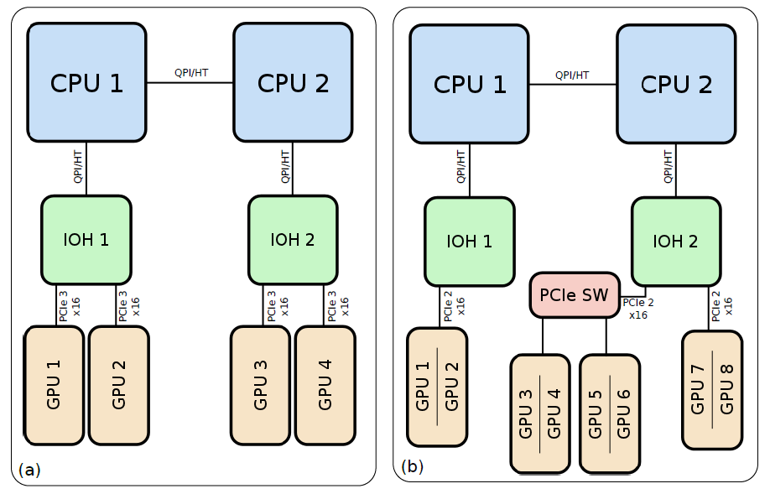
Heterogeneous Compute Node
Dense PCIe-based multi-GPU compute node
Application would ideally exploit all of the CPU, GPU, and I/O resources concurrently…
(I/O devs not shown)
~12GB/s
Simulation of reaction diffusion processes over biologically relevant size and time scales using multi-GPU workstations
  Michael J. Hallock, John E. Stone, Elijah Roberts, Corey Fry, and Zaida Luthey-Schulten.
  Journal of Parallel Computing, 40:86-99, 2014.
  http://dx.doi.org/10.1016/j.parco.2014.03.009

Slide 31
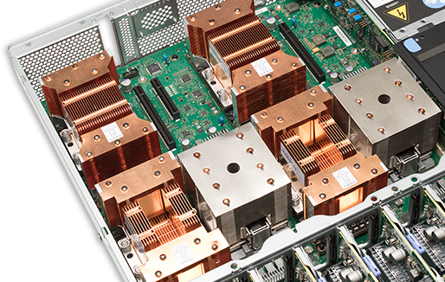
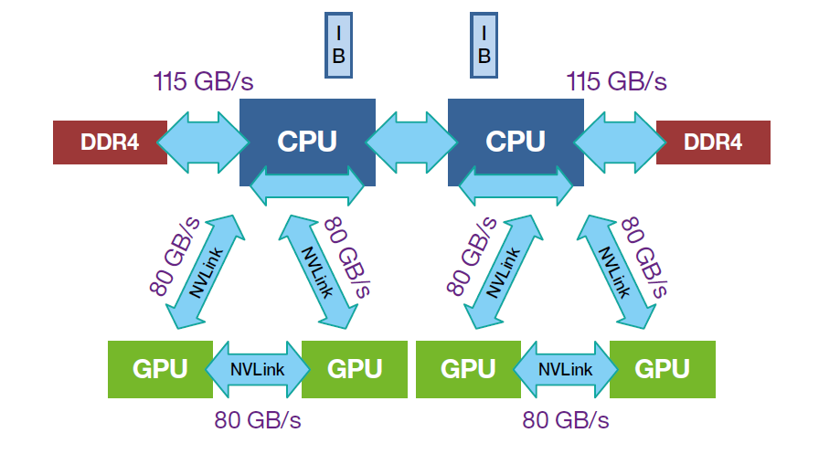
IBM S822LC w/ NVLink
“Minsky”

Slide 32
Ongoing VMD Work on POWER
Early observations about P8+CUDA+NVLink:
  P8 single-thread perf more of an issue than on x86 for small untuned parts of existing code – greater need for GPU offload of formerly insignificant host code
  P8+CUDA NUMA-correctness w/ NVLink much more important than PCIe (e.g. x86) due to larger benefits/penalties when NVLink is used effectively vs. not
  P8 “Minsky” systems get extra benefits for algorithms that have lots of host-GPU DMA transfers, where the NVLink interconnect speeds greatly outpeform PCIe

Slide 33
Benefits of P8+NVLink for VMD
Rapid access to host-side data too large to fit entirely in P100 GPU memory
  Many existing VMD CUDA kernels already used this strategy w/ PCIe, performance gains from NVLink are large and immediate
Rapid peer-to-peer GPU data transfers:
  Bypass host whenever possible, perform nearest-neighbor exchanges for pairwise calculations, e.g. those that arise in algorithms for simulation trajectory clustering
  Use aggregate GPU memory to collectively store/cache large data:
    Distribute time-varying trajectory timesteps among memories of multiple GPUs
    High-fidelity ray tracing of scenes containing massive amounts of geometry

Slide 34
Directives and Potential Hardware Evolution
Think of ORNL Summit node as an “entry point” to potential future possibilities…
Questions:
Would the need for ongoing growth in memory bandwidth among tightly connected accelerators w/ HBM predict even denser nodes?
  Leadership systems use 6-GPU nodes now, how many in 2022 or thereafter?
As accelerated systems advance, will directives encompass peer-to-peer accelerator operations better?
What if future accelerators can directly RDMA to remote accelerators (over a communication fabric) via memory accesses?
In the future, will directives make it easier to program potentially complex collective operations, reductions, fine-grained distributed-shared-memory data structures among multiple accelerators?

Slide 35
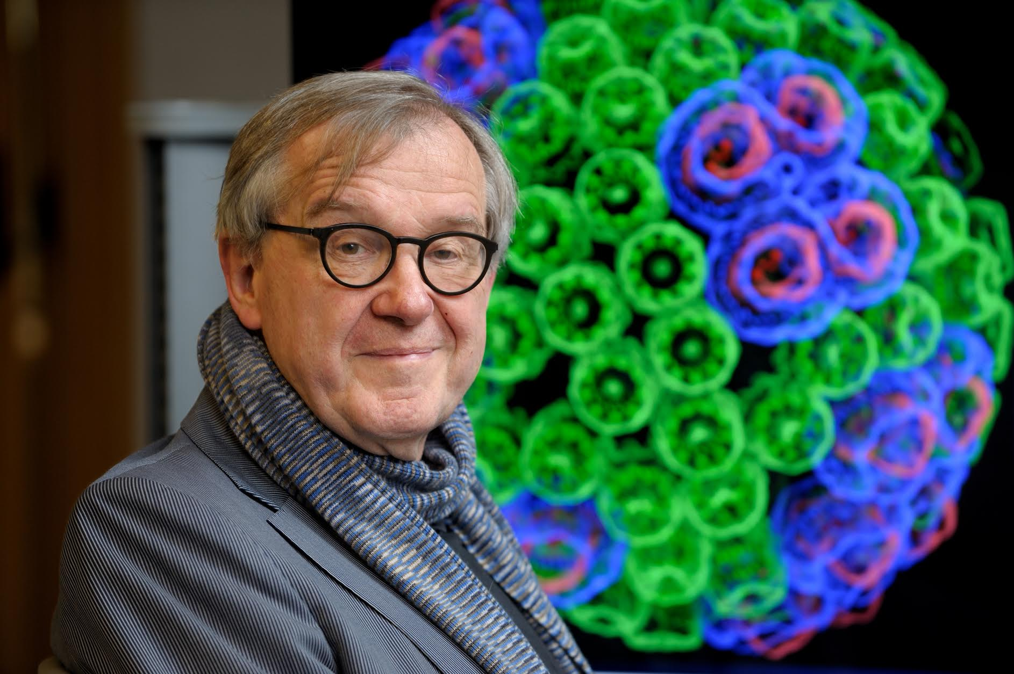
“When I was a young man, my goal was to look with mathematical and computational means at the inside of cells, one atom at a time, to decipher how living systems work. That is what I strived for and I never deflected from this goal.” – Klaus Schulten

Slide 36
Acknowledgements
Theoretical and Computational Biophysics Group, University of Illinois at Urbana-Champaign
NVIDIA, PGI, and DOE’s ORNL OLCF OpenACC teams/members
Funding:
  NIH support: P41GM104601
  NSF Blue Waters: NSF OCI 07-25070, PRAC “The Computational Microscope”, ACI-1238993, ACI-1440026
  DOE INCITE, ORNL Titan: DE-AC05-00OR22725
Notes:
36

Slide 37
Related Publications http://www.ks.uiuc.edu/Research/gpu/
Challenges of Integrating Stochastic Dynamics and Cryo-electron Tomograms in Whole-cell Simulations. T. M. Earnest, R. Watanabe, J. E. Stone, J. Mahamid, W. Baumeister, E. Villa, and Z. Luthey-Schulten. J. Physical Chemistry B, 121(15): 3871-3881, 2017.
Early Experiences Porting the NAMD and VMD Molecular Simulation and Analysis Software to GPU-Accelerated OpenPOWER Platforms. J. E. Stone, A.-P. Hynninen, J. C. Phillips, and K. Schulten. International Workshop on OpenPOWER for HPC (IWOPH'16), LNCS 9945, pp. 188-206, 2016.
Immersive Molecular Visualization with Omnidirectional Stereoscopic Ray Tracing and Remote Rendering. J. E. Stone, W. R. Sherman, and K. Schulten. High Performance Data Analysis and Visualization Workshop, IEEE International Parallel and Distributed Processing Symposium Workshop (IPDPSW), pp. 1048-1057, 2016.
High Performance Molecular Visualization: In-Situ and Parallel Rendering with EGL. J. E. Stone, P. Messmer, R. Sisneros, and K. Schulten. High Performance Data Analysis and Visualization Workshop, IEEE International Parallel and Distributed Processing Symposium Workshop (IPDPSW), pp. 1014-1023, 2016.
Evaluation of Emerging Energy-Efficient Heterogeneous Computing Platforms for Biomolecular and Cellular Simulation Workloads. J. E. Stone, M. J. Hallock, J. C. Phillips, J. R. Peterson, Z. Luthey-Schulten, and K. Schulten.25th International Heterogeneity in Computing Workshop, IEEE International Parallel and Distributed Processing Symposium Workshop (IPDPSW), pp. 89-100, 2016.
Atomic Detail Visualization of Photosynthetic Membranes with GPU-Accelerated Ray Tracing. J. E. Stone, M. Sener, K. L. Vandivort, A. Barragan, A. Singharoy, I. Teo, J. V. Ribeiro, B. Isralewitz, B. Liu, B.-C. Goh, J. C. Phillips, C. MacGregor-Chatwin, M. P. Johnson, L. F. Kourkoutis, C. Neil Hunter, and K. Schulten. J. Parallel Computing, 55:17-27, 2016.

Slide 38
Related Publications http://www.ks.uiuc.edu/Research/gpu/
Chemical Visualization of Human Pathogens: the Retroviral Capsids. Juan R. Perilla, Boon Chong Goh, John E. Stone, and Klaus Schulten. SC'15 Visualization and Data Analytics Showcase, 2015.
Visualization of Energy Conversion Processes in a Light Harvesting Organelle at Atomic Detail. M. Sener, J. E. Stone, A. Barragan, A. Singharoy, I. Teo, K. L. Vandivort, B. Isralewitz, B. Liu, B. Goh, J. C. Phillips, L. F. Kourkoutis, C. N. Hunter, and K. Schulten. SC'14 Visualization and Data Analytics Showcase, 2014. ***Winner of the SC'14 Visualization and Data Analytics Showcase
Runtime and Architecture Support for Efficient Data Exchange in Multi-Accelerator Applications. J. Cabezas, I. Gelado, J. E. Stone, N. Navarro, D. B. Kirk, and W. Hwu. IEEE Transactions on Parallel and Distributed Systems, 26(5):1405-1418, 2015.
Unlocking the Full Potential of the Cray XK7 Accelerator. M. D. Klein and J. E. Stone. Cray Users Group, Lugano Switzerland, May 2014.
GPU-Accelerated Analysis and Visualization of Large Structures Solved by Molecular Dynamics Flexible Fitting. J. E. Stone, R. McGreevy, B. Isralewitz, and K. Schulten. Faraday Discussions, 169:265-283, 2014.
Simulation of reaction diffusion processes over biologically relevant size and time scales using multi-GPU workstations. M. J. Hallock, J. E. Stone, E. Roberts, C. Fry, and Z. Luthey-Schulten. Journal of Parallel Computing, 40:86-99, 2014.

Slide 39
Related Publications http://www.ks.uiuc.edu/Research/gpu/
GPU-Accelerated Molecular Visualization on Petascale Supercomputing Platforms. J. Stone, K. L. Vandivort, and K. Schulten. UltraVis'13: Proceedings of the 8th International Workshop on Ultrascale Visualization, pp. 6:1-6:8, 2013.
Early Experiences Scaling VMD Molecular Visualization and Analysis Jobs on Blue Waters. J. Stone, B. Isralewitz, and K. Schulten. In proceedings, Extreme Scaling Workshop, 2013.
Lattice Microbes: High‐performance stochastic simulation method for the reaction‐diffusion master equation. E. Roberts, J. Stone, and Z. Luthey‐Schulten.
J. Computational Chemistry 34 (3), 245-255, 2013.
Fast Visualization of Gaussian Density Surfaces for Molecular Dynamics and Particle System Trajectories. M. Krone, J. Stone, T. Ertl, and K. Schulten. EuroVis Short Papers, pp. 67-71, 2012.
Immersive Out-of-Core Visualization of Large-Size and Long-Timescale Molecular Dynamics Trajectories. J. Stone, K. L. Vandivort, and K. Schulten. G. Bebis et al. (Eds.): 7th International Symposium on Visual Computing (ISVC 2011), LNCS 6939, pp. 1-12, 2011.
Fast Analysis of Molecular Dynamics Trajectories with Graphics Processing Units – Radial Distribution Functions. B. Levine, J. Stone, and A. Kohlmeyer. J. Comp. Physics, 230(9):3556-3569, 2011.

Slide 40
Related Publications http://www.ks.uiuc.edu/Research/gpu/
Quantifying the Impact of GPUs on Performance and Energy Efficiency in HPC Clusters. J. Enos, C. Steffen, J. Fullop, M. Showerman, G. Shi, K. Esler, V. Kindratenko, J. Stone, J Phillips. International Conference on Green Computing, pp. 317-324, 2010.
GPU-accelerated molecular modeling coming of age. J. Stone, D. Hardy, I. Ufimtsev, K. Schulten. J. Molecular Graphics and Modeling, 29:116-125, 2010.
OpenCL: A Parallel Programming Standard for Heterogeneous Computing. J. Stone, D. Gohara, G. Shi. Computing in Science and Engineering, 12(3):66-73, 2010.
An Asymmetric Distributed Shared Memory Model for Heterogeneous Computing Systems. I. Gelado, J. Stone, J. Cabezas, S. Patel, N. Navarro, W. Hwu. ASPLOS ’10: Proceedings of the 15th International Conference on Architectural Support for Programming Languages and Operating Systems, pp. 347-358, 2010.

Slide 41
Related Publications http://www.ks.uiuc.edu/Research/gpu/
GPU Clusters for High Performance Computing. V. Kindratenko, J. Enos, G. Shi, M. Showerman, G. Arnold, J. Stone, J. Phillips, W. Hwu. Workshop on Parallel Programming on Accelerator Clusters (PPAC), In Proceedings IEEE Cluster 2009, pp. 1-8, Aug. 2009.
Long time-scale simulations of in vivo diffusion using GPU hardware. E. Roberts, J. Stone, L. Sepulveda, W. Hwu, Z. Luthey-Schulten. In IPDPS’09: Proceedings of the 2009 IEEE International Symposium on Parallel & Distributed Computing, pp. 1-8, 2009.
High Performance Computation and Interactive Display of Molecular Orbitals on GPUs and Multi-core CPUs. J. E. Stone, J. Saam, D. Hardy, K. Vandivort, W. Hwu, K. Schulten, 2nd Workshop on General-Purpose Computation on Graphics Pricessing Units (GPGPU-2), ACM International Conference Proceeding Series, volume 383, pp. 9-18, 2009.
Probing Biomolecular Machines with Graphics Processors. J. Phillips, J. Stone. Communications of the ACM, 52(10):34-41, 2009.
Multilevel summation of electrostatic potentials using graphics processing units. D. Hardy, J. Stone, K. Schulten. J. Parallel Computing, 35:164-177, 2009.

Slide 42
Related Publications http://www.ks.uiuc.edu/Research/gpu/
Adapting a message-driven parallel application to GPU-accelerated clusters. J. Phillips, J. Stone, K. Schulten. Proceedings of the 2008 ACM/IEEE Conference on Supercomputing, IEEE Press, 2008.
GPU acceleration of cutoff pair potentials for molecular modeling applications. C. Rodrigues, D. Hardy, J. Stone, K. Schulten, and W. Hwu. Proceedings of the 2008 Conference On Computing Frontiers, pp. 273-282, 2008.
GPU computing. J. Owens, M. Houston, D. Luebke, S. Green, J. Stone, J. Phillips. Proceedings of the IEEE, 96:879-899, 2008.
Accelerating molecular modeling applications with graphics processors. J. Stone, J. Phillips, P. Freddolino, D. Hardy, L. Trabuco, K. Schulten. J. Comp. Chem., 28:2618-2640, 2007.
Continuous fluorescence microphotolysis and correlation spectroscopy. A. Arkhipov, J. Hüve, M. Kahms, R. Peters, K. Schulten. Biophysical Journal, 93:4006-4017, 2007.

