Slide 1
Adapting Scientific Software and Designing Algorithms for Next Generation GPU Computing Platforms
John E. Stone
Theoretical and Computational Biophysics Group
Beckman Institute for Advanced Science and Technology
University of Illinois at Urbana-Champaign
http://www.ks.uiuc.edu/Research/gpu/
http://www.ks.uiuc.edu/Research/namd/
http://www.ks.uiuc.edu/Research/vmd/
Novel Computational Algorithms for Future Computing Platforms I
SIAM CSE 2019, Wednesday, February 27th, 2019
Notes:
Novel Computational Algorithms for Future Computing Platforms - Part I of II
Wednesday, February 27
Adapting Scientific Software and Designing Algorithms for Next Generation Gpu Computing Platforms
Abstract
Over the past decade, the massively parallel hardware architecture of
GPUs has enabled them to become the de facto accelerator of choice to
address high performance computing needs across a broad range of
scientific and technical computing domains. The adaptation of existing
software and algorithms to so-called heterogeneous computing systems
composed of a mix of CPU and GPU processors poses many challenges
to implementors, which have been addressed in part through a decade
of improvements to programming abstractions, languages, and libraries.
State-of-the-art systems such as ORNL Summit and the NVIDIA DGX-2
bring significant hardware advances that have begun to outpace progress
the programming side, and one can forecast a number of likely
directions for ongoing hardware evolution that will create additional
needs for further programming abstractions, language features,
and algorithm design methodologies. This talk will discuss past
and ongoing experiences with the adaptation of technical and
scientific software for GPU-accelerated platforms and the challenges
they embody, and will describe challenges associated with emerging
and future hardware capabilities and the their impact on algorithm
and software design.

Slide 2
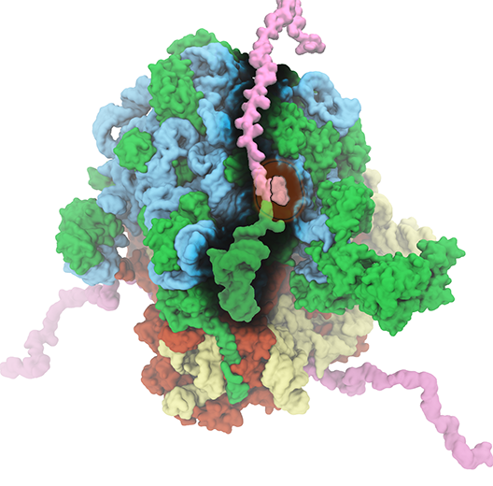
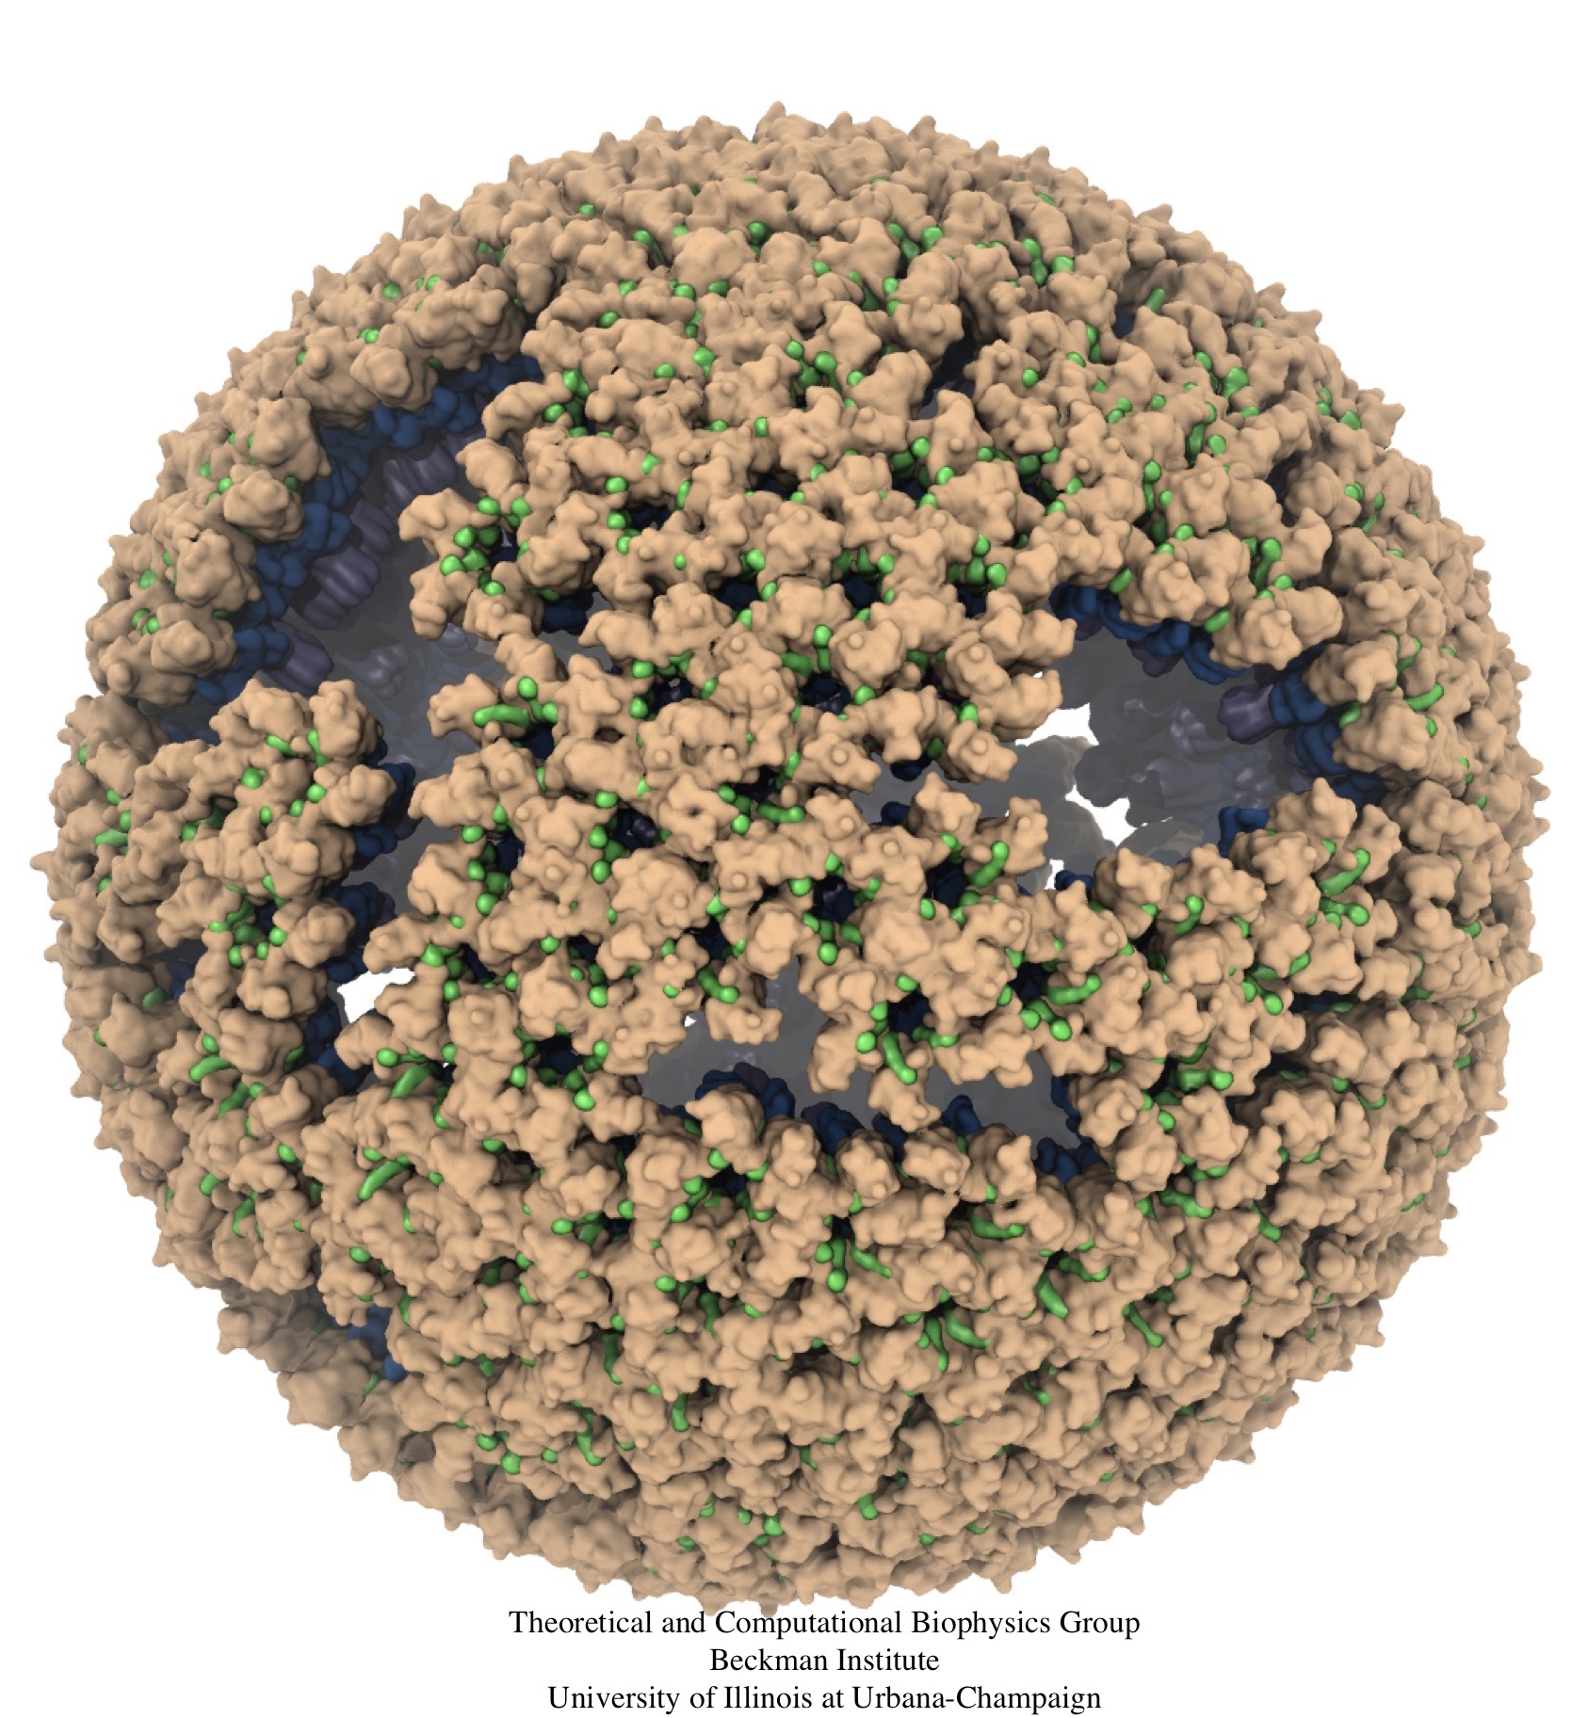
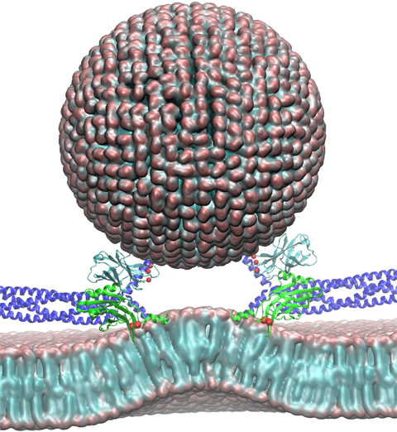
NAMD & VMD: Computational Microscope
Enable researchers to investigate systems described at the atomic scale
NAMD - molecular dynamics simulation
VMD - visualization, system preparation and analysis
Neuron
Ribosome
Virus Capsid

Slide 3
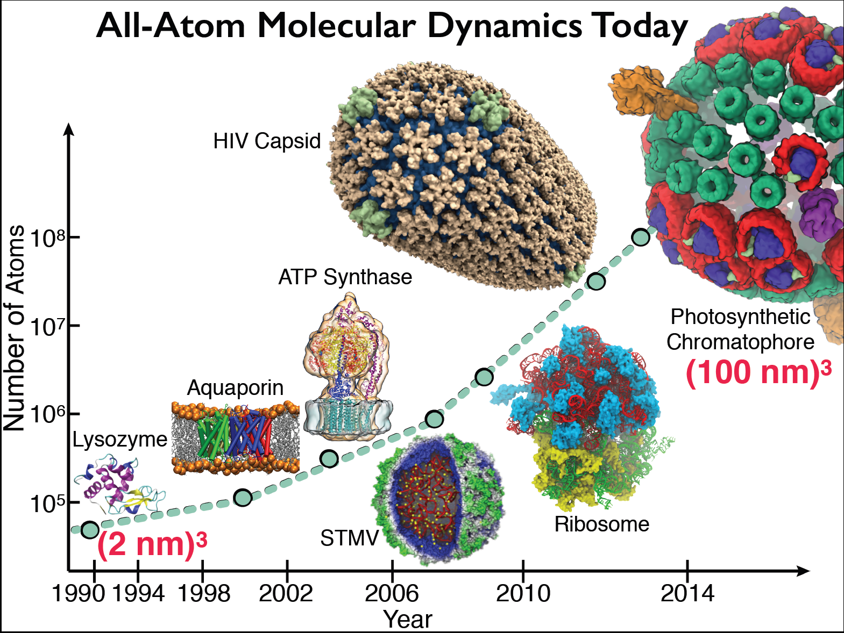

Slide 4
Major Approaches For Programming Hybrid Architectures
Use drop-in libraries in place of CPU-only libraries
Little or no code development
Examples: MAGMA, BLAS-variants, FFT libraries, etc.
Speedups limited by Amdahl’s Law and overheads associated with data movement between CPUs and GPU accelerators
Generate accelerator code as a variant of CPU source, e.g. using OpenMP and OpenACC directives, and similar
Write lower-level accelerator-specific code, e.g. using CUDA, OpenCL, other approaches

Slide 5
Exemplary Hetereogeneous Computing Challenges
Tuning, adapting, or developing software for multiple processor types
Decomposition of problem(s) and load balancing work across heterogeneous resources for best overall performance and work-efficiency
Managing data placement in disjoint memory systems with varying performance attributes
Transferring data between processors, memory systems, interconnect, and I/O devices

Slide 6
Mol. Orbital GPU Parallel Decomposition
MO 3-D lattice decomposes into 2-D slices (CUDA grids)
…
GPU 2
GPU 1
GPU 0
Small 8x8 thread blocks afford large
per-thread register count, shared memory
Lattice computed using multiple GPUs
0,0
0,1
…
Threads producing results that are used
Each thread computes one MO lattice point.
1,0
1,1
…
…
…
…
Padding optimizes global memory performance, guaranteeing coalesced global memory accesses
Threads producing results that are discarded
Grid of thread blocks
Notes:
Threads in a thread block (potentially) execute in parallel
Threads in a block can communicate via fast shared memory
Global memory reads are slow
Constant memory is fast, but can only be written by host at kernel startup.

Slide 7
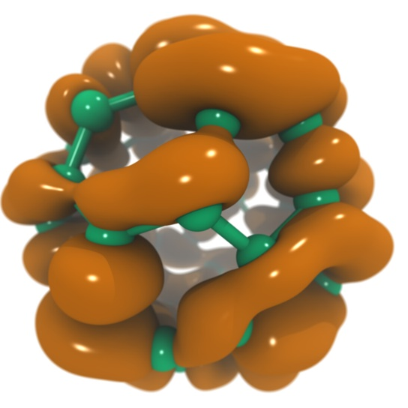
VMD Tesla V100 Performance for C₆₀ Molecular Orbitals, 516x519x507 grid
Hardware platform | Runtime, Speedup
IBM Power8 (ORNL ‘crest’) + 1x Tesla K40 [1] | 3.49s, 1.0x
Intel Xeon E5-2697Av4 + 1x Tesla V100 [2] | 0.610s, 5.7x
Intel Xeon E5-2697Av4 + 2x Tesla V100 [2] | 0.294s, 11.8x
Intel Xeon E5-2697Av4 + 3x Tesla V100 [2] | 0.220s, 15.9x
IBM Power9 “Newell” + 1x Tesla V100 | 0.394s, 8.8x
IBM Power9 “Newell” + 2x Tesla V100 | 0.207s, 16.8x
IBM Power9 “Newell” + 3x Tesla V100 | 0.151s, 23.1x
IBM Power9 “Newell” + 4x Tesla V100 | 0.130s, 26.8x
NVLink perf. boost
[1] Early Experiences Porting the NAMD and VMD Molecular Simulation and Analysis Software to GPU-Accelerated OpenPOWER Platforms. J. E. Stone, A.-P. Hynninen, J. C. Phillips, K. Schulten. International Workshop on OpenPOWER for HPC (IWOPH'16), LNCS 9945, pp. 188-206, 2016.
[2] NAMD goes quantum: An integrative suite for hybrid simulations. Melo et al., Nature Methods, 2018.

Slide 8
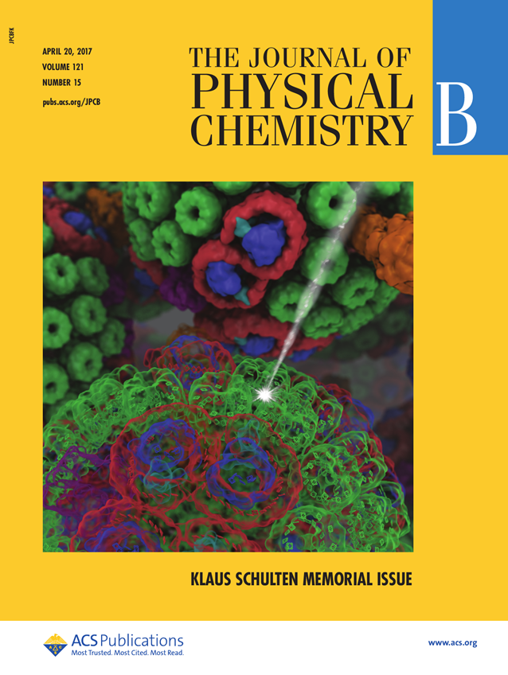
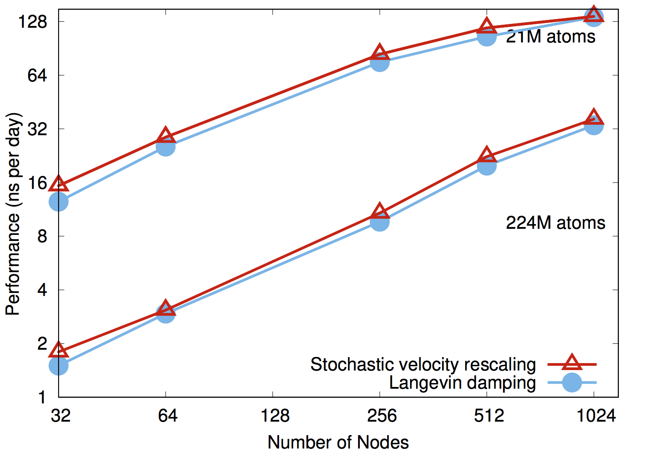
NAMD on Summit, May 2018: ~20% Performance Increase
NAMD simulations can generate up to 10TB of output per day on 20% of Summit

Slide 9
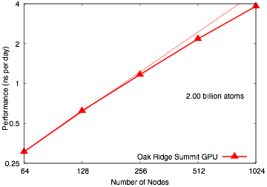
NAMD 2 Billion Atom Benchmark on 20% of Summit “Scalable Molecular Dynamics with NAMD on the Summit System” IBM Journal of Research and Development, 2018. (In press)

Slide 10
Challenges Adapting Large Software Systems for State-of-the-Art Hardware Platforms
Initial focus on key computational kernels eventually gives way to the need to optimize an ocean of less critical routines, due to observance of Amdahl’s Law
Even though these less critical routines might be easily ported to CUDA or similar, the sheer number of routines often poses a challenge
Need a low-cost approach for getting “some” speedup out of these second-tier routines
In many cases, it is completely sufficient to achieve memory-bandwidth-bound GPU performance with an existing algorithm

Slide 11
Amdahl’s Law and Role of High Abstraction Accelerator Programming Approaches
Initial partitioning of algorithm(s) between host CPUs and accelerators is typically based on initial performance balance point
Time passes and accelerators get MUCH faster, and/or compute nodes get denser…
Formerly harmless CPU code ends up limiting overall performance!
Need to address bottlenecks in increasing fraction of code
High level programming tools like Kokkos and OpenACC directives provide low cost, low burden, approach to improve incrementally vs. status quo
Complementary to lower level approaches such as CPU intrinsics, CUDA, OpenCL, and they all need to coexist and interoperate very gracefully alongside each other

Slide 12
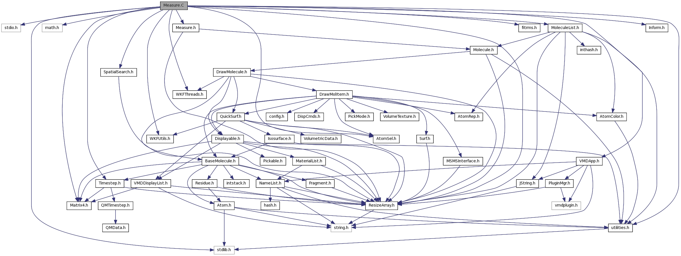
Example of VMD Module Connectivity
Early progress focused acceleration efforts on handful of high level analysis kernels that were the most computationally demanding
Future hardware requires pervasive acceleration
Top image shows script interface links to top level analytical routines
Bottom image shows links among subset of data analytics algorithms to leaf-node functions

Slide 13
OLD OLD XXX VMD Software Decomposition
Externally developed collective variables module:
C++: 20,000 LOC
Headers: 11,000 LOC
Internally+externally developed scripts
Tcl / Python scripts: 284,000 LoC
VMD “plugin” shared lib modules:
C: 102,000 LoC
C++: 36,000 LoC
Headers: 17,000 LoC
CUDA: 5,000 LoC
VMD Core (~230,000 LoC)
C++: 140,000 LoC
Headers: 36,000 LoC
C: 14,000 LoC
Tcl bindings: 12,000 LoC
Python bindings: 8,000 LoC
Hand-coded accelerator and vectorization:
CUDA: 17,000 LoC
Intel x86 intrinsics: 2,500 LoC
IBM POWER intrinsics: 500 LoC
ARM NEON intrinsics: 100 LoC

Slide 14
VMD Software Decomposition
Computational code is 50% of VMD core
Hand-written accelerator + vectorized code (CUDA + CPU intrinsics) represents only 14% of core computational code
20,000 lines of CUDA
3,100 lines of intrinics
Percent coverage of leaf-node analytical functions is lower yet
Need to evolve VMD toward high coverage of performance-critical analysis code with fine-grained parallelism on accelerators and vectorization

Slide 15
Petascale Simulations Driving NAMD/VMD Development
NCSA ORNL | Blue Waters (4,228 XK7 nodes) Titan (18,688 XK7 nodes) | AMD Opteron + K20X Kepler GPU | 16 CPU cores / GPU
TACC | Stampede 2 (4200 KNL nodes, 1736 Skylake nodes) | Intel Knights Landing Intel Xeon Skylake | 68 CPU cores 48 CPU cores
ORNL | Summit (~4600 nodes) | 2 IBM Power9 + 6 Tesla V100 GPUs | 7 CPU cores / GPU
Notes:
a large number of them drive large-scale simulation and visualization challenges that you will see

Slide 16
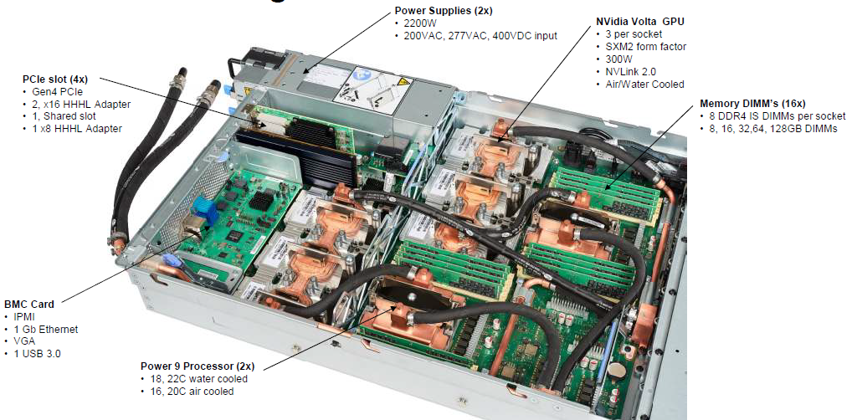
IBM AC922 w/ 6 GPUs

Slide 17
IBM AC922 NVLink 2.0 Topologies
2 GPUs Per CPU Socket
3 GPUs Per CPU Socket
Tesla V100 GPU
Tesla V100 GPU
Tesla V100 GPU
Tesla V100 GPU
Tesla V100 GPU
3x 50GBps:
150GBps
2x 50GBps:
100GBps
POWER9
CPU
POWER9
CPU

Slide 18
IBM AC922 Summit Node
3 GPUs Per CPU Socket
Tesla V100 GPU
Tesla V100 GPU
Tesla V100 GPU
Tesla V100 GPU
Tesla V100 GPU
Tesla V100 GPU
Nvlink 2.0
2x 50GBps:
100GBps
DDR4 DRAM
DDR4 DRAM
POWER9
CPU
POWER9
CPU
X-Bus
64GBps
120GBps
120GBps
InfiniBand
12GBps
InfiniBand
12GBps
1.6TB SSD
“Burst Buffer”

Slide 19
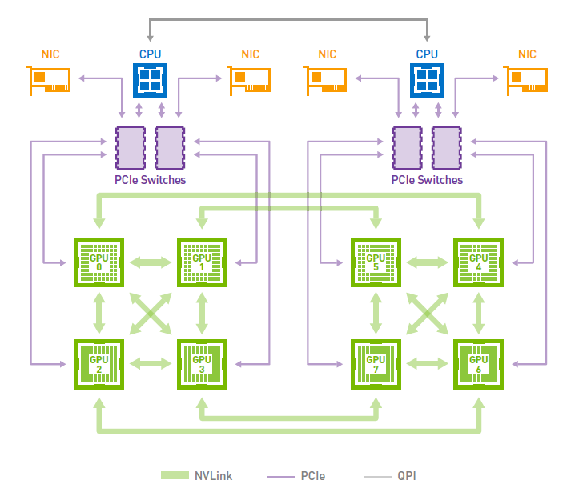
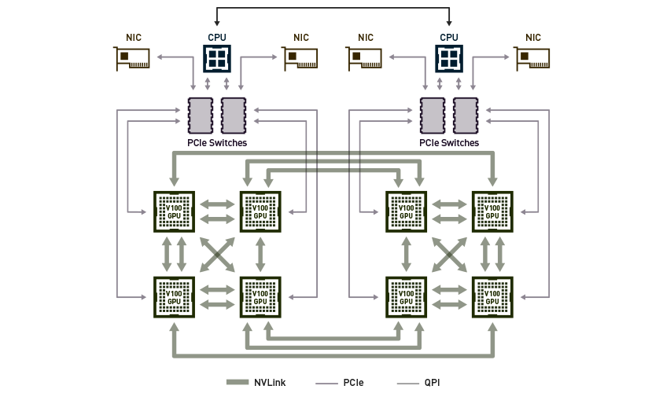
NVIDIA DGX-1

Slide 20
NVIDIA DGX-2 16x 32GB Tesla V100 GPUs w/ 300GB/s NVLink, fully switched 512GB HBM2 RAM w/ 2.4TB/s Bisection Bandwidth, 2 PFLOPS
Tesla V100 GPU
Tesla V100 GPU
Tesla V100 GPU
Tesla V100 GPU
Tesla V100 GPU
Tesla V100 GPU
Tesla V100 GPU
Tesla V100 GPU
NVSwitch
NVSwitch
NVSwitch
NVSwitch
NVSwitch
NVSwitch
NVSwitch
NVSwitch
NVSwitch
NVSwitch
NVSwitch
NVSwitch
Tesla V100 GPU
Tesla V100 GPU
Tesla V100 GPU
Tesla V100 GPU
Tesla V100 GPU
Tesla V100 GPU
Tesla V100 GPU
Tesla V100 GPU

Slide 21
Opportunities and Challenges Posed by DGX-2-Like System Designs
CPUs “oversubscribed” by GPUs
Unfavorable for algorithm designs that perform “siloed” GPU calculations followed by reductions
GPU algorithms must dis-involve CPUs to greatest possible extent
Fully-switched NVLink-connected memory systems permit fine-grained multi-GPU algorithms via direct peer memory load/stores
Throughput oriented GPU algorithms can hide both local and remote memory latencies gracefully
Use atomic operations where needed during kernel execution rather than bulk-synchronization and reduction ex post facto
New levels of algorithm sophistication are possible, but not yet well supported by existing high level programming abstractions

Slide 22
Potential Hardware Evolution
Think of ORNL Summit node and DGX-2 as “entry points” to potential future possibilities…
Questions and observations:
Would the need for ongoing growth in memory bandwidth among tightly connected accelerators w/ HBM predict even denser nodes?
Leadership systems use 6-GPU nodes now. How many in 2022 or thereafter?
Will future DGX-2 like hardware permit multi-node NVLink-connected load/store memory access?
As accelerated systems advance, will directives and other high level programming approaches encompass peer-to-peer accelerator operations better?
Future programming approaches:
Support both existing tightly-coupled Summit- and DGX-2 type systems, and future descendants that may implement multi-node shared memory via switched NVLink-based fabrics.
Need to make it much easier to program complex collective operations, reductions, fine-grained distributed-shared-memory data structures among multiple accelerators

Slide 23
Other Challenges and Needs
I/O performance growth has largely stalled, at least as compared to compute performance, start trading compute for reduced I/O
Scientific reproducibility benefits from tools that produce completely deterministic output
Hard to engineer complete determinism in light of floating point non-associativity, increasing asynchrony, and massive fine-grained parallelism, greater need for techniques like fixed-point summation for greater determinism
State-of-the-art hardware to provides a multitude of bespoke numeric representations and arithmetic capabilities that make it challenging for algorithm designers and software implementors to have a complete grasp of their achieved end-to-end numerical accuracy and precision
Software development tools should help algorithm designers safely exploit the custom numerical representations and arithmetic operations on next-generation hardware

Slide 24
Acknowledgements
Theoretical and Computational Biophysics Group, University of Illinois at Urbana-Champaign
NVIDIA CUDA and OptiX teams
Funding:
NIH support: P41GM104601
ORNL Center for Advanced Application Readiness (CAAR)
IBM POWER team, IBM Poughkeepsie Customer Center
NVIDIA CUDA, OptiX, Devtech teams
UIUC/IBM C3SR
NCSA ISL
Notes:
24

Slide 25
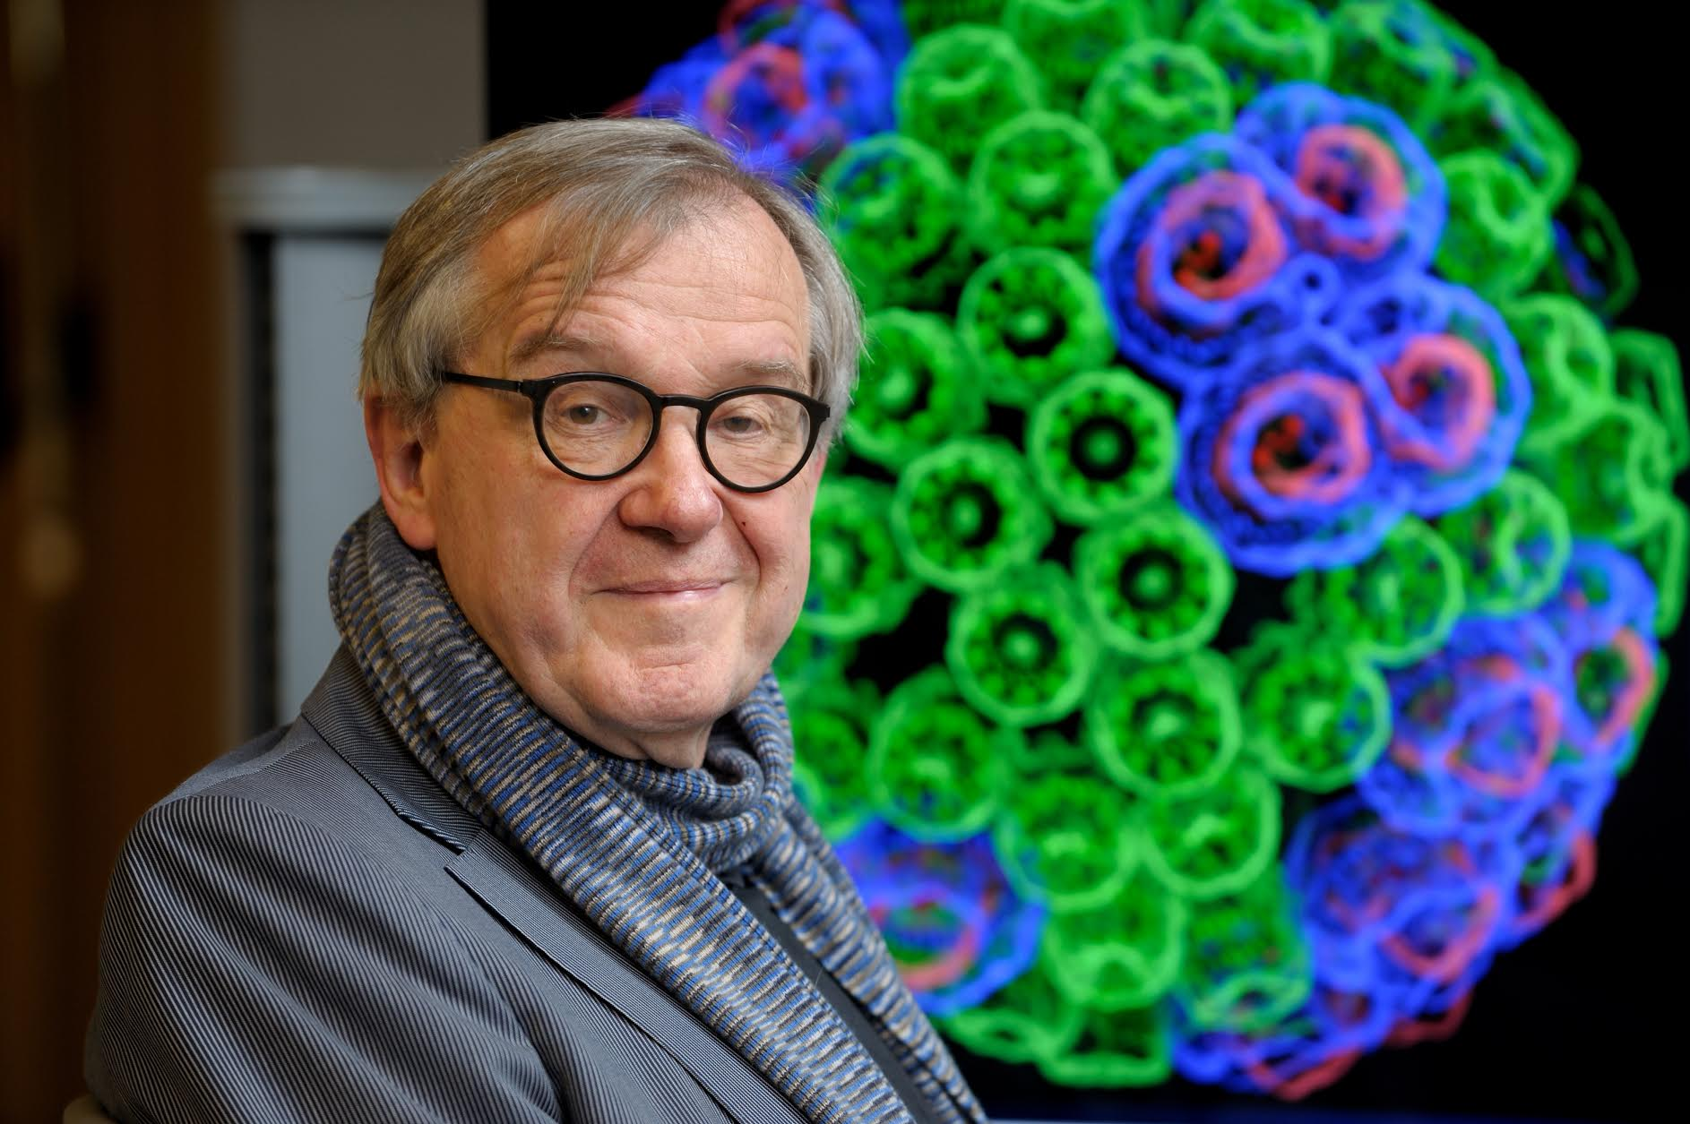
“When I was a young man, my goal was to look with mathematical and computational means at the inside of cells, one atom at a time, to decipher how living systems work. That is what I strived for and I never deflected from this goal.” – Klaus Schulten

