Slide 1
Challenges for Analysis and Visualization of Atomic-Detail Simulations of Minimal Cells
John E. Stone
Theoretical and Computational Biophysics Group
Beckman Institute for Advanced Science and Technology
University of Illinois at Urbana-Champaign
http://www.ks.uiuc.edu/Research/gpu/
http://www.ks.uiuc.edu/Research/namd/
http://www.ks.uiuc.edu/Research/vmd/
Computational Tools and Precision Medicine, SIAM CSE 2019,
10:35am-10:55am Tuesday, February 26th, 2019
Notes:
Computational Tools and Precision Medicine, Tuesday, February 26, 10:35-10:55
Challenges for Analysis and Visualization of Atomic-Detail Simulations of Minimal Cells
John E. Stone, University of Illinois at Urbana-Champaign, U.S.
Abstract: The combination of experimental structure information,
molecular dynamics (MD) simulation, interactive and parallel analysis,
and high-fidelity visualization techniques with HPC computing resources
creates a powerful "computational microscope" that permits molecular
scientists to view the structure and dynamics of biomolecular complexes
in atomic detail within realistic cellular environments.
Pre-exascale supercomputers create new opportunities for the study of
the structure and function of large biomolecular complexes such as
viruses, and photosynthetic organelles, and the cellular envelope of
engineered minimal cells permitting all-atom molecular dynamics
simulations of hundreds of millions to billions of atoms.
Such simulations present many challenges for simulation preparation,
analysis, and visualization, producing terabytes of data that is
impractical to transfer to remote facilities. It is therefore
necessary to perform visualization and analysis tasks in-situ
as the data are generated, by running interactive analysis and
visualization tasks in remote sessions, and through batch-mode
post-hoc analyses co-located with direct access to high performance
storage systems. This talk will describe some of the key
challenges arising for state-of-the-art MD simulations and methodologies,
and how scientific tools such as NAMD and VMD address them using
state-of-the-art algorithms and heterogeneous computing hardware platforms.

Slide 2
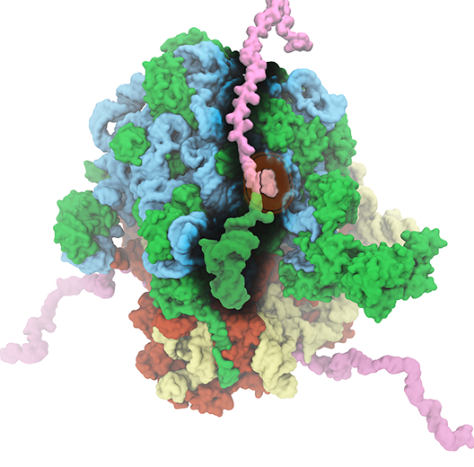
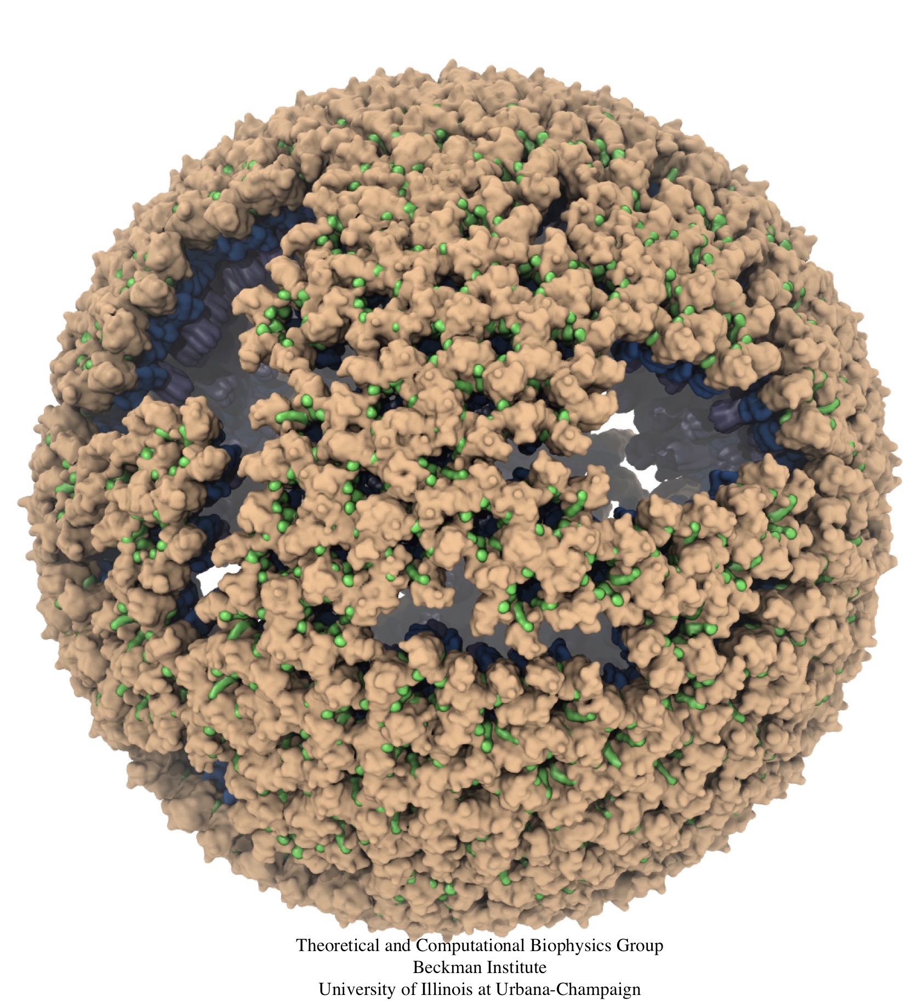
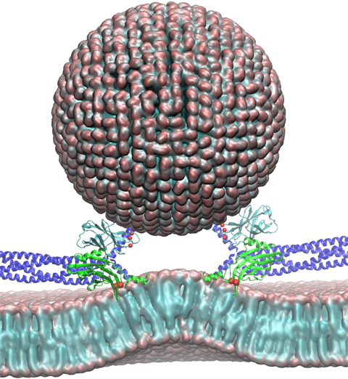
NAMD & VMD: Computational Microscope
Enable researchers to investigate systems described at the atomic scale
NAMD - molecular dynamics simulation
VMD - visualization, system preparation and analysis
Neuron
Ribosome
Virus Capsid

Slide 3
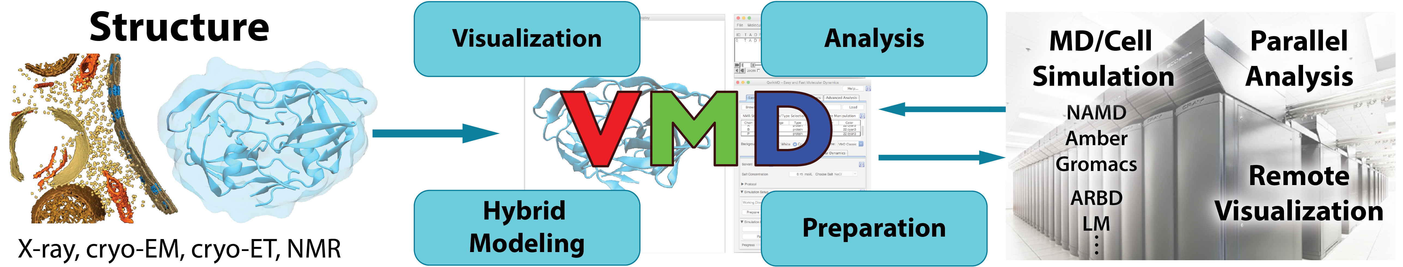
NAMD+VMD: Building A Next Generation Modeling Platform
Provide tools for preparation, simulation, visualization, and analysis
Reach cell-scale modeling w/ all-atom MD, coarse graining, Lattice Microbes
Improved performance, visual fidelity, exploit advanced technologies (GPUs, VR HMDs)
Enable hybrid modeling and computational electron microscopy
Load, filter, process, interpret, visualize multi-modal structural information
Connect key software tools to enable state-of-the-art simulations
Support new data types, file formats, software interfaces
Openness, extensibility, and interoperability are our hallmarks
Reusable algorithms made available in NAMD, for other tools

Slide 4
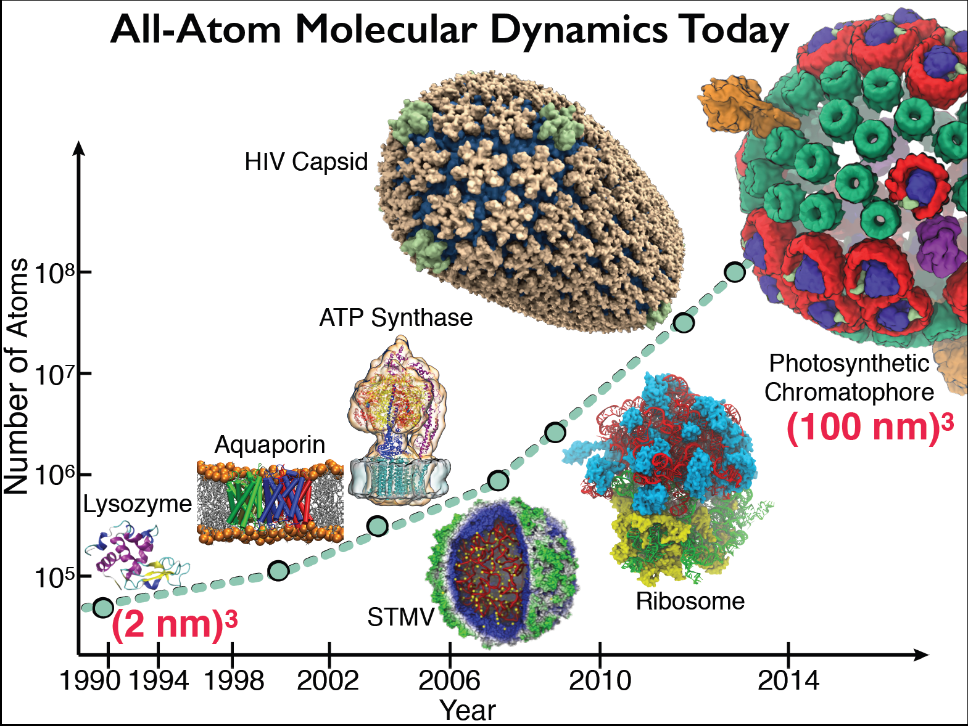

Slide 5
What Drives Increasing Molecular Dynamics System Size and Timescale?
Working to gain insight into structure and dynamics of molecular basis of disease
Many health-relevant biomolecular complexes are large, and key processes often occur at long timescales, presenting many computational challenges…
New hybrid modeling approaches that combine the best structure information from multiple modalities of experimental imaging, physics, e.g. from MD force fields:
“Computational Microscopy”
Parallel computing provides the resources required to keep pace with advances in structure determination and modeling

Slide 6
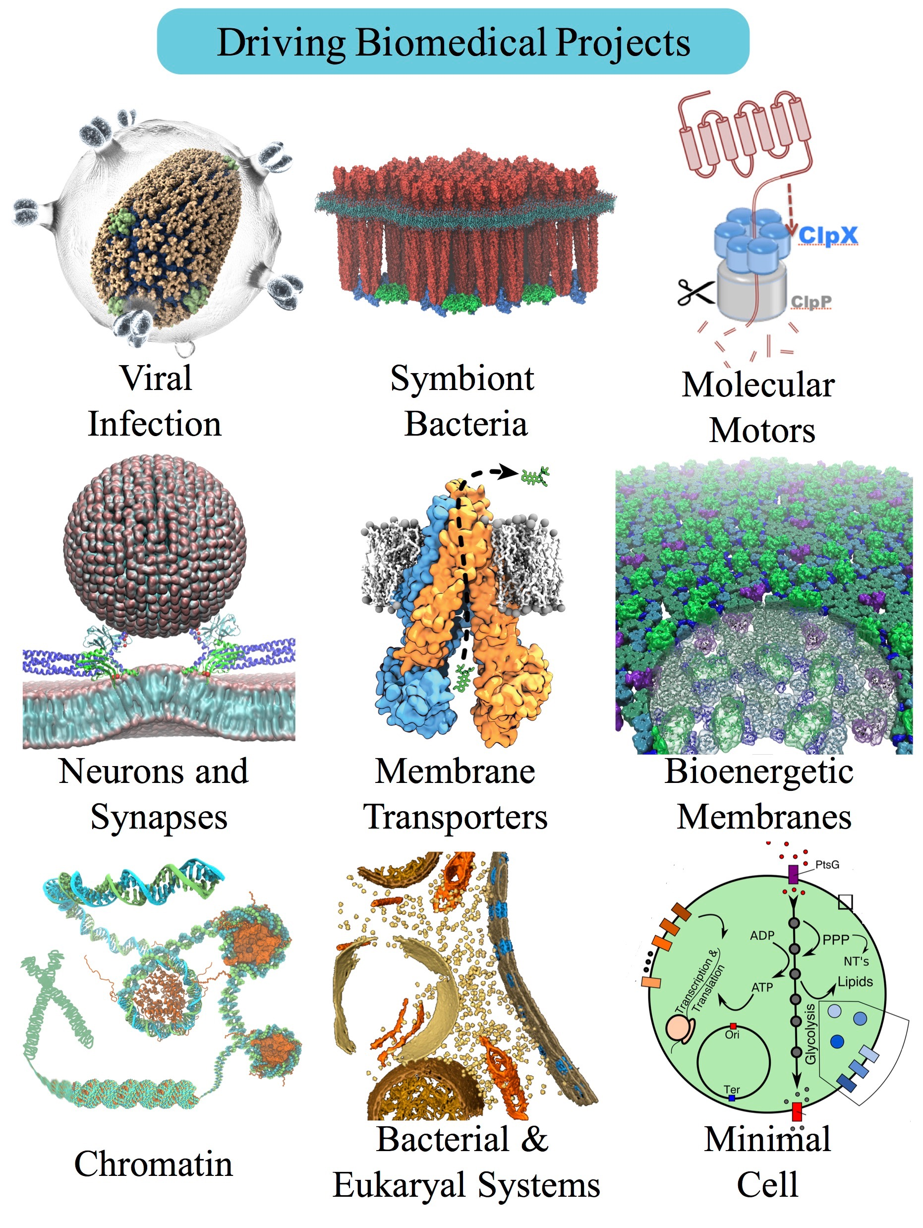
Petascale Simulations Driving NAMD/VMD Development
NCSA ORNL | Blue Waters (4,228 XK7 nodes) Titan (18,688 XK7 nodes) | AMD Opteron + K20X Kepler GPU | 16 CPU cores / GPU
TACC | Stampede 2 (4200 KNL nodes, 1736 Skylake nodes) | Intel Knights Landing Intel Xeon Skylake | 68 CPU cores 48 CPU cores
ORNL | Summit (~4600 nodes) | 2 IBM Power9 + 6 Tesla V100 GPUs | 7 CPU cores / GPU
Notes:
a large number of them drive large-scale simulation and visualization challenges that you will see

Slide 7
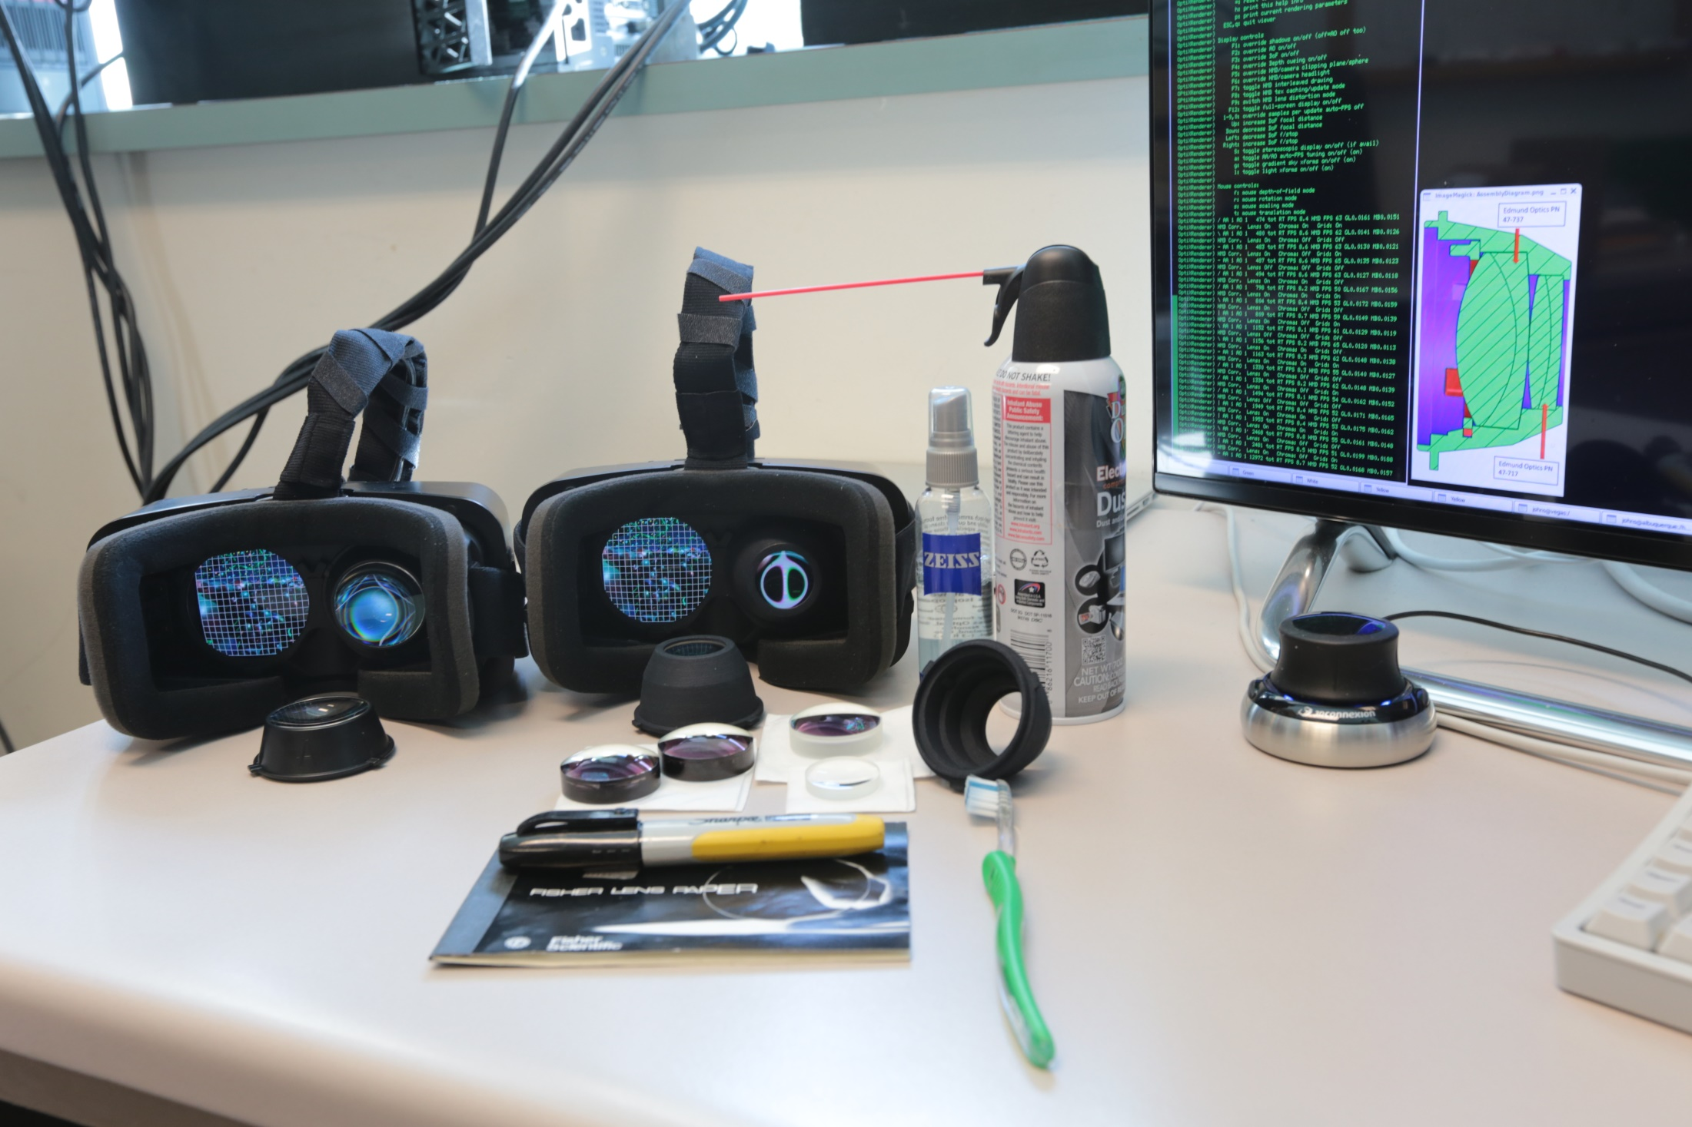
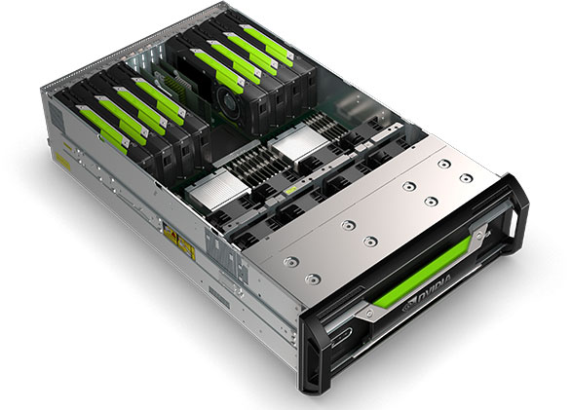
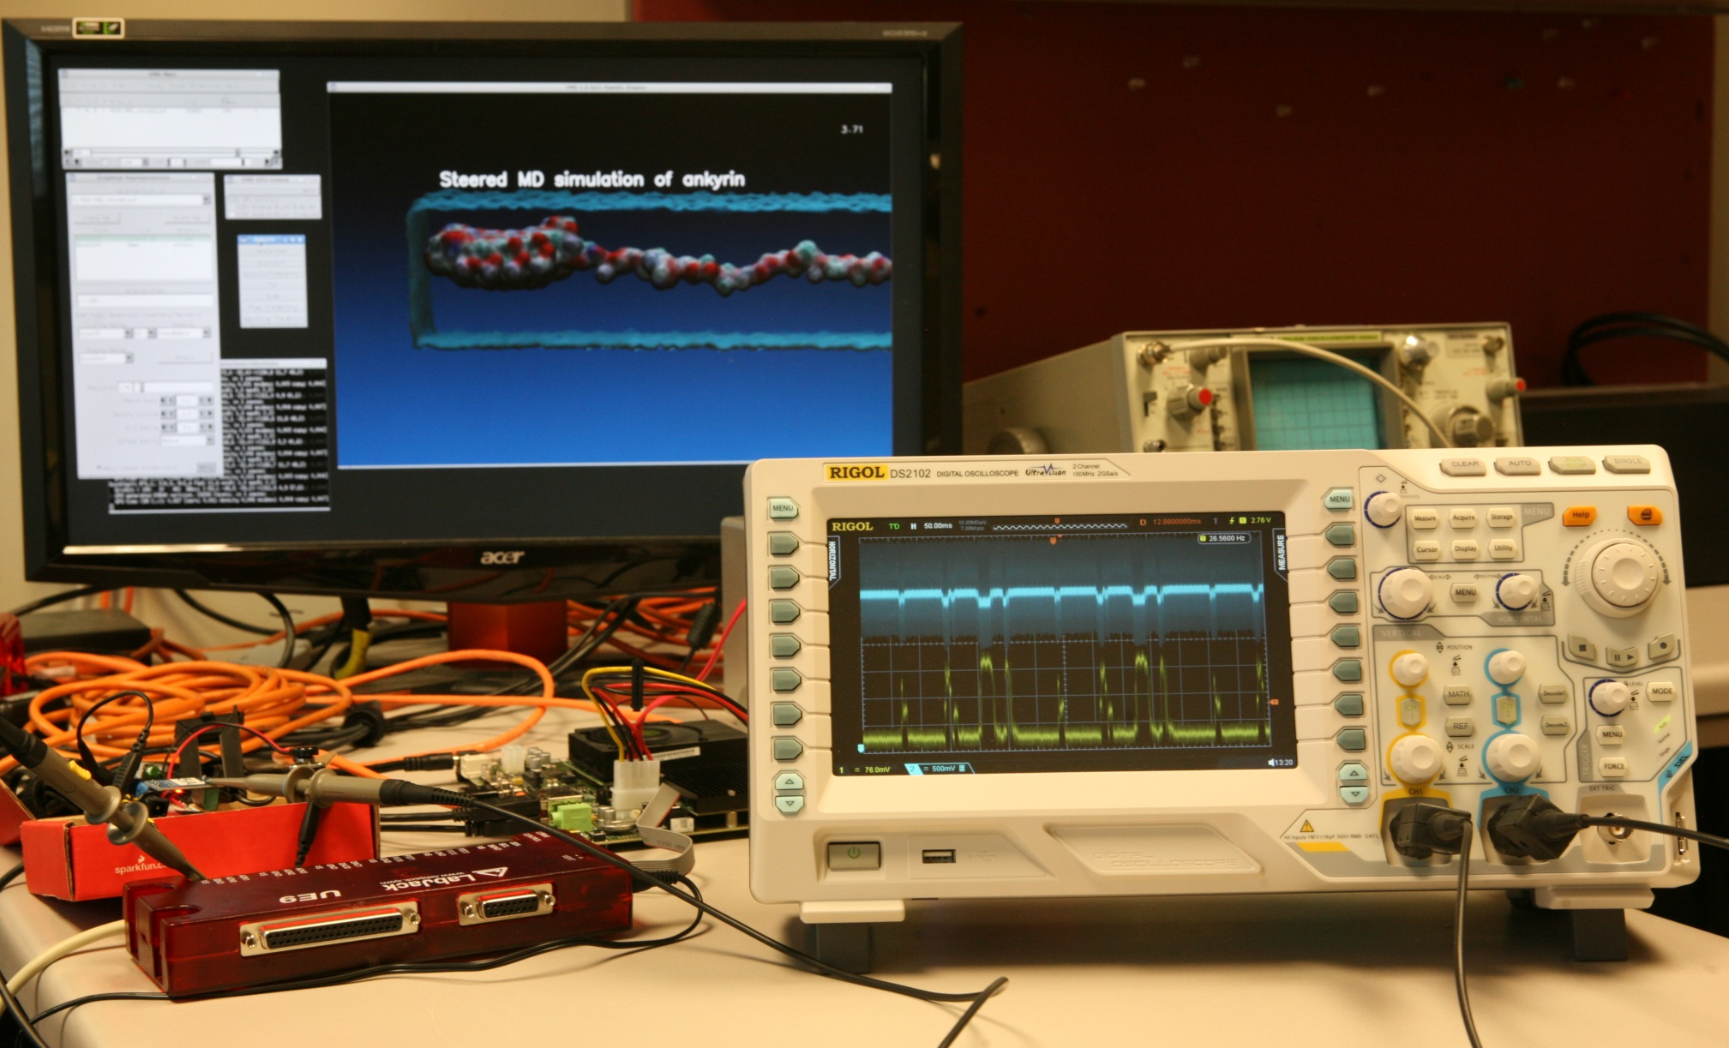
Technology Opportunities and Collaborations
Supercomputer Centers, Cray, IBM
GPU accelerated supercomputing
In-situ and remote visualization technologies
NVIDIA
GPU computing
Performance profiling and optimization
Ray tracing
In-situ and remote visualization
HPC/AI containers and clouds
Intel
CPU vectorization and sw optimization
Ray tracing
Non-volatile memory systems
Amazon
Cloud deployment of VMD/NAMD, related tools
Universities:
T. Ertl, U. Stuttgart: visualization algorithms
G. Fiorin, J. Henin, Toni Giorgino, collective variables
W. Sherman, Indiana U.: VR HMDs, visualization
VR HMDs, 6DoF input devices
GPU computing,
Ray tracing,
Remote viz.
Energy efficiency: ARM+GPU

Slide 8
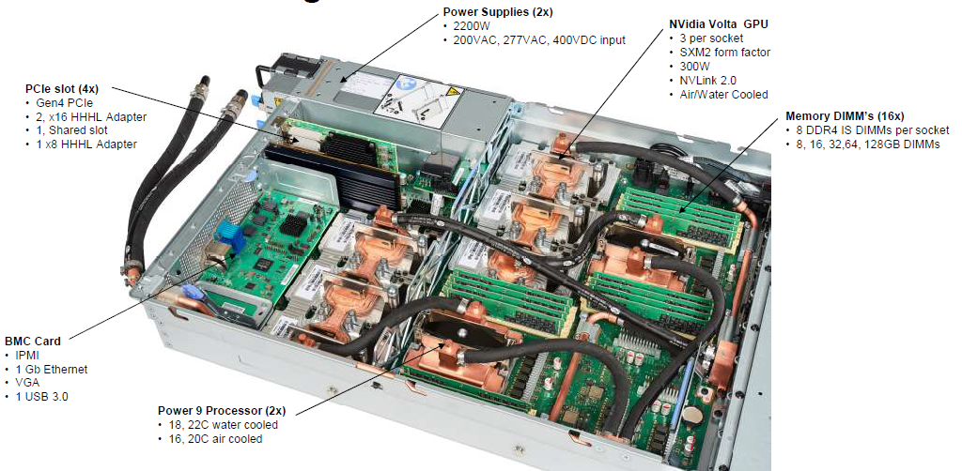
IBM AC922 w/ 6 GPUs

Slide 9
IBM AC922 Summit Node
3 GPUs Per CPU Socket
Tesla V100 GPU
Tesla V100 GPU
Tesla V100 GPU
Tesla V100 GPU
Tesla V100 GPU
Tesla V100 GPU
Nvlink 2.0
2x 50GBps:
100GBps
DDR4 DRAM
DDR4 DRAM
POWER9
CPU
POWER9
CPU
X-Bus
64GBps
120GBps
120GBps
InfiniBand
12GBps
InfiniBand
12GBps
1.6TB SSD
“Burst Buffer”

Slide 10
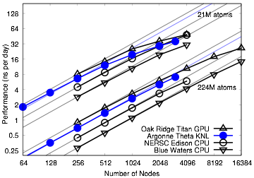
Earliest NAMD Runs on Summit

Slide 11
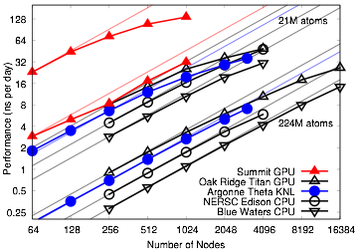
Earliest NAMD Runs on Summit

Slide 12
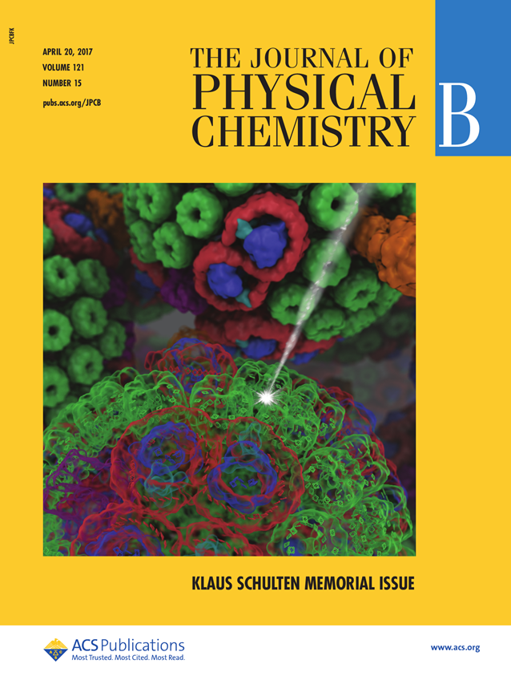
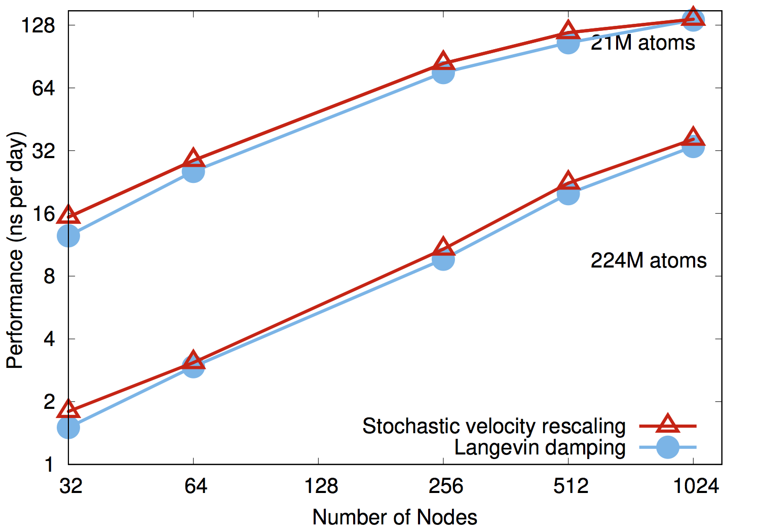
NAMD on Summit, May 2018: ~20% Performance Increase
NAMD simulations can generate up to 10TB of output per day on 20% of Summit

Slide 13
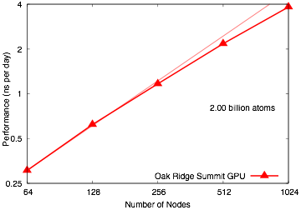
NAMD 2 Billion Atom Benchmark on 20% of Summit “Scalable Molecular Dynamics with NAMD on the Summit System” IBM Journal of Research and Development, 2018. (In press)

Slide 14
Molecular Dyamics Trajectory Analysis
MD simulations sample femtosecond timescales
Millions of timesteps stored per trajectory
Dynamics of biomolecular complexes are main interest, but solvent often accounts for half or more of the simulation content
Skip I/O for regions of bulk solvent where possible [1]
Modern MD tools, e.g., VMD, NAMD, LAMMPS, HOOMD, employ extensive embedded scripting (Python, Tcl, etc) to permit simulation preparation, custom simulation protocols, analysis, and visualization
Unified collective variables module allows identical analytical computations to be performed within LAMMPS, NAMD, and VMD, during pre-simulation modeling, in-situ, and post-hoc [2]
[1] Immersive Out-of-Core Visualization of Large-Size and Long-Timescale Molecular Dynamics Trajectories. J. Stone, K. L. Vandivort, and K. Schulten. G. Bebis et al. (Eds.): 7th International Symposium on Visual Computing (ISVC 2011), LNCS 6939, pp. 1-12, 2011.
[2] Using collective variables to drive molecular dynamics simulations. G. Fiorin, M. L. Klein, and J. Hénin. Molecular Physics, 111:22-23, 3345-3362, 2013.

Slide 15
Petascale Molecular Dynamics I/O and Storage Challenges
NAMD simulations can produce up to 10TB/day @ 1024 nodes (~20%) of ORNL Summit, more as ongoing performance optimizations raise NAMD performance further
Petascale science campaigns require months of simulation runs
Long-term storage of large-fractional petabytes impractical
Historical “download output files for analysis and visualization” approach is a non-starter at this scale
Demands visualization and analysis operate on the data in-place on the HPC system, whether post-hoc, in-transit, or in-situ
Analyses must identify salient features of structure, dynamics, cull data that don’t contribute to biomolecular processes of interest

Slide 16
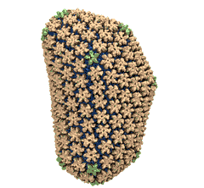
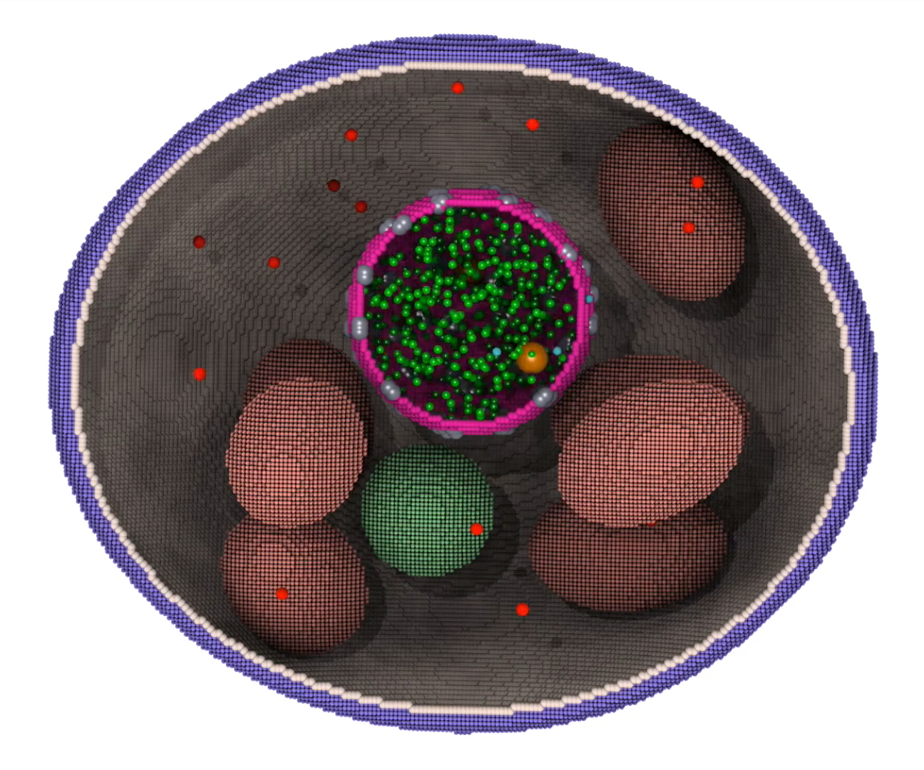
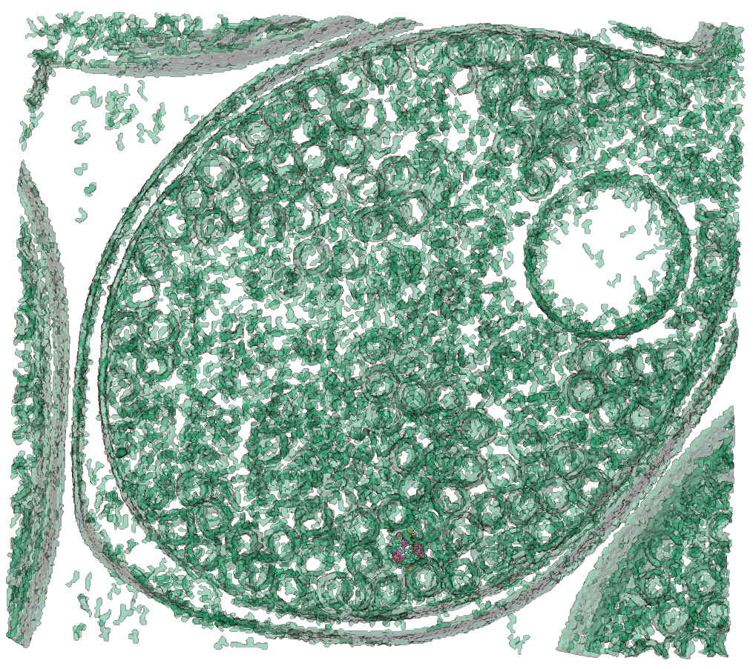
VMD – “Visual Molecular Dynamics”
Unique capabilities:
Trajectories are fundamental to VMD
Support for very large systems, now reaching billions of particles
Extensive GPU acceleration
Parallel analysis/visualization with MPI
Visualization and analysis of:
Molecular dynamics simulations
“Particle” systems and whole cells
Cryo-EM densities, volumetric data
Quantum chemistry calculations
Sequence information
MD Simulations
Cell-Scale Simulation
Integrate w/ Cryo-EM/ET

Slide 17
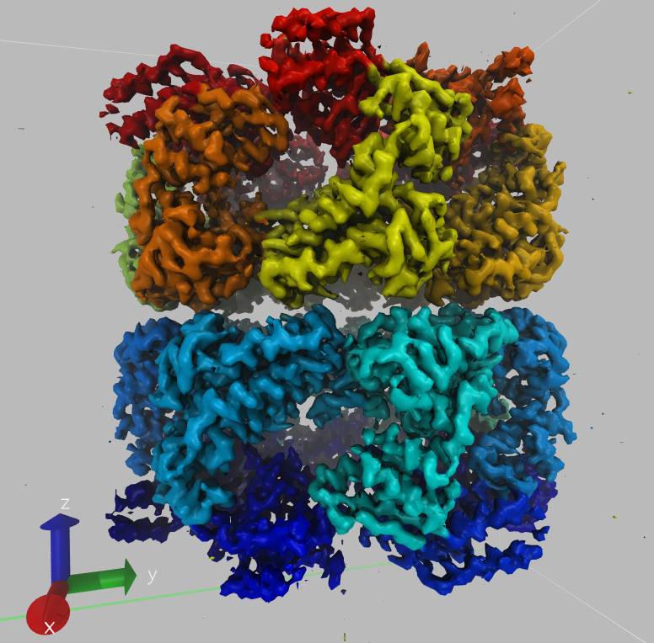
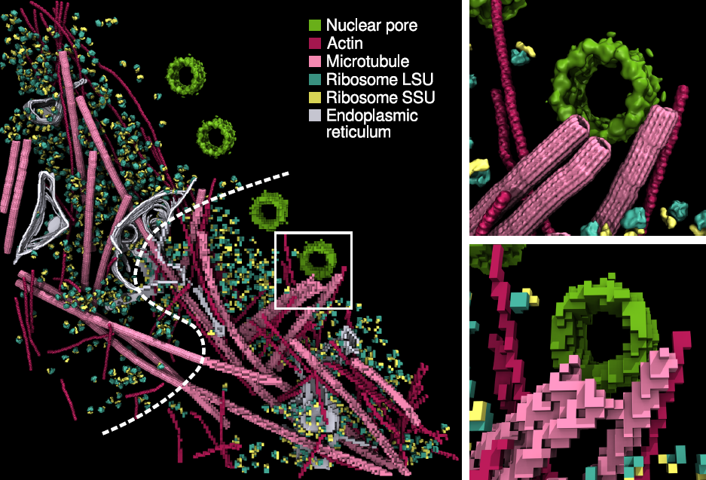
Density Map Segmentation
VMD GPU-accelerated density map segmentation of GroEL
Earnest, et al. J. Physical Chemistry B, 121(15): 3871-3881, 2017.

Slide 18
VMD Tesla V100 Cross Correlation Performance Rabbit Hemorrhagic Disease Virus: 702K atoms, 6.5Å resolution VMD on Volta GPUs now ~9x faster than Kepler GPUs
Application and Hardware platform | Runtime, Speedup vs. Chimera, VMD+GPU
Chimera Xeon E5-2687W (2 socket) [1] | 15.860s, 1x
VMD-CUDA IBM Power8 + 1x Tesla K40 [2] | 0.488s, 32x 0.9x
VMD-CUDA Intel Xeon E5-2687W + 1x Quadro K6000 [1,2] | 0.458s, 35x 1.0x
VMD-CUDA Intel Xeon E5-2698v3 + 1x Tesla P100 | 0.090s, 176x 5.1x
VMD-CUDA IBM Power8 “Minsky” + 1x Tesla P100 | 0.080s, 198x 5.7x
VMD-CUDA Intel Xeon E5-2697Av4 + 1x Tesla V100 | 0.050s, 317x 9.2x
VMD-CUDA IBM Power9 “Newell” + 1x Tesla V100 | 0.049s, 323x 9.3x
[1] GPU-Accelerated Analysis and Visualization of Large Structures Solved by Molecular Dynamics Flexible Fitting. J. E. Stone, R. McGreevy, B. Isralewitz, and K. Schulten. Faraday Discussions 169:265-283, 2014.
[2] Early Experiences Porting the NAMD and VMD Molecular Simulation and Analysis Software to GPU-Accelerated OpenPOWER Platforms. J. E. Stone, A.-P. Hynninen, J. C. Phillips, K. Schulten. International Workshop on OpenPOWER for HPC (IWOPH'16), LNCS 9945, pp. 188-206, 2016.

Slide 19
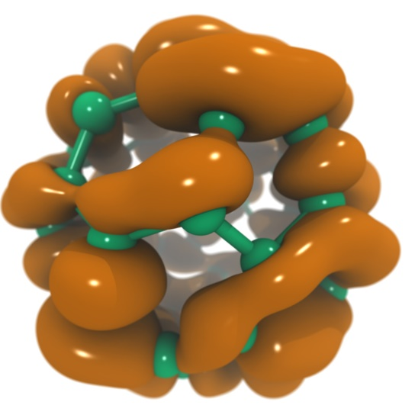
VMD Tesla V100 Performance for C₆₀ Molecular Orbitals, 516x519x507 grid
Hardware platform | Runtime, Speedup
IBM Power8 (ORNL ‘crest’) + 1x Tesla K40 [1] | 3.49s, 1.0x
Intel Xeon E5-2697Av4 + 1x Tesla V100 [2] | 0.610s, 5.7x
Intel Xeon E5-2697Av4 + 2x Tesla V100 [2] | 0.294s, 11.8x
Intel Xeon E5-2697Av4 + 3x Tesla V100 [2] | 0.220s, 15.9x
IBM Power9 “Newell” + 1x Tesla V100 | 0.394s, 8.8x
IBM Power9 “Newell” + 2x Tesla V100 | 0.207s, 16.8x
IBM Power9 “Newell” + 3x Tesla V100 | 0.151s, 23.1x
IBM Power9 “Newell” + 4x Tesla V100 | 0.130s, 26.8x
NVLink perf. boost
[1] Early Experiences Porting the NAMD and VMD Molecular Simulation and Analysis Software to GPU-Accelerated OpenPOWER Platforms. J. E. Stone, A.-P. Hynninen, J. C. Phillips, K. Schulten. International Workshop on OpenPOWER for HPC (IWOPH'16), LNCS 9945, pp. 188-206, 2016.
[2] NAMD goes quantum: An integrative suite for hybrid simulations. Melo et al., Nature Methods, 2018.

Slide 20
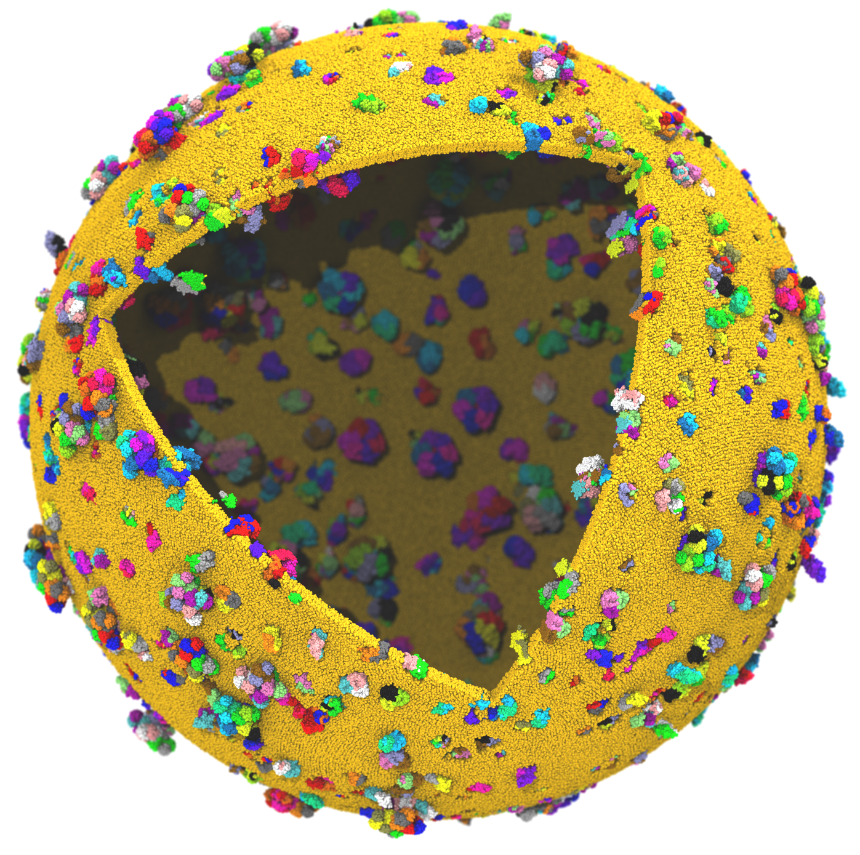
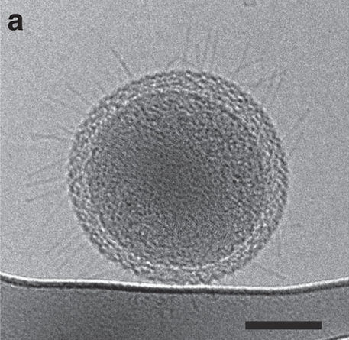
Next Generation: Simulating a Proto-Cell
Emulate aspects of the Mycoplasma mycoides bacterium
200nm diameter
~1 billion atoms w/ solvent
~1400 proteins in membrane
Cryo-ET image of ultra-small bacteria (scale bar 100nm)
Luef et al. Nature Comm., 6:6372, 2015.

Slide 21
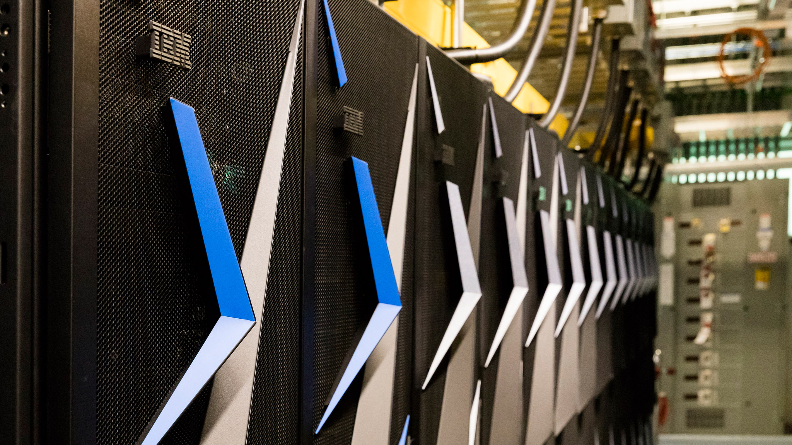
Next Generation: Simulating a Proto-Cell
ORNL Summit: NVLink-connected Tesla V100 GPUs enable next-gen visualizations
200nm diameter
~1 billion atoms w/ solvent
~1400 proteins in membrane

Slide 22
Proto-Cell Data Challenges
1B-atom proto-cell requires nodes with more than TB RAM to build complete model…
1B-atom proto-cell binary structure file: 63GB
Trajectory frame atomic coordinates: 12GB, 1.2TB/ns of simulation (1 frame per 10ps)
Routine modeling and visualization tasks are a big challenge at this scale
Models contain thousands of atomic-detail components that must work together in harmony
Exploit persistent memory technologies to enable “instant on” operation on massive cell-scale models – eliminate several minutes of startup during analysis/visualization of known structure
Sparse output of results at multiple timescales will help ameliorate visualization and analysis I/O
Data quantization, compression, APIs like ZFP

Slide 23
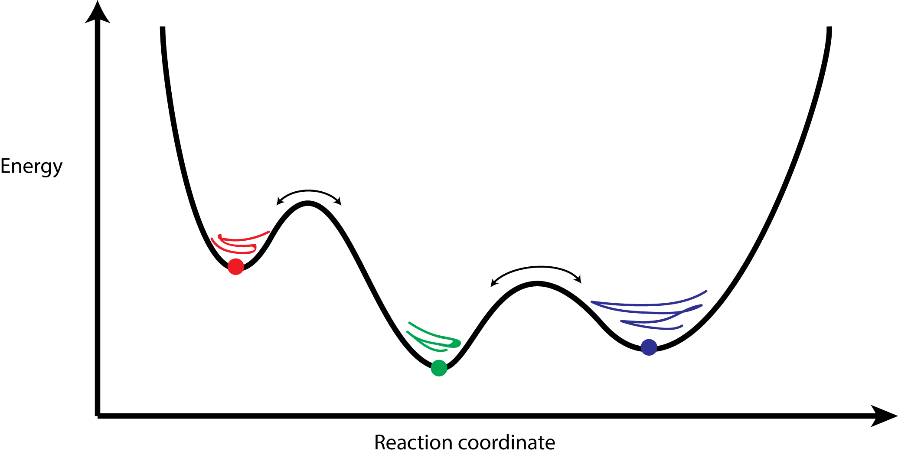
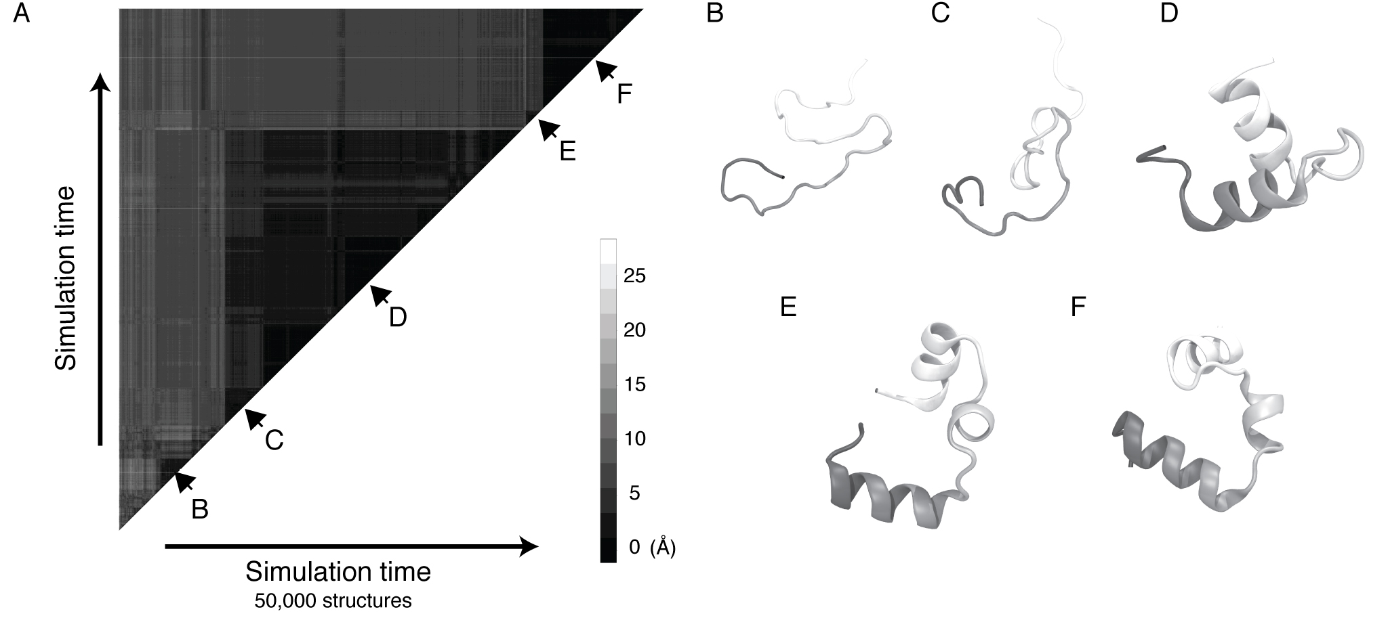
Clustering Analysis of Molecular Dynamics Trajectories: Requires I/O+Memory for All-Pairs of Trajectory Frames
GPU-Accelerated Molecular Dynamics Clustering Analysis with OpenACC. J.E. Stone, J.R. Perilla, C. K. Cassidy, and K. Schulten. In, Robert Farber, ed., Parallel Programming with OpenACC, Morgan Kaufmann, Chapter 11, pp. 215-240, 2016.

Slide 24
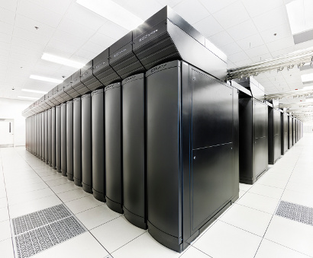
VMD Petascale Visualization and Analysis
Combination of growing system sizes and timescales of simulation trajectories poses a major data size challenge for molecular visualization and analysis
Parallel I/O rates up to 275 GB/sec on 8192 Cray XE6 nodes – can read in 231 TB in 15 minutes!
Analyze/visualize large trajectories too large to transfer off-site:
User-defined parallel analysis operations, data types
Parallel rendering, movie making
Supports GPU-accelerated compute nodes for both visualization and analysis tasks:
GPU accelerated trajectory analysis w/ CUDA
OpenGL and GPU ray tracing for visualization and movie rendering
NCSA Blue Waters Hybrid Cray XE6 / XK7
22,640 XE6 dual-Opteron CPU nodes
4,224 XK7 nodes w/ Telsa K20X GPUs
Parallel VMD currently available on:
ORNL Summit and Titan, NCSA Blue Waters, IU Big Red II, CSCS Piz Daint, many similar systems

Slide 25
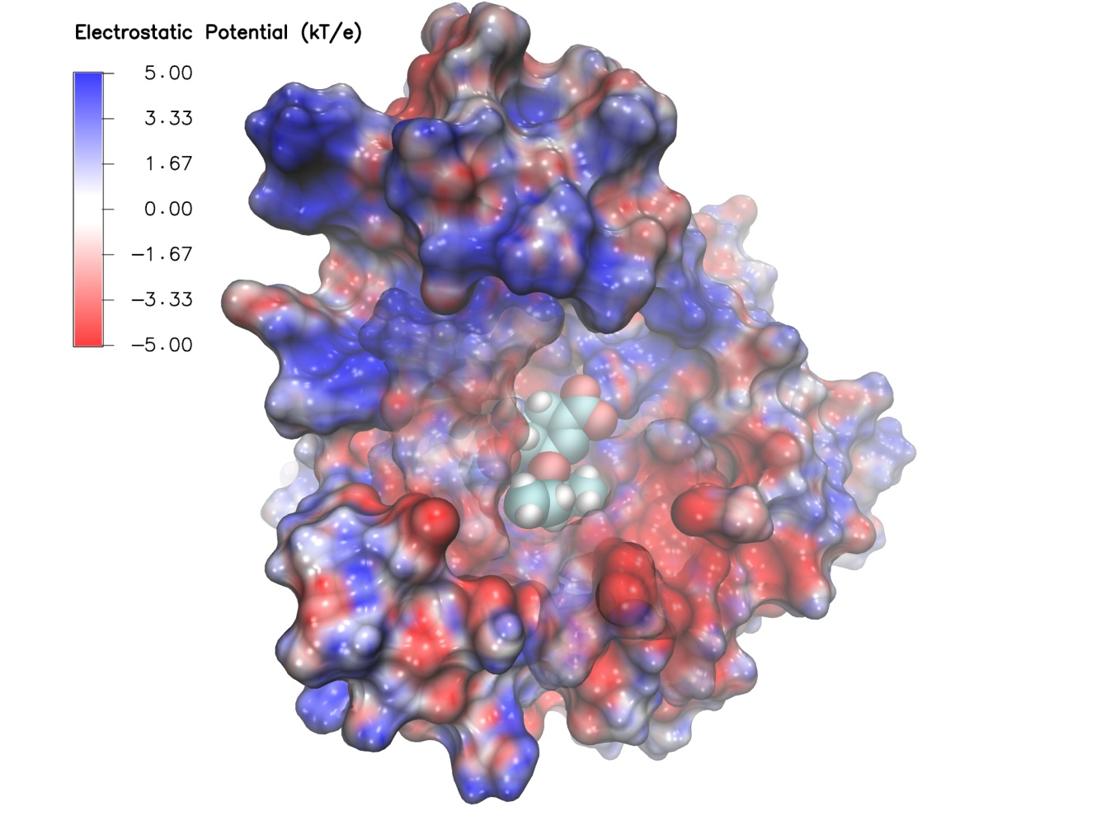
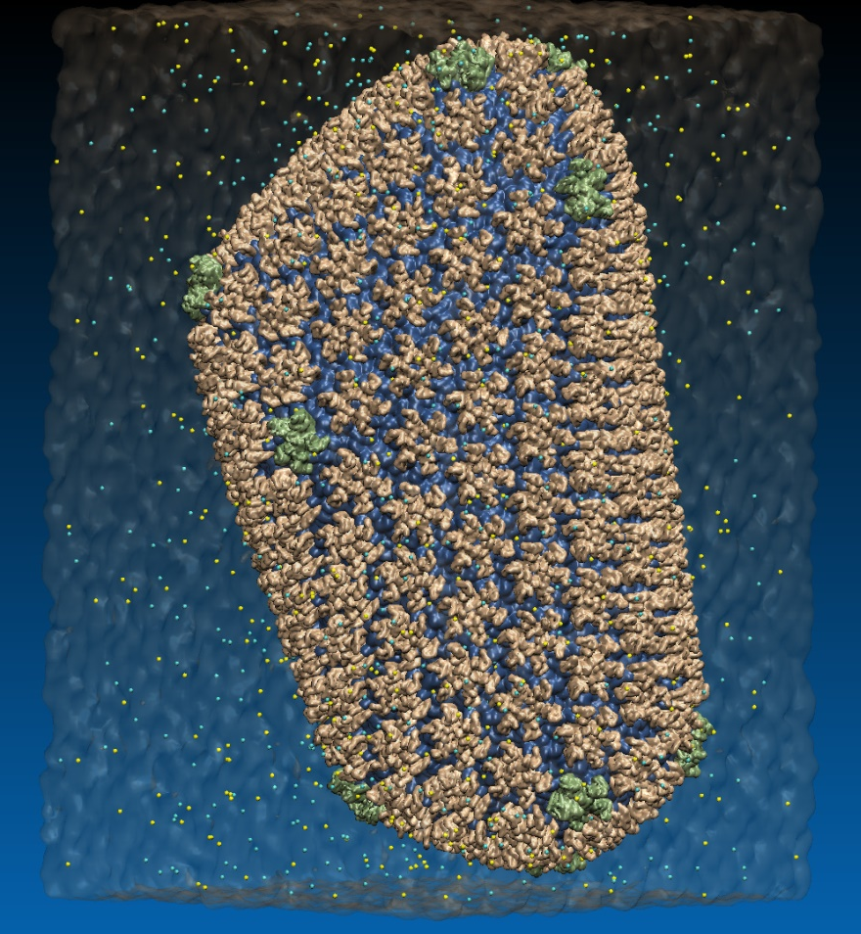
VMD EGL Rendering: Supports full VMD GLSL shading features Vulkan support coming soon...
Swine Flu A/H1N1 neuraminidase bound to Tamiflu
64M atom HIV-1 capsid simulation
High Performance Molecular Visualization: In-Situ and Parallel Rendering with EGL. J. E. Stone, P. Messmer, R. Sisneros, and K. Schulten. High Performance Data Analysis and Visualization Workshop, IEEE IPDPSW, pp. 1014-1023, 2016.

Slide 26


NEW: Power9+V100 Interactive Remote Visualization
Built-into VMD itself
Enable access to massive data sets
Uses GPU H.264 / HEVC hardware accelerated video encode/decode
Supports interactive remote visualizations (both rasterization and ray tracing)
Development ongoing, expected in next major VMD release, 2019…

Slide 27
Use of Node-Local Burst Buffers and Non-Volatile Memory DIMMs
Perform viz+analysis in-transit in node-local SSDs, persistent memory NVDIMMs
ORNL Summit I/O:
Parallel FS: 2.5 TB/s
Node-local PCIe “burst buffer” SSDs: 10+ TB/sec, 7PB capacity
Plenty of capacity for full-detail MD trajectories, could enable ~100x increase in temporal resolution in cases where it would be valuable to the science
Enable all-pairs trajectory clustering analyses and resulting visualizations
Future systems with NVDIMMs (3D Xpoint, phase change memory) could eventually provide bandwidths approaching DRAM
Use NVDIMMs w/ mmap(), APIs like PMDK to perform formerly-out-of-core calculations using persistent memory:
https://github.com/pmem/pmdk
Imagine future Summit-like machines w/ NVLink-connected GPUs w/ access to high-bandwidth persistent memory on each node

Slide 28
Trade FLOPS for Reduced I/O
ORNL Summit compute node:
6x Tesla V100 GPUs, 2x POWER9 CPUs
GPUs Peak: ~46 DP TFLOPS, ~96 SP TFLOPS
Peak IB rate per node: ~23GB/sec
Ratio of FLOPS vs. I/O:
~2,000 DP FLOPS/byte, ~4000 SP FLOPS/byte
~16K FLOPS per FP word
Unconventional approach: Recompute to avoid I/O

Slide 29
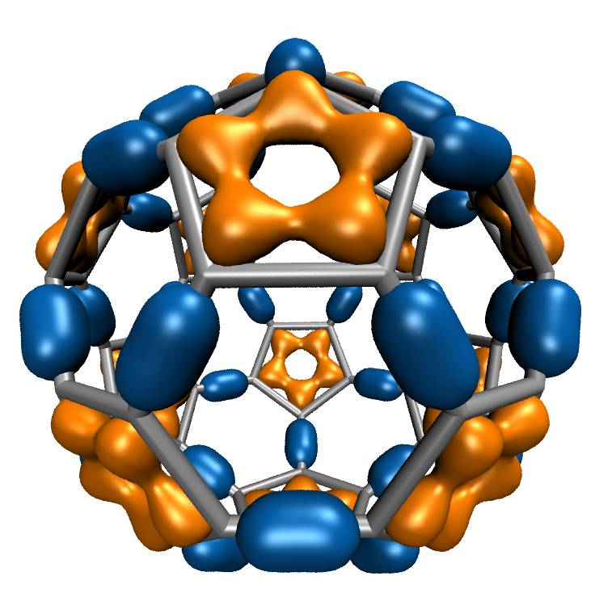
Computing+Visualizing Molecular Orbitals
Movies of simulation trajectories provides insight into results
QM, and hybrid (QM/MM) MO visualizations historically done from huge “cube” files, impractical
Store QM wavefunctions + Gaussian basis set, only 10s of KB per stored timestep compared to 100s of MB
Recompute MO grid on-the-fly from QM basis set, huge decrease in RAM+I/O in exchange for heavy FP arithmetic
C₆₀
NAMD goes quantum: An integrative suite for hybrid simulations. Melo, M. C. R.; Bernardi, R. C.; Rudack T.; Scheurer, M.; Riplinger, C.; Phillips, J. C.; Maia, J. D. C.; Rocha, G. D.; Ribeiro, J. V.; Stone, J. E.; Neese, F.; Schulten, K.; Luthey-Schulten, Z.; Nature Methods, 2018.
http://dx.doi.org/10.1038/nmeth.4638
High Performance Computation and Interactive Display of Molecular Orbitals on GPUs and Multi-core CPUs. J. E. Stone, J. Saam, D. Hardy, K. Vandivort, W. Hwu, K. Schulten, 2nd Workshop on General-Purpose Computation on Graphics Processing Units (GPGPU-2), ACM International Conference Proceeding Series, volume 383, pp. 9-18, 2009.
Notes:
29
CBH – we should probably write “electron(s)”. Most people are used to closed shell calcs in which the MO contains 2 electrons; but open shell calcs are definitely on the rise in which each MO contains only 1 electron.

Slide 30
VMD C₆₀ MO Viz. Perf, 516x519x507 Grid: @ .13s/frame, avoids 3.8GB/s I/O per-node
Hardware platform | Runtime, Speedup
IBM Power8 (ORNL ‘crest’) + 1x Tesla K40 [1] | 3.49s, 1.0x
Intel Xeon E5-2697Av4 + 1x Tesla V100 | 0.610s, 5.7x
Intel Xeon E5-2697Av4 + 2x Tesla V100 | 0.294s, 11.8x
Intel Xeon E5-2697Av4 + 3x Tesla V100 | 0.220s, 15.9x
IBM Power9 “Newell” + 1x Tesla V100 | 0.394s, 8.8x
IBM Power9 “Newell” + 2x Tesla V100 | 0.207s, 16.8x
IBM Power9 “Newell” + 3x Tesla V100 | 0.151s, 23.1x
IBM Power9 “Newell” + 4x Tesla V100 | 0.130s, 26.8x
NVLink perf. boost w/ no code tuning
(YET)
[1] Early Experiences Porting the NAMD and VMD Molecular Simulation and Analysis Software to GPU-Accelerated OpenPOWER Platforms. J. E. Stone, A.-P. Hynninen, J. C. Phillips, K. Schulten. International Workshop on OpenPOWER for HPC (IWOPH'16), LNCS 9945, pp. 188-206, 2016.

Slide 31
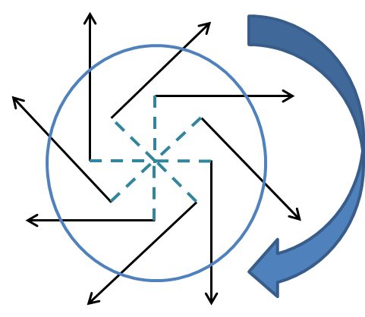
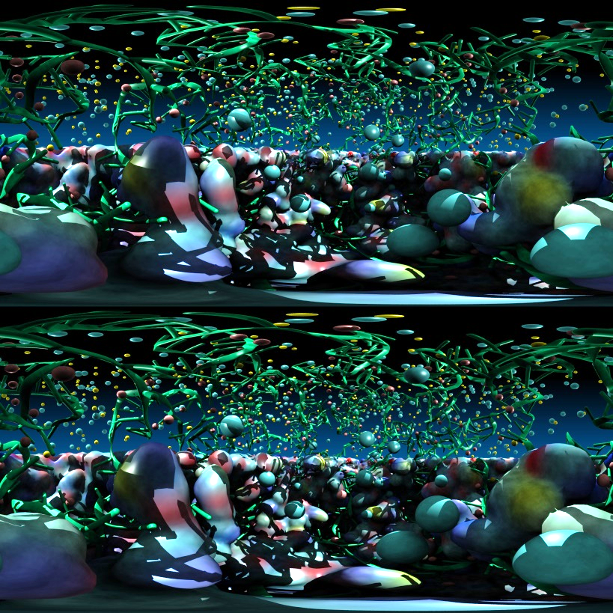
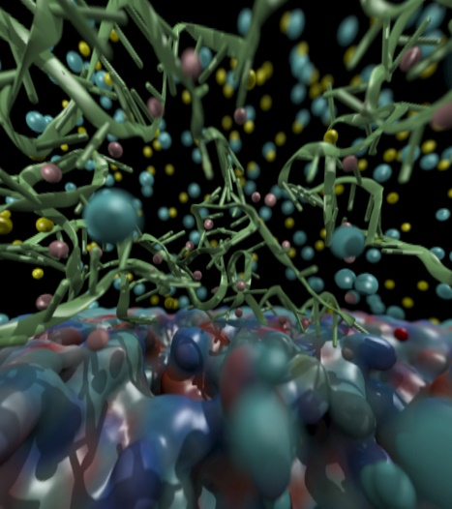
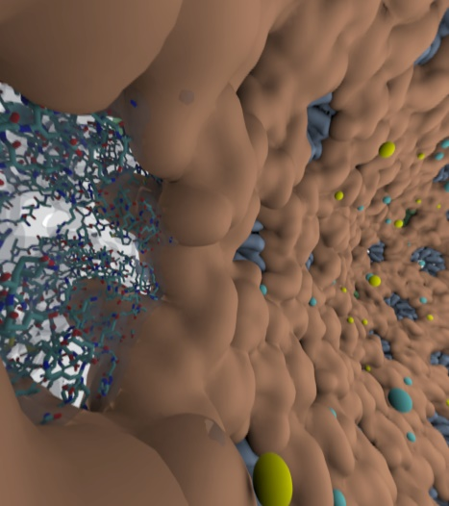
Omnidirectional Stereoscopic Ray Tracing
Ray trace 360° images and movies for Desk and VR HMDs: Oculus, Vive, Cardboard
Stereo spheremaps or cubemaps allow very high-frame-rate interactive OpenGL display
AO lighting, depth of field, shadows, transparency, curved geometry, …
Summit 6x Tesla V100 GPU nodes:
Render many omni-stereo viewpoints, no acceleration structure rebuilds, tens of frames/sec per-node!
OptiX multi-GPU rendering, NVLink compositing and data distribution, etc…
Future: AI for warping between views
Atomic Detail Visualization of Photosynthetic Membranes with GPU-Accelerated Ray Tracing. J. E. Stone, et al. J. Parallel Computing, 55:17-27, 2016.
Immersive Molecular Visualization with Omnidirectional Stereoscopic Ray Tracing and Remote Rendering. J. E. Stone, W. R. Sherman, and K. Schulten. High Performance Data Analysis and Visualization Workshop, IEEE International Parallel and Distributed Processing Symposium Workshops (IPDPSW), pp. 1048-1057, 2016.

Slide 32
Acknowledgements
Theoretical and Computational Biophysics Group, University of Illinois at Urbana-Champaign
NVIDIA CUDA and OptiX teams
Funding:
NIH support: P41GM104601
ORNL Center for Advanced Application Readiness (CAAR)
IBM POWER team, IBM Poughkeepsie Customer Center
NVIDIA CUDA, OptiX, Devtech teams
UIUC/IBM C3SR
NCSA ISL
Notes:
32

Slide 33
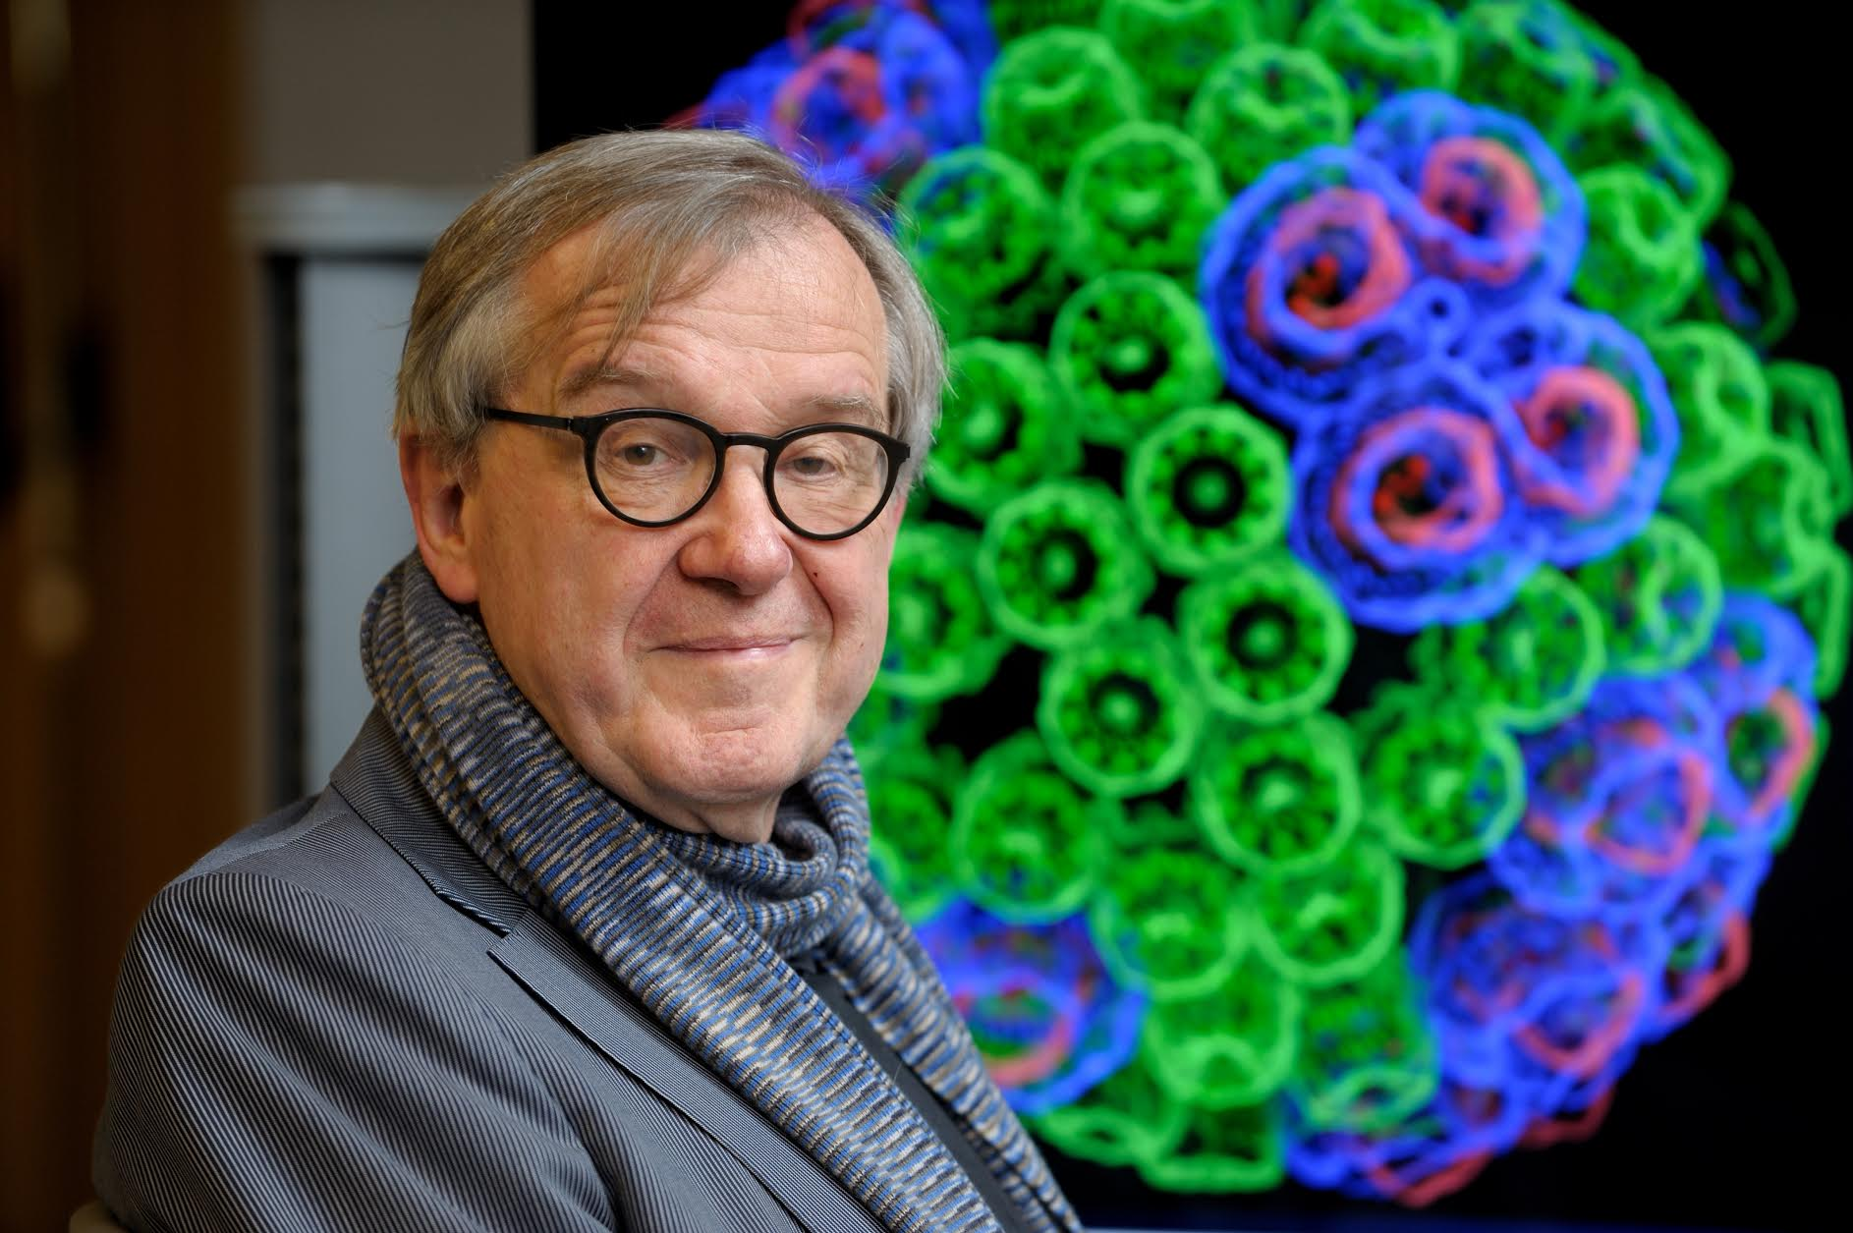
“When I was a young man, my goal was to look with mathematical and computational means at the inside of cells, one atom at a time, to decipher how living systems work. That is what I strived for and I never deflected from this goal.” – Klaus Schulten

