Slide 1
Using AWS EC2 GPU Instances for Computational Microscopy and Biomolecular Simulation
John E. Stone
Theoretical and Computational Biophysics Group
Beckman Institute for Advanced Science and Technology
University of Illinois at Urbana-Champaign
http://www.ks.uiuc.edu/Research/cloud/
1:00-1:25, Amazon Booth, Supercomputing 2018 Exhibition
Dallas, TX, Wednesday, November 14th, 2018
Notes:
State-of-the-art computational methodologies such as molecular
dynamics flexible fitting (MDFF) enable scientists to improve the
resolution of atomic structures obtained from cryo-electron
microscopy using the NAMD and VMD molecular dynamics simulation and
analysis tools. Many would-be users of these computational
structure refinement methodologies are not HPC practitioners, and
they lack the in-house computing resources and technical support staff to
run such advanced workflows, particularly on only an occasional use basis.
By providing pre-configured Amazon Machine Images (AMIs) containing
all of the required software tools, libraries, and drivers, within
the Amazon EC2 Marketplace, scientists can more easily make use of
advanced biomolecular simulation, analysis, and visualization
workflows, bringing these technologies to molecular scientists that
are not traditional HPC users. The talk will describe how we deploy
NAMD and VMD on EC2 GPU-accelerated instance types, how NICE DCV
can be used with VMD to provide high performance remote visualization on
GPU-accelerated EC2 instances, and it will showcase scientific workloads that
are well suited to EC2 GPU instances and pricing models.

Slide 2
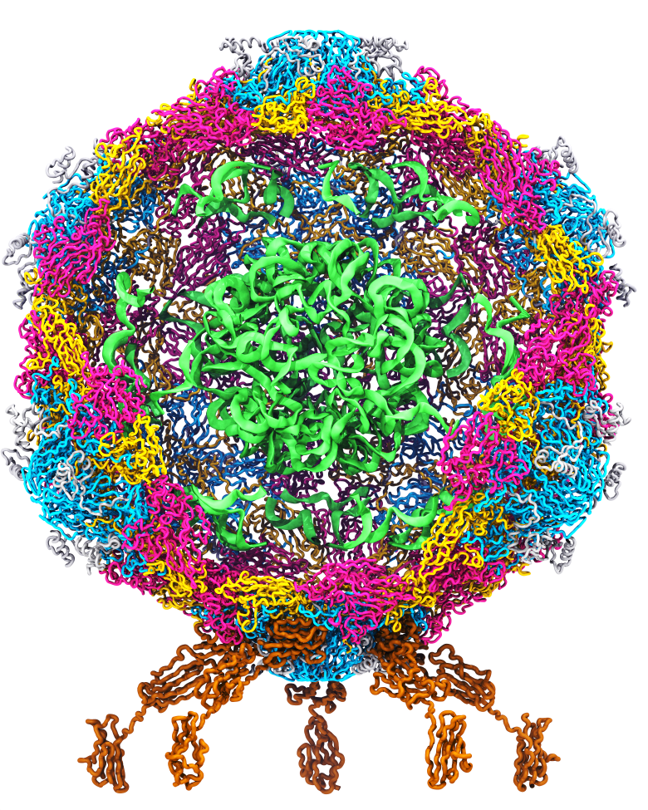
Goal: A Computational Microscope
Study the molecular machines in living cells
Ribosome: target for antibiotics
Poliovirus
Notes:
Ribosomes synthesize new proteins from genetic information
Bacterial ribosome is a target for antibiotics, which interfere with its ability to function by binding to sites on the structure, preventing proteins from being synthesized
Ribosome simulations are extremely computationally challenging due to the size of the structure and its natural environment (solvent, ions, etc, large box, 3 million atoms or so)
Bionanodevice for sequencing DNA efficiently
Knowledge of an individual’s genetic makeup can lead to the prediction and treatment of many diseases by the means of personal genomic medicine and pharmacogenomics. In order for genome sequencing to become practical for common medical use, an inexpensive high throughput genome sequencing technique is required. NIH has set a goal of reducing the cost of genome sequencing by a factor of 10,000, to less than $1,000 within ten years.
The computer is the best microscope to guide the development of bionanodevices, for example to sequence DNA. While experiments can measure DNA electrostatic potentials, they cannot visualize the DNA’s location and conformation at the time of measurement.

Slide 3
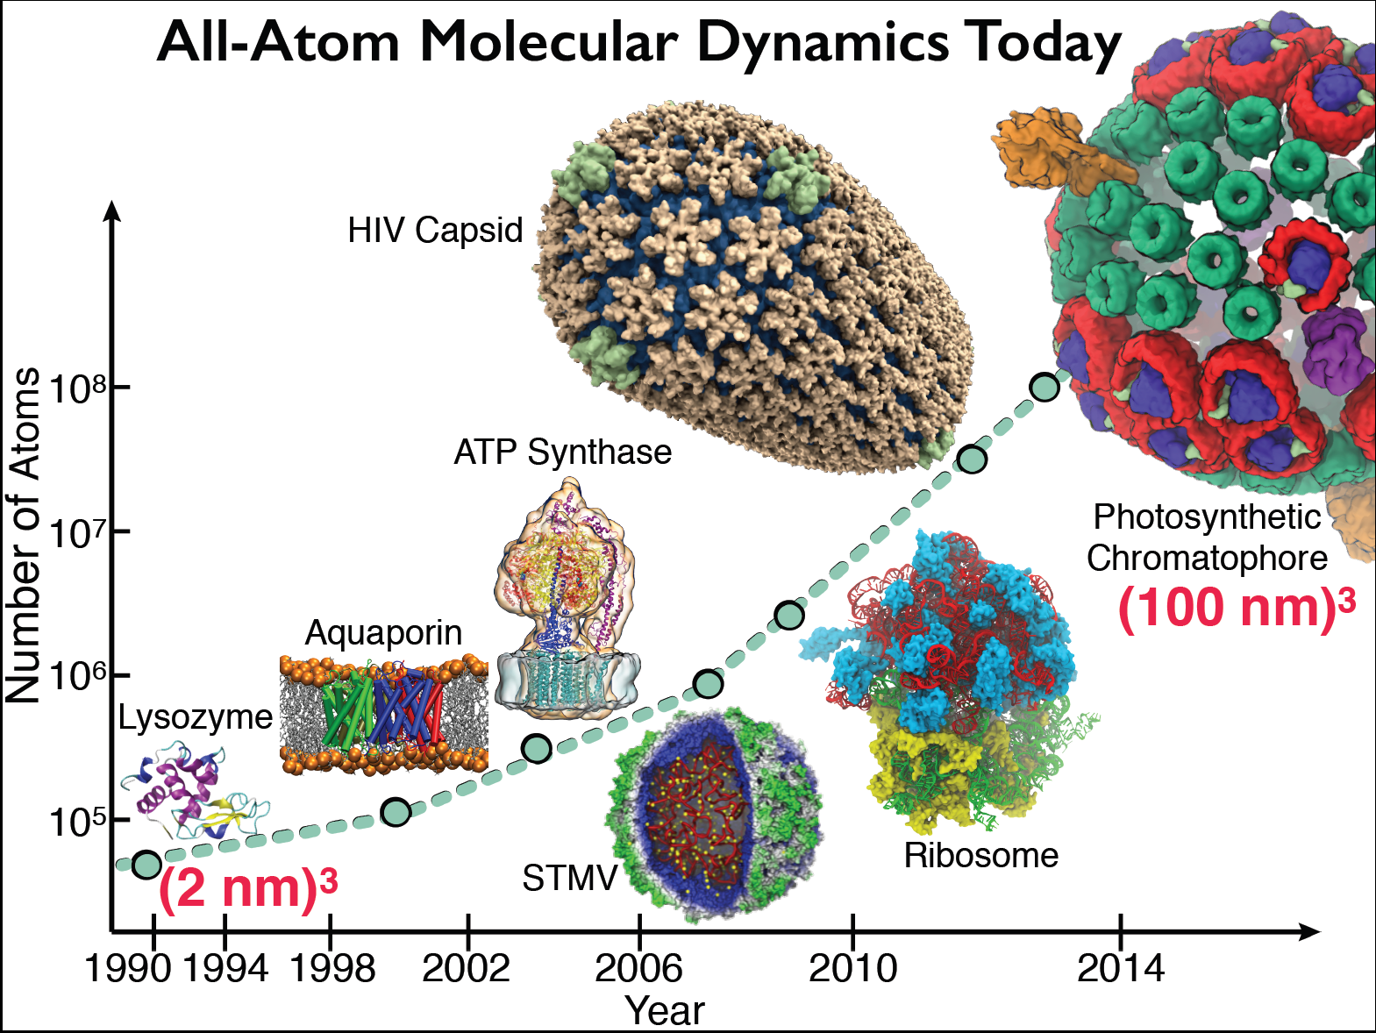
Goal: A Computational Microscope
Study the molecular machines in living cells

Slide 4
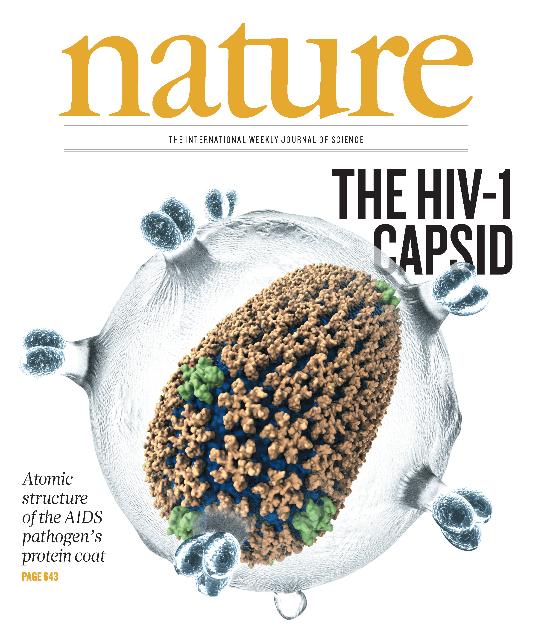
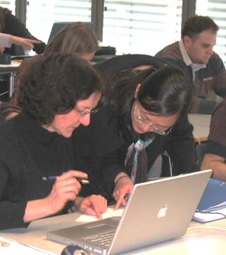
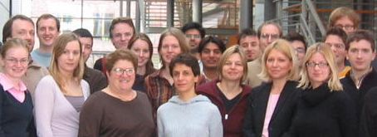
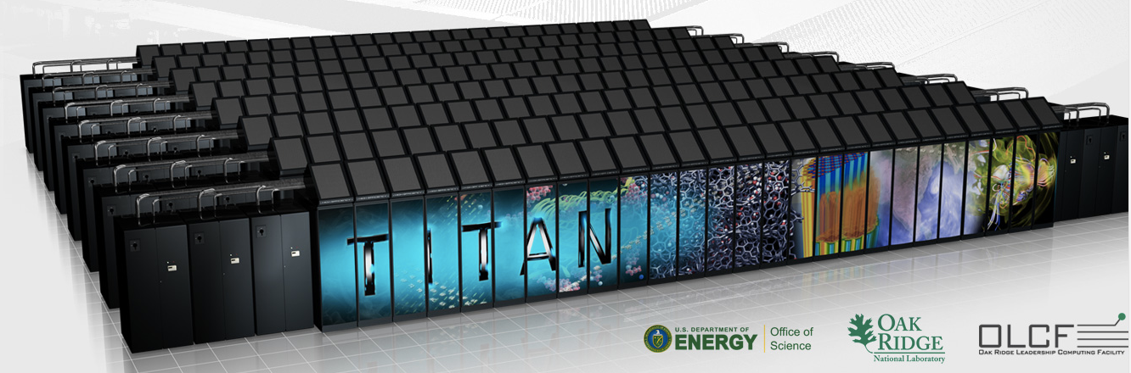
NAMD Highlights
Parallel Molecular Dynamics
Over 12,600 citations of NAMD
One program available on all platforms.
Desktops and laptops – setup and testing
Linux clusters – affordable local workhorses
Supercomputers – free allocations on XSEDE
Blue Waters – sustained petaflop/s performance
GPUs – from desktop to supercomputer
User knowledge is preserved across platforms.
Run any simulation on any number of cores.
Available free of charge to all.
http://www.ks.uiuc.edu/Research/namd/
Hands-On Workshops
Oak Ridge TITAN

Slide 5
Lattice Microbes
BMC Sys. Biol. 2015
Whole-cell modeling and simulation, including heterogeneous environments and kinetic network of thousands of reactions
Incorporate multiple forms of experimental imaging for model construction
Scriptable in Python
Glucose/Agar
http://www.scs.illinois.edu/schulten/lm
Biophys. J. 2015
Biopolymers, 2016

Slide 6
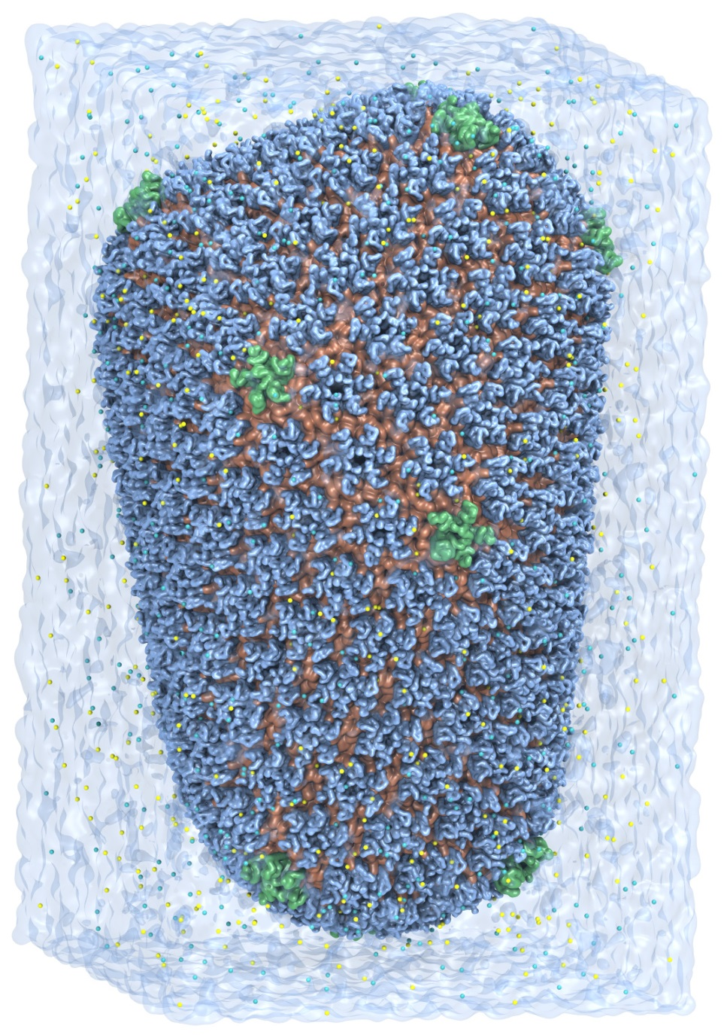
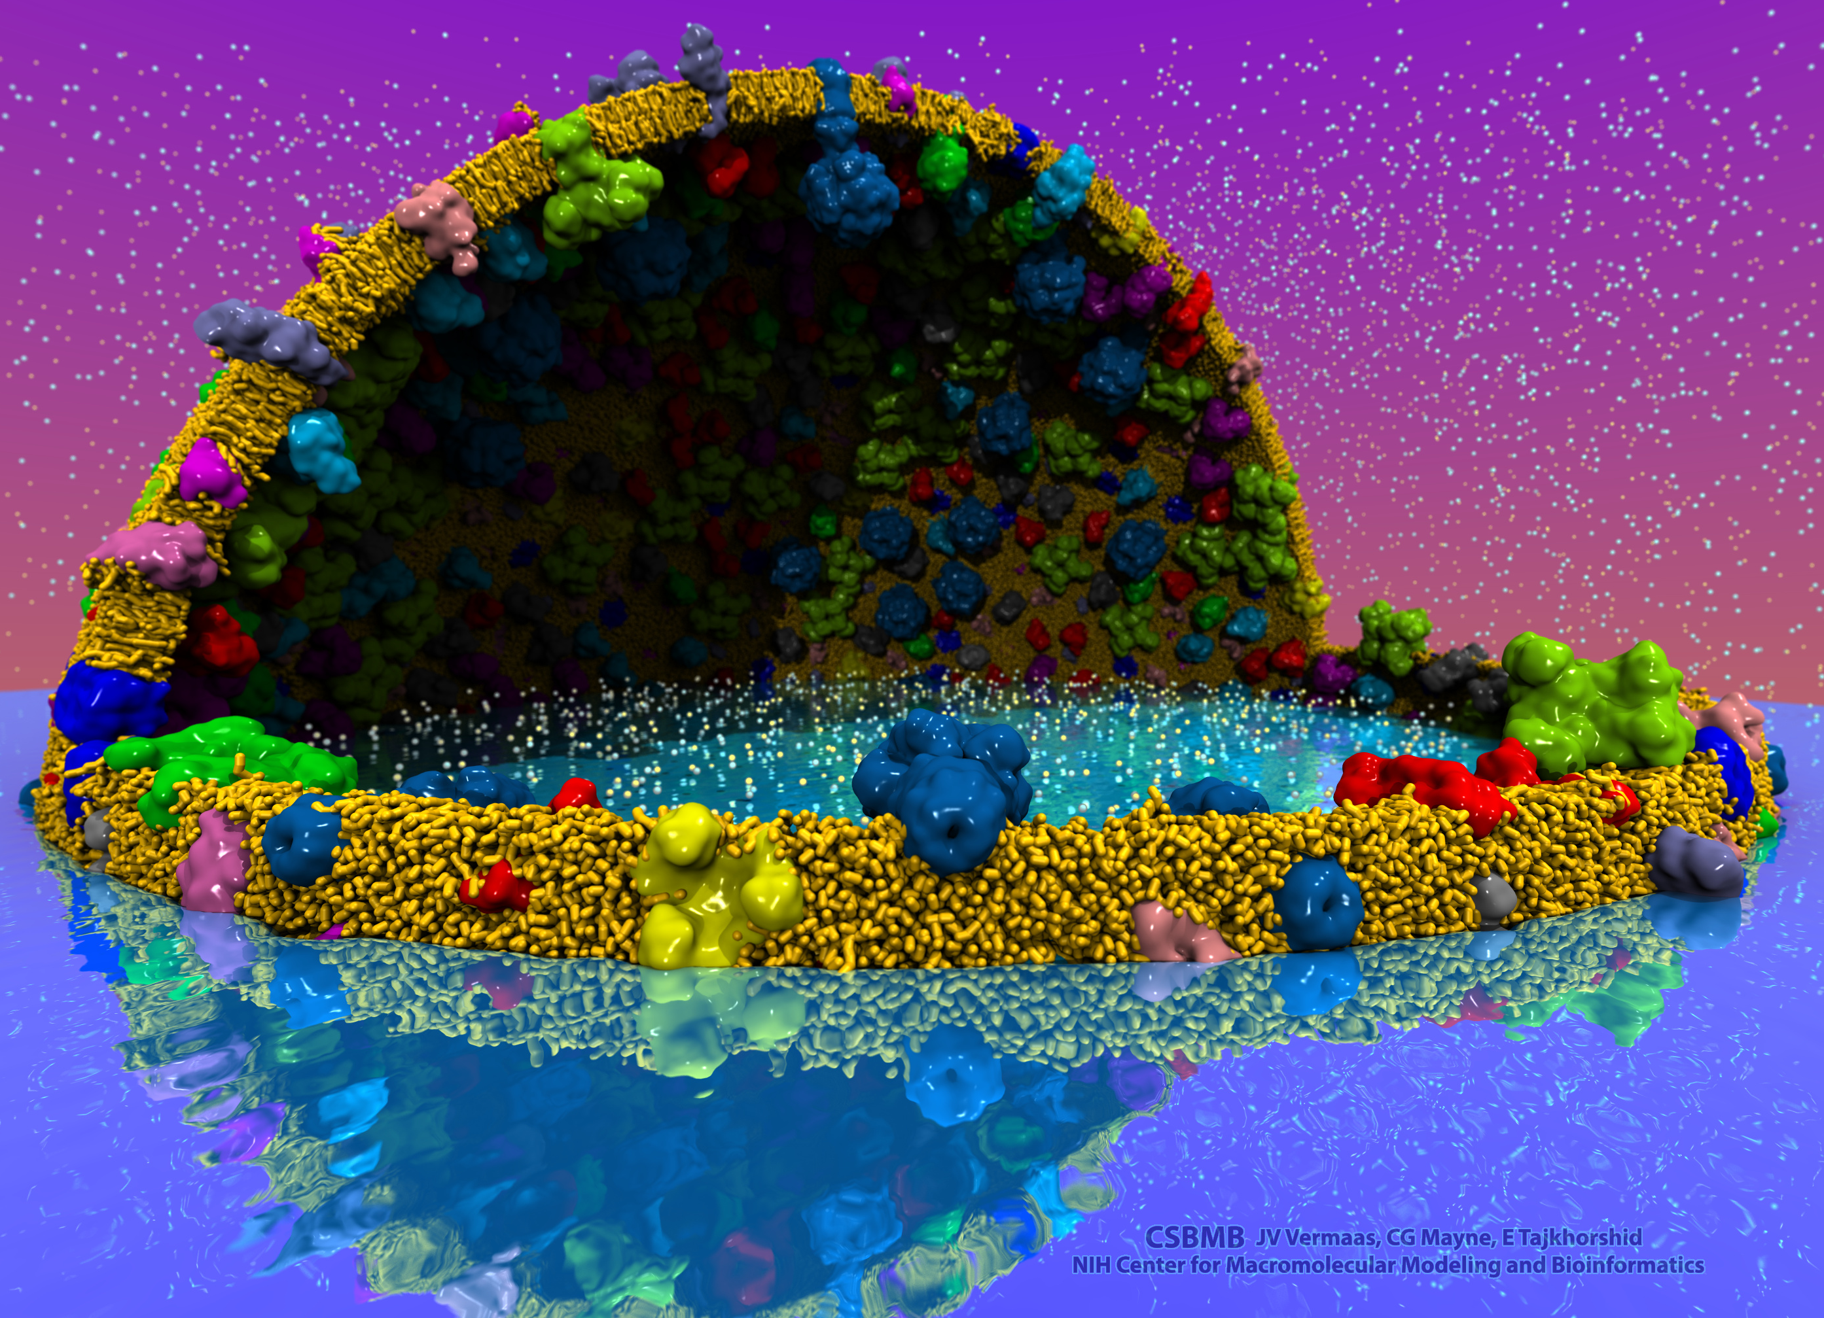
VMD – “Visual Molecular Dynamics”
Visualization and analysis of:
Molecular dynamics simulations
Lattice cell simulations
Quantum chemistry calculations
Sequence information
User extensible scripting and plugins
http://www.ks.uiuc.edu/Research/vmd/
Cell-Scale Modeling
MD Simulation

Slide 7
Making Our Research Tools Easily Accessible
Cloud based deployment
Full virtual machines (known as “AMI” in Amazon terminology)
Amazon AWS EC2 GPU-accelerated instances:
http://www.ks.uiuc.edu/Research/cloud/
Docker “container” images available in NVIDIA NGC registry
Users obtain Docker images via registry, download and run on the laptop, workstation, cloud, or supercomputer of their choosing
https://ngc.nvidia.com/registry/
https://ngc.nvidia.com/registry/hpc-vmd
Research articles incorporating use of Amazon AWS EC2:
Molecular dynamics-based refinement and validation for sub-5 Å cryo-electron microscopy maps. Abhishek Singharoy, Ivan Teo, Ryan McGreevy, John E. Stone, Jianhua Zhao, and Klaus Schulten. eLife, 10.7554/eLife.16105, 2016. (66 pages).
QwikMD-integrative molecular dynamics toolkit for novices and experts. Joao V. Ribeiro, Rafael C. Bernardi, Till Rudack, John E. Stone, James C. Phillips, Peter L. Freddolino, and Klaus Schulten. Scientific Reports, 6:26536, 2016.
High performance molecular visualization: In-situ and parallel rendering with EGL. John E. Stone, Peter Messmer, Robert Sisneros, and Klaus Schulten. 2016 IEEE International Parallel and Distributed Processing Symposium Workshop (IPDPSW), pp. 1014-1023, 2016.

Slide 8
Easy to Launch: AWS EC2 Marketplace

Slide 9
NAMD+VMD AWS EC2 AMIs
Production AMI:
(ami-a01125df) VMD-NAMD-VNC-R1.9.4.1, 64-bit Ubuntu Linux, EBS storage, HVM, created July 10, 2018
Pre-release or developmental AMI:
(ami-ac604ed3) 64-bit Centos 7.5 Linux, EBS storage, HVM, created July 6, 2018
This is an experimental image using Centos and DCV for increased remote visualization performance and smoother interaction. This image will only run on g3 instance types.

Slide 10
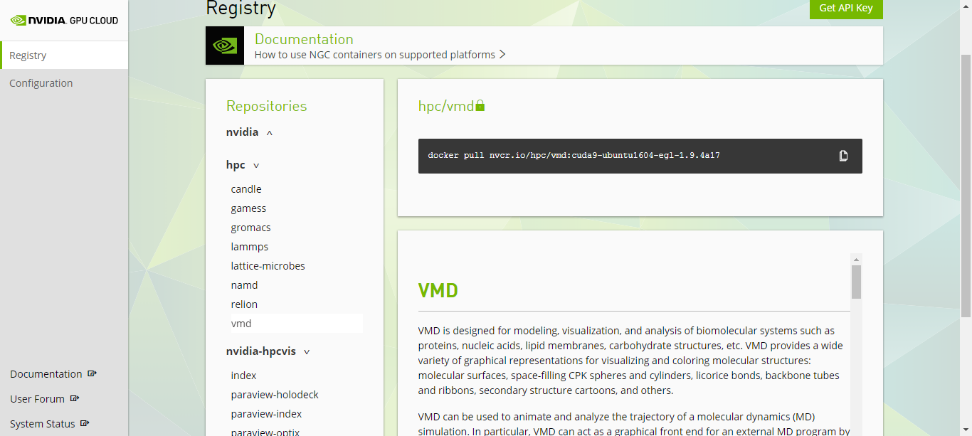
VMD / NAMD / LM, NGC Containers

Slide 11
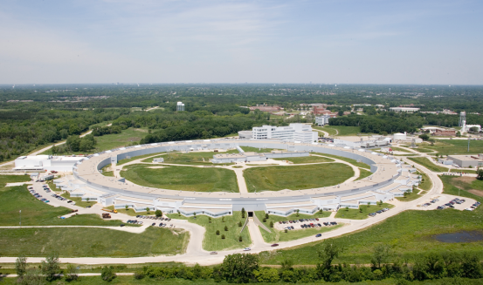
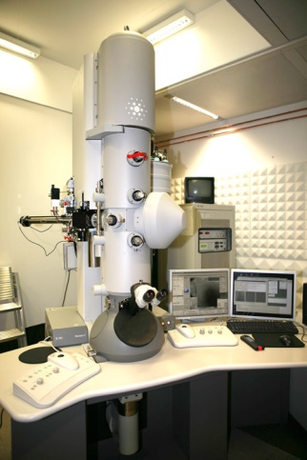
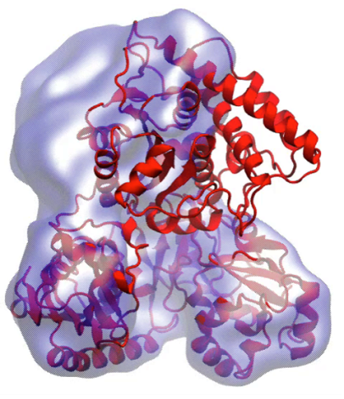
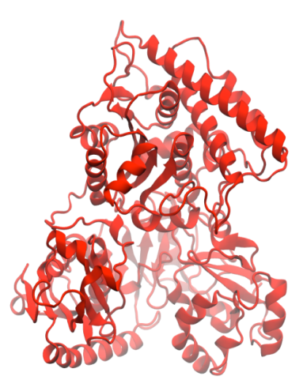
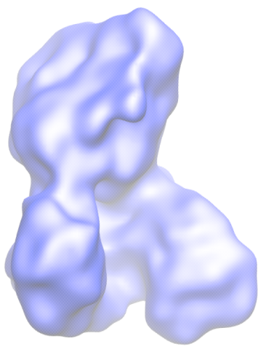
Molecular Dynamics Flexible Fitting (MDFF)
X-ray crystallography
MDFF
Electron microscopy
APS at Argonne
FEI microscope
ORNL Titan
Molecular dynamics-based refinement and validation for sub-5Å cryo-electron microscopy maps. A. Singharoy, I. Teo, R. McGreevy, J. E. Stone, J. Zhao, and K. Schulten. eLife 2016;10.7554/eLife.16105
Acetyl - CoA Synthase

Slide 12
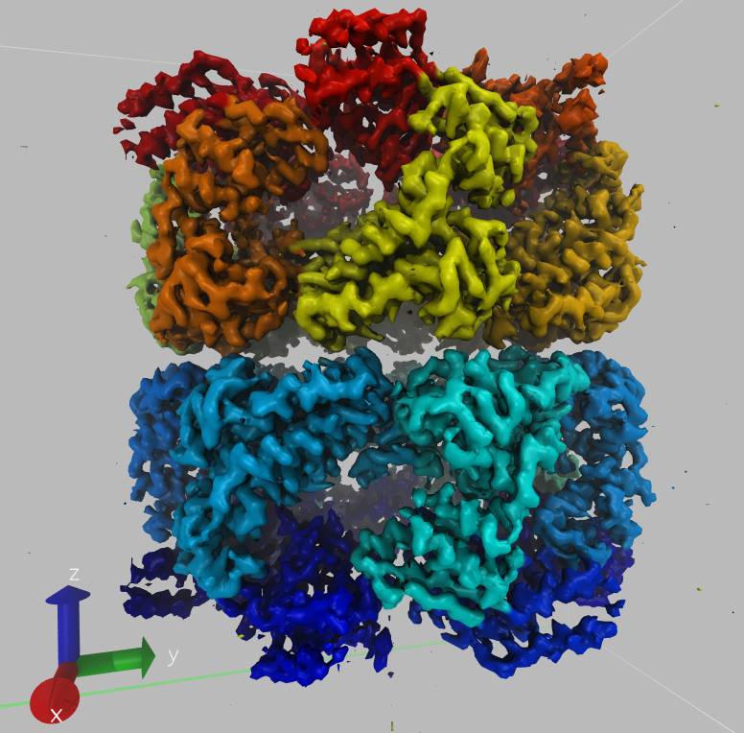
Density Map Segmentation
VMD GPU-accelerated density map segmentation of GroEL
Earnest, et al. J. Physical Chemistry B, 121(15): 3871-3881, 2017.

Slide 13
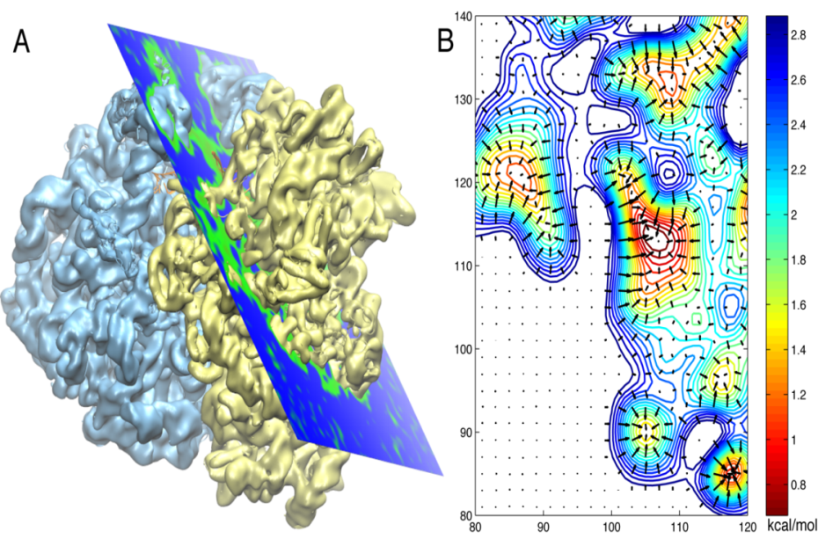
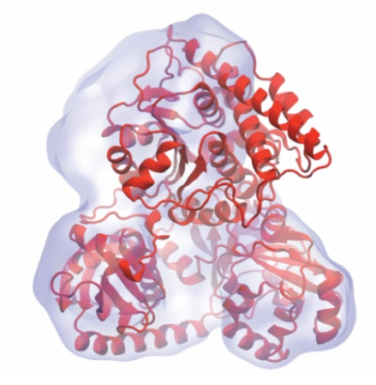
Molecular Dynamics Flexible Fitting - Theory
Two terms are added to the MD potential
An external potential derived from the EM map is defined on a grid as
A mass-weighted force is then applied to each atom

Slide 14
MDFF on the Cloud Costs Less than a Cup of Coffee
MDFF and ReMDFF (Resolution Exchange) require many CPU/GPU cores but
little compute time, making making them good candidates for cloud computing
Singharoy, et al. eLife 2016
Molecule | Instance | Performance (ns/day) | Time (hours) | Simulation Cost / ns ($)
Adenylate Kinase | p3.2xlarge | 112 | 0.2 | 0.67
Acetyl-CoA Synthase | p3.2xlarge | 82 | 0.3 | 0.89
J1 Nitrilase | p3.2xlarge | 5 | 4.8 | 14.6
Singharoy, et al. eLife 2016
Cloud computing allows researchers to focus on the scientific challenges of their project without having to worry about local availability and administration of suitable computer hardware, and installation or compilation of software.
Notes:
Resolution Exchange MDFF uses the replica exchange feature of NAMD to run the parallel fitting simulations. The parallel simulations require many computer cores, however the simulations converge very rapidly and require little computational time, making them well-suited for a cloud computing environment. A cloud computer like Amazon’s EC2 provides a user with a many-cored machine with the click of a button, and a user can run an full MDFF simulation from start to finish for less than the cost of a cup of coffee. Cloud computing provides researchers the necessary means to run the simulation without the need to acquire and maintain their own hardware, allowing them to focus on the scientific challenges of their project. Providing our software like MDFF on the cloud is an ongoing goal of the Center, to meet the needs of an even wider range of users.
- Make sure to make clear the ease of use aspect with packaging all the software up that is needed in a modeling workflow (no installation or compilation) and giving users a “one click” approach to running the method.
Make it clear we have done this and others can do it now too. Mention the aspect of packaging up all the different software and making it easy for an experimentalist to run these methods.
Not only are cloud platforms cost effective, but they give us the ability to create a working computer environment with all of the software components already installed and ready to run at the click of a button. Users therefore do not have to worry about acquiring……and instead can focus on the scientific challenges of their project. Using cloud computing platforms therefore gives a wider range of researchers access to our software.

Slide 15
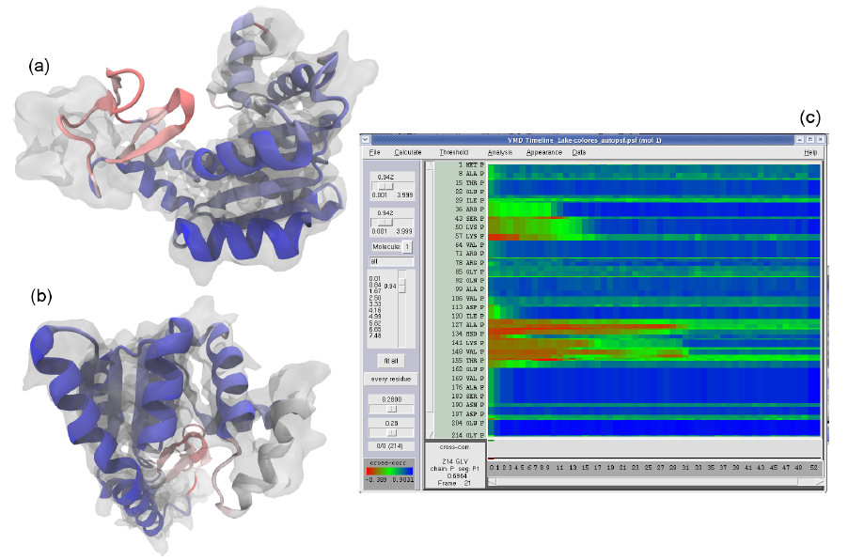
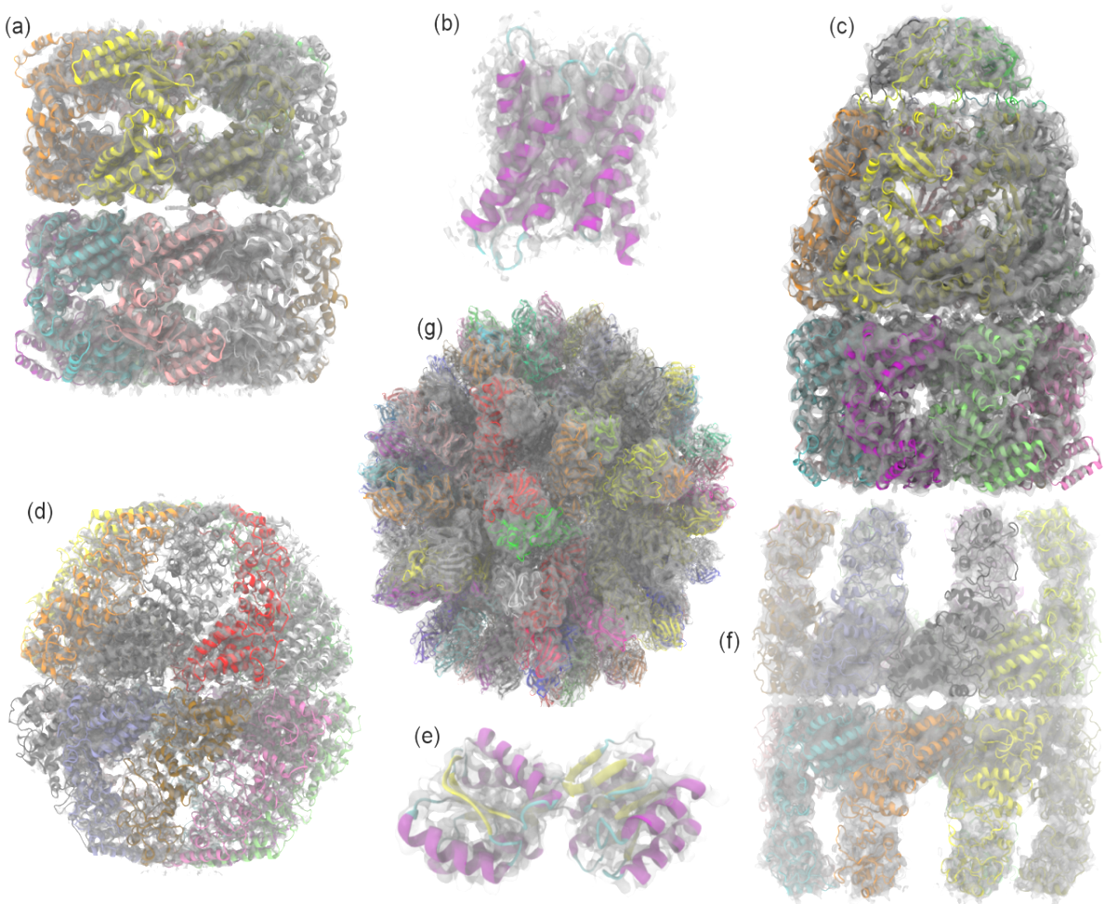
Evaluating Quality-of-Fit for Structures Solved by Hybrid Fitting Methods
Compute Pearson correlation to evaluate quality-of-fit between a reference cryo-EM density map and a simulated density map from an all-atom structure.
MDFF Cross Correlation Timeline
Regions with poor fit Regions with good fit

Slide 16
VMD Tesla V100 Cross Correlation Performance Rabbit Hemorrhagic Disease Virus: 702K atoms, 6.5Å resolution Volta GPU architecture almost 2x faster than previous gen Pascal:
Application and Hardware platform | Runtime, Speedup vs. Chimera, VMD+GPU
Chimera Xeon E5-2687W (2 socket) [1] | 15.860s, 1x
VMD-CUDA Intel Xeon E5-2687W + 1x Quadro K6000 [1,2] | 0.458s, 35x 1.0x
VMD-CUDA Intel Xeon E5-2698v3 + 1x Tesla P100 | 0.090s, 176x 5.1x
VMD-CUDA Intel Xeon E5-2697Av4 + 1x Tesla V100 | 0.050s, 317x 9.2x
[1] GPU-Accelerated Analysis and Visualization of Large Structures Solved by Molecular Dynamics Flexible Fitting. J. E. Stone, R. McGreevy, B. Isralewitz, and K. Schulten. Faraday Discussions 169:265-283, 2014.
[2] Early Experiences Porting the NAMD and VMD Molecular Simulation and Analysis Software to GPU-Accelerated OpenPOWER Platforms. J. E. Stone, A.-P. Hynninen, J. C. Phillips, K. Schulten. International Workshop on OpenPOWER for HPC (IWOPH'16), LNCS 9945, pp. 188-206, 2016.

Slide 17
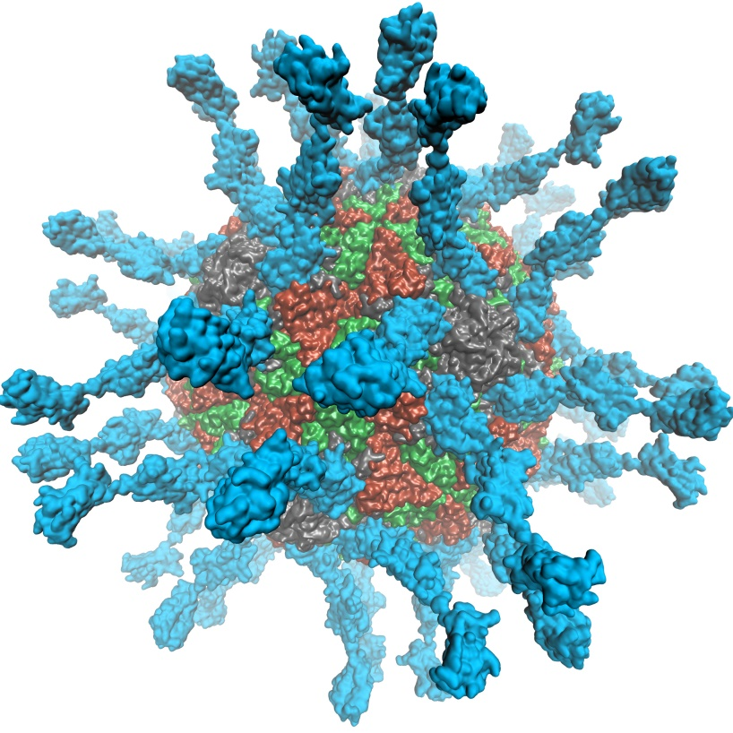
VMD supports EGL for in-situ and parallel rendering on Amazon EC2
No windowing system dependency
Easily deploy parallel VMD builds supporting off-screen rendering
Maintains 100% of VMD OpenGL shaders and rendering features
Poliovirus

Slide 18
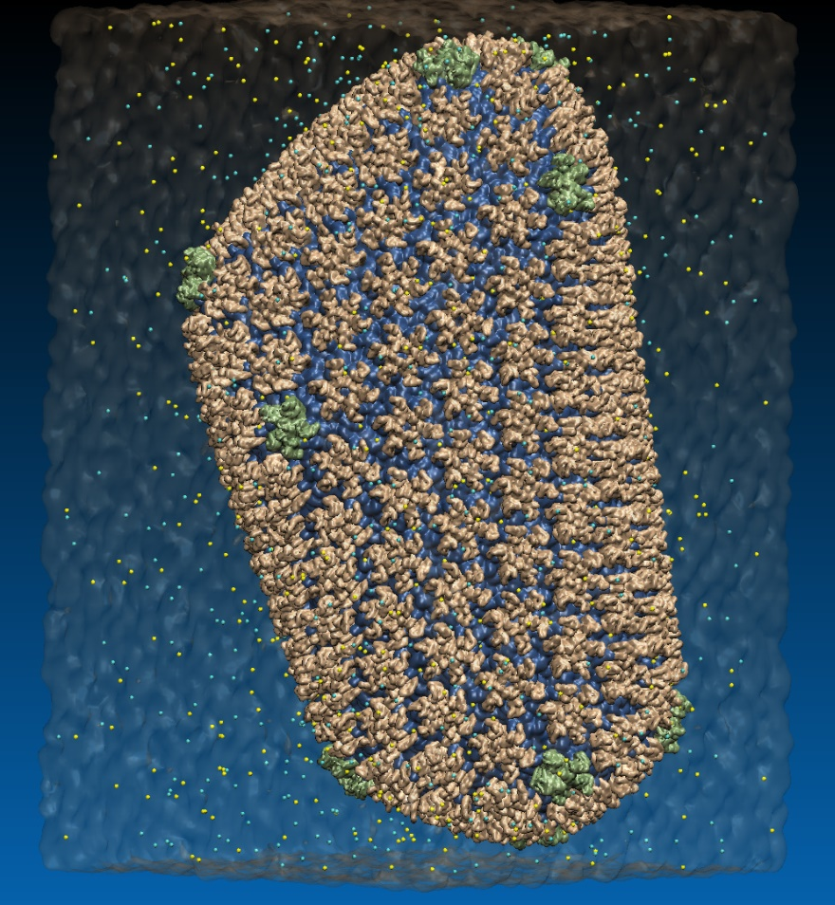
VMD EGL Performance on Amazon EC2 Cloud
MPI Ranks | EC2 “G2.8xlarge” GPU Instances | HIV-1 movie rendering time (sec), (I/O %) 3840x2160 resolution
1 | 1 | 626s (10% I/O)
2 | 1 | 347s (19% I/O)
4 | 1 | 221s (31% I/O)
8 | 2 | 141s (46% I/O)
16 | 4 | 107s (64% I/O)
32 | 8 | 90s (76% I/O)
Performance at 32 nodes reaches ~48 frames per second
High Performance Molecular Visualization: In-Situ and Parallel Rendering with EGL. J. E. Stone, P. Messmer, R. Sisneros, and K. Schulten. High Performance Data Analysis and Visualization Workshop, IEEE IPDPSW, 2016.
64M atom HIV-1 capsid simulation rendered via EGL

Slide 19
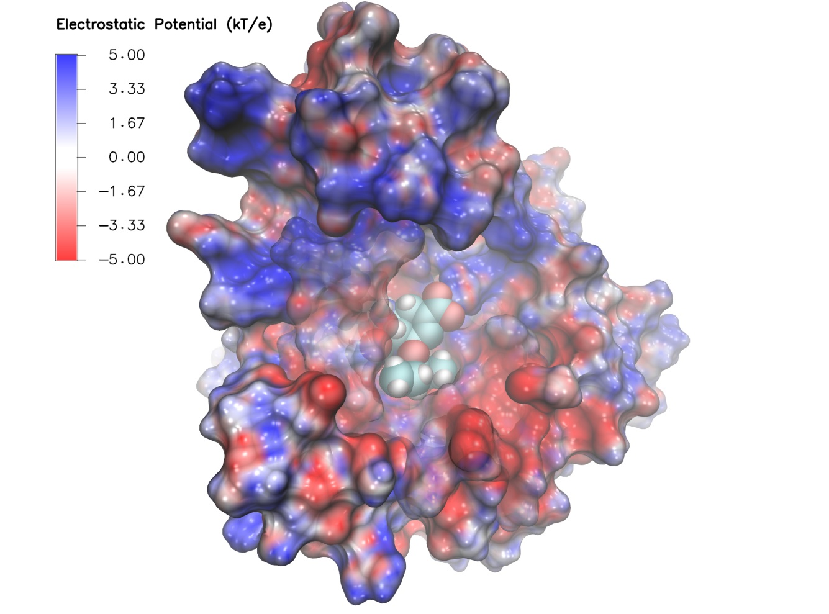
VMD EGL Rendering: Supports full VMD GLSL shading features Vulkan support coming soon...
Swine Flu A/H1N1 neuraminidase bound to Tamiflu
64M atom HIV-1 capsid simulation
High Performance Molecular Visualization: In-Situ and Parallel Rendering with EGL. J. E. Stone, P. Messmer, R. Sisneros, and K. Schulten. High Performance Data Analysis and Visualization Workshop, IEEE IPDPSW, pp. 1014-1023, 2016.

Slide 20
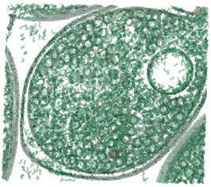
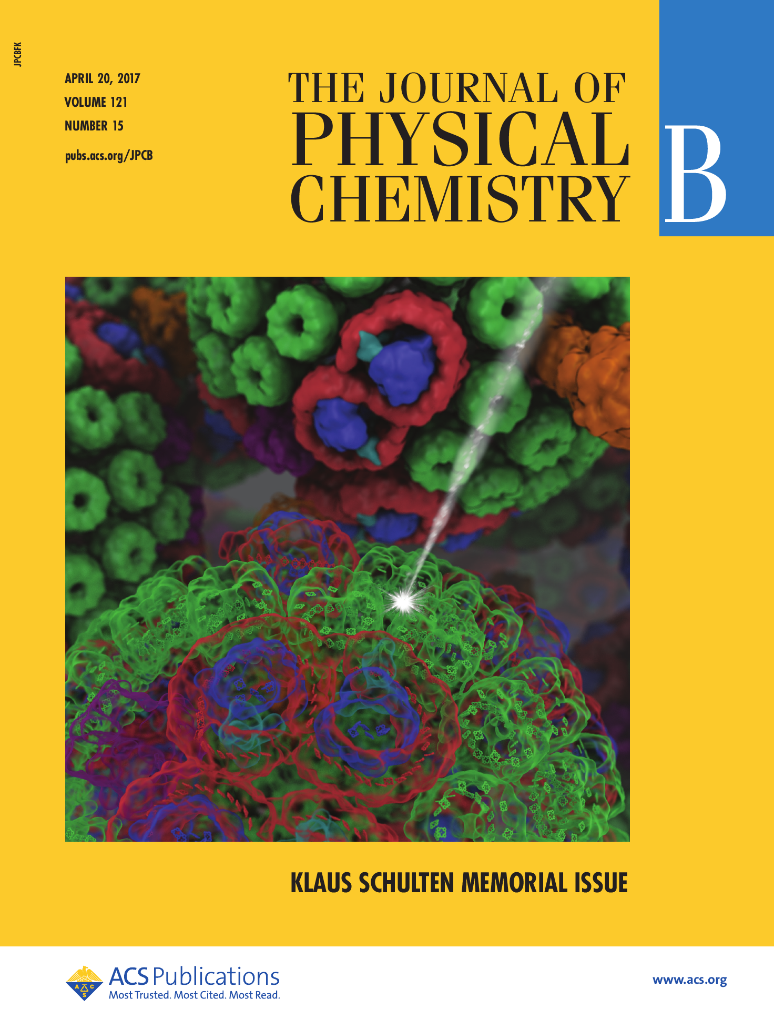
NEW: Cloud-Based Interactive Remote Visualization
Built-into VMD itself
Enable access to massive data sets
Uses GPU H.264 / HEVC hardware accelerated video encode/decode
Supports interactive remote visualizations (both rasterization and ray tracing)
Development ongoing, expected in next major VMD release, in 1H 2019…

Slide 21
Cloud-Based Interactive Remote Visualization
Enable access to massive data sets
A Grander Goal: A Thousand-Fold Increase In Human Capabilities. B. Shneiderman. Educom Review, 32, 6 (Nov/Dec 1997), 4-10.
Continuous visual display of status
Rapid, incremental, and reversible actions with 100ms updates
Visual Information Seeking Mantra: “Overview first, zoom and filter, then details-on-demand”

Slide 22
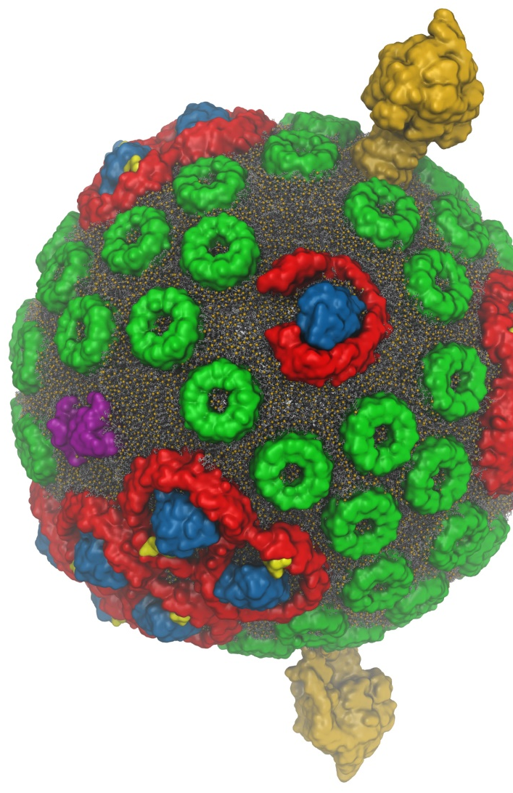
VMD Interactive Ray Tracing
Exploit computational power to improve rendering of the structural details of biomolecular complexes
Remote visualization tasks on very large macromolecular complexes
High fidelity shading, shadows, AO lighting, depth of field, …
GPU-Accelerated Molecular Visualization on Petascale Supercomputing Platforms. J. E. Stone, K. L. Vandivort, and K. Schulten. UltraVis’13, pp. 6:1-6:8, 2013.
Visualization of Energy Conversion Processes in a Light Harvesting Organelle at Atomic Detail. M. Sener, et al. SC'14 Visualization and Data Analytics Showcase, 2014.
Chemical Visualization of Human Pathogens: the Retroviral Capsids. J. R. Perilla, B.-C. Goh, J. E. Stone, and K. Schulten. SC'15 Visualization and Data Analytics Showcase, 2015.
Atomic Detail Visualization of Photosynthetic Membranes with GPU-Accelerated Ray Tracing. J. E. Stone et al., J. Parallel Computing, 55:17-27, 2016.
Immersive Molecular Visualization with Omnidirectional Stereoscopic Ray Tracing and Remote Rendering J. E. Stone, W. R. Sherman, and K. HPDAV, IPDPSW, pp. 1048-1057, 2016.
VMD/OptiX GPU Ray Tracing of all-atom Chromatophore w/ lipids.

Slide 23
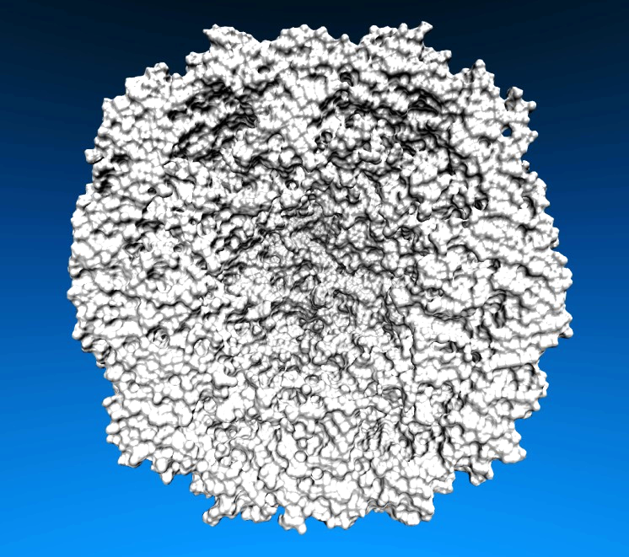
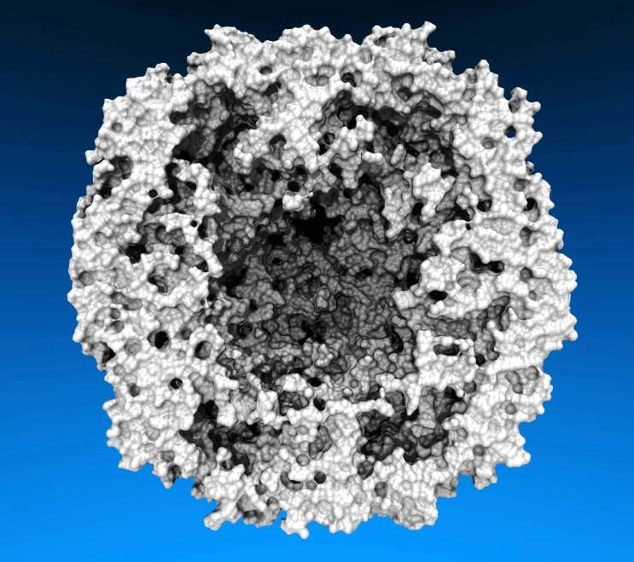
Interactive Ray Tracing, Lighting Comparison: STMV Capsid
Two lights, no shadows
(e.g. as used by OpenGL)
Ambient occlusion lighting and shadows w/ RT

Slide 24
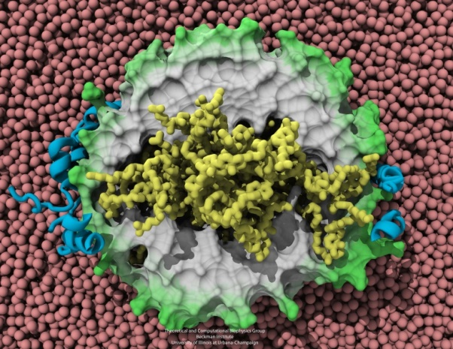
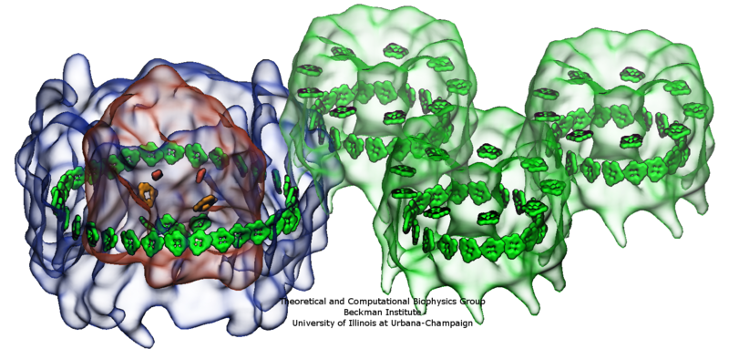
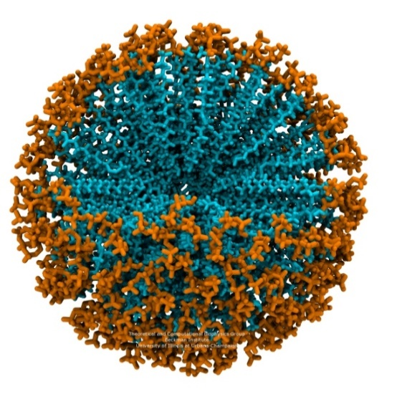
Benefits of Advanced Lighting and Shading Techniques
Exploit visual intuition
Spend computer time in exchange for scientists’ time, make images that are more easily interpreted

Slide 25
Interactive Ray Tracing of Cells
High resolution cellular tomograms, billions of voxels
Even isosurface or lattice site graphical representations involve ~100M geometric primitives
Amazon P3 instance types
Tesla V100 GPUs benefit from OptiX support for NVLink and distribution of scene data across multiple GPUs
Earnest, et al. J. Physical Chemistry B, 121(15): 3871-3881, 2017.

Slide 26
Acknowledgements
Theoretical and Computational Biophysics Group, University of Illinois at Urbana-Champaign
NVIDIA CUDA and OptiX teams
Funding:
NIH support: P41GM104601
DOE INCITE, ORNL Titan: DE-AC05-00OR22725
NSF Blue Waters: NSF OCI 07-25070, PRAC “The Computational Microscope”, ACI-1238993, ACI-1440026
Notes:
26

Slide 27
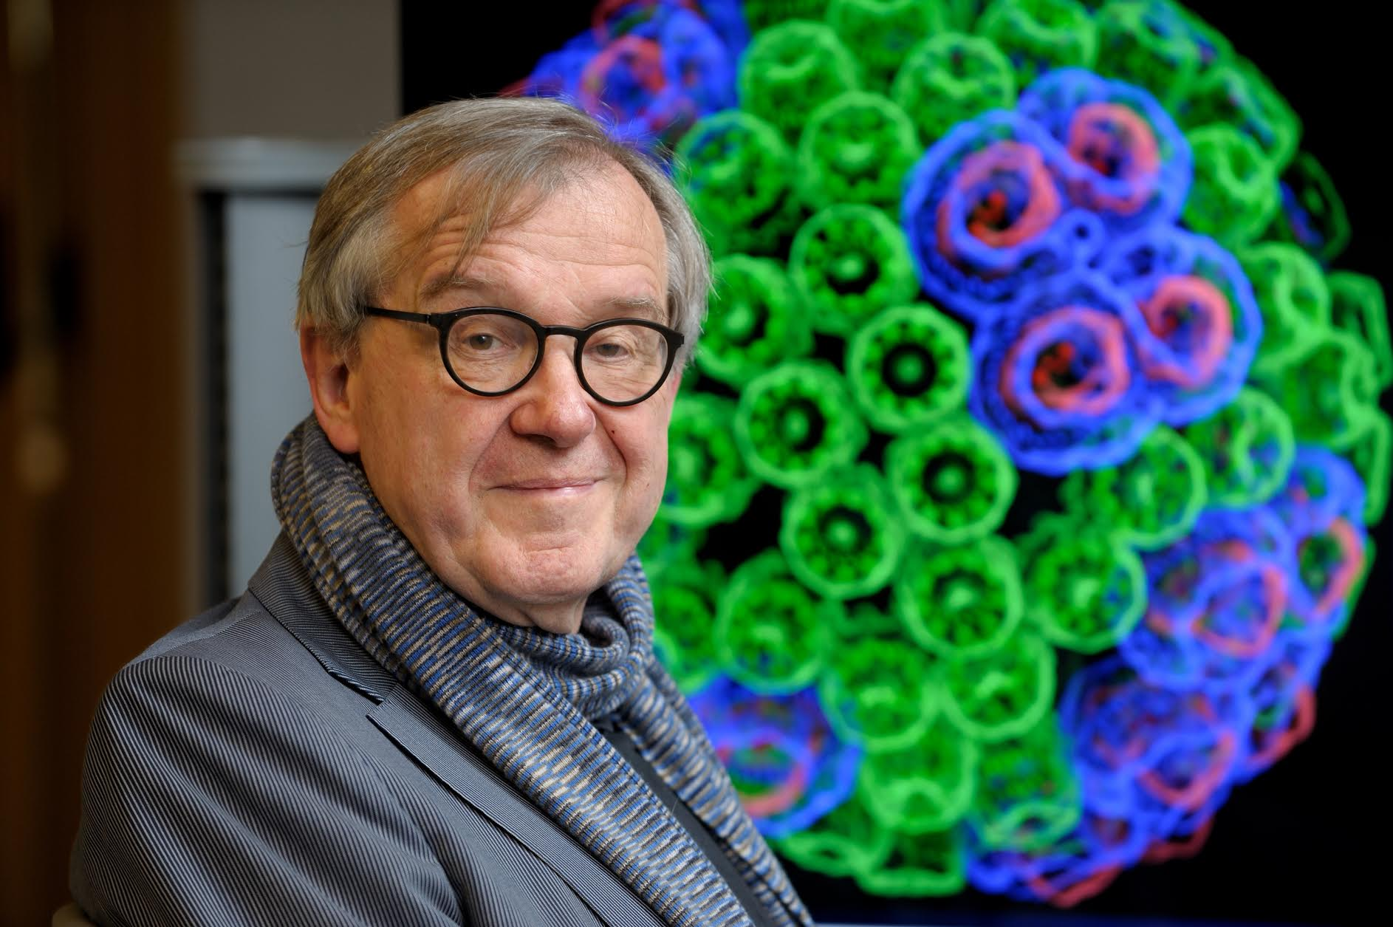
“When I was a young man, my goal was to look with mathematical and computational means at the inside of cells, one atom at a time, to decipher how living systems work. That is what I strived for and I never deflected from this goal.” – Klaus Schulten

