Slide 1
Quantifying the Impact of GPUs on Performance and Energy Efficiency in HPC Clusters
Craig Steffen csteffen@ncsa.uiuc.edu
NCSA Innovative Systems Lab
First International Green Computing Conference
Workshop in Progress in Green Computing
August 16, 2010

Slide 2
Cast of Characters
Jim Philips and John Stone: Theoretical and Computational Biophysics Group, Beckman Institute, UIUC
Kenneth Esler: NCSA and UIUC Physics
Joshi Fullop: NCSA Systems Monitoring
Jeremy Enos, Volodymyr Kindratenko, Craig Steffen, Guochun Shi, Mike Showerman: NCSA Innovative Systems Laboratory

Slide 3
Overview
AC GPU computing cluster
Power monitoring
Search for power monitors
Roll our own--version 1: Tweet-A-Watt
Roll our own--version 2: Arduino-based power monitor
Current power monitoring on real applications

Slide 4
AC cluster (Accelerator Cluster)
Originally “QP” cluster for “Quadro Plex”
32 HP XW9400 nodes. Each node:
2 dual-core 2.4 GHz Opteron 2216
8 GB RAM per node
NVIDIA Tesla S1070 each:
4 Tesla C1060 GPUs (128 total in cluster)
Interconnect network is QDR Infiniband
CUDA 3.1 compiler/build stack
Job control/scheduler Moab
Specific resource management for jobs via Torque
QP first commissioned November 2007
AC on-line since December 2008

Slide 5
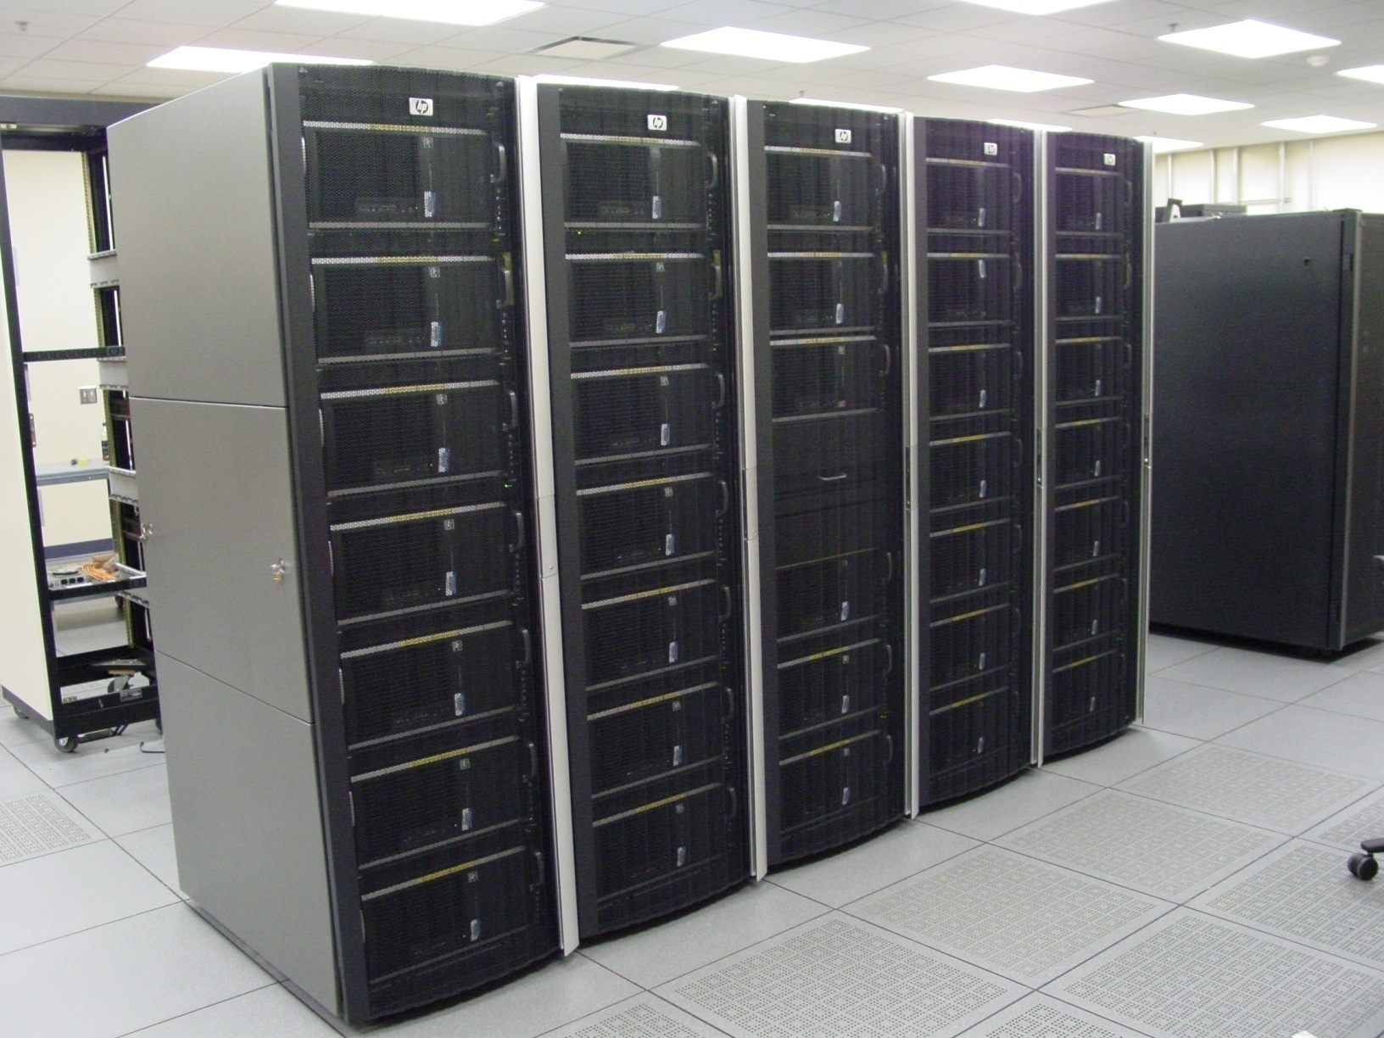
AC Cluster

Slide 6
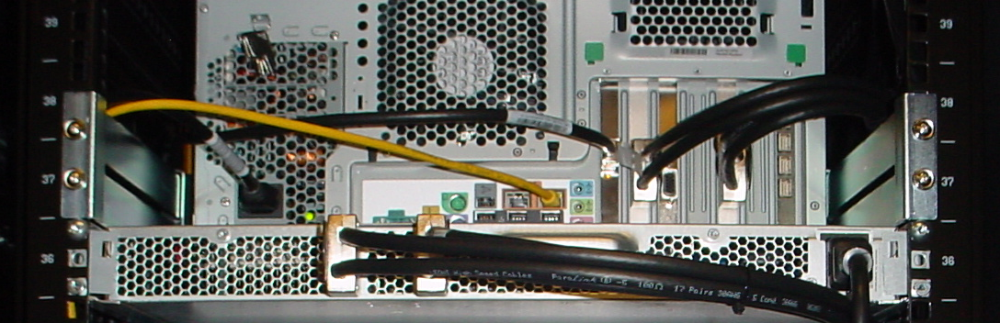
AC01-32 nodes
HP xw9400 workstation
2216 AMD Opteron 2.4 GHz dual socket dual core
8GB DDR2 in ac04-ac32
16GB DDR2 in ac01-03, “bigmem” on qsub line
PCI-E 1.0
Infiniband QDR
Tesla S1070 1U GPU Computing Server
1.3 GHz Tesla T10 processors
4x4 GB GDDR3 SDRAM
1 per host
IB
QDR IB
HP xw9400 workstation
PCIe x16
PCIe x16
Tesla S1070
PCIe interface
PCIe interface
T10
T10
T10
T10
DRAM
DRAM
DRAM
DRAM

Slide 7
AC cluster used for
Virtual school for Science and Engineering (attached to the Great Lakes Consortium for Petascale Computing) NVIDIA/CUDA August 2008,2009,2010
Other classes in 2010:
“Intro to CUDA” Volodymyr Kindratenko, Singapore June 13-19
Barcelona Spain, Wen-Mei Hwu July 5-9
Thomas Scavo July 13-23
“Proven Algorithmic Techniques for Many-core Processors” Thomas Scavo August 2-6
John Stone August 7-8

Slide 8
AC GPU Cluster Power Measurements
State | Host Peak (Watt) | Tesla Peak (Watt) | Host power factor (pf) | Tesla power factor (pf)
power off | 4 | 10 | .19 | .31
start-up | 310 | 182
pre-GPU use idle | 173 | 178 | .98 | .96
after NVIDIA driver module unload/reload⁽¹⁾ | 173 | 178 | .98 | .96
after deviceQuery⁽²⁾ (idle) | 173 | 365 | .99 | .99
GPU memtest #10 (stress) | 269 | 745 | .99 | .99
after memtest kill (idle) | 172 | 367 | .99 | .99
after NVIDIA module unload/reload⁽³⁾ (idle) | 172 | 367 | .99 | .99
VMD Madd | 268 | 598 | .99 | .99
NAMD GPU STMV | 321 | 521 | .97-1.0 | .85-1.0⁽⁴⁾
NAMD CPU only ApoA1 | 322 | 365 | .99 | .99
NAMD CPU only STMV | 324 | 365 | .99 | .99
Kernel module unload/reload does not increase Tesla power
Any access to Tesla (e.g., deviceQuery) results in doubling power consumption after the application exits
Note that second kernel module unload/reload cycle does not return Tesla power to normal, only a complete reboot can
Power factor stays near one except while load transitions. Range varies with consumption swings

Slide 9
Search for Power Monitors: What questions do we want to answer?
How much power do jobs use?
How much do they use for pure CPU jobs vs. GPU-accelerated jobs?
Do GPUs deliver a hoped-for improvement in power efficiency?

Slide 10
Hardware: Criteria for data-sampling device
Cheap
Easy to buy/produce
Allows access to real data (database or USB, no CD-installed GUIs)
Monitors 208V 16A power feed
Scalable solution across machine room (one node can collect one-node’s data)

Slide 11
Search for Good (and Cheap) Hardware Power Monitoring
Laboratory units too expensive
Commercial Units:
1A granularity?
No direct data logging
No real-time data logging

Slide 12
Very capable
PS3000 PowerSight Power Analyzer $ 2495.00

Slide 13
Capable; Closer but still too expensive
ElitePro™ Recording Poly-Phase Power Meter Standard Version consists of:
US/No. America 110V 60 Hz Transformer
128Kb Capacity
Serial Port Communications
Indoor Use with Crocodile Clips
Communications Package (Software) and Current Transformers sold separately.
More Information Price: $965.00 Part Number: EP

Slide 14
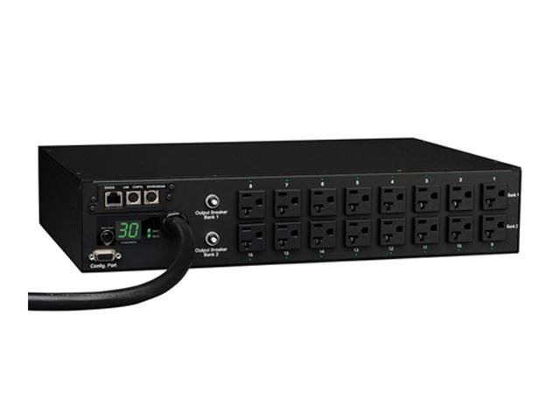
Instrumented PDUs: poor power granularity
1A granularity
120V circuits

Slide 15
Watts-up integrated power monitor: CLOSE
Smart Circuit 20 31298 $194.95
Outputs data to web page (how to efficiently harvest this data?)

Slide 16
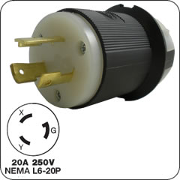
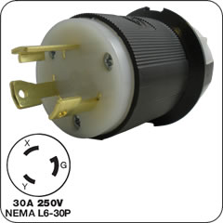
Data Center Power—208 V, 20 or 30A

Slide 17
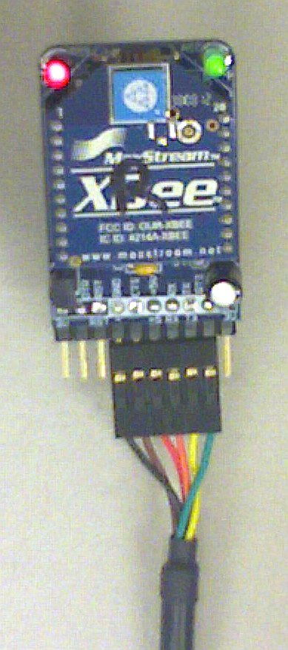
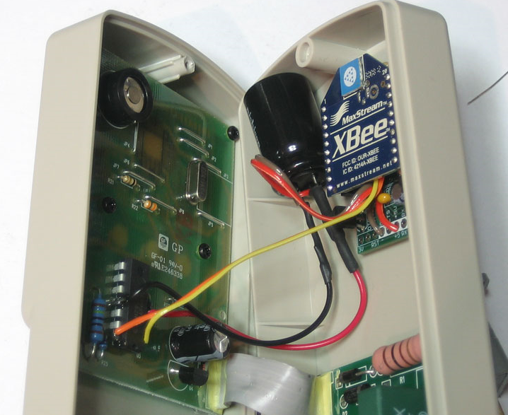
Power Monitoring Version 1: Tweet-a-Watt Receiver and Transmitter
http://www.ladyada.net/make/tweetawatt/
Kits available from www.adafruit.com

Slide 18
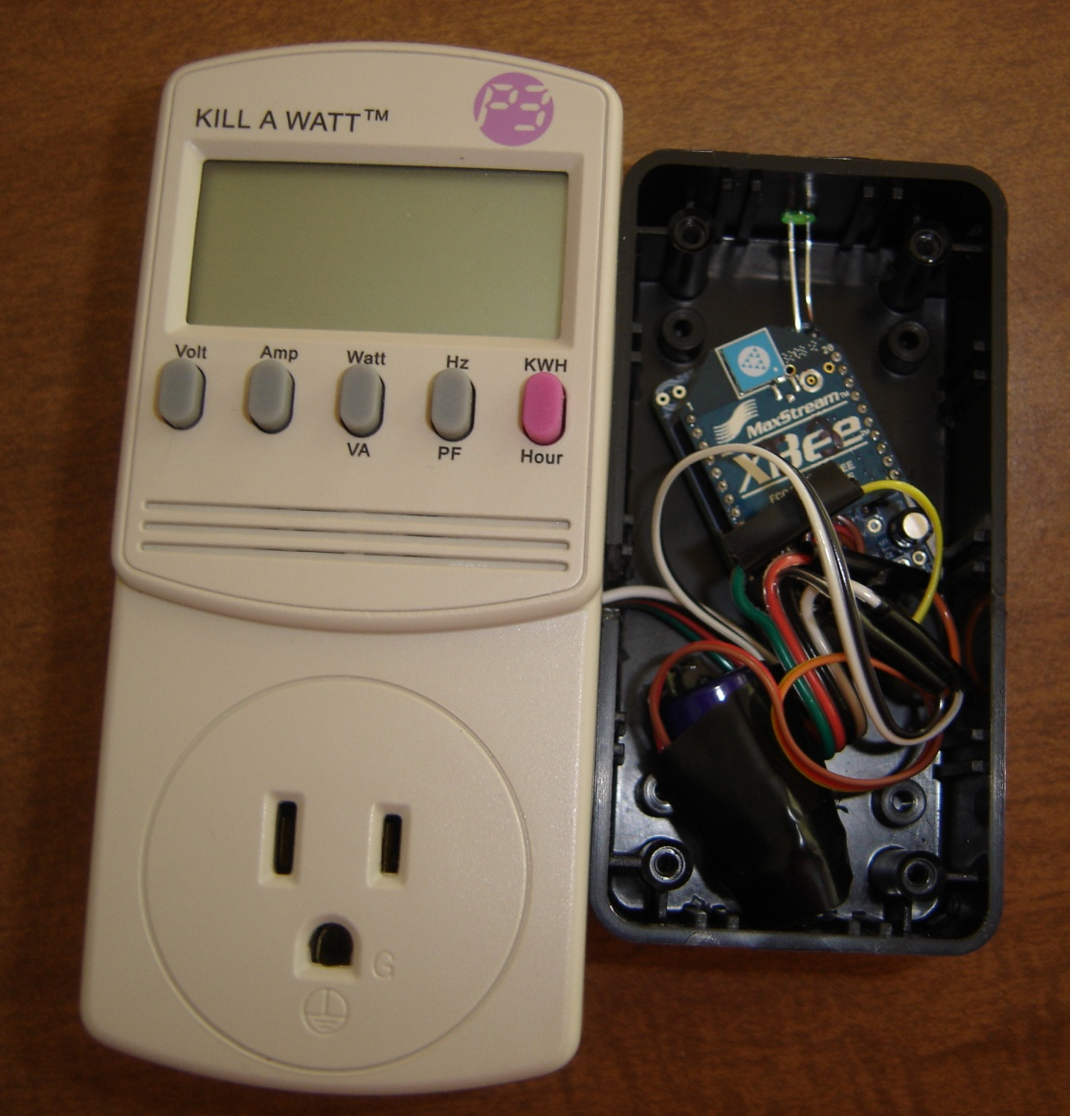
Tweet-a-Watt
Kill-a-watt power meter
Xbee wireless transmitter
power, voltage, shunt sensing tapped from op amp
Lower transmit rate to smooth power through large capacitor
Readout software modified from available Python scripts to upload sample answers to local database
We built 3 transmitter units and one Xbee receiver
Currently integrated into AC cluster as power monitor

Slide 19
Evaluation of Tweet-a-Watt
Limited to Kill-a-Watt capability (120V, 15A circuit)
Low sampling rate (report every 2 seconds, readout every 30 seconds)
Either TWO XBEE units required or scaling issue
Fixed but configurable program; one set, difficult to program (low sampling rate means unit is off most of the time)
Correlated voltage and current (read power factor and true power usage)
50-foot plus range (through two interior walls)
Currently tied to software infrastructure: Application power studies done with Tweet-a-Watt

Slide 20
Power Monitor version 2: One-off function Prototype Power Monitor
Used chassis from existing (120 V) PDU for interior space
Connectors, breaker, and wiring to carry 208V 16A power distribution
Current sense transformers and Arduino microcontroller for current monitoring
Prototyped (but not deployed) Python script to insert output into power monitor database

Slide 21
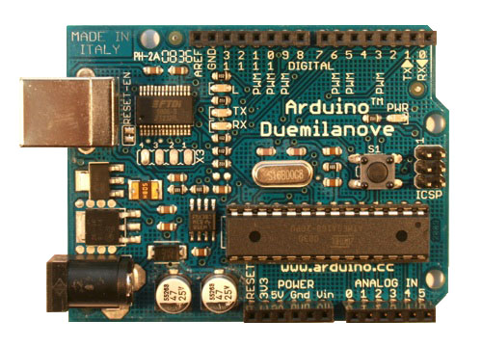
Arduino-based Power Monitor
Based on Arduino Duemilanove
Runs at 16 MHz
has 6 analog voltage-to-digital converters (sampled explicitly by read() function)
Runs microcode when powered on (from non-volatile memory)
Accumulates sample arrays for N samples per channel per report (N is on subsequent slides)
Accumulates current measurements, computes RMS values, and outputs results in ASCII on USB connection
Arduino is powered from the USB connection
USB
analog inputs

Slide 22
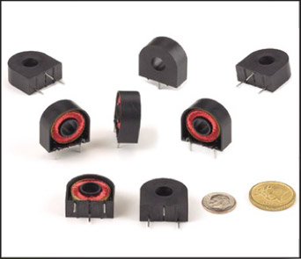
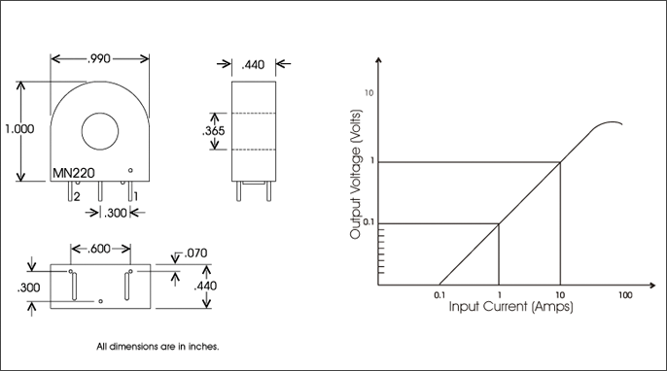
MN 220 picking transformer from Manutech
Manutech.us
1000 to 1 voltage transformer; 1 to 1000 current transformer
Suggested burden resistor: 100 Ohms.
AC output voltage proportional to AC current input.
Output at 100 Ohms: 100 mV/Amp.
Various ranges of output are achievable by using different burden resistors.

Slide 23
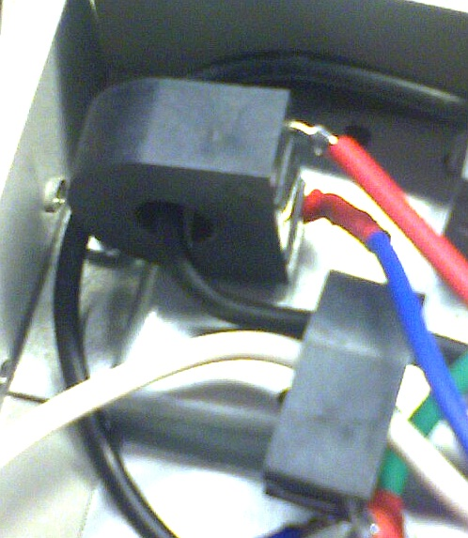
Current Sense Transformer
MN-220 current “transformer” designed for 1 to 20 amp primary
1000-1 step-up current transformer
Burden resistor sets the sensitivity; sets “volts per count” calibration constant
Allows current monitoring without Arduino contact with high-voltage wires
Sense wires
AC Current carrying wire

Slide 24
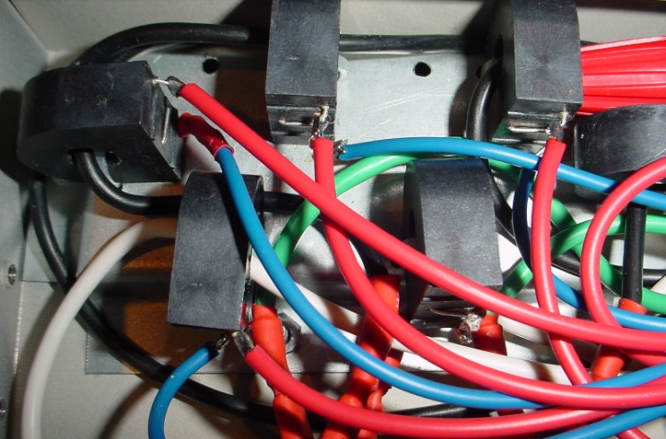
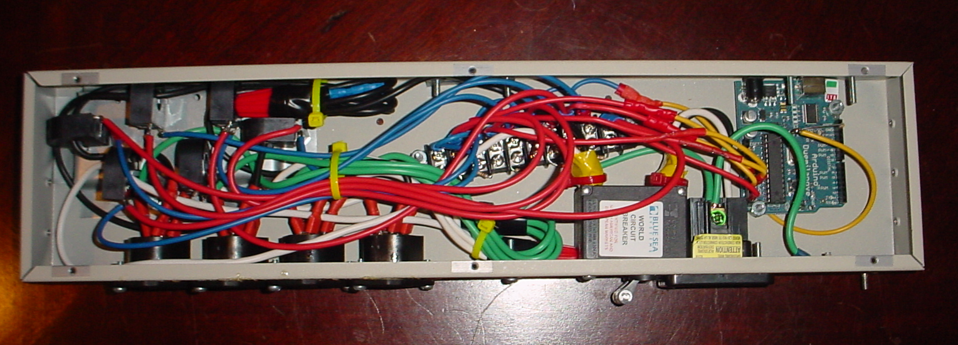
Industrial Design
5 separate sense transformers for 4 power legs and opposite leg of input
Current sense ONLY; Arduino is competely isolated from power conductors. No phase or power factor information, RMS current only
Current sense transformers
Interchangeable burden resistors
Arduino

Slide 25
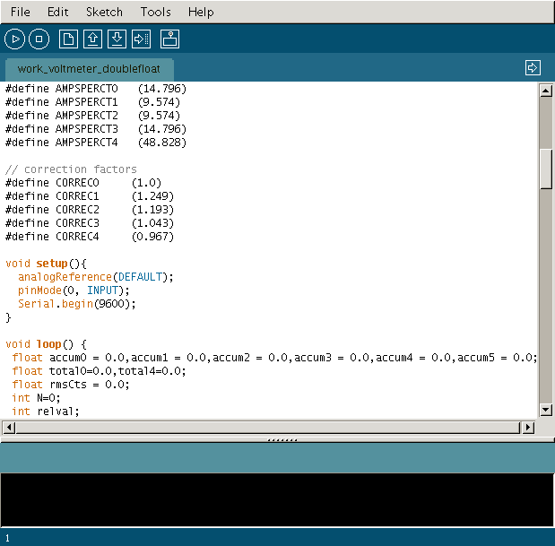
Arduino development environment
C-like language environment
#defines for calibration constants
Initial setup() function runs once
loop() function repeats forever
SPECIAL WARNING: Arduino INTs are 16 bits! Summing the squares of measured voltages (in the 200 to 400 range) will OVERFLOW the accumulator INT. (Convert to float b
efore squaring)

Slide 26
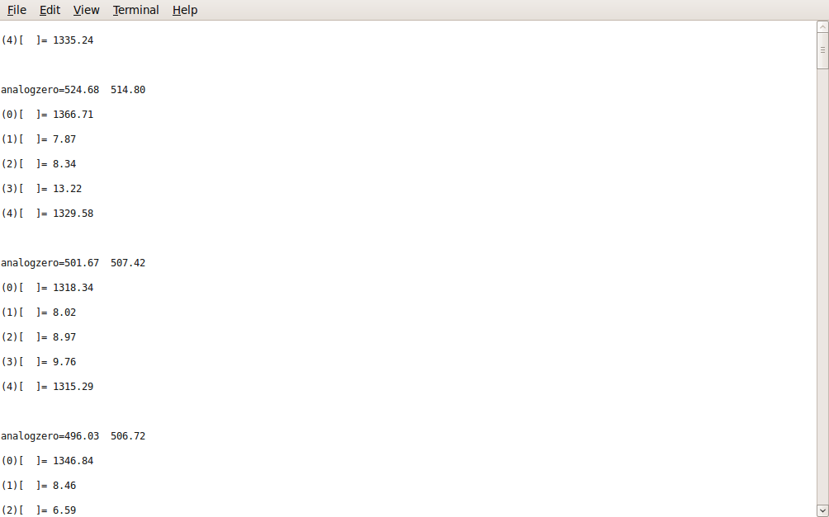
Output Format (our implementation
Every sampling period outputs block of ASCII text to virtual console (accessed under Linux typically at /dev/ttyUSB0)
No protocol or readers necessary; software can be checked with commands tail or more
If ANY sample on a channel is within 10% of the hard limit, then the channel is flagged as “overflow” in the output stream
(note the \r \n double-line breaks)

Slide 27
Calibration, Uncertainty and Readout Speed
Arduino only does RMS summing; not synchronized with AC clock. Possible sampling errors from undersampling AC waveform (hopefully eliminated by enough samples)
Samples-per-report is set high enough to minimize undersampling errors
Uncertainty measured with idle node (upper uncertainty limit only)
Measurements per report | Time between reports (s) | Uncertainty (mA)
250 | .28 | ±7
125 | .2 | ±8
60 | .15 | ±35

Slide 28
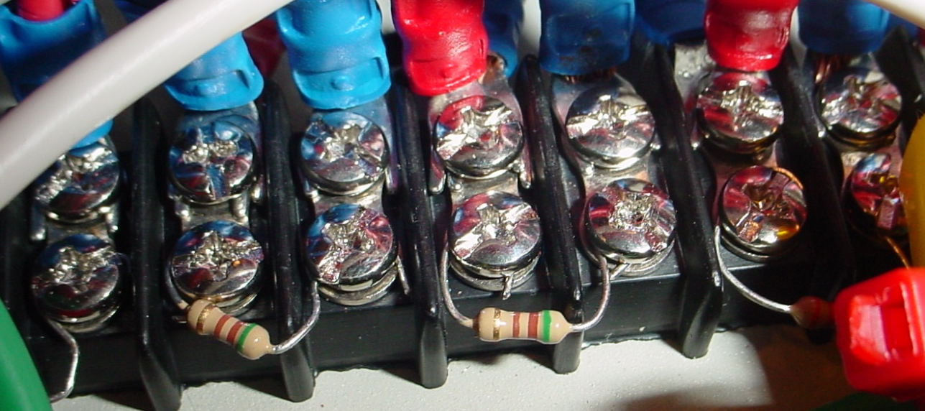
Industrial design continued
Interchangable burden resistors to match pickup transformer output voltage to Arduino voltage sense
Initially configured with two 600W channels, two 1000W channels, and main leg monitor is about 3300W for 16A at 208V
Conclusion: no advantage to careful matching of burden resistors. Uncertainty of 3300W channel vs. 600W:
250 samples: 6 vs 7mA
125 samples: 8 vs 8
60 samples: 37 vs 35
Advantage: eliminates a LOT of wiring from the prototype

Slide 29
Data storage and calibration database
Prolog scripts identify the (one) power monitored node (via Torque)
Job history entry tags job to be attached to time window of power monitor data
The job scripts create an automagic link to graphed output data per-sample and total usage summary

Slide 30
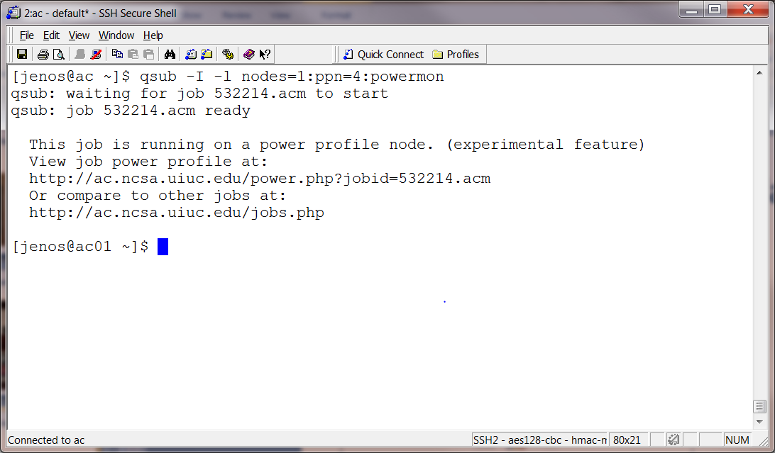
Power monitor data presentation
http://ac.ncsa.uiuc.edu/docs/power.readme
submit job with prescribed Torque resource (powermon)
Run application as usual, follow link(s)

Slide 31
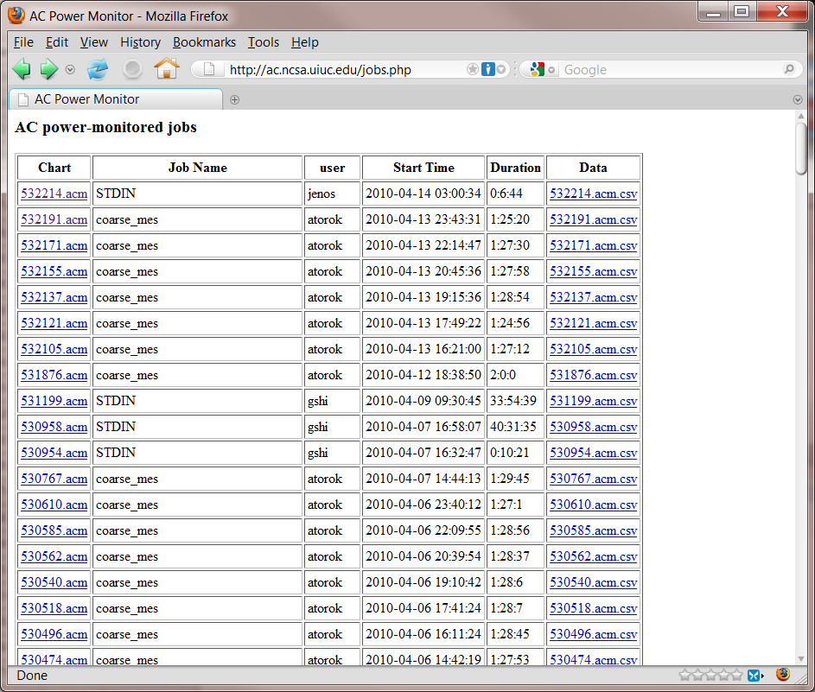
Each monitored job shows up as a link at http://ac.ncsa.uiuc.edu/jobs.php

Slide 32
Power Profiling – Walk through
Mouse-over value displays
Under curve totals displayed
If there is user interest, we may support calls to add custom tags from application

Slide 33
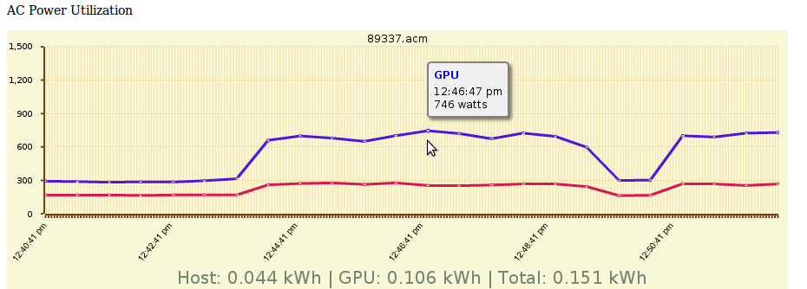
Output Graphs
Job ID

Slide 34
Unique Features of this Hardware+Software Setup
Hardware solution
Cheap
Scalable
Presentation integrated with job software
Simple to use with jobs.php link
Not required; can be ignored by other users

Slide 35
Real Application Speed and Efficiency
Speedup measured in terms of wall clock time for whole application to run
Power consumption measurements made over at least 20 sample runs
Removed power measurements from startup and shutdown phases of applications
NOTE: The NVIDIA cards have internal power measuring. We didn’t use them because
That leaves out the power supply of the Tesla
We got inconsistent node-to-node results
We wanted to understand the systematics of the data

Slide 36
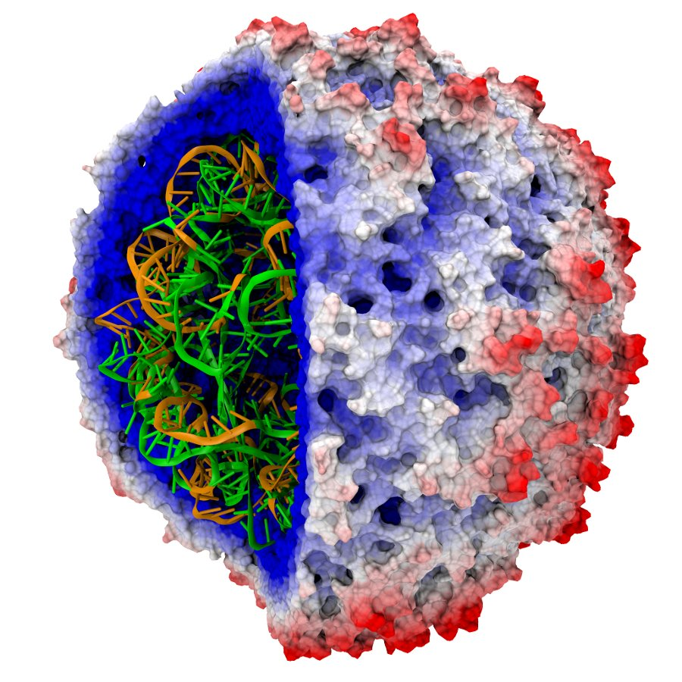
Case Study: NAMD
Molecular Dynamics based on Charmm++ parallel programming environment; contains support for GPU codes
Sample set was “STMV” 1 million atom virus simulation
Performance measure is simulation time step per wall clock time
CPU-only: 6.6 seconds per timestep; 316 Watts
CPU+GPU: 1.1 seconds per timestep; 681 Watts
Speedup: 6
Speedup-per-watt: 2.8

Slide 37
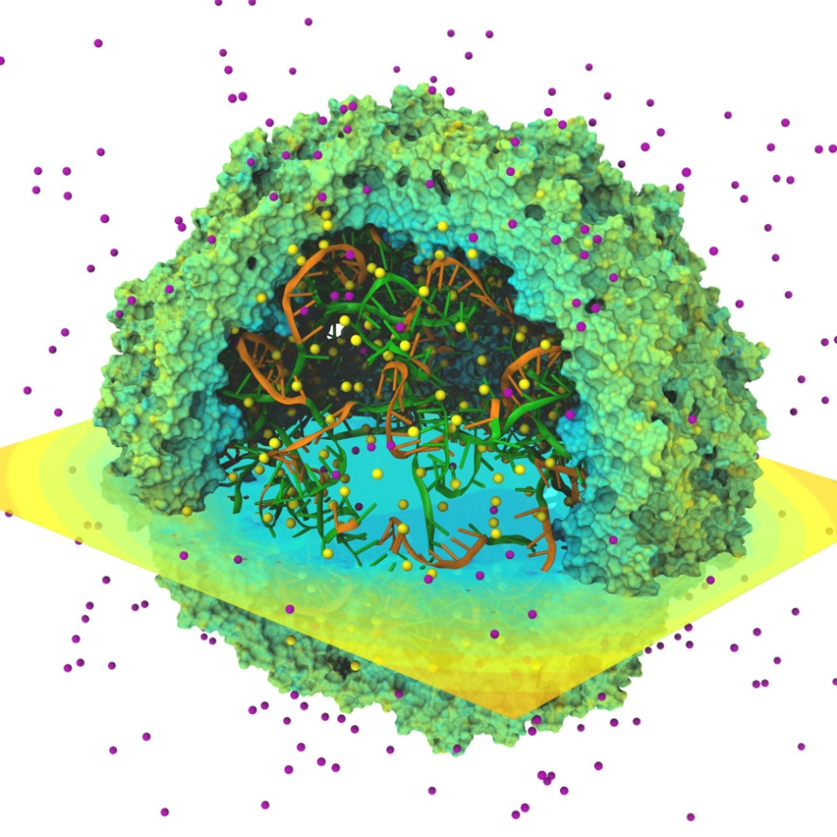
Case Study: VMD
Molecular visualization and analysis tool
Computes 3D electrostatic potential fields, forces, and electron orbitals
Computation problem: 685,000 atom STMV trajectory using multilevel summation method
CPU-only: t=1465 seconds; 300 watts
CPU+GPU: t=58 seconds; 742 watts
Speedup factor: 26
Speedup-per-watt: 10.5

Slide 38
Case Study: QMCPACK
Quantum Monte Carlo for tracking movement of interacting QM particles
Simulating 128-atom simulation cell of bulk diamond, including 512 valence electrons
Caviat:
CPU-only version uses double precision
CPU/GPU version uses mostly single-precision
Results are consistent within result uncertainty
Results reported for Diffusion Monte Carlo; results for variational Monte Carlo are similar
CPU-only: 1.16 walker generations per second
CPU+GPU: 71.1 walker generations per second
Speedup: 62
Speedup-per-watt: 23

Slide 39
Application Case Study: MILC
MIMD Lattice Computation of QCD
MILC calculations must now include electromagnetic effects in the calculations
Problem set 28x28x28x96 lattice
Single-core version only at this time
Computation on single-core vs. single-core+GPU
Power monitoring is for whole CPU node or CPU node+GPU
CPU core: 77324 s
CPU+GPU: 3881 s
Speedup: 20
Speedup-per-watt: 8

Slide 40
Current State: Speedup to Efficiency Correlation
The GPU consumes roughly double the CPU power, so a 3x GPU is require to break even
Performance-per-watt is asymptotically roughly half speedup factor or less

Slide 41
Future Work
Arduino-based power monitor not yet commissioned
Data-collection issues with higher granularity:
Only take data for jobs (no monitoring idle nodes)
User selects sampling rate (high-res power monitoring only when it will be used
Future: user tags application phases to refine data analysis (startup, shutdown, computation, communication)

Slide 42
HPRCTA 2010 (workshop at SC 2010 in New Orleans)
Fourth International Workshop on High-Performance Reconfigurable Computing Technology and Applications
All day Sunday, November 14
The workshop is co-organized by the National Center for Supercomputing Applications (NCSA) at the University of Illinois at Urbana-Champaign, the George Washington University, OpenFPGA, and Xilinx
Submissions due September 3, 2010
http://www.ncsa.illinois.edu/Conferences/HPRCTA10/
http://tinyurl.com/hprcta2010

Slide 43
SAAHPC 2011
Symposium on Application Accelerators in High Performance Computing 2011
Covers all accelerators including GPUs, FPGAs, Cell
Co-hosted by NCSA, University of Illinois and University of Tennessee, Knoxville
2011 dates and location not announced (June or July)
Submissions due in April/May 2011
Current news can be found at: saahpc.org

