Slide 1
Using GPUs to Supercharge
Visualization and Analysis of
Molecular Dynamics Simulations with VMD
John E. Stone
http://www.ks.uiuc.edu/Research/vmd/

Slide 2
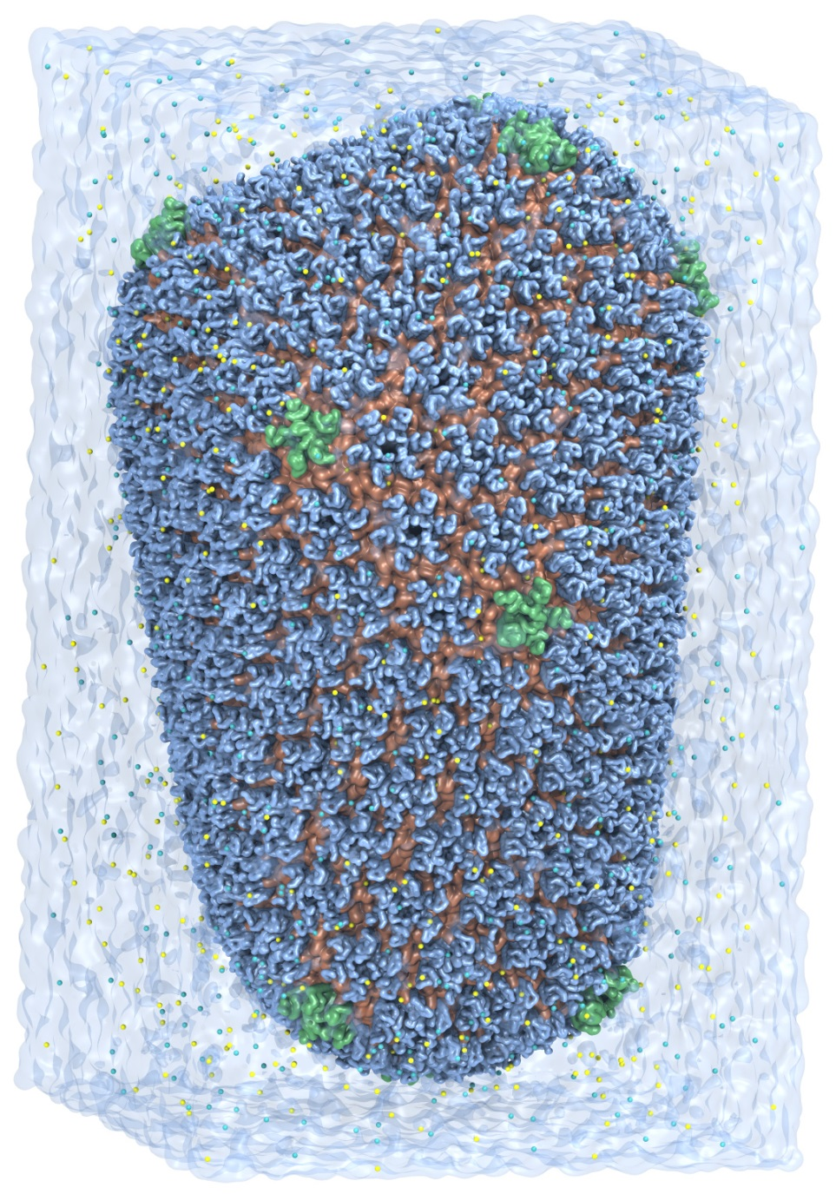
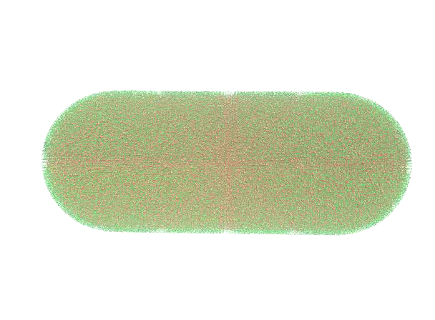
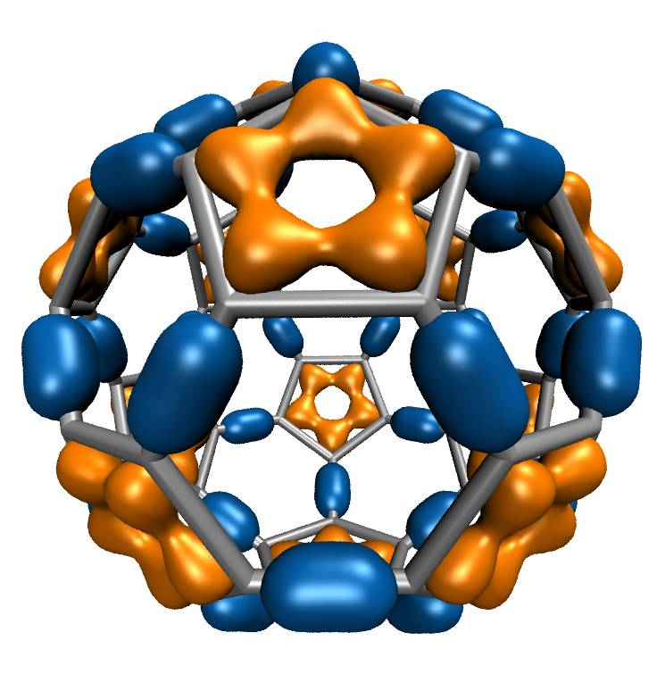
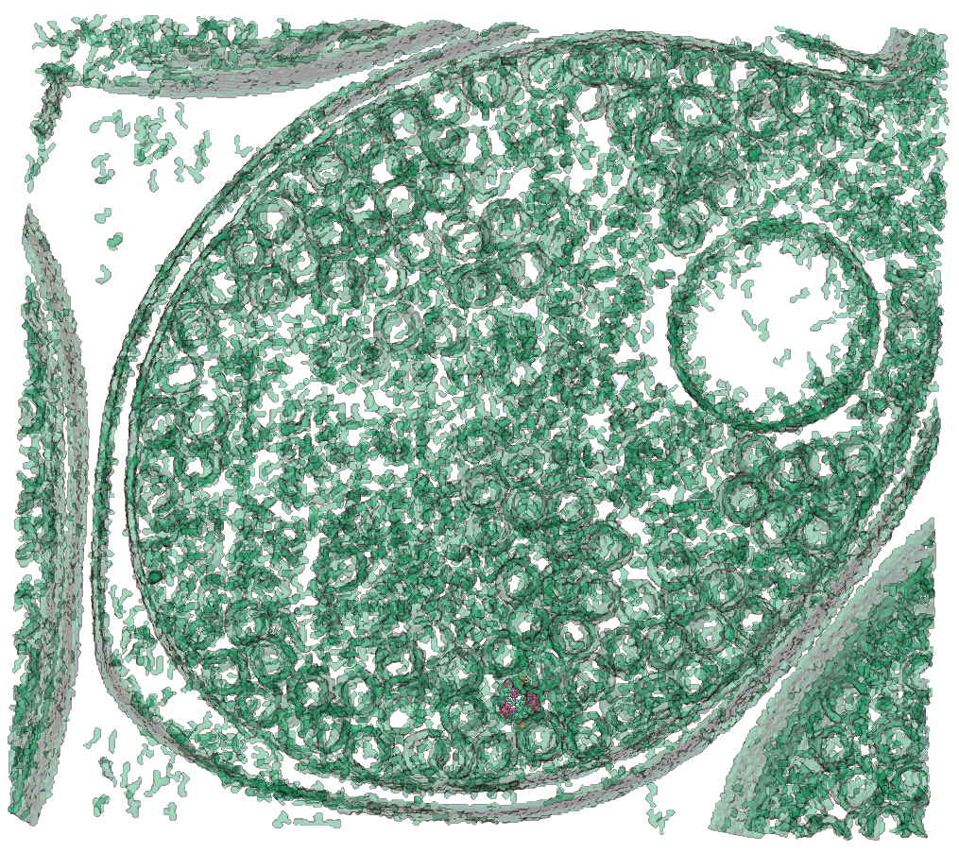
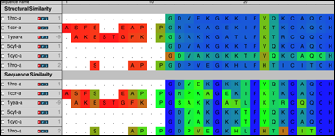
VMD – “Visual Molecular Dynamics”
Visualization and analysis of:
  molecular dynamics simulations
  particle systems and whole cells
  cryoEM densities, volumetric data
  quantum chemistry calculations
  sequence information
User extensible w/ scripting and plugins
http://www.ks.uiuc.edu/Research/vmd/
Whole Cell Simulation
MD Simulations
CryoEM, Cellular Tomography
Sequence Data
Quantum Chemistry

Slide 3
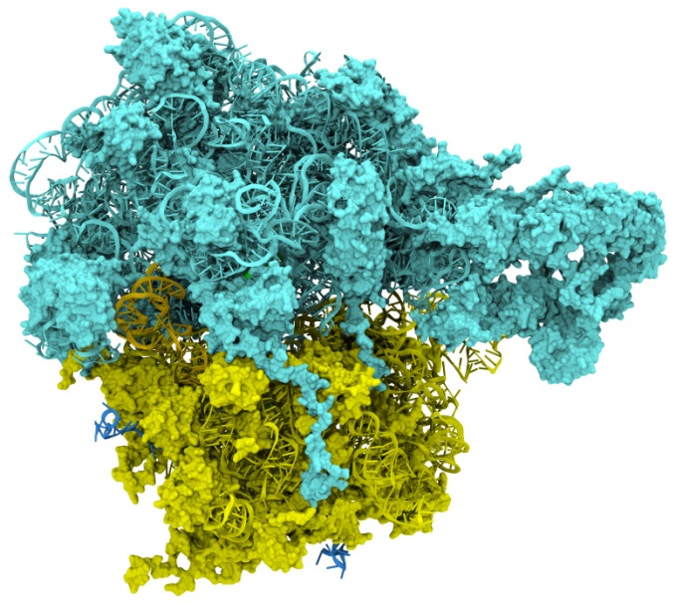
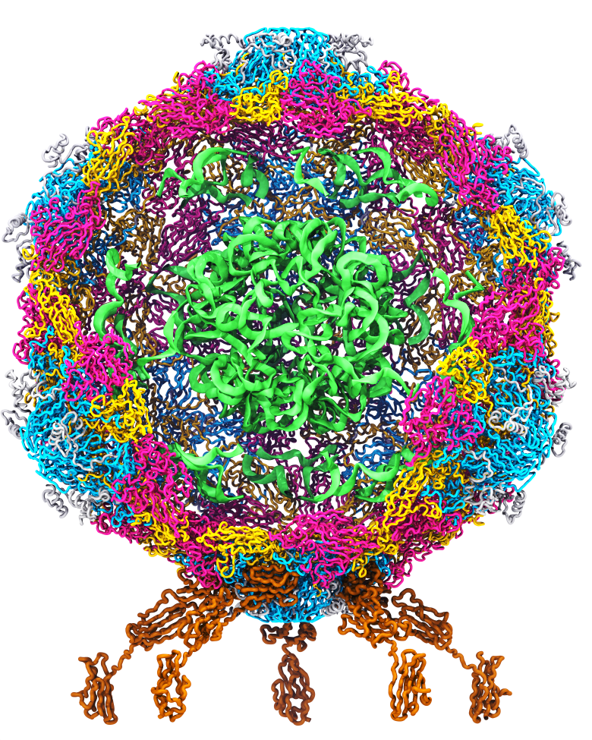
Goal: A Computational Microscope
Study the molecular machines in living cells
Ribosome: target for antibiotics
Poliovirus
Notes:
Ribosomes synthesize new proteins from genetic information
Bacterial ribosome is a target for antibiotics, which interfere with its ability to function by binding to sites on the structure, preventing proteins from being synthesized
Ribosome simulations are extremely computationally challenging due to the size of the structure and its natural environment (solvent, ions, etc, large box, 3 million atoms or so)
Bionanodevice for sequencing DNA efficiently
Knowledge of an individual’s genetic makeup can lead to the prediction and treatment of many diseases by the means of personal genomic medicine and pharmacogenomics. In order for genome sequencing to become practical for common medical use, an inexpensive high throughput genome sequencing technique is required. NIH has set a goal of reducing the cost of genome sequencing by a factor of 10,000, to less than $1,000 within ten years.
The computer is the best microscope to guide the development of bionanodevices, for example to sequence DNA. While experiments can measure DNA electrostatic potentials, they cannot visualize the DNA’s location and conformation at the time of measurement.

Slide 4
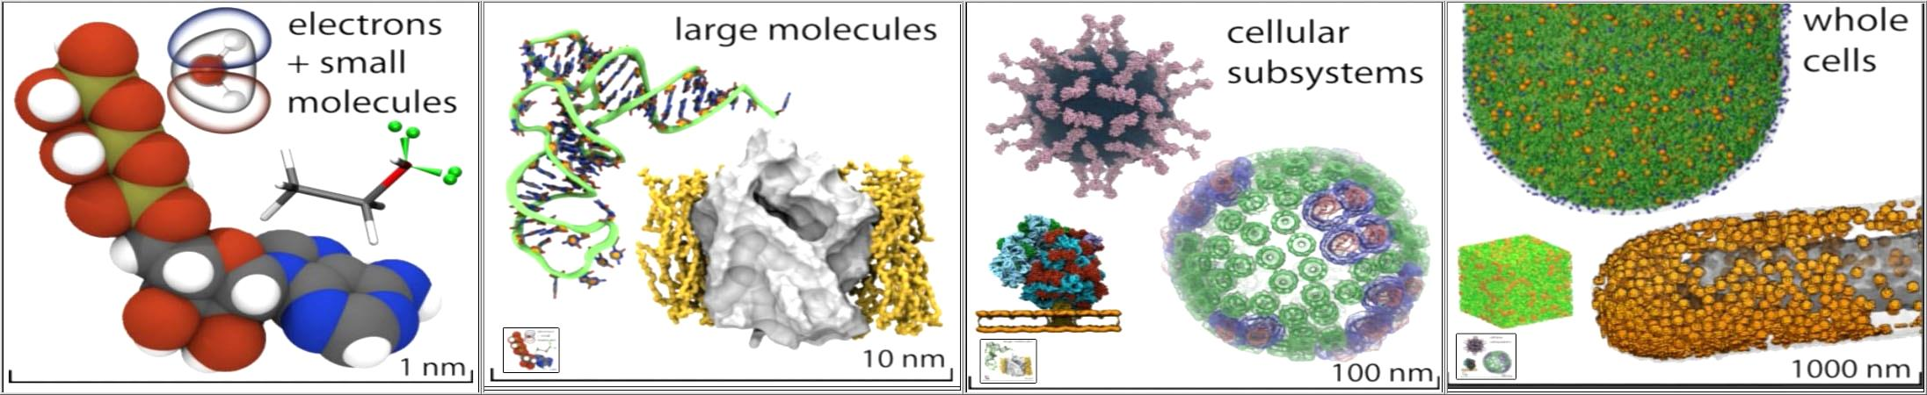
VMD Interoperability Serves Many Communities
VMD 1.9.1 user statistics:
  74,933 unique registered users from all over the world
Uniquely interoperable with a broad range of tools: AMBER, CHARMM, CPMD, DL_POLY, GAMESS, GROMACS, HOOMD, LAMMPS, NAMD, and many more …
Supports key data types, file formats, and databases, e.g. electron microscopy, quantum chemistry, MD trajectories, sequence alignments, super resolution light microscopy
Incorporates tools for simulation preparation, visualization, and analysis

Slide 5
NAMD and VMD Use GPUs and Petascale Computing to Meet
Computational Biology’s Insatiable Demand for Processing Power

Slide 6
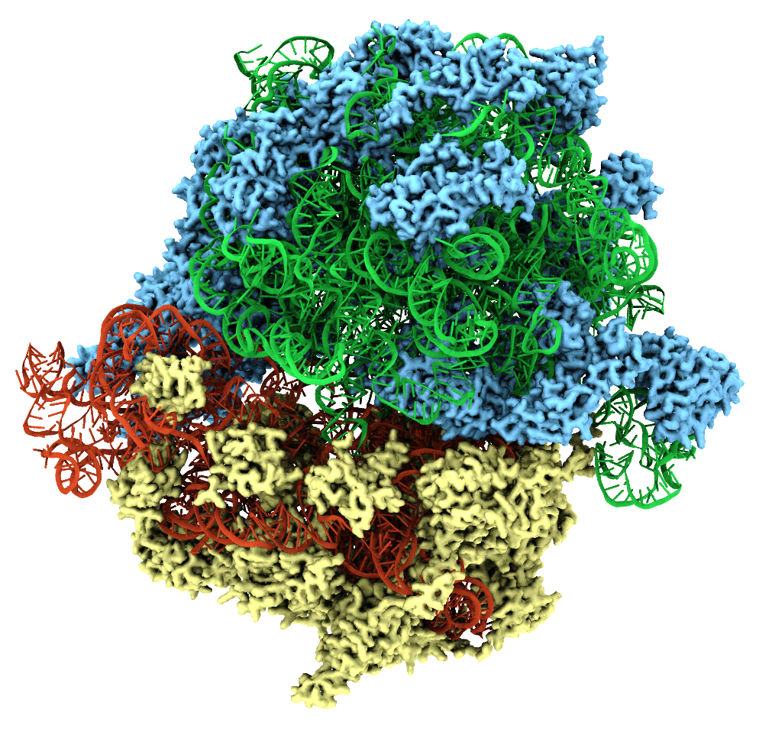
Large-Size and Long-Timescale MD
Simulations Drive VMD Development
Extend VMD to enable large state-of-the-art simulations to be performed “routinely”
Improve display fidelity and performance
Improve model building tools
Enable flexible and rapid analysis of multi-terabyte simulation trajectories
Enable development of force field parameters for drug compounds
Adapt VMD file formats and internal data structures for new simulation types
Ribosome

Slide 7
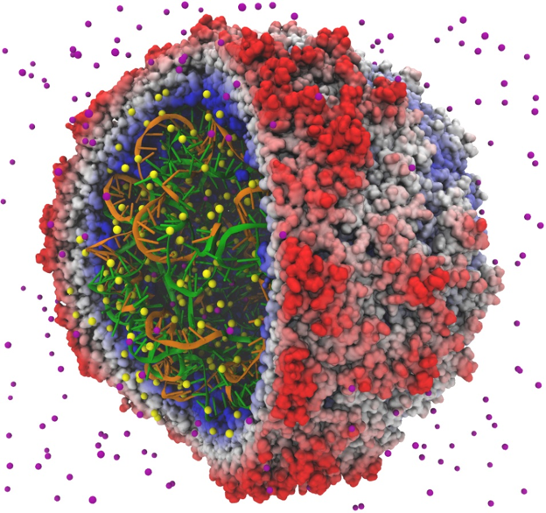
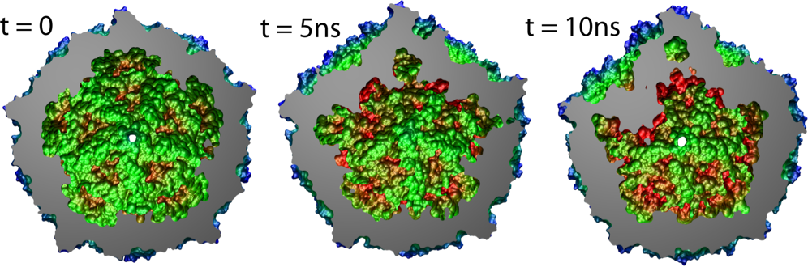
First Simulation of a Virus Capsid (2006)
Satellite Tobacco Mosaic Virus (STMV)
First MD simulation of a complete virus capsid
STMV smallest available capsid structure
STMV simulation, visualization, and analysis pushed us toward GPU computing!
MD showed that STMV capsid collapses without its RNA core
1 million atoms A huge system for 2006
Freddolino et al., Structure, 14:437 (2006)

Slide 8
Taking STMV From a “Hero” Simulation to a “Routine” Simulation with GPUs
The STMV project was a turning point
  Preparing STMV models and placing ions tremendously demanding computational task
  Existing approaches to visualizing and analyzing the simulation began to break down
It was already clear in 2006 that the study of viruses relevant to human health would require a long-term investment in better parallel algorithms and extensive use of acceleration technologies in NAMD and VMD
These difficulties led us to accelerate key modeling tasks with GPUs

Slide 9
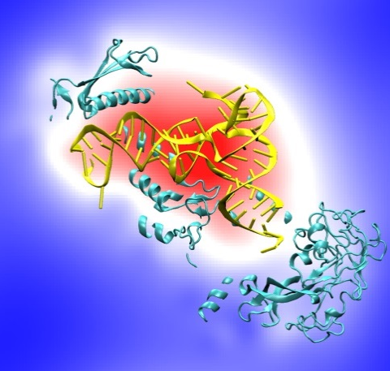
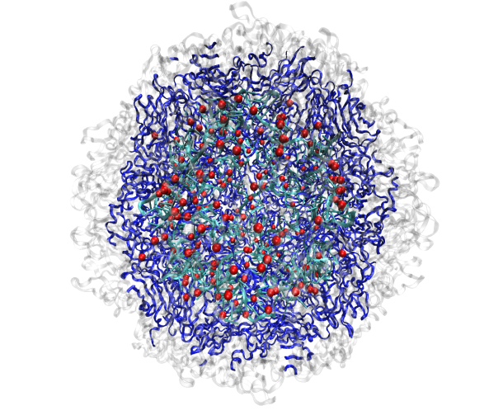
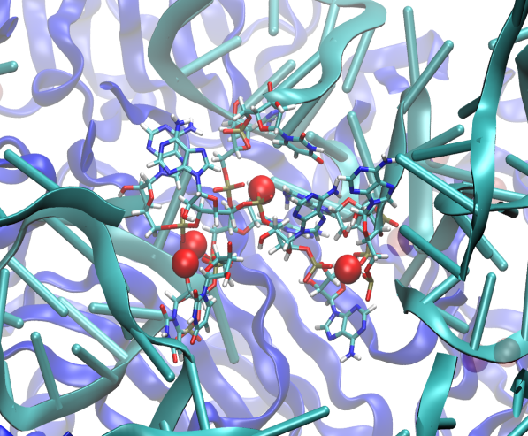
VMD Electrostatics: First Use of CUDA
Spring 2007: CUDA v0.7
Electrostatic potential maps evaluated on 3-D lattice:
Applications include:
  Ion placement for structure building
  Visualization
  Trajectory analysis
  Speedups up to 11x vs. 4-core CPUs
STMV Ion Placement
Isoleucine tRNA synthetase
Accelerating Molecular Modeling Applications with Graphics Processors. Stone et al., J. Computational Chemistry, 28:2618-2640, 2007.
Multilevel summation of electrostatic potentials using graphics processing units. Hardy, et al. J. Parallel Computing, 35:164-177, 2009.

Slide 10
GPU Computing
Commodity devices, omnipresent in modern computers (over a million sold per week)
Massively parallel hardware, hundreds of processing units, throughput oriented architecture
Standard integer and floating point types supported
Programming tools allow software to be written in dialects of familiar C/C++ and integrated into legacy software
GPU algorithms are often multicore friendly due to attention paid to data locality and data-parallel work decomposition

Slide 11
What Speedups Can GPUs Achieve?
Single-GPU speedups of 2.5x to 7x vs. 4-core CPU core are common
Best speedups can reach 25x or more, attained on codes dominated by floating point arithmetic, especially native GPU machine instructions, e.g. expf(), rsqrtf(), …
Amdahl’s Law can prevent legacy codes from achieving peak speedups with shallow GPU acceleration efforts

Slide 12
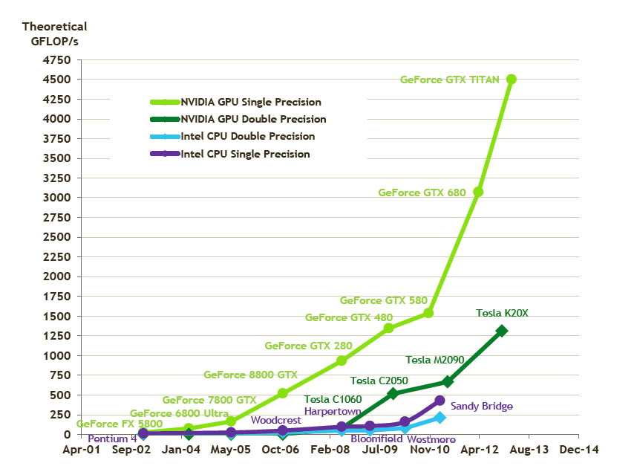
Peak Arithmetic Performance: Exponential Trend

Slide 13
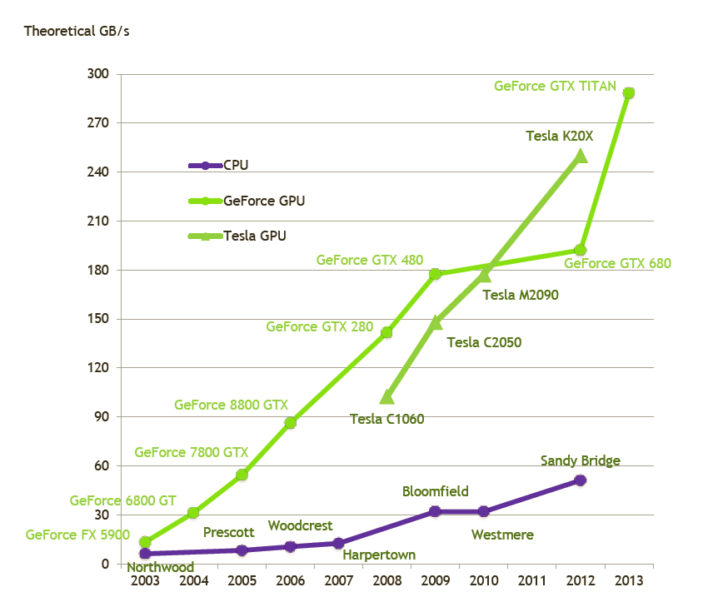
Peak Memory Bandwidth: Linear Trend

Slide 14
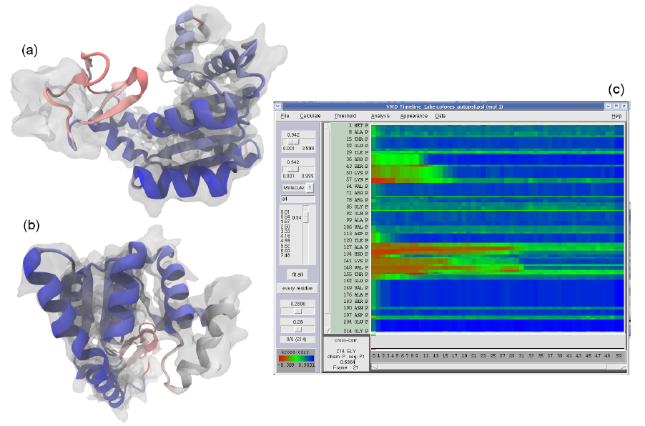
GPUs Can Reduce Trajectory Analysis Runtimes from Hours to Minutes
Enable laptops and desktop workstations to handle tasks that would have previously required a cluster, or a very long wait…
GPU-accelerated MDFF Cross Correlation Timeline

Slide 15
Example VMD Startup Messages with GPU Accelerators:
Info) VMD for LINUXAMD64, version 1.9.2a36 (December 12, 2013)
Info) http://www.ks.uiuc.edu/Research/vmd/
Info) Email questions and bug reports to vmd@ks.uiuc.edu
Info) Please include this reference in published work using VMD:
Info) Humphrey, W., Dalke, A. and Schulten, K., `VMD - Visual
Info) Molecular Dynamics', J. Molec. Graphics 1996, 14.1, 33-38.
Info) -------------------------------------------------------------
Info) Multithreading available, 16 CPUs detected.
Info) Free system memory: 58392MB (96%)
Info) Creating CUDA device pool and initializing hardware...
Info) Detected 4 available CUDA accelerators:
Info) [0] Tesla K20c 13 SM_3.5 @ 0.71 GHz, 5.0GB RAM, OIO, ZCP
Info) [1] Tesla K20c 13 SM_3.5 @ 0.71 GHz, 5.0GB RAM, OIO, ZCP
Info) [2] Quadro 7000 16 SM_2.0 @ 1.30 GHz, 6.0GB RAM, KTO, OIO, ZCP
Info) [3] Quadro 7000 16 SM_2.0 @ 1.30 GHz, 6.0GB RAM, KTO, OIO, ZCP
Info) Dynamically loaded 2 plugins in directory:
Info) /Projects/vmd/pub/linux64/lib/vmdtest/plugins/LINUXAMD64/molfile

Slide 16
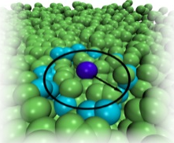
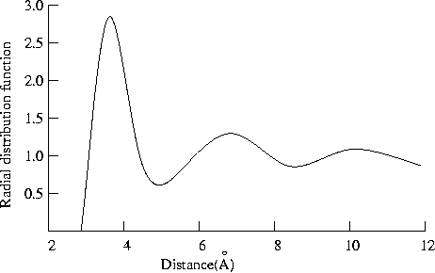
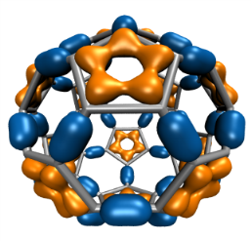
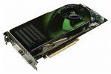
CUDA GPU-Accelerated Trajectory Analysis and Visualization in VMD
VMD GPU-Accelerated Feature or GPU Kernel | Exemplary speedup vs. contemporary 4-core CPU
Molecular orbital display | 30x
Radial distribution function | 23x
Molecular surface display | 15x
Electrostatic field calculation | 11x
Ray tracing w/ shadows, AO lighting | 7x
cryoEM cross correlation quality-of-fit | 7x
Ion placement | 6x
MDFF density map synthesis | 6x
Implicit ligand sampling | 6x
Root mean squared fluctuation | 6x
Radius of gyration | 5x
Close contact determination | 5x
Dipole moment calculation | 4x

Slide 17
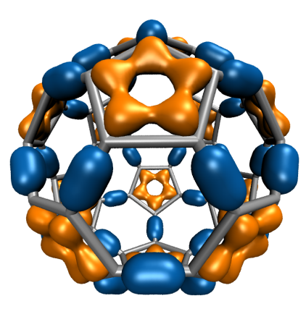
GPU-Accelerated C₆₀ Molecular Orbitals
3-D orbital lattice: millions of points
Device | CPUs, GPUs | Runtime (s) | Speedup
2x Intel X5550-SSE | 8 | 4.13 | 1
GeForce GTX 480 | 1 | 0.255 | 16
GeForce GTX 480 | 4 | 0.081 | 51
GPU threads compute one point
Lattice slices computed on multiple GPUs
CUDA thread blocks
2-D CUDA grid on each GPU

Slide 18
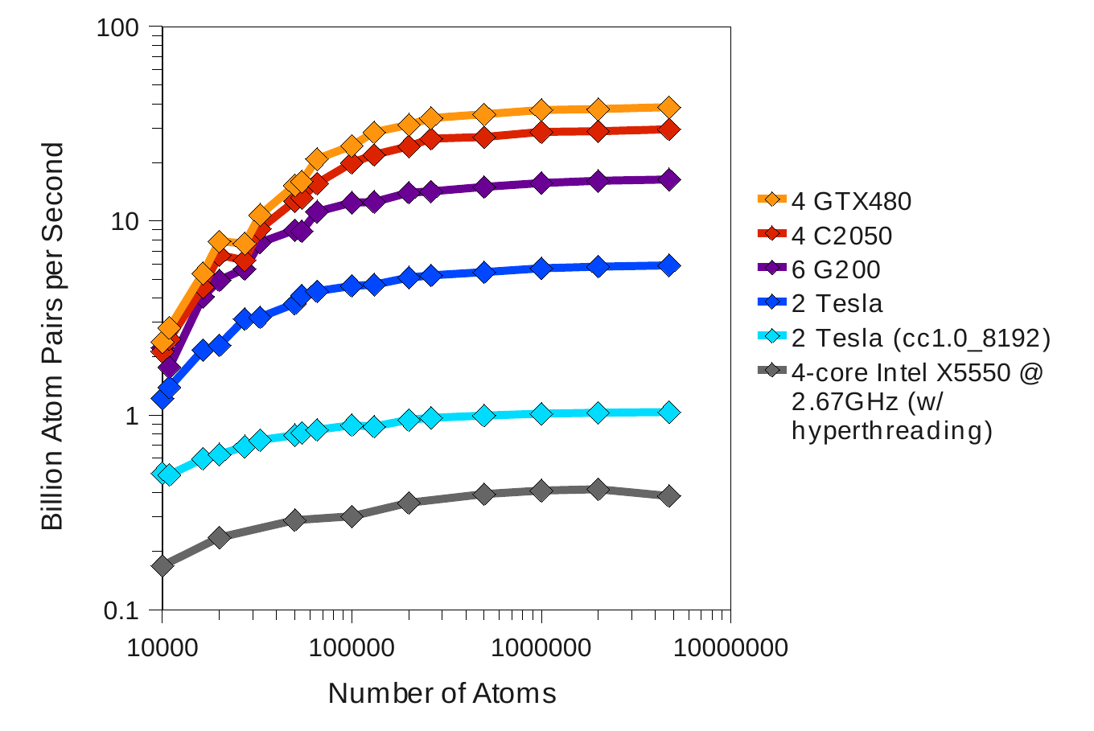
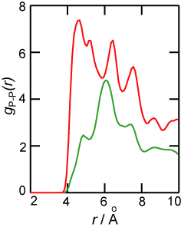
Multi-GPU RDF Performance
4 NVIDIA GTX480 GPUs 30 to 92x faster than 4-core Intel X5550 CPU
Fermi GPUs ~3x faster than GT200 GPUs: larger on-chip shared memory
Solid
Fast Analysis of Molecular Dynamics Trajectories with Graphics Processing Units – Radial Distribution Functions. Levine, et al., J. Comp. Physics, 230(9):3556-3569, 2011.
Liquid

Slide 19
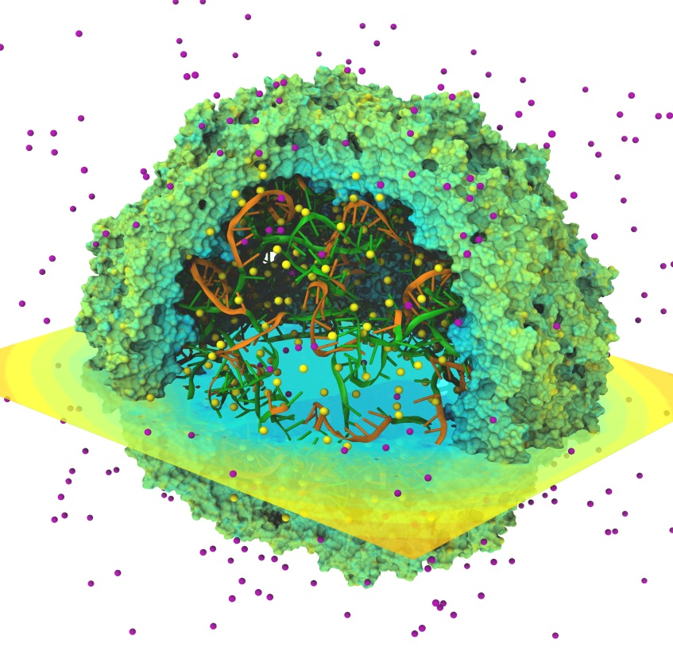
Time-Averaged Electrostatics Analysis on Energy-Efficient GPU Cluster
1.5 hour job (CPUs) reduced to 3 min (CPUs+GPU)
Electrostatics of thousands of trajectory frames averaged
Per-node power consumption on NCSA “AC” GPU cluster:
  CPUs-only: 448 Watt-hours
  CPUs+GPUs: 43 Watt-hours
GPU Speedup: 25.5x
Power efficiency gain: 10.5x
Quantifying the Impact of GPUs on Performance and Energy Efficiency in HPC Clusters. Enos, et al. The Work in Progress in Green Computing, pp. 317-324, 2010.

Slide 20
Time-Averaged Electrostatics Analysis on
Blue Waters Cray XK6/XK7
NCSA Blue Waters Node Type | Seconds per trajectory frame for one compute node
Cray XE6 Compute Node: 32 CPU cores (2xAMD 6200 CPUs) | 9.33
Cray XK6 GPU-accelerated Compute Node: 16 CPU cores + NVIDIA X2090 (Fermi) GPU | 2.25
Speedup for GPU XK6 nodes vs. CPU XE6 nodes | XK6 nodes are 4.15x faster overall
XK7 tests indicate MSM is CPU-bound with the Kepler K20X GPU. Performance is not much faster (yet) than Fermi X2090: Move spatial hashing, prolongation, interpolation onto the GPU… | XK7 nodes 4.3x faster overall In progress….
Performance for VMD time-averaged electrostatics w/ Multilevel Summation Method on the NCSA Blue Waters Early Science System

Slide 21
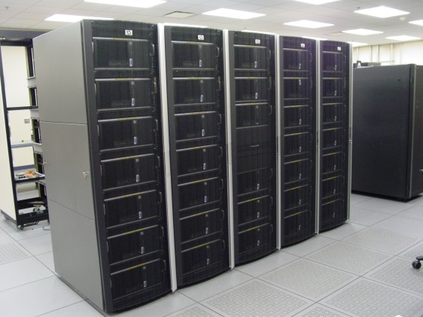
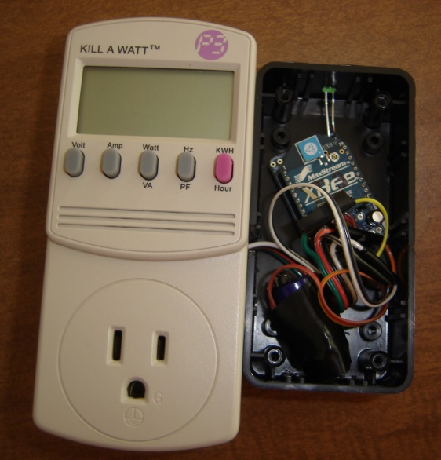
Getting Past the “Chicken and the Egg”
GPU clusters still rare circa 2009-2011, most were not quite big enough to be used for large scale production science yet … but the potential was definitely there
Performance and power efficiency benefits were seen for VMD and NAMD, on ever larger node counts
Larger GPU accelerated systems were on the horizon
GPU Clusters for High Performance Computing. Kindratenko et al., IEEE Cluster’09, pp. 1-8, 2009.
Probing biomolecular machines with graphics processors. Phillips et al. CACM, 52:34-41, 2009.
GPU-accelerated molecular modeling coming of age. Stone et al., J. Mol. Graphics and Modelling, 29:116-125, 2010.
Quantifying the impact of GPUs on performance and energy efficiency in HPC clusters. Enos et al., International Conference on Green Computing, pp. 317-324, 2010.
Fast analysis of molecular dynamics trajectories with graphics processing units-radial distribution function histogramming. Levine et al., J. Computational Physics, 230:3556-3569, 2011.

Slide 22
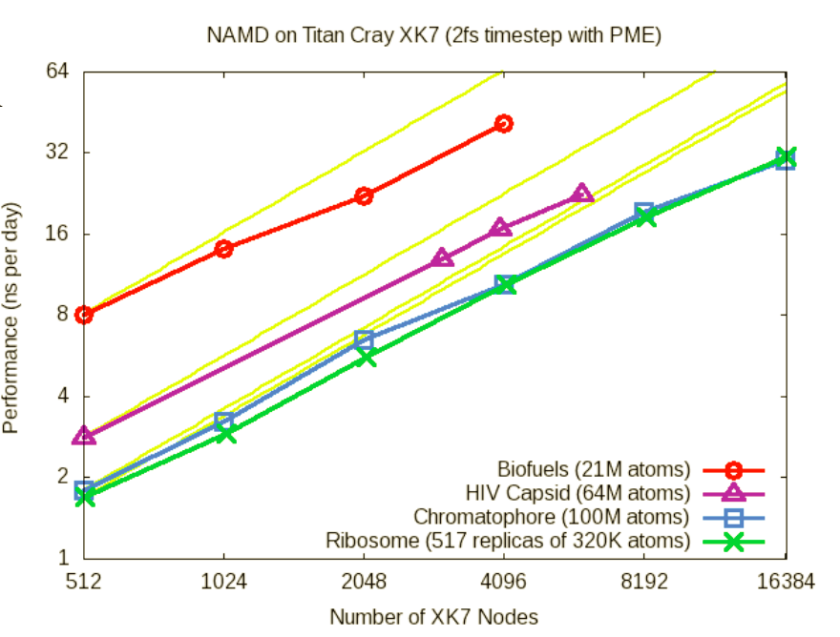
NAMD Titan XK7 Performance August 2013
NAMD XK7 vs. XE6
GPU Speedup: 3x-4x
HIV-1 Trajectory: ~1.2 TB/day @ 4096 XK7 nodes

Slide 23
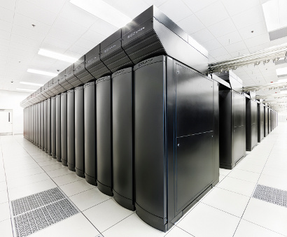
VMD Petascale Visualization and Analysis
Analyze/visualize large trajectories too large to transfer off-site:
  User-defined parallel analysis operations, data types
  Parallel rendering, movie making
Supports GPU-accelerated Cray XK7 nodes for both visualization and analysis:
  GPU accelerated trajectory analysis w/ CUDA
  OpenGL and GPU ray tracing for visualization and movie rendering
Parallel I/O rates up to 275 GB/sec on 8192 Cray XE6 nodes – can read in 231 TB in 15 minutes!
Parallel VMD currently available on:
ORNL Titan, NCSA Blue Waters, Indiana Big Red II
NCSA Blue Waters Hybrid Cray XE6 / XK7
22,640 XE6 dual-Opteron CPU nodes
4,224 XK7 nodes w/ Telsa K20X GPUs

Slide 24
Example of parallel VMD startup on IU Big Red II:
johstone@login1:~> qsub -I -V -l nodes=4:ppn=16 -q gpu
qsub: waiting for job 338070 to start
qsub: job 338070 ready
johstone@login1:~> module add vmd
Visual Molecular Dynamics version 1.9.2a36 loaded.
johstone@aprun1:~> vmd -e testmpi.vmd
Launching VMD w/ mppwidth=4, mppdepth=16, mppnppn=1
Info) VMD for BLUEWATERS, version 1.9.2a36 (January 24, 2014)
Info) http://www.ks.uiuc.edu/Research/vmd/
Info) Email questions and bug reports to vmd@ks.uiuc.edu
Info) Please include this reference in published work using VMD:
Info) Humphrey, W., Dalke, A. and Schulten, K., `VMD - Visual
Info) Molecular Dynamics', J. Molec. Graphics 1996, 14.1, 33-38.
Info) -------------------------------------------------------------
Info) Creating CUDA device pool and initializing hardware...
Info) Initializing parallel VMD instances via MPI...
Info) Found 4 VMD MPI nodes containing a total of 64 CPUs and 4 GPUs:
Info) 0: 16 CPUs, 30.78GB (97%) free mem, 1 GPUs, Name: nid00838
Info) 1: 16 CPUs, 30.78GB (97%) free mem, 1 GPUs, Name: nid00600
Info) 2: 16 CPUs, 30.79GB (97%) free mem, 1 GPUs, Name: nid00743
Info) 3: 16 CPUs, 30.79GB (97%) free mem, 1 GPUs, Name: nid00749

Slide 25
Visualization Goals, Challenges
Increased GPU acceleration for visualization of petascale molecular dynamics trajectories
Overcome GPU memory capacity limits, enable high quality visualization of >100M atom systems
Use GPU to accelerate not only interactive-rate visualizations, but also photorealistic ray tracing with artifact-free ambient occlusion lighting, etc.
Maintain ease-of-use, intimate link to VMD analytical features, atom selection language, etc.

Slide 26
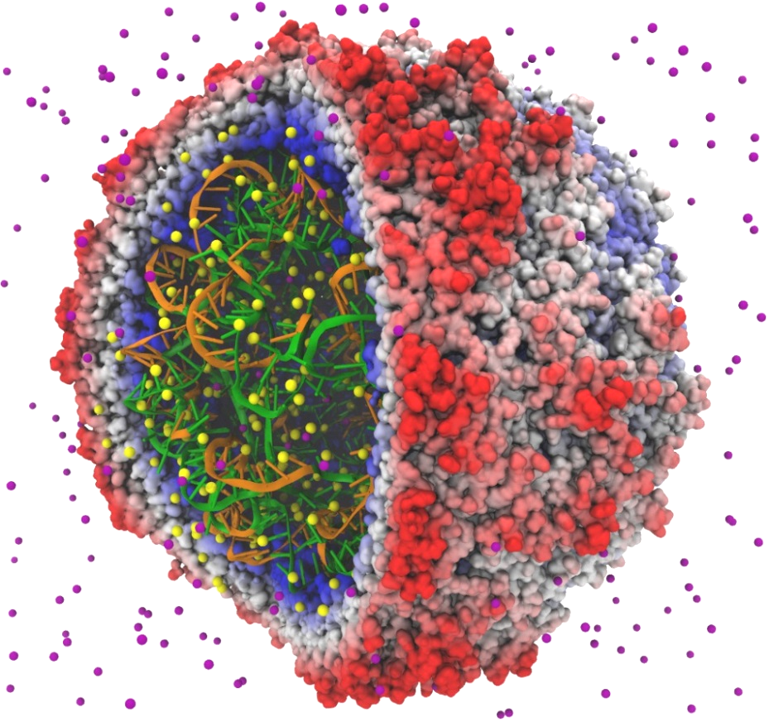
VMD “QuickSurf” Representation
Displays continuum of structural detail:
  All-atom, coarse-grained, cellular models
  Smoothly variable detail controls
Linear-time algorithm, scales to millions of particles, as limited by memory capacity
Uses multi-core CPUs and GPU acceleration to enable smooth interactive animation of molecular dynamics trajectories w/ up to ~1-2 million atoms
GPU acceleration yields 10x-15x speedup vs. multi-core CPUs
Fast Visualization of Gaussian Density Surfaces for Molecular Dynamics and Particle System Trajectories. M. Krone, J. E. Stone, T. Ertl, K. Schulten. EuroVis Short Papers, pp. 67-71, 2012
Satellite Tobacco Mosaic Virus

Slide 27
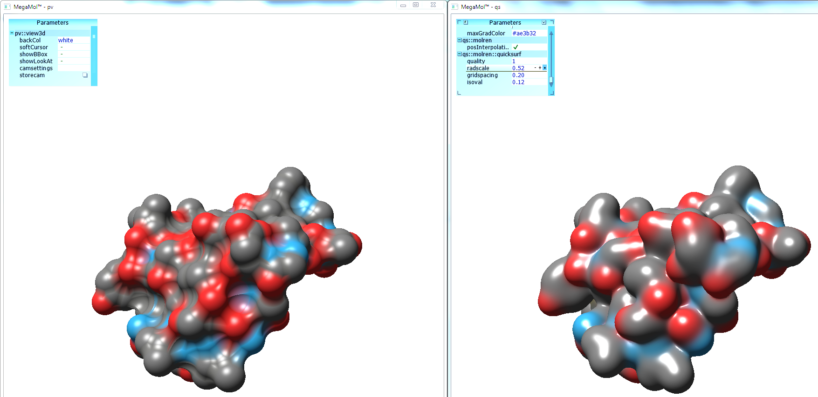
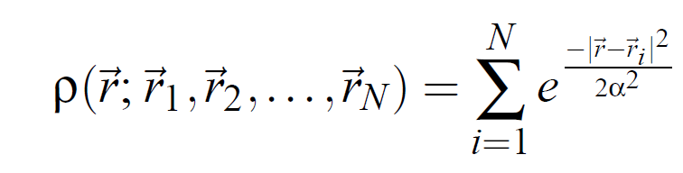
VMD 1.9.2 QuickSurf Algorithm Improvements
50%-66% memory use, 1.5x-2x speedup
Build spatial acceleration data structures, optimize data for GPU
Compute 3-D density map, 3-D color texture map with data-parallel “gather” algorithm:
Normalize, quantize, and compress density, color, surface normal data while in registers, before writing out to GPU global memory
Extract isosurface, maintaining quantized/compressed data representation
3-D density map lattice, spatial acceleration grid, and extracted surface

Slide 28
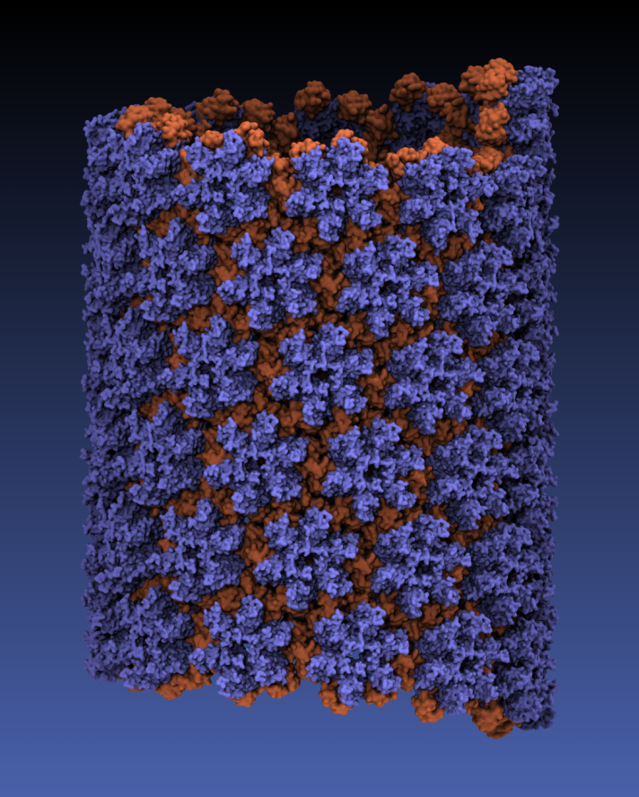
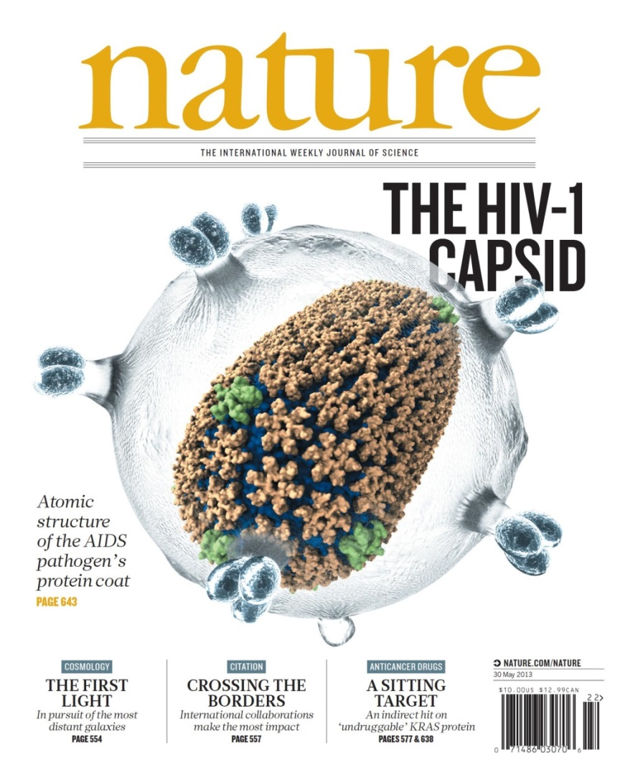
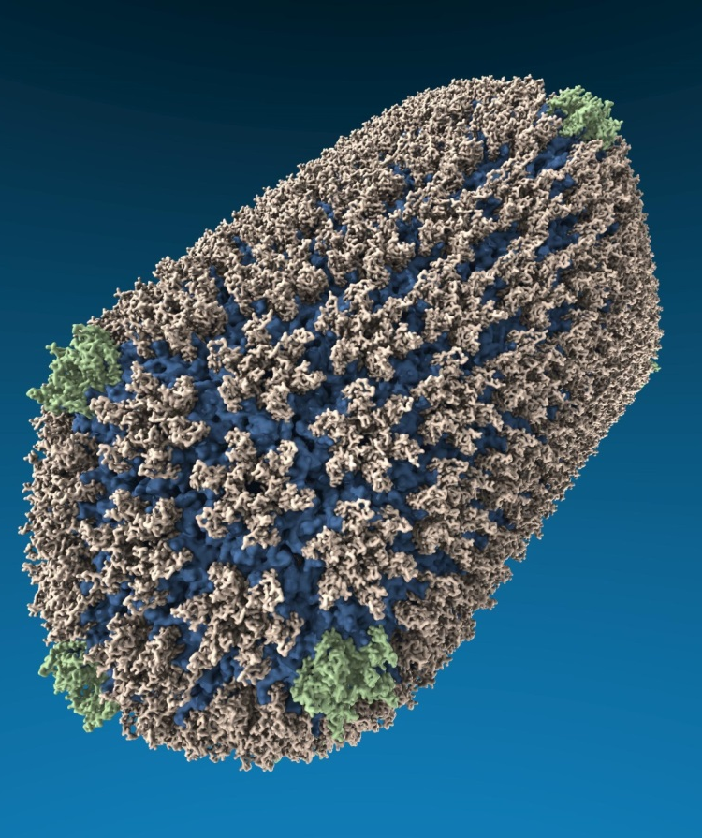
VMD “QuickSurf” Representation, Ray Tracing
All-atom HIV capsid simulations w/ up to 64M atoms on Blue Waters

Slide 29
VMD w/ OpenGL GLSL vs. GPU Ray Tracing
OpenGL GLSL:
  No significant per-frame preprocessing required
  Minimal persistent GPU memory footprint
  Implements point sprites, ray cast spheres, pixel-rate lighting, …
GPU Ray Tracing:
  Entire scene resident in GPU on-board memory for speed
  RT performance is heavily dependent on BVH acceleration, particularly for scenes with large secondary ray workloads – shadow rays, ambient occlusion shadow feelers, transmission rays

Slide 30
VMD GPU-Accelerated Ray Tracing Engine
Complementary to VMD OpenGL GLSL renderer that uses fast, interactivity-oriented rendering techniques
Key ray tracing benefits: ambient occlusion lighting, shadows, high quality transparent surfaces, …
  Subset of Tachyon parallel ray tracing engine in VMD
  GPU acceleration w/ CUDA+OptiX ameliorates long rendering times associated with advanced lighting and shading algorithms
    Ambient occlusion generates large secondary ray workload
    Transparent surfaces and transmission rays can increase secondary ray counts by another order of magnitude
  Adaptation of Tachyon to the GPU required careful avoidance of GPU branch divergence, use of GPU memory layouts, etc.

Slide 31
Why Built-In VMD Ray Tracing Engines?
No disk I/O or communication to outboard renderers
Eliminate unnecessary data replication and host-GPU memory transfers
Directly operate on VMD internal molecular scene, quantized/compressed data formats
Implement all curved surface primitives, volume rendering, texturing, shading features required by VMD
Same scripting, analysis, atom selection, and rendering features are available on all platforms, graceful CPU fallback

Slide 32
Molecular Structure Data and Global VMD State
Scene Graph
Graphical Representations
User Interface Subsystem
DrawMolecule
Tcl/Python Scripting
Non-Molecular
Geometry
Mouse + Windows
VR Input “Tools”
Display Subsystem
Windowed OpenGL GPU
VMDDisplayList
OpenGLDisplayDevice
OpenGL Pbuffer GPU
DisplayDevice
FileRenderer
Tachyon CPU
TachyonL-OptiX GPU

Slide 33
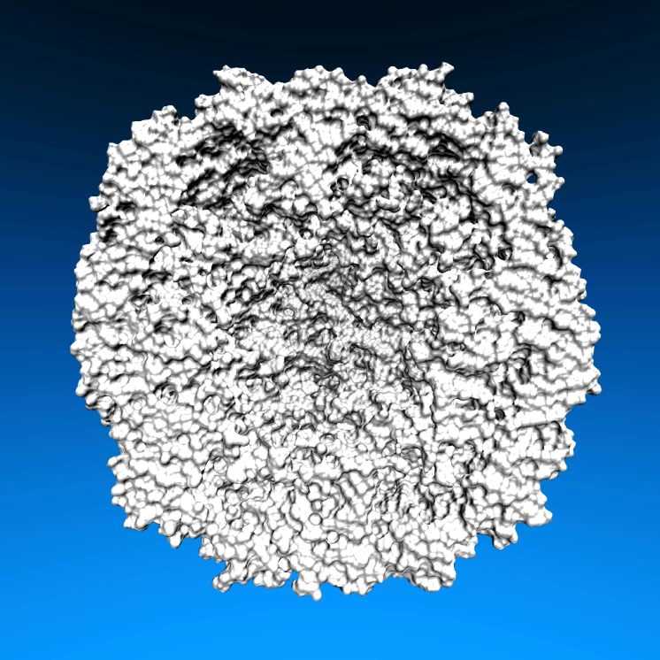
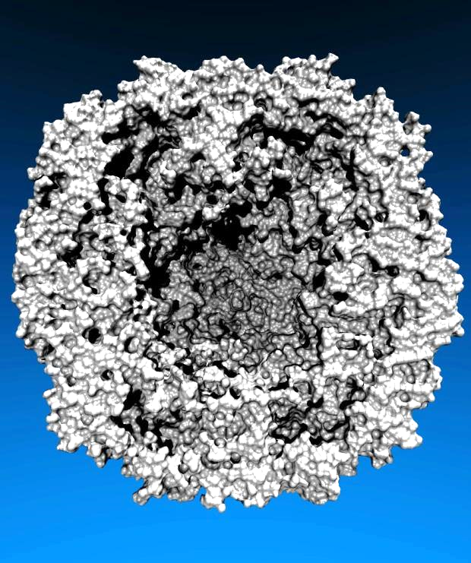
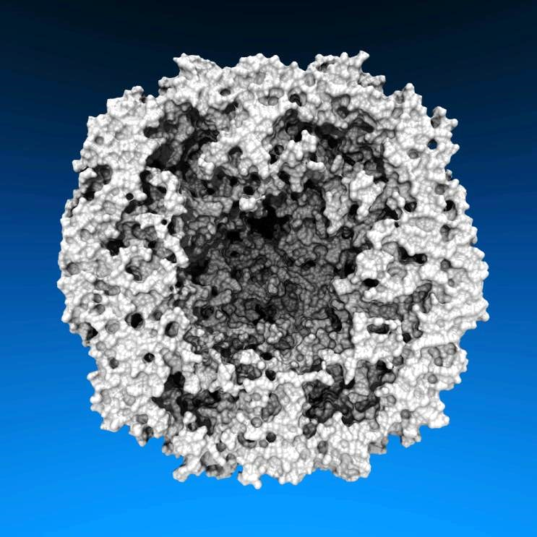
Lighting Comparison, STMV Capsid
Two lights, no shadows
Two lights, hard shadows, 1 shadow ray per light
Ambient occlusion + two lights, 144 AO rays/hit

Slide 34
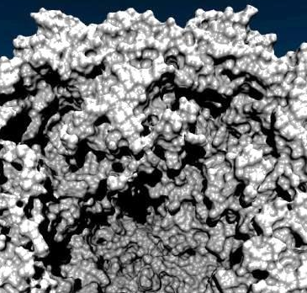
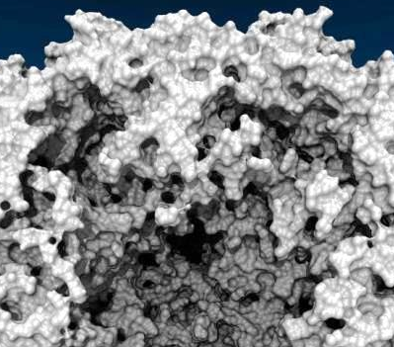
“My Lights are Always in the Wrong Place…”
Two lights, harsh shadows, 1 shadow ray per light per hit
Ambient occlusion (~80%) + two directional lights (~20%), 144 AO rays/hit

Slide 35
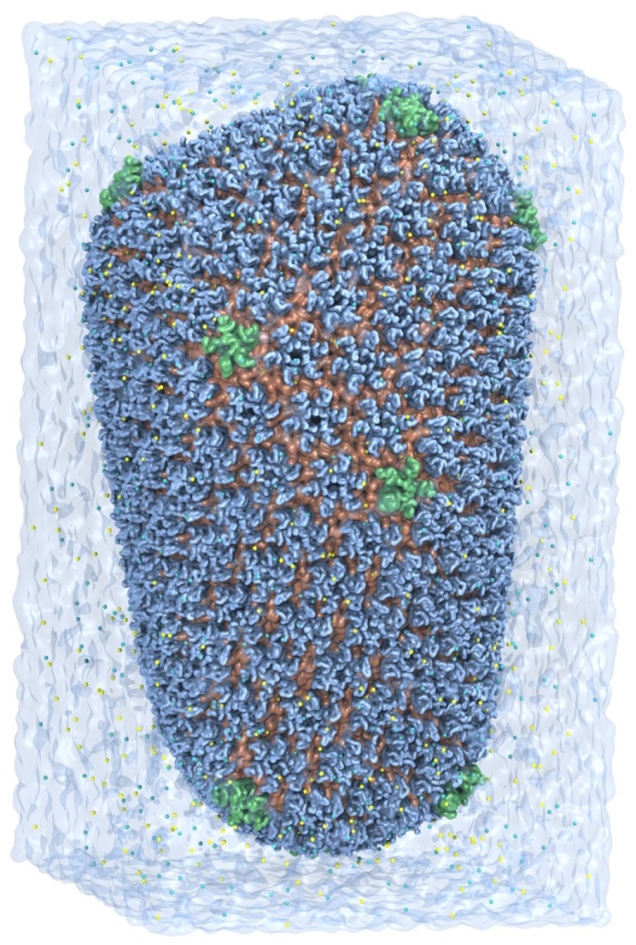
GPU Ray Tracing of HIV-1 on Blue Waters
64M atom simulation, 1079 movie frames
Ambient occlusion lighting, shadows, transparency, antialiasing, depth cueing, 144 rays/pixel minimum
GPU memory capacity hurdles:
  Surface calc. and ray tracing each use over 75% of K20X 6GB on-board GPU memory even with quantized/compressed colors, surface normals, …
  Evict non-RT GPU data to host prior to ray tracing
  Eviction was still required on a test machine with a 12GB Quadro K6000 GPU – the multi-pass “QuickSurf” surface algorithm grows the per-pass chunk size to reduce the number of passes

Slide 36


Slide 37

HIV-1 Parallel Movie Rendering on Blue Waters Cray XE6/XK7
VMD 1.9.2
HIV-1 “HD” 1920x1080 movie rendering: GPUs speed up geom+ray tracing by up to eight times
Node Type and Count | Script Load Time | State Load Time | Geometry + Ray Tracing | Total Time
256 XE6 CPUs | 7 s | 160 s | 1,374 s | 1,541 s
512 XE6 CPUs | 13 s | 211 s | 808 s | 1,032 s
64 XK7 Tesla K20X GPUs | 2 s | 38 s | 655 s | 695 s
128 XK7 Tesla K20X GPUs | 4 s | 74 s | 331 s | 410 s
256 XK7 Tesla K20X GPUs | 7 s | 110 s | 171 s | 288 s
GPU-Accelerated Molecular Visualization on Petascale Supercomputing Platforms,
Stone et al. UltraVis'13: Eighth Workshop on Ultrascale Visualization Proceedings, 2013.

Slide 38
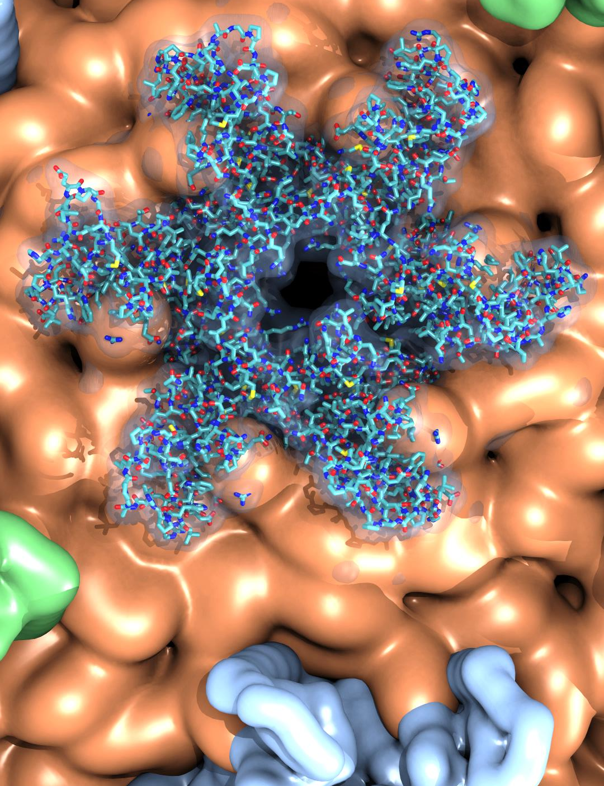
VMD 1.9.2 Coming Soon
Handle very large structures:
  Tested with up to 240M atoms/particles
  Atom selections: 1.5x to 4x faster
  QuickSurf surface display: 1.5x to 2x faster
  GPU ray tracing: 4x-8x faster than CPU
Improved movie making tools, off-screen OpenGL movie rendering, parallel movie rendering
Improved structure building tools
Many new and updated user-contributed plugins:
  Bendix – intuitive helix visualization and analysis
  NMWiz – visual analysis of normal modes
  Topotools – structure preparation, e.g. for LAMMPS
GPU Ray Tracing of
HIV-1 Capsid Detail

Slide 39
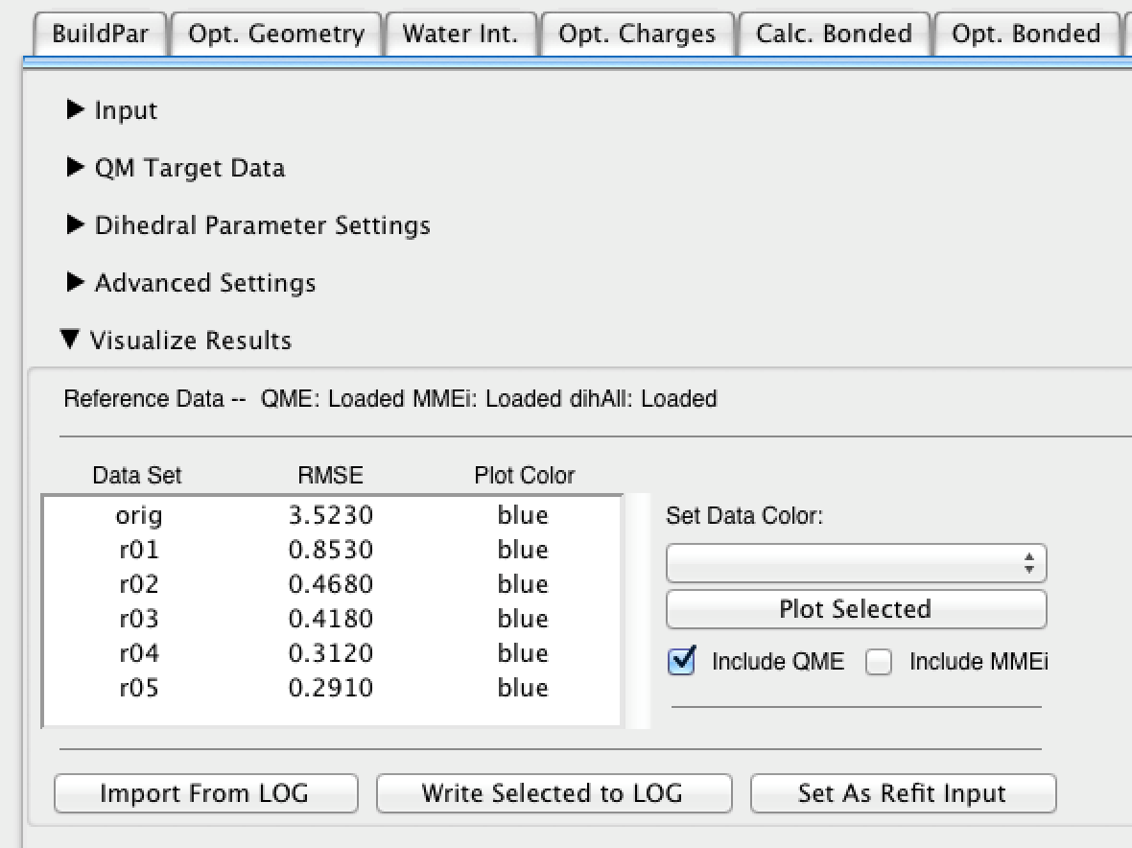
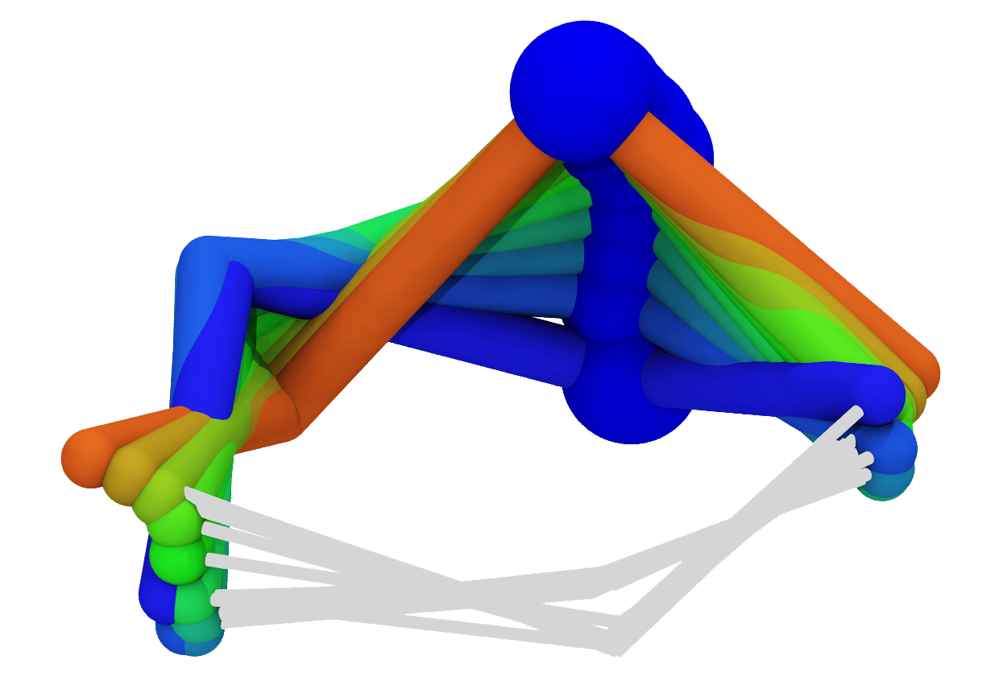
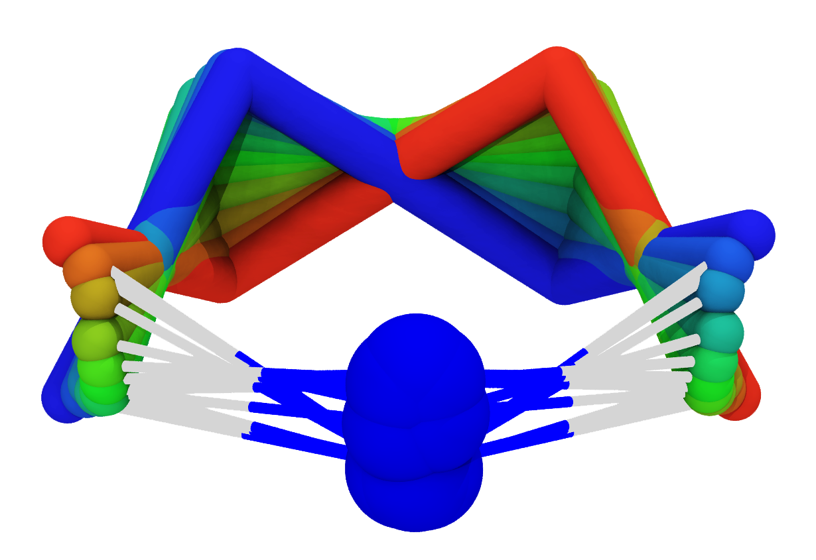
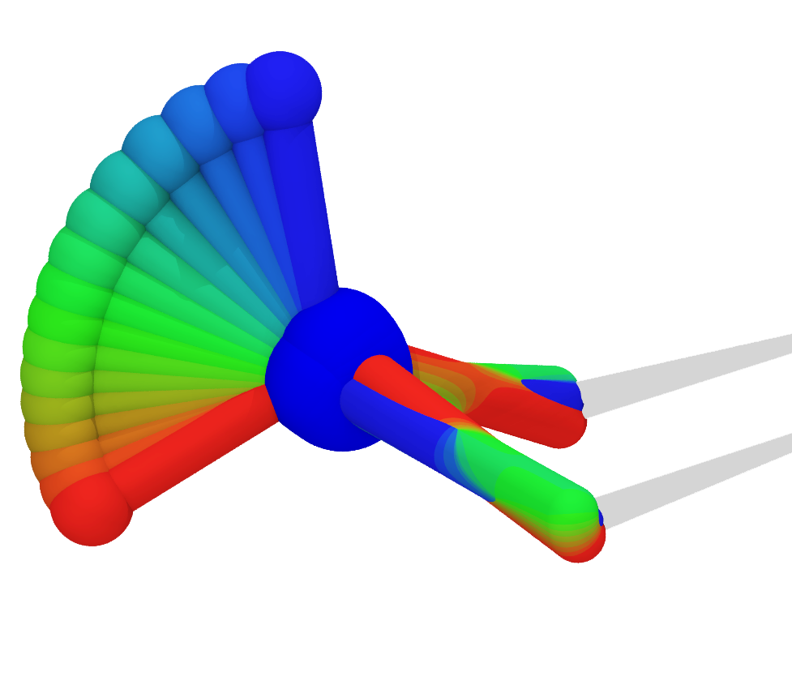
Force Field Toolkit (ffTK)
VMD 1.9.2
rapid parameterization of small molecules
Current Features
Optimize charges, bonds, angles, dihedrals
GUI with a defined modular workflow
Automation of tedious tasks
Tools to assess parameter performance
Planned Features
Support multiple QM software packages
Optimize AMBER parameters
J. Comp. Chem, 34:2757-2770, 2013

Slide 40
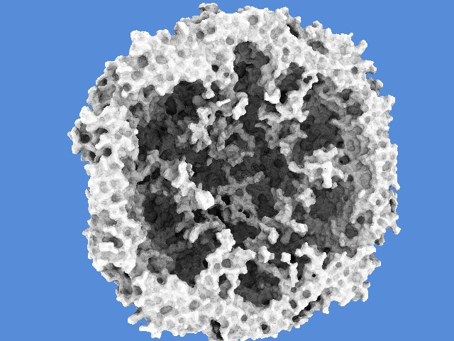
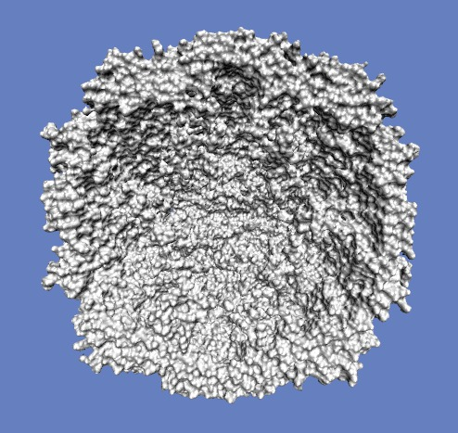
Plans: Interactive Ray Tracing of Molecular Graphics
STMV virus capsid on a laptop GeForce GTX 560M
Ambient occlusion lighting, shadows, reflections, transparency, and much more…
Standard OpenGL rasterization
VMD w/ new GPU ray tracing engine based on CUDA + OptiX: 5-10 FPS

Slide 41
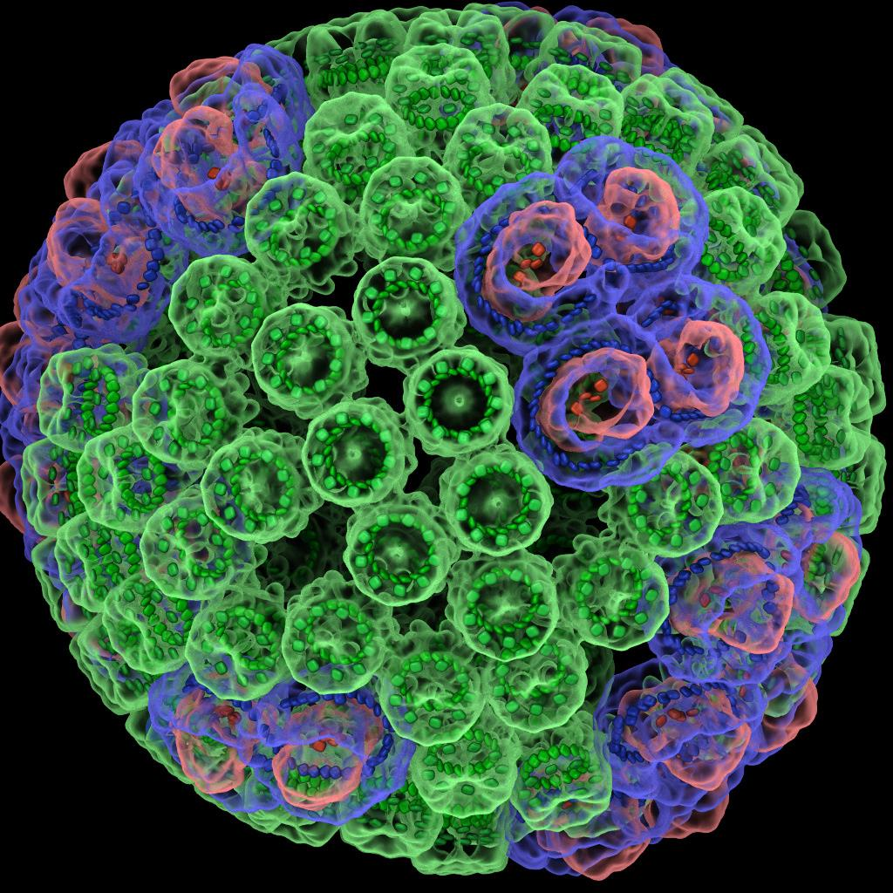
Plans: Extend/Improve Structure Building Features of VMD
Exemplary features:
New tools for solvation, ion placement, other common structure preparation tasks
Improve structure building tools for very large biomolecular complexes, e.g. HIV-1 capsid
  Increase performance
  Improve user-customizability
  Support for more structure file formats
Add infrastructure for development of new cell packing tools for whole cell simulations
10M atom chromatophore

Slide 42
Plans: Extend Analysis Features of VMD
Exemplary features:
New secondary structure determination algorithm
  Support large biomolecular complexes
  Compute and display time-varying secondary structure interactively
Simplify analysis of multi-terabyte MD trajectories
  Circumvent storing large trajectories in memory
  Out-of-core SSD trajectory access: 7.5 GB/sec
Automate parallelization of user-defined analysis calculations, interfaced to Timeline plugin
Parallel VMD
Analysis
Tens to hundreds of multi-TB trajectories
Immersive Out-of-Core Visualization of Large-Size and Long-Timescale Molecular Dynamics Trajectories. J. Stone, K. L. Vandivort, and K. Schulten. G. Bebis et al. (Eds.): 7th International Symposium on Visual Computing (ISVC 2011), LNCS 6939, pp. 1-12, 2011.
Early Experiences Scaling VMD Molecular Visualization and Analysis Jobs on Blue Waters,
Proceedings of the Extreme Scaling Workshop, Stone, et al., XSEDE Extreme Scaling Workshop, 2013.

Slide 43
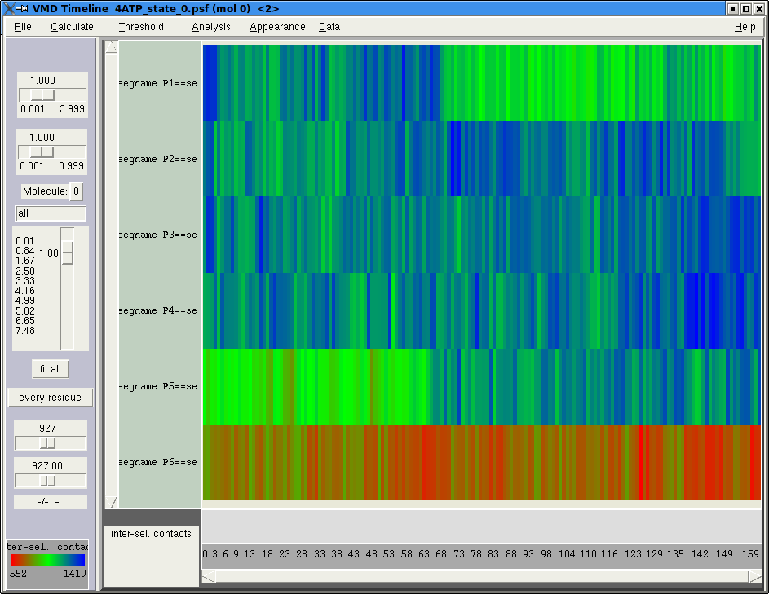

Plans: Analyze Long Simulations with Timeline
Timeline:
graphing and analysis tool to identify events in an MD trajectory
live 2D whole-trajectory plot linked to 3D structure
user-extendable
TimeLine 2D plot
Rho hexameric helicase 3D structure
Perform analysis faster
  High-performance parallel trajectory analysis on supercomputers and clusters
  Prototypes show 3500x speedup on Blue Waters
Analysis types: filtering, time series analysis, sorting (e.g. bond energies)
Remote interactive analysis: data at supercomputer center; view in office

Slide 44

Plans: Tablet VMD, Improved Touch Interfaces
Developed first multi-touch VMD interface
  Early technology development in advance of devices
  Collaborative multi-user wireless control of VMD session
Features in development:
  tablet display of trajectory timelines, sequence data, plots, and tabular information
Goal: full tablet-native VMD

Slide 45

Optimizing VMD for Power Consumption

Slide 46
Upcoming GTC Express Webinars
February 27: Massive Acceleration of Installed Antenna Performance Simulations Using NVIDIA GPUs
April 3: Getting the Most Out of Citrix XenServer with NVIDIA® vGPU™ Technology
May 27: The Next Steps for Folding@home
Register at www.gputechconf.com/gtcexpress

Slide 47

GTC 2014 Registration is Open
Hundreds of sessions including:
Molecular Dynamics
Bioinformatics
Quantum Chemistry
Scientific Visualization
Computational Physics
Performance Optimization
Register with GM20EXP for 20% discount
www.gputechconf.com

Slide 48


Test Drive the World’s Fastest GPU
Accelerate Your Science on the New Tesla K40 GPU
Accelerate applications like
AMBER, NAMD, GROMACS, LAMMPS
OR
Your own Molecular Dynamics code
on latest K40 GPUs today
Sign up for FREE GPU Test Drive on remotely hosted clusters
www.nvidia.com/GPUTestDrive

Slide 49
Acknowledgements
Theoretical and Computational Biophysics Group, University of Illinois at Urbana-Champaign
NVIDIA CUDA Center of Excellence, University of Illinois at Urbana-Champaign
NVIDIA CUDA team
NVIDIA OptiX team
NCSA Blue Waters Team
Funding:
  DOE INCITE, ORNL Titan: DE-AC05-00OR22725
  NSF Blue Waters: NSF OCI 07-25070, PRAC “The Computational Microscope”
  NIH support: 9P41GM104601, 5R01GM098243-02
Notes:
49

Slide 50


Slide 51
GPU Computing Publications http://www.ks.uiuc.edu/Research/gpu/
GPU-Accelerated Molecular Visualization on Petascale Supercomputing Platforms. J. Stone, K. L. Vandivort, and K. Schulten. UltraVis'13: Proceedings of the 8th International Workshop on Ultrascale Visualization, pp. 6:1-6:8, 2013.
Early Experiences Scaling VMD Molecular Visualization and Analysis Jobs on Blue Waters. J. Stone, B. Isralewitz, and K. Schulten. In proceedings, Extreme Scaling Workshop, 2013.
Lattice Microbes: High‐performance stochastic simulation method for the reaction‐diffusion master equation. E. Roberts, J. Stone, and Z. Luthey‐Schulten.
J. Computational Chemistry 34 (3), 245-255, 2013.
Fast Visualization of Gaussian Density Surfaces for Molecular Dynamics and Particle System Trajectories. M. Krone, J. Stone, T. Ertl, and K. Schulten. EuroVis Short Papers, pp. 67-71, 2012.
Immersive Out-of-Core Visualization of Large-Size and Long-Timescale Molecular Dynamics Trajectories. J. Stone, K. L. Vandivort, and K. Schulten. G. Bebis et al. (Eds.): 7th International Symposium on Visual Computing (ISVC 2011), LNCS 6939, pp. 1-12, 2011.
Fast Analysis of Molecular Dynamics Trajectories with Graphics Processing Units – Radial Distribution Functions. B. Levine, J. Stone, and A. Kohlmeyer. J. Comp. Physics, 230(9):3556-3569, 2011.

Slide 52
GPU Computing Publications http://www.ks.uiuc.edu/Research/gpu/
Quantifying the Impact of GPUs on Performance and Energy Efficiency in HPC Clusters. J. Enos, C. Steffen, J. Fullop, M. Showerman, G. Shi, K. Esler, V. Kindratenko, J. Stone, J Phillips. International Conference on Green Computing, pp. 317-324, 2010.
GPU-accelerated molecular modeling coming of age. J. Stone, D. Hardy, I. Ufimtsev, K. Schulten. J. Molecular Graphics and Modeling, 29:116-125, 2010.
OpenCL: A Parallel Programming Standard for Heterogeneous Computing. J. Stone, D. Gohara, G. Shi. Computing in Science and Engineering, 12(3):66-73, 2010.
An Asymmetric Distributed Shared Memory Model for Heterogeneous Computing Systems. I. Gelado, J. Stone, J. Cabezas, S. Patel, N. Navarro, W. Hwu. ASPLOS ’10: Proceedings of the 15th International Conference on Architectural Support for Programming Languages and Operating Systems, pp. 347-358, 2010.

Slide 53
GPU Computing Publications http://www.ks.uiuc.edu/Research/gpu/
GPU Clusters for High Performance Computing. V. Kindratenko, J. Enos, G. Shi, M. Showerman, G. Arnold, J. Stone, J. Phillips, W. Hwu. Workshop on Parallel Programming on Accelerator Clusters (PPAC), In Proceedings IEEE Cluster 2009, pp. 1-8, Aug. 2009.
Long time-scale simulations of in vivo diffusion using GPU hardware. E. Roberts, J. Stone, L. Sepulveda, W. Hwu, Z. Luthey-Schulten. In IPDPS’09: Proceedings of the 2009 IEEE International Symposium on Parallel & Distributed Computing, pp. 1-8, 2009.
High Performance Computation and Interactive Display of Molecular Orbitals on GPUs and Multi-core CPUs. J. Stone, J. Saam, D. Hardy, K. Vandivort, W. Hwu, K. Schulten, 2nd Workshop on General-Purpose Computation on Graphics Pricessing Units (GPGPU-2), ACM International Conference Proceeding Series, volume 383, pp. 9-18, 2009.
Probing Biomolecular Machines with Graphics Processors. J. Phillips, J. Stone. Communications of the ACM, 52(10):34-41, 2009.
Multilevel summation of electrostatic potentials using graphics processing units. D. Hardy, J. Stone, K. Schulten. J. Parallel Computing, 35:164-177, 2009.

Slide 54
GPU Computing Publications http://www.ks.uiuc.edu/Research/gpu/
Adapting a message-driven parallel application to GPU-accelerated clusters. J. Phillips, J. Stone, K. Schulten. Proceedings of the 2008 ACM/IEEE Conference on Supercomputing, IEEE Press, 2008.
GPU acceleration of cutoff pair potentials for molecular modeling applications. C. Rodrigues, D. Hardy, J. Stone, K. Schulten, and W. Hwu. Proceedings of the 2008 Conference On Computing Frontiers, pp. 273-282, 2008.
GPU computing. J. Owens, M. Houston, D. Luebke, S. Green, J. Stone, J. Phillips. Proceedings of the IEEE, 96:879-899, 2008.
Accelerating molecular modeling applications with graphics processors. J. Stone, J. Phillips, P. Freddolino, D. Hardy, L. Trabuco, K. Schulten. J. Comp. Chem., 28:2618-2640, 2007.
Continuous fluorescence microphotolysis and correlation spectroscopy. A. Arkhipov, J. Hüve, M. Kahms, R. Peters, K. Schulten. Biophysical Journal, 93:4006-4017, 2007.

