Slide 1
VMD: Immersive Molecular Visualization with High-Fidelity Ray Tracing
John E. Stone
Theoretical and Computational Biophysics Group
Beckman Institute for Advanced Science and Technology
University of Illinois at Urbana-Champaign
http://www.ks.uiuc.edu/
9:00am, Monday August 13, 2018
BOF: Immersive Visualization for Science and Research
Siggraph 2018, Vancouver, BC, Canada

Slide 2
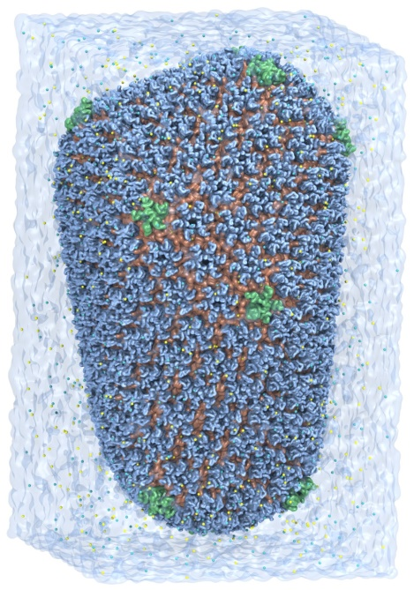
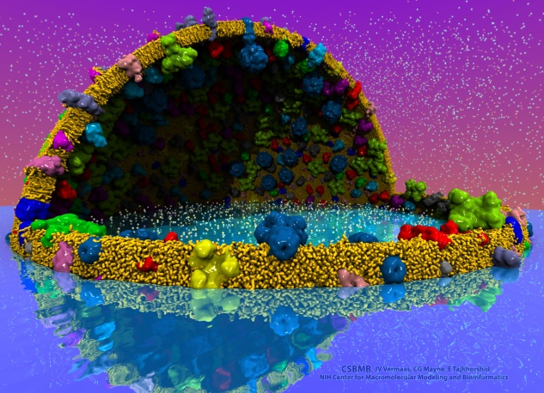
VMD – “Visual Molecular Dynamics”
100,000 active users worldwide
Visualization and analysis of:
Molecular dynamics simulations
Lattice cell simulations
Quantum chemistry calculations
Cryo-EM densities, volumetric data
User extensible scripting and plugins
http://www.ks.uiuc.edu/Research/vmd/
Cell-Scale Modeling
MD Simulation

Slide 3
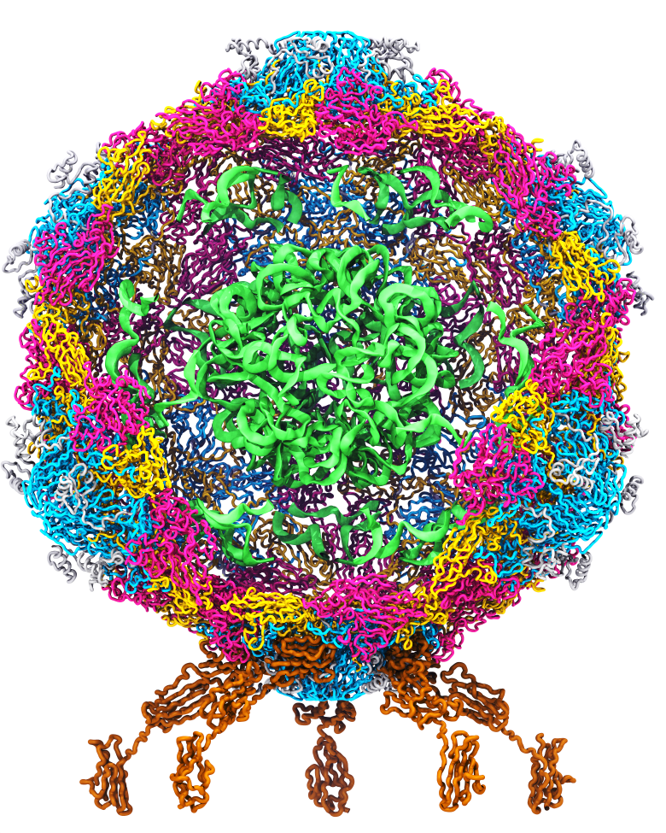
Goal: A Computational Microscope
Study the molecular machines in living cells
Ribosome: target for antibiotics
Poliovirus
Notes:
Ribosomes synthesize new proteins from genetic information
Bacterial ribosome is a target for antibiotics, which interfere with its ability to function by binding to sites on the structure, preventing proteins from being synthesized
Ribosome simulations are extremely computationally challenging due to the size of the structure and its natural environment (solvent, ions, etc, large box, 3 million atoms or so)
Bionanodevice for sequencing DNA efficiently
Knowledge of an individual’s genetic makeup can lead to the prediction and treatment of many diseases by the means of personal genomic medicine and pharmacogenomics. In order for genome sequencing to become practical for common medical use, an inexpensive high throughput genome sequencing technique is required. NIH has set a goal of reducing the cost of genome sequencing by a factor of 10,000, to less than $1,000 within ten years.
The computer is the best microscope to guide the development of bionanodevices, for example to sequence DNA. While experiments can measure DNA electrostatic potentials, they cannot visualize the DNA’s location and conformation at the time of measurement.

Slide 4
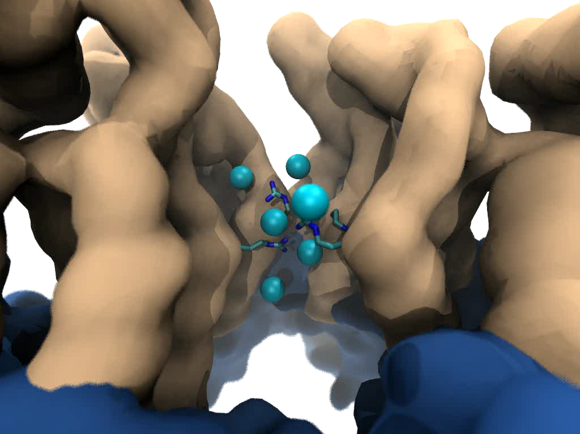
Goal: Intuitive interactive viz. in crowded molecular complexes
Results from 64M atom, 1 μs sim!
Close-up view of chloride ions permeating through HIV-1 capsid hexameric centers
Notes:
High quality lighting/shading are very beneficial for scientists
Techniques like AO are easy to use by scientists who are non-experts in computer graphics
Use of methods like AO simplifies the process of producing easy-to-interpret images of complex
molecular structures, no need to adjust positions of lights, or deal with them during animation of
Molecular

Slide 5
High Fidelity Ray Tracing
Ambient Occlusion, Depth of Field, high quality transparency, instancing, ….
Interactive RT on laptop, desk, cloud
Large-scale parallel rendering: in situ or post hoc visualization tasks
Stereoscopic panorama and full-dome projections
Omnidirectional VR: YouTube, HMDs
Built-in ray tracing engines:
- Tachyon: cross-platform RT
- NVIDIA OptiX: GPU-accelerated and remote RT on VCA clusters
- Intel OSPRay: CPU x86/Phi-optimized parallel rendering w/ MPI
VMD/OptiX all-atom Chromatophore
Notes:
-----
Credits:
GPU-Accelerated Molecular Visualization on Petascale Supercomputing Platforms. J. E. Stone, K. L. Vandivort, and K. Schulten. UltraVis’13, pp. 6:1-6:8, 2013.
Visualization of Energy Conversion Processes in a Light Harvesting Organelle at Atomic Detail. M. Sener, et al. SC'14 Visualization and Data Analytics Showcase, 2014.
Chemical Visualization of Human Pathogens: the Retroviral Capsids. J. R. Perilla, B.-C. Goh, J. E. Stone, and K. Schulten. SC'15 Visualization and Data Analytics Showcase, 2015.
Atomic Detail Visualization of Photosynthetic Membranes with GPU-Accelerated Ray Tracing. J. E. Stone et al., J. Parallel Computing, 55:17-27, 2016.
Immersive Molecular Visualization with Omnidirectional Stereoscopic Ray Tracing and Remote Rendering J. E. Stone, W. R. Sherman, and K. HPDAV, IPDPSW, pp. 1048-1057, 2016.

Slide 6
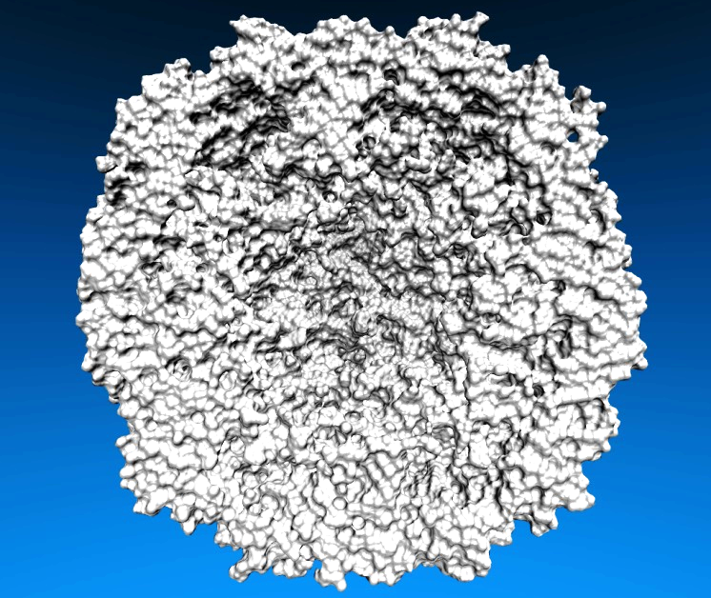
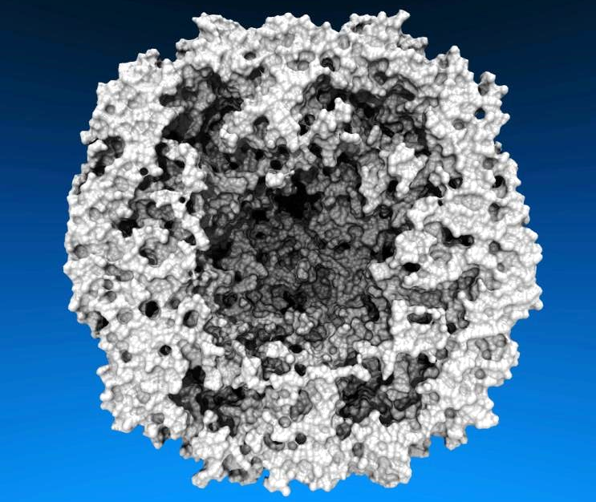
Lighting Comparison, STMV Capsid
Two lights, no shadows
Ambient occlusion + two lights, 144 AO rays/hit

Slide 7
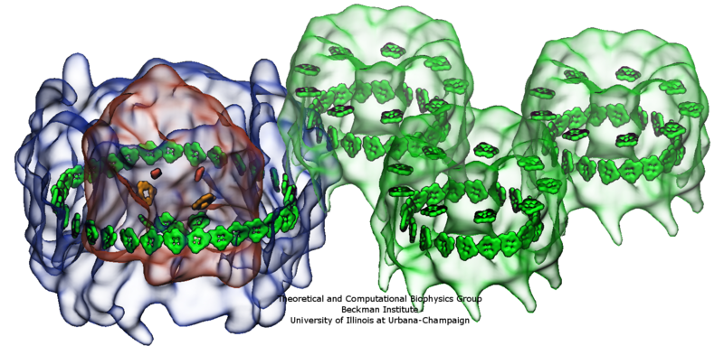
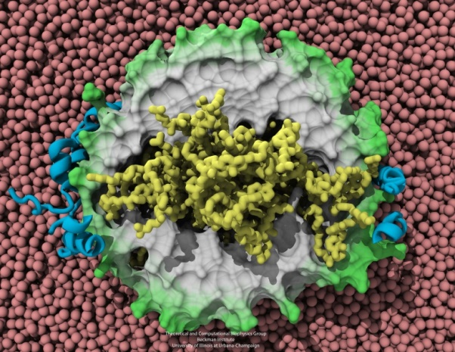
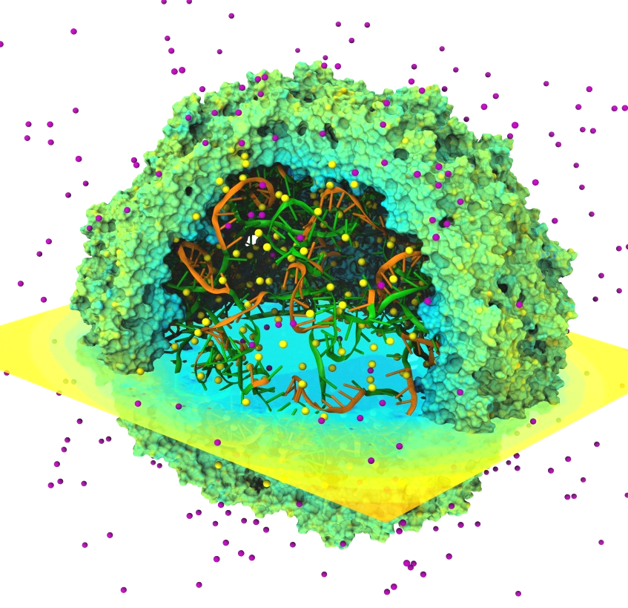
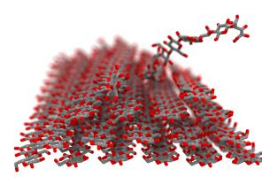
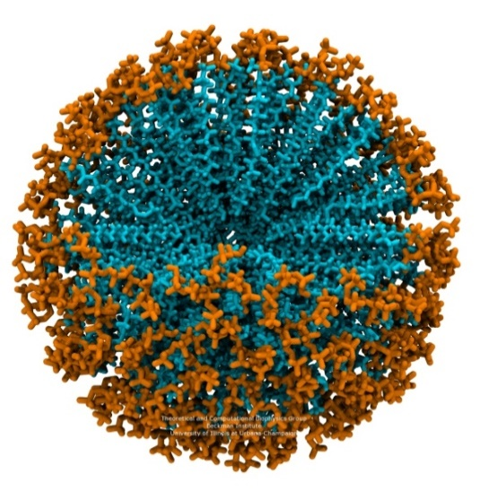
Notes:
Benefits of Advanced Lighting and Shading Techniques
Exploit visual intuition
Spend computer time in exchange for scientists’ time, make images that are more easily interpreted
High-quality transparent surface display, DoF, and AO are a few of the tools that can be used to better visualize complex molecular structures and their dynamics, and to focus viewer’s attention on key parts of a protein or macromolecular complex

Slide 8
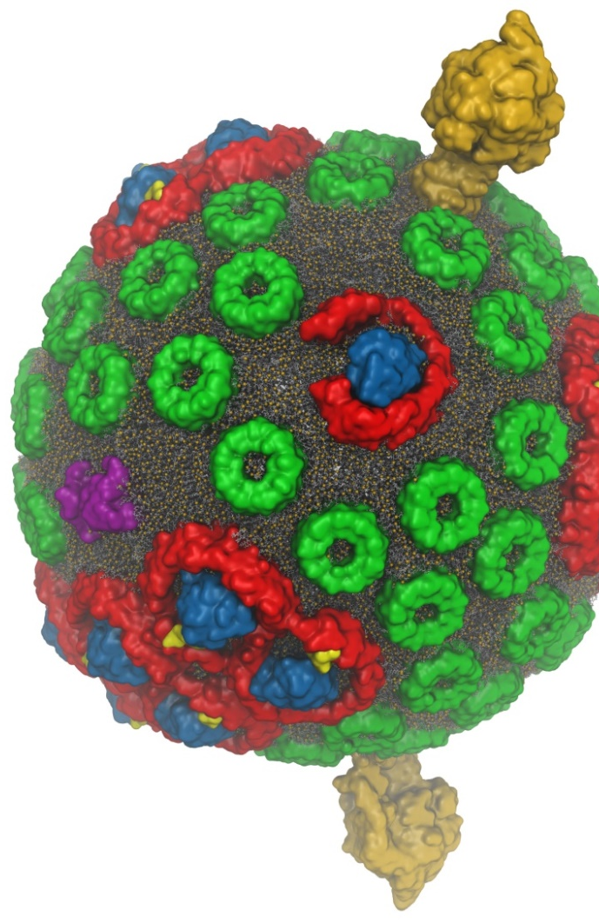
VMD w/ OptiX
Interactive RT on laptops, desktops, and cloud
Large-scale parallel rendering: in situ or post hoc visualization tasks
Remote RT on NVIDIA VCA clusters
Stereoscopic panoramic and full-dome projections
Omnidirectional VR for YouTube, VR HMDs
GPU memory sharing via NVLink
GPU-Accelerated Molecular Visualization on Petascale Supercomputing Platforms. J. E. Stone, K. L. Vandivort, and K. Schulten. UltraVis’13, pp. 6:1-6:8, 2013.
Visualization of Energy Conversion Processes in a Light Harvesting Organelle at Atomic Detail. M. Sener, et al. SC'14 Visualization and Data Analytics Showcase, 2014.
Chemical Visualization of Human Pathogens: the Retroviral Capsids. J. R. Perilla, B.-C. Goh, J. E. Stone, and K. Schulten. SC'15 Visualization and Data Analytics Showcase, 2015.
Atomic Detail Visualization of Photosynthetic Membranes with GPU-Accelerated Ray Tracing. J. E. Stone et al., J. Parallel Computing, 55:17-27, 2016.
Immersive Molecular Visualization with Omnidirectional Stereoscopic Ray Tracing and Remote Rendering J. E. Stone, W. R. Sherman, and K. Schulten. HPDAV, IPDPSW, pp. 1048-1057, 2016.
VMD/OptiX GPU Ray Tracing of all-atom Chromatophore w/ lipids.

Slide 9
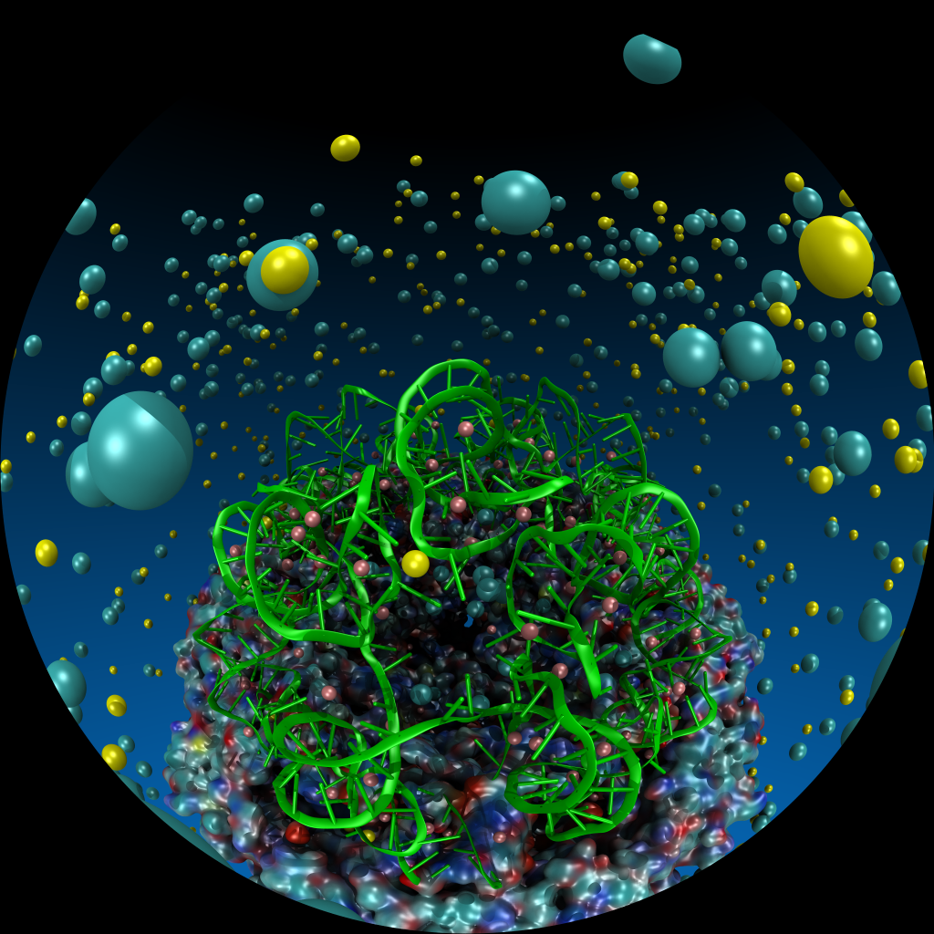
VMD Planetarium Dome Master Camera
Fully interactive RT with ambient occlusion, shadows, depth of field, reflections, and so on
Both mono and stereoscopic
No further post-processing required

Slide 10
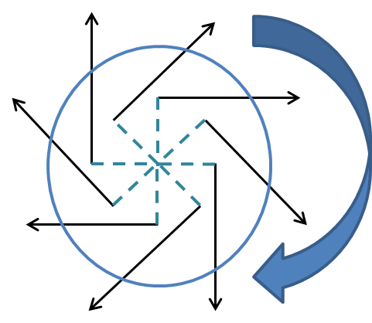
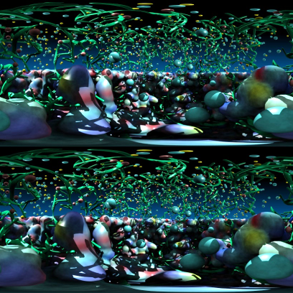
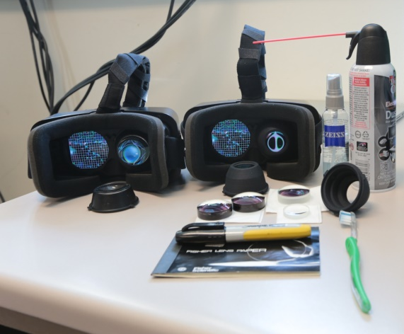
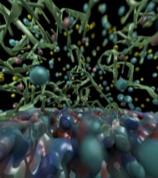
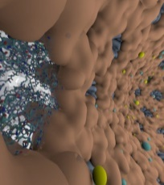
Omnidirectional Stereoscopic Ray Tracing
Ray trace 360° images and movies for Desk and VR HMDs: Oculus, Vive, Cardboard
Stereo spheremaps or cubemaps allow very high-frame-rate interactive OpenGL display
AO lighting, depth of field, shadows, transparency, curved geometry, …
Atomic Detail Visualization of Photosynthetic Membranes with GPU-Accelerated Ray Tracing. J. E. Stone, et al. J. Parallel Computing, 55:17-27, 2016.
Immersive Molecular Visualization with Omnidirectional Stereoscopic Ray Tracing and Remote Rendering. J. E. Stone, W. R. Sherman, and K. Schulten. High Performance Data Analysis and Visualization Workshop, IEEE International Parallel and Distributed Processing Symposium Workshops (IPDPSW), pp. 1048-1057, 2016.

Slide 11
A) Monoscopic circular projection.
Eye at center of projection (COP).
B) Left eye stereo circular projection.
Eye offset from COP by half of interocular distance.
Polar Axis
Zero Eye Sep
C) Stereo eye separation smoothly decreased to zero at zenith and nadir points on the polar axis to prevent incorrect stereo when HMD sees the poles.
Decreasing Eye Sep
Full Eye Separation
Decreasing Eye Sep
Zero Eye Sep

Slide 12
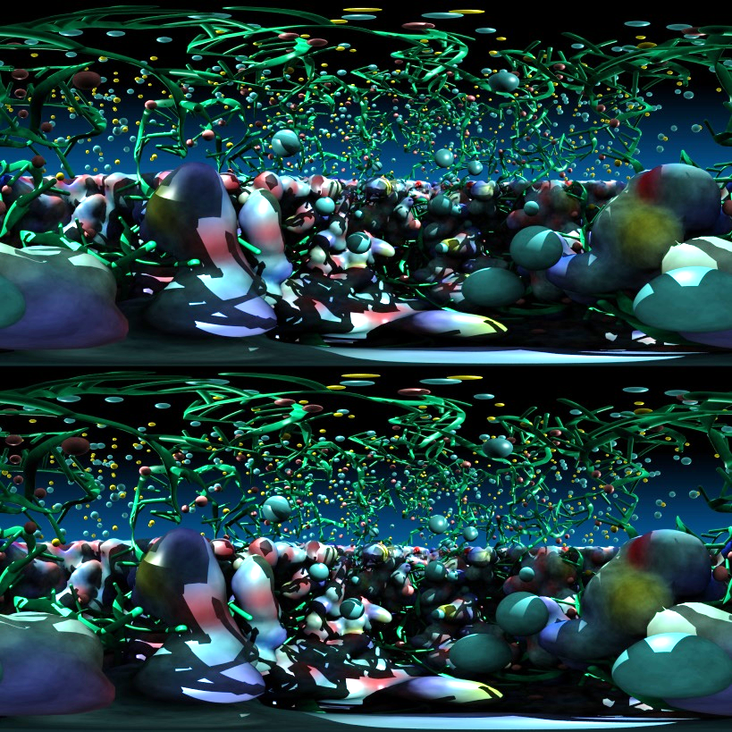
Stereoscopic Panorama Ray Tracing w/ OptiX
Render 360° images and movies for VR headsets such as Oculus Rift, Google Cardboard
Ray trace panoramic stereo spheremaps or cubemaps for very high-frame-rate display via OpenGL texturing onto simple geometry
Stereo requires spherical camera projections poorly suited to rasterization
Benefits from OptiX multi-GPU rendering and load balancing, remote visualization

Slide 13
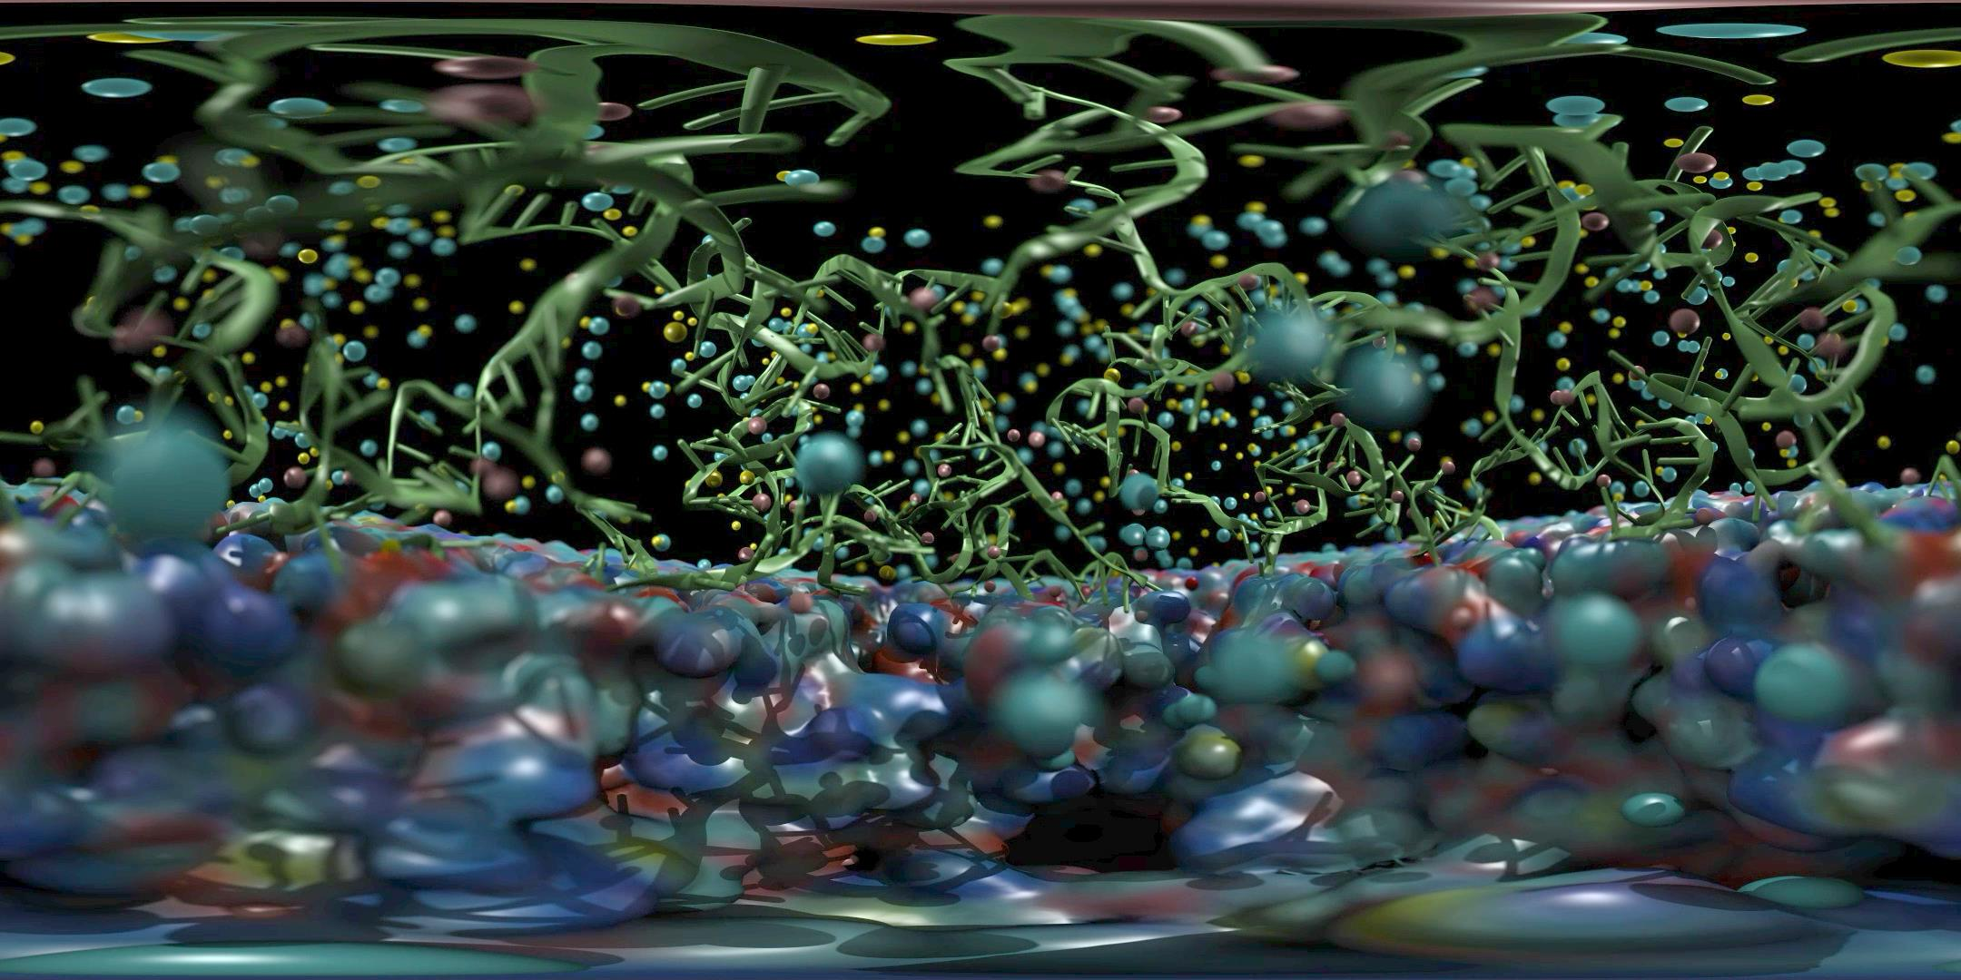
Satellite Tobacco Mosaic Virus: Capsid, Interior RNA, and Ions
Ambient Occlusion Lighting, Depth-of-Field Focal Blur, …

Slide 14
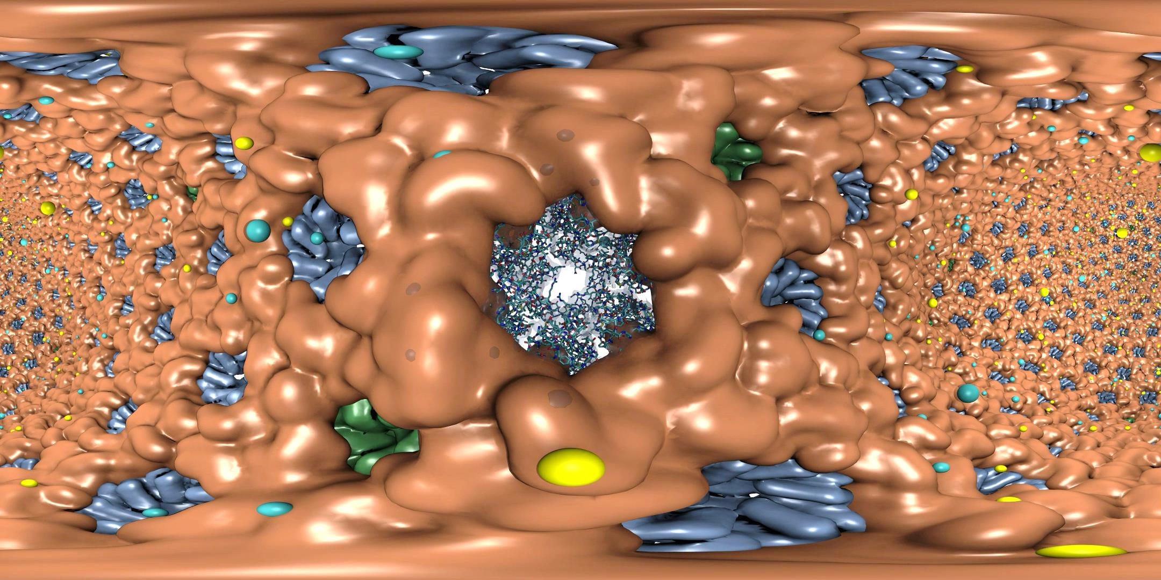
HIV-1 Capsid, Capsid Hexamer Detail, and Ions
Range-Limited Ambient Occlusion Lighting, VR “Headlight”, …

Slide 15
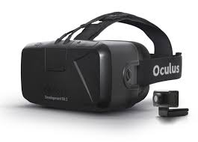
Progressive
Ray Tracing Engine Ray tracing loop runs
continuously in new thread
Decodes H.264 video
stream from remote
VCA GPU cluster
Omnistereo
Image Stream
HMD Display Loop HMD loop runs in main
VMD application thread
at max OpenGL draw rate
View-dependent
stereo reprojection for
current HMD head pose
HMD distortion correction
Camera
+ Scene
RT Code
+ Camera
+ Scene
Omnistereo
H.264 Video
HMD Video
HMD Pose
VMD
15Mbps Internet Link
HMD
Remote VCA GPU Cluster
Ray tracing runs continuously,
streams H.264 video to VMD client

Slide 16
Remote Omnidirectional Stereoscopic RT Performance @ 3072x1536 w/ 2-subframes
Scene | Per-subframe samples AA : AO (AO per-hit) | RT update rate (FPS)
STMV shadows | 1:0 2:0 4:0 | 22.2 18.1 10.3
STMV Shadows+AO | 1:1 1:2 1:4 | 18.2 16.1 12.4
STMV Shadows+AO+DoF | 1:1 2:1 2:2 | 16.1 11.1 8.5
HIV-1 Shadows | 1:0 2:0 4:0 | 20.1 18.1 10.2
HIV-1 Shadows+AO | 1:1 1:2 1:4 | 17.4 12.2 8.1

Slide 17
HMD View-Dependent Reprojection with OpenGL
Texture map panoramic image onto reprojection geometry that matches the original RT image formation surface
HMD sees standard perspective frustum view of the textured surface
Commodity HMD optics require software lens distortion and chromatic aberration correction prior to display, implemented with multi-pass FBO rendering
Low-latency, high-frame-rate redraw as HMD head pose changes (150Hz or more)

Slide 18
VMD can support a variety of HMD lens designs, e.g.
http://research.microsoft.com/en-us/um/redmond/projects/lensfactory/oculus/

Slide 19
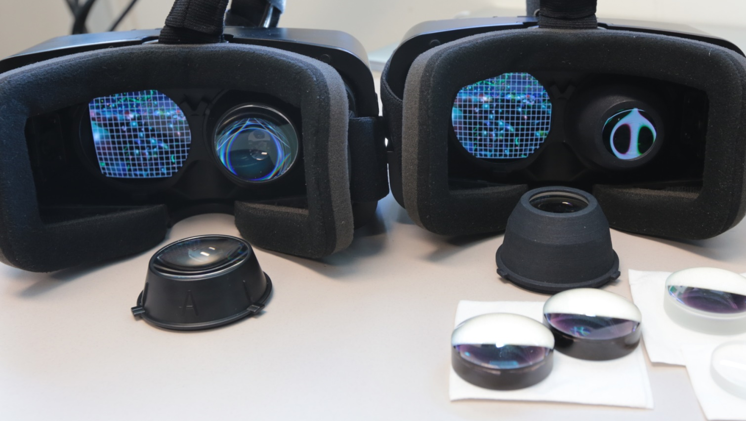

Slide 20
Immersive Molecular Visualization with Omnidirectional Stereoscopic Ray Tracing and Remote Rendering. J. E. Stone, W. R. Sherman, and K. Schulten. High Performance Data Analysis and Visualization Workshop, IEEE International Parallel and Distributed Processing Symposium Workshops (IPDPSW), pp. 1048-1057, 2016.

Slide 21
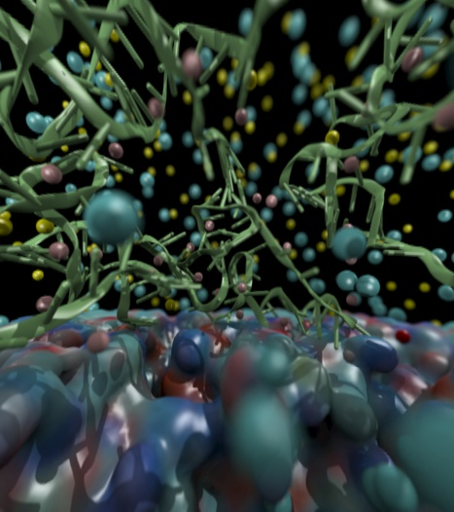
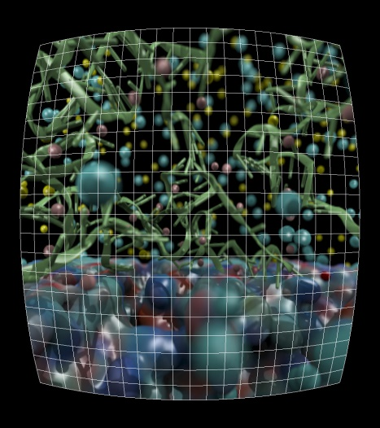
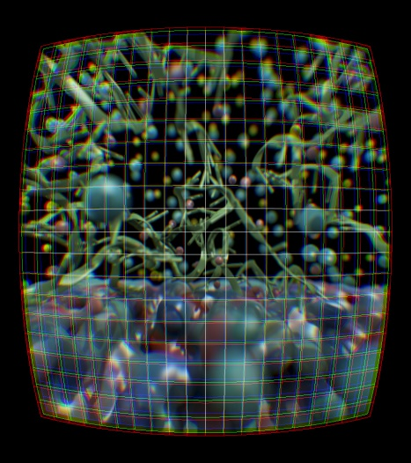
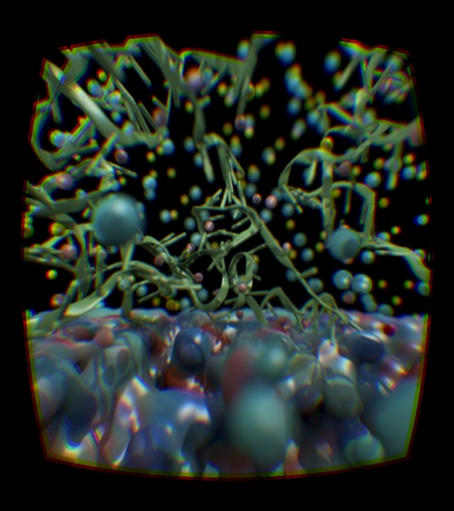
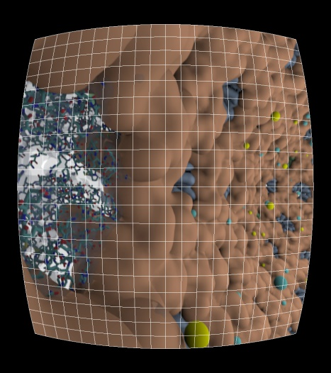
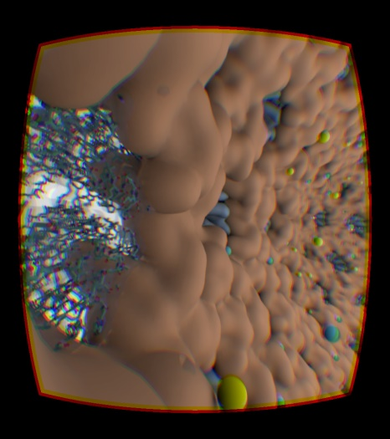

Slide 22
Ongoing VR Work
OpenXR – cross platform muti-vendor HMD support
Ray tracing engine and optimizations:
AI denoising for better average quality
Interactive RT stochastic sampling strategies to improve interactivity
Improved omnidirectional cubemap/spheremap sampling approaches
AI multi-view warping to allow rapid in-between view generation amid multiple HMD head locations
H.265 for high-res omnidirectional video streaming
Multi-node parallel RT and remote viz. on general clusters and supercomputers, e.g. NCSA Blue Waters, ORNL Titan
Tons of work to do on VR user interfaces, multi-user collaborative visualization, …

Slide 23
Acknowledgements
Theoretical and Computational Biophysics Group, University of Illinois at Urbana-Champaign
NVIDIA CUDA and OptiX teams
Funding:
NIH support: P41GM104601
DOE INCITE, ORNL Titan: DE-AC05-00OR22725
NSF Blue Waters: NSF OCI 07-25070, PRAC “The Computational Microscope”, ACI-1238993, ACI-1440026
Notes:
23

Slide 24
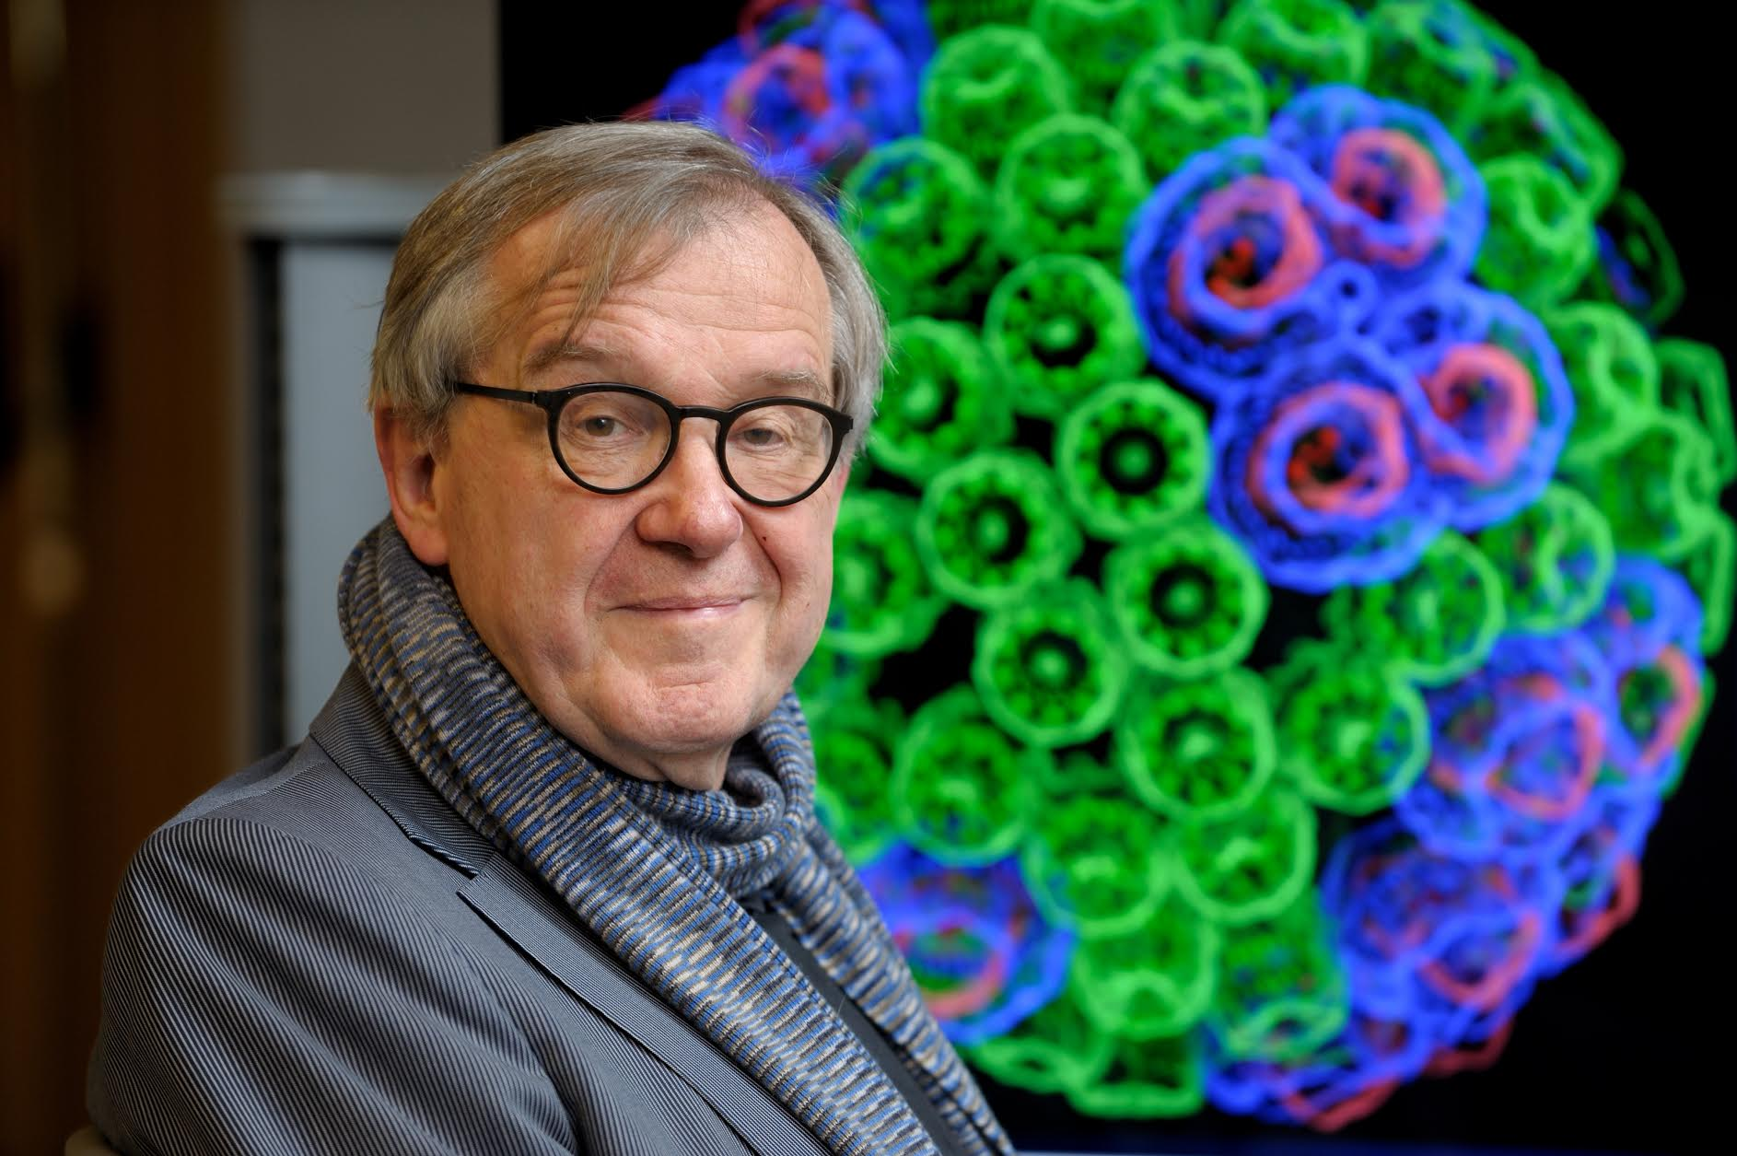
“When I was a young man, my goal was to look with mathematical and computational means at the inside of cells, one atom at a time, to decipher how living systems work. That is what I strived for and I never deflected from this goal.” – Klaus Schulten

