Slide 1
Interactive Supercomputing for State-of-the-art Biomolecular Simulation
John E. Stone
Theoretical and Computational Biophysics Group
Beckman Institute for Advanced Science and Technology
University of Illinois at Urbana-Champaign
http://www.ks.uiuc.edu/Research/namd/
http://www.ks.uiuc.edu/Research/vmd/
Interactivity in Supercomputing BoF,
12:15pm-1:15pm, Rooms 503-504, Colorado Convention Center
Denver, CO, Tuesday Nov 14th, 2017

Slide 2
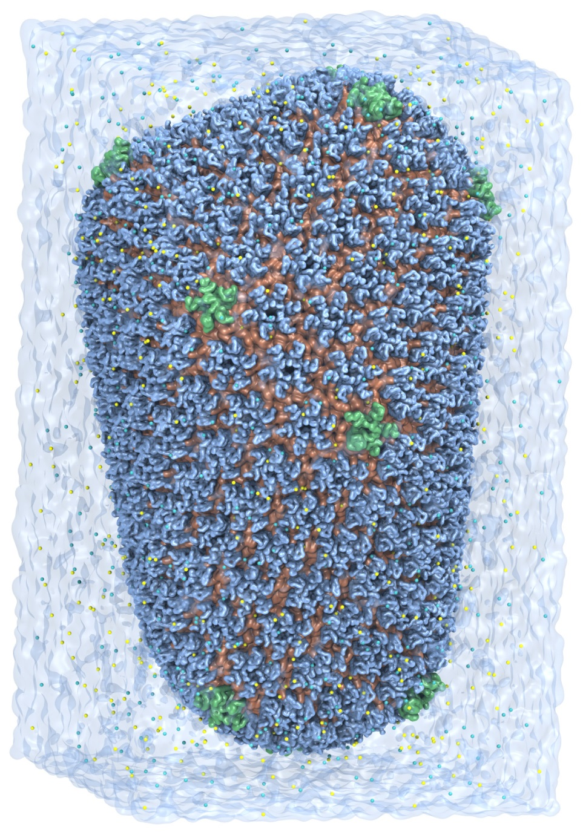
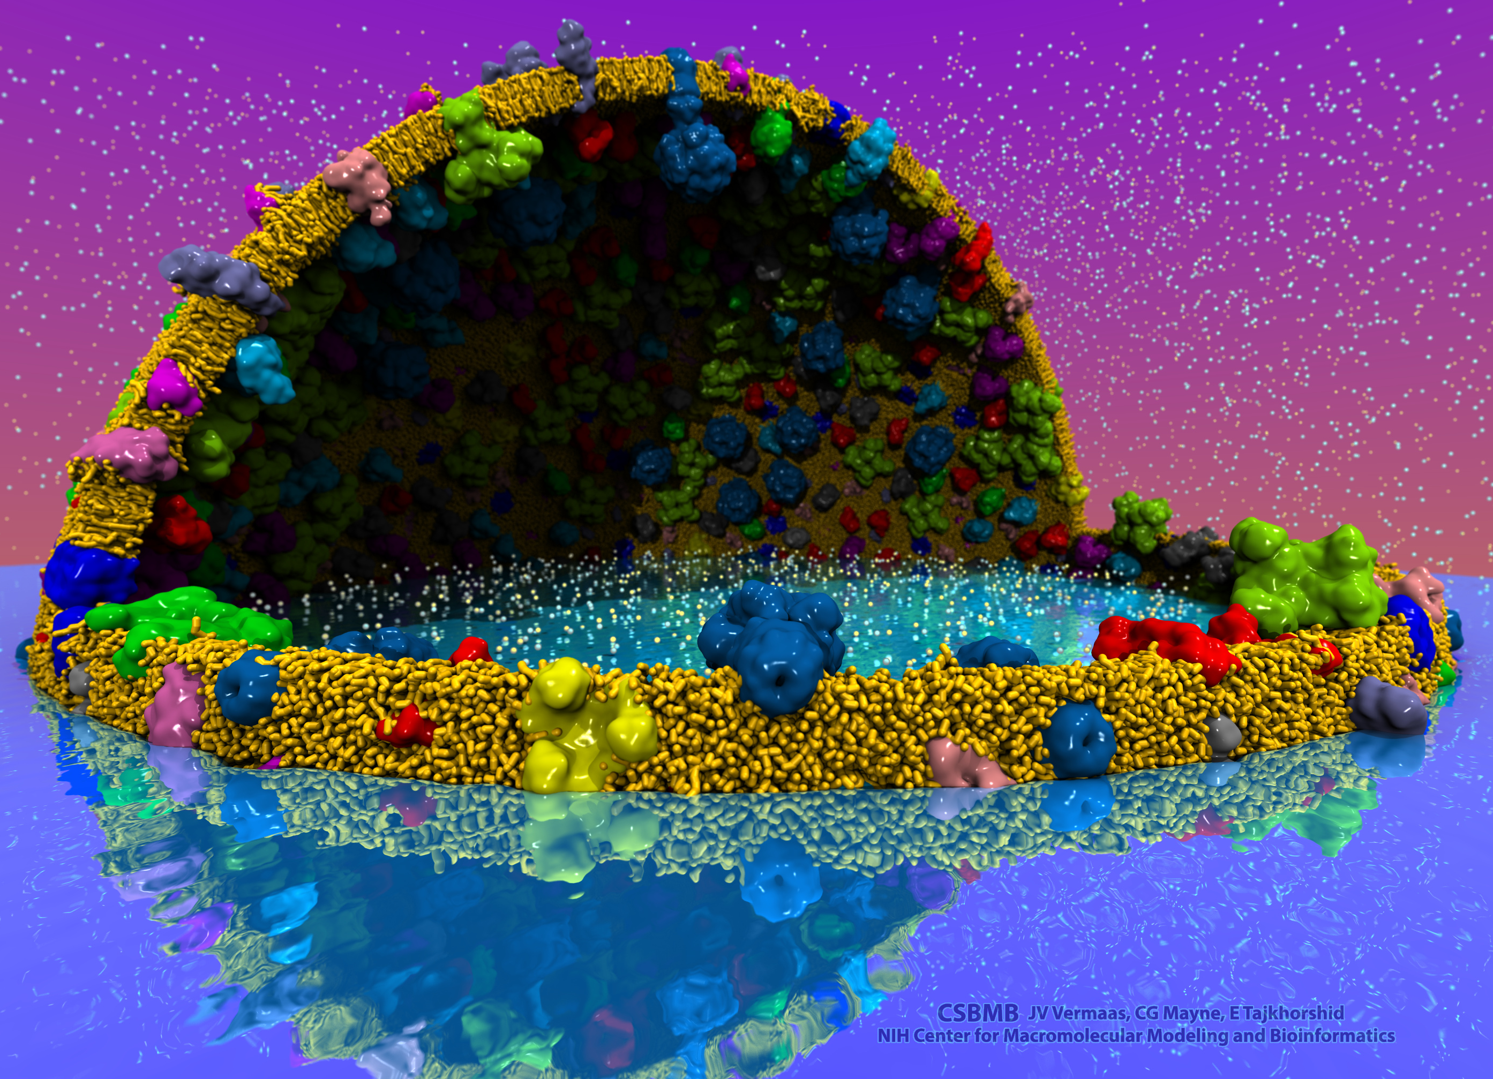
VMD – “Visual Molecular Dynamics”
Visualization and analysis of:
Molecular dynamics simulations
Lattice cell simulations
Quantum chemistry calculations
Sequence information
User extensible scripting and plugins
http://www.ks.uiuc.edu/Research/vmd/
Cell-Scale Modeling
MD Simulation

Slide 3
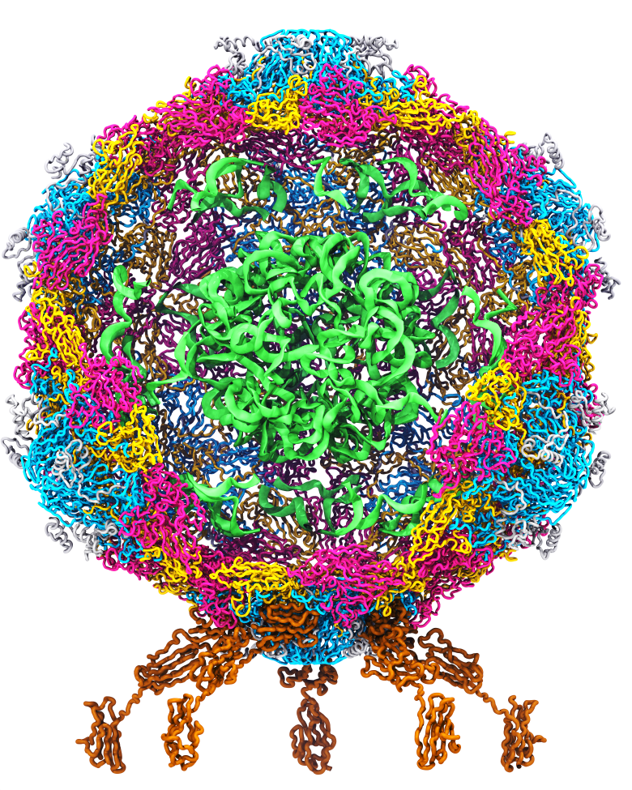
Goal: A Computational Microscope
Study the molecular machines in living cells
Ribosome: target for antibiotics
Poliovirus
Notes:
Ribosomes synthesize new proteins from genetic information
Bacterial ribosome is a target for antibiotics, which interfere with its ability to function by binding to sites on the structure, preventing proteins from being synthesized
Ribosome simulations are extremely computationally challenging due to the size of the structure and its natural environment (solvent, ions, etc, large box, 3 million atoms or so)
Bionanodevice for sequencing DNA efficiently
Knowledge of an individual’s genetic makeup can lead to the prediction and treatment of many diseases by the means of personal genomic medicine and pharmacogenomics. In order for genome sequencing to become practical for common medical use, an inexpensive high throughput genome sequencing technique is required. NIH has set a goal of reducing the cost of genome sequencing by a factor of 10,000, to less than $1,000 within ten years.
The computer is the best microscope to guide the development of bionanodevices, for example to sequence DNA. While experiments can measure DNA electrostatic potentials, they cannot visualize the DNA’s location and conformation at the time of measurement.

Slide 4
How Does Interactivity in HPC Benefit Scientific Productivity
Until 2008, MD simulation performance was the major limiting factor on biomolecular modeling productivity, maybe 95% factor
In 2017: Batch MD sim code performance is likely only a 50% factor on overall scientific productivity
An extremely simplified outline:
Months or years of science team effort go into preparing state-of-the-art biomolecular simulations w/ experimental structures before MD sims begin
During the initial and early phases of a simulation campaign, hundreds of modeling problems must be identified and addressed
Interactivity is a fundamental requirement during these phases
After sim campaign has produced required outputs, extensive analytical work begins, and science teams then make key decisions about outcomes, potentially conducting further sim studies, developing manuscripts with detailed analyses, figures, and movies of dynamics of systems under study

Slide 5
Proto-Cell Modeling Project
Initial model of minimal cell membrane and proteins
Candidate for our ORNL Summit early science project
~1 billion atoms presently with explicit water, ions, etc.
Main structure file used for modeling and simulation tasks is currently ~60GB
Initial simulation preparation requires many repeated build / viz / measure / simulate cycles…
MD trajectory output : ~12GB/frame
Need to run all tools required for science campaign at remote supercomputer sites:
Optimize work-efficiency of science team
Not just NAMD and VMD, but also other tools
Old approach of repeatedly transferring files back and forth between UIUC lab and remote supercomputers is untenable at this scale!!!

Slide 6
What Do We Need?
Science campaign “Bullpen” interactive compute/viz
Interactive resources supporting the human-intensive parts of science team activities
Specific examples:
Interactive remote visualization supporting use of arbitrary science tools, including those that are not traditional HPC tools (e.g. CryoEM and X-Ray crystallography pkgs)
Special batch queues, or queue policies that support the initial and early phase of simulation bring-up activities, so that meso-scale interactive calculations can be performed “at a mouse click” to provide rapid-turnaround of results in interactive modeling sessions to correct flaws in molecular models, simulation parameters, etc.
A few (10s or less) HPC systems supporting very large memory capacities and dense GPU counts, to run the interactive supercomputing job “front end”

Slide 7
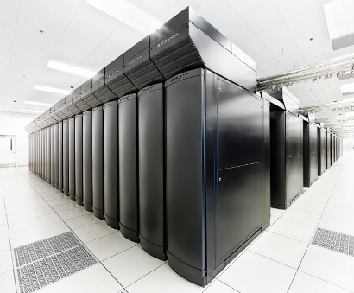
VMD Petascale Visualization and Analysis
Analyze/visualize large trajectories too large to transfer off-site:
User-defined parallel analysis operations, data types
Parallel rendering, movie making
Supports GPU-accelerated Cray XK7 nodes for both visualization and analysis:
GPU accelerated trajectory analysis w/ CUDA
OpenGL and GPU ray tracing for visualization and movie rendering
Parallel I/O rates up to 275 GB/sec on 8192 Cray XE6 nodes – can read in 231 TB in 15 minutes!
Parallel VMD currently available on:
ORNL Titan, NCSA Blue Waters, Indiana Big Red II, CSCS Piz Daint, and similar systems
NCSA Blue Waters Hybrid Cray XE6 / XK7
22,640 XE6 dual-Opteron CPU nodes
4,224 XK7 nodes w/ Telsa K20X GPUs

Slide 8
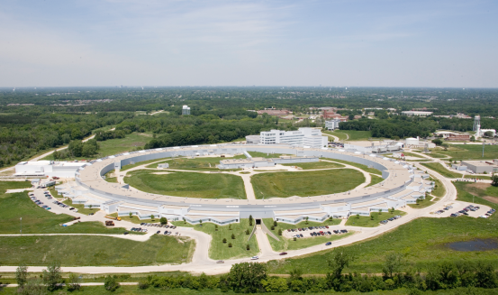
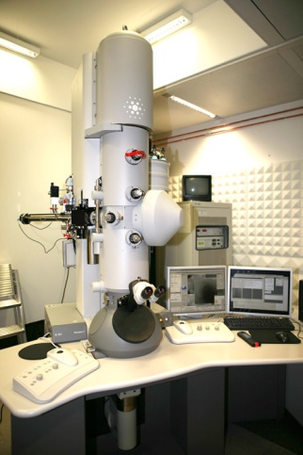
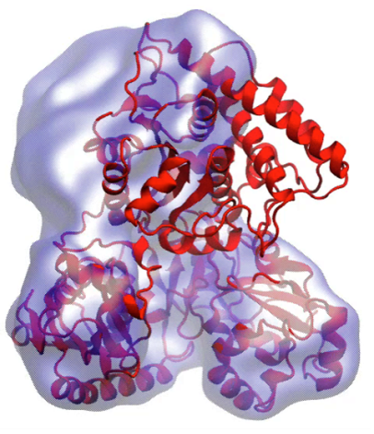
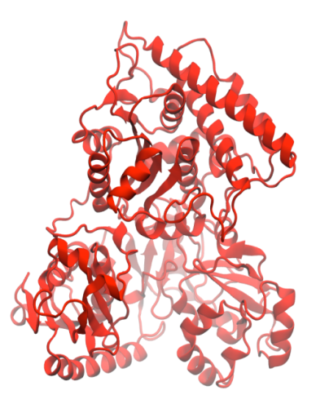
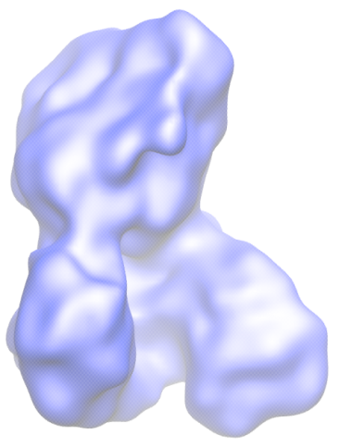
Molecular Dynamics Flexible Fitting (MDFF)
X-ray crystallography
MDFF
Electron microscopy
APS at Argonne
FEI microscope
ORNL Titan
Molecular dynamics-based refinement and validation for sub-5Å cryo-electron microscopy maps. A. Singharoy, I. Teo, R. McGreevy, J. E. Stone, J. Zhao, and K. Schulten. eLife 2016;10.7554/eLife.16105
Acetyl - CoA Synthase

Slide 9
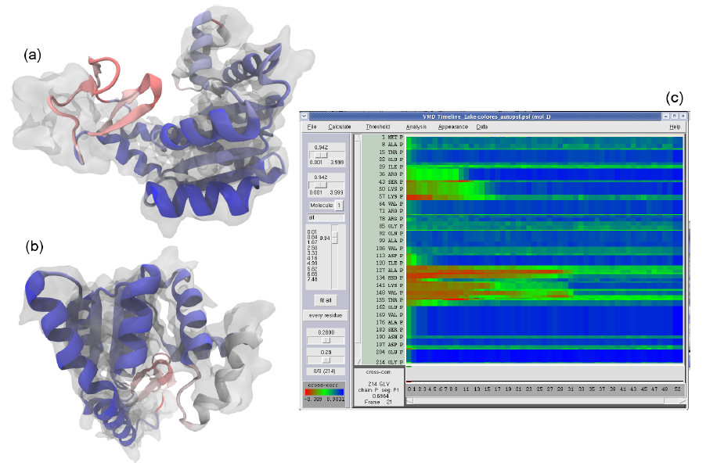
GPUs Can Reduce MDFF Trajectory Analysis Runtimes from Hours to Minutes
GPUs enable laptops and desktop workstations to handle tasks that would have previously required a cluster, or a very long wait…
GPU-accelerated petascale supercomputers enable analyses that were previously impractical, allowing detailed study of very large structures such as viruses
GPU-accelerated MDFF Cross Correlation Timeline
Regions with poor fit Regions with good fit

Slide 10
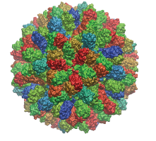
Parallel MDFF Cross Correlation Analysis on Cray XK7
Relative CC
Rabbit Hemorrhagic Disease Virus (RHDV)
Traj. frames | 10,000
Structure component selections | 720
Single-node XK7 (projected) | 336 hours (14 days)
128-node XK7 | 3.2 hours 105x speedup
2048-node XK7 | 19.5 minutes 1035x speedup
Structure
RHDV colored by relative CC
Time
Calculation of 7M CCs would take 5 years using serial CPU algorithm!
Stone et al., Faraday Discuss., 169:265-283, 2014.

Slide 11
VMD Tesla P100+V100 Cross Correlation Performance Rabbit Hemorrhagic Disease Virus: 702K atoms, 6.5Å resolution Latest results on Pascal P100, first runs on Volta V100
Hardware platform | Runtime, Speedup vs. Chimera, VMD+GPU
Chimera Xeon E5-2687W (2 socket) [1] | 15.860s, 1x
VMD-CUDA IBM Power8 + 1x Tesla K40 [2] | 0.488s, 32x 0.9x
VMD-CUDA Intel Xeon E5-2687W + 1x Quadro K6000 [1,2] | 0.458s, 35x 1.0x
VMD-CUDA Intel Xeon E5-2698v3 + 1x Tesla P100 | 0.090s, 176x 5.1x
VMD-CUDA IBM Power8 “Minsky” + 1x Tesla P100 | 0.080s, 198x 5.7x
VMD-CUDA Intel Xeon E5-2697Av4 + 1x Tesla V100 | 0.050s, 317x 9.2x
[1] GPU-Accelerated Analysis and Visualization of Large Structures Solved by Molecular Dynamics Flexible Fitting. J. E. Stone, R. McGreevy, B. Isralewitz, and K. Schulten. Faraday Discussions 169:265-283, 2014.
[2] Early Experiences Porting the NAMD and VMD Molecular Simulation and Analysis Software to GPU-Accelerated OpenPOWER Platforms. J. E. Stone, A.-P. Hynninen, J. C. Phillips, K. Schulten. International Workshop on OpenPOWER for HPC (IWOPH'16), LNCS 9945, pp. 188-206, 2016.

Slide 12
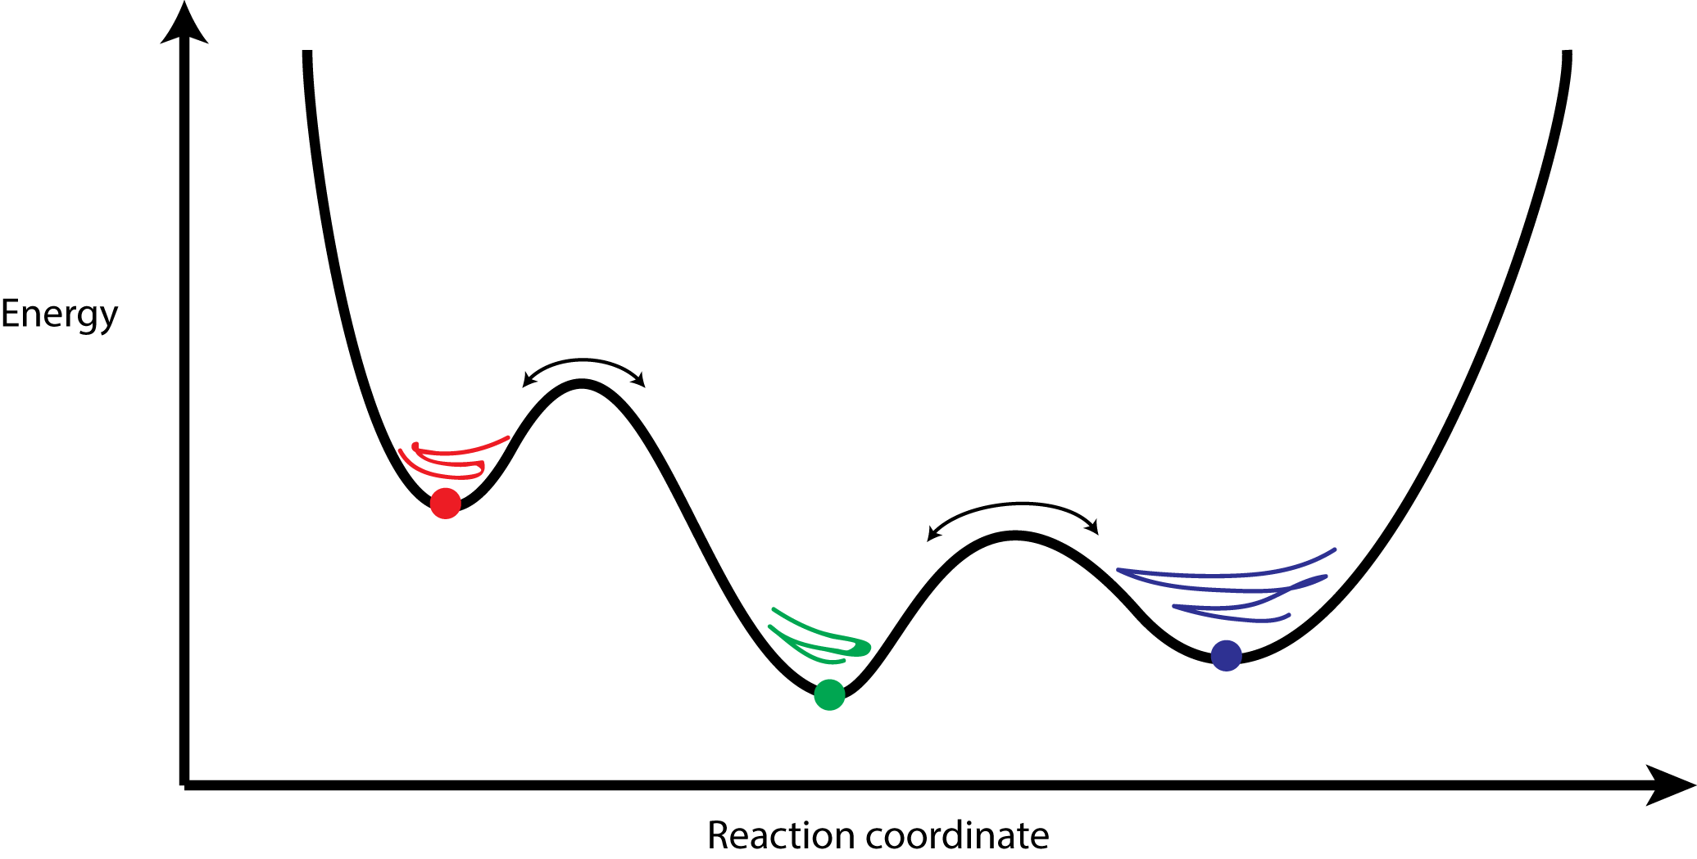
Clustering Analysis of Molecular Dynamics Trajectories
GPU-Accelerated Molecular Dynamics Clustering Analysis with OpenACC. J.E. Stone, J.R. Perilla, C. K. Cassidy, and K. Schulten. In, Robert Farber, ed., Parallel Programming with OpenACC, Morgan Kaufmann, Chapter 11, pp. 215-240, 2016.

Slide 13
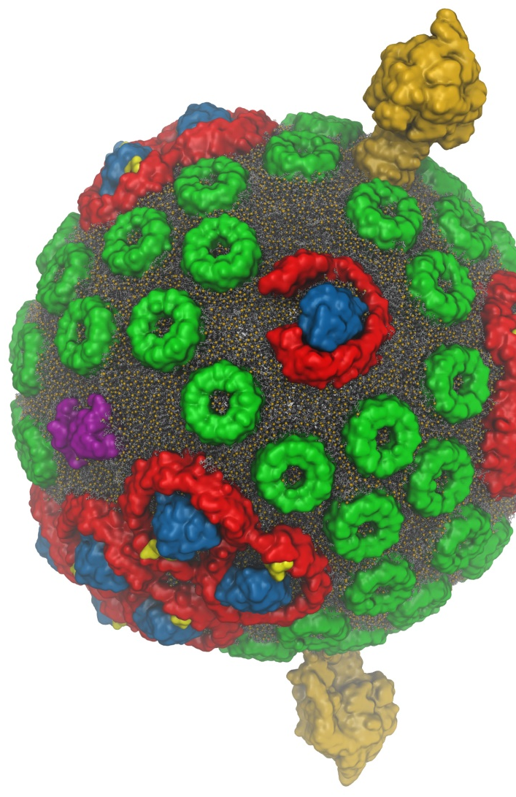
Interactive Ray Tracing
Remote visualization tasks on very large macromolecular complexes
Large-scale parallel rendering: in situ or post hoc visualization tasks
GPU-Accelerated Molecular Visualization on Petascale Supercomputing Platforms. J. E. Stone, K. L. Vandivort, and K. Schulten. UltraVis’13, pp. 6:1-6:8, 2013.
Visualization of Energy Conversion Processes in a Light Harvesting Organelle at Atomic Detail. M. Sener, et al. SC'14 Visualization and Data Analytics Showcase, 2014.
Chemical Visualization of Human Pathogens: the Retroviral Capsids. J. R. Perilla, B.-C. Goh, J. E. Stone, and K. Schulten. SC'15 Visualization and Data Analytics Showcase, 2015.
Atomic Detail Visualization of Photosynthetic Membranes with GPU-Accelerated Ray Tracing. J. E. Stone et al., J. Parallel Computing, 55:17-27, 2016.
Immersive Molecular Visualization with Omnidirectional Stereoscopic Ray Tracing and Remote Rendering J. E. Stone, W. R. Sherman, and K. HPDAV, IPDPSW, pp. 1048-1057, 2016.
VMD/OptiX GPU Ray Tracing of all-atom Chromatophore w/ lipids.

Slide 14
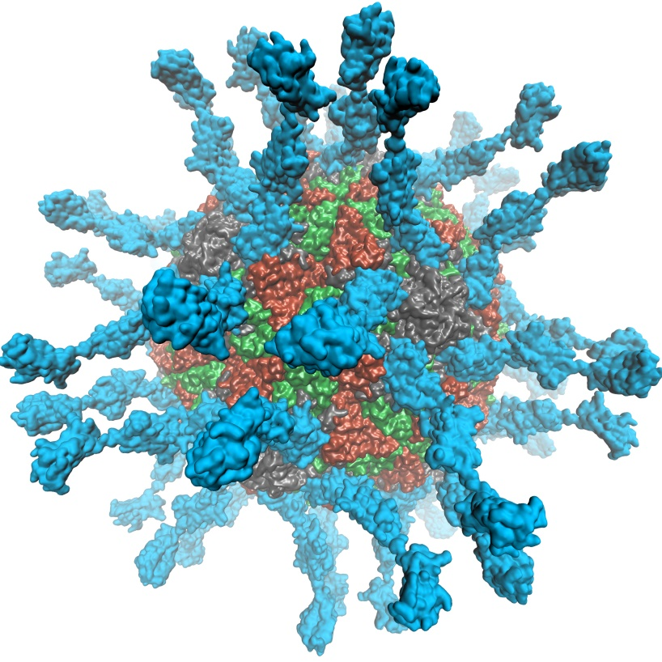
VMD 1.9.3 supports EGL for in-situ and parallel rendering on clouds, clusters, and supercomputers
Eliminate dependency on windowing systems
Simplified deployment of parallel VMD builds supporting off-screen rendering
Maintains 100% of VMD OpenGL shaders and rendering features
Support high-quality vendor-supported commercial OpenGL implementations in HPC systems that were previously limited to Mesa
Poliovirus

Slide 15
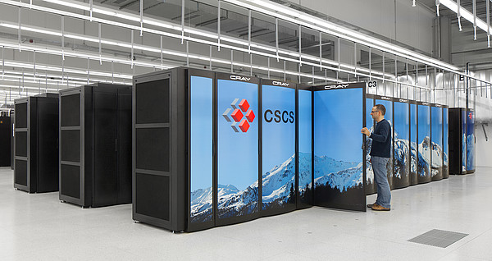
EGL Is Supported Now!
Cloud+Workstations with most recent NVIDIA drivers
VMD on HPC systems w/ latest Tesla P100 GPUs:
Cray XC50, CSCS Piz Daint, driver 375.39
IBM OpenPOWER, drivers 375.66 and later support both GLX and EGL

Slide 16
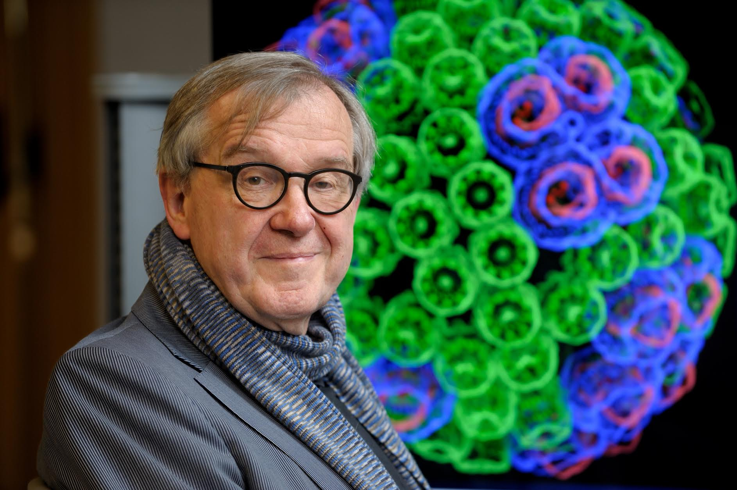
“When I was a young man, my goal was to look with mathematical and computational means at the inside of cells, one atom at a time, to decipher how living systems work. That is what I strived for and I never deflected from this goal.” – Klaus Schulten

Slide 17
Acknowledgements
Theoretical and Computational Biophysics Group, University of Illinois at Urbana-Champaign
Funding:
NIH support: P41GM104601
DOE INCITE, ORNL Titan: DE-AC05-00OR22725
NSF Blue Waters: NSF OCI 07-25070, PRAC “The Computational Microscope”, ACI-1238993, ACI-1440026
Notes:
17

