Slide 1
Bringing State-of-the-Art GPU-Accelerated Molecular Modeling Tools to the Research Community
John E. Stone
Theoretical and Computational Biophysics Group
Beckman Institute for Advanced Science and Technology
University of Illinois at Urbana-Champaign
http://www.ks.uiuc.edu/
10:00am-10:50am, San Carlos Room, Hilton Hotel
San Jose, CA, Wednesday, March 20th, 2019
Notes:
NAMD and VMD provide state-of-the-art molecular simulation, analysis,
and visualization tools that leverage a panoply of GPU acceleration
technologies to achieve performance levels that enable scientists to
routinely apply research methods that were formerly too computationally
demanding to be practical. To make state-of-the-art MD simulation and
computational microscopy workflows available to a broader range of
molecular scientists including non-traditional users of HPC systems,
our center has begun producing pre-configured container images and
Amazon EC2 AMIs that streamline deployment, particularly for
specialized occasional-use workflows, e.g., for refinement of
atomic structures obtained through cryo-electron microscopy.
This talk will describe the latest technological advances in NAMD and VMD,
using CUDA, OpenACC, and OptiX, including early results on ORNL Summit,
state-of-the-art RTX hardware ray tracing on Turing GPUs,
and easy deployment using containers and cloud computing infrastructure.

Slide 2
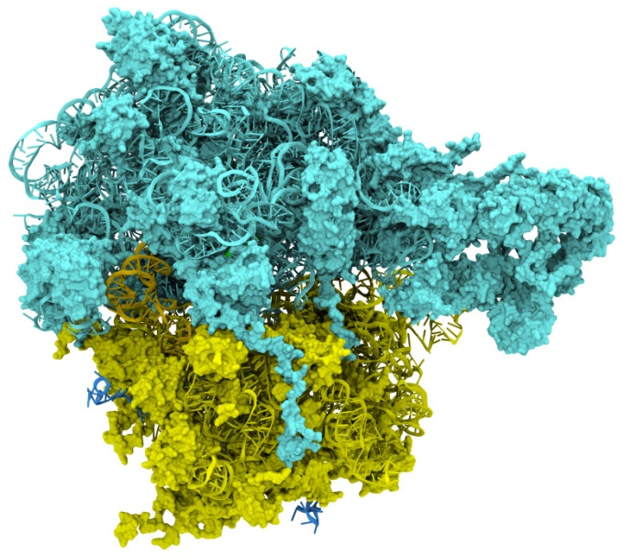
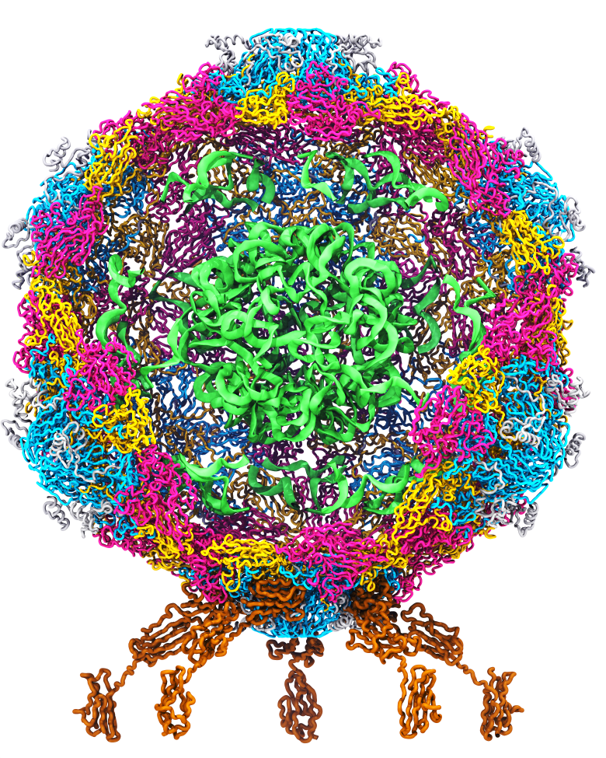
Goal: A Computational Microscope
Study the molecular machines in living cells
Ribosome: target for antibiotics
Poliovirus
Notes:
Ribosomes synthesize new proteins from genetic information
Bacterial ribosome is a target for antibiotics, which interfere with its ability to function by binding to sites on the structure, preventing proteins from being synthesized
Ribosome simulations are extremely computationally challenging due to the size of the structure and its natural environment (solvent, ions, etc, large box, 3 million atoms or so)
Bionanodevice for sequencing DNA efficiently
Knowledge of an individual’s genetic makeup can lead to the prediction and treatment of many diseases by the means of personal genomic medicine and pharmacogenomics. In order for genome sequencing to become practical for common medical use, an inexpensive high throughput genome sequencing technique is required. NIH has set a goal of reducing the cost of genome sequencing by a factor of 10,000, to less than $1,000 within ten years.
The computer is the best microscope to guide the development of bionanodevices, for example to sequence DNA. While experiments can measure DNA electrostatic potentials, they cannot visualize the DNA’s location and conformation at the time of measurement.

Slide 3
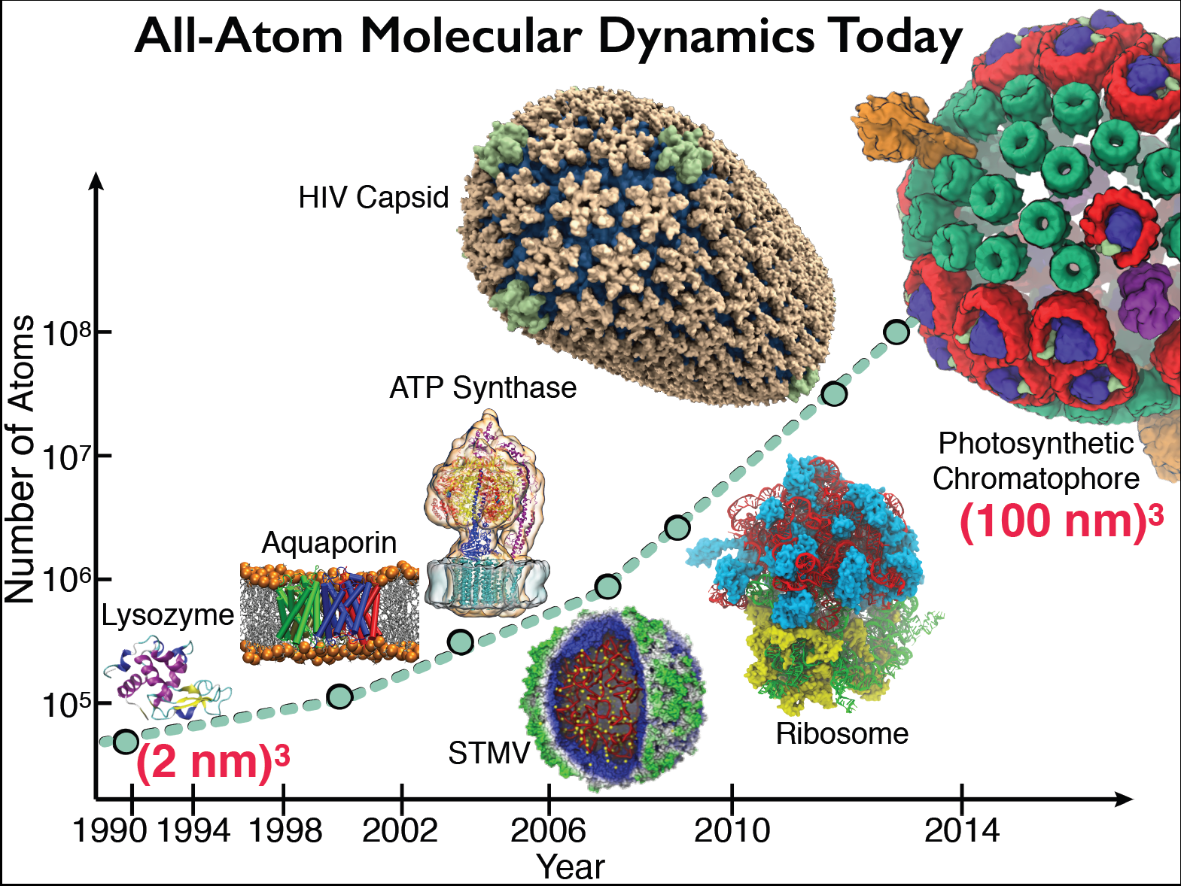
Goal: A Computational Microscope
Study the molecular machines in living cells

Slide 4
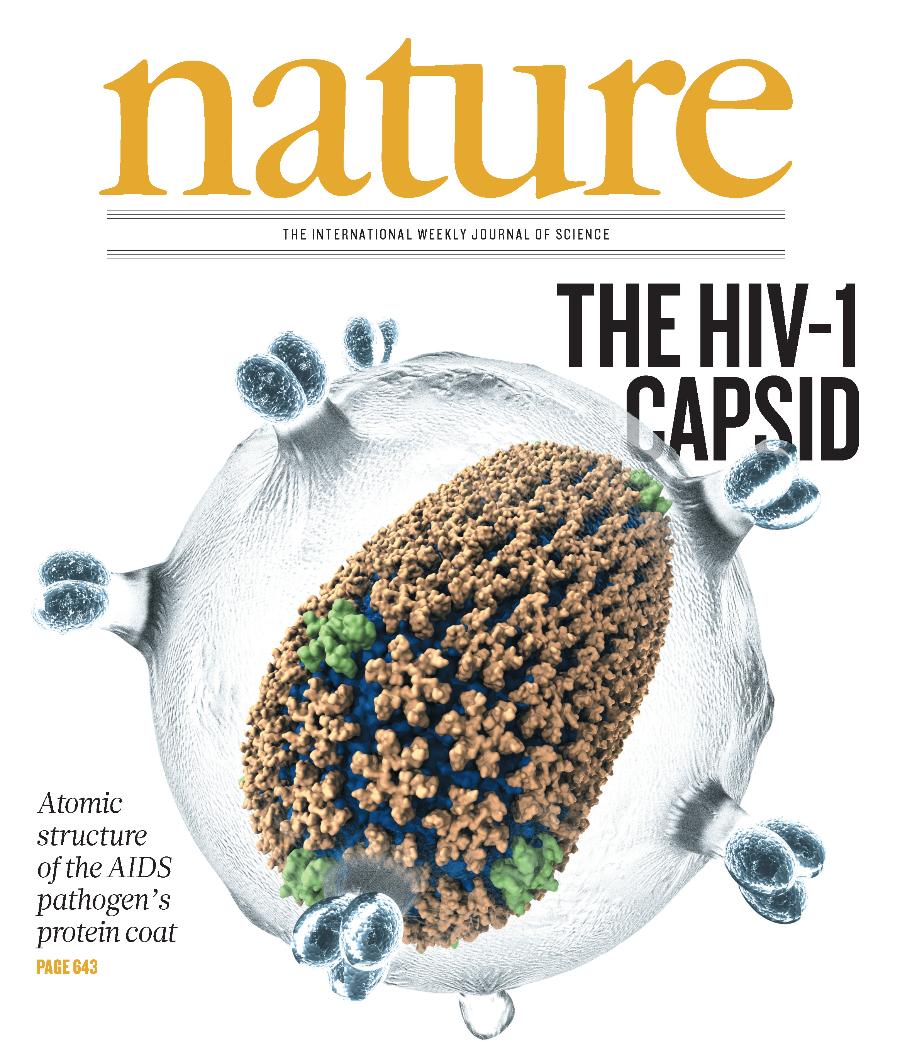
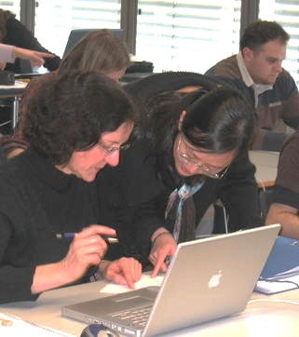
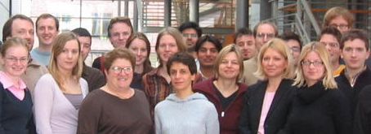
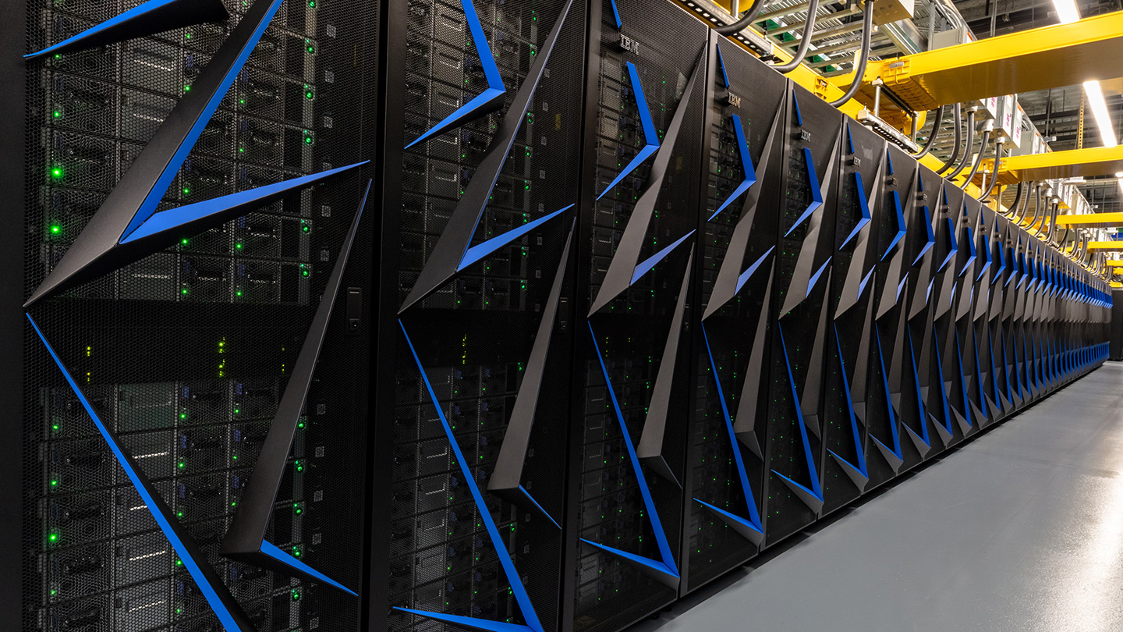
NAMD
Parallel Molecular Dynamics
Over 14,000 citations of NAMD
One program available on all platforms.
  Desktops and laptops – setup and testing
  Linux clusters – affordable local workhorses
  Supercomputers – free allocations on XSEDE
  Blue Waters – sustained petaflop/s performance
  GPUs – from desktop to supercomputers
User knowledge is preserved across platforms.
  No change in input or output files.
  Run any simulation on any number of cores.
Available free of charge to all.
http://www.ks.uiuc.edu/Research/namd/
Hands-On Workshops
Oak Ridge Summit

Slide 5
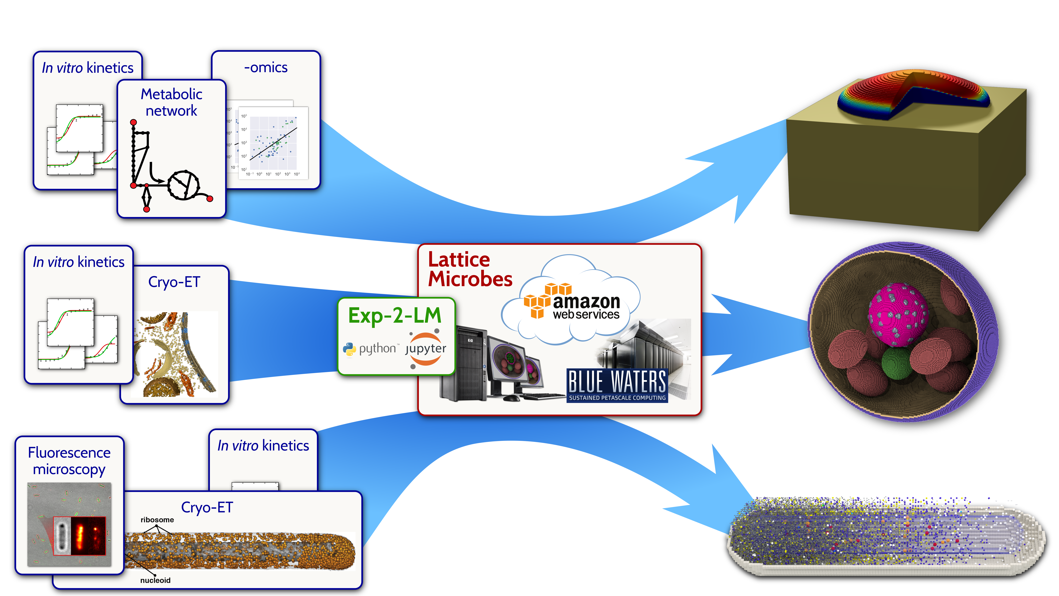
Lattice Microbes
BMC Sys. Biol. 2015
Whole-cell modeling and simulation, including heterogeneous environments and kinetic network of thousands of reactions
Incorporate multiple forms of experimental imaging for model construction
Scriptable in Python
Glucose/Agar
http://www.scs.illinois.edu/schulten/lm
Biophys. J. 2015
Biopolymers, 2016

Slide 6
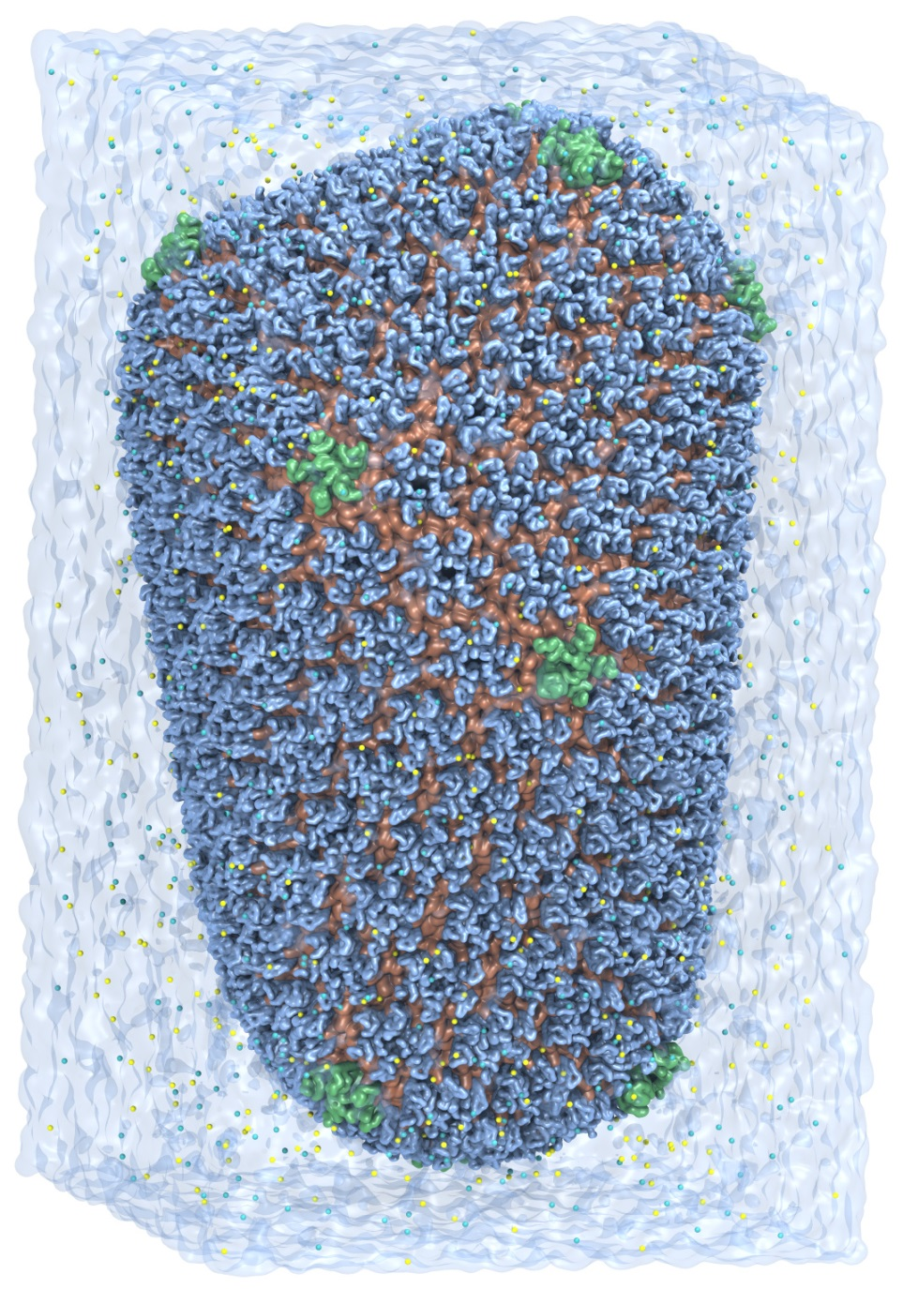
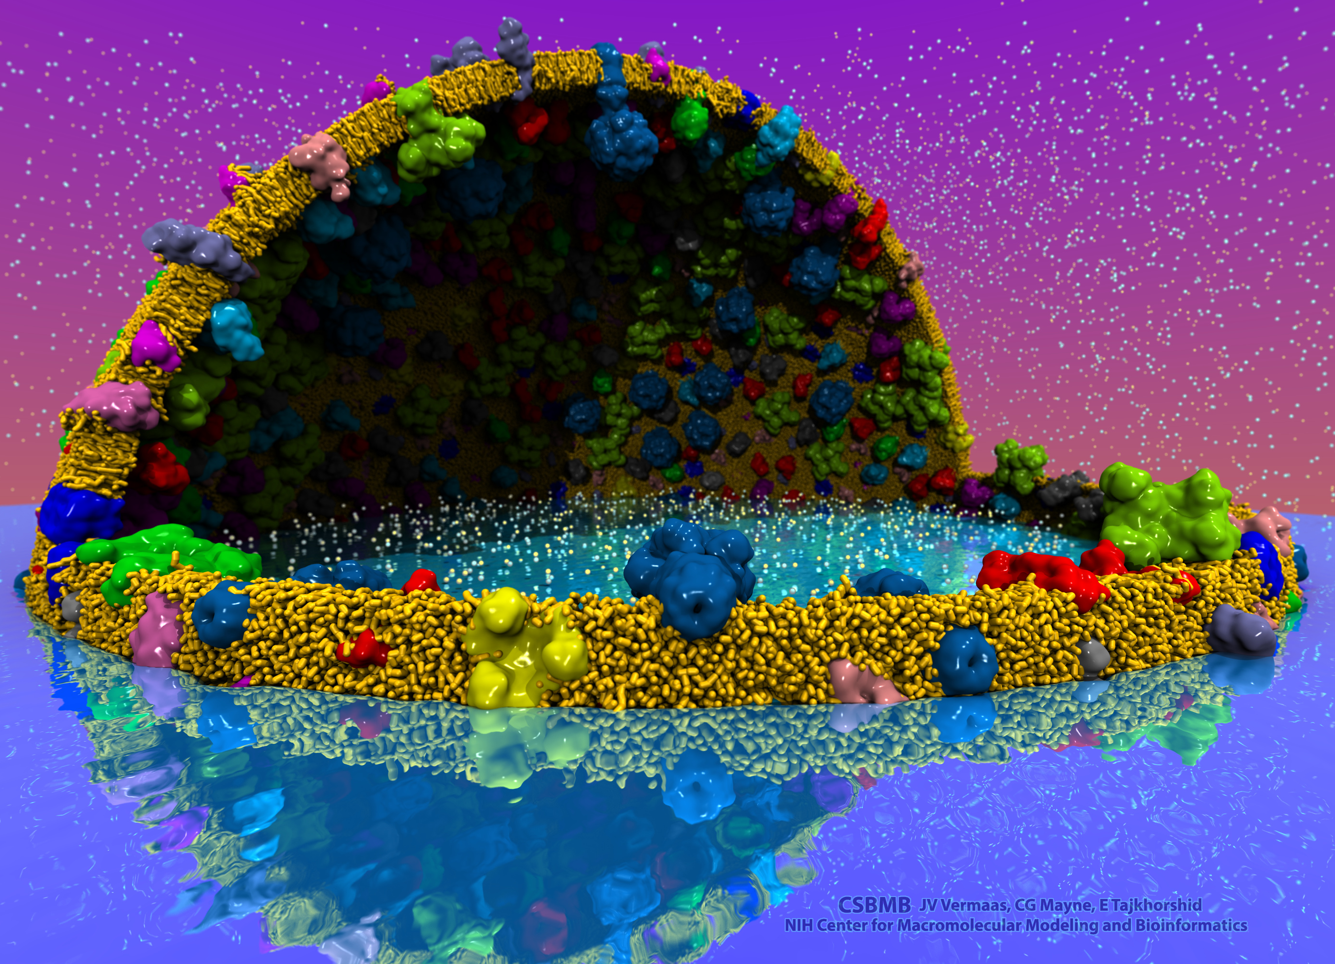
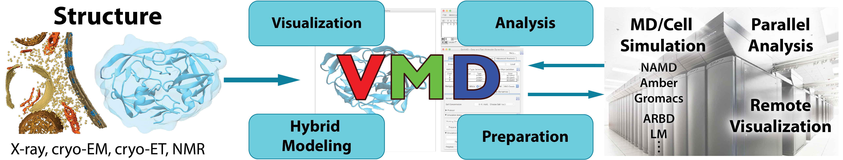
VMD – “Visual Molecular Dynamics”
Visualization and analysis of:
  Molecular dynamics simulations
  Lattice cell simulations
  Quantum chemistry calculations
  Sequence information
User extensible scripting and plugins
Over 28,000 citations of VMD
http://www.ks.uiuc.edu/Research/vmd/
Cell-Scale Modeling
MD Simulation

Slide 7
VMD: Building A Next Generation Modeling Platform
Provide tools for simulation preparation, visualization, and analysis
  Reach cell-scale modeling w/ all-atom MD, coarse grained, Lattice Microbes
  Improved performance, visual fidelity, exploit advanced technologies (GPUs, VR HMDs)
Enable hybrid modeling and computational electron microscopy
  Load, filter, process, interpret, visualize multi-modal structural information
Connect key software tools to enable state-of-the-art simulations
  Support new data types, file formats, software interfaces
Openness, extensibility, and interoperability are VMD hallmarks
  Reusable algorithms made available in NAMD, for other tools

Slide 8

Making Our Research Tools Easily Accessible
Cloud deployment:
  Full virtual machines (known as “AMI” in Amazon terminology)
  Amazon AWS EC2 GPU-accelerated instances:
  http://www.ks.uiuc.edu/Research/cloud/
Container images available in NVIDIA NGC registry
  Users obtain Docker images via registry, download and run on the laptop, workstation, cloud, or supercomputer of their choosing
  https://ngc.nvidia.com/registry/
  https://ngc.nvidia.com/registry/hpc-vmd
Our research articles incorporating use of Amazon AWS EC2:
Molecular dynamics-based refinement and validation for sub-5 Å cryo-electron microscopy maps. Abhishek Singharoy, Ivan Teo, Ryan McGreevy, John E. Stone, Jianhua Zhao, and Klaus Schulten. eLife, 10.7554/eLife.16105, 2016. (66 pages).
QwikMD-integrative molecular dynamics toolkit for novices and experts. Joao V. Ribeiro, Rafael C. Bernardi, Till Rudack, John E. Stone, James C. Phillips, Peter L. Freddolino, and Klaus Schulten. Scientific Reports, 6:26536, 2016.
High performance molecular visualization: In-situ and parallel rendering with EGL. John E. Stone, Peter Messmer, Robert Sisneros, and Klaus Schulten. 2016 IEEE International Parallel and Distributed Processing Symposium Workshop (IPDPSW), pp. 1014-1023, 2016.

Slide 9
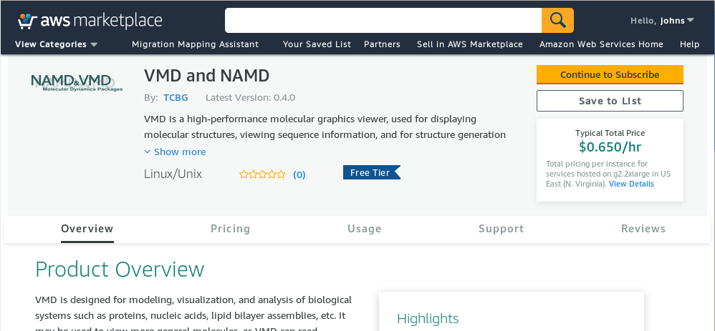
Easy to Launch: AWS EC2 Marketplace

Slide 10
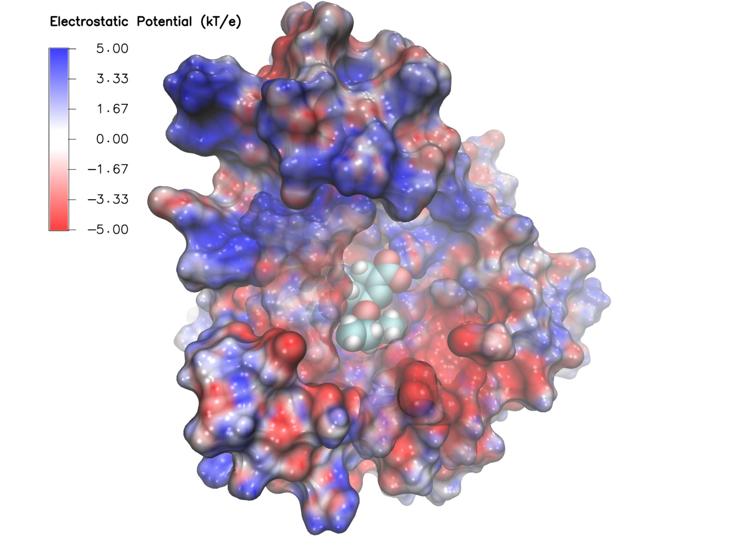
VMD/NAMD NGC Containers, Amazon EC2 AMIs
  http://www.ks.uiuc.edu/Research/cloud/
  https://ngc.nvidia.com/registry/
NAMD
CUDA-accelerated simulation
VMD:
CUDA-accelerated analysis
EGL off-screen rendering – no windowing system needed
OptiX high-fidelity GPU ray tracing engine built in
NEW: Remote Visualization Streaming
All dependencies included
Easy to deploy on diverse GPU accelerated platforms
High performance molecular visualization: In-situ and parallel rendering with EGL. J. E. Stone, P. Messmer, R. Sisneros, and K. Schulten. 2016 IEEE International Parallel and Distributed Processing Symposium Workshop (IPDPSW), pp. 1014-1023, 2016.

Slide 11
NAMD+VMD AWS EC2 AMIs
Current Production AMI:
(ami-064edc9149f8430c8) VMD+NAMD, 64-bit CentOS Linux with DCV remote visualization, created Nov 27, 2018
This is the current production image using Centos and DCV for increased remote visualization performance and smoother interaction. This image will only run on g3 instance types.
New AMIs supporting VMD RTX ray tracing coming soon…
Old Production AMI:
(ami-a01125df) VMD-NAMD-VNC-R1.9.4.1, 64-bit Ubuntu Linux, EBS storage, HVM, created July 10, 2018

Slide 12
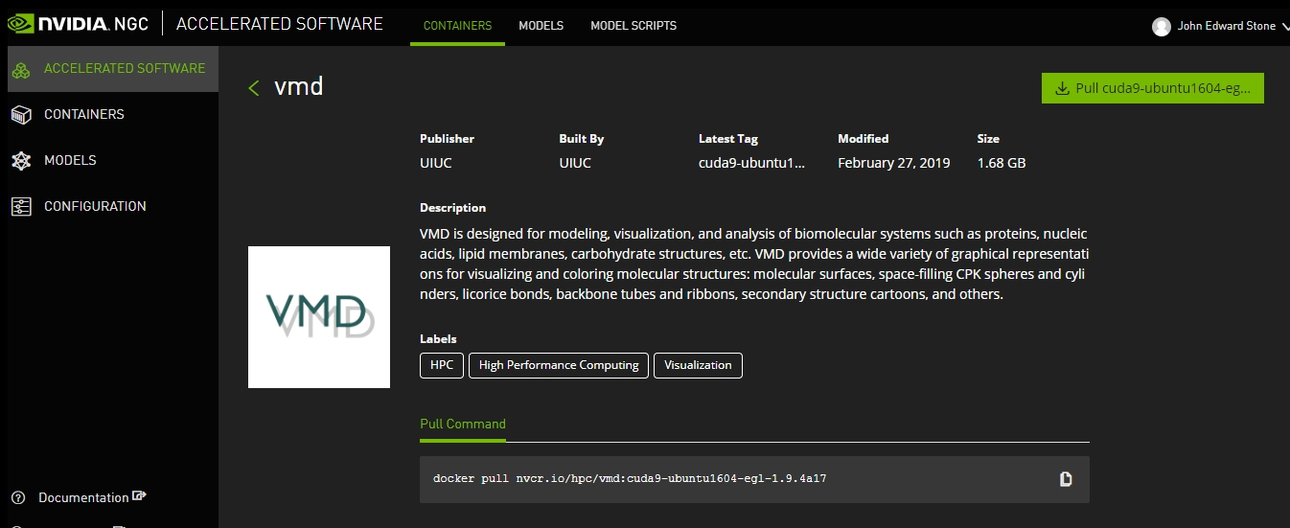
VMD, NAMD, LM NGC Containers

Slide 13
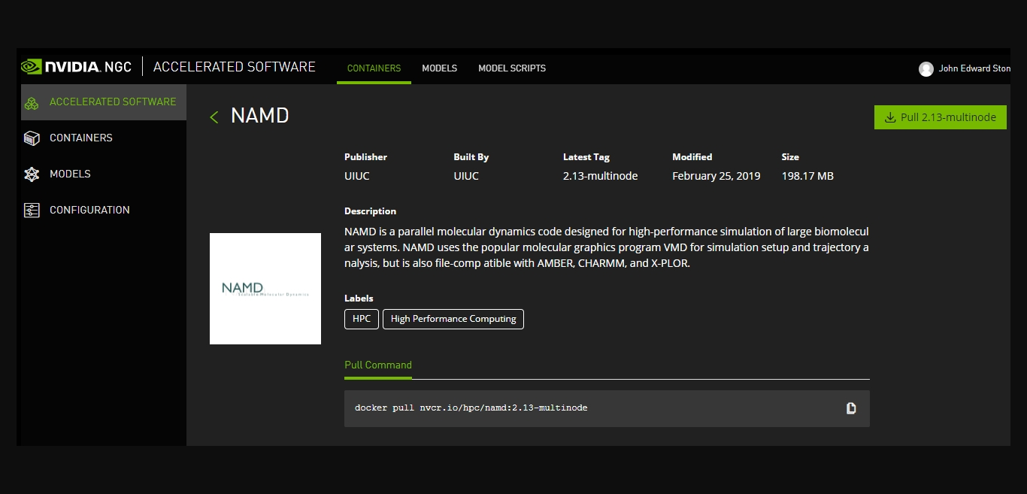
NAMD 2.13 Multi-Node Container

Slide 14
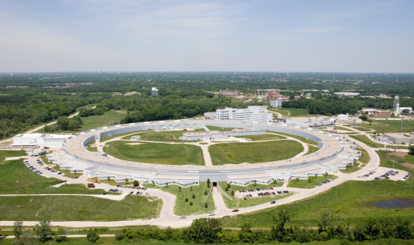
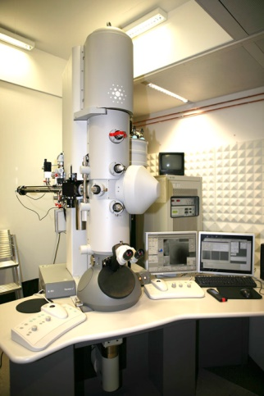
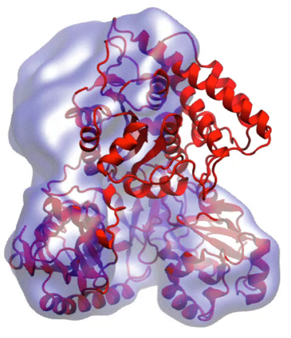
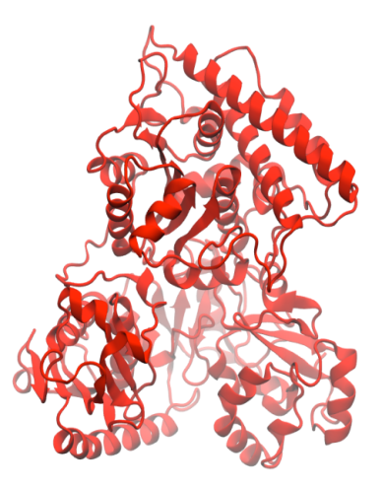
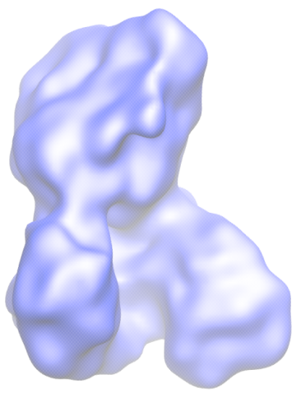
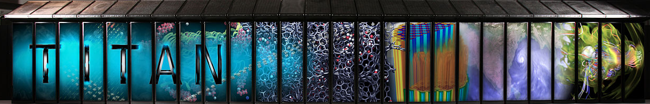
Molecular Dynamics Flexible Fitting (MDFF)
X-ray crystallography
MDFF
Electron microscopy
APS at Argonne
FEI microscope
ORNL Titan
Molecular dynamics-based refinement and validation for sub-5Å cryo-electron microscopy maps. A. Singharoy, I. Teo, R. McGreevy, J. E. Stone, J. Zhao, and K. Schulten. eLife 2016;10.7554/eLife.16105
Acetyl - CoA Synthase

Slide 15
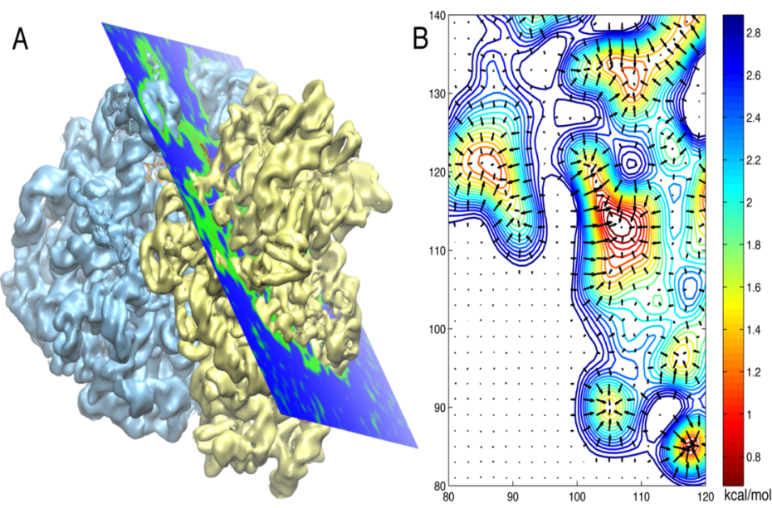

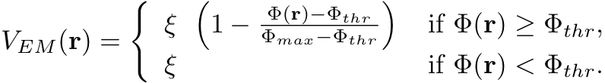
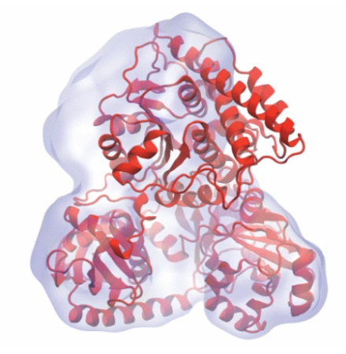
Molecular Dynamics Flexible Fitting - Theory
Two terms are added to the MD potential
An external potential derived from the EM map is defined on a grid as
A mass-weighted force is then applied to each atom

Slide 16
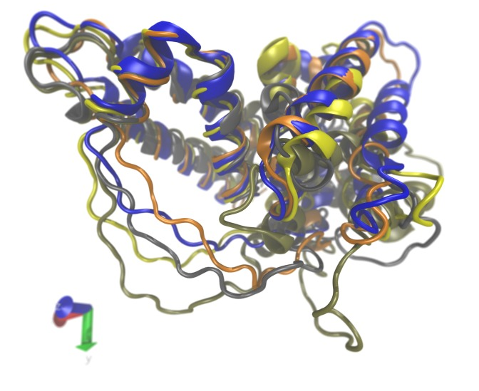
VMD Development Efforts
Supporting Integrative Hybrid Modeling
Extending mmCIF PDBx parser to encompass new IHM-specific records, data types
Revising VMD “molfile plugin” APIs to communicate IHM data to VMD and represent it natively
New atom selection keywords that encompass IHM structure data
New graphical interfaces to query and interact with IHM data both quantitatively and visually
Serum Albumin Domains,
PDB-DEV IHM #5

Slide 17
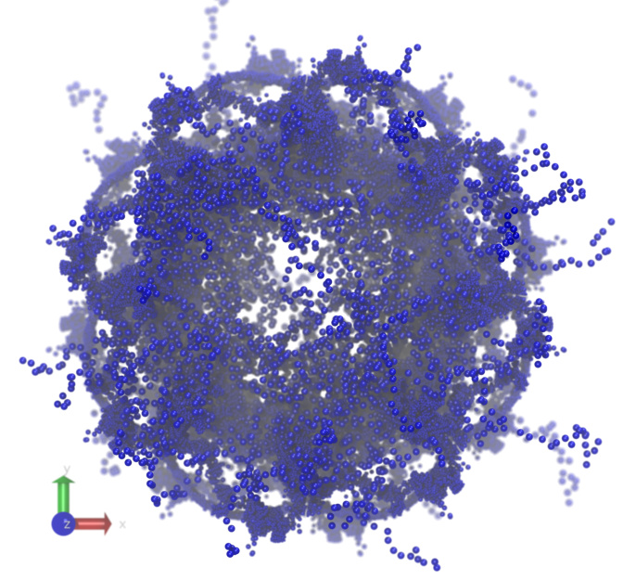
Coarse-Grained IHM Data
Coarse grained sphere/bead models
Restraint information from experiments
Multi-modal structure alignments, comparisons
Linkage to underlying experimental images, statistics, etc.
Nuclear Pore Complex,
PDB-DEV IHM #12

Slide 18
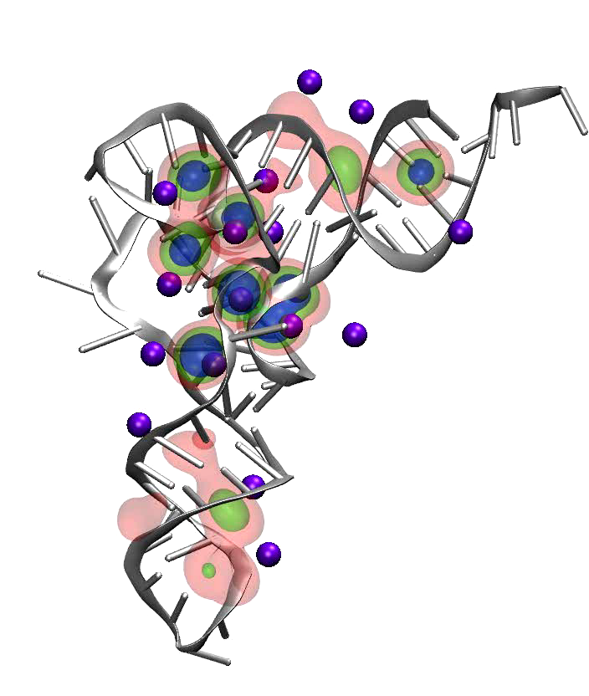
Display of Uncertainty, Error in IHM Models
Query, visualize uncertainty, error, variance, in EM density maps, tomograms, atomic structure
Requires IHM models to specify these statistics in the files
Modeling tools, graphical interfaces can use this to guide user modeling tasks, analyses
tRNA magnesium ion occupancy probability density surfaces, VMD volmap plugin

Slide 19
Selected VMD Plugins: Center Developed, and User Developed
Analysis
  APBSRun
  CatDCD
  Contact Map
  GofRGUI
  HeatMapper
  ILSTools
  IRSpecGUI
  MultiSeq
  NAMD Energy
  NAMD Plot
  NetworkView
  NMWiz
  ParseFEP
  PBCTools
  PMEpot
  PropKa GUI
  RamaPlot
  RMSD Tool
  RMSD Trajectory Tool
  RMSD Visualizer Tool
  Salt Bridges
  Sequence Viewer
  Symmetry Tool
  Timeline
  TorsionPlot
  VolMap
Modeling
  AutoIonize
  AutoPSF
  Chirality
  Cionize
  Cispeptide
  CGTools
  Dowser
  ffTK
  Inorganic Builder
  MDFF
  Membrane
  Merge Structs
  Molefacture
  Mutator
  Nanotube
  Psfgen
  RESPTool
  RNAView
  Solvate
  SSRestraints
  Topotools
Visualization
  Clipping Plane Tool
  Clone Rep
  DemoMaster
  Dipole Watcher
  Intersurf
  Navigate
  NavFly
  MultiMolAnim
  Color Scale Bar
  Remote
  Palette Tool
  ViewChangeRender
  ViewMaster
  Virtual DNA Viewer
  VMD Movie Maker
Simulation
  AlaScan
  AutoIMD
  IMDMenu
  NAMD GUI
  NAMD Server
  QMTool
Collaboration
  Remote Control
Data Import and Plotting
  Data Import
  Multiplot
  PDBTool
  MultiText
Externally Hosted Plugins and Extensions
  Check sidechains
  MultiMSMS
  Interactive Essential Dynamics
  Mead Ionize
  Clustering Tool
  iTrajComp
  Swap RMSD
  Intervor
  SurfVol
  vmdICE
75 MolFile I/O Plugins: structure, trajectory, sequence, and density map
http://www.ks.uiuc.edu/Research/vmd/plugins/

Slide 20
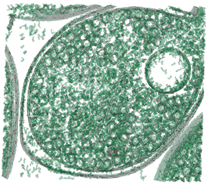
Computing Challenges Posed by Large Hybrid Models
Techniques like coarse graining allow modeling to reach the cell scale, but data sizes and interactivity remain a tremendous challenge
Next-generation parallel- and GPU-accelerated computing techniques can make powerful analytical and visualization tools interactive for the first time:
  Clustering analyses (structure RMSD, quality-of-fit, docking scores, etc)
  Image segmentation, docking, alignment, fitting, coarse-graining…
VMD supports analysis and visualization of multi-gigavoxel EM tomograms, density maps

Slide 21
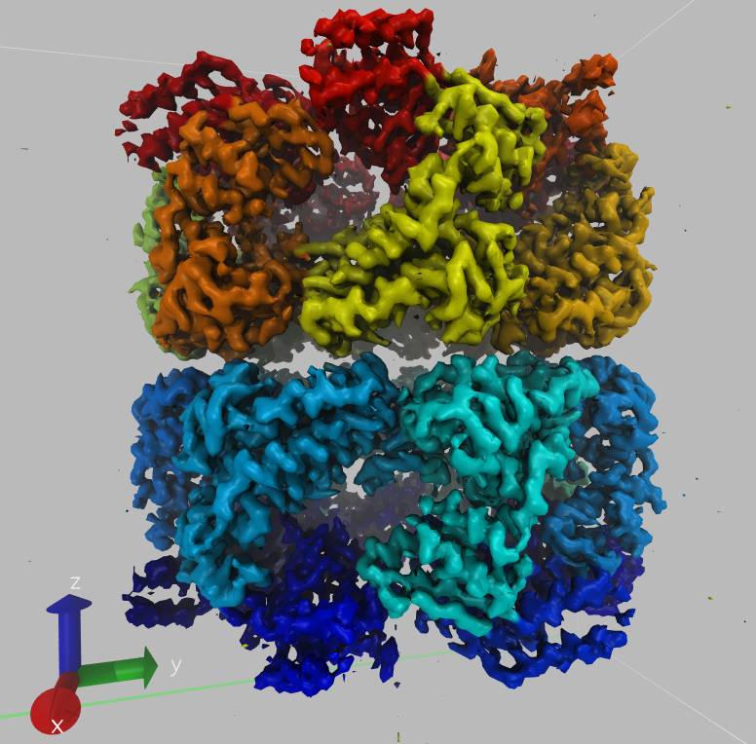
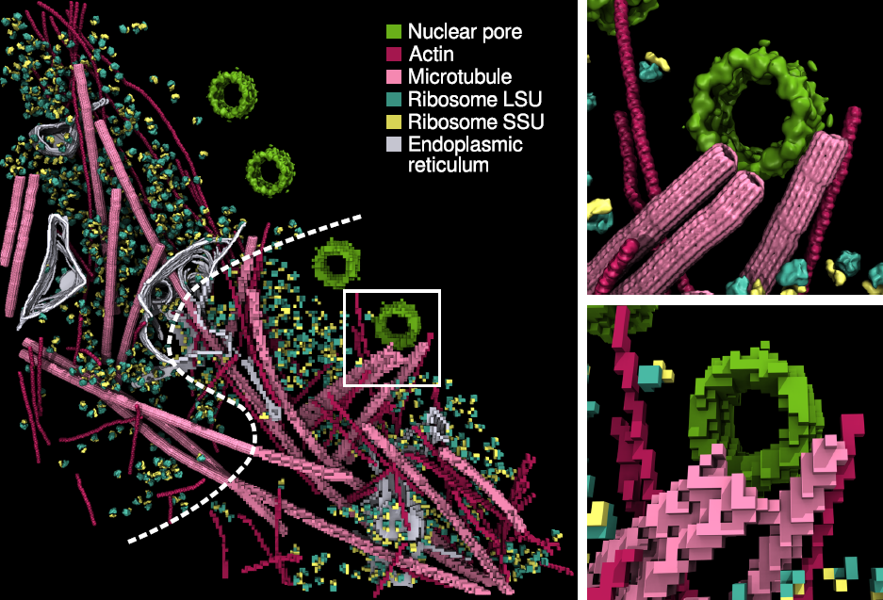
Density Map Segmentation
VMD GPU-accelerated density map segmentation of GroEL
Earnest, et al. J. Physical Chemistry B, 121(15): 3871-3881, 2017.

Slide 22
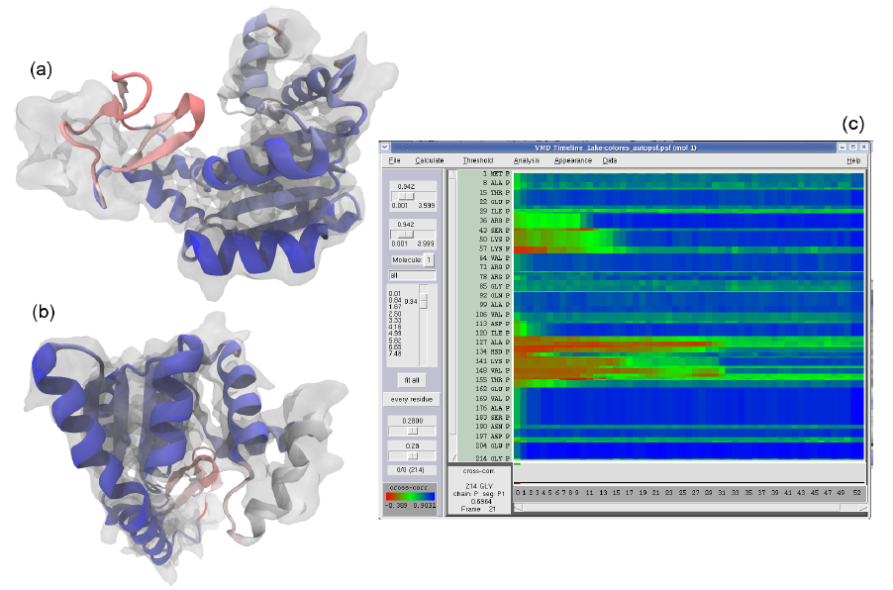
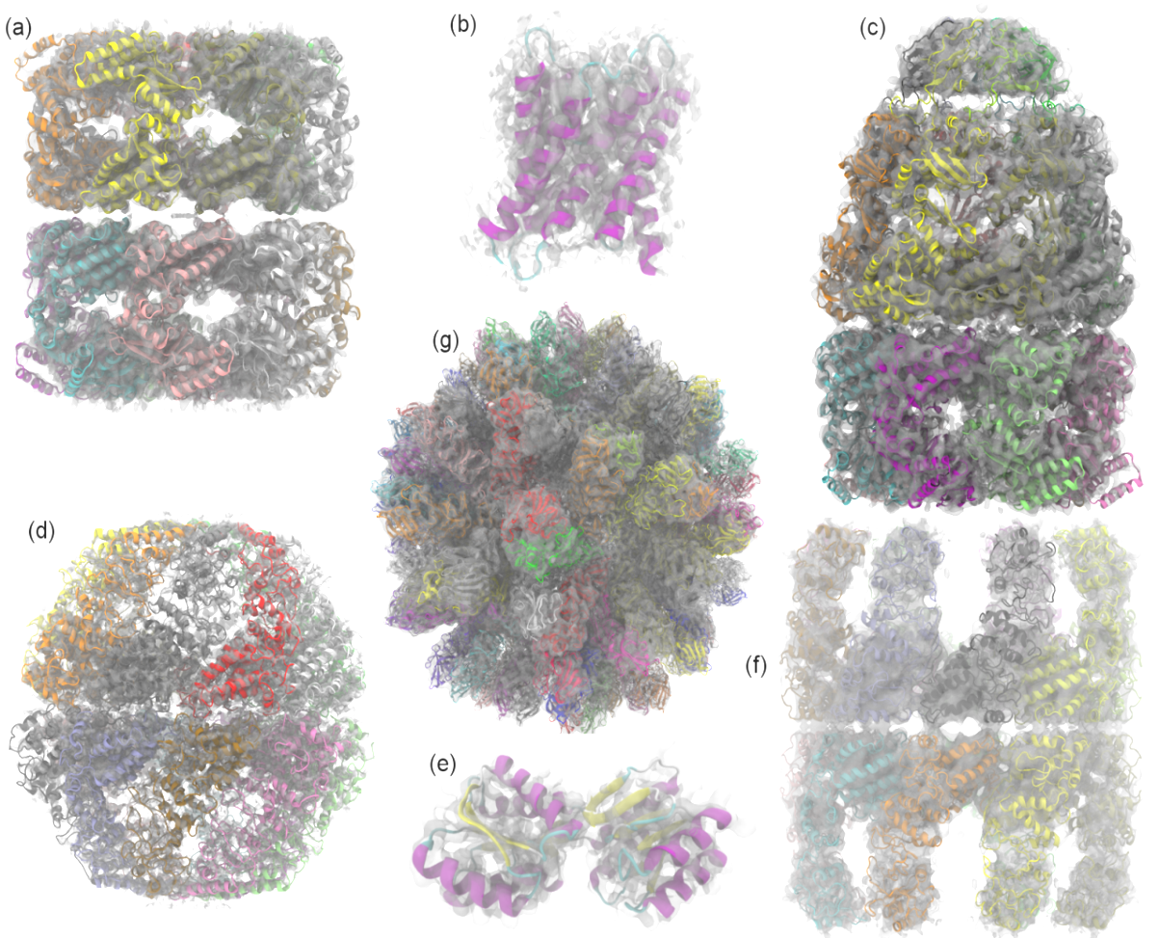
Evaluating Quality-of-Fit for Structures Solved by Hybrid Fitting Methods
Compute Pearson correlation to evaluate quality-of-fit between a reference cryo-EM density map and a simulated density map from an all-atom structure.
MDFF Cross Correlation Timeline
Regions with poor fit Regions with good fit

Slide 23
VMD Tesla V100 Cross Correlation Performance
Rabbit Hemorrhagic Disease Virus: 702K atoms, 6.5Å resolution
Volta GPU architecture almost 2x faster than previous gen Pascal:
Application and Hardware platform | Runtime, Speedup vs. Chimera, VMD+GPU
Chimera Xeon E5-2687W (2 socket) [1] | 15.860s, 1x
VMD-CUDA IBM Power8 + 1x Tesla K40 [2] | 0.488s, 32x 0.9x
VMD-CUDA Intel Xeon E5-2687W + 1x Quadro K6000 [1,2] | 0.458s, 35x 1.0x
VMD-CUDA Intel Xeon E5-2698v3 + 1x Tesla P100 | 0.090s, 176x 5.1x
VMD-CUDA IBM Power8 “Minsky” + 1x Tesla P100 | 0.080s, 198x 5.7x
VMD-CUDA Intel Xeon E5-2697Av4 + 1x Tesla V100 | 0.050s, 317x 9.2x
VMD-CUDA IBM Power9 “Newell” + 1x Tesla V100 | 0.049s, 323x 9.3x
[1] GPU-Accelerated Analysis and Visualization of Large Structures Solved by Molecular Dynamics Flexible Fitting. J. E. Stone, R. McGreevy, B. Isralewitz, and K. Schulten. Faraday Discussions 169:265-283, 2014.
[2] Early Experiences Porting the NAMD and VMD Molecular Simulation and Analysis Software to GPU-Accelerated OpenPOWER Platforms. J. E. Stone, A.-P. Hynninen, J. C. Phillips, K. Schulten. International Workshop on OpenPOWER for HPC (IWOPH'16), LNCS 9945, pp. 188-206, 2016.

Slide 24
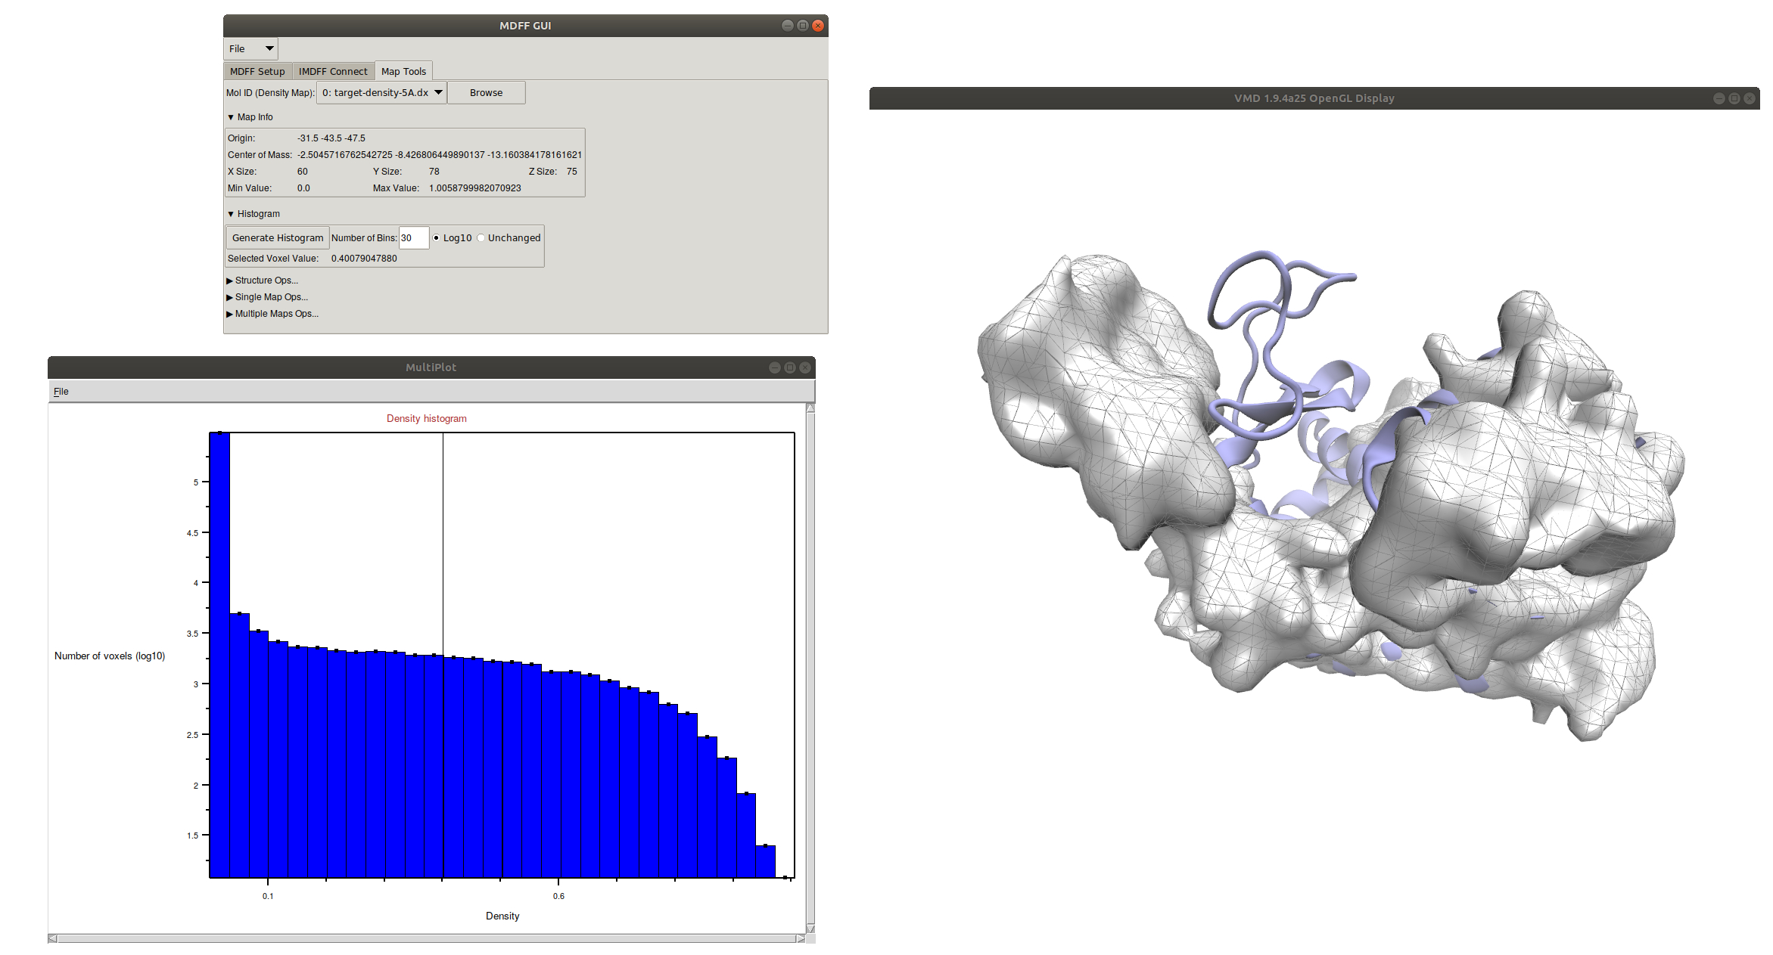
New VMD MDFF Density Map Tools
New Map Tools tab of MDFF GUI provides wide array of density map manipulation tools including:
  New Rigid Body Fitting
  New Interactive Histogram
  Trim, Crop, Clamp, Smooth…
  Easy Masking routine
New Density Segmentation
Add, subtract, multiply maps
Cross correlation and potential calculations for MDFF

Slide 25
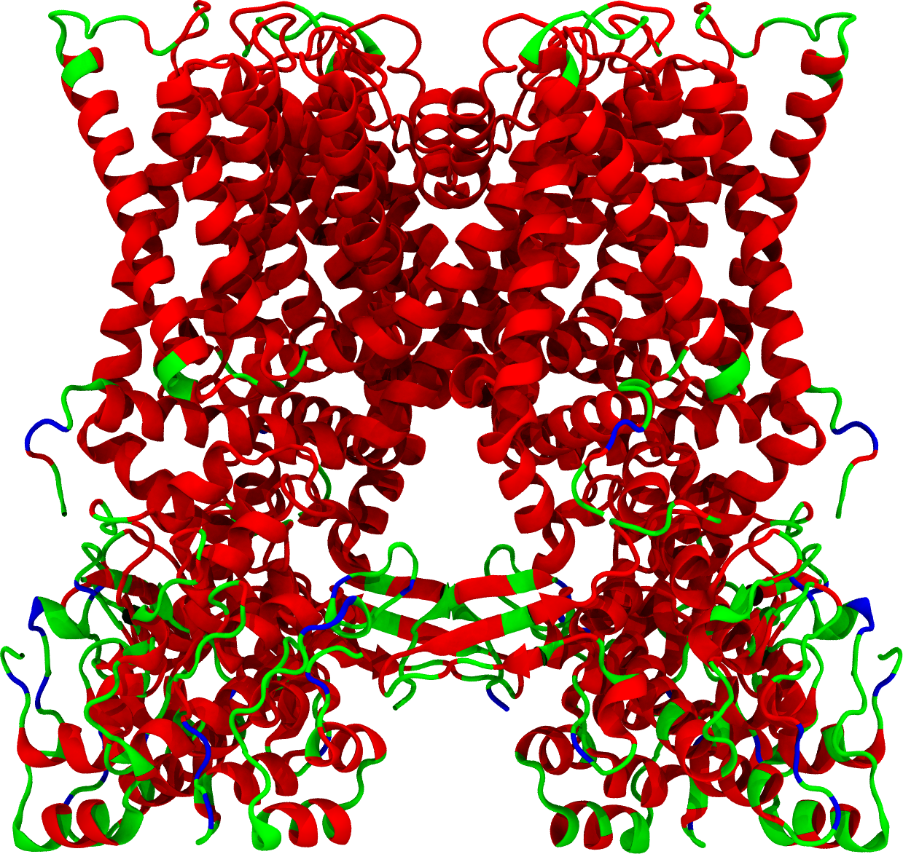
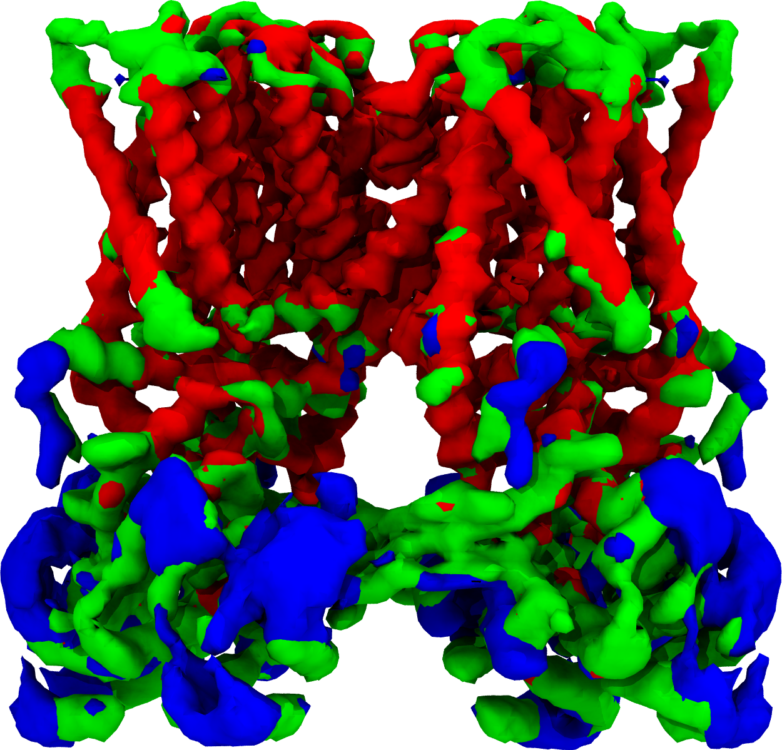
New Density Map Tools - Masking
Easily select and mask density map regions with VMD selection language
TRPV1 structure (3J5P) and cryo-EM density (emd-5778) colored by local resolution obtained by ResMap
High Res
(~3 Å)
Med Res
(~4 Å)
Low Res
(~5 Å)
A. Kucukelbir, F.J. Sigworth, H.D. Tagare, Quantifying the Local Resolution of
Cryo-EM Density Maps, Nature Methods, Volume 11, Issue 1, Pages 63-65, 2014.

Slide 26
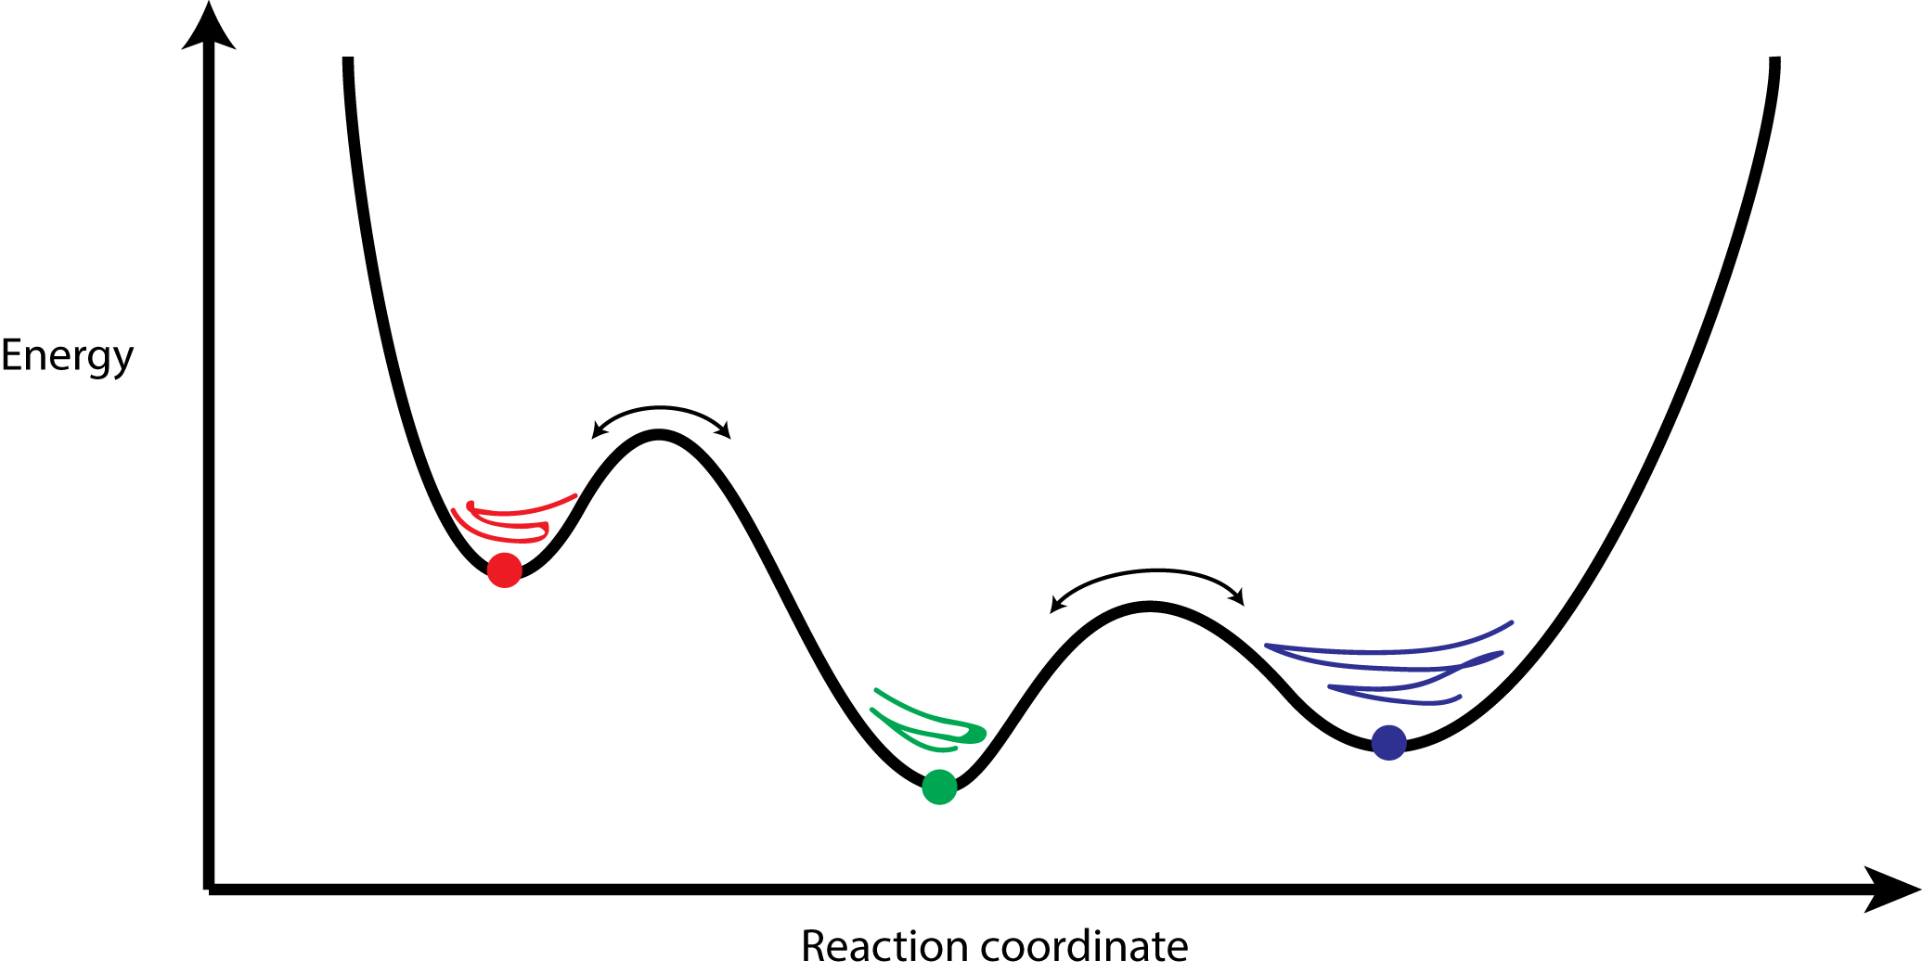
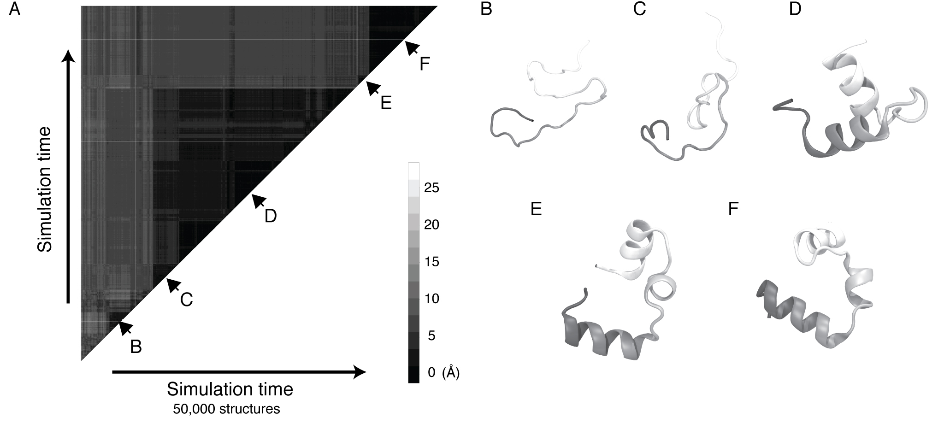
Interactive Clustering Analysis of IHM Models, Docking Poses, MD Trajectories
GPU-Accelerated Molecular Dynamics Clustering Analysis with OpenACC. J.E. Stone, J.R. Perilla, C. K. Cassidy, and K. Schulten. In, Robert Farber, ed., Parallel Programming with OpenACC, Morgan Kaufmann, Chapter 11, pp. 215-240, 2016.

Slide 27


MDFF on the Cloud Costs Less than a Cup of Coffee
ReMDFF (Resolution Exchange) requires many cores but little compute time, making it a good candidate for cloud computing
Singharoy, et al. eLife 2016
Molecule | Instance | Performance (ns/day) | Time (hours) | Simulation Cost / ns ($)
Adenylate Kinase | p3.2xlarge | 112 | 0.2 | 0.67
Acetyl-CoA Synthase | p3.2xlarge | 82 | 0.3 | 0.89
J1 Nitrilase | p3.2xlarge | 5 | 4.8 | 14.6
Singharoy, et al. eLife 2016
Cloud computing allows researchers to focus on the scientific challenges of their project without having to worry about local availability and administration of suitable computer hardware and installing or compiling software.
Notes:
Resolution Exchange MDFF uses the replica exchange feature of NAMD to run the parallel fitting simulations. The parallel simulations require many computer cores, however the simulations converge very rapidly and require little computational time, making them well-suited for a cloud computing environment. A cloud computer like Amazon’s EC2 provides a user with a many-cored machine with the click of a button, and a user can run an full MDFF simulation from start to finish for less than the cost of a cup of coffee. Cloud computing provides researchers the necessary means to run the simulation without the need to acquire and maintain their own hardware, allowing them to focus on the scientific challenges of their project. Providing our software like MDFF on the cloud is an ongoing goal of the Center, to meet the needs of an even wider range of users.
- Make sure to make clear the ease of use aspect with packaging all the software up that is needed in a modeling workflow (no installation or compilation) and giving users a “one click” approach to running the method.
Make it clear we have done this and others can do it now too. Mention the aspect of packaging up all the different software and making it easy for an experimentalist to run these methods.
Not only are cloud platforms cost effective, but they give us the ability to create a working computer environment with all of the software components already installed and ready to run at the click of a button. Users therefore do not have to worry about acquiring……and instead can focus on the scientific challenges of their project. Using cloud computing platforms therefore gives a wider range of researchers access to our software.

Slide 28
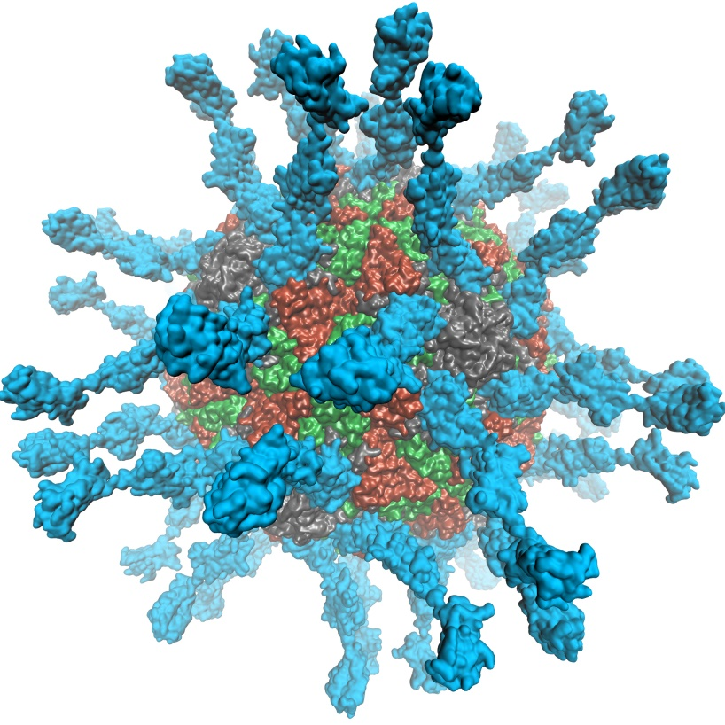
VMD supports EGL for in-situ and parallel rendering on Amazon EC2
No windowing system dependency
Easily deploy parallel VMD builds supporting off-screen rendering
Maintains 100% of VMD OpenGL shaders and rendering features
Poliovirus

Slide 29
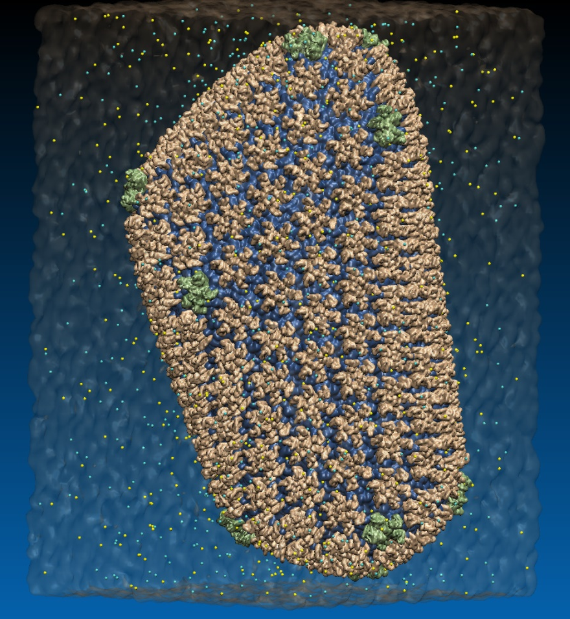
VMD EGL Rendering: Supports full VMD GLSL shading features
Vulkan support coming soon...
Swine Flu A/H1N1 neuraminidase bound to Tamiflu
64M atom HIV-1 capsid simulation
High Performance Molecular Visualization: In-Situ and Parallel Rendering with EGL. J. E. Stone, P. Messmer, R. Sisneros, and K. Schulten. High Performance Data Analysis and Visualization Workshop, IEEE IPDPSW, pp. 1014-1023, 2016.

Slide 30
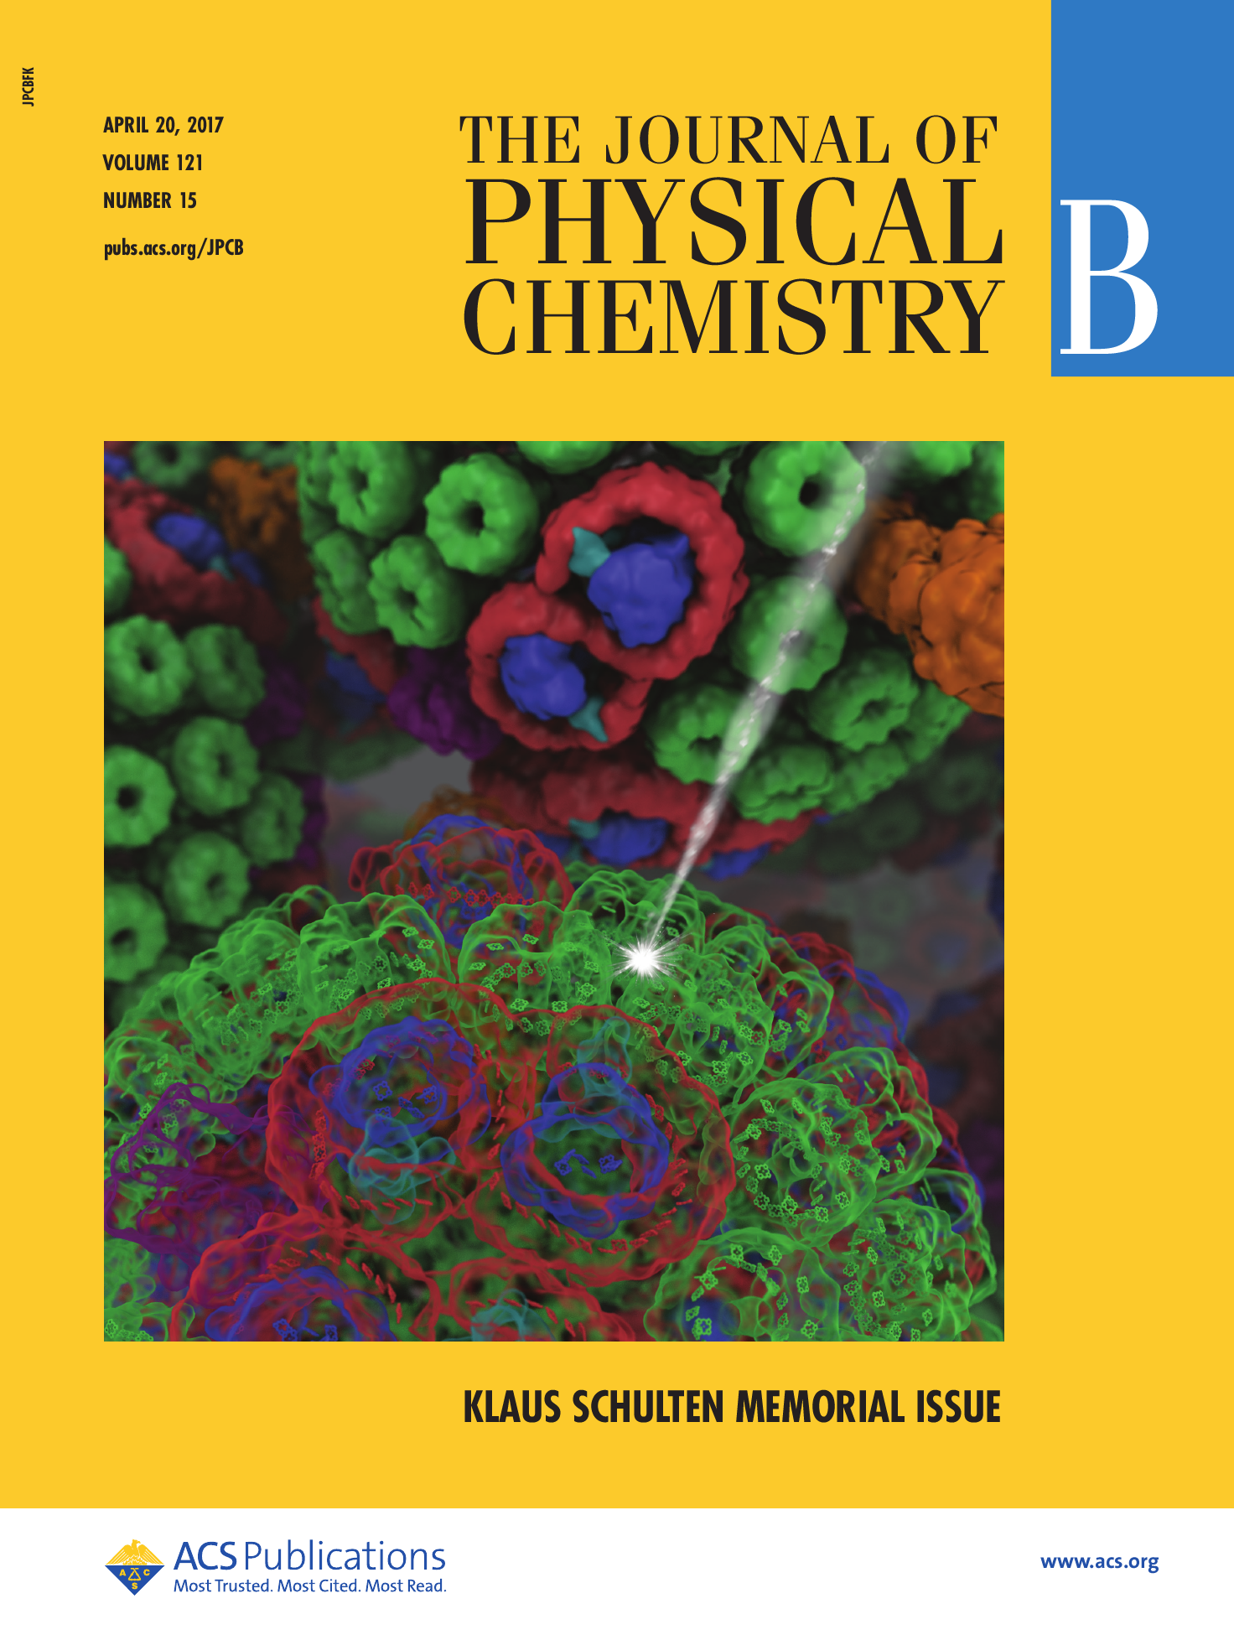
NEW: Cloud-Based Interactive Remote Visualization
Built-into VMD itself
Enable access to massive data sets
Uses GPU H.264 / HEVC hardware accelerated video encode/decode
Supports interactive remote visualizations (both rasterization and ray tracing)
Development ongoing, expected in next major VMD release, in 1H 2019…

Slide 31
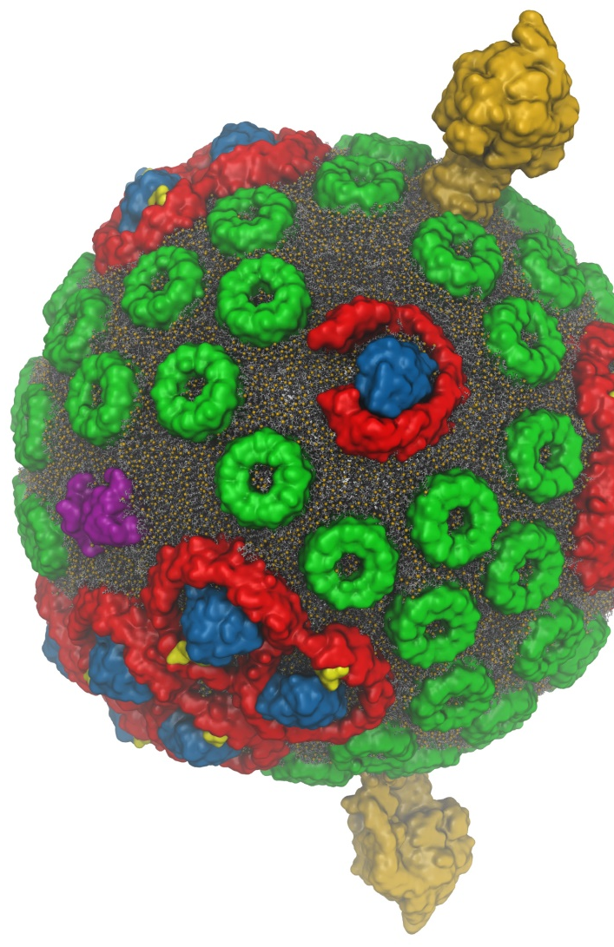
VMD Interactive Ray Tracing
Exploit computational power to improve rendering of the structural details of biomolecular complexes
Remote visualization tasks on very large macromolecular complexes
High fidelity shading, shadows, AO lighting, depth of field, …
GPU-Accelerated Molecular Visualization on Petascale Supercomputing Platforms. J. E. Stone, K. L. Vandivort, and K. Schulten. UltraVis’13, pp. 6:1-6:8, 2013.
Visualization of Energy Conversion Processes in a Light Harvesting Organelle at Atomic Detail. M. Sener, et al. SC'14 Visualization and Data Analytics Showcase, 2014.
Chemical Visualization of Human Pathogens: the Retroviral Capsids. J. R. Perilla, B.-C. Goh, J. E. Stone, and K. Schulten. SC'15 Visualization and Data Analytics Showcase, 2015.
Atomic Detail Visualization of Photosynthetic Membranes with GPU-Accelerated Ray Tracing. J. E. Stone et al., J. Parallel Computing, 55:17-27, 2016.
Immersive Molecular Visualization with Omnidirectional Stereoscopic Ray Tracing and Remote Rendering J. E. Stone, W. R. Sherman, and K. HPDAV, IPDPSW, pp. 1048-1057, 2016.
VMD/OptiX GPU Ray Tracing of all-atom Chromatophore w/ lipids.

Slide 32
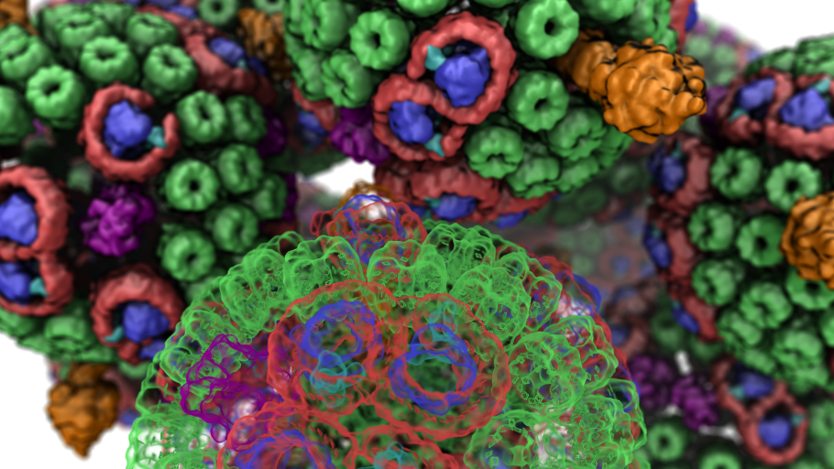

Slide 33

VMD w/ OptiX RTX: High-Fidelity Interactive Ray Tracing of
Hybrid Models of Large Complexes, Organelles, Cell-Scale Models

Slide 34

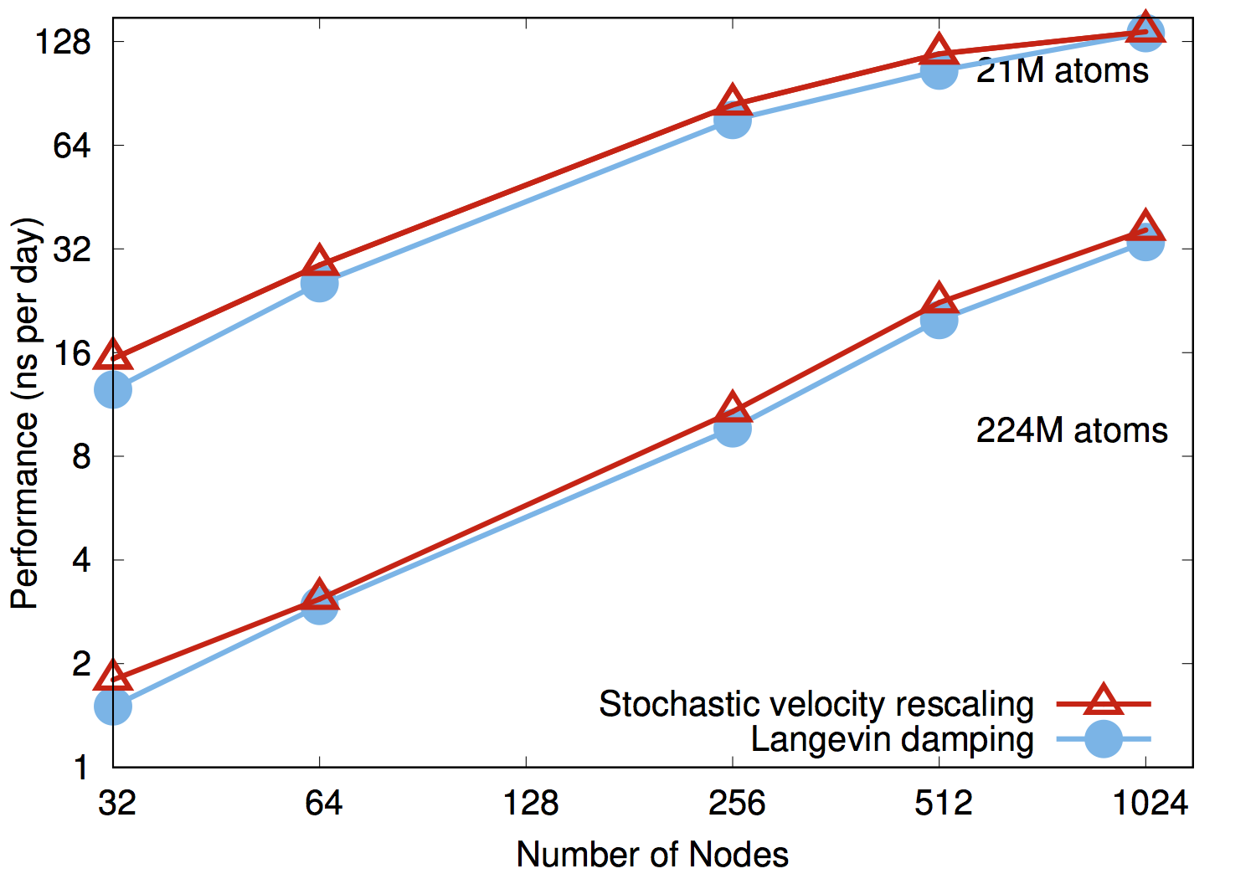
NAMD on Summit, May 2018
NAMD simulations can generate up to 10TB of output per day on 20% of Summit

Slide 35
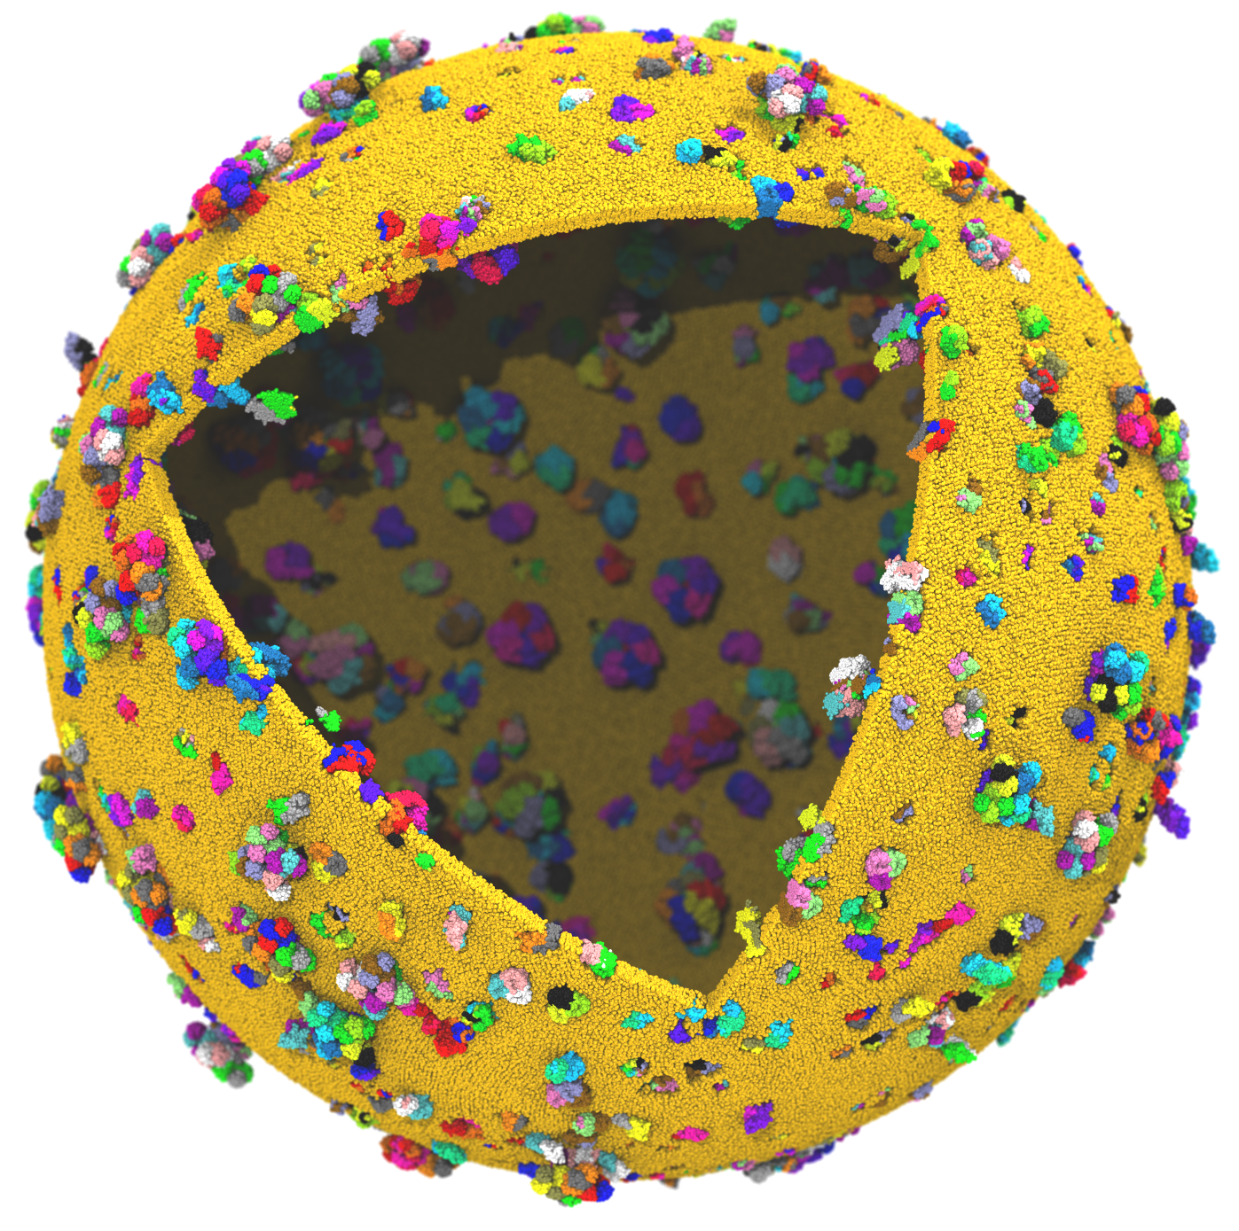

Next Generation: Simulating a Proto-Cell
ORNL Summit: NVLink-connected Tesla V100 GPUs enable next-gen visualizations
200nm diameter
~1 billion atoms w/ solvent
~1400 proteins in membrane

Slide 36
Proto-Cell Data Challenges
1B-atom proto-cell requires nodes with more than TB RAM to build complete model…
1B-atom proto-cell binary structure file: 63GB
Trajectory frame atomic coordinates: 12GB, 1.2TB/ns of simulation (1 frame per 10ps)
Routine modeling and visualization tasks are a big challenge at this scale
  Models contain thousands of atomic-detail components that must work together in harmony
  Exploit persistent memory technologies to enable “instant on” operation on massive cell-scale models – eliminate several minutes of startup during analysis/visualization of known structure
  Sparse output of results at multiple timescales will help ameliorate visualization and analysis I/O
Need for in-situ and remote visualization

Slide 37
NVIDIA DGX-2
16x 32GB Tesla V100 GPUs w/ 300GB/s NVLink, fully switched
512GB HBM2 RAM w/ 2.4TB/s Bisection Bandwidth, 2 PFLOPS
Tesla V100 GPU
Tesla V100 GPU
Tesla V100 GPU
Tesla V100 GPU
Tesla V100 GPU
Tesla V100 GPU
Tesla V100 GPU
Tesla V100 GPU
NVSwitch
NVSwitch
NVSwitch
NVSwitch
NVSwitch
NVSwitch
NVSwitch
NVSwitch
NVSwitch
NVSwitch
NVSwitch
NVSwitch
Tesla V100 GPU
Tesla V100 GPU
Tesla V100 GPU
Tesla V100 GPU
Tesla V100 GPU
Tesla V100 GPU
Tesla V100 GPU
Tesla V100 GPU

Slide 38
Opportunities and Challenges Posed by Future DGX-2-Like System Designs
CPUs “oversubscribed” by GPUs
Unfavorable for algorithm designs that perform “siloed” GPU calculations followed by reductions
GPU algorithms must dis-involve CPUs to greatest possible extent
Fully-switched NVLink-connected memory systems permit fine-grained multi-GPU algorithms via direct peer memory load/stores
Throughput oriented GPU algorithms can hide both local and remote memory latencies gracefully
Use atomic operations where needed during kernel execution rather than bulk-synchronization and reduction ex post facto
New levels of algorithm sophistication are possible, but not yet well supported by existing high level programming abstractions

Slide 39
Acknowledgements
Theoretical and Computational Biophysics Group, University of Illinois at Urbana-Champaign
NVIDIA CUDA and OptiX teams
Funding:
  NIH support: P41GM104601
  DOE INCITE, ORNL Titan: DE-AC05-00OR22725
  NSF Blue Waters: NSF OCI 07-25070, PRAC “The Computational Microscope”, ACI-1238993, ACI-1440026
Notes:
39

Slide 40
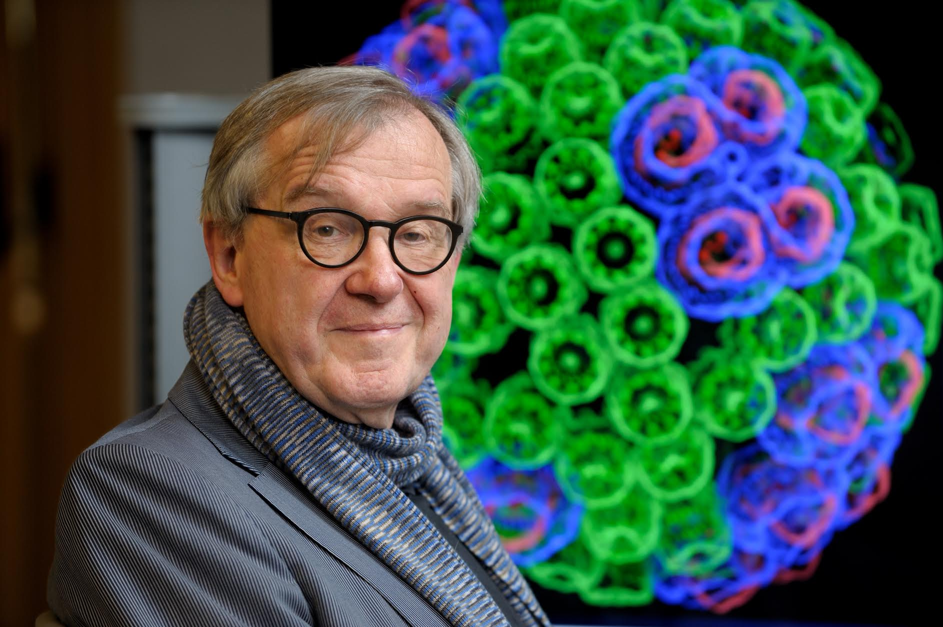
“When I was a young man, my goal was to look with mathematical and computational means at the inside of cells, one atom at a time, to decipher how living systems work. That is what I strived for and I never deflected from this goal.” – Klaus Schulten

Slide 41
Related Publications http://www.ks.uiuc.edu/Research/gpu/
Scalable Molecular Dynamics with NAMD on the Summit System. B. Acun, D. J. Hardy, L. V. Kale, K. Li, J. C. Phillips, and J. E. Stone. (In press)
NAMD goes quantum: An integrative suite for hybrid simulations. Melo, M. C. R.; Bernardi, R. C.; Rudack T.; Scheurer, M.; Riplinger, C.; Phillips, J. C.; Maia, J. D. C.; Rocha, G. D.; Ribeiro, J. V.; Stone, J. E.; Neese, F.; Schulten, K.; Luthey-Schulten, Z.; Nature Methods 15:351-354, 2018.
Challenges of Integrating Stochastic Dynamics and Cryo-electron Tomograms in Whole-cell Simulations. T. M. Earnest, R. Watanabe, J. E. Stone, J. Mahamid, W. Baumeister, E. Villa, and Z. Luthey-Schulten. J. Physical Chemistry B, 121(15): 3871-3881, 2017.
Early Experiences Porting the NAMD and VMD Molecular Simulation and Analysis Software to GPU-Accelerated OpenPOWER Platforms. J. E. Stone, A.-P. Hynninen, J. C. Phillips, and K. Schulten. International Workshop on OpenPOWER for HPC (IWOPH'16), LNCS 9945, pp. 188-206, 2016.
Immersive Molecular Visualization with Omnidirectional Stereoscopic Ray Tracing and Remote Rendering. J. E. Stone, W. R. Sherman, and K. Schulten. High Performance Data Analysis and Visualization Workshop, IEEE International Parallel and Distributed Processing Symposium Workshop (IPDPSW), pp. 1048-1057, 2016.
High Performance Molecular Visualization: In-Situ and Parallel Rendering with EGL. J. E. Stone, P. Messmer, R. Sisneros, and K. Schulten. High Performance Data Analysis and Visualization Workshop, IEEE International Parallel and Distributed Processing Symposium Workshop (IPDPSW), pp. 1014-1023, 2016.
Evaluation of Emerging Energy-Efficient Heterogeneous Computing Platforms for Biomolecular and Cellular Simulation Workloads. J. E. Stone, M. J. Hallock, J. C. Phillips, J. R. Peterson, Z. Luthey-Schulten, and K. Schulten.25th International Heterogeneity in Computing Workshop, IEEE International Parallel and Distributed Processing Symposium Workshop (IPDPSW), pp. 89-100, 2016.

Slide 42
Related Publications http://www.ks.uiuc.edu/Research/gpu/
Atomic Detail Visualization of Photosynthetic Membranes with GPU-Accelerated Ray Tracing. J. E. Stone, M. Sener, K. L. Vandivort, A. Barragan, A. Singharoy, I. Teo, J. V. Ribeiro, B. Isralewitz, B. Liu, B.-C. Goh, J. C. Phillips, C. MacGregor-Chatwin, M. P. Johnson, L. F. Kourkoutis, C. Neil Hunter, and K. Schulten. J. Parallel Computing, 55:17-27, 2016.
Chemical Visualization of Human Pathogens: the Retroviral Capsids. Juan R. Perilla, Boon Chong Goh, John E. Stone, and Klaus Schulten. SC'15 Visualization and Data Analytics Showcase, 2015.
Visualization of Energy Conversion Processes in a Light Harvesting Organelle at Atomic Detail. M. Sener, J. E. Stone, A. Barragan, A. Singharoy, I. Teo, K. L. Vandivort, B. Isralewitz, B. Liu, B. Goh, J. C. Phillips, L. F. Kourkoutis, C. N. Hunter, and K. Schulten. SC'14 Visualization and Data Analytics Showcase, 2014. ***Winner of the SC'14 Visualization and Data Analytics Showcase
Runtime and Architecture Support for Efficient Data Exchange in Multi-Accelerator Applications. J. Cabezas, I. Gelado, J. E. Stone, N. Navarro, D. B. Kirk, and W. Hwu. IEEE Transactions on Parallel and Distributed Systems, 26(5):1405-1418, 2015.
Unlocking the Full Potential of the Cray XK7 Accelerator. M. D. Klein and J. E. Stone. Cray Users Group, Lugano Switzerland, May 2014.
GPU-Accelerated Analysis and Visualization of Large Structures Solved by Molecular Dynamics Flexible Fitting. J. E. Stone, R. McGreevy, B. Isralewitz, and K. Schulten. Faraday Discussions, 169:265-283, 2014.
Simulation of reaction diffusion processes over biologically relevant size and time scales using multi-GPU workstations. M. J. Hallock, J. E. Stone, E. Roberts, C. Fry, and Z. Luthey-Schulten. Journal of Parallel Computing, 40:86-99, 2014.

Slide 43
Related Publications http://www.ks.uiuc.edu/Research/gpu/
GPU-Accelerated Molecular Visualization on Petascale Supercomputing Platforms. J. Stone, K. L. Vandivort, and K. Schulten. UltraVis'13: Proceedings of the 8th International Workshop on Ultrascale Visualization, pp. 6:1-6:8, 2013.
Early Experiences Scaling VMD Molecular Visualization and Analysis Jobs on Blue Waters. J. Stone, B. Isralewitz, and K. Schulten. In proceedings, Extreme Scaling Workshop, 2013.
Lattice Microbes: High‐performance stochastic simulation method for the reaction‐diffusion master equation. E. Roberts, J. Stone, and Z. Luthey‐Schulten.
J. Computational Chemistry 34 (3), 245-255, 2013.
Fast Visualization of Gaussian Density Surfaces for Molecular Dynamics and Particle System Trajectories. M. Krone, J. Stone, T. Ertl, and K. Schulten. EuroVis Short Papers, pp. 67-71, 2012.
Immersive Out-of-Core Visualization of Large-Size and Long-Timescale Molecular Dynamics Trajectories. J. Stone, K. L. Vandivort, and K. Schulten. G. Bebis et al. (Eds.): 7th International Symposium on Visual Computing (ISVC 2011), LNCS 6939, pp. 1-12, 2011.
Fast Analysis of Molecular Dynamics Trajectories with Graphics Processing Units – Radial Distribution Functions. B. Levine, J. Stone, and A. Kohlmeyer. J. Comp. Physics, 230(9):3556-3569, 2011.

Slide 44
Related Publications http://www.ks.uiuc.edu/Research/gpu/
Quantifying the Impact of GPUs on Performance and Energy Efficiency in HPC Clusters. J. Enos, C. Steffen, J. Fullop, M. Showerman, G. Shi, K. Esler, V. Kindratenko, J. Stone, J Phillips. International Conference on Green Computing, pp. 317-324, 2010.
GPU-accelerated molecular modeling coming of age. J. Stone, D. Hardy, I. Ufimtsev, K. Schulten. J. Molecular Graphics and Modeling, 29:116-125, 2010.
OpenCL: A Parallel Programming Standard for Heterogeneous Computing. J. Stone, D. Gohara, G. Shi. Computing in Science and Engineering, 12(3):66-73, 2010.
An Asymmetric Distributed Shared Memory Model for Heterogeneous Computing Systems. I. Gelado, J. Stone, J. Cabezas, S. Patel, N. Navarro, W. Hwu. ASPLOS ’10: Proceedings of the 15th International Conference on Architectural Support for Programming Languages and Operating Systems, pp. 347-358, 2010.

Slide 45
Related Publications http://www.ks.uiuc.edu/Research/gpu/
GPU Clusters for High Performance Computing. V. Kindratenko, J. Enos, G. Shi, M. Showerman, G. Arnold, J. Stone, J. Phillips, W. Hwu. Workshop on Parallel Programming on Accelerator Clusters (PPAC), In Proceedings IEEE Cluster 2009, pp. 1-8, Aug. 2009.
Long time-scale simulations of in vivo diffusion using GPU hardware. E. Roberts, J. Stone, L. Sepulveda, W. Hwu, Z. Luthey-Schulten. In IPDPS’09: Proceedings of the 2009 IEEE International Symposium on Parallel & Distributed Computing, pp. 1-8, 2009.
High Performance Computation and Interactive Display of Molecular Orbitals on GPUs and Multi-core CPUs. J. E. Stone, J. Saam, D. Hardy, K. Vandivort, W. Hwu, K. Schulten, 2nd Workshop on General-Purpose Computation on Graphics Pricessing Units (GPGPU-2), ACM International Conference Proceeding Series, volume 383, pp. 9-18, 2009.
Probing Biomolecular Machines with Graphics Processors. J. Phillips, J. Stone. Communications of the ACM, 52(10):34-41, 2009.
Multilevel summation of electrostatic potentials using graphics processing units. D. Hardy, J. Stone, K. Schulten. J. Parallel Computing, 35:164-177, 2009.

Slide 46
Related Publications http://www.ks.uiuc.edu/Research/gpu/
Adapting a message-driven parallel application to GPU-accelerated clusters. J. Phillips, J. Stone, K. Schulten. Proceedings of the 2008 ACM/IEEE Conference on Supercomputing, IEEE Press, 2008.
GPU acceleration of cutoff pair potentials for molecular modeling applications. C. Rodrigues, D. Hardy, J. Stone, K. Schulten, and W. Hwu. Proceedings of the 2008 Conference On Computing Frontiers, pp. 273-282, 2008.
GPU computing. J. Owens, M. Houston, D. Luebke, S. Green, J. Stone, J. Phillips. Proceedings of the IEEE, 96:879-899, 2008.
Accelerating molecular modeling applications with graphics processors. J. Stone, J. Phillips, P. Freddolino, D. Hardy, L. Trabuco, K. Schulten. J. Comp. Chem., 28:2618-2640, 2007.
Continuous fluorescence microphotolysis and correlation spectroscopy. A. Arkhipov, J. Hüve, M. Kahms, R. Peters, K. Schulten. Biophysical Journal, 93:4006-4017, 2007.

