Slide 1
Interactive High-Fidelity Biomolecular and Cellular Visualization with RTX Ray Tracing APIs
John E. Stone
Theoretical and Computational Biophysics Group
Beckman Institute for Advanced Science and Technology
University of Illinois at Urbana-Champaign
http://www.ks.uiuc.edu/Research/gpu/
15:00-15:50, Room 230B, San Jose Convention Center
San Jose, CA, Wednesday March 20th, 2019
Notes:
Advances in OptiX and RTX ray tracing bring tremendous performance improvements for rendering scenes from technical and scientific visualization workloads. New OptiX acceleration structures enable rendering of scenes with much greater geometric complexity on a single GPU, making it possible for scientists to interactively render high fidelity visualizations of complex scenes. This talk will describe the results from the adapation of VMD, a widely used molecular visualization tool with over 1000,000 users, to exploit the latest capabilities of OptiX.

Slide 2
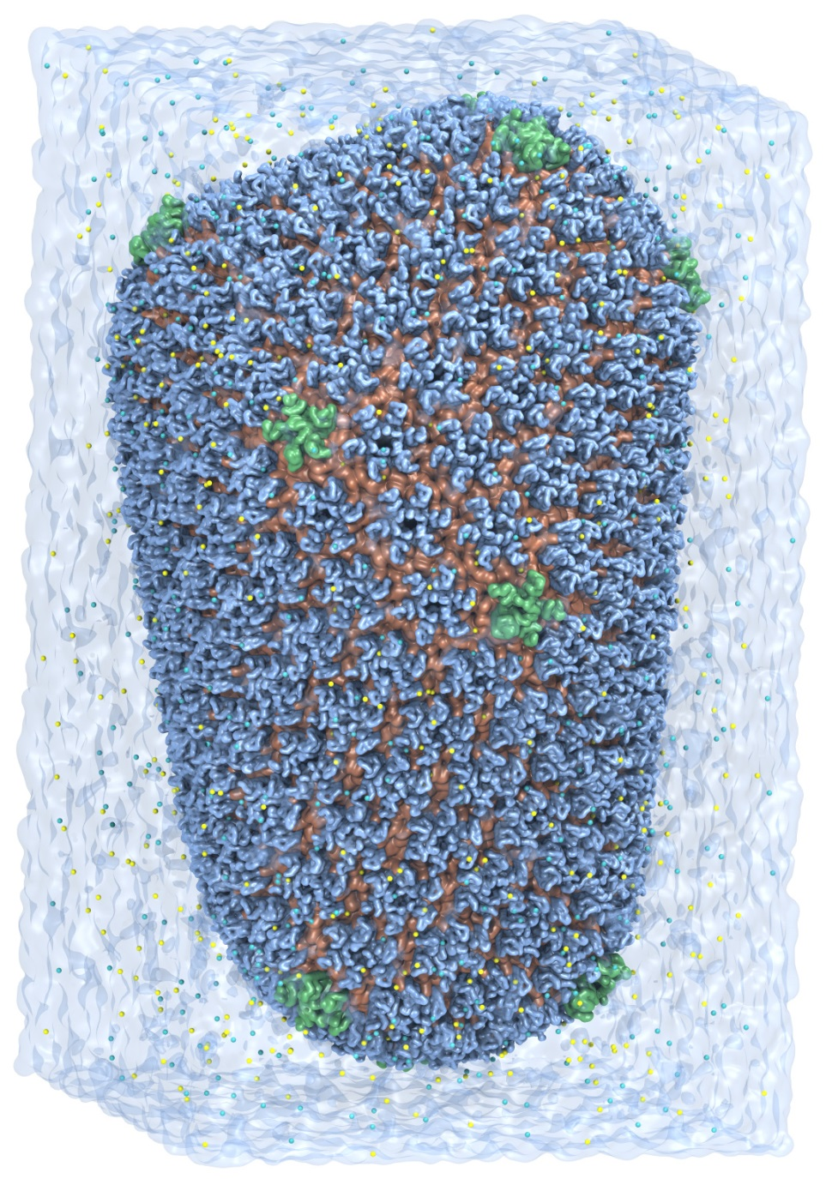
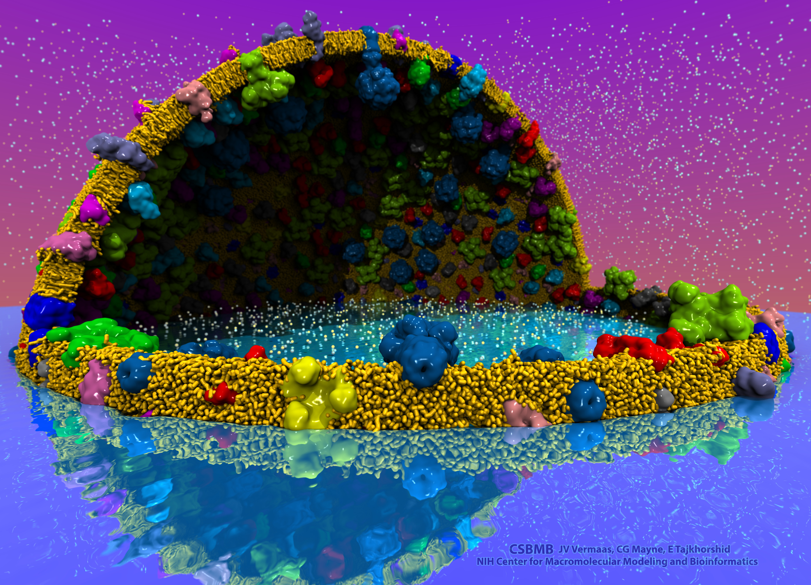
VMD – “Visual Molecular Dynamics”
Visualization and analysis of:
Molecular dynamics simulations
Lattice cell simulations
Quantum chemistry calculations
Cryo-EM densities, volumetric data
Sequence information
User extensible scripting and plugins
Over 100,000 users, 28,000 citations
http://www.ks.uiuc.edu/Research/vmd/
Cell-Scale Modeling
MD Simulation

Slide 3
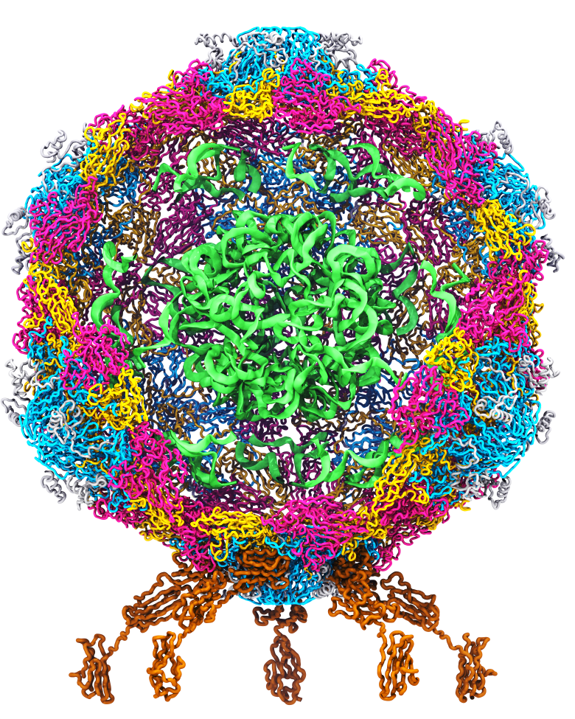
Goal: A Computational Microscope
Study the molecular machines in living cells
Ribosome: target for antibiotics
Poliovirus
Notes:
Ribosomes synthesize new proteins from genetic information
Bacterial ribosome is a target for antibiotics, which interfere with its ability to function by binding to sites on the structure, preventing proteins from being synthesized
Ribosome simulations are extremely computationally challenging due to the size of the structure and its natural environment (solvent, ions, etc, large box, 3 million atoms or so)
Bionanodevice for sequencing DNA efficiently
Knowledge of an individual’s genetic makeup can lead to the prediction and treatment of many diseases by the means of personal genomic medicine and pharmacogenomics. In order for genome sequencing to become practical for common medical use, an inexpensive high throughput genome sequencing technique is required. NIH has set a goal of reducing the cost of genome sequencing by a factor of 10,000, to less than $1,000 within ten years.
The computer is the best microscope to guide the development of bionanodevices, for example to sequence DNA. While experiments can measure DNA electrostatic potentials, they cannot visualize the DNA’s location and conformation at the time of measurement.

Slide 4
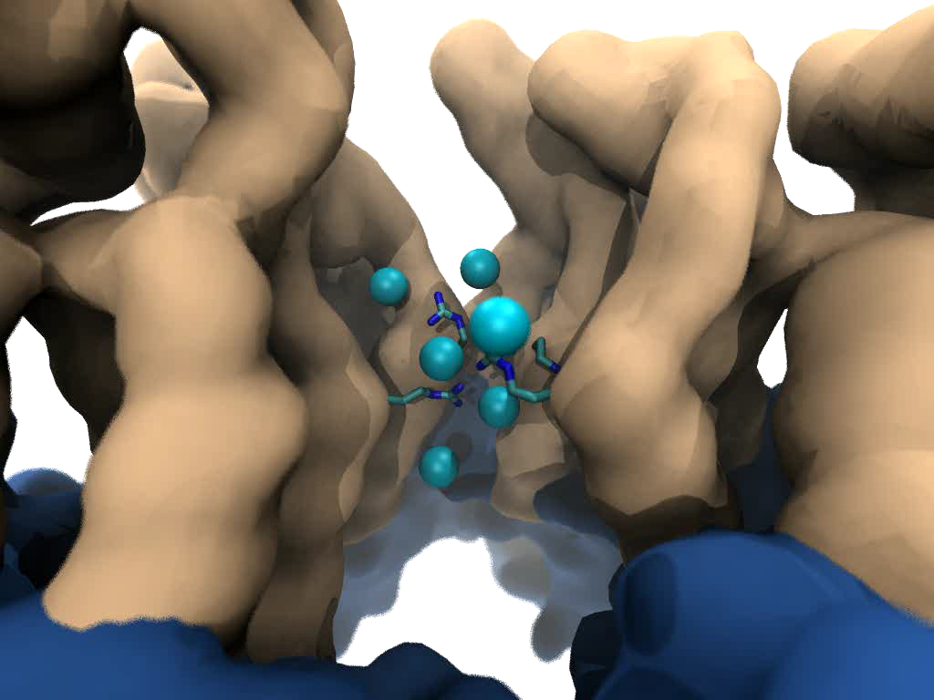
Goal: Intuitive interactive viz. in crowded molecular complexes
Results from 64M atom, 1 μs sim!
Close-up view of chloride ions permeating through HIV-1 capsid hexameric centers
Notes:
High quality lighting/shading are very beneficial for scientists
Techniques like AO are easy to use by scientists who are non-experts in computer graphics
Use of methods like AO simplifies the process of producing easy-to-interpret images of complex
molecular structures, no need to adjust positions of lights, or deal with them during animation of
Molecular

Slide 5
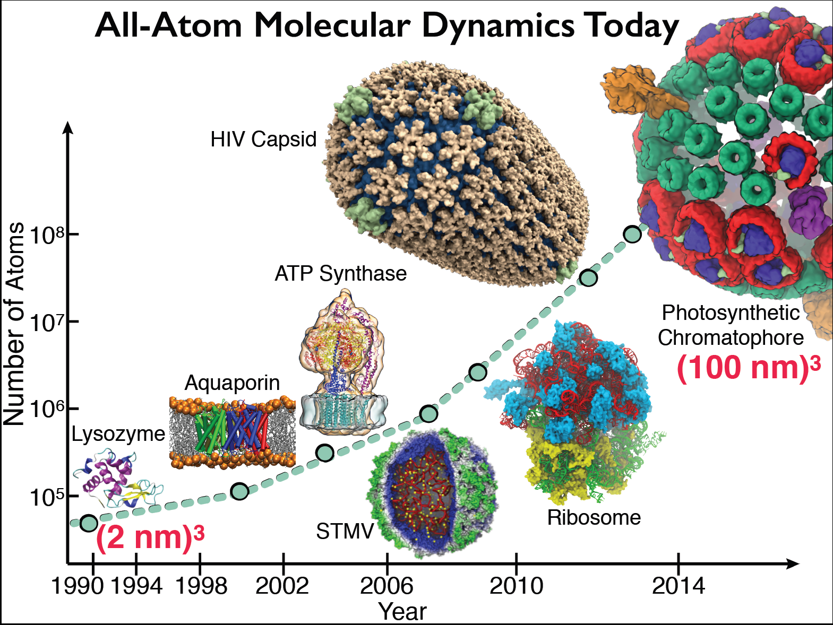

Slide 6
High Fidelity Ray Tracing with OptiX
Advanced rendering techniques save scientists time, produce images that are easier to interpret
Ambient Occlusion, Depth of Field, high quality transparency, instancing, ….
Interactive RT on laptop, desk, cloud, and remote supercomputers
Interactivity is critically important for scientists that need to obtain results without becoming a graphics expert
Large-scale parallel rendering: in situ or post hoc visualization tasks
Stereoscopic panorama and full-dome projections
Omnidirectional VR: YouTube, HMDs
VMD/OptiX all-atom Chromatophore
Notes:
-----
Credits:
GPU-Accelerated Molecular Visualization on Petascale Supercomputing Platforms. J. E. Stone, K. L. Vandivort, and K. Schulten. UltraVis’13, pp. 6:1-6:8, 2013.
Visualization of Energy Conversion Processes in a Light Harvesting Organelle at Atomic Detail. M. Sener, et al. SC'14 Visualization and Data Analytics Showcase, 2014.
Chemical Visualization of Human Pathogens: the Retroviral Capsids. J. R. Perilla, B.-C. Goh, J. E. Stone, and K. Schulten. SC'15 Visualization and Data Analytics Showcase, 2015.
Atomic Detail Visualization of Photosynthetic Membranes with GPU-Accelerated Ray Tracing. J. E. Stone et al., J. Parallel Computing, 55:17-27, 2016.
Immersive Molecular Visualization with Omnidirectional Stereoscopic Ray Tracing and Remote Rendering J. E. Stone, W. R. Sherman, and K. HPDAV, IPDPSW, pp. 1048-1057, 2016.

Slide 7
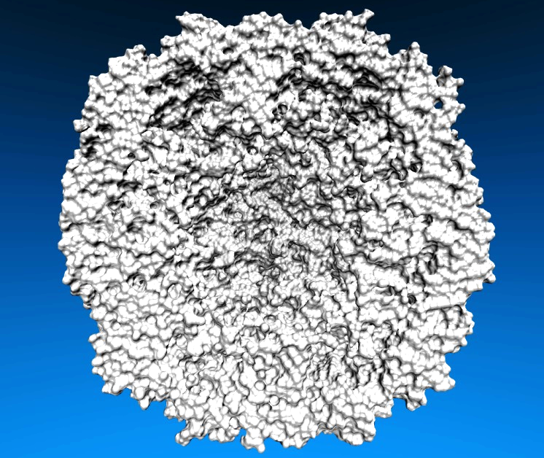
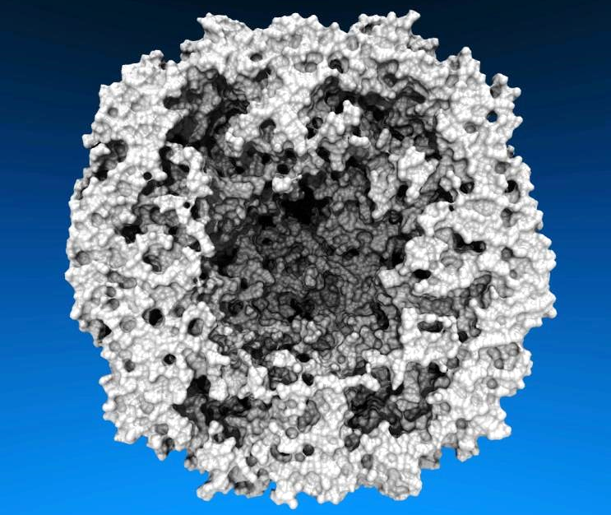
Lighting Comparison, STMV Capsid
Two lights, no shadows
Ambient occlusion + two lights, 144 AO rays/hit

Slide 8
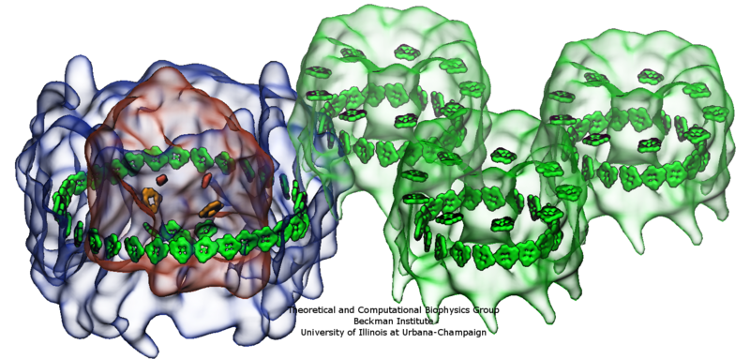
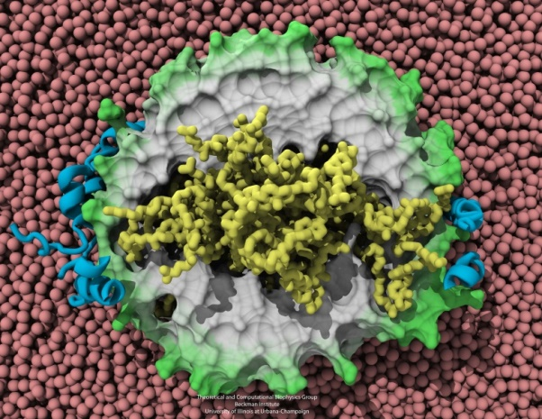
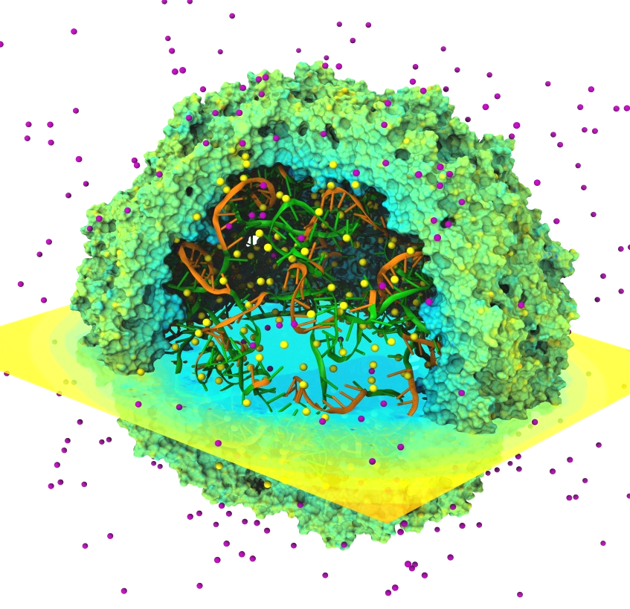
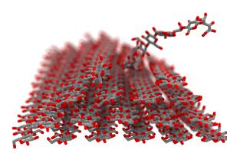
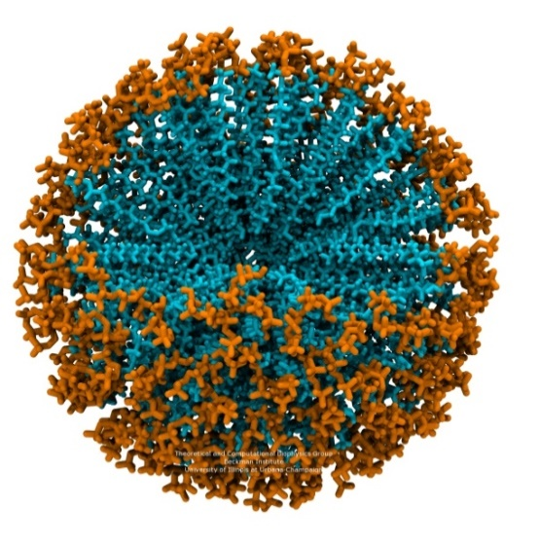
Notes:
Benefits of Advanced Lighting and Shading Techniques
Exploit visual intuition
Spend computer time in exchange for scientists’ time, make images that are more easily interpreted
High-quality transparent surface display, DoF, and AO are a few of the tools that can be used to better visualize complex molecular structures and their dynamics, and to focus viewer’s attention on key parts of a protein or macromolecular complex

Slide 9
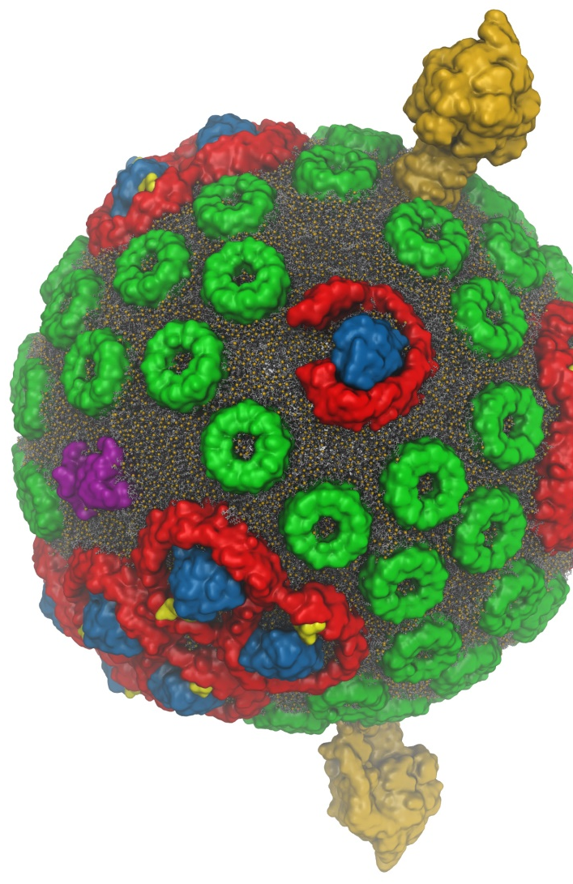
VMD w/ OptiX 6
Interactive RT on laptops, desktops, and cloud
Large-scale parallel rendering: in situ or post hoc visualization
Remote ray tracing with NvPipe video streaming
Stereoscopic panoramic and full-dome projections
Omnidirectional VR for YouTube, VR HMDs
VMD+OptiX NGC container: https://ngc.nvidia.com/registry/
In-progress:
Denoising: faster turnaround w/ AO, DoF, etc
GPU-Accelerated Molecular Visualization on Petascale Supercomputing Platforms. J. E. Stone, K. L. Vandivort, and K. Schulten. UltraVis’13, pp. 6:1-6:8, 2013.
Visualization of Energy Conversion Processes in a Light Harvesting Organelle at Atomic Detail. M. Sener, et al. SC'14 Visualization and Data Analytics Showcase, 2014.
Chemical Visualization of Human Pathogens: the Retroviral Capsids. J. R. Perilla, B.-C. Goh, J. E. Stone, and K. Schulten. SC'15 Visualization and Data Analytics Showcase, 2015.
Atomic Detail Visualization of Photosynthetic Membranes with GPU-Accelerated Ray Tracing. J. E. Stone et al., J. Parallel Computing, 55:17-27, 2016.
Immersive Molecular Visualization with Omnidirectional Stereoscopic Ray Tracing and Remote Rendering J. E. Stone, W. R. Sherman, and K. HPDAV, IPDPSW, pp. 1048-1057, 2016.
VMD/OptiX GPU Ray Tracing of all-atom Chromatophore w/ lipids.

Slide 10
Interactive Ray Tracing of Tomograms
High resolution cellular tomograms, billions of voxels
Even isosurface or lattice site graphical representations involve ~100M geometric primitives
>= 24GB GPUs allow interactive RT of large cellular tomograms
Earnest, et al. J. Physical Chemistry B, 121(15): 3871-3881, 2017.

Slide 11
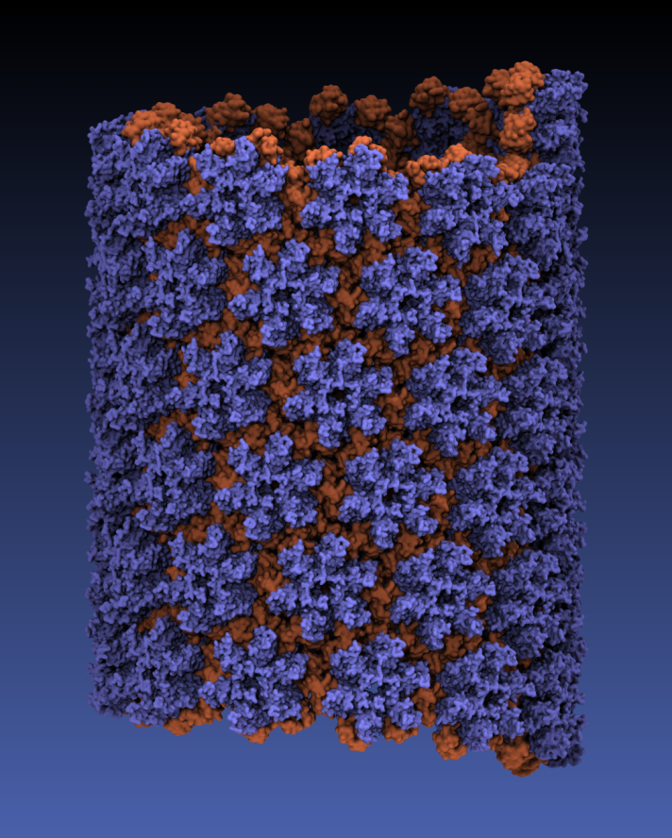
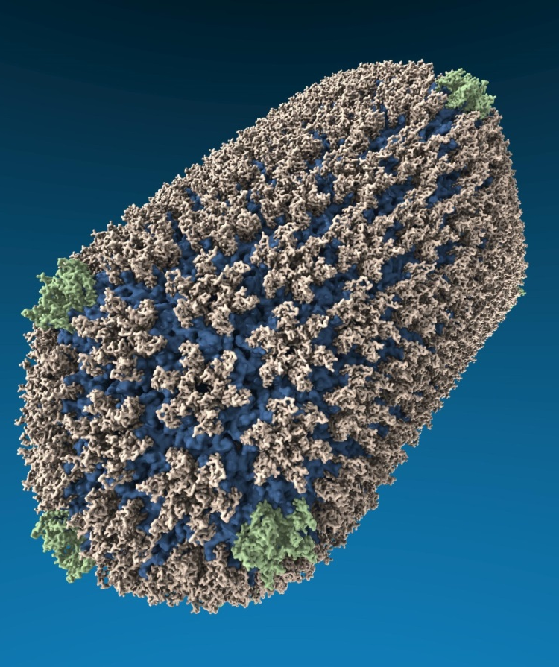
VMD “QuickSurf” Representation, Ray Tracing
All-atom HIV capsid simulations w/ 64M atoms on Blue Waters

Slide 12
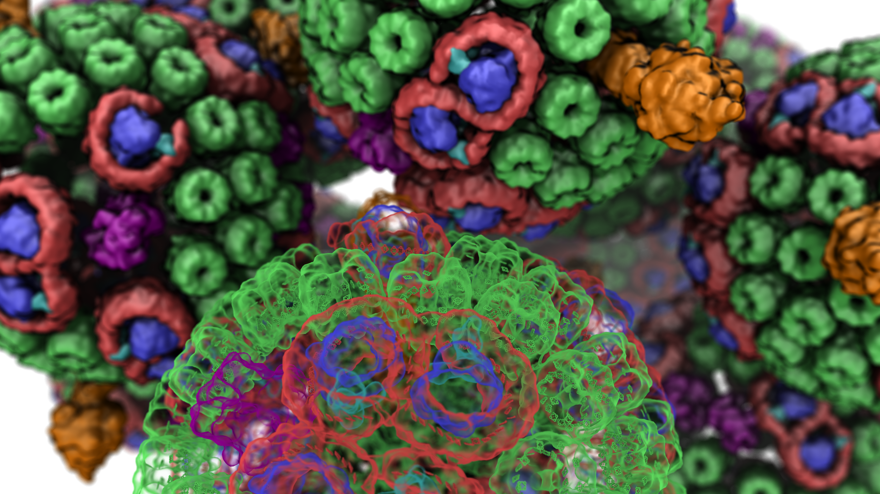
VMD/OpiX RTX Acceleration

Slide 13
What is RTX Acceleration Doing?
Hardware acceleration (Turing RT cores) of:
BVH AS traversal
Ray-triangle intersection
BVH AS can embed triangle geometry
Triangle geometry buffer can then be ephemeral

Slide 14
Secondary Benefits and RTX Performance Observations
Traversal and intersection work performed by RT cores vacates GPU SMs and makes them available for other RT work
RTX hardware traversal performance approaches GPU memory bandwidth limits
Future RTX hardware could end up being bandwidth bound in some cases
Start adapting geometric data representations for minimum footprint, e.g. by using compressed or quantized data representations such as Octohedron Normal Vector encoding (replace 3x 32-bit floats with a single 32-bit int)

Slide 15
Ray Tracing Gems
Ch. 4, “A Planetarium Dome Master Camera”
Ch. 27, “Interactive Ray Tracing Techniques for High-Fidelity Scientific Visualization”
Tons of great material and code samples!
See Eric Haines RTG GTC talk:
Room 230B (Concourse Level) on Thursday 2-3 PM
RTG book signings on Thursday, 3-4pm @ GTC book seller

Slide 16
VMD Molecular Structure Data and Global State
Scene Graph
Graphical Representations
User Interface Subsystem
DrawMolecule
Tcl/Python Scripting
Non-Molecular
Geometry
Mouse + Windows
VR Input “Tools”
Display Subsystem
Windowed OpenGL GPU
VMDDisplayList
OpenGL Pbuffer GPU
OpenGLDisplayDevice
Tachyon CPU RT
DisplayDevice
FileRenderer
TachyonL-OptiX GPU RT
Batch + Interactive

Slide 17
VMD Scene w/ OptiX Classic APIs
OptiX Classic Scene Construction
Scene Graph
Incoming VMD Geom
All Geometry
Alloc Geom Buffers
Assign Closest-Hit
Material Shaders
TrBvh RT Acceleration Structure
…

Slide 18
VMD Scene w/ OptiX RTX APIs
OptiX RTX Scene Construction
Scene Graph
Incoming VMD Geom
General Geometry
Triangle Meshes
Alloc Geom Buffers
Alloc Tri Buffers
Assign Closest-Hit
Material Shaders
Assign Closest-Hit
Material Shaders
TrBvh RT Acceleration Structure
…
…

Slide 23
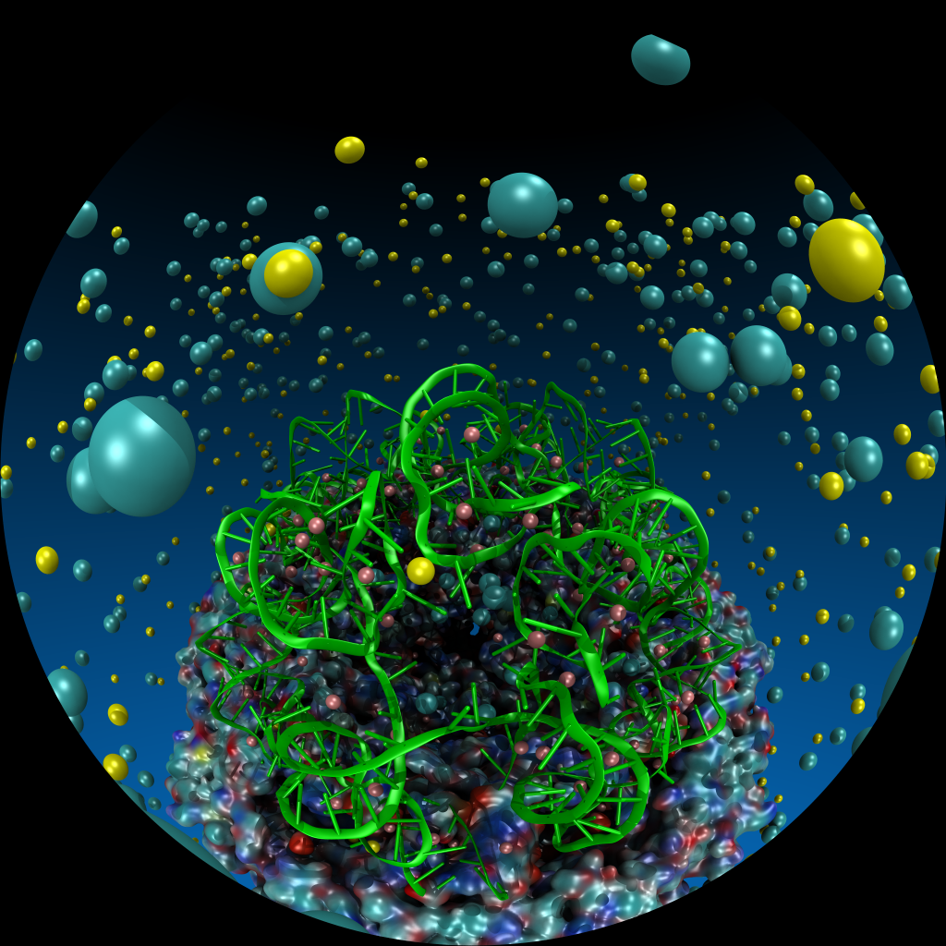
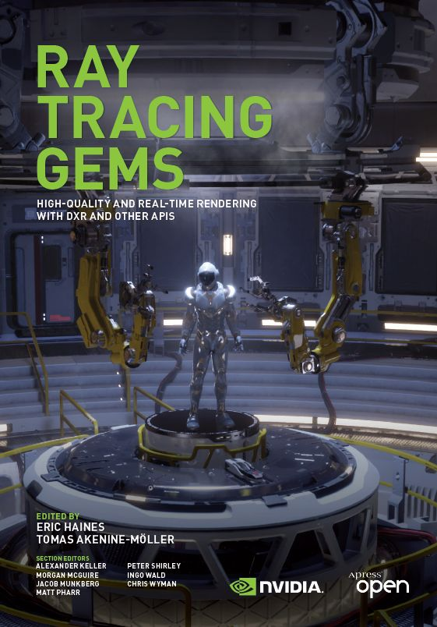
VMD Planetarium Dome Master Camera
Fully interactive RT with ambient occlusion, shadows, depth of field, reflections, …
Both mono and stereoscopic
No post-processing required
Ray Tracing Gems Ch. 4

Slide 24
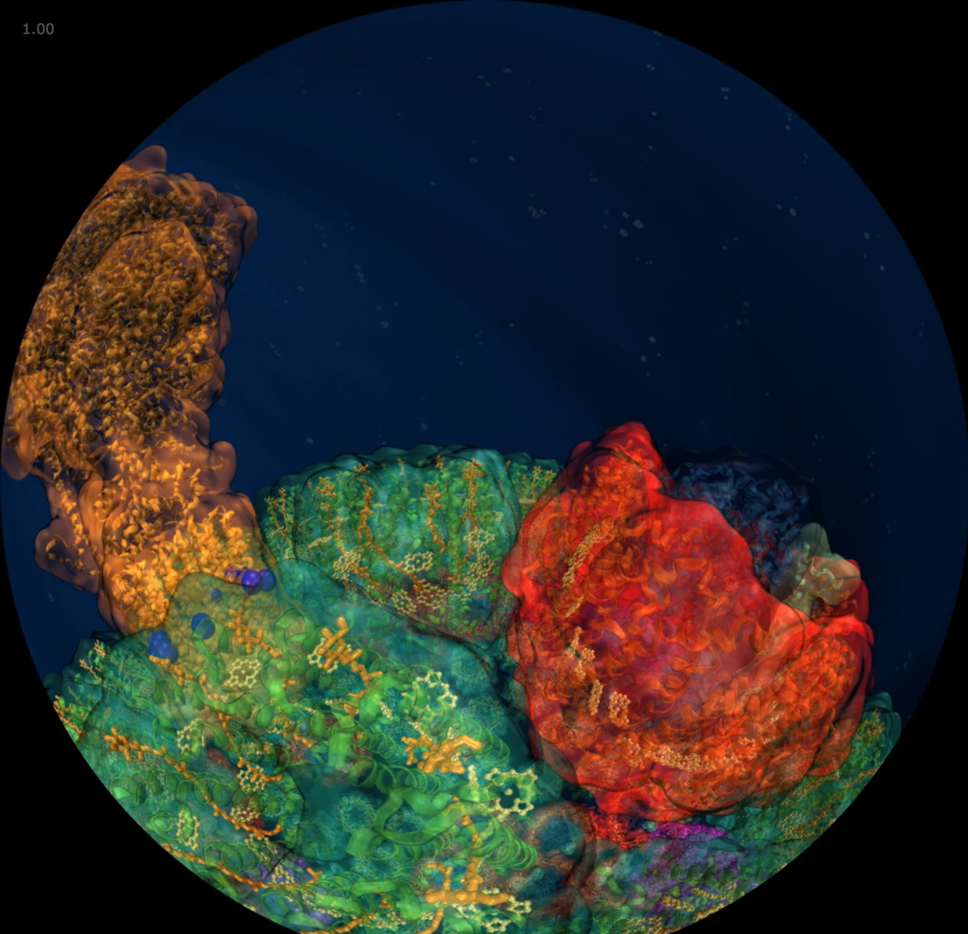
Planetarium Dome Master Projections NSF CADENS Dome Show w/ NCSA AVL
Notes:
VMD Planetarium Dome Master Camera
RT-based dome projection -- rasterization poorly suited to non-planar projections
Fully interactive RT with ambient occlusion, shadows, depth of field, reflections, and so on
Both mono and stereoscopic
No further post-processing required

Slide 25
Birth of Planet Earth Fulldome Show
Premieres March 28, Zeiss Großplanetarium, Berlin, Germany
First public showing on March 30, Das Planetarium am Insulaner, Berlin, Germany
Joint project with:
Spitz Creative Media
NCSA Advanced Visualization Lab
Thomas Lucas Productions, Inc.
Tellus Science Museum
NSF Support: CADENS award ACI-1445176

Slide 26
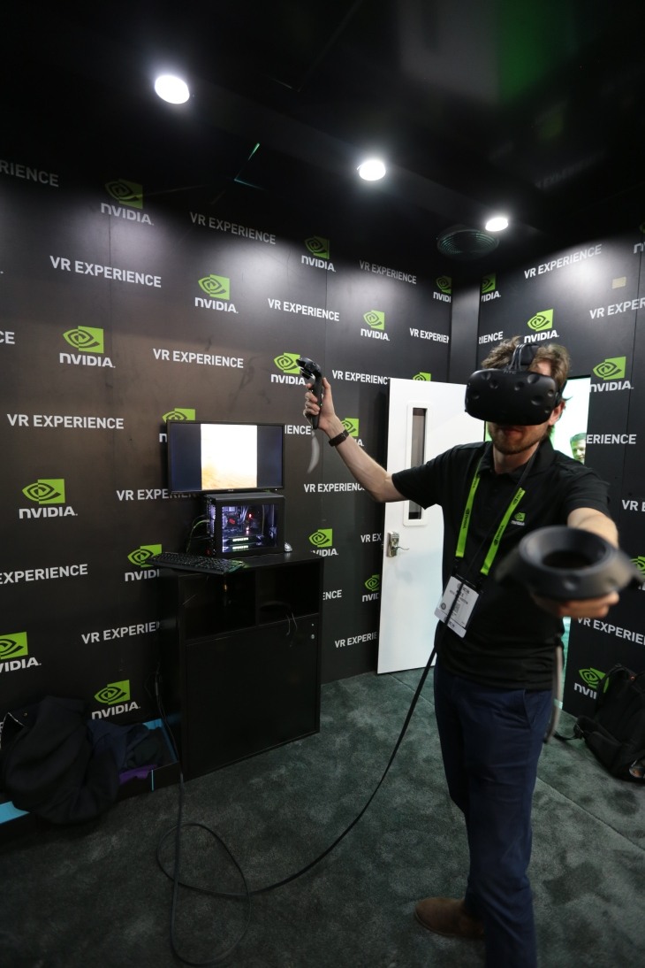
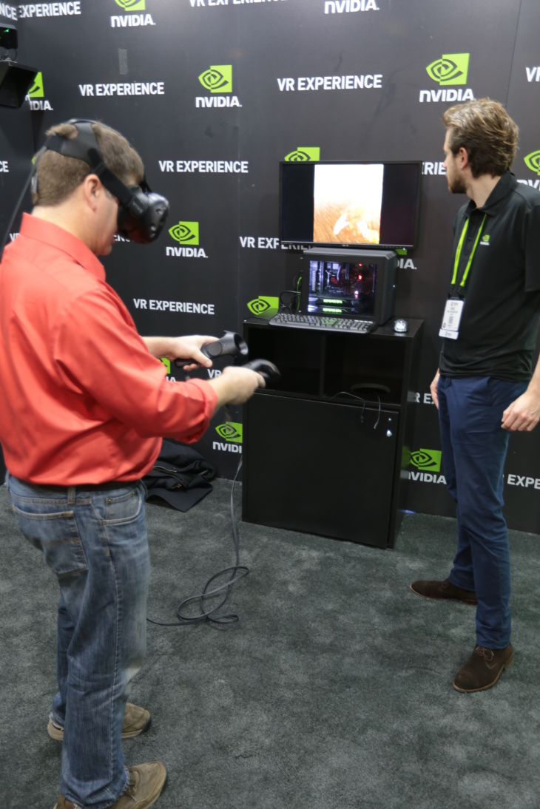
In-Progress VMD VR Development, Demos
VMD VR ray tracing:
Google Cardboard [1]
Demo w/ Indiana U., SC’15 [2]
Prototype of VR user interaction with VMD models in room-scale VR with NVIDIA @ SC’16
[1] Atomic Detail Visualization of Photosynthetic Membranes with GPU-Accelerated Ray Tracing. Stone et al., J. Parallel Computing, 55:17-27, 2016.
[2] Immersive Molecular Visualization with Omnidirectional Stereoscopic Ray Tracing and Remote Rendering. J.E. Stone, W.R. Sherman, K. Schulten. IEEE HPDAV (IPDPSW), pp. 1048-1057, 2016.
VMD Chromatophore Demo, NVIDIA VR Room at SC‘16

Slide 27
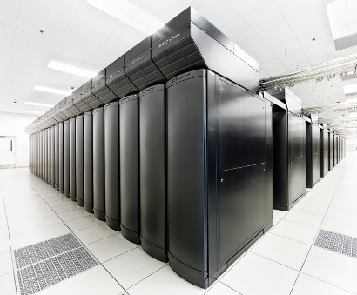
VMD Petascale Visualization and Analysis
Analyze/visualize large trajectories too large to transfer off-site:
User-defined parallel analysis operations, data types
Parallel rendering, movie making
Supports GPU-accelerated Cray XK7 nodes for both visualization and analysis:
GPU accelerated trajectory analysis w/ CUDA
OpenGL and GPU ray tracing for visualization and movie rendering
Parallel I/O rates up to 275 GB/sec on 8192 Cray XE6 nodes – can read in 231 TB in 15 minutes!
Parallel VMD currently available on:
ORNL Titan, NCSA Blue Waters, Indiana Big Red II, CSCS Piz Daint, and similar systems
NCSA Blue Waters Hybrid Cray XE6 / XK7
22,640 XE6 dual-Opteron CPU nodes
4,224 XK7 nodes w/ Telsa K20X GPUs

Slide 28
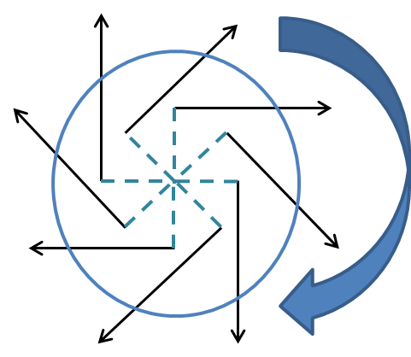
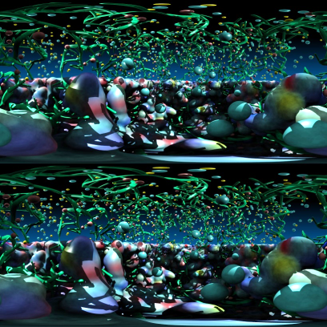
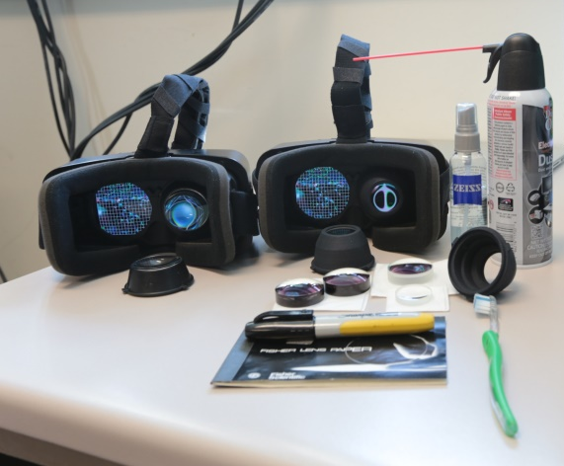
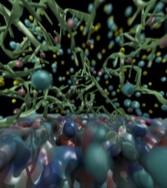
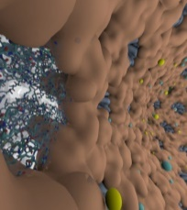
Omnidirectional Stereoscopic Ray Tracing
Ray trace 360° images and movies for Desk and VR HMDs: Oculus, Vive, Cardboard
Stereo spheremaps or cubemaps allow very high-frame-rate interactive OpenGL display
AO lighting, depth of field, shadows, transparency, curved geometry, …
Atomic Detail Visualization of Photosynthetic Membranes with GPU-Accelerated Ray Tracing. J. E. Stone, et al. J. Parallel Computing, 55:17-27, 2016.
Immersive Molecular Visualization with Omnidirectional Stereoscopic Ray Tracing and Remote Rendering. J. E. Stone, W. R. Sherman, and K. Schulten. High Performance Data Analysis and Visualization Workshop, IEEE International Parallel and Distributed Processing Symposium Workshops (IPDPSW), pp. 1048-1057, 2016.

Slide 29
HMD Ray Tracing Challenges
HMDs require high frame rates (90Hz or more) and minimum latency between IMU sensor reads and presentation on the display
Multi-GPU workstations fast enough to direct-drive HMDs at required frame rates for simple scenes with direct lighting, hard shadows
Advanced RT effects such as AO lighting, depth of field, path tracing require large sample counts, difficult for direct-driving HMDs today
Remote viz. required for many HPC problems due to large data
Remote viz. latencies too high for direct-drive of HMD
Our two-phase approach: moderate-FPS remote RT combined with local high-FPS view-dependent HMD reprojection w/ OpenGL

Slide 30
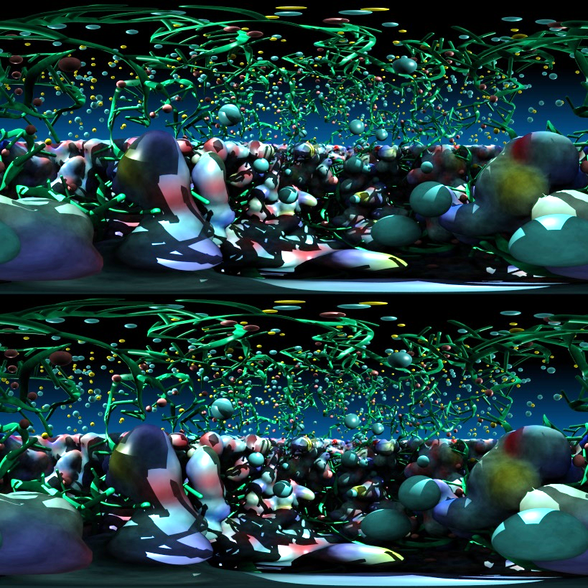
Stereoscopic Panorama Ray Tracing w/ OptiX
Render 360° images and movies for VR headsets such as Oculus Rift, Google Cardboard
Ray trace panoramic stereo spheremaps or cubemaps for very high-frame-rate display via OpenGL texturing onto simple proxy geometry
Stereo requires spherical camera projections poorly suited to rasterization
Benefits from OptiX multi-GPU rendering and load balancing, remote visualization

Slide 31
A) Monoscopic circular projection.
Eye at center of projection (COP).
B) Left eye stereo circular projection.
Eye offset from COP by half of interocular distance.
Polar Axis
Zero Eye Sep
C) Stereo eye separation smoothly decreased to zero at zenith and nadir points on the polar axis to prevent incorrect stereo when HMD sees the poles.
Decreasing Eye Sep
Full Eye Separation
Decreasing Eye Sep
Zero Eye Sep

Slide 32
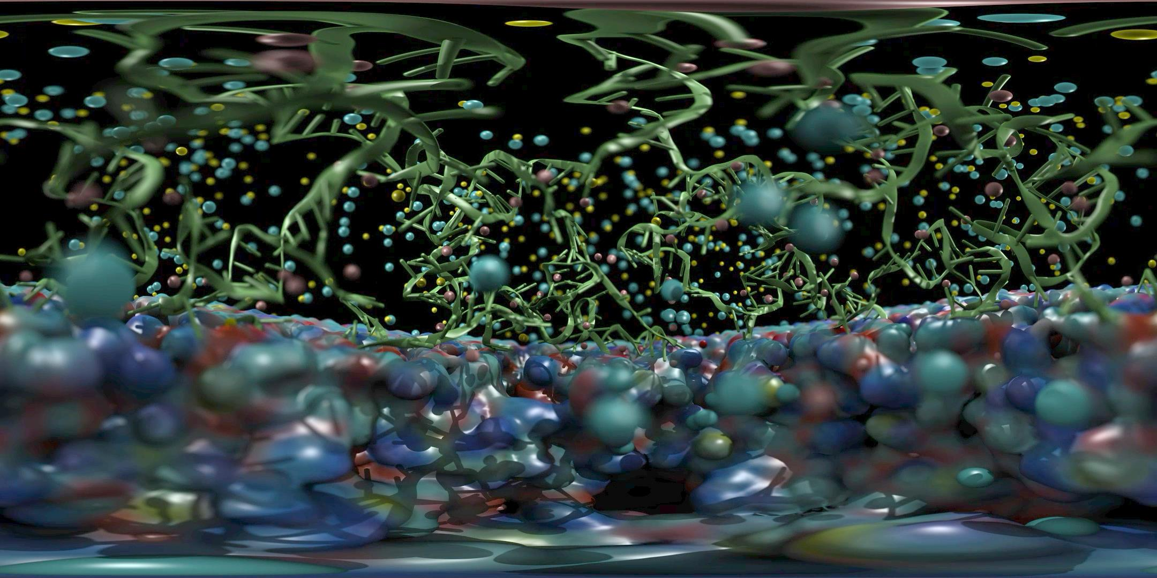
Satellite Tobacco Mosaic Virus: Capsid, Interior RNA, and Ions
Ambient Occlusion Lighting, Depth-of-Field Focal Blur, …

Slide 33
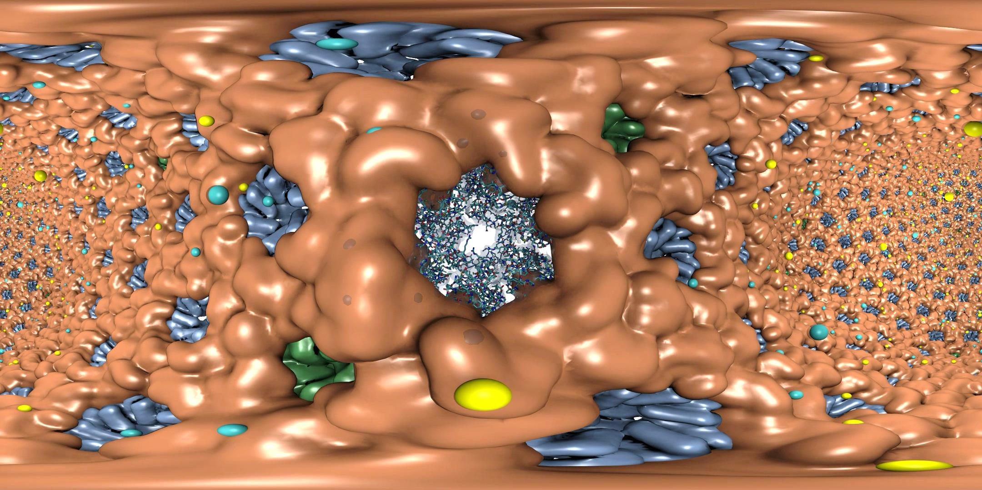
HIV-1 Capsid, Capsid Hexamer Detail, and Ions
Range-Limited Ambient Occlusion Lighting, VR “Headlight”, …

Slide 34
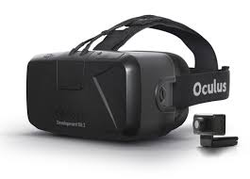
Progressive
Ray Tracing Engine Ray tracing loop runs
continuously in new thread
Decodes H.264 video
stream from remote
VCA GPU cluster
Omnistereo
Image Stream
HMD Display Loop HMD loop runs in main
VMD application thread
at max OpenGL draw rate
View-dependent
stereo reprojection for
current HMD head pose
HMD distortion correction
Camera
+ Scene
RT Code
+ Camera
+ Scene
Omnistereo
H.264 Video
HMD Video
HMD Pose
VMD
15Mbps Internet Link
HMD
Remote VCA GPU Cluster
Ray tracing runs continuously,
streams H.264 video to VMD client

Slide 35
2016: Remote Omnidirectional Stereoscopic RT Performance @ 3072x1536 w/ 2-subframes
Scene | Per-subframe samples AA : AO (AO per-hit) | RT update rate (FPS)
STMV shadows | 1:0 2:0 4:0 | 22.2 18.1 10.3
STMV Shadows+AO | 1:1 1:2 1:4 | 18.2 16.1 12.4
STMV Shadows+AO+DoF | 1:1 2:1 2:2 | 16.1 11.1 8.5
HIV-1 Shadows | 1:0 2:0 4:0 | 20.1 18.1 10.2
HIV-1 Shadows+AO | 1:1 1:2 1:4 | 17.4 12.2 8.1

Slide 36
2019: Local RTX Omnidirectional Stereoscopic RT Performance @ 3072x1536 w/ 1-subframe
Scene | Per-subframe samples AA : AO (AO per-hit) | RT update rate (FPS)
STMV shadows | 1:0 2:0 4:0 | 75.0 37.5 18.3
STMV Shadows+AO | 1:1 1:2 1:4 1:8 | 65.8 57.5 37.5 25.2
STMV Shadows+AO+DoF | 1:1 2:1 2:2 | 61.5 22.1 18.5
HIV-1 Shadows | 1:0 2:0 4:0 | 75..0 74.2 37.5
HIV-1 Shadows+AO | 1:1 1:2 1:4 1:8 | 72.0 61.0 37.5 23.1

Slide 37
HMD View-Dependent Reprojection with OpenGL
Texture map panoramic image onto reprojection geometry that matches the original RT image formation surface (sphere for equirectangular, cube for cube map)
HMD sees standard perspective frustum view of the textured surface
Commodity HMD optics require software lens distortion and chromatic aberration correction prior to display, implemented with multi-pass FBO rendering
Enables low-latency, high-frame-rate redraw as HMD head pose changes (150Hz or more)

Slide 38
Immersive Molecular Visualization with Omnidirectional Stereoscopic Ray Tracing and Remote Rendering. J. E. Stone, W. R. Sherman, and K. Schulten. High Performance Data Analysis and Visualization Workshop, IEEE International Parallel and Distributed Processing Symposium Workshops (IPDPSW), pp. 1048-1057, 2016.

Slide 39
Ongoing Ray Traced VR Work
OpenXR – cross platform muti-vendor HMD support
VMD RTX ray tracing engine and optimizations:
AI denoising for better average quality
Interactive RT stochastic sampling strategies to improve interactivity
Improved omnidirectional cubemap/spheremap sampling approaches
AI multi-view warping to allow rapid in-between view generation amid multiple HMD head locations
H.265 for high-res omnidirectional video streaming
Multi-node parallel RT and remote viz. on general clusters and supercomputers, e.g. NCSA Blue Waters, ORNL Titan
Tons of work to do on VR user interfaces, multi-user collaborative visualization, …

Slide 40
Next Generation: Simulating a Proto-Cell
ORNL Summit: NVLink-connected Tesla V100 GPUs enable next-gen visualizations
200nm diameter
~1 billion atoms w/ solvent
~1400 proteins in membrane

Slide 41
IBM AC922, ORNL Summit Node
3 GPUs Per CPU Socket
Tesla V100 GPU
Tesla V100 GPU
Tesla V100 GPU
Tesla V100 GPU
Tesla V100 GPU
Tesla V100 GPU
Nvlink 2.0
2x 50GBps:
100GBps
DDR4 DRAM
DDR4 DRAM
POWER9
CPU
POWER9
CPU
X-Bus
64GBps
120GBps
120GBps
InfiniBand
12GBps
InfiniBand
12GBps

Slide 42
NVIDIA DGX-2 16x 32GB Tesla V100 GPUs w/ 300GB/s NVLink, fully switched 512GB HBM2 RAM w/ 2.4TB/s Bisection Bandwidth, 2 PFLOPS
Tesla V100 GPU
Tesla V100 GPU
Tesla V100 GPU
Tesla V100 GPU
Tesla V100 GPU
Tesla V100 GPU
Tesla V100 GPU
Tesla V100 GPU
NVSwitch
NVSwitch
NVSwitch
NVSwitch
NVSwitch
NVSwitch
NVSwitch
NVSwitch
NVSwitch
NVSwitch
NVSwitch
NVSwitch
Tesla V100 GPU
Tesla V100 GPU
Tesla V100 GPU
Tesla V100 GPU
Tesla V100 GPU
Tesla V100 GPU
Tesla V100 GPU
Tesla V100 GPU

Slide 43
RT Opportunities and Challenges Posed by Future DGX-2-Like Node/System Designs
512GB of fast HBM2 RAM w/ 2.4TB/sec bisection bandwidth!!!
CPUs “oversubscribed” by GPUs
GPU RT must dis-involve CPUs to greatest possible extent
Fully-switched NVLink-connected memory systems permit fine-grained multi-GPU RT algorithms via direct peer memory load/stores
Throughput oriented GPU RT work scheduling can hide both local and remote memory latencies gracefully
Application control of the distribution of scene geometry among GPUs, replication or distribution of RT acceleration structures
Permit both “capacity” oriented distributed memory RT approaches and “performance” focused RT approaches heavy on data replication.

Slide 44
Ray Tracing Gems
Ch. 4, “A Planetarium Dome Master Camera”
Ch. 27, “Interactive Ray Tracing Techniques for High-Fidelity Scientific Visualization”
Tons of great material and code samples!
See Eric Haines RTG GTC talk:
Room 230B (Concourse Level) on Thursday 2-3 PM
RTG book signings on Thursday, 3-4pm @ GTC book seller

Slide 45
Making Our Research Tools Easily Accessible
Docker “container” images available in NVIDIA NGC registry
Users obtain Docker images via registry, download and run on the laptop, workstation, cloud, or supercomputer of their choosing
https://ngc.nvidia.com/registry/
https://ngc.nvidia.com/registry/hpc-vmd
Cloud based deployment
Full virtual machines (known as “AMI” in Amazon terminology)
Amazon AWS EC2 GPU-accelerated instances:
http://www.ks.uiuc.edu/Research/cloud/
Clusters, Supercomputers
Workstations,
Servers,
Cloud
Molecular dynamics-based refinement and validation for sub-5 Å cryo-electron microscopy maps. Abhishek Singharoy, Ivan Teo, Ryan McGreevy, John E. Stone, Jianhua Zhao, and Klaus Schulten. eLife, 10.7554/eLife.16105, 2016. (66 pages).
QwikMD-integrative molecular dynamics toolkit for novices and experts. Joao V. Ribeiro, Rafael C. Bernardi, Till Rudack, John E. Stone, James C. Phillips, Peter L. Freddolino, and Klaus Schulten. Scientific Reports, 6:26536, 2016.
High performance molecular visualization: In-situ and parallel rendering with EGL. John E. Stone, Peter Messmer, Robert Sisneros, and Klaus Schulten. 2016 IEEE International Parallel and Distributed Processing Symposium Workshop (IPDPSW), pp. 1014-1023, 2016.

Slide 46
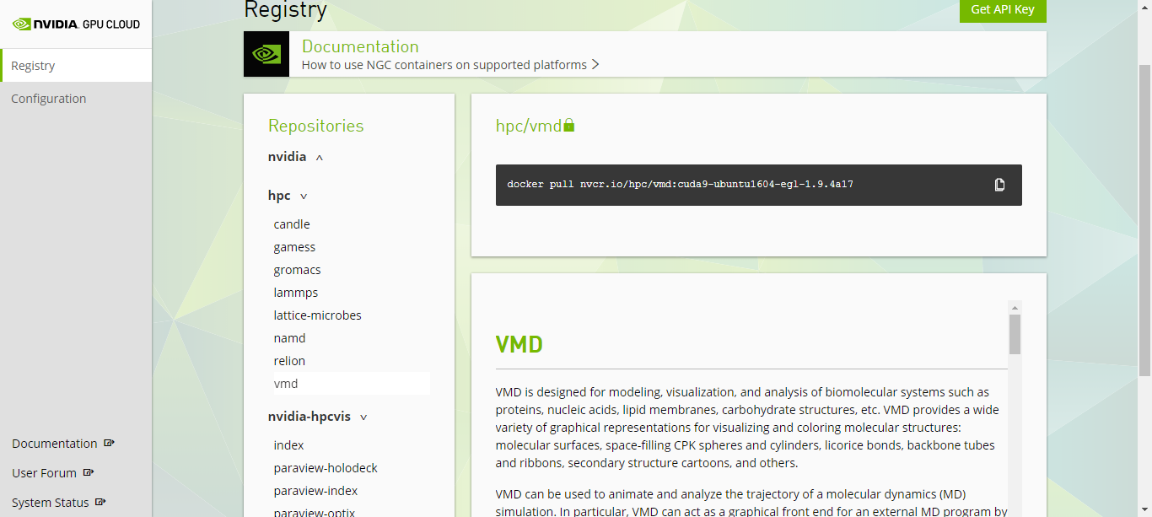
VMD / NAMD / LM, NGC Containers

Slide 47
VMD OptiX/EGL NGC Container
https://ngc.nvidia.com/registry/
CUDA-accelerated viz+analysis
EGL off-screen rendering – no windowing system needed
OptiX high-fidelity GPU ray tracing engine built in
All dependencies included
Easy to deploy on a wide range of GPU accelerated platforms
High performance molecular visualization: In-situ and parallel rendering with EGL. J. E. Stone, P. Messmer, R. Sisneros, and K. Schulten. 2016 IEEE International Parallel and Distributed Processing Symposium Workshop (IPDPSW), pp. 1014-1023, 2016.

Slide 48
Acknowledgements
Theoretical and Computational Biophysics Group, University of Illinois at Urbana-Champaign
NVIDIA CUDA and OptiX teams
Funding:
NIH support: P41GM104601
DOE INCITE, ORNL Titan: DE-AC05-00OR22725
NSF Blue Waters: NSF OCI 07-25070, PRAC “The Computational Microscope”, ACI-1238993, ACI-1440026
Notes:
48

Slide 49
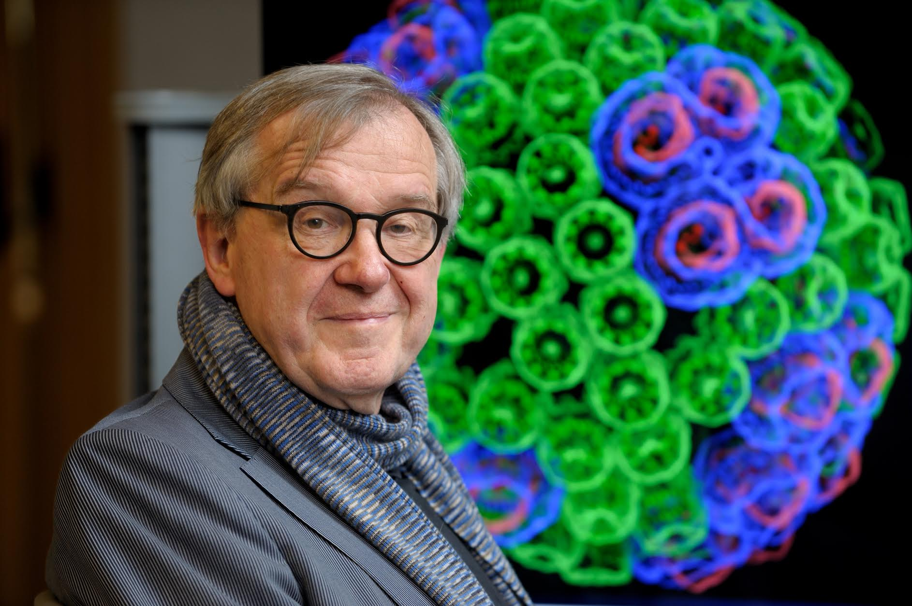
“When I was a young man, my goal was to look with mathematical and computational means at the inside of cells, one atom at a time, to decipher how living systems work. That is what I strived for and I never deflected from this goal.” – Klaus Schulten

Slide 50
Related Publications http://www.ks.uiuc.edu/Research/gpu/
NAMD goes quantum: An integrative suite for hybrid simulations. Melo, M. C. R.; Bernardi, R. C.; Rudack T.; Scheurer, M.; Riplinger, C.; Phillips, J. C.; Maia, J. D. C.; Rocha, G. D.; Ribeiro, J. V.; Stone, J. E.; Neese, F.; Schulten, K.; Luthey-Schulten, Z.; Nature Methods, 2018. (In press)
Challenges of Integrating Stochastic Dynamics and Cryo-electron Tomograms in Whole-cell Simulations. T. M. Earnest, R. Watanabe, J. E. Stone, J. Mahamid, W. Baumeister, E. Villa, and Z. Luthey-Schulten. J. Physical Chemistry B, 121(15): 3871-3881, 2017.
Early Experiences Porting the NAMD and VMD Molecular Simulation and Analysis Software to GPU-Accelerated OpenPOWER Platforms. J. E. Stone, A.-P. Hynninen, J. C. Phillips, and K. Schulten. International Workshop on OpenPOWER for HPC (IWOPH'16), LNCS 9945, pp. 188-206, 2016.
Immersive Molecular Visualization with Omnidirectional Stereoscopic Ray Tracing and Remote Rendering. J. E. Stone, W. R. Sherman, and K. Schulten. High Performance Data Analysis and Visualization Workshop, IEEE International Parallel and Distributed Processing Symposium Workshop (IPDPSW), pp. 1048-1057, 2016.
High Performance Molecular Visualization: In-Situ and Parallel Rendering with EGL. J. E. Stone, P. Messmer, R. Sisneros, and K. Schulten. High Performance Data Analysis and Visualization Workshop, IEEE International Parallel and Distributed Processing Symposium Workshop (IPDPSW), pp. 1014-1023, 2016.
Evaluation of Emerging Energy-Efficient Heterogeneous Computing Platforms for Biomolecular and Cellular Simulation Workloads. J. E. Stone, M. J. Hallock, J. C. Phillips, J. R. Peterson, Z. Luthey-Schulten, and K. Schulten.25th International Heterogeneity in Computing Workshop, IEEE International Parallel and Distributed Processing Symposium Workshop (IPDPSW), pp. 89-100, 2016.

Slide 51
Related Publications http://www.ks.uiuc.edu/Research/gpu/
Atomic Detail Visualization of Photosynthetic Membranes with GPU-Accelerated Ray Tracing. J. E. Stone, M. Sener, K. L. Vandivort, A. Barragan, A. Singharoy, I. Teo, J. V. Ribeiro, B. Isralewitz, B. Liu, B.-C. Goh, J. C. Phillips, C. MacGregor-Chatwin, M. P. Johnson, L. F. Kourkoutis, C. Neil Hunter, and K. Schulten. J. Parallel Computing, 55:17-27, 2016.
Chemical Visualization of Human Pathogens: the Retroviral Capsids. Juan R. Perilla, Boon Chong Goh, John E. Stone, and Klaus Schulten. SC'15 Visualization and Data Analytics Showcase, 2015.
Visualization of Energy Conversion Processes in a Light Harvesting Organelle at Atomic Detail. M. Sener, J. E. Stone, A. Barragan, A. Singharoy, I. Teo, K. L. Vandivort, B. Isralewitz, B. Liu, B. Goh, J. C. Phillips, L. F. Kourkoutis, C. N. Hunter, and K. Schulten. SC'14 Visualization and Data Analytics Showcase, 2014. ***Winner of the SC'14 Visualization and Data Analytics Showcase
Runtime and Architecture Support for Efficient Data Exchange in Multi-Accelerator Applications. J. Cabezas, I. Gelado, J. E. Stone, N. Navarro, D. B. Kirk, and W. Hwu. IEEE Transactions on Parallel and Distributed Systems, 26(5):1405-1418, 2015.
Unlocking the Full Potential of the Cray XK7 Accelerator. M. D. Klein and J. E. Stone. Cray Users Group, Lugano Switzerland, May 2014.
GPU-Accelerated Analysis and Visualization of Large Structures Solved by Molecular Dynamics Flexible Fitting. J. E. Stone, R. McGreevy, B. Isralewitz, and K. Schulten. Faraday Discussions, 169:265-283, 2014.
Simulation of reaction diffusion processes over biologically relevant size and time scales using multi-GPU workstations. M. J. Hallock, J. E. Stone, E. Roberts, C. Fry, and Z. Luthey-Schulten. Journal of Parallel Computing, 40:86-99, 2014.

Slide 52
Related Publications http://www.ks.uiuc.edu/Research/gpu/
GPU-Accelerated Molecular Visualization on Petascale Supercomputing Platforms. J. Stone, K. L. Vandivort, and K. Schulten. UltraVis'13: Proceedings of the 8th International Workshop on Ultrascale Visualization, pp. 6:1-6:8, 2013.
Early Experiences Scaling VMD Molecular Visualization and Analysis Jobs on Blue Waters. J. Stone, B. Isralewitz, and K. Schulten. In proceedings, Extreme Scaling Workshop, 2013.
Lattice Microbes: High‐performance stochastic simulation method for the reaction‐diffusion master equation. E. Roberts, J. Stone, and Z. Luthey‐Schulten. J. Computational Chemistry 34 (3), 245-255, 2013.
Fast Visualization of Gaussian Density Surfaces for Molecular Dynamics and Particle System Trajectories. M. Krone, J. Stone, T. Ertl, and K. Schulten. EuroVis Short Papers, pp. 67-71, 2012.
Immersive Out-of-Core Visualization of Large-Size and Long-Timescale Molecular Dynamics Trajectories. J. Stone, K. L. Vandivort, and K. Schulten. G. Bebis et al. (Eds.): 7th International Symposium on Visual Computing (ISVC 2011), LNCS 6939, pp. 1-12, 2011.
Fast Analysis of Molecular Dynamics Trajectories with Graphics Processing Units – Radial Distribution Functions. B. Levine, J. Stone, and A. Kohlmeyer. J. Comp. Physics, 230(9):3556-3569, 2011.

Slide 53
Related Publications http://www.ks.uiuc.edu/Research/gpu/
Quantifying the Impact of GPUs on Performance and Energy Efficiency in HPC Clusters. J. Enos, C. Steffen, J. Fullop, M. Showerman, G. Shi, K. Esler, V. Kindratenko, J. Stone, J Phillips. International Conference on Green Computing, pp. 317-324, 2010.
GPU-accelerated molecular modeling coming of age. J. Stone, D. Hardy, I. Ufimtsev, K. Schulten. J. Molecular Graphics and Modeling, 29:116-125, 2010.
OpenCL: A Parallel Programming Standard for Heterogeneous Computing. J. Stone, D. Gohara, G. Shi. Computing in Science and Engineering, 12(3):66-73, 2010.
An Asymmetric Distributed Shared Memory Model for Heterogeneous Computing Systems. I. Gelado, J. Stone, J. Cabezas, S. Patel, N. Navarro, W. Hwu. ASPLOS ’10: Proceedings of the 15th International Conference on Architectural Support for Programming Languages and Operating Systems, pp. 347-358, 2010.

Slide 54
Related Publications http://www.ks.uiuc.edu/Research/gpu/
GPU Clusters for High Performance Computing. V. Kindratenko, J. Enos, G. Shi, M. Showerman, G. Arnold, J. Stone, J. Phillips, W. Hwu. Workshop on Parallel Programming on Accelerator Clusters (PPAC), In Proceedings IEEE Cluster 2009, pp. 1-8, Aug. 2009.
Long time-scale simulations of in vivo diffusion using GPU hardware. E. Roberts, J. Stone, L. Sepulveda, W. Hwu, Z. Luthey-Schulten. In IPDPS’09: Proceedings of the 2009 IEEE International Symposium on Parallel & Distributed Computing, pp. 1-8, 2009.
High Performance Computation and Interactive Display of Molecular Orbitals on GPUs and Multi-core CPUs. J. E. Stone, J. Saam, D. Hardy, K. Vandivort, W. Hwu, K. Schulten, 2nd Workshop on General-Purpose Computation on Graphics Pricessing Units (GPGPU-2), ACM International Conference Proceeding Series, volume 383, pp. 9-18, 2009.
Probing Biomolecular Machines with Graphics Processors. J. Phillips, J. Stone. Communications of the ACM, 52(10):34-41, 2009.
Multilevel summation of electrostatic potentials using graphics processing units. D. Hardy, J. Stone, K. Schulten. J. Parallel Computing, 35:164-177, 2009.

Slide 55
Related Publications http://www.ks.uiuc.edu/Research/gpu/
Adapting a message-driven parallel application to GPU-accelerated clusters. J. Phillips, J. Stone, K. Schulten. Proceedings of the 2008 ACM/IEEE Conference on Supercomputing, IEEE Press, 2008.
GPU acceleration of cutoff pair potentials for molecular modeling applications. C. Rodrigues, D. Hardy, J. Stone, K. Schulten, and W. Hwu. Proceedings of the 2008 Conference On Computing Frontiers, pp. 273-282, 2008.
GPU computing. J. Owens, M. Houston, D. Luebke, S. Green, J. Stone, J. Phillips. Proceedings of the IEEE, 96:879-899, 2008.
Accelerating molecular modeling applications with graphics processors. J. Stone, J. Phillips, P. Freddolino, D. Hardy, L. Trabuco, K. Schulten. J. Comp. Chem., 28:2618-2640, 2007.
Continuous fluorescence microphotolysis and correlation spectroscopy. A. Arkhipov, J. Hüve, M. Kahms, R. Peters, K. Schulten. Biophysical Journal, 93:4006-4017, 2007.

Slide 56
Related Publications http://www.ks.uiuc.edu/Research/gpu/
GPU Clusters for High Performance Computing. V. Kindratenko, J. Enos, G. Shi, M. Showerman, G. Arnold, J. Stone, J. Phillips, W. Hwu. Workshop on Parallel Programming on Accelerator Clusters (PPAC), In Proceedings IEEE Cluster 2009, pp. 1-8, Aug. 2009.
Long time-scale simulations of in vivo diffusion using GPU hardware. E. Roberts, J. Stone, L. Sepulveda, W. Hwu, Z. Luthey-Schulten. In IPDPS’09: Proceedings of the 2009 IEEE International Symposium on Parallel & Distributed Computing, pp. 1-8, 2009.
High Performance Computation and Interactive Display of Molecular Orbitals on GPUs and Multi-core CPUs. J. E. Stone, J. Saam, D. Hardy, K. Vandivort, W. Hwu, K. Schulten, 2nd Workshop on General-Purpose Computation on Graphics Pricessing Units (GPGPU-2), ACM International Conference Proceeding Series, volume 383, pp. 9-18, 2009.
Probing Biomolecular Machines with Graphics Processors. J. Phillips, J. Stone. Communications of the ACM, 52(10):34-41, 2009.
Multilevel summation of electrostatic potentials using graphics processing units. D. Hardy, J. Stone, K. Schulten. J. Parallel Computing, 35:164-177, 2009.

Slide 57
Related Publications http://www.ks.uiuc.edu/Research/gpu/
Adapting a message-driven parallel application to GPU-accelerated clusters. J. Phillips, J. Stone, K. Schulten. Proceedings of the 2008 ACM/IEEE Conference on Supercomputing, IEEE Press, 2008.
GPU acceleration of cutoff pair potentials for molecular modeling applications. C. Rodrigues, D. Hardy, J. Stone, K. Schulten, and W. Hwu. Proceedings of the 2008 Conference On Computing Frontiers, pp. 273-282, 2008.
GPU computing. J. Owens, M. Houston, D. Luebke, S. Green, J. Stone, J. Phillips. Proceedings of the IEEE, 96:879-899, 2008.
Accelerating molecular modeling applications with graphics processors. J. Stone, J. Phillips, P. Freddolino, D. Hardy, L. Trabuco, K. Schulten. J. Comp. Chem., 28:2618-2640, 2007.
Continuous fluorescence microphotolysis and correlation spectroscopy. A. Arkhipov, J. Hüve, M. Kahms, R. Peters, K. Schulten. Biophysical Journal, 93:4006-4017, 2007.

