Slide 1
Optimizing HPC Simulation and Visualization Code using
NVIDIA Nsight Systems
Daniel Horowitz – Director of Platform Developer Tools, NVIDIA,
Robert (Bob) Knight – Principal System Software Engineer, NVIDIA
Mike Hallock - Research Programmer, U.Illinois at Urbana Champaign
John Stone – Senior Research Programmer, U.Illinos at Urbana Champaign
March 26, 2018

Slide 2

Introducing Nsight Systems
System-wide Performance Analysis Tool
Focus on the application’s algorithm – a unique perspective
Scale your application efficiently across any number of CPUs & GPUs
3.2x-4.1x Speedup Achieved on Visual Molecular Dynamics!
Stay tuned for the details

Slide 3
Nsight product family
Standalone Performance Tools
Nsight Systems - System-wide application algorithm tuning
Nsight Compute - Debug/optimize specific CUDA kernel
- Use NVIDIA Visual Profiler today
Nsight Graphics - Debug/optimize specific graphics shader
IDE Plugins
Nsight Visual Studio/Eclipse Edition – editor, debugger, some perf analysis
Workflow
Nsight
Systems
Start
Here
available @next
major CUDA release
Nsight
Compute
Nsight
Graphics

Slide 4

Nsight Systems User
Notes:
Image sourced from https://commons.wikimedia.org/wiki/File:Yannick_N%C3%A9zet-S%C3%A9guin_2011.jpg
This file is licensed under the Creative Commons Attribution 2.0 Generic license.

Slide 5

Maximize your GPU Investment
Find the right optimization opportunities
Balance your workload across CPUs and GPUs
Achieve real-time performance requirements
Optimize for HPC environments – minimum time to solution

Slide 6
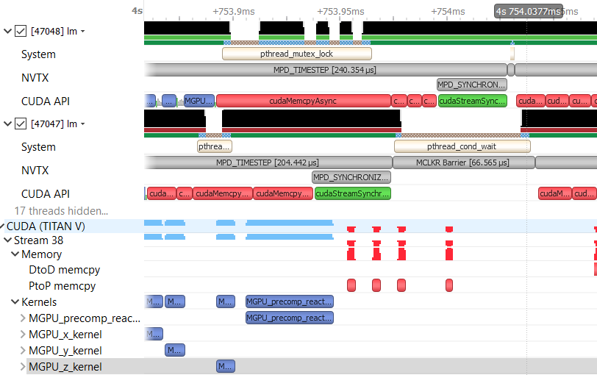
Features
User Instrumentation
NVidia Tools eXtension
- aka NVTX
API Tracing
CUDA, OpenGL,
cuDNN, cuBLAS
System strace-lite
Backtrace Collection
Sampled IPs
Blocked state

Slide 7
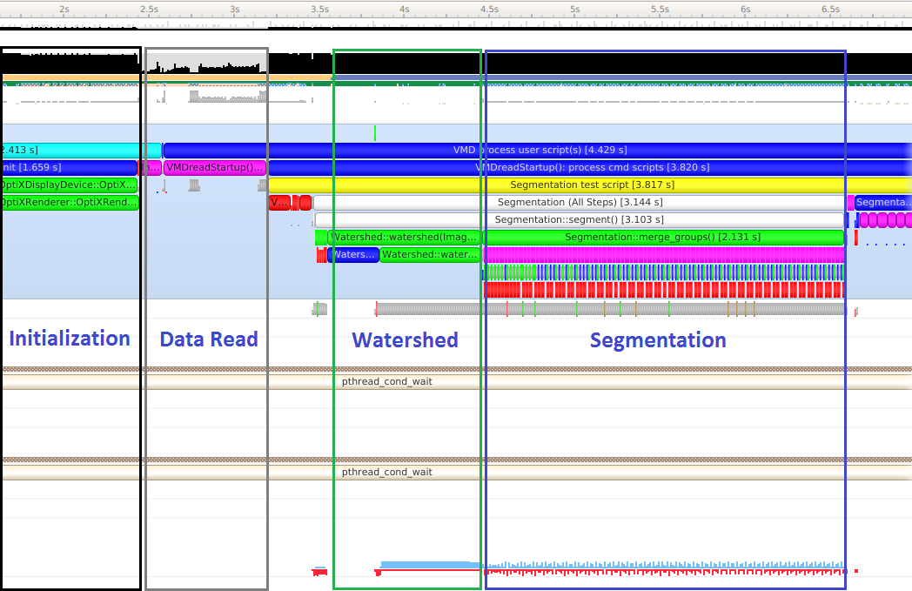
Application Algorithm
Zoom Out
Four Distinct Phases of VMD Algorithm Become Visible

Slide 8
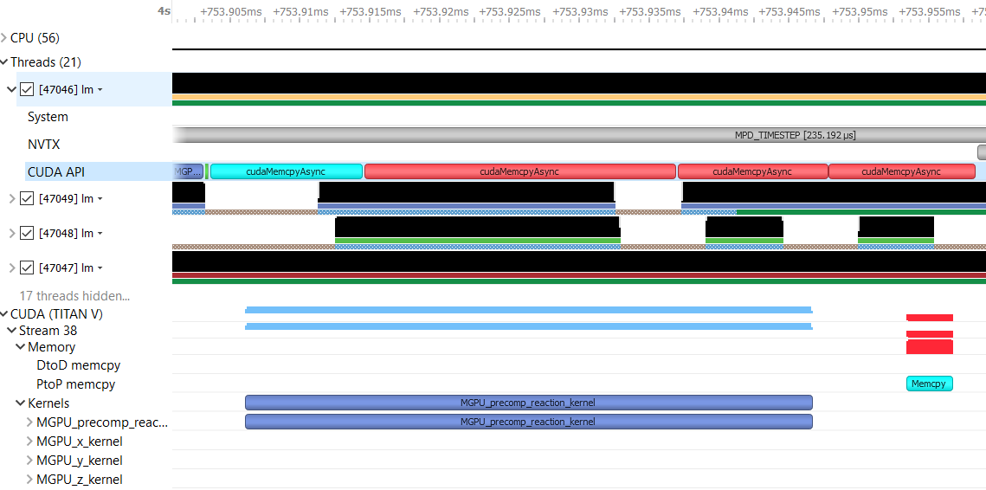
Correlation Ties API to GPU Behavior
Zoom In
Track Algorithm from CPU to GPU or from GPU to CPU!
Selecting one highlights both cause and effect,
i.e. dependency analysis

Slide 9
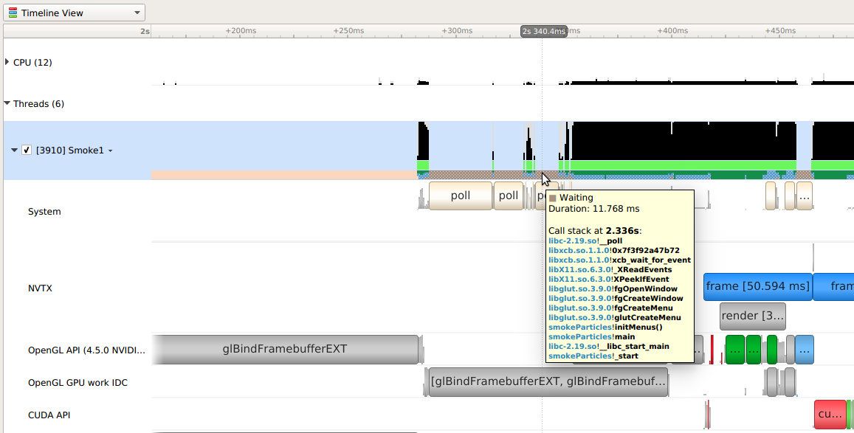
Blocked state backtrace

Slide 10

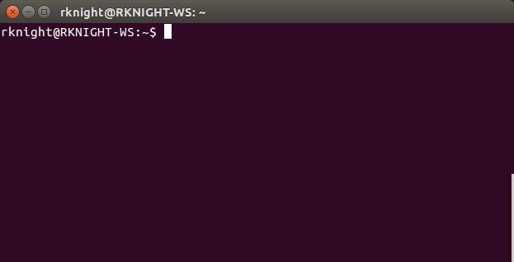

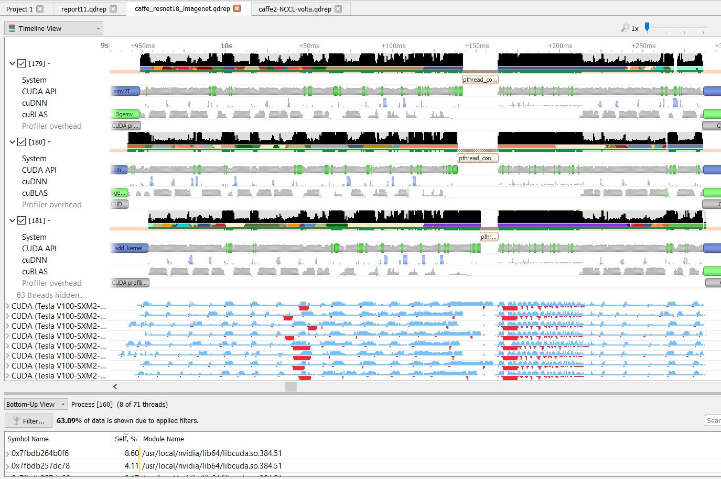
Data Collection
Host
Target
Command Line Interface
No connection! Import later
CLI enables easy collection on servers and in containers
Host-Target
Remote Collection

Slide 11
Report Navigation Demo
New Tool – Outstanding Interactive Performance and Level of Detail Available
Core Areas
Algorithm Overview Using NVTX Tags
OS Thread Timeline including APIs Traced
Correlation of OS Thread API Use with GPU
  Activity
CPU Sampling Shows Hot OS Thread
  Code/Bottlenecks

Slide 12

Common optimization opportunities
CPU
Thread synchronization
Algorithm bottlenecks starve the GPUs
Single GPU
Memory operations – blocking, serial, unnecessary
Excessive synchronization - device, context, stream, default stream, implicit
CPU/GPU overlap – avoid excessive communication
Multi GPU
Communication between GPUs
Lack of stream overlap in memory management, kernel execution

Slide 13
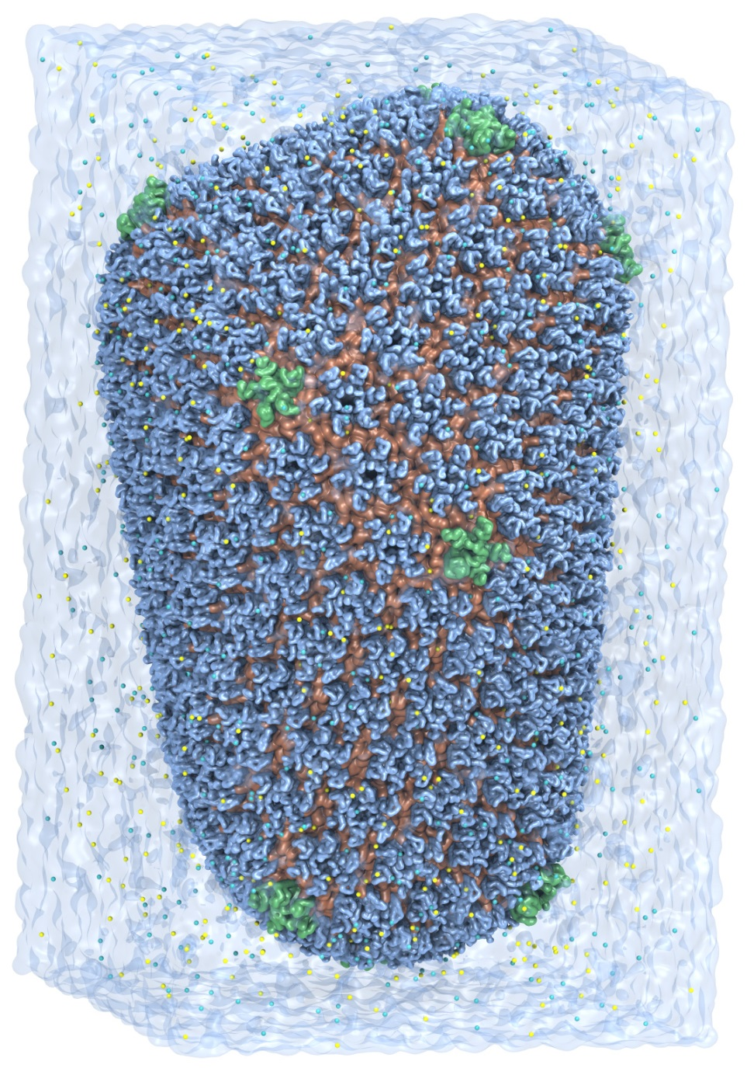
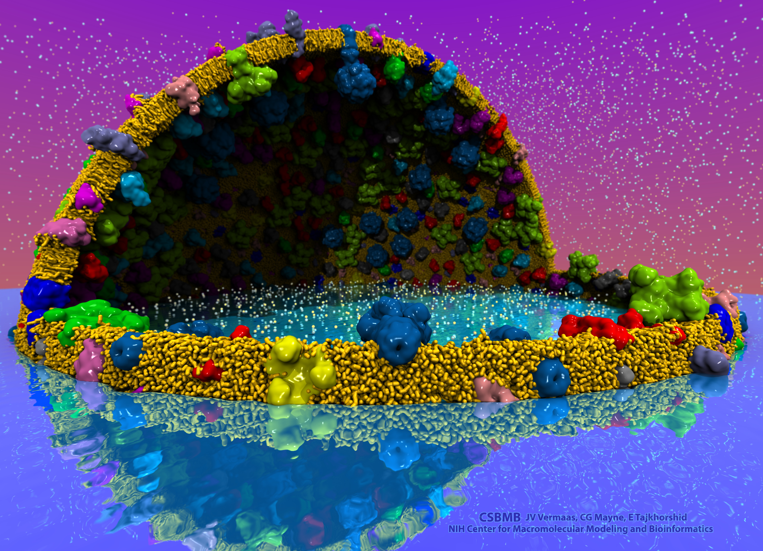
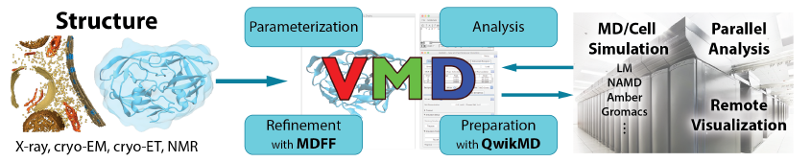
VMD – “Visual Molecular Dynamics”
Visualization and analysis of:
  Molecular dynamics simulations
  Lattice cell simulations
  Quantum chemistry calculations
  Sequence information
User extensible scripting and plugins
http://www.ks.uiuc.edu/Research/vmd/
Cell-Scale Modeling
MD Simulation

Slide 14
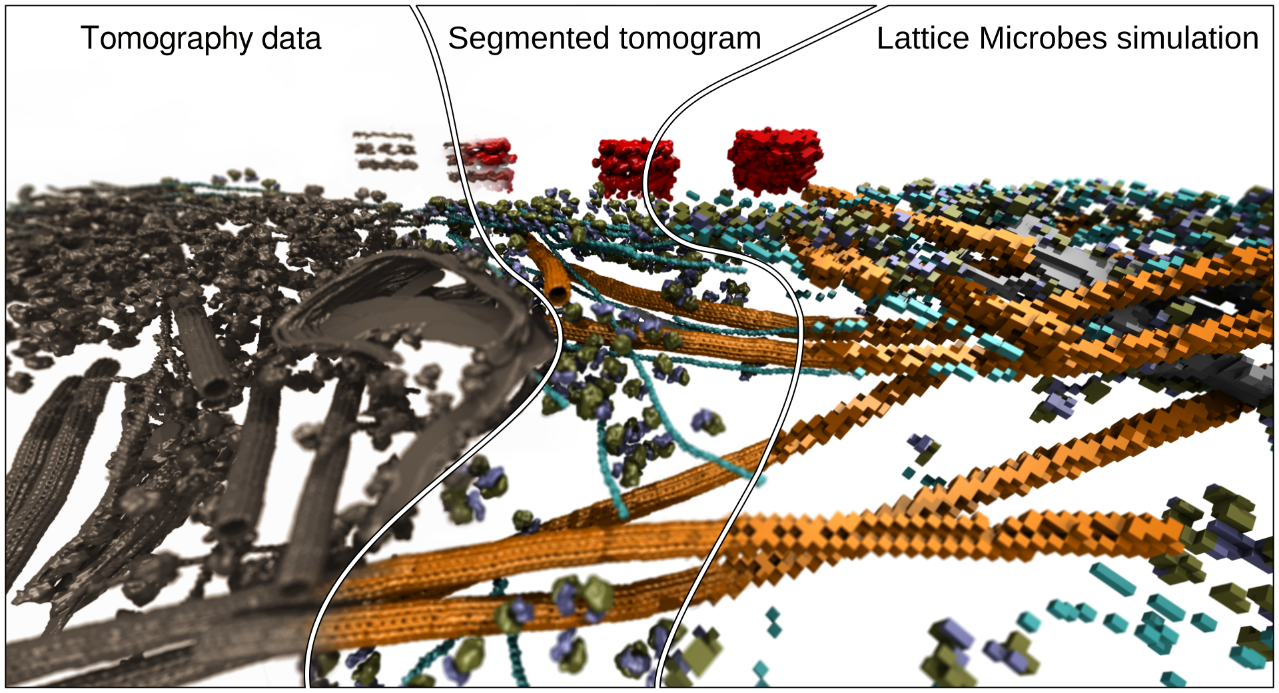


Cryo-EM / Cryo-ET Image Segmentation
Evaluate 3-D volumetric electron density maps and segment them, to identify key structural components
Index/label components so they can be referred to, colored, analyzed, and simulated…
Biomedical Technology Research Center for Macromolecular Modeling and Bioinformatics
Beckman Institute, University of Illinois at Urbana-Champaign – www.ks.uiuc.edu

Slide 15
Cryo-EM Density Map Segmentation
Approach, goals
Watershed segmentation:
Smooth/denoise image (e.g. blur)
Find local minima of image/gradients
Connect minimum voxels with neighbors of similar intensity, marking them with the same “group” number
“Grow” each group (merging groups where rules allow) until no more updates occur
Scale-space segmentation variant does further blurring and group merging
Goals:
Reach interactive performance rates (under 1 second) for common density map sizes between 128³ to 256³ voxels
Handle next-generation problem sizes (768³ to 2048³) smoothly with only a brief wait
Biomedical Technology Research Center for Macromolecular Modeling and Bioinformatics
Beckman Institute, University of Illinois at Urbana-Champaign – www.ks.uiuc.edu

Slide 16
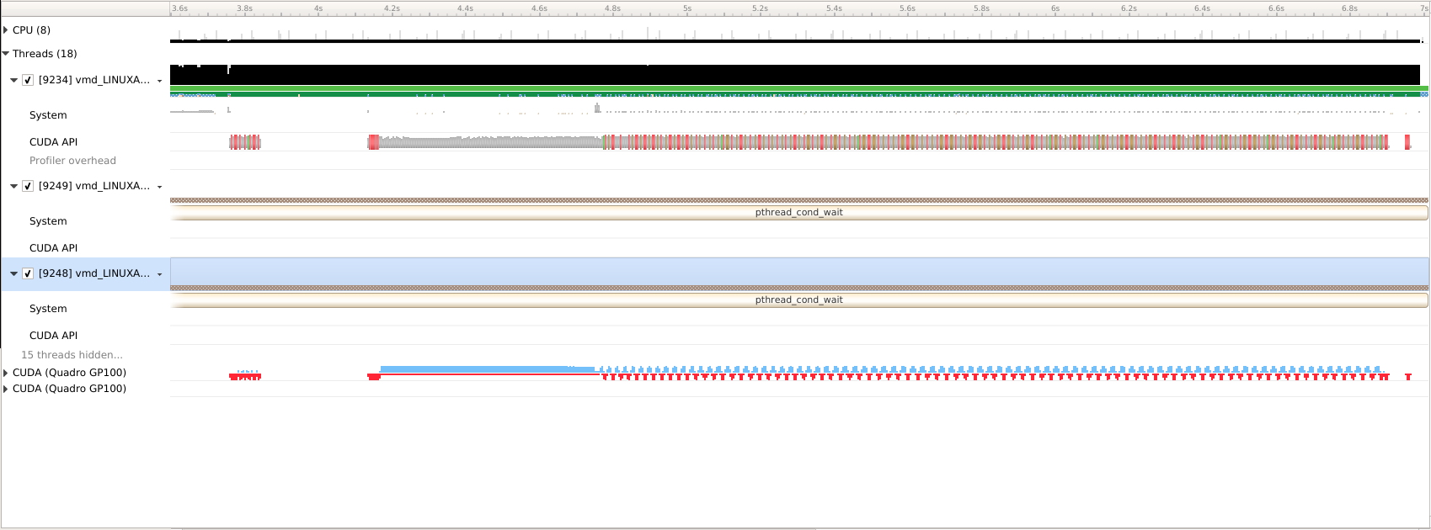
1: Initial VMD Image Segmentation Trace
GPU compute activity shown in BLUE.
Memory transfer activity shown in RED.
Trace shows memory transfers taking a lot of the time in the second phase…
What is the algorithm doing here? Why?

Slide 17
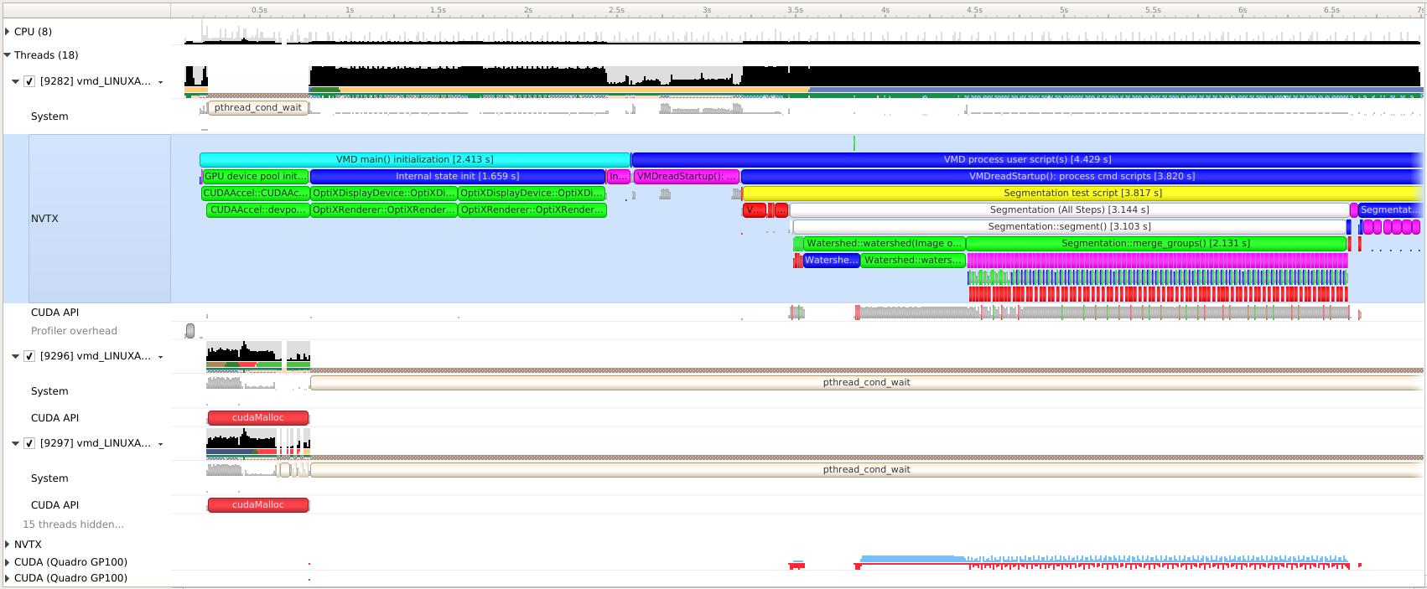
2: VMD Profile w/ NVTX Tags
Added NVTX tags clearly show algorithm phases in the Nsight System timeline.
Biomedical Technology Research Center for Macromolecular Modeling and Bioinformatics
Beckman Institute, University of Illinois at Urbana-Champaign – www.ks.uiuc.edu

Slide 18
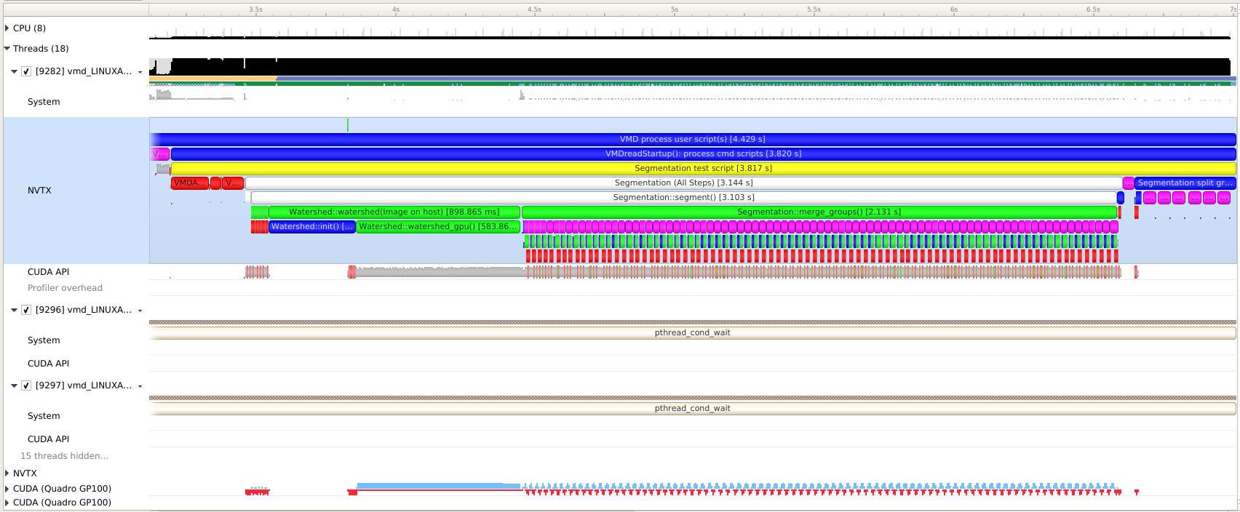
2: VMD Image Segmentation w/ NVTX
Can easily zoom in on NVTX tags (double click) so they fill horizonal view.
Selected yellow “Segmentation test script” view relevant work
Tags shown are algorithm phases, sub-phases, iterations, kernels, and CUDA API calls…
Total time: 3.14s
Total speedup: 1.0x
Phases:
Constructors: 0.1s
Watershed: 0.9s
Scale-Space: 2.13s
Other: 0.014s

Slide 19
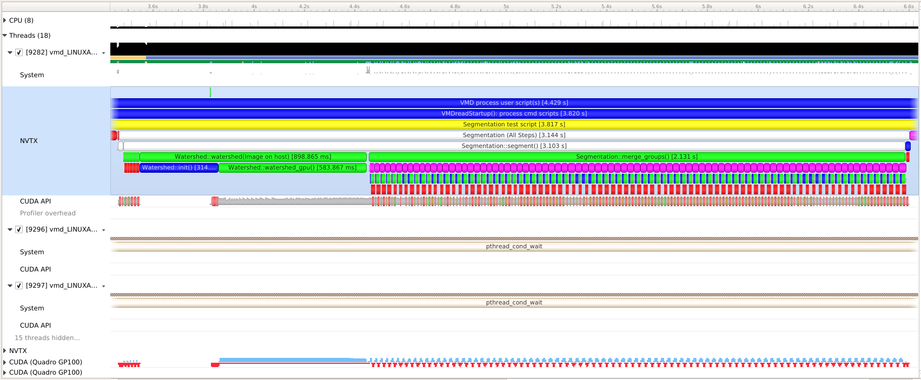
2: Identified Bogus Copies, Slow CPU Init
CPU init routine is slow (30% of Watershed time).
Scale-space algorithm phase dominated by GPU-host memory transfers that shouldn’t be there!

Slide 20
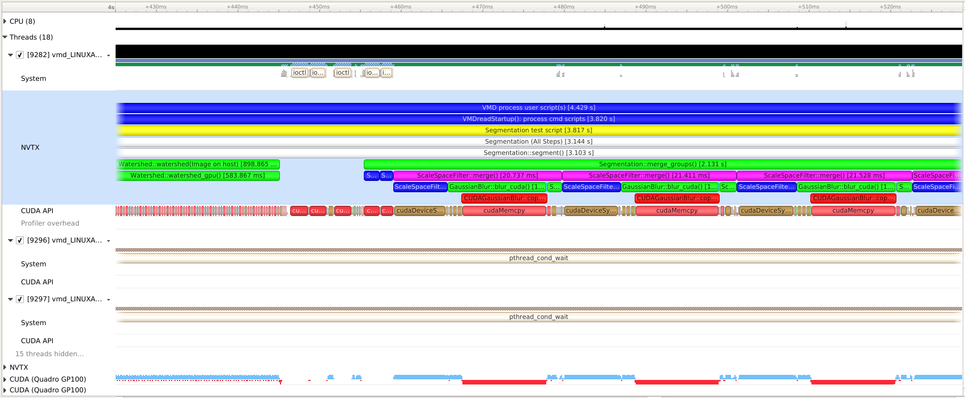
2: Detail: Identified Bogus GPU-Host Copies
Bogus memory copies!
Create gaps in GPU execution
Biomedical Technology Research Center for Macromolecular Modeling and Bioinformatics
Beckman Institute, University of Illinois at Urbana-Champaign – www.ks.uiuc.edu

Slide 21
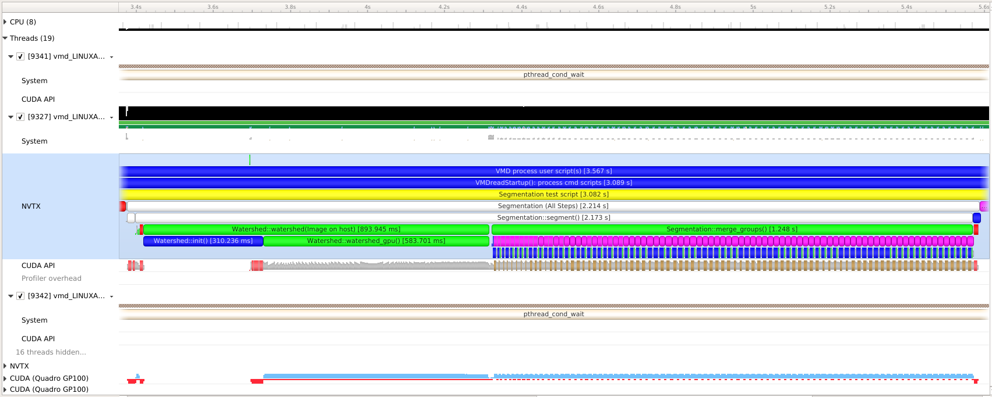
3: Bogus Copies Eliminated
Total time: 2.21s
Total speedup: 1.4x
Phases:
Constructors: 0.1s
Watershed: 0.9s
Scale-Space: 1.25s
Other: -
Bogus copies eliminated.

Slide 22
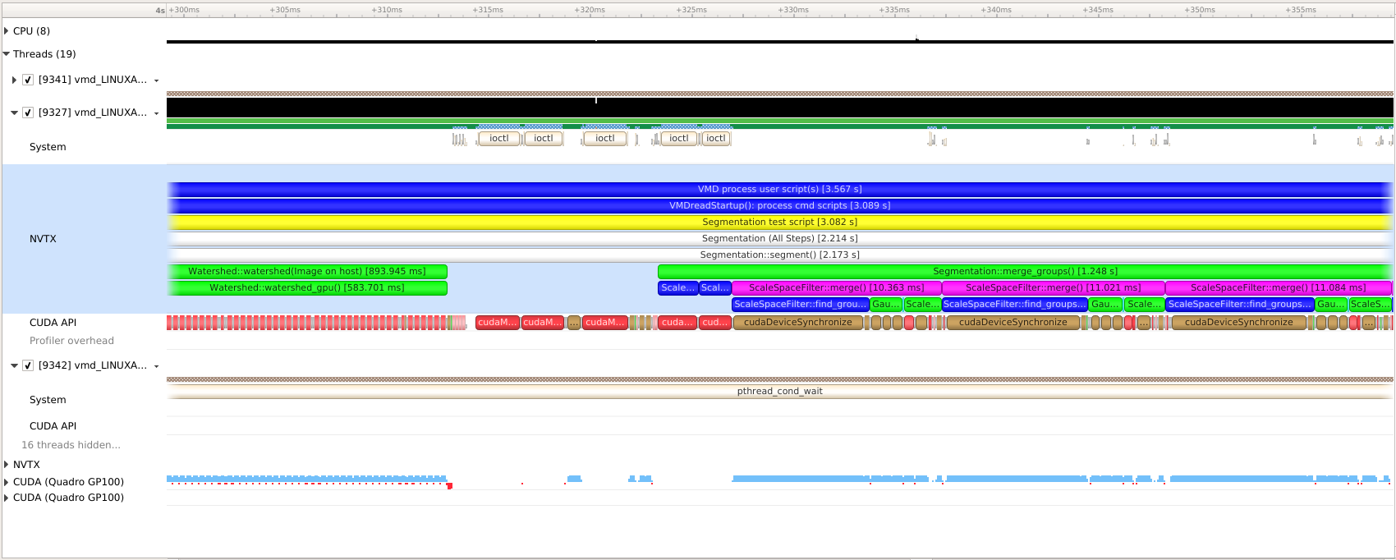
3: Detail: Bogus Copies Eliminated
Bogus copies eliminated.
Gaps between GPU kernels are now very short.
Speedup for just the scale-space algorithm phase is 1.7x

Slide 23
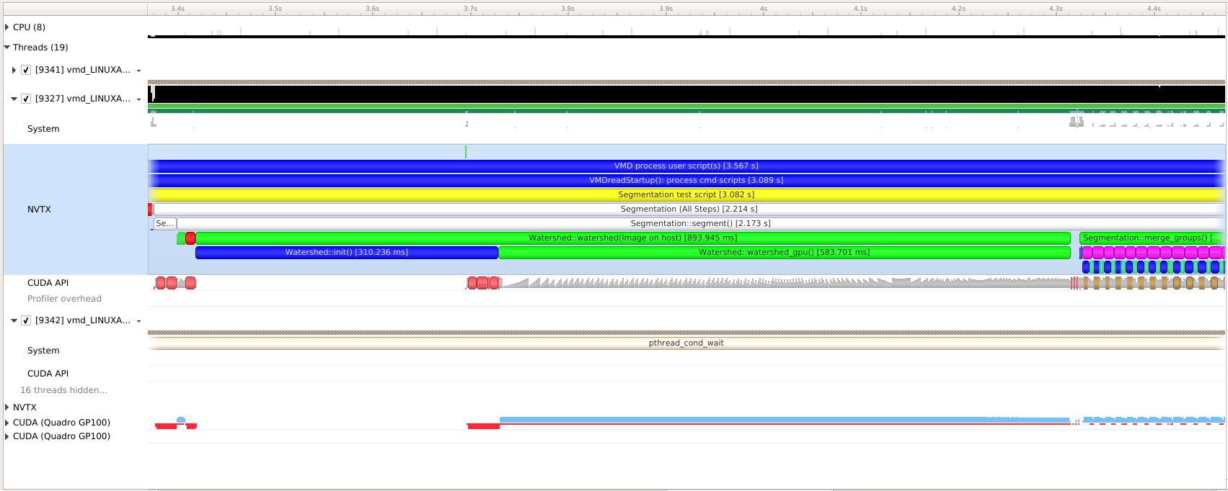
3: Detail: Slow CPU Init Routine
Watershed algorithm CPU init takes 310ms.
Total Watershed runtime is 894ms.
CPU init taking 34% of the runtime for this phase!??!
Biomedical Technology Research Center for Macromolecular Modeling and Bioinformatics
Beckman Institute, University of Illinois at Urbana-Champaign – www.ks.uiuc.edu

Slide 24
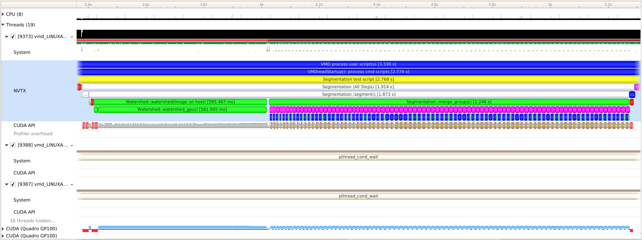
4: Fast GPU Init Routine
GPU-based Watershed init kernel 13.4ms.
Speedup over CPU-based initialization: 23x
Total time: 1.91s
Total speedup: 1.6x
Phases:
Constructors: 0.1s
Watershed: 0.59s
Scale-Space: 1.25s
Other: -

Slide 25
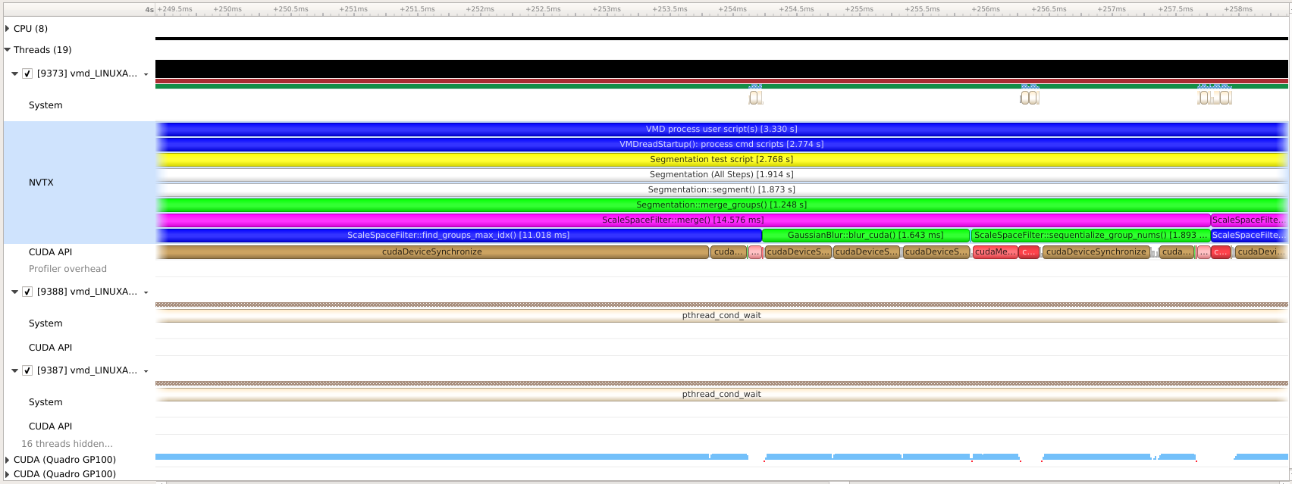
4: Detail: Slow Scale-Space Merge Groups Kernel
GPU kernel for scale-space group merge operations is slow compared to other kernels, opportunity!
Write new special-case scale-space merge kernels for problem sizes small enough to allow atomic ops in shared memory rather than global memory.

Slide 26
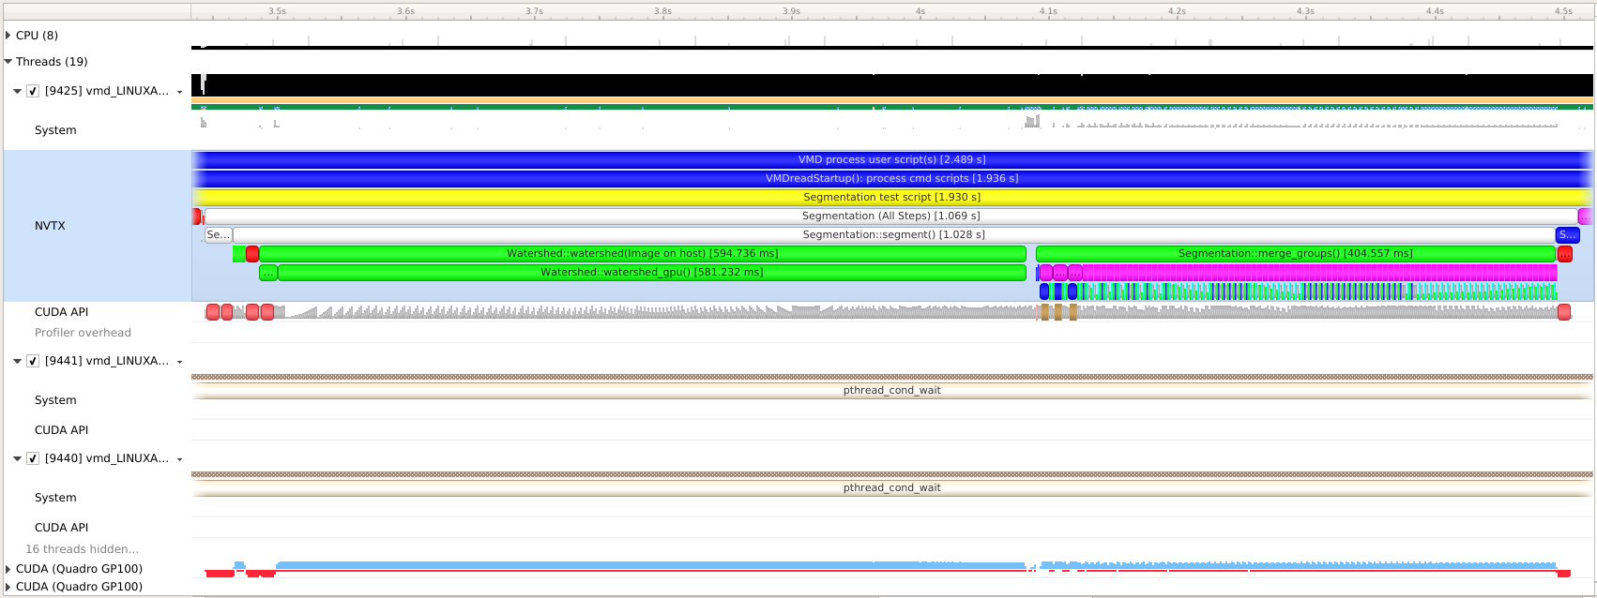
5: Faster Merge Groups Kernels
Total time: 1.07s
Total speedup: 2.9x
Phases:
Constructors: 0.1s
Watershed: 0.59s
Scale-Space: 0.4s
Other: -
Use Nsight Compute to examine kernel in detail.
New problem-size-specific shared memory kernels speed up scale-space segmentation phase by 3x over original kernel.

Slide 27
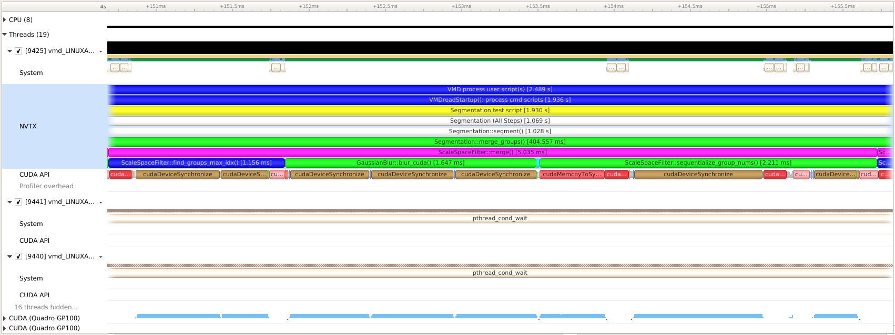
5: Detail: Faster Merge Groups Kernels
New problem-size-specific shared memory kernels speed up scale-space segmentation phase by 3x over original kernel.
New kernels have comparable runtime to neighboring scale space kernels, no longer an outstanding optimization opportunity.
Biomedical Technology Research Center for Macromolecular Modeling and Bioinformatics
Beckman Institute, University of Illinois at Urbana-Champaign – www.ks.uiuc.edu

Slide 28
5: Detail: Excessive Error Checking
Excessive synchronizations happening here
Many calls to cudaDeviceSynchronize(), checking error status, etc.
Biomedical Technology Research Center for Macromolecular Modeling and Bioinformatics
Beckman Institute, University of Illinois at Urbana-Champaign – www.ks.uiuc.edu

Slide 29
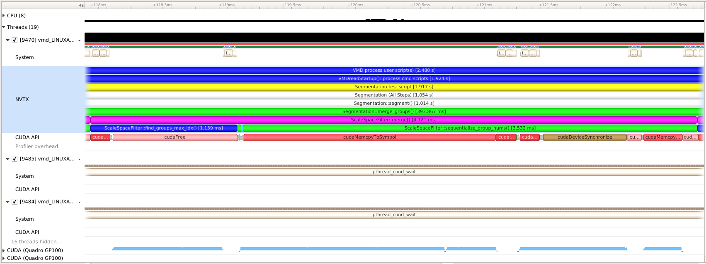
6: Detail: Streamlined Error Checking
Total time: 1.05s
Total speedup: 3.0x
Phases:
Constructors: 0.1s
Watershed: 0.59s
Scale-Space: 0.4s
Other: -
Excessive cudaDeviceSynchronize() calls eliminated
Biomedical Technology Research Center for Macromolecular Modeling and Bioinformatics
Beckman Institute, University of Illinois at Urbana-Champaign – www.ks.uiuc.edu

Slide 30
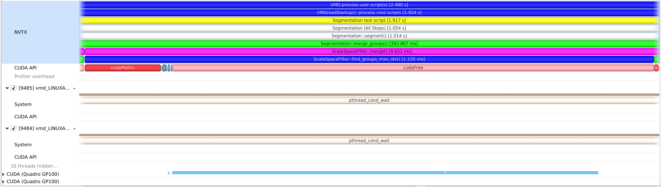
6: Detail: Iterated Malloc/Free
Several areas of trace show CUDA malloc/free calls in iterative algorithm phase
(Re)allocation APIs create gaps in GPU execution stream
Biomedical Technology Research Center for Macromolecular Modeling and Bioinformatics
Beckman Institute, University of Illinois at Urbana-Champaign – www.ks.uiuc.edu

Slide 31
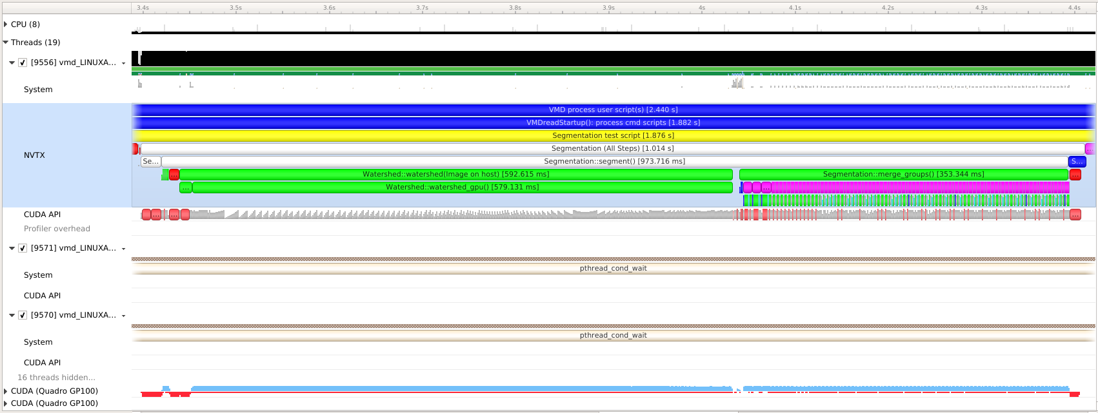
7: Made Work Buffers Persistent
Total time: 1.01s
Total speedup: 3.1x
Phases:
Constructors: 0.1s
Watershed: 0.57s
Scale-Space: 0.35s
Other: -
All VMD kernel work buffers persistent across iterations

Slide 32
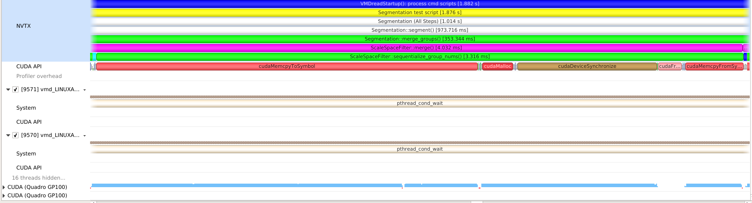
7: Detail: … Except Thrust Scan()
Thrust scan performs GPU malloc/free
Allocations disrupt GPU work stream slightly
Can use special allocation scheme or use CUB instead
Biomedical Technology Research Center for Macromolecular Modeling and Bioinformatics
Beckman Institute, University of Illinois at Urbana-Champaign – www.ks.uiuc.edu

Slide 33
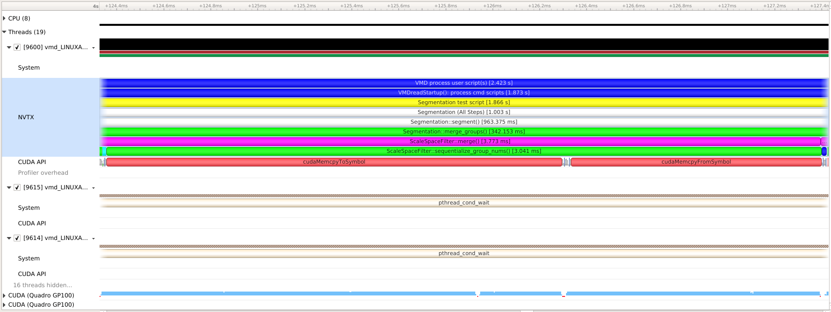
8: Detail: CUB Scan Persistent Work Buffers
Persistent CUB work area eliminates iterated GPU malloc/free
No significant interruptions in GPU work stream now
Total time: 1.00s
Total speedup: 3.1x
Phases:
Constructors: 0.1s
Watershed: 0.57s
Scale-Space: 0.35s
Other: -
Biomedical Technology Research Center for Macromolecular Modeling and Bioinformatics
Beckman Institute, University of Illinois at Urbana-Champaign – www.ks.uiuc.edu

Slide 34
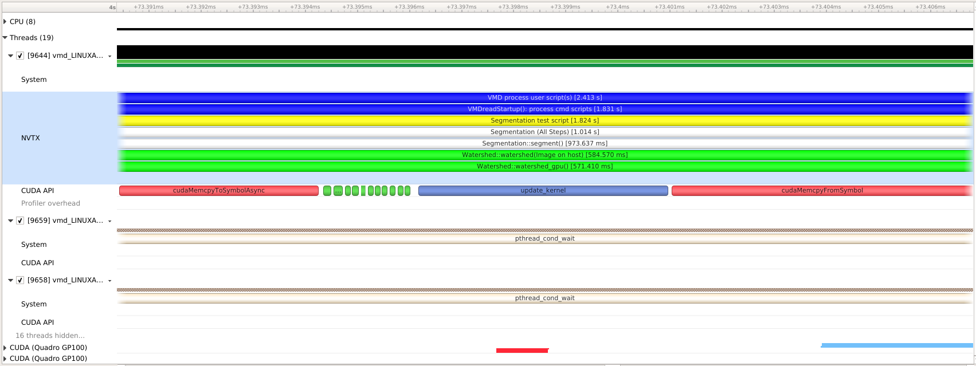
9: Detail: Use of CUDA Async APIs
Use of cudaMemcpyToSymbolAsync() allows CPU to enqueue subsequent kernel and result copy-back efficiently while first copy is still running
Biomedical Technology Research Center for Macromolecular Modeling and Bioinformatics
Beckman Institute, University of Illinois at Urbana-Champaign – www.ks.uiuc.edu

Slide 35
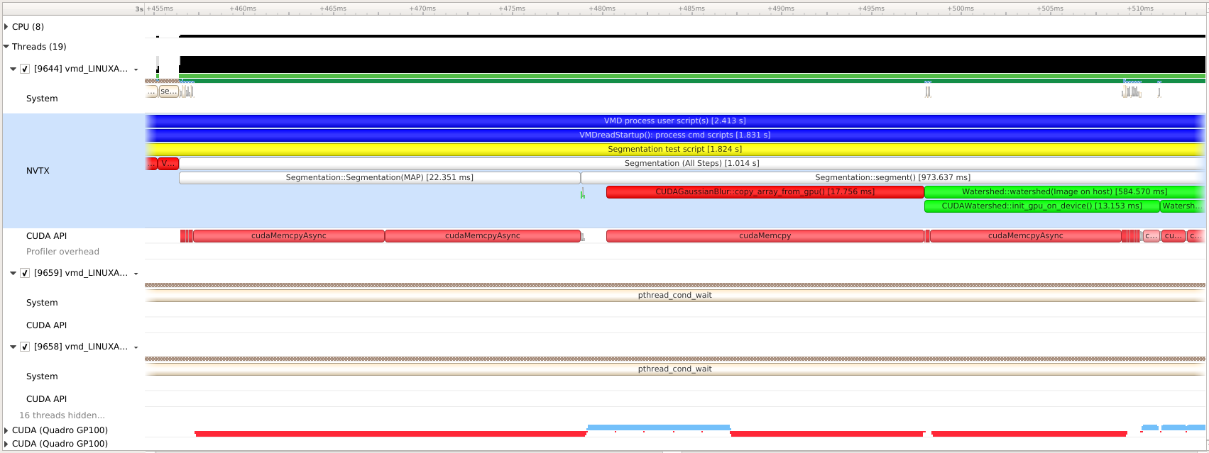
9: Detail: Constructor Host-GPU Copy
Extra copy: side effect of a C++ class constructor
Eliminate via tiny refactoring
Biomedical Technology Research Center for Macromolecular Modeling and Bioinformatics
Beckman Institute, University of Illinois at Urbana-Champaign – www.ks.uiuc.edu

Slide 36
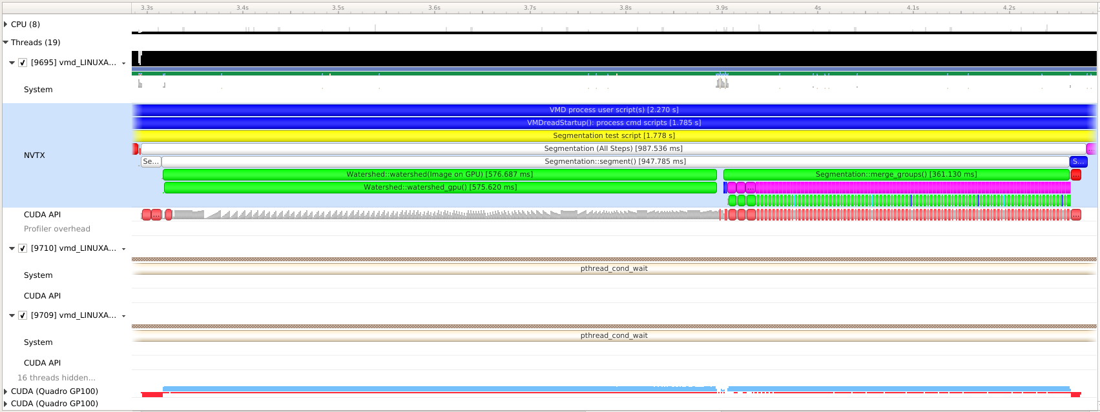
10: Final Result
Total time: 0.98s
Total speedup: 3.2x
Phases:
Constructors: 0.03s
Watershed: 0.57s
Scale-Space: 0.36s
Other: -

Slide 37
VMD Cryo-EM Segmentation:
Lessons Learned
Nsight Sytems helped identify unintentional copies caused by indirect side-effects of C++ class designs
Demonstrates the value of applying profiling tool during ongoing algorithm development
Final performance result on Quadro GP100 is 3.2x faster
Speedup on Tesla V100 (Volta) is even more dramatic:
  Initial runtime 2.66 seconds
  Final optimized runtime: 0.64 seconds, 4.1x faster
VMD GPU image segmentation is now 12x faster than competing tools

Slide 38
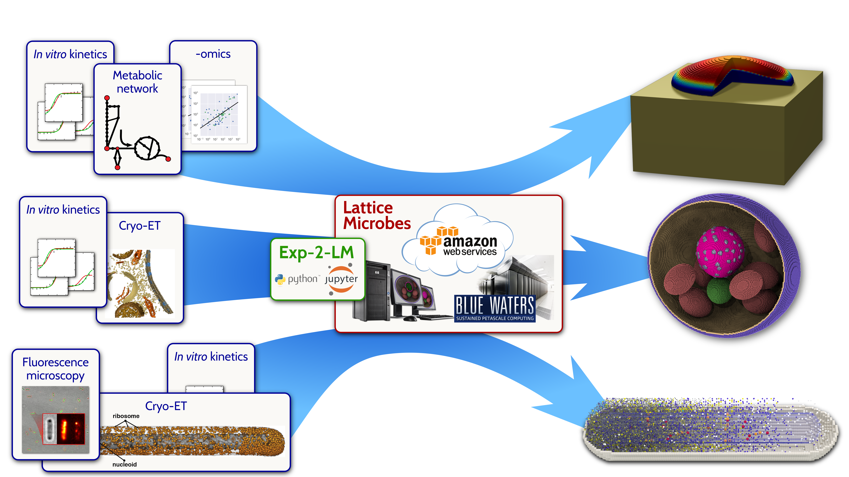
Lattice Microbes
BMC Sys. Biol. 2015
Whole-cell modeling and simulation, including heterogeneous environments and kinetic network of thousands of reactions
Incorporate multiple forms of experimental imaging for model construction
Scriptable in Python
Glucose/Agar
http://www.scs.illinois.edu/schulten/lm
Biophys. J. 2015
Biopolymers, 2016

Slide 39
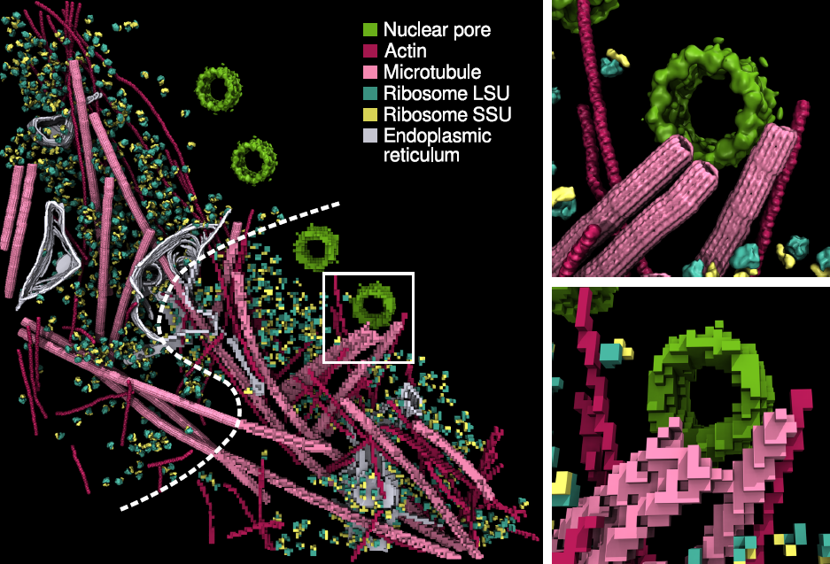
Lattice Microbes Description
Simulate cell dynamics on biologically relevant timescales using a lattice-based model
Earnest, et al. J. Physical Chemistry B, 121(15): 3871-3881, 2017.

Slide 40
Lattice Microbes Simulation
Simulation Timestep Loop
X-axis Diffusion
Y-axis Diffusion
Z-axis Diffusion
Reactions
Check Overflows
Simulation Lattice

Slide 41
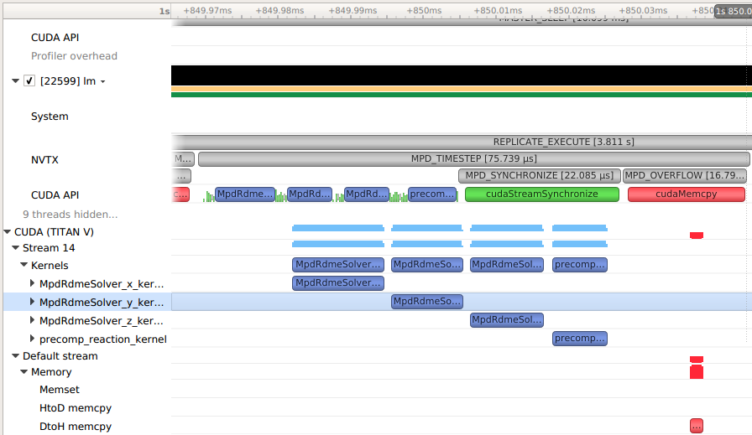
Default stream Synchronization
Synchronized
Twice
Default stream – Implicitly Synchronized

Slide 42
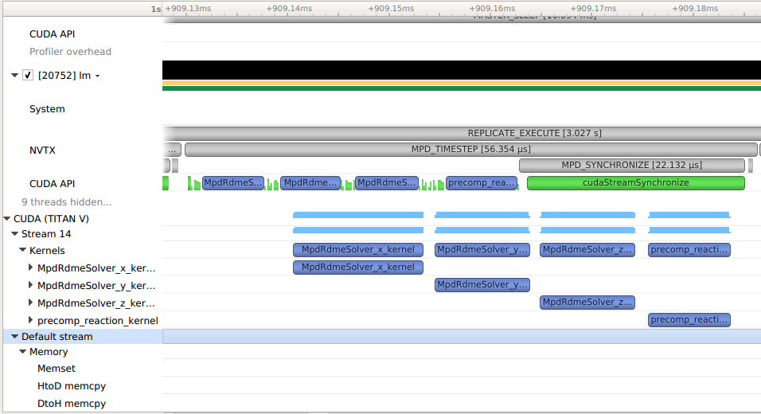
Default stream Synchronization 2
cudaMemcpy replaced with zero-copy-memory
20% performance gain

Slide 43
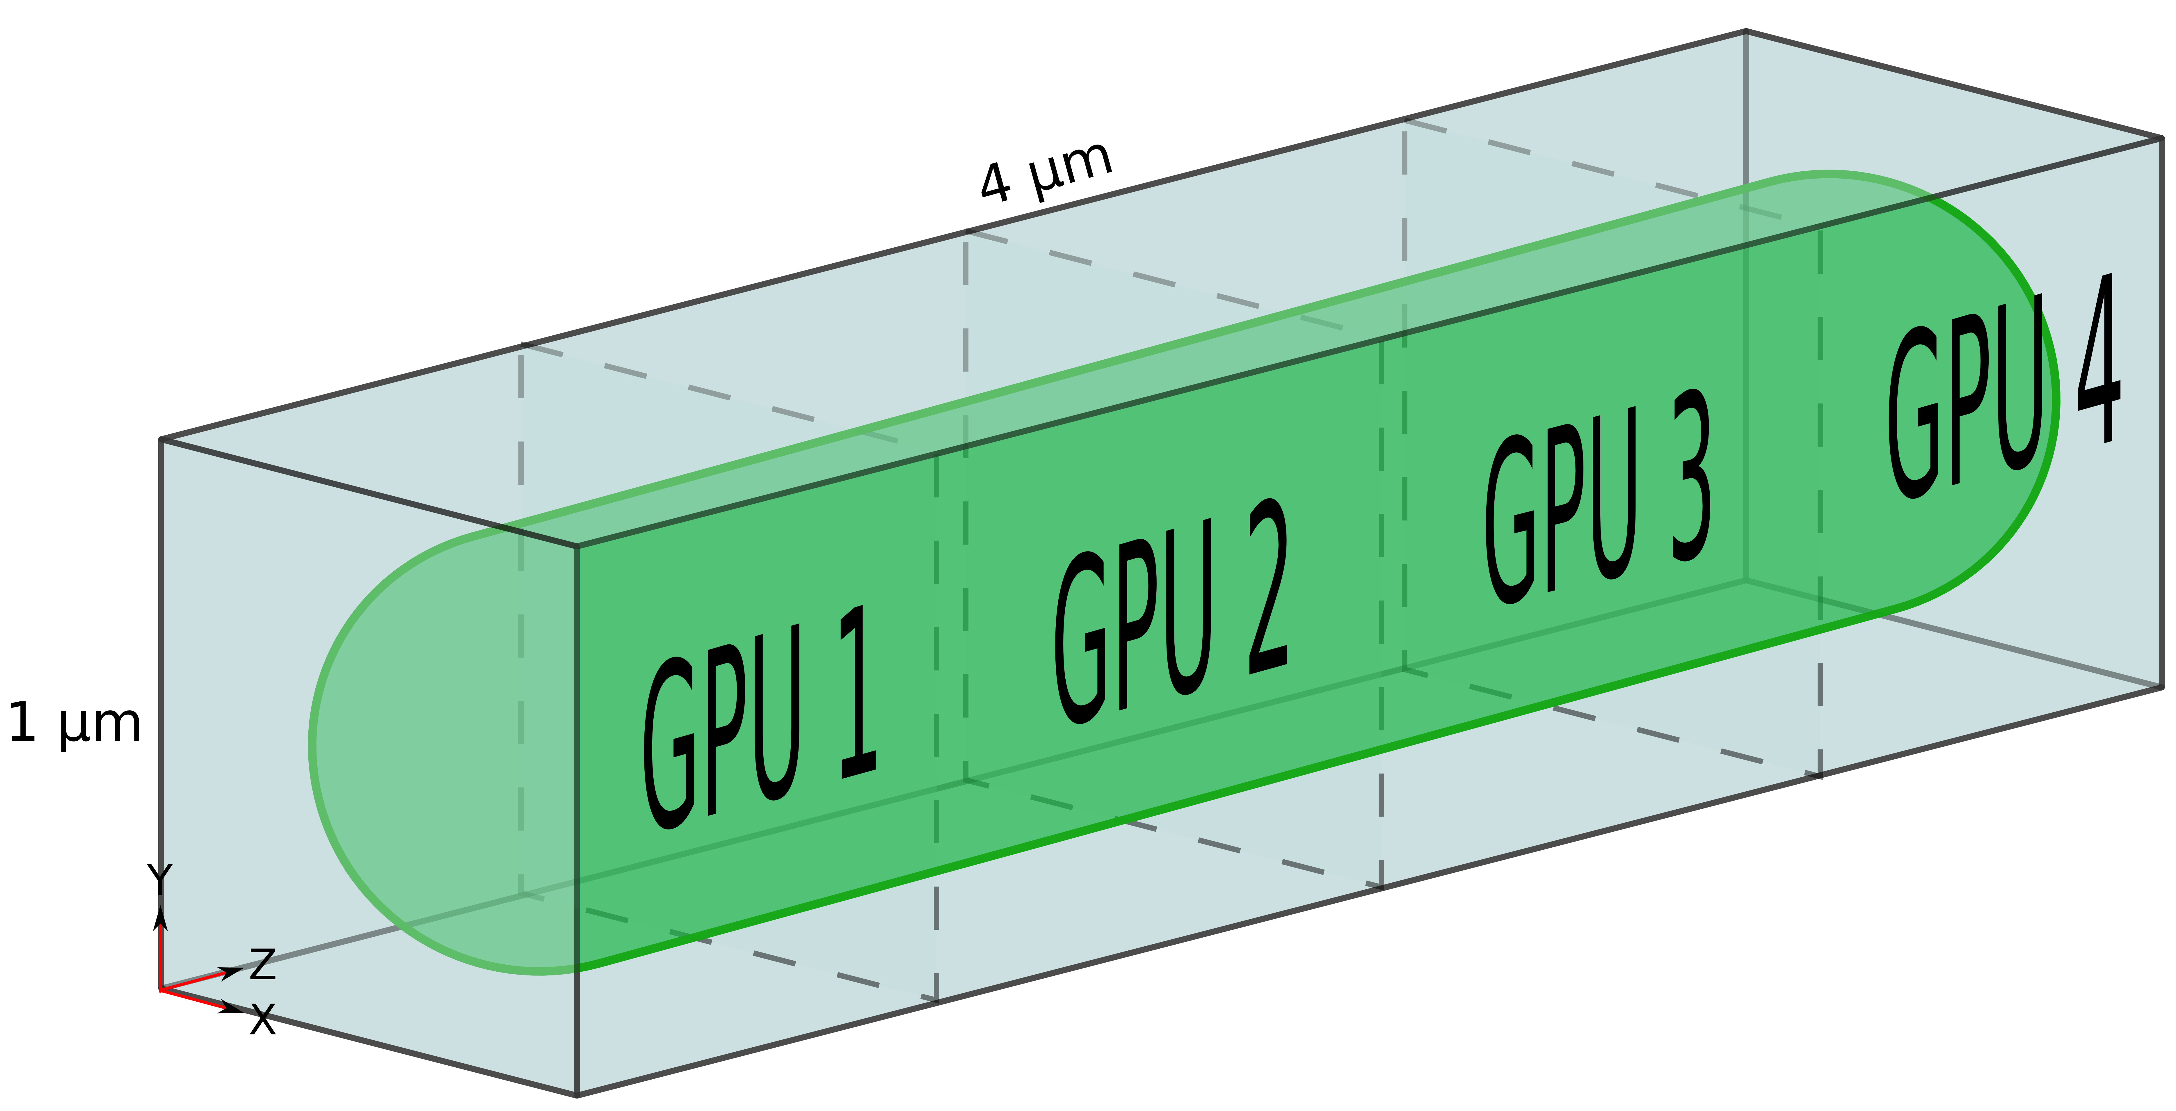
Lattice Microbes Multi-GPU Simulation
Simulation Timestep Loop
Divide the cell into chunks for each GPU to process
Communicate particles on the edge of each volume to neighboring GPU
Receive Lattice Edges
X-axis Diffusion
Y-axis Diffusion
Z-axis Diffusion
Reactions
Send Lattice Edges
Check Overflows

Slide 44
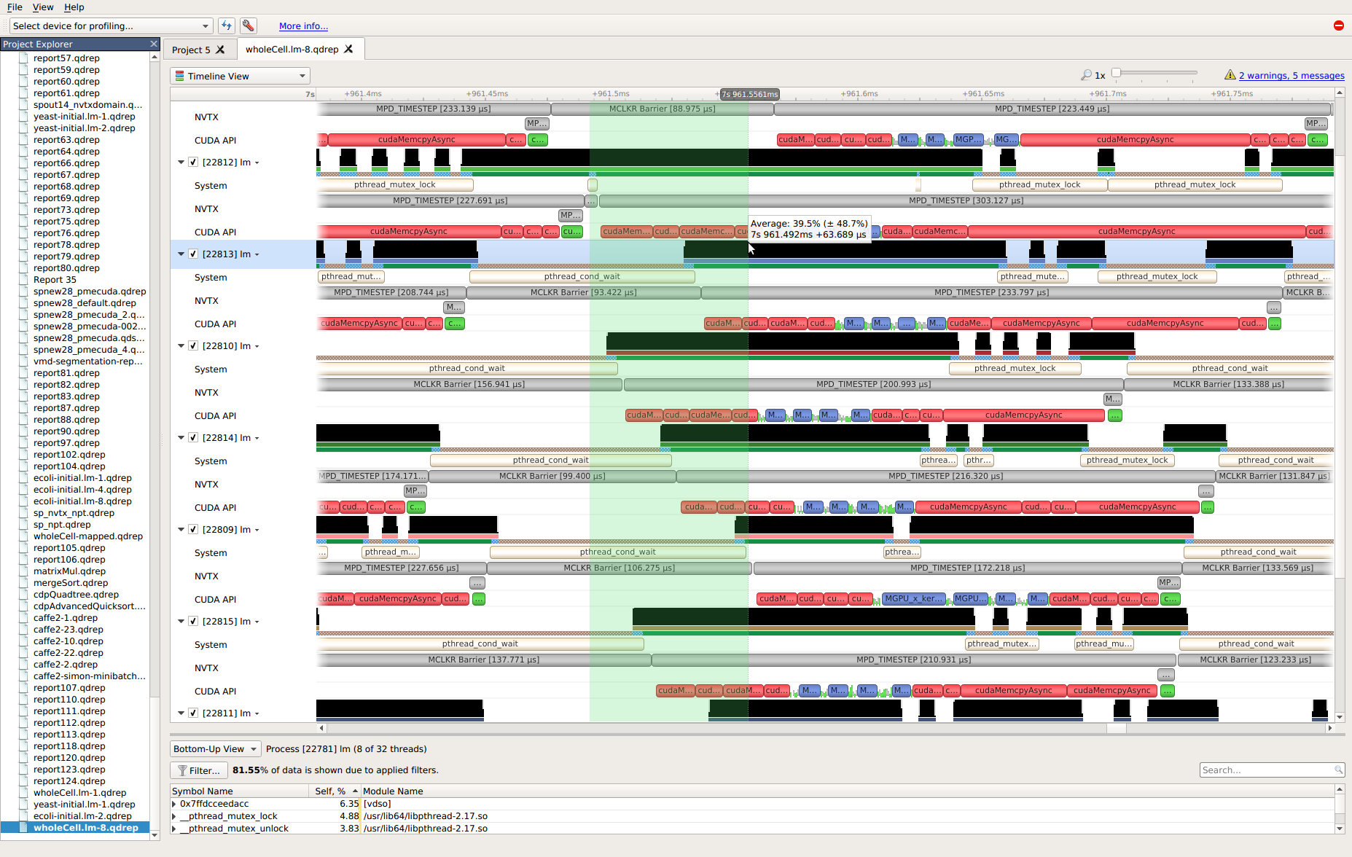
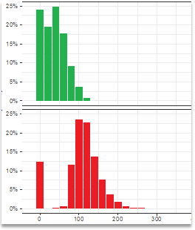
Host Thread Parallel Optimization
Synchronization
Histogram
Conditions
(original)
Using System API trace
pthread_cond_broadcast
Replaced with CPU spinlock
60us faster on average!
Spinlocks
(optimized)
~25% performance gain
Analyzed via Python

Slide 45
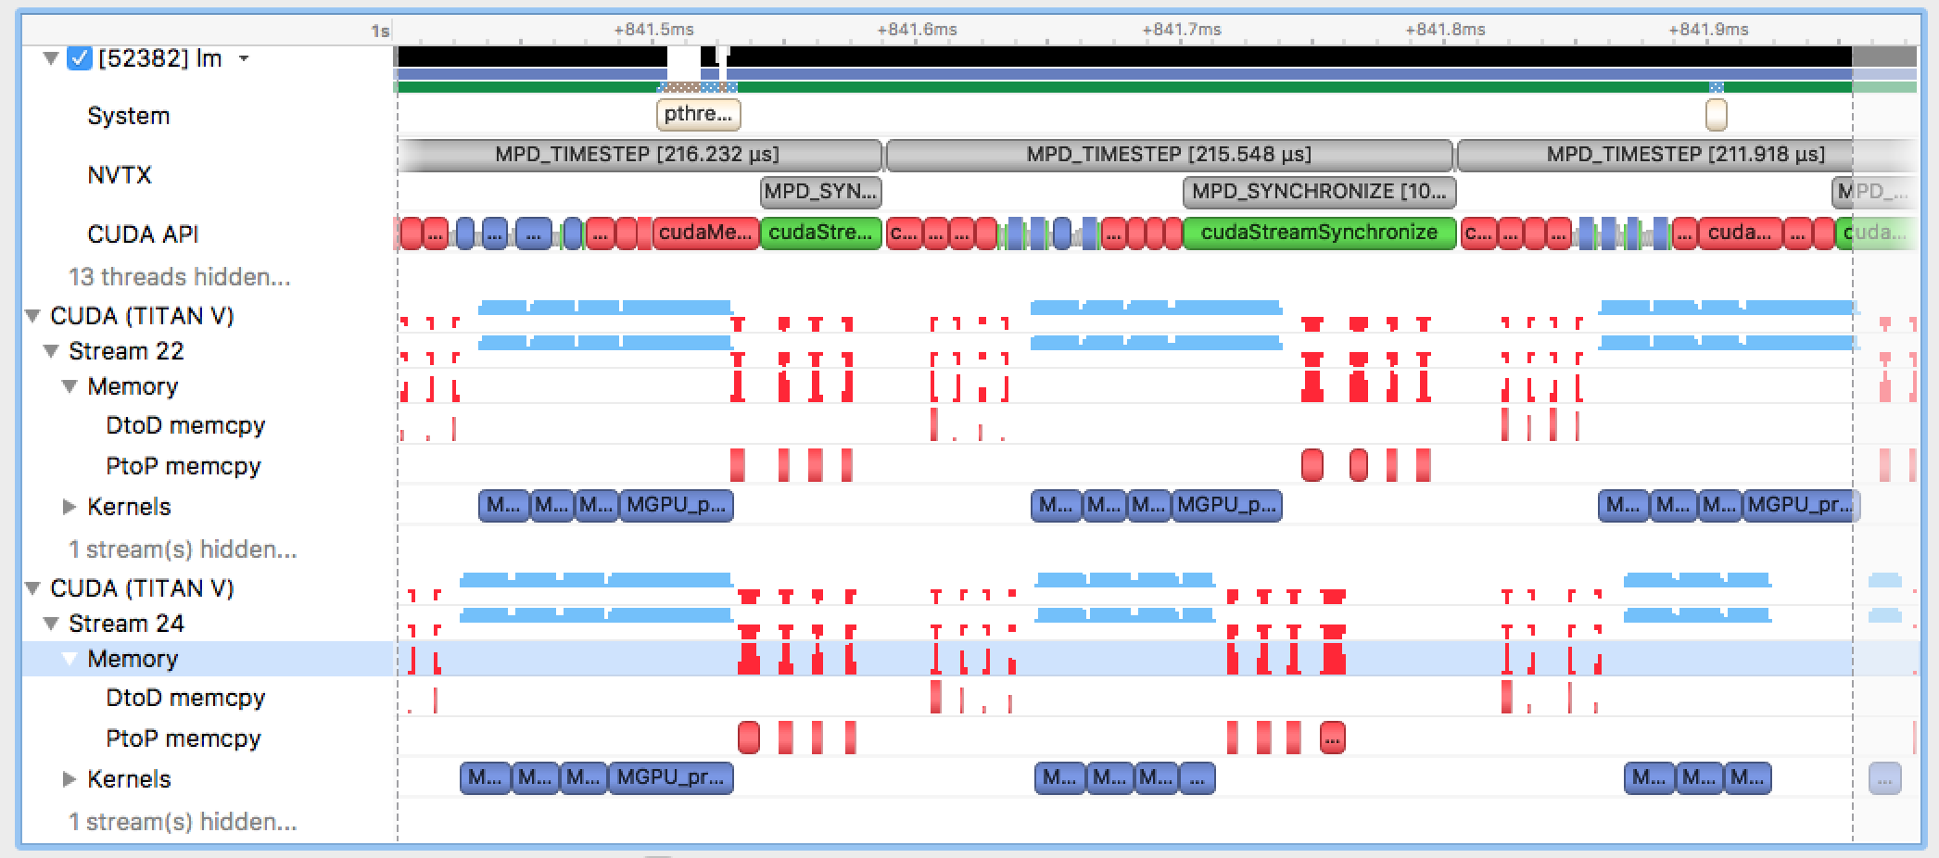
Inter-GPU Transfer Improvements
Eliminate small D2D Copies
Reduce transfer overhead by packing multiple transfers in to one

Slide 46
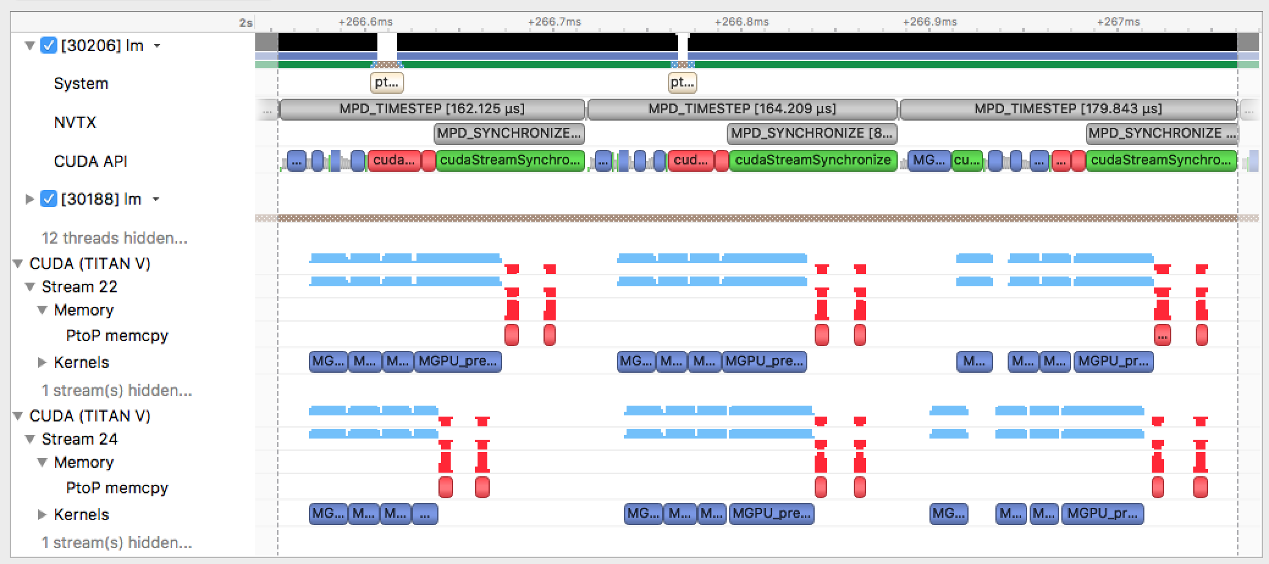
Inter-GPU Transfer Improvements
10 - 75% performance gain based on cell size
Only one copy to each neighbor

Slide 47
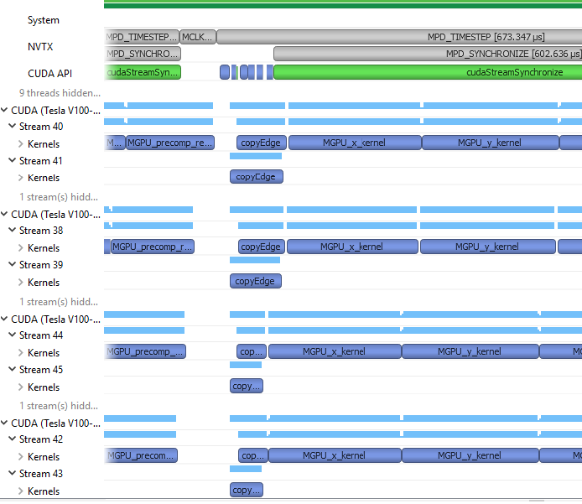
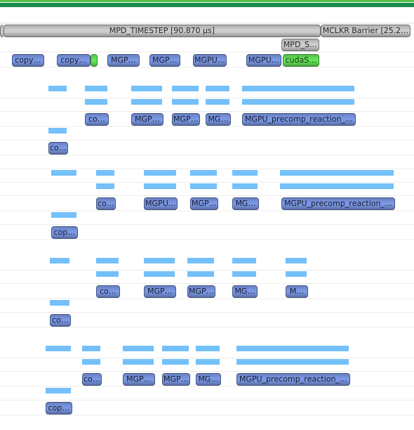
4-Way DGX Inter-GPU Transfers with NVLINK
5 - 28% performance gain kernel-based P2P copy
Communicate
Compute
Communicate
Compute
Larger Size Cells
Smaller Size Cells
A kernel directly accessing remote lattice via P2P copies can achieve concurrent bidirectional transfers
Notes:
We did quite well on our Titans. We want to scale this further though and take advantage of NVLinks on new servers like the DGX, HGX, and some of the newer super computer clusters.
We modified to store more copies of the lattice so we could not worry about race conditions with overwriting information that our neighbor still needed to read. Prototyped a kernel to do the P2P copy.
Performance varied by molecule size. On a DGX Station with four V100 with large molecules like yeast, this scheme achieved ~5% gain. With small molecules like ecoli, this scheme, achieved a 28% gain over previous improvements. Note that the inter-GPU copies happen concurrently across devices, reducing the time experienced for all GPUs in how long it takes to complete a timestep.

Slide 48
Common optimization opportunities
CPU
Thread synchronization
Algorithm bottlenecks starve the GPUs
Single GPU
Memory operations – blocking, serial, unnecessary
Too much synchronization - device, context, stream, default stream, implicit
CPU GPU Overlap – avoid excessive communication
Multi GPU
Communication between GPUs
Lack of Stream Overlap in memory management, kernel execution
Notes:
Numbers indicate the slide that illustrates the opportunity.
CPU
Thread synchronization (45)
Algorithm Bottlenecks Starve the GPUs (24, 26)
Single GPU
Memory Operations – Blocking, Serial, Unnecessary (20, 35)
Too Much Synchronization - Device, Context, Stream, Default Stream, Implicit (29, 42)
CPU GPU Overlap – avoid excessive communication
Multi GPU
Communication between GPUs (46)
Lack of Stream Overlap in memory management, kernel execution

Slide 49
Tool Comparison
 | NVIDIA © Nsight ™ Systems | NVIDIA© Nsight™ Compute | NVIDIA© Visual Profiler | Intel © VTune ™ Amplifier | Linux perf OProfile
Target OS | Linux | Linux, Windows | Linux, Mac, Windows | Linux, Windows | Linux
GPUs | Pascal, Volta, Future | Pascal, Volta, Future | Kepler, Maxwell, Pascal, Volta, Future | None | None
CPUs | x86_64 | x86_64 | x86, x86_64, Power | x86, x86_64 | x86, x86_64, Power
Trace | NVTX, CUDA, OpenGL, CuDNN, CuBLAS, System | NVTX, CUDA | MPI, CUDA, OpenACC | MPI, ITT | Kernel
PC Sampling | High Speed | No | Yes | High Speed | High Speed
UVM, NVLINK, Power,Thermal | Future |  | Yes | No | No
Src Code View | No | Yes | Yes | Yes | No
Compare Sessions | No | Yes | Yes | Yes | No

Slide 50
Nsight Systems
Visit us at the NVIDIA booth in the exhibit hall for a live demo!
When can you get it?
  Soon. Fixing the last issues now.
Where can you get it?
  http://developer.nvidia.com/nsight-systems
Questions/Requests/Comments?
  nsight-systems@nvidia.com
Workflow
Nsight
Systems
Nsight
Compute
Nsight
Graphics
For Tegra-based systems
Codeworks
JetPack
DriveInstall
Note: Currently still
NVIDIA System Profiler
in some packages

Slide 51
Nsight Systems
Upcoming features:
NVIDIA GPU Cloud (near future)
Future GPUs
Future CUDA Releases
Windows targets
Many more HPC and cluster features

Slide 52
Don’t Miss these presentations
S8481: CUDA Kernel Profiling: Deep-Dive Into NVIDIA's Next-Gen Tools (Thursday 11:00AM)
S8337: NVIDIA SDK Manager - Simplify Your Development Environment Setup
(Wednesday 3:30 PM)
S8275: Introducing NVIDIA's New Graphics Debugger (Wednesday 4:00 PM)
S8665: VMD: Biomolecular Visualization from Atoms to Cells Using Ray Tracing, Rasterization, and VR (Thursday 11:00AM)
S8709: Accelerating Molecular Modeling Tasks on Desktop and Pre-Exascale Supercomputers (Monday 4:00PM)
Show floor demos available:
Tuesday 11-1 and 5:30-7:30; Wednesday 12-2 and 5-7; Thursday 12-2

Slide 53
Q & A

Slide 54
Backup

Slide 55
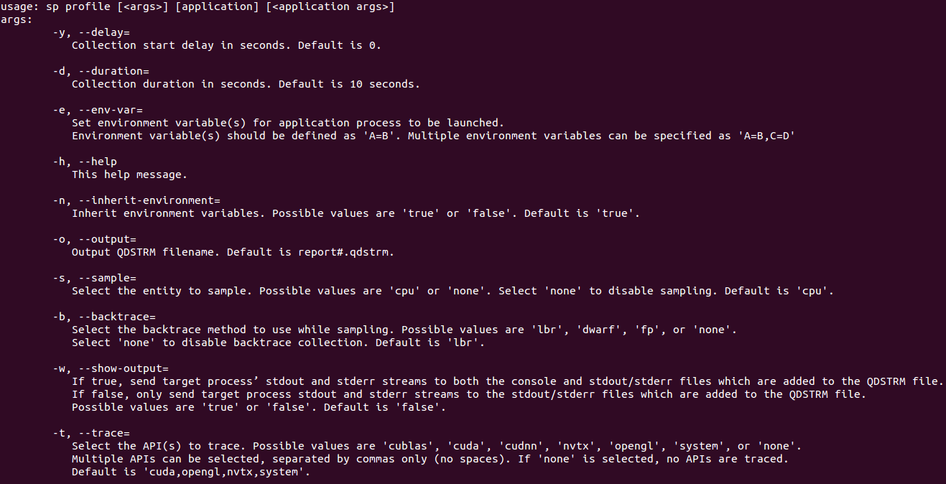
Command Line Interface

