Slide 1
S8709—Accelerating Molecular Modeling on Desktop and Pre-Exascale Supercomputers
John E. Stone
Theoretical and Computational Biophysics Group
Beckman Institute for Advanced Science and Technology
University of Illinois at Urbana-Champaign
http://www.ks.uiuc.edu/Research/gpu/
S8709, GPU Technology Conference
4:00-4:50, San Carlos Room, Hilton,
San Jose, CA, Monday March 26th, 2018

Slide 2
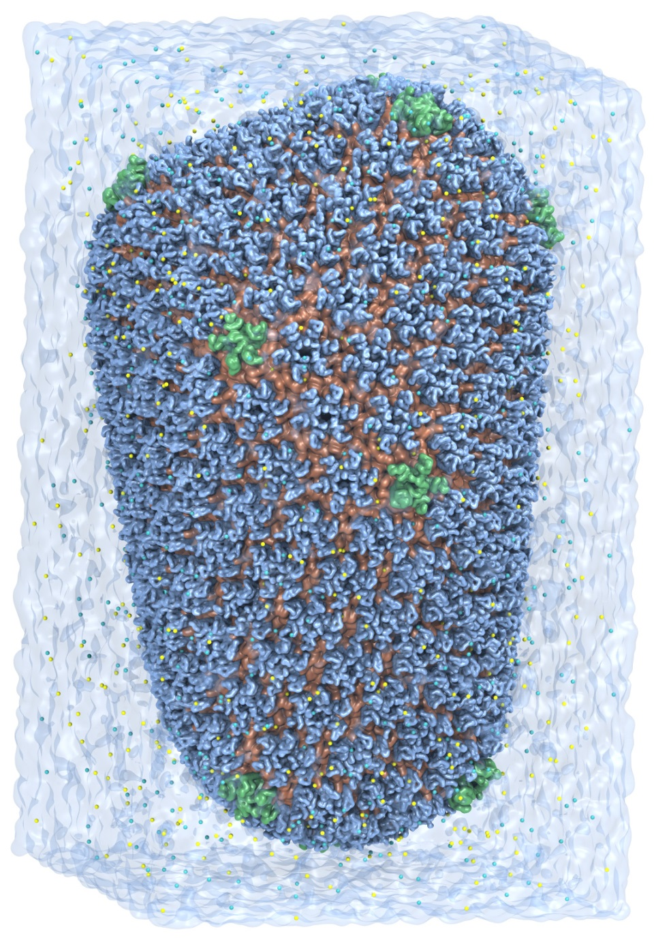
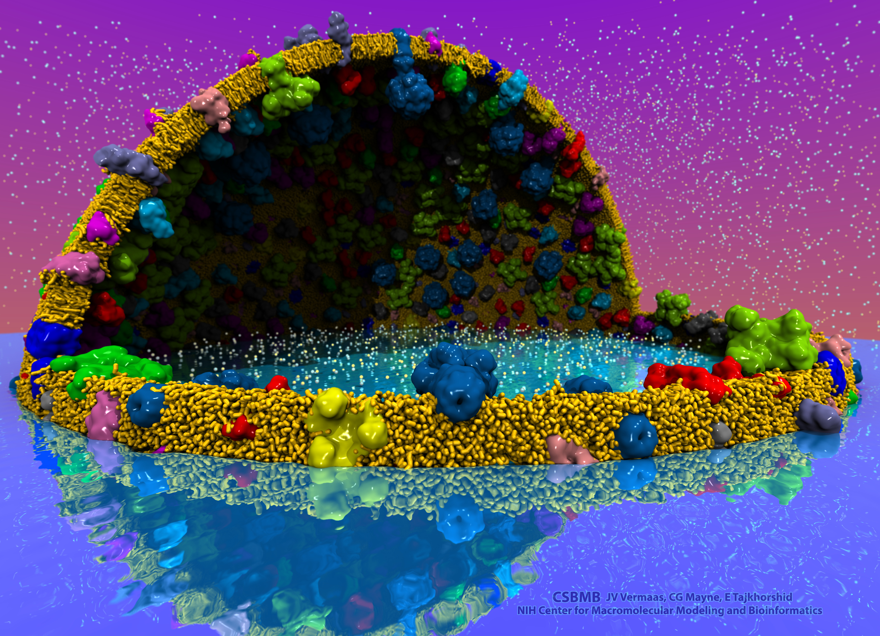
VMD – “Visual Molecular Dynamics”
Visualization and analysis of:
Molecular dynamics simulations
Lattice cell simulations
Quantum chemistry calculations
Sequence information
User extensible scripting and plugins
http://www.ks.uiuc.edu/Research/vmd/
Cell-Scale Modeling
MD Simulation

Slide 3
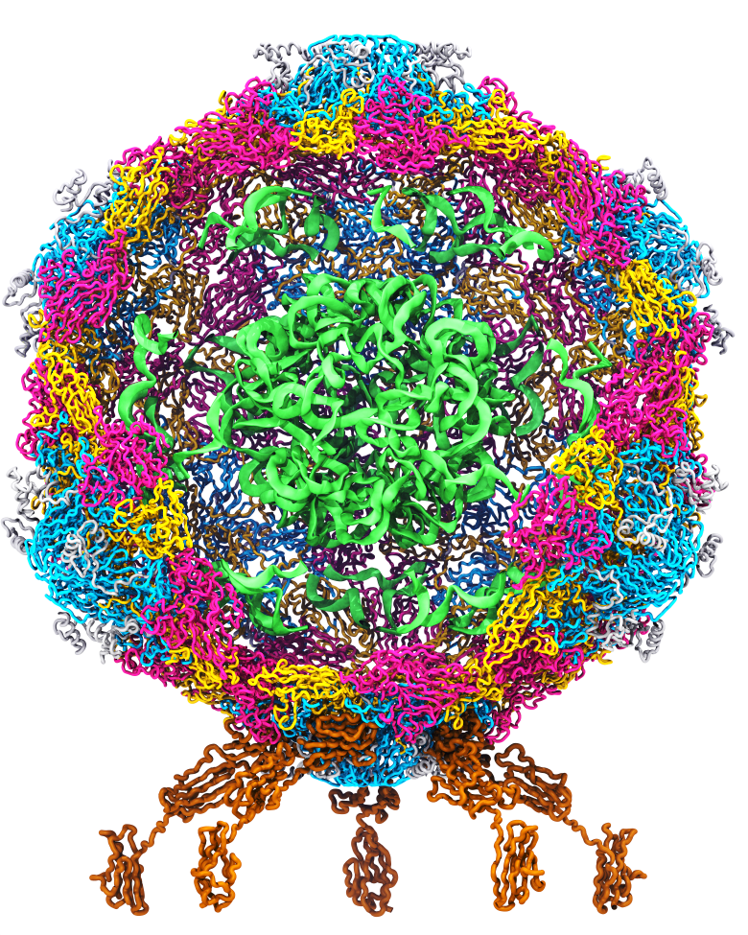
Goal: A Computational Microscope
Study the molecular machines in living cells
Ribosome: target for antibiotics
Poliovirus
Notes:
Ribosomes synthesize new proteins from genetic information
Bacterial ribosome is a target for antibiotics, which interfere with its ability to function by binding to sites on the structure, preventing proteins from being synthesized
Ribosome simulations are extremely computationally challenging due to the size of the structure and its natural environment (solvent, ions, etc, large box, 3 million atoms or so)
Bionanodevice for sequencing DNA efficiently
Knowledge of an individual’s genetic makeup can lead to the prediction and treatment of many diseases by the means of personal genomic medicine and pharmacogenomics. In order for genome sequencing to become practical for common medical use, an inexpensive high throughput genome sequencing technique is required. NIH has set a goal of reducing the cost of genome sequencing by a factor of 10,000, to less than $1,000 within ten years.
The computer is the best microscope to guide the development of bionanodevices, for example to sequence DNA. While experiments can measure DNA electrostatic potentials, they cannot visualize the DNA’s location and conformation at the time of measurement.

Slide 4
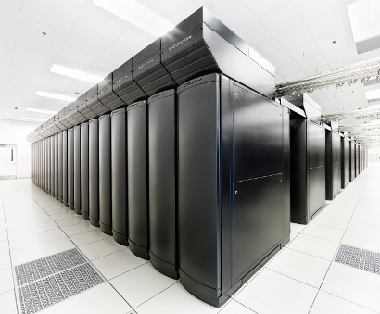
VMD Petascale Visualization and Analysis
Analyze/visualize large trajectories too large to transfer off-site:
User-defined parallel analysis operations, data types
Parallel rendering, movie making
Supports GPU-accelerated Cray XK7 nodes for both visualization and analysis:
GPU accelerated trajectory analysis w/ CUDA
OpenGL and GPU ray tracing for visualization and movie rendering
Parallel I/O rates up to 275 GB/sec on 8192 Cray XE6 nodes – can read in 231 TB in 15 minutes!
Parallel VMD currently available on:
ORNL Titan, NCSA Blue Waters, Indiana Big Red II, CSCS Piz Daint, and similar systems
NCSA Blue Waters Hybrid Cray XE6 / XK7
22,640 XE6 dual-Opteron CPU nodes
4,224 XK7 nodes w/ Telsa K20X GPUs

Slide 5
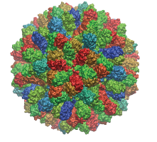
Parallel MDFF Cross Correlation Analysis on Cray XK7
Relative CC
Rabbit Hemorrhagic Disease Virus (RHDV)
Traj. frames | 10,000
Structure component selections | 720
Single-node XK7 (projected) | 336 hours (14 days)
128-node XK7 | 3.2 hours 105x speedup
2048-node XK7 | 19.5 minutes 1035x speedup
Structure
RHDV colored by relative CC
Time
Calculation of 7M CCs would take 5 years using serial CPU algorithm!
Stone et al., Faraday Discuss., 169:265-283, 2014.

Slide 6
Making Our Research Tools Easily Accessible
Docker “container” images available in NVIDIA NGC registry
Users obtain Docker images via registry, download and run on the laptop, workstation, cloud, or supercomputer of their choosing
https://ngc.nvidia.com/registry/
https://ngc.nvidia.com/registry/hpc-vmd
Cloud based deployment
Full virtual machines (known as “AMI” in Amazon terminology)
Amazon AWS EC2 GPU-accelerated instances:
http://www.ks.uiuc.edu/Research/cloud/
Clusters, Supercomputers
Workstations,
Servers,
Cloud
Molecular dynamics-based refinement and validation for sub-5 Å cryo-electron microscopy maps. Abhishek Singharoy, Ivan Teo, Ryan McGreevy, John E. Stone, Jianhua Zhao, and Klaus Schulten. eLife, 10.7554/eLife.16105, 2016. (66 pages).
QwikMD-integrative molecular dynamics toolkit for novices and experts. Joao V. Ribeiro, Rafael C. Bernardi, Till Rudack, John E. Stone, James C. Phillips, Peter L. Freddolino, and Klaus Schulten. Scientific Reports, 6:26536, 2016.
High performance molecular visualization: In-situ and parallel rendering with EGL. John E. Stone, Peter Messmer, Robert Sisneros, and Klaus Schulten. 2016 IEEE International Parallel and Distributed Processing Symposium Workshop (IPDPSW), pp. 1014-1023, 2016.

Slide 7
VMD EGL-Enabled NGC Container
https://ngc.nvidia.com/registry/
CUDA-accelerated analysis
EGL off-screen rendering – no windowing system needed
OptiX high-fidelity GPU ray tracing engine built in
All dependencies included
Easy to deploy on a wide range of GPU accelerated platforms
High performance molecular visualization: In-situ and parallel rendering with EGL. J. E. Stone, P. Messmer, R. Sisneros, and K. Schulten. 2016 IEEE International Parallel and Distributed Processing Symposium Workshop (IPDPSW), pp. 1014-1023, 2016.

Slide 8
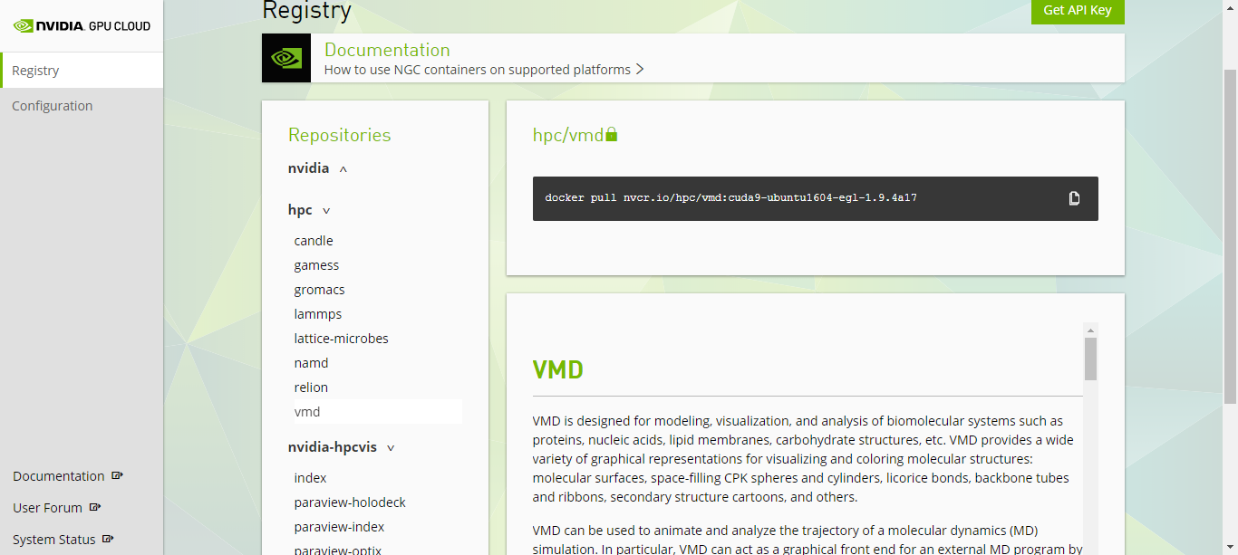
VMD / NAMD / LM, NGC Containers

Slide 9
VMD on IBM OpenPOWER, CORAL Systems
VMD has supported POWER hardware since 1998!
OpenPOWER + CORAL: Linux OS running in little-endian mode:
VMD 1.9.3 (Nov 2016): first release on OpenPOWER
POWER VSX instructions, hand-vectorized CPU kernels [1]
In-progress VMD 1.9.4 development:
VMD supports full OpenGL via GLX and EGL on POWER
ORNL Summit: Power9, CUDA 9.x w/ Tesla V100 (Volta) and NVLink
Ongoing work: NUMA optimality, and more pervasive use of NVLink
[1] Early Experiences Porting the NAMD and VMD Molecular Simulation and Analysis Software to GPU-Accelerated OpenPOWER Platforms. J. E. Stone, A.-P. Hynninen, J. C. Phillips, K. Schulten. International Workshop on OpenPOWER for HPC (IWOPH'16), LNCS 9945, pp. 188-206, 2016.

Slide 10
Benefits of P9+NVLink for VMD
Rapid access to host-side data too large to fit entirely in GPU memory
Many existing VMD CUDA kernels already used this strategy w/ PCIe, performance gains from NVLink are large and immediate
Rapid peer-to-peer GPU data transfers:
Bypass host whenever possible, perform nearest-neighbor exchanges for pairwise calculations, e.g. those that arise in algorithms for simulation trajectory clustering
Use aggregate GPU memory to collectively store/cache large data – well suited for high-fidelity ray tracing of scenes containing massive amounts of geometry

Slide 11
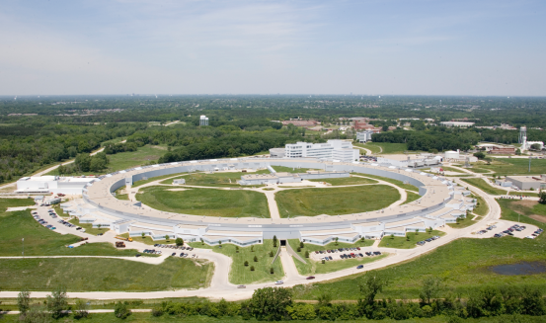
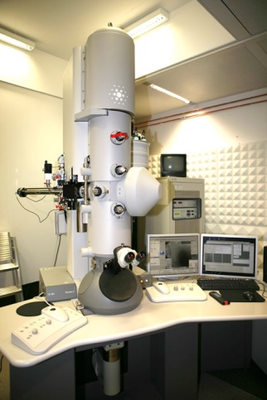
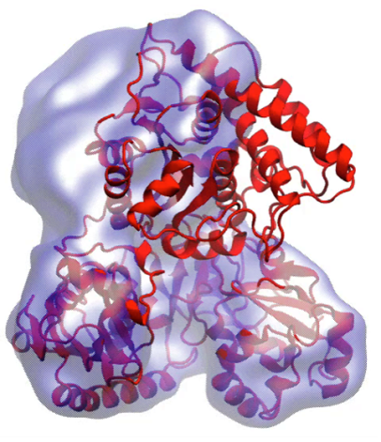
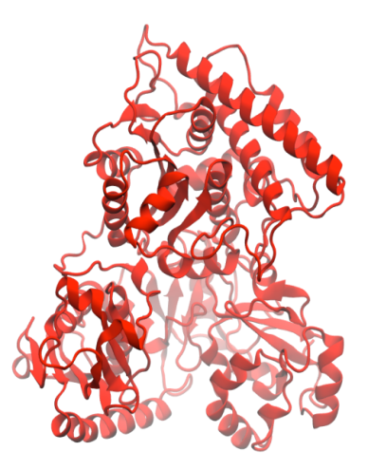
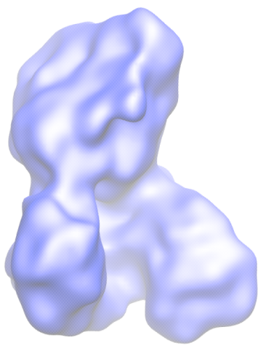
Molecular Dynamics Flexible Fitting (MDFF)
X-ray crystallography
MDFF
Electron microscopy
APS at Argonne
FEI microscope
ORNL Titan
Molecular dynamics-based refinement and validation for sub-5Å cryo-electron microscopy maps. A. Singharoy, I. Teo, R. McGreevy, J. E. Stone, J. Zhao, and K. Schulten. eLife 2016;10.7554/eLife.16105
Acetyl - CoA Synthase

Slide 12
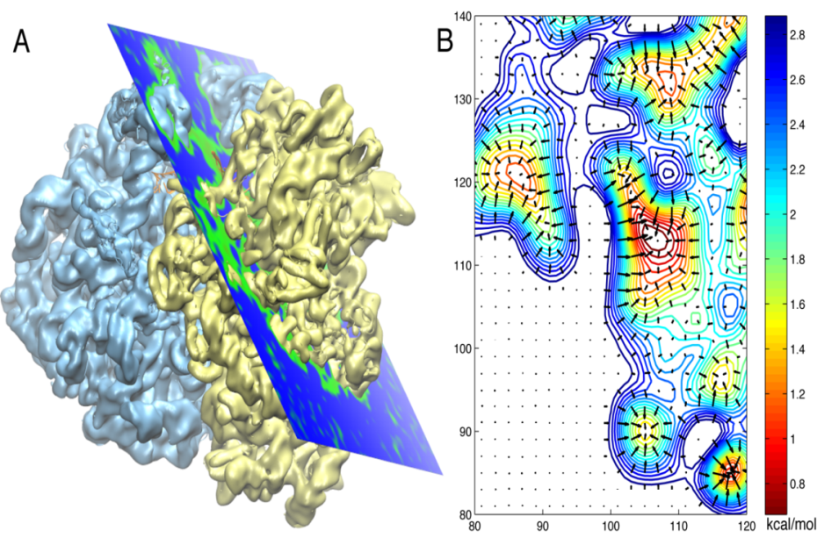
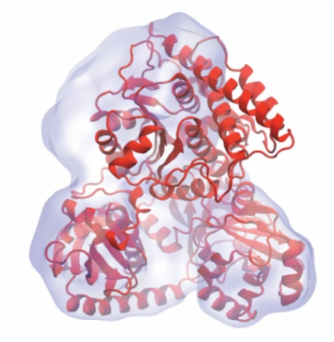
Molecular Dynamics Flexible Fitting - Theory
Two terms are added to the MD potential
An external potential derived from the EM map is defined on a grid as
A mass-weighted force is then applied to each atom

Slide 13
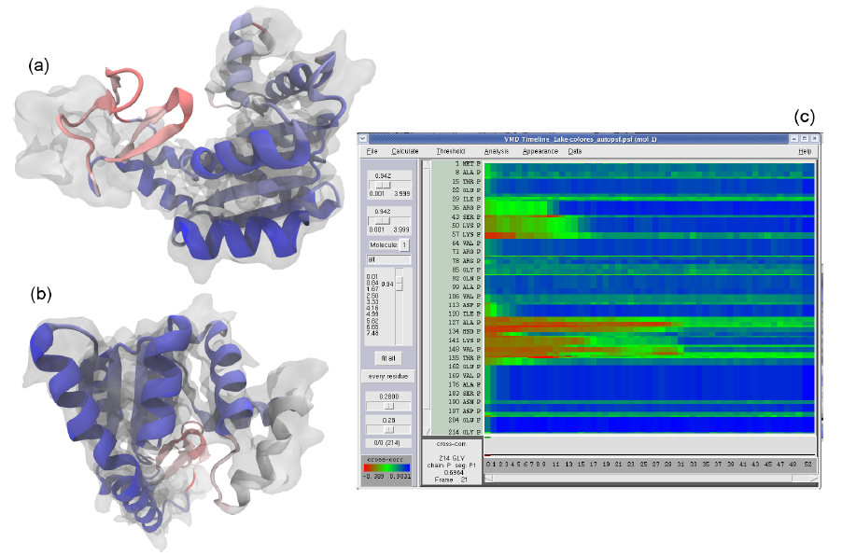
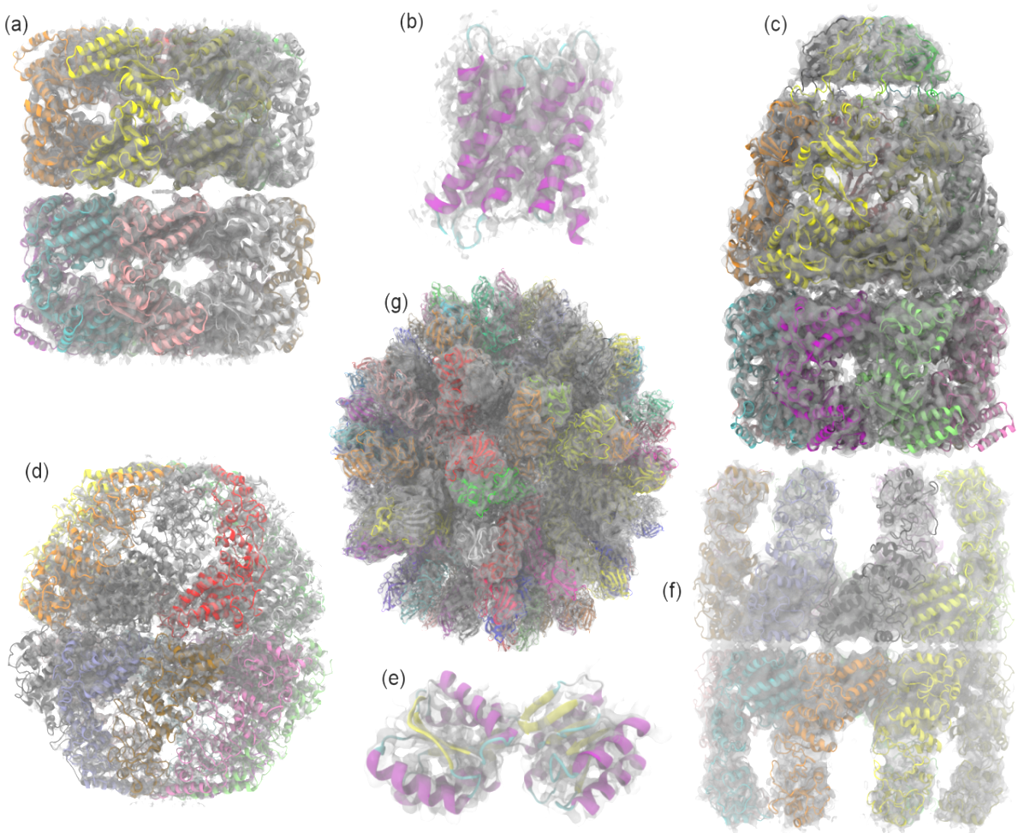
Evaluating Quality-of-Fit for Structures Solved by Hybrid Fitting Methods
Compute Pearson correlation to evaluate quality-of-fit between a reference cryo-EM density map and a simulated density map from an all-atom structure.
MDFF Cross Correlation Timeline
Regions with poor fit Regions with good fit

Slide 14
Simulated Density Map Algorithm
Build spatial acceleration data structures, optimize data for GPU
Compute 3-D density map:
Truncated Gaussian and spatial acceleration grid ensure linear time-complexity
3-D density map lattice point and the neighboring spatial acceleration cells it references

Slide 15
Single-Pass GPU Cross-Correlation
3-D density map decomposes into 3-D grid of 8x8x8 tiles containing CC partial sums and local CC values
Fusion of density and CC calculations into a single CUDA kernel!!!
Spatial CC map and overall CC value computed in a single pass
Small 8x8x2 CUDA thread blocks afford large
per-thread register count, shared memory
Each thread computes 4 z-axis density map lattice points and associated CC partial sums
0,0
0,1
…
Threads producing results that are used
1,0
1,1
…
…
…
…
Inactive threads, region of discarded output
Padding optimizes global memory performance, guaranteeing coalesced global memory accesses
Grid of thread blocks
Notes:
Threads in a thread block (potentially) execute in parallel
Threads in a block can communicate via fast shared memory
Global memory reads are slow
Constant memory is fast, but can only be written by host at kernel startup.

Slide 16
VMD Tesla V100 Cross Correlation Performance Rabbit Hemorrhagic Disease Virus: 702K atoms, 6.5Å resolution Volta GPU architecture almost 2x faster than previous gen Pascal:
Application and Hardware platform | Runtime, Speedup vs. Chimera, VMD+GPU
Chimera Xeon E5-2687W (2 socket) [1] | 15.860s, 1x
VMD-CUDA IBM Power8 + 1x Tesla K40 [2] | 0.488s, 32x 0.9x
VMD-CUDA Intel Xeon E5-2687W + 1x Quadro K6000 [1,2] | 0.458s, 35x 1.0x
VMD-CUDA Intel Xeon E5-2698v3 + 1x Tesla P100 | 0.090s, 176x 5.1x
VMD-CUDA IBM Power8 “Minsky” + 1x Tesla P100 | 0.080s, 198x 5.7x
VMD-CUDA Intel Xeon E5-2697Av4 + 1x Tesla V100 | 0.050s, 317x 9.2x
VMD-CUDA IBM Power9 “Newell” + 1x Tesla V100 | 0.049s, 323x 9.3x
[1] GPU-Accelerated Analysis and Visualization of Large Structures Solved by Molecular Dynamics Flexible Fitting. J. E. Stone, R. McGreevy, B. Isralewitz, and K. Schulten. Faraday Discussions 169:265-283, 2014.
[2] Early Experiences Porting the NAMD and VMD Molecular Simulation and Analysis Software to GPU-Accelerated OpenPOWER Platforms. J. E. Stone, A.-P. Hynninen, J. C. Phillips, K. Schulten. International Workshop on OpenPOWER for HPC (IWOPH'16), LNCS 9945, pp. 188-206, 2016.

Slide 17
Volta-Specific CC Optimization Opportunities
Optimized precision for both ref/simulated maps:
Improved memory bandwidth, lower arithmetic cost
FP16: half-precision EM density map representation
INT8: byte density map representation for EM tomograms
Explore use of Tensor Core for certain parts of cross correlation calculations, convolutions for noise filters:
Challenge: CUDA 9.x APIs for TC limit the range of data movement patterns that perform well
Difficult to prevent TC from becoming mem bandwidth-bound
Ongoing TC experiments for VMD image segmentation kernels may lead to schemes that can work for cross correlation and other calculations

Slide 18
Challenges Posed by Next-Gen GPU-Dense Workstation/Node Designs
Application and Hardware platform | Runtime, VMD+GPU
VMD-CUDA Intel Xeon E5-2687W + 1x Quadro K6000 [1,2] | 0.458s, 1.0x
VMD-CUDA IBM Power9 “Newell” + 1x Tesla V100 | 0.049s, 9.3x
~9x observed performance gain from Kepler to Volta GPUs
CPUs and PCIe have not matched this performance gain
New GPU-dense nodes have far less CPU available to manage GPUs and execute non-GPU code
More GPUs per CPU socket, fewer CPU threads per GPU
ORNL Summit 3 GPUs/socket, 7 CPU cores per GPU

Slide 19
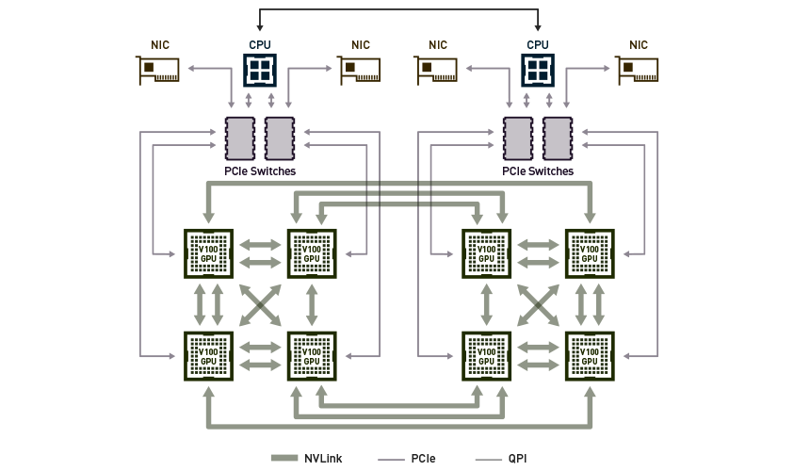
NVIDIA DGX-1

Slide 20
IBM AC922 NVLink 2.0 Topologies
2 GPUs Per CPU Socket
3 GPUs Per CPU Socket
Tesla V100 GPU
Tesla V100 GPU
Tesla V100 GPU
Tesla V100 GPU
Tesla V100 GPU
3x 50GBps:
150GBps
2x 50GBps:
100GBps
POWER9
CPU
POWER9
CPU

Slide 21
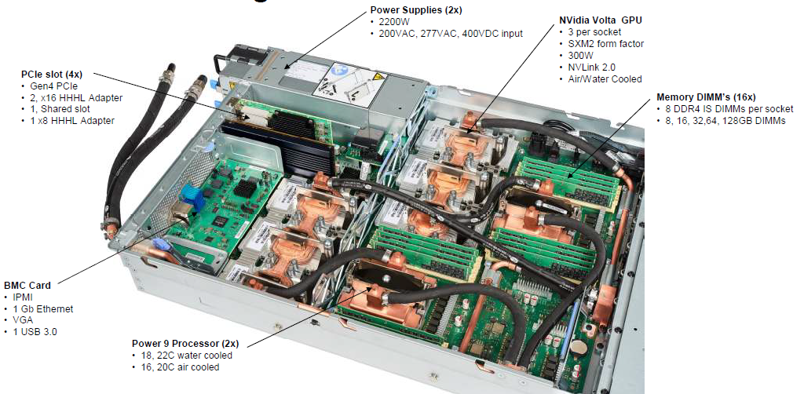
IBM AC922 w/ 6 GPUs

Slide 22
IBM AC922 Summit Node
3 GPUs Per CPU Socket
Tesla V100 GPU
Tesla V100 GPU
Tesla V100 GPU
Tesla V100 GPU
Tesla V100 GPU
Tesla V100 GPU
Nvlink 2.0
2x 50GBps:
100GBps
DDR4 DRAM
DDR4 DRAM
POWER9
CPU
POWER9
CPU
X-Bus
64GBps
120GBps
120GBps
InfiniBand
12GBps
InfiniBand
12GBps

Slide 23
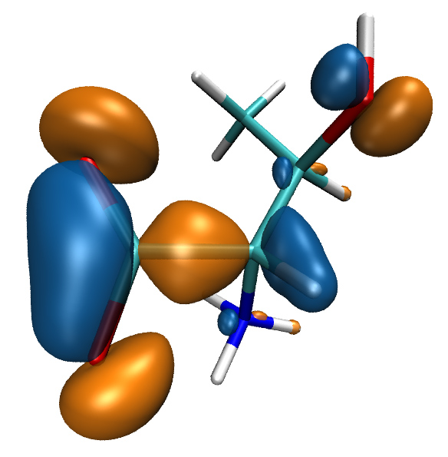
Computing Molecular Orbitals
Animation of (classical mechanics) molecular dynamics trajectories provides insight into simulation results
To do the same for QM or hybrid QM/MM simulations one must compute MOs at ~5-10 FPS or more
NAMD goes quantum: An integrative suite for hybrid simulations. Melo, M. C. R.; Bernardi, R. C.; Rudack T.; Scheurer, M.; Riplinger, C.; Phillips, J. C.; Maia, J. D. C.; Rocha, G. D.; Ribeiro, J. V.; Stone, J. E.; Neese, F.; Schulten, K.; Luthey-Schulten, Z.; Nature Methods, 2018.
http://dx.doi.org/10.1038/nmeth.4638
High Performance Computation and Interactive Display of Molecular Orbitals on GPUs and Multi-core CPUs. J. E. Stone, J. Saam, D. Hardy, K. Vandivort, W. Hwu, K. Schulten, 2nd Workshop on General-Purpose Computation on Graphics Processing Units (GPGPU-2), ACM International Conference Proceeding Series, volume 383, pp. 9-18, 2009.
Notes:
23
CBH – we should probably write “electron(s)”. Most people are used to closed shell calcs in which the MO contains 2 electrons; but open shell calcs are definitely on the rise in which each MO contains only 1 electron.

Slide 24
GPU Traversal of Atom Type, Basis Set, Shell Type, and Wavefunction Coefficients
Constant for all MOs, all timesteps
Monotonically increasing memory references
Different at each timestep, for each MO
Strictly sequential memory references
Loop iterations always access same or consecutive array elements for all threads in a thread block:
Yields good constant memory and L1 cache performance
Increases shared memory tile reuse

Slide 25
MO GPU Parallel Decomposition
MO 3-D lattice decomposes into 2-D slices (CUDA grids)
…
GPU 2
GPU 1
GPU 0
Small 8x8 thread blocks afford large
per-thread register count, shared memory
Lattice computed using multiple GPUs
0,0
0,1
…
Threads producing results that are used
Each thread computes one MO lattice point.
1,0
1,1
…
…
…
…
Padding optimizes global memory performance, guaranteeing coalesced global memory accesses
Threads producing results that are discarded
Grid of thread blocks
Notes:
Threads in a thread block (potentially) execute in parallel
Threads in a block can communicate via fast shared memory
Global memory reads are slow
Constant memory is fast, but can only be written by host at kernel startup.

Slide 26
MO Kernel for One Grid Point (Naive C)
…
for (at=0; at<numatoms; at++) {
int prim_counter = atom_basis[at];
calc_distances_to_atom(&atompos[at], &xdist, &ydist, &zdist, &dist2, &xdiv);
for (contracted_gto=0.0f, shell=0; shell < num_shells_per_atom[at]; shell++) {
int shell_type = shell_symmetry[shell_counter];
for (prim=0; prim < num_prim_per_shell[shell_counter]; prim++) {
float exponent = basis_array[prim_counter ];
float contract_coeff = basis_array[prim_counter + 1];
contracted_gto += contract_coeff * expf(-exponent*dist2);
prim_counter += 2;
}
for (tmpshell=0.0f, j=0, zdp=1.0f; j<=shell_type; j++, zdp*=zdist) {
int imax = shell_type - j;
for (i=0, ydp=1.0f, xdp=pow(xdist, imax); i<=imax; i++, ydp*=ydist, xdp*=xdiv)
tmpshell += wave_f[ifunc++] * xdp * ydp * zdp;
}
value += tmpshell * contracted_gto;
shell_counter++;
}
} …..
Loop over atoms
Loop over shells
Loop over primitives: largest component of runtime, due to expf()
Loop over angular momenta
(unrolled in real code)

Slide 27
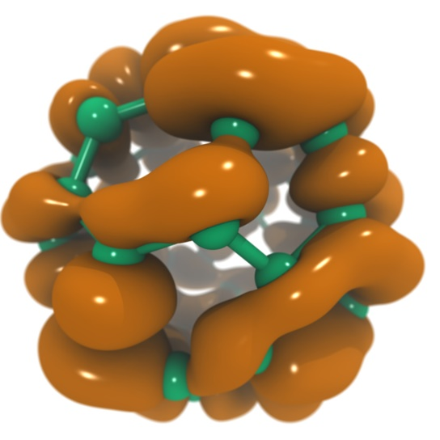
VMD Tesla P100 Performance for C₆₀ Molecular Orbitals, 516x519x507 grid
Hardware platform | Runtime, Speedup
IBM Power8 (2 socket) (ORNL ‘crest’) [1] | 8.03s, 0.4x
Intel Xeon E5-2660v3 (2 socket) [1] | 7.14s, 0.5x
IBM Power8 (ORNL ‘crest’) + 1x Tesla K40 [1] | 3.49s, 1.0x
Intel Xeon E5-2698v3 + 1x Tesla P100 | 1.35s, 2.5x
IBM Power8 “Minsky” + 1x Tesla P100 | 1.09s, 3.3x
IBM Power8 (ORNL ‘crest’) + 4x Tesla K40 [1] | 0.91s, 3.8x
Intel Xeon E5-2698v3 + 4x Tesla P100 | 0.37s, 9.4x
IBM Power8 “Minsky” + 4x Tesla P100 | 0.30s, 11.6x
NVLink perf. boost w/ no code tuning
(YET)
[1] Early Experiences Porting the NAMD and VMD Molecular Simulation and Analysis Software to GPU-Accelerated OpenPOWER Platforms. J. E. Stone, A.-P. Hynninen, J. C. Phillips, K. Schulten. International Workshop on OpenPOWER for HPC (IWOPH'16), LNCS 9945, pp. 188-206, 2016.

Slide 28
VMD Tesla V100 Performance for C₆₀ Molecular Orbitals, 516x519x507 grid
Hardware platform | Runtime, Speedup
IBM Power8 (ORNL ‘crest’) + 1x Tesla K40 [1] | 3.49s, 1.0x
Intel Xeon E5-2697Av4 + 1x Tesla V100 | 0.610s, 5.7x
Intel Xeon E5-2697Av4 + 2x Tesla V100 | 0.294s, 11.8x
Intel Xeon E5-2697Av4 + 3x Tesla V100 | 0.220s, 15.9x
IBM Power9 “Newell” + 1x Tesla V100 | 0.394s, 8.8x
IBM Power9 “Newell” + 2x Tesla V100 | 0.207s, 16.8x
IBM Power9 “Newell” + 3x Tesla V100 | 0.151s, 23.1x
IBM Power9 “Newell” + 4x Tesla V100 | 0.130s, 26.8x
IBM Power9 “Newell” + 6x Tesla V100 | 0.156s, 22.3x
NVLink perf. boost w/ no code tuning
(YET)
Need tune
[1] Early Experiences Porting the NAMD and VMD Molecular Simulation and Analysis Software to GPU-Accelerated OpenPOWER Platforms. J. E. Stone, A.-P. Hynninen, J. C. Phillips, K. Schulten. International Workshop on OpenPOWER for HPC (IWOPH'16), LNCS 9945, pp. 188-206, 2016.

Slide 29
Molecular Orbital Alg. Behavior on Summit
3 GPUs Per CPU Socket
Tesla V100 GPU
Tesla V100 GPU
Tesla V100 GPU
Tesla V100 GPU
Tesla V100 GPU
Tesla V100 GPU
Nvlink 2.0
2x 50GBps:
100GBps
DDR4 DRAM
DDR4 DRAM
POWER9
CPU
POWER9
CPU
X-Bus
64GBps
120GBps
120GBps
InfiniBand
12GBps
InfiniBand
12GBps

Slide 30
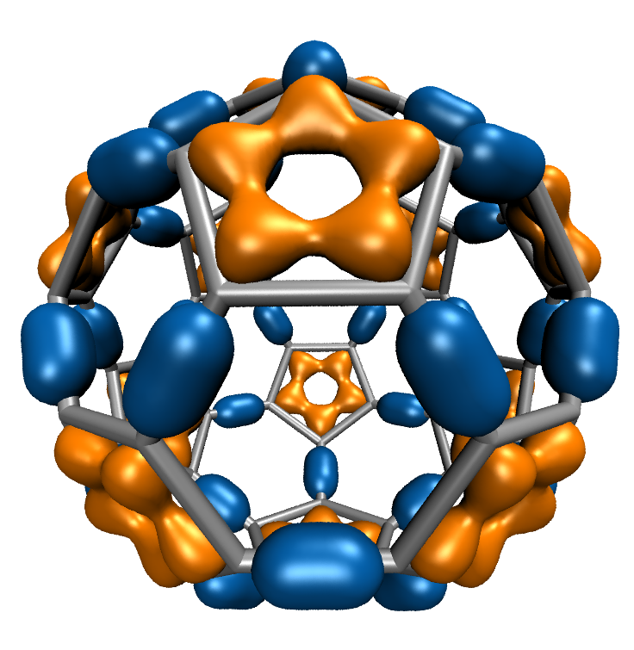
Molecular Orbitals w/ NVRTC JIT
Visualization of MOs aids in understanding the chemistry of molecular system
MO spatial distribution is correlated with probability density for an electron(s)
Animation of (classical mechanics) molecular dynamics trajectories provides insight into simulation results
To do the same for QM or QM/MM simulations MOs must be computed at 10 FPS or more
Large GPU speedups (up to 30x vs. current generation 4-core CPUs) over existing tools makes this possible!
Run-time code generation (JIT) and compilation via CUDA NVRTC enable further optimizations and the highest performance to date: 1.8x faster than fully-general data-driven loops
C₆₀
High Performance Computation and Interactive Display of Molecular Orbitals on GPUs and Multi-core CPUs. J. E. Stone, J. Saam, D. Hardy, K. Vandivort, W. Hwu, K. Schulten, 2nd Workshop on General-Purpose Computation on Graphics Processing Units (GPGPU-2), ACM International Conference Proceeding Series, volume 383, pp. 9-18, 2009.
Notes:
30
CBH – we should probably write “electron(s)”. Most people are used to closed shell calcs in which the MO contains 2 electrons; but open shell calcs are definitely on the rise in which each MO contains only 1 electron.

Slide 31
MO Kernel Structure, Opportunity for NRTC JIT… Data-driven execution, but representative loop trip counts in (…)
Loop over atoms (1 to ~200) {
Loop over electron shells for this atom type (1 to ~6) {
Loop over primitive functions for this shell type (1 to ~6) {
}
Small loop trip counts result in significant loop overhead. Runtime kernel generation and NVRTC JIT compilation can achieve in a large (1.8x!) speed boost via loop unrolling, constant folding, elimination of array accesses, …
Loop over angular momenta for this shell type (1 to ~15) {}
}
}
Notes:
31
expf() is very costly on the CPU, often several hundred clock cycles
On GPUs expf() is implemented as a native machine instruction executing in just tens of clock cycles which gives us a huge performance boost all by itself, but the other large component of GPU performance comes from the massive parallelism.
We can launch a calculation on tens of thousands of grid points at once on the GPU, fully utilizing all of its hardware.
CBH – much better. I modifited “shells” to “electron shells” and “primitives” to “primitive functions”

Slide 32
Molecular Orbital Computation and Display Process Runtime Kernel Generation, NVRTC Just-In-Time (JIT) Compilation
One-time initialization
Read QM simulation log file, trajectory
Preprocess MO coefficient data
eliminate duplicates, sort by type, etc…
Initialize Pool of GPU
Worker Threads
Generate/compile basis set-specific CUDA kernel
For current frame and MO index,
retrieve MO wavefunction coefficients
Compute 3-D grid of MO wavefunction amplitudes
using basis set-specific CUDA kernel
For each trj frame, for each MO shown
Extract isosurface mesh from 3-D MO grid
Render the resulting surface

Slide 33
for (shell=0; shell < maxshell; shell++) {
float contracted_gto = 0.0f;
// Loop over the Gaussian primitives of CGTO
int maxprim = const_num_prim_per_shell[shell_counter];
int shell_type = const_shell_symmetry[shell_counter];
for (prim=0; prim < maxprim; prim++) {
float exponent = const_basis_array[prim_counter ];
float contract_coeff = const_basis_array[prim_counter + 1];
contracted_gto += contract_coeff * expf(-exponent*dist2);
prim_counter += 2;
}
General loop-based data-dependent MO CUDA kernel
Runtime-generated data-specific MO CUDA kernel compiled via CUDA NVRTC JIT…
contracted_gto = 1.832937 * expf(-7.868272*dist2);
contracted_gto += 1.405380 * expf(-1.881289*dist2);
contracted_gto += 0.701383 * expf(-0.544249*dist2);
1.8x Faster

Slide 34
for (shell=0; shell < maxshell; shell++) {
float contracted_gto = 0.0f;
// Loop over the Gaussian primitives of CGTO
int maxprim = const_num_prim_per_shell[shell_counter];
int shell_type = const_shell_symmetry[shell_counter];
for (prim=0; prim < maxprim; prim++) {
float exponent = const_basis_array[prim_counter ];
float contract_coeff = const_basis_array[prim_counter + 1];
contracted_gto += contract_coeff * expf(-exponent*dist2);
prim_counter += 2;
}
float tmpshell=0;
switch (shell_type) {
case S_SHELL:
value += const_wave_f[ifunc++] * contracted_gto;
break;
[…..]
case D_SHELL:
tmpshell += const_wave_f[ifunc++] * xdist2;
tmpshell += const_wave_f[ifunc++] * ydist2;
tmpshell += const_wave_f[ifunc++] * zdist2;
tmpshell += const_wave_f[ifunc++] * xdist * ydist;
tmpshell += const_wave_f[ifunc++] * xdist * zdist;
tmpshell += const_wave_f[ifunc++] * ydist * zdist;
value += tmpshell * contracted_gto;
break;
contracted_gto = 1.832937 * expf(-7.868272*dist2);
contracted_gto += 1.405380 * expf(-1.881289*dist2);
contracted_gto += 0.701383 * expf(-0.544249*dist2);
// P_SHELL
tmpshell = const_wave_f[ifunc++] * xdist;
tmpshell += const_wave_f[ifunc++] * ydist;
tmpshell += const_wave_f[ifunc++] * zdist;
value += tmpshell * contracted_gto;
contracted_gto = 0.187618 * expf(-0.168714*dist2);
// S_SHELL
value += const_wave_f[ifunc++] * contracted_gto;
contracted_gto = 0.217969 * expf(-0.168714*dist2);
// P_SHELL
tmpshell = const_wave_f[ifunc++] * xdist;
tmpshell += const_wave_f[ifunc++] * ydist;
tmpshell += const_wave_f[ifunc++] * zdist;
value += tmpshell * contracted_gto;
contracted_gto = 3.858403 * expf(-0.800000*dist2);
// D_SHELL
tmpshell = const_wave_f[ifunc++] * xdist2;
tmpshell += const_wave_f[ifunc++] * ydist2;
tmpshell += const_wave_f[ifunc++] * zdist2;
tmpshell += const_wave_f[ifunc++] * xdist * ydist;
tmpshell += const_wave_f[ifunc++] * xdist * zdist;
tmpshell += const_wave_f[ifunc++] * ydist * zdist;
value += tmpshell * contracted_gto;
General loop-based data-dependent MO CUDA kernel
Runtime-generated data-specific MO CUDA kernel compiled via CUDA NVRTC JIT…
1.8x Faster

Slide 35
Challenges Adapting Large Software Systems for State-of-the-Art Hardware Platforms
Initial focus on key computational kernels eventually gives way to the need to optimize an ocean of less critical routines, due to observance of Amdahl’s Law
Even though these less critical routines might be easily ported to CUDA or similar, the sheer number of routines often poses a challenge
Need a low-cost approach for getting “some” speedup out of these second-tier routines
In many cases, it is completely sufficient to achieve memory-bandwidth-bound GPU performance with an existing algorithm

Slide 36
Directive-Based Parallel Programming with OpenACC
Annotate loop nests in existing code with #pragma compiler directives:
Annotate opportunities for parallelism
Annotate points where host-GPU memory transfers are best performed, indicate propagation of data
Evolve original code structure to improve efficacy of parallelization
Eliminate false dependencies between loop iterations
Revise algorithms or constructs that create excess data movement

Slide 37
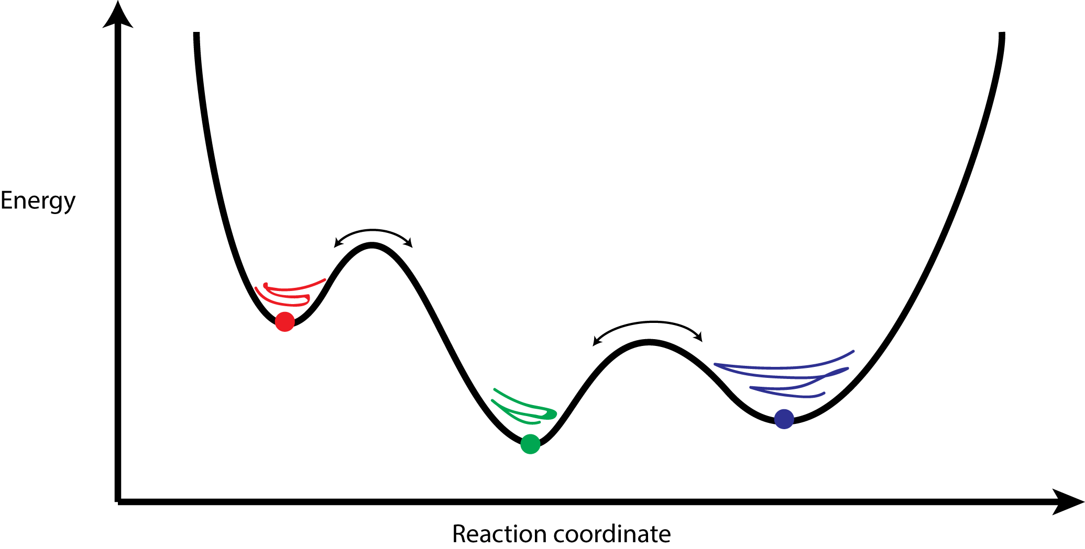
Clustering Analysis of Molecular Dynamics Trajectories
GPU-Accelerated Molecular Dynamics Clustering Analysis with OpenACC. J.E. Stone, J.R. Perilla, C. K. Cassidy, and K. Schulten. In, Robert Farber, ed., Parallel Programming with OpenACC, Morgan Kaufmann, Chapter 11, pp. 215-240, 2016.

Slide 38
Serial QCP RMSD Inner Product Loop
for (int l=0; l<cnt; l++) {
double x1, x2, y1, y2, z1, z2;
x1 = crdx1[l];
y1 = crdy1[l];
z1 = crdz1[l];
G1 += x1*x1 + y1*y1 + z1*z1;
x2 = crdx2[l];
y2 = crdy2[l];
z2 = crdz2[l];
G2 += x2*x2 + y2*y2 + z2*z2;
a0 += x1 * x2;
a1 += x1 * y2;
a2 += x1 * z2;
a3 += y1 * x2;
a4 += y1 * y2;
a5 += y1 * z2;
a6 += z1 * x2;
a7 += z1 * y2;
a8 += z1 * z2;
}
Simple example where directive based parallelism can be applied easily and effectively
Such a loop is inherently a memory-bandwidth-bound algorithm, so that’s the goal for acceleration

Slide 39
OpenACC QCP RMSD Inner Product Loop
Simple example where directive based parallelism can be applied easily and effectively
Such a loop is inherently a memory-bandwidth-bound algorithm, so that’s the goal for acceleration
// excerpted code that has been abridged for brevity…
void rmsdmat_qcp_acc(int cnt, int padcnt, int framecrdsz,
int framecount, const float * restrict crds,
long i, j, k;
#pragma acc kernels copyin(crds[0:tsz]), copy(rmsdmat[0:msz])
for (k=0; k<(framecount*(framecount-1))/2; k++) {
// compute triangular matrix index ‘k’ in a helper function
// to ensure that the compiler doesn’t think that we have
// conflicts or dependencies between loop iterations
acc_idx2sub_tril(long(framecount-1), k, &i, &j);
long x1addr = j * 3L * framecrdsz;
long x2addr = i * 3L * framecrdsz;
#pragma acc loop vector(256)
for (long l=0; l<cnt; l++) {
// abridged for brevity ...
rmsdmat[k]=rmsd; // store linearized triangular matrix
}
}

Slide 40
OpenACC QCP RMSD Inner Product Loop Performance Results
Xeon 2867W v3, w/ hand-coded AVX and FMA intrinsics: 20.7s
Tesla K80 w/ OpenACC: 6.5s (3.2x speedup)
OpenACC on K80 achieved 65% of theoretical peak memory bandwidth, with 2016 compiler and just a few lines of #pragma directives. Excellent speedup for minimal changes to code.
Future OpenACC compiler revs should provide higher performance yet

Slide 41
Acknowledgements
Theoretical and Computational Biophysics Group, University of Illinois at Urbana-Champaign
NVIDIA CUDA and OptiX teams
Funding:
NIH support: P41GM104601
DOE INCITE, ORNL Titan: DE-AC05-00OR22725
NSF Blue Waters: NSF OCI 07-25070, PRAC “The Computational Microscope”, ACI-1238993, ACI-1440026
Notes:
41

Slide 42
Please See These Other Talks:
S8727 - Improving NAMD Performance on Volta GPUs
S8718 - Optimizing HPC Simulation and Visualization Codes using Nsight Systems
S8747 - ORNL Summit: Petascale Molecular Dynamics Simulations on the Summit POWER9/Volta Supercomputer
SE150572 - OpenACC User Group Meeting
S8665: VMD: Biomolecular Visualization from Atoms to Cells Using Ray Tracing, Rasterization, and VR

Slide 43
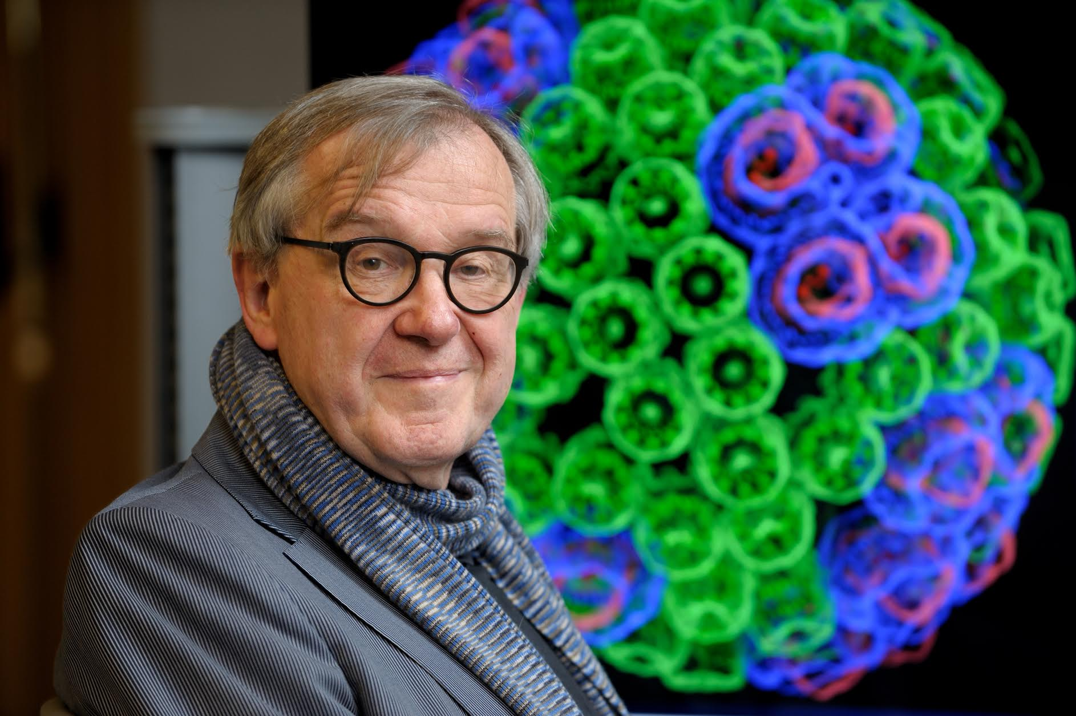
“When I was a young man, my goal was to look with mathematical and computational means at the inside of cells, one atom at a time, to decipher how living systems work. That is what I strived for and I never deflected from this goal.” – Klaus Schulten

Slide 44
Related Publications http://www.ks.uiuc.edu/Research/gpu/
NAMD goes quantum: An integrative suite for hybrid simulations. Melo, M. C. R.; Bernardi, R. C.; Rudack T.; Scheurer, M.; Riplinger, C.; Phillips, J. C.; Maia, J. D. C.; Rocha, G. D.; Ribeiro, J. V.; Stone, J. E.; Neese, F.; Schulten, K.; Luthey-Schulten, Z.; Nature Methods, 2018. (In press)
Challenges of Integrating Stochastic Dynamics and Cryo-electron Tomograms in Whole-cell Simulations. T. M. Earnest, R. Watanabe, J. E. Stone, J. Mahamid, W. Baumeister, E. Villa, and Z. Luthey-Schulten. J. Physical Chemistry B, 121(15): 3871-3881, 2017.
Early Experiences Porting the NAMD and VMD Molecular Simulation and Analysis Software to GPU-Accelerated OpenPOWER Platforms. J. E. Stone, A.-P. Hynninen, J. C. Phillips, and K. Schulten. International Workshop on OpenPOWER for HPC (IWOPH'16), LNCS 9945, pp. 188-206, 2016.
Immersive Molecular Visualization with Omnidirectional Stereoscopic Ray Tracing and Remote Rendering. J. E. Stone, W. R. Sherman, and K. Schulten. High Performance Data Analysis and Visualization Workshop, IEEE International Parallel and Distributed Processing Symposium Workshop (IPDPSW), pp. 1048-1057, 2016.
High Performance Molecular Visualization: In-Situ and Parallel Rendering with EGL. J. E. Stone, P. Messmer, R. Sisneros, and K. Schulten. High Performance Data Analysis and Visualization Workshop, IEEE International Parallel and Distributed Processing Symposium Workshop (IPDPSW), pp. 1014-1023, 2016.
Evaluation of Emerging Energy-Efficient Heterogeneous Computing Platforms for Biomolecular and Cellular Simulation Workloads. J. E. Stone, M. J. Hallock, J. C. Phillips, J. R. Peterson, Z. Luthey-Schulten, and K. Schulten.25th International Heterogeneity in Computing Workshop, IEEE International Parallel and Distributed Processing Symposium Workshop (IPDPSW), pp. 89-100, 2016.

Slide 45
Related Publications http://www.ks.uiuc.edu/Research/gpu/
Atomic Detail Visualization of Photosynthetic Membranes with GPU-Accelerated Ray Tracing. J. E. Stone, M. Sener, K. L. Vandivort, A. Barragan, A. Singharoy, I. Teo, J. V. Ribeiro, B. Isralewitz, B. Liu, B.-C. Goh, J. C. Phillips, C. MacGregor-Chatwin, M. P. Johnson, L. F. Kourkoutis, C. Neil Hunter, and K. Schulten. J. Parallel Computing, 55:17-27, 2016.
Chemical Visualization of Human Pathogens: the Retroviral Capsids. Juan R. Perilla, Boon Chong Goh, John E. Stone, and Klaus Schulten. SC'15 Visualization and Data Analytics Showcase, 2015.
Visualization of Energy Conversion Processes in a Light Harvesting Organelle at Atomic Detail. M. Sener, J. E. Stone, A. Barragan, A. Singharoy, I. Teo, K. L. Vandivort, B. Isralewitz, B. Liu, B. Goh, J. C. Phillips, L. F. Kourkoutis, C. N. Hunter, and K. Schulten. SC'14 Visualization and Data Analytics Showcase, 2014. ***Winner of the SC'14 Visualization and Data Analytics Showcase
Runtime and Architecture Support for Efficient Data Exchange in Multi-Accelerator Applications. J. Cabezas, I. Gelado, J. E. Stone, N. Navarro, D. B. Kirk, and W. Hwu. IEEE Transactions on Parallel and Distributed Systems, 26(5):1405-1418, 2015.
Unlocking the Full Potential of the Cray XK7 Accelerator. M. D. Klein and J. E. Stone. Cray Users Group, Lugano Switzerland, May 2014.
GPU-Accelerated Analysis and Visualization of Large Structures Solved by Molecular Dynamics Flexible Fitting. J. E. Stone, R. McGreevy, B. Isralewitz, and K. Schulten. Faraday Discussions, 169:265-283, 2014.
Simulation of reaction diffusion processes over biologically relevant size and time scales using multi-GPU workstations. M. J. Hallock, J. E. Stone, E. Roberts, C. Fry, and Z. Luthey-Schulten. Journal of Parallel Computing, 40:86-99, 2014.

Slide 46
Related Publications http://www.ks.uiuc.edu/Research/gpu/
GPU-Accelerated Molecular Visualization on Petascale Supercomputing Platforms. J. Stone, K. L. Vandivort, and K. Schulten. UltraVis'13: Proceedings of the 8th International Workshop on Ultrascale Visualization, pp. 6:1-6:8, 2013.
Early Experiences Scaling VMD Molecular Visualization and Analysis Jobs on Blue Waters. J. Stone, B. Isralewitz, and K. Schulten. In proceedings, Extreme Scaling Workshop, 2013.
Lattice Microbes: High‐performance stochastic simulation method for the reaction‐diffusion master equation. E. Roberts, J. Stone, and Z. Luthey‐Schulten. J. Computational Chemistry 34 (3), 245-255, 2013.
Fast Visualization of Gaussian Density Surfaces for Molecular Dynamics and Particle System Trajectories. M. Krone, J. Stone, T. Ertl, and K. Schulten. EuroVis Short Papers, pp. 67-71, 2012.
Immersive Out-of-Core Visualization of Large-Size and Long-Timescale Molecular Dynamics Trajectories. J. Stone, K. L. Vandivort, and K. Schulten. G. Bebis et al. (Eds.): 7th International Symposium on Visual Computing (ISVC 2011), LNCS 6939, pp. 1-12, 2011.
Fast Analysis of Molecular Dynamics Trajectories with Graphics Processing Units – Radial Distribution Functions. B. Levine, J. Stone, and A. Kohlmeyer. J. Comp. Physics, 230(9):3556-3569, 2011.

Slide 47
Related Publications http://www.ks.uiuc.edu/Research/gpu/
Quantifying the Impact of GPUs on Performance and Energy Efficiency in HPC Clusters. J. Enos, C. Steffen, J. Fullop, M. Showerman, G. Shi, K. Esler, V. Kindratenko, J. Stone, J Phillips. International Conference on Green Computing, pp. 317-324, 2010.
GPU-accelerated molecular modeling coming of age. J. Stone, D. Hardy, I. Ufimtsev, K. Schulten. J. Molecular Graphics and Modeling, 29:116-125, 2010.
OpenCL: A Parallel Programming Standard for Heterogeneous Computing. J. Stone, D. Gohara, G. Shi. Computing in Science and Engineering, 12(3):66-73, 2010.
An Asymmetric Distributed Shared Memory Model for Heterogeneous Computing Systems. I. Gelado, J. Stone, J. Cabezas, S. Patel, N. Navarro, W. Hwu. ASPLOS ’10: Proceedings of the 15th International Conference on Architectural Support for Programming Languages and Operating Systems, pp. 347-358, 2010.

Slide 48
Related Publications http://www.ks.uiuc.edu/Research/gpu/
GPU Clusters for High Performance Computing. V. Kindratenko, J. Enos, G. Shi, M. Showerman, G. Arnold, J. Stone, J. Phillips, W. Hwu. Workshop on Parallel Programming on Accelerator Clusters (PPAC), In Proceedings IEEE Cluster 2009, pp. 1-8, Aug. 2009.
Long time-scale simulations of in vivo diffusion using GPU hardware. E. Roberts, J. Stone, L. Sepulveda, W. Hwu, Z. Luthey-Schulten. In IPDPS’09: Proceedings of the 2009 IEEE International Symposium on Parallel & Distributed Computing, pp. 1-8, 2009.
High Performance Computation and Interactive Display of Molecular Orbitals on GPUs and Multi-core CPUs. J. E. Stone, J. Saam, D. Hardy, K. Vandivort, W. Hwu, K. Schulten, 2nd Workshop on General-Purpose Computation on Graphics Pricessing Units (GPGPU-2), ACM International Conference Proceeding Series, volume 383, pp. 9-18, 2009.
Probing Biomolecular Machines with Graphics Processors. J. Phillips, J. Stone. Communications of the ACM, 52(10):34-41, 2009.
Multilevel summation of electrostatic potentials using graphics processing units. D. Hardy, J. Stone, K. Schulten. J. Parallel Computing, 35:164-177, 2009.

Slide 49
Related Publications http://www.ks.uiuc.edu/Research/gpu/
Adapting a message-driven parallel application to GPU-accelerated clusters. J. Phillips, J. Stone, K. Schulten. Proceedings of the 2008 ACM/IEEE Conference on Supercomputing, IEEE Press, 2008.
GPU acceleration of cutoff pair potentials for molecular modeling applications. C. Rodrigues, D. Hardy, J. Stone, K. Schulten, and W. Hwu. Proceedings of the 2008 Conference On Computing Frontiers, pp. 273-282, 2008.
GPU computing. J. Owens, M. Houston, D. Luebke, S. Green, J. Stone, J. Phillips. Proceedings of the IEEE, 96:879-899, 2008.
Accelerating molecular modeling applications with graphics processors. J. Stone, J. Phillips, P. Freddolino, D. Hardy, L. Trabuco, K. Schulten. J. Comp. Chem., 28:2618-2640, 2007.
Continuous fluorescence microphotolysis and correlation spectroscopy. A. Arkhipov, J. Hüve, M. Kahms, R. Peters, K. Schulten. Biophysical Journal, 93:4006-4017, 2007.

