Slide 1
S8665—VMD: Biomolecular Visualization from Atoms to Cells Using Ray Tracing, Rasterization, and VR
John E. Stone
Theoretical and Computational Biophysics Group
Beckman Institute for Advanced Science and Technology
University of Illinois at Urbana-Champaign
http://www.ks.uiuc.edu/Research/gpu/
S8665, GPU Technology Conference
11:00-11:50, Hilton Almaden 2,
San Jose, CA, Thursday March 29th, 2018

Slide 2
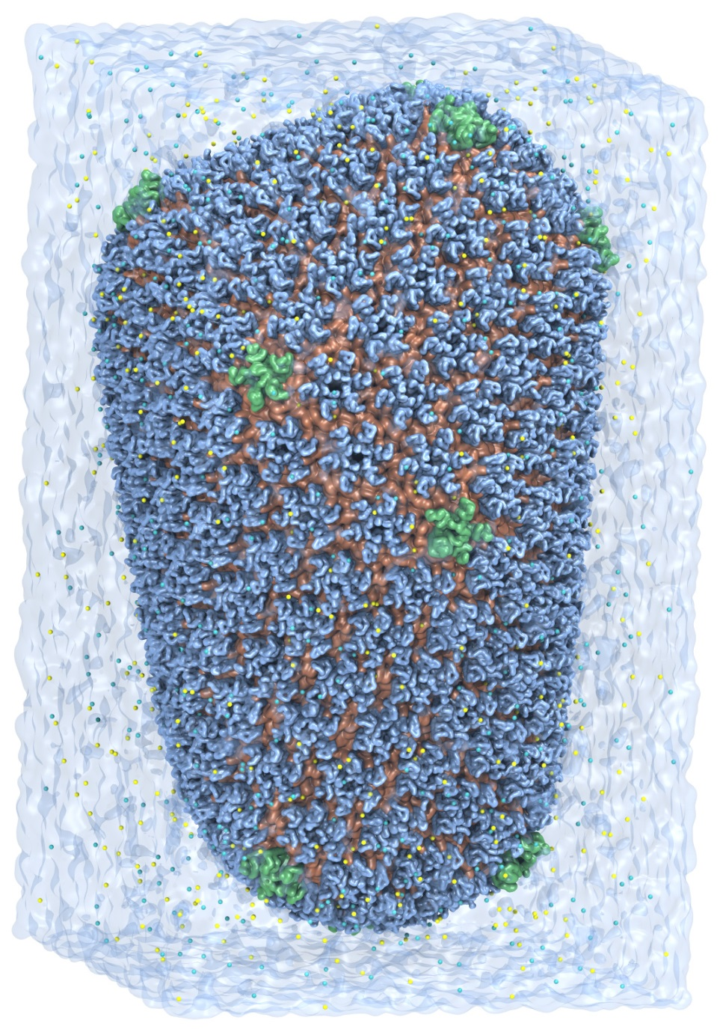
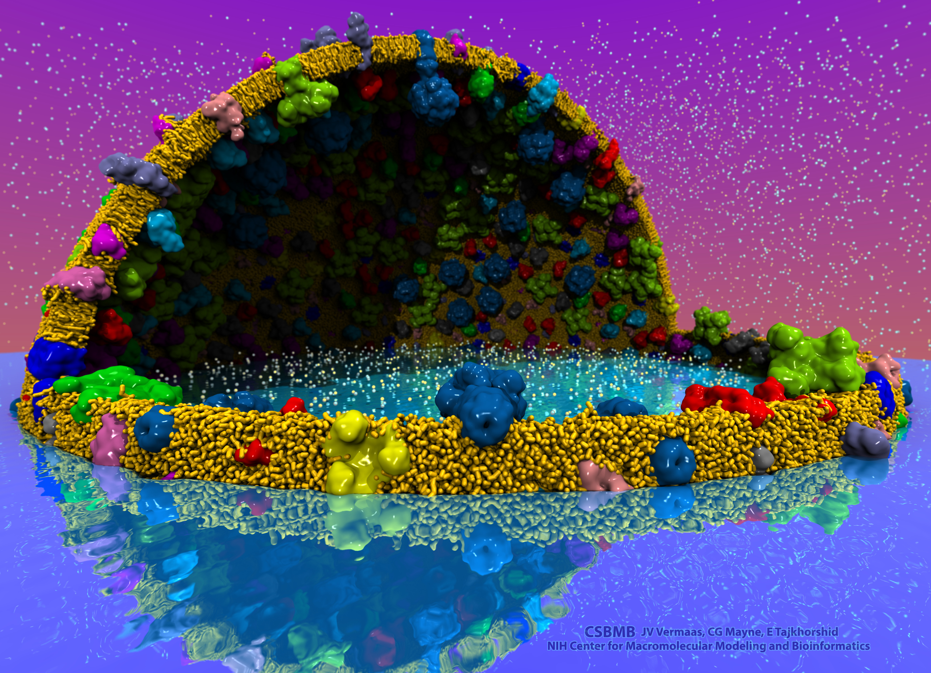
VMD – “Visual Molecular Dynamics”
Visualization and analysis of:
Molecular dynamics simulations
Lattice cell simulations
Quantum chemistry calculations
Cryo-EM densities, volumetric data
Sequence information
User extensible scripting and plugins
http://www.ks.uiuc.edu/Research/vmd/
Cell-Scale Modeling
MD Simulation

Slide 3
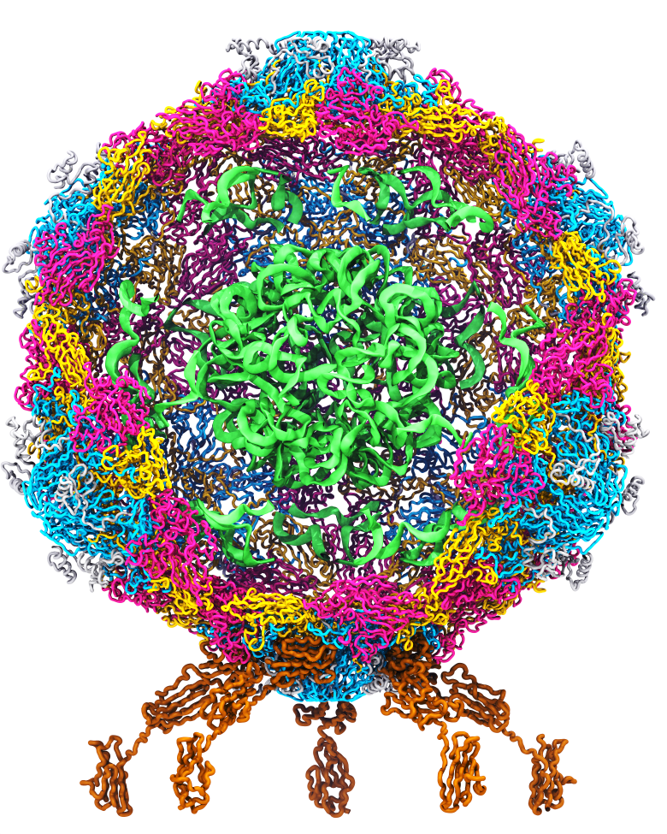
Goal: A Computational Microscope
Study the molecular machines in living cells
Ribosome: target for antibiotics
Poliovirus
Notes:
Ribosomes synthesize new proteins from genetic information
Bacterial ribosome is a target for antibiotics, which interfere with its ability to function by binding to sites on the structure, preventing proteins from being synthesized
Ribosome simulations are extremely computationally challenging due to the size of the structure and its natural environment (solvent, ions, etc, large box, 3 million atoms or so)
Bionanodevice for sequencing DNA efficiently
Knowledge of an individual’s genetic makeup can lead to the prediction and treatment of many diseases by the means of personal genomic medicine and pharmacogenomics. In order for genome sequencing to become practical for common medical use, an inexpensive high throughput genome sequencing technique is required. NIH has set a goal of reducing the cost of genome sequencing by a factor of 10,000, to less than $1,000 within ten years.
The computer is the best microscope to guide the development of bionanodevices, for example to sequence DNA. While experiments can measure DNA electrostatic potentials, they cannot visualize the DNA’s location and conformation at the time of measurement.

Slide 4
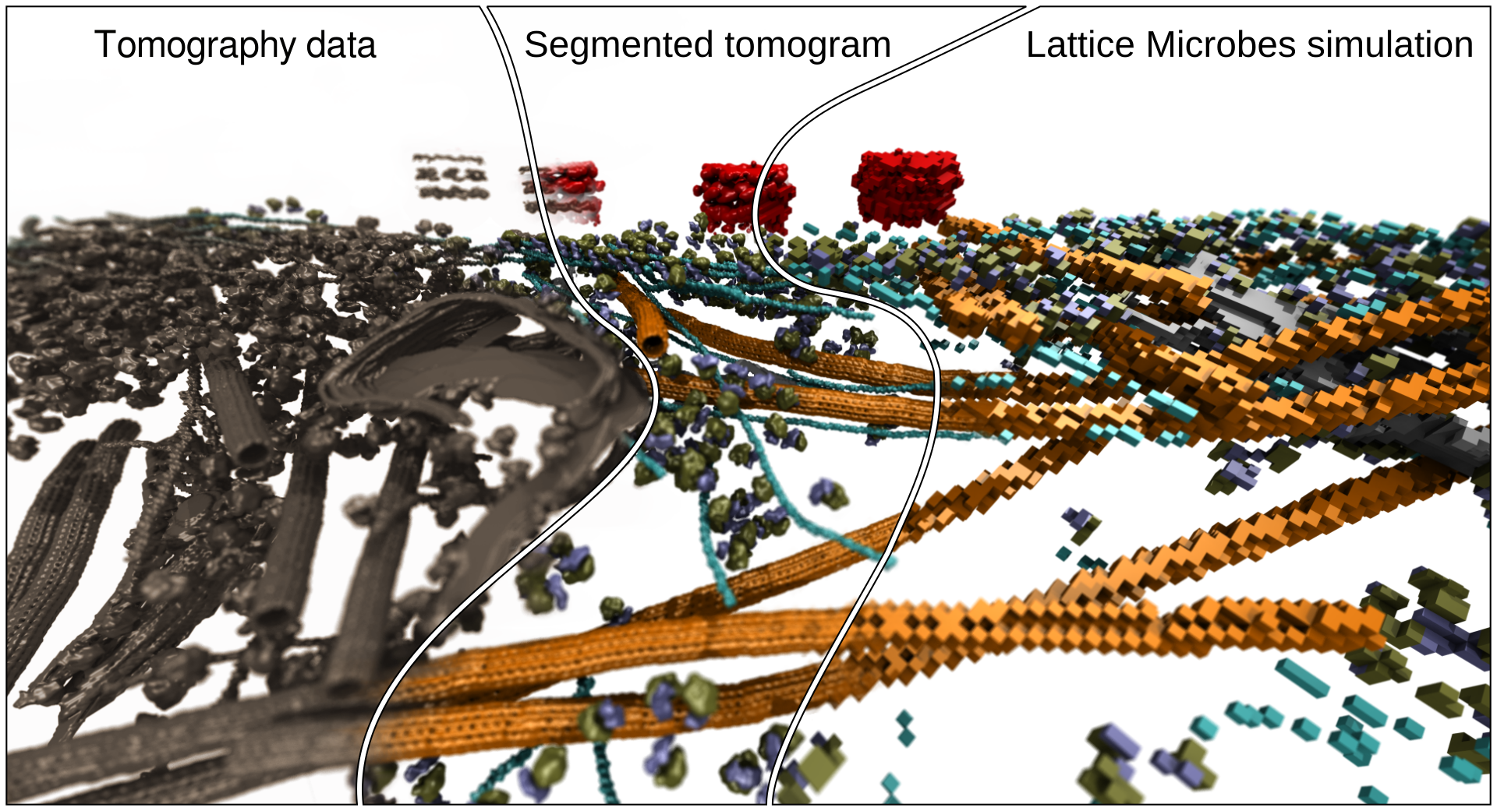
Cryo-EM / Cryo-ET Image Segmentation
Evaluate 3-D volumetric electron density maps and segment them, to identify key structural components
Index/label components so they can be referred to, colored, analyzed, and simulated…

Slide 5
Cryo-EM Density Map Segmentation Approach, goals
Goals:
Reach interactive performance rates (under 1 second) for common density map sizes between 128³ to 256³ voxels
Handle next-generation problem sizes (768³ to 2048³) smoothly with only a brief wait
Key methods:
Tile-based early-exit schemes pervasively used for all iterative segmentation update/merge kernels
Privatization, shared memory atomic counters for segmentation group index kernels
Significantly faster than published algorithm designs we are aware of
Watershed segmentation:
Smooth/denoise image (e.g. blur)
Find local minima of image/gradients
Connect minimum voxels with neighbors of similar intensity, marking them with the same “group” number
“Grow” each group (merging groups where rules allow) until no more updates occur
Scale-space segmentation variant does further blurring and group merging to reach a user-specified target segment count

Slide 6
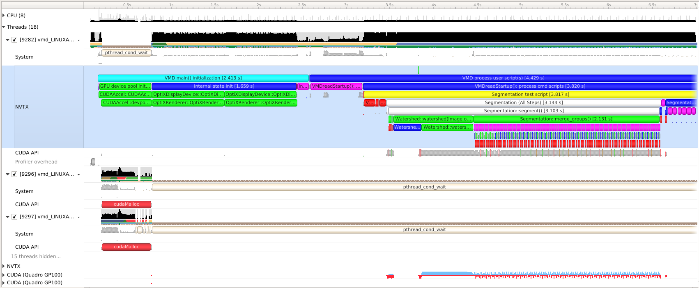
Profiled VMD Segmentation w/ NVIDIA Nsight Systems
See S8718 - Optimizing HPC Simulation and Visualization Codes using Nsight Systems
Added NVTX tags clearly show algorithm phases in the Nsight System timeline.

Slide 7
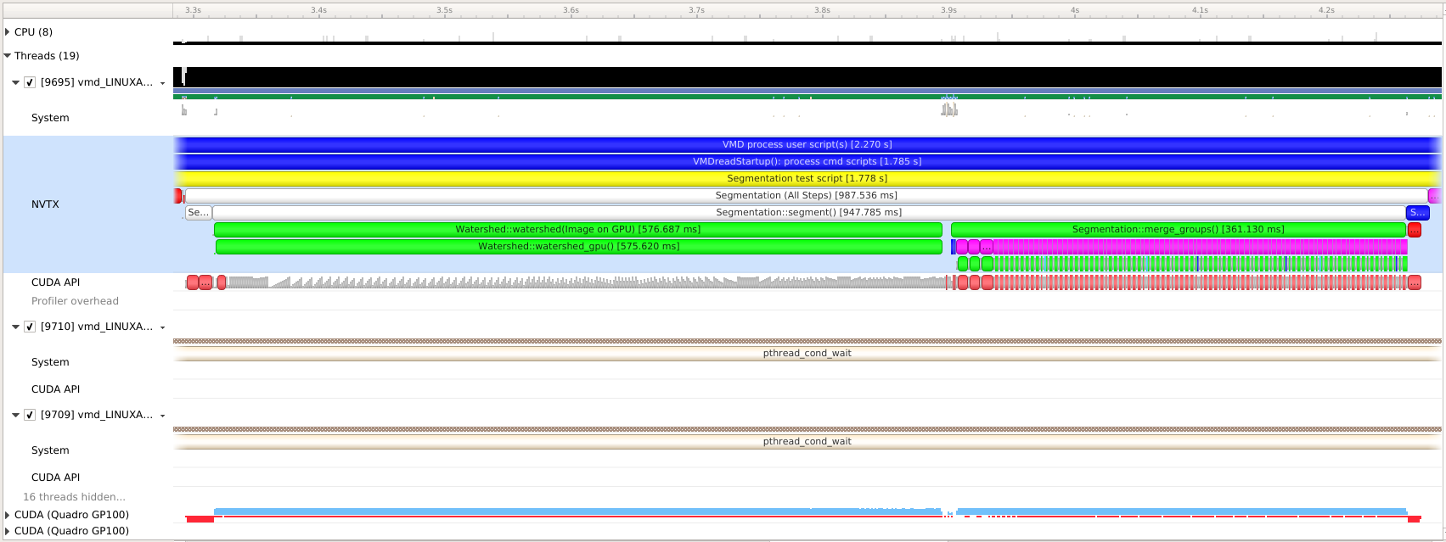
VMD Optimized GPU Segmentation Pipeline
256³ voxels:
Quadro GP100
Total time: 0.98s
Total speedup: 3.2x
Tesla V100
Total time: 0.67s
Total speedup: 4.1x
VMD GPU Segmentation now over 12x faster than competing tools

Slide 8
Volta-Specific Segmentation Optimization Opportunities
Optimized precision for 3-D density maps:
Improved memory bandwidth, lower arithmetic cost
FP16: half-precision EM density map representation
INT8: byte density map representation for EM tomograms
Explore Tensor Core for iterative scale-space segmentation merge/blur convolutions, and initial noise filtering steps:
Difficult to prevent TC from becoming mem bandwidth-bound
Challenge: CUDA 9.x APIs for TC limit the range of data movement patterns that perform well
Some dimensionalities and matrix-based problem decompositions perform much better than others – this is an area of ongoing exploration

Slide 9
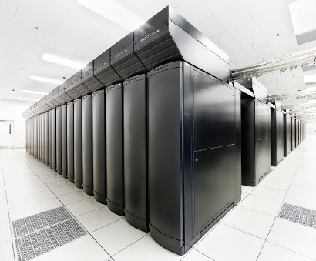
VMD Petascale Visualization and Analysis
Analyze/visualize large trajectories too large to transfer off-site:
User-defined parallel analysis operations, data types
Parallel rendering, movie making
Supports GPU-accelerated Cray XK7 nodes for both visualization and analysis:
GPU accelerated trajectory analysis w/ CUDA
OpenGL and GPU ray tracing for visualization and movie rendering
Parallel I/O rates up to 275 GB/sec on 8192 Cray XE6 nodes – can read in 231 TB in 15 minutes!
Parallel VMD currently available on:
ORNL Titan, NCSA Blue Waters, Indiana Big Red II, CSCS Piz Daint, and similar systems
NCSA Blue Waters Hybrid Cray XE6 / XK7
22,640 XE6 dual-Opteron CPU nodes
4,224 XK7 nodes w/ Telsa K20X GPUs

Slide 10
Info) VMD for OPENPOWER, version 1.9.3 (April 27, 2017)
Info) http://www.ks.uiuc.edu/Research/vmd/
[…]
Info) Multithreading available, 160 CPUs detected.
Info) Free system memory: 501GB (98%)
Info) Creating CUDA device pool and initializing hardware...
Info) Detected 4 available CUDA accelerators:
Info) [0] Tesla P100-SXM2-16GB 56 SM_6.0 @ 1.48 GHz, 16GB RAM, AE3, ZCP
[…]
Info) EGL: node[0] bound to display[0], 4 displays total
Info) EGL version 1.4
Info) OpenGL Pbuffer size: 4096x2400
Info) OpenGL renderer: Tesla P100-SXM2-16GB/PCIe
Info) Features: STENCIL MSAA(4) MDE CVA MTX NPOT PP PS GLSL(OVFGS)
Info) Full GLSL rendering mode is available.
Info) Textures: 2-D (32768x32768), 3-D (16384x16384x16384), Multitexture (4)
Info) Created EGL OpenGL Pbuffer for off-screen rendering

Slide 11
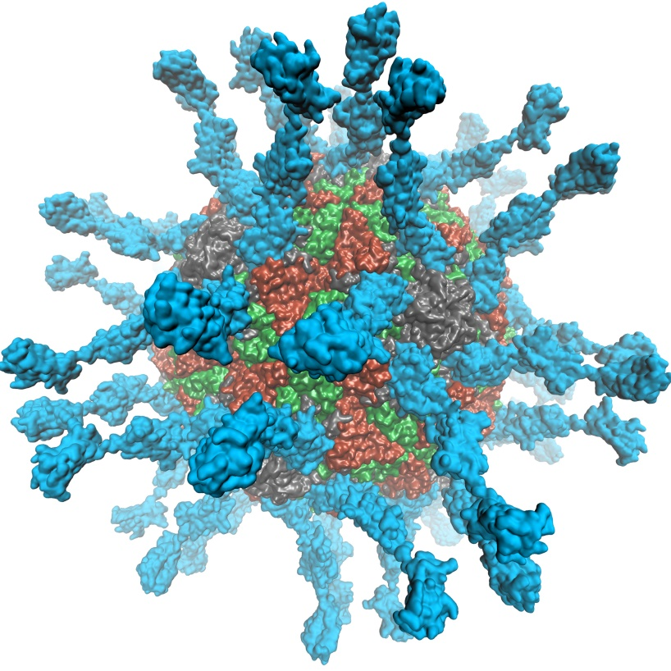
VMD supports EGL for in-situ and parallel rendering on clouds, clusters, and supercomputers
No windowing system dependency
Easily deploy parallel VMD builds supporting off-screen rendering
Maintains 100% of VMD OpenGL shaders and rendering features
Support high-quality vendor-supported commercial OpenGL implementations in HPC systems that were previously limited to Mesa
Poliovirus

Slide 12
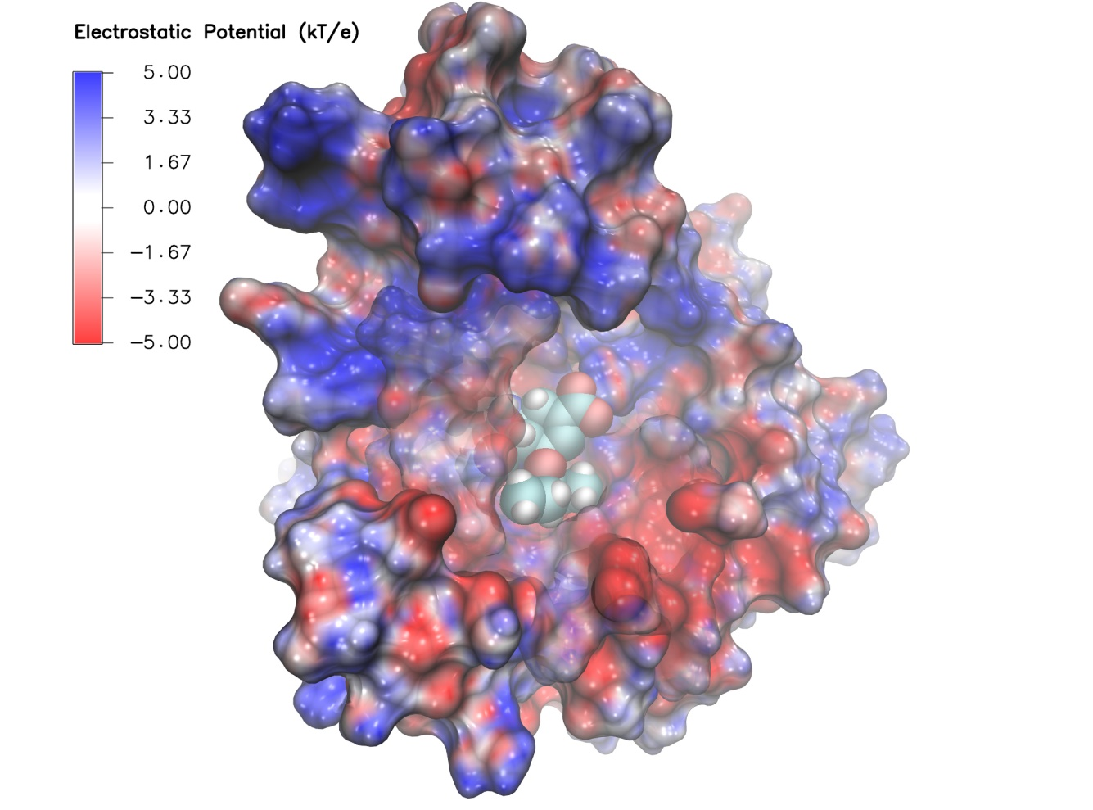
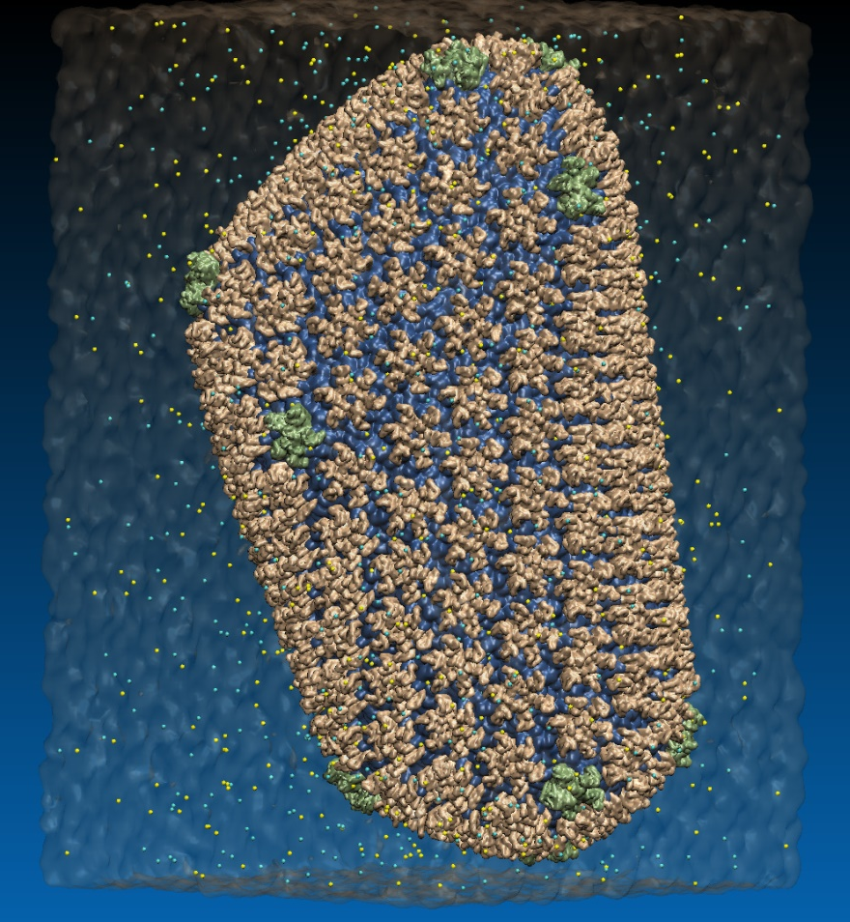
VMD EGL Rendering: Supports full VMD GLSL shading features, multisample antialiasing, ray cast spheres, 3-D tex mapping, ...
Swine Flu A/H1N1 neuraminidase bound to Tamiflu
64M atom HIV-1 capsid simulation
High Performance Molecular Visualization: In-Situ and Parallel Rendering with EGL. J. E. Stone, P. Messmer, R. Sisneros, and K. Schulten. High Performance Data Analysis and Visualization Workshop, IEEE IPDPSW, pp. 1014-1023, 2016.

Slide 13
OpenGL: GLX vs. EGL
Viz Application
(user)
Viz Application
(user)
OpenGL
GLX
OpenGL
X server
(root)
OpenGL
EGL
Driver
Driver
GPU
GPU

Slide 14
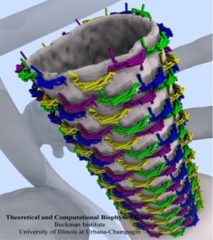
Molecular Structure Data and Global VMD State
Scene Graph
Graphical Representations
User Interface Subsystem
DrawMolecule
Tcl/Python Scripting
Non-Molecular
Geometry
Mouse + Windows
6DoF Input “Tools”
VMDDisplayList
Display
Subsystem
GLX+X11+Drv
OpenGL Pbuffer/FBO
DisplayDevice
Windowed OpenGL
EGL+Drv
OpenGLRenderer
OpenGL Pbuffer/FBO

Slide 15
VMD EGL Performance on Amazon EC2 Cloud
MPI Ranks | EC2 “G2.8xlarge” GPU Instances | HIV-1 movie rendering time (sec), (I/O %) 3840x2160 resolution
1 | 1 | 626s (10% I/O)
2 | 1 | 347s (19% I/O)
4 | 1 | 221s (31% I/O)
8 | 2 | 141s (46% I/O)
16 | 4 | 107s (64% I/O)
32 | 8 | 90s (76% I/O)
Performance at 32 nodes reaches ~48 frames per second
High Performance Molecular Visualization: In-Situ and Parallel Rendering with EGL. J. E. Stone, P. Messmer, R. Sisneros, and K. Schulten. High Performance Data Analysis and Visualization Workshop, IEEE IPDPSW, pp. 1014-1023, 2016.
64M atom HIV-1 capsid simulation rendered via EGL

Slide 16
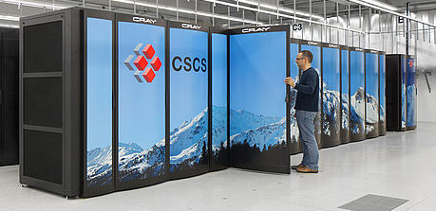
VMD Off-Screen Rendering w/ EGL
Containers+Cloud+Workstations with recent NVIDIA drivers
VMD on HPC systems w/ latest GPUs:
Cray XC50, CSCS Piz Daint
ORNL Summit in progress now
IBM OpenPOWER, drivers 375.66 and later support both GLX and EGL

Slide 17
Benefits of EGL Platform Interfaces
EGL interfaces make it EASY to bind a GPU to a thread with optimal CPU affinity with respect to NUMA topology, NVLink GPU topology
High-perf. multi-GPU image compositing, video streaming
EGL plays nicely with MPI, CUDA/OpenCL, OptiX, NVENC, etc
NVIDIA EGL supports multiple GPU indexing schemes, e.g. PCIe ordering
Exploit NVLink interconnect topology on IBM OpenPOWER platforms, DOE/ORNL “Summit” system

Slide 18
IBM AC922 Summit Node
3 GPUs Per CPU Socket
Tesla V100 GPU
Tesla V100 GPU
Tesla V100 GPU
Tesla V100 GPU
Tesla V100 GPU
Tesla V100 GPU
Nvlink 2.0
2x 50GBps:
100GBps
DDR4 DRAM
DDR4 DRAM
POWER9
CPU
POWER9
CPU
X-Bus
64GBps
120GBps
120GBps
InfiniBand
12GBps
InfiniBand
12GBps

Slide 19
Example Node NUMA Topology
DRAM
GPU 1
QPI/HT
IOH 1
PCIe 3.0 x16
CPU 1
GPU 2
PCIe 3.0 x16
CPU Bus 25GB/sec
QuickPath (QPI)
HyperTransport (HT)
NET
QPI/
HT
PCIe 3.0 x4/x8/x16
PCIe 3.0 x16 12GB/sec
GPU 3
CPU 2
IOH 2
PCIe 3.0 x16
QPI/HT
GPU 4
DRAM
PCIe 3.0 x16

Slide 20
https://www.khronos.org/vulkan/
High performance, low-overhead, reduced abstraction, rasterization API:
Modern API, benefits from past experiences with OpenGL, DX, etc
Core features essentially start w/ OpenGL 4.x function, and continue from there
Fewer extensions required for modern functionality
Significantly reduced API overheads relative to OpenGL, some apps have seen up to ~3x performance gains vs. traditional OpenGL
Shaders (e.g. GLSL) compiled to SPIR-V intermediate code at app compile time
Compile-time validation of shaders, rendering pipelines (lower runtime overhead)
Core Vulkan doesn’t deal with on-screen display, only rendering
Integration with windowing system is handled by Vulkan “WSI” extensions
Multi-GPU rendering included in the new Vulkan 1.1 spec!

Slide 21
VMD on
In-progress: Vulkan-based rasterization path for VMD
Vulkan opportunities for VMD:
Vulkan ideally suited as the API for high-end GPUs
Maintain existing OpenGL renderer to support integrated/legacy GPUs
Parallel Vulkan command buffer generation will allow deep multithreading of time-varying VMD graphical representation updates
VMD Vulkan rendering path will be able to go all-in on techniques that are only viable on high-end GPUs
Headless operation supported, akin to EGL and GLX Pbuffer APIs

Slide 22
Molecular Structure Data and Global VMD State
Multithreaded Parallel Update/Generation of Graphical Representations
User Interface Subsystem
DispCmd GenerationThreads
DrawMolecule
Tcl/Python Scripting
Non-Molecular
Geometry
Mouse + Windows
6DoF Input “Tools”
Scene Graph
Display Subsystem
CMD
CMD
CMD
CMD
DisplayDevice
Vulkan Command Buffers
VMDDisplayList

Slide 23
on Cloud/HPC Systems
Straightforward use within Amazon EC2 AMIs
Containers: requires just a few additional steps beyond those for OpenGL, placement of Vulkan-specific JSON files, etc.
Early tests have demonstrated viability of off-screen Vulkan rendering on Cray XC50 supercomputers:
Headless Vulkan works on CSCS Piz Daint test and development system
Vulkan SDK open source, eases debug/testing/deployment on new or specialized systems such as HPC platforms:
Compilation of Vulkan SDK on IBM POWER9 pretty close to “out-of-box”
A few small missing pieces (assembly language in Vulkan loader) for POWER9 might be relatively easy to address
Support OpenPOWER, ORNL Summit, with SDK updates, future drivers?
I will find out. Watch this space! ☺

Slide 24
Making Our Research Tools Easily Accessible
Docker “container” images available in NVIDIA NGC registry
Users obtain Docker images via registry, download and run on the laptop, workstation, cloud, or supercomputer of their choosing
https://ngc.nvidia.com/registry/
https://ngc.nvidia.com/registry/hpc-vmd
Cloud based deployment
Full virtual machines (known as “AMI” in Amazon terminology)
Amazon AWS EC2 GPU-accelerated instances:
http://www.ks.uiuc.edu/Research/cloud/
Clusters, Supercomputers
Workstations,
Servers,
Cloud
Molecular dynamics-based refinement and validation for sub-5 Å cryo-electron microscopy maps. Abhishek Singharoy, Ivan Teo, Ryan McGreevy, John E. Stone, Jianhua Zhao, and Klaus Schulten. eLife, 10.7554/eLife.16105, 2016. (66 pages).
QwikMD-integrative molecular dynamics toolkit for novices and experts. Joao V. Ribeiro, Rafael C. Bernardi, Till Rudack, John E. Stone, James C. Phillips, Peter L. Freddolino, and Klaus Schulten. Scientific Reports, 6:26536, 2016.
High performance molecular visualization: In-situ and parallel rendering with EGL. John E. Stone, Peter Messmer, Robert Sisneros, and Klaus Schulten. 2016 IEEE International Parallel and Distributed Processing Symposium Workshop (IPDPSW), pp. 1014-1023, 2016.

Slide 25
VMD OptiX/EGL NGC Container
https://ngc.nvidia.com/registry/
CUDA-accelerated viz+analysis
EGL off-screen rendering – no windowing system needed
OptiX high-fidelity GPU ray tracing engine built in
All dependencies included
Easy to deploy on a wide range of GPU accelerated platforms
High performance molecular visualization: In-situ and parallel rendering with EGL. J. E. Stone, P. Messmer, R. Sisneros, and K. Schulten. 2016 IEEE International Parallel and Distributed Processing Symposium Workshop (IPDPSW), pp. 1014-1023, 2016.

Slide 26
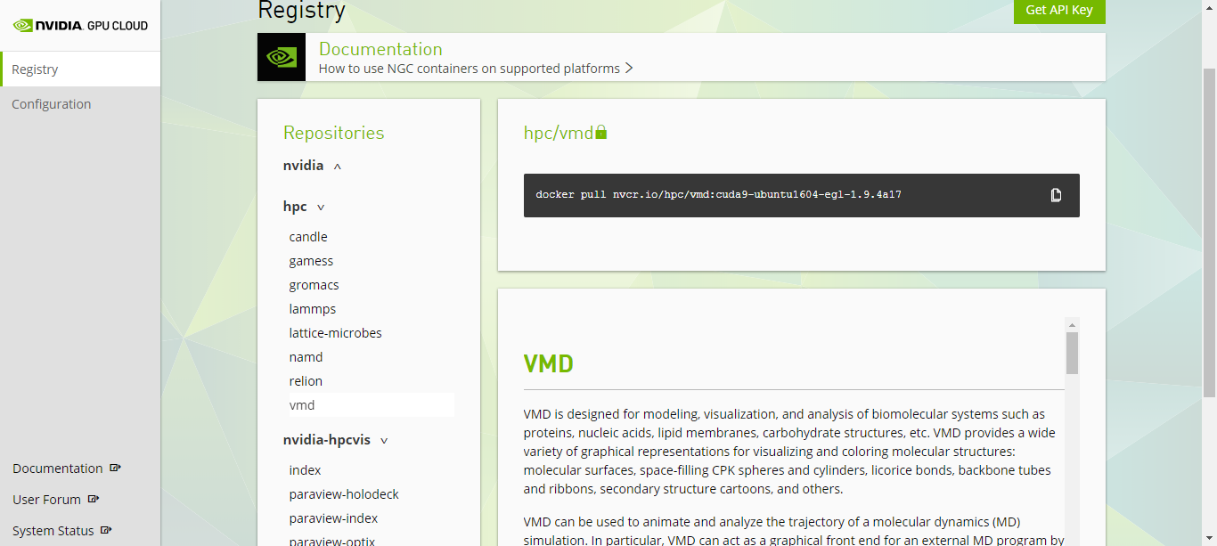
VMD / NAMD / LM, NGC Containers

Slide 27
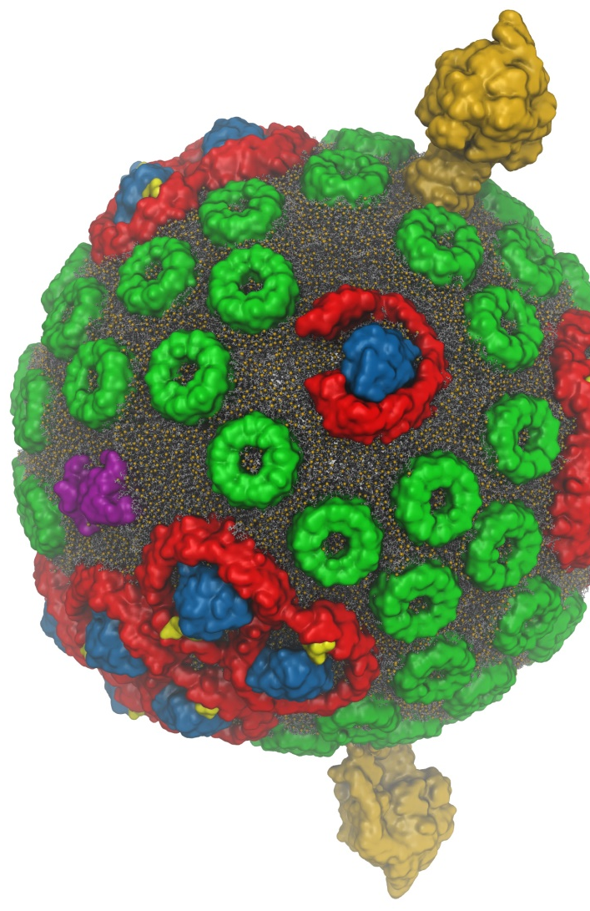
VMD w/ OptiX 5
Interactive RT on laptops, desktops, and cloud
Large-scale parallel rendering: in situ or post hoc visualization
Remote RT on NVIDIA GPU clusters
Stereoscopic panoramic and full-dome projections
Omnidirectional VR for YouTube, VR HMDs
GPU memory sharing via NVLink on Quadro GP100, Tesla P100
VMD+OptiX 5, NVIDIA NGC container: https://ngc.nvidia.com/registry/
In-progress:
OptiX denoising support: fast turnaround w/ AO, DoF, etc
Denoising to enable practical use of path tracing in VMD
GPU-Accelerated Molecular Visualization on Petascale Supercomputing Platforms. J. E. Stone, K. L. Vandivort, and K. Schulten. UltraVis’13, pp. 6:1-6:8, 2013.
Visualization of Energy Conversion Processes in a Light Harvesting Organelle at Atomic Detail. M. Sener, et al. SC'14 Visualization and Data Analytics Showcase, 2014.
Chemical Visualization of Human Pathogens: the Retroviral Capsids. J. R. Perilla, B.-C. Goh, J. E. Stone, and K. Schulten. SC'15 Visualization and Data Analytics Showcase, 2015.
Atomic Detail Visualization of Photosynthetic Membranes with GPU-Accelerated Ray Tracing. J. E. Stone et al., J. Parallel Computing, 55:17-27, 2016.
Immersive Molecular Visualization with Omnidirectional Stereoscopic Ray Tracing and Remote Rendering J. E. Stone, W. R. Sherman, and K. HPDAV, IPDPSW, pp. 1048-1057, 2016.
VMD/OptiX GPU Ray Tracing of all-atom Chromatophore w/ lipids.

Slide 28
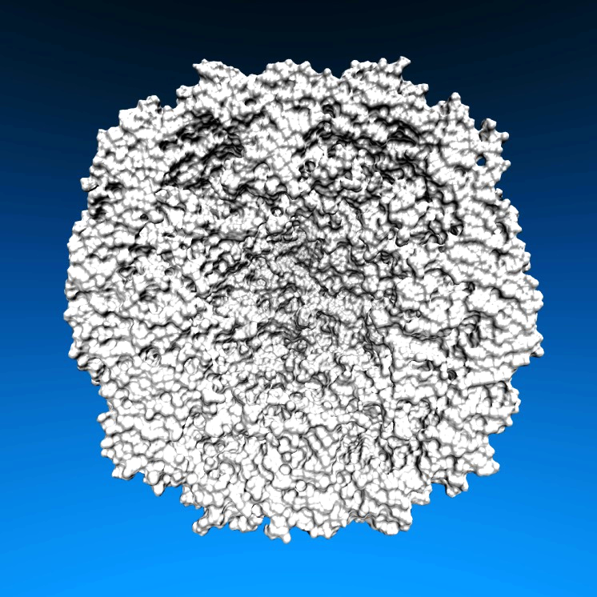
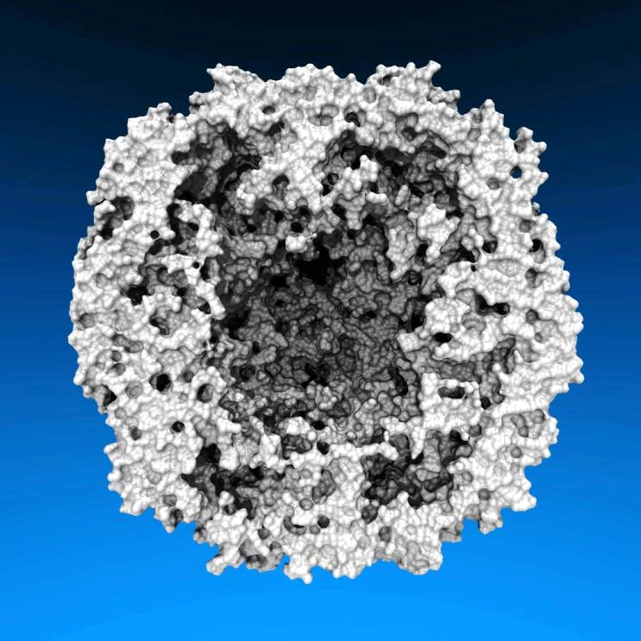
Lighting Comparison, STMV Capsid
Two lights, no shadows
Two lights, hard shadows, 1 shadow ray per light
Ambient occlusion + two lights, 144 AO rays/hit

Slide 29
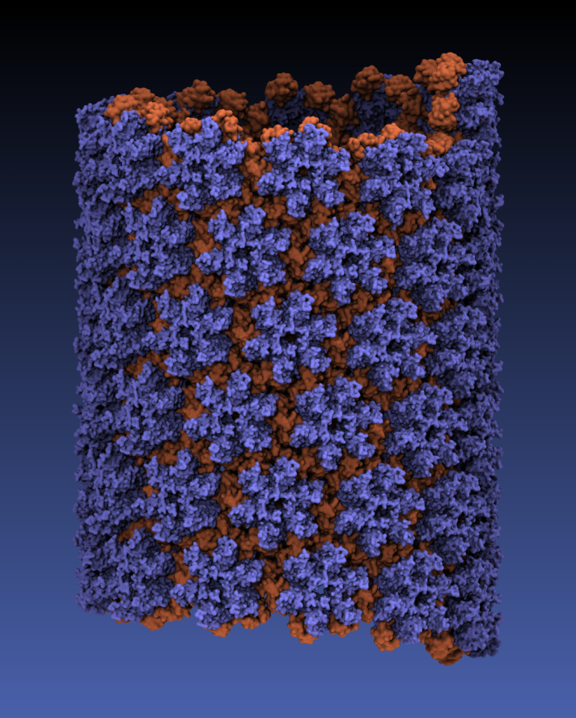
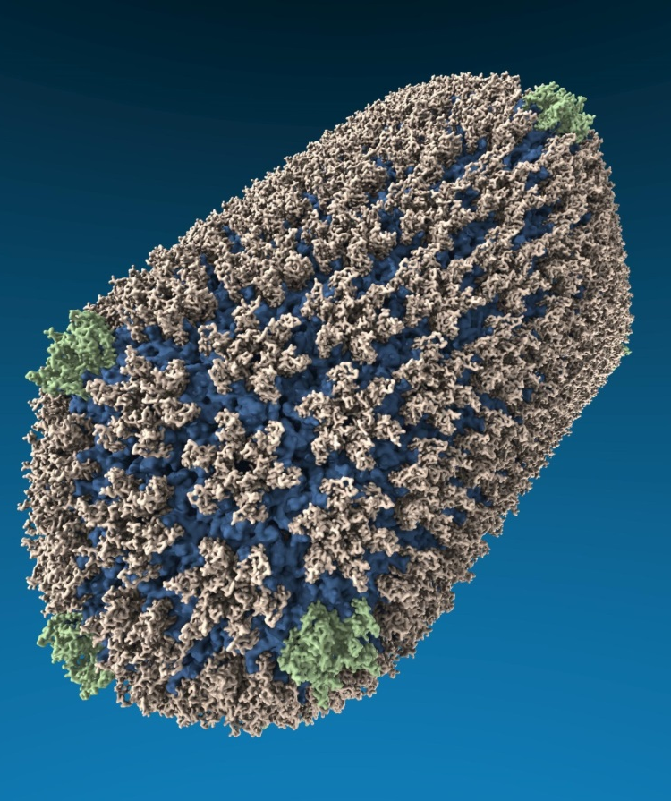
VMD “QuickSurf” Representation, Ray Tracing
All-atom HIV capsid simulations w/ up to 64M atoms on Blue Waters

Slide 30
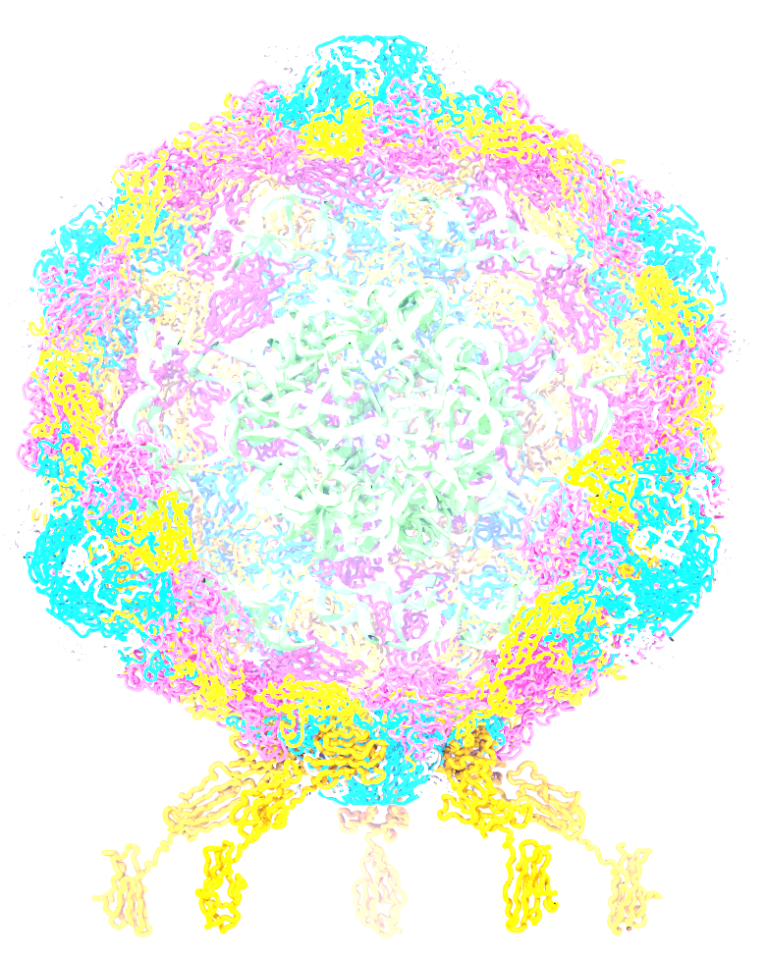
VMD TachyonL-OptiX Interactive Ray Tracing Engine
Scene Graph
RT Rendering Pass
Seed RNGs
Accumulate RT samples
Accum. Buf
Normalize+copy accum. buf
TrBvh RT Acceleration Structure
Compute ave. FPS,
adjust RT samples per pass
Output Framebuffer

Slide 31
VMD TachyonL-OptiX Interactive RT w/ OptiX Progressive RT API
Scene Graph
RT Progressive Subframe
rtContextLaunchProgressive2D()
Check for User Interface Inputs,
Update OptiX Variables
TrBvh RT Acceleration Structure
rtBufferGetProgressiveUpdateReady()
rtContextStopProgressive()
Draw Output Framebuffer

Slide 32
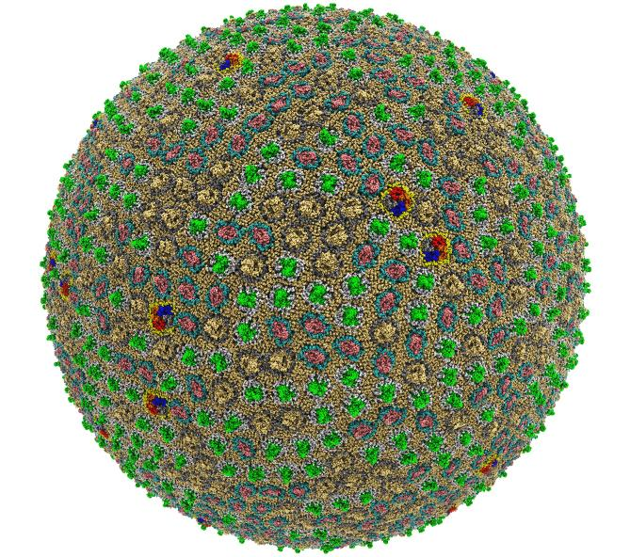
Preparation, Visualization, Analysis of All-Atom Cell-Scale Simulations
Interactive rasterization w/ OpenGL/EGL now, Vulkan in future releases of VMD
Interactive ray tracing on CPUs and GPUs
Support for large host memory (TB), up to 2 billion atoms per “molecule” now
Parallel analysis, visualization w/ MPI
200 nm spherical envelope
Membrane with ~50% occupancy by proteins
63M atoms in envelope model
Atomic Detail Visualization of Photosynthetic Membranes with GPU-Accelerated Ray Tracing. J.E. Stone, …, K. Schulten, J. Parallel Computing, 55:17-27, 2016.
High Performance Molecular Visualization: In-Situ and Parallel Rendering with EGL. J.E. Stone, ..., K. Schulten. IEEE High Performance Data Analysis and Visualization, IPDPSW, pp. 1014-1023, 2016.

Slide 33
Proto-Cell Rendered with VMD+OptiX
113M particles
1,397 copies of 14 different membrane proteins
Preparing for simulations on pre-exascale computers

Slide 34
Interactive Ray Tracing of Cells
High resolution cellular tomograms, billions of voxels
Even isosurface or lattice site graphical representations involve ~100M geometric primitives
24GB Quadro M6000s used for interactive RT of cellular tomograms of this size
Quadro GP100 / GV100 GPUs benefit from OptiX support for NVLink and distribution of scene data across multiple GPUs
Earnest, et al. J. Physical Chemistry B, 121(15): 3871-3881, 2017.

Slide 35
VMD Atomic Detail Visualization of Cellular Architecture with Instancing
VMD 1.9.4 supports instancing of graphical representations associated with molecules
Exploit VBO caching in OpenGL to eliminate host-GPU geometry transfers
OptiX instancing of geometry buffers to minimize GPU memory footprint for cell-scale scenes w/ atomic structures

Slide 36
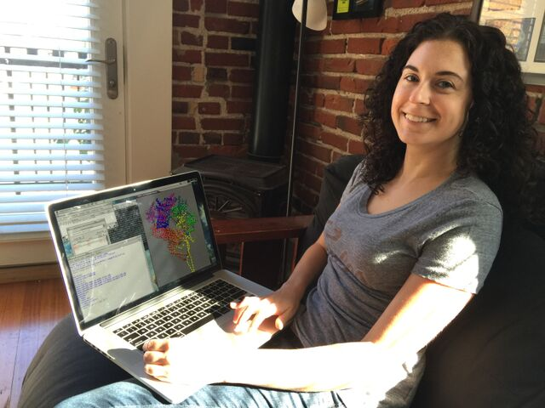
Interactive Remote Visualization and Analysis
Enabled by hardware H.264/H.265 video encode/decode
Enable visualization and analyses not possible with conventional workstations
Access data located anywhere in the world
Same VMD session available to any device
Linux prototype in-development using NVIDIA Video Codec SDK, easy-to-use NvPipe wrapper library
Notes:
Use a schematic that’s generic rather than titan
1-12 viz machines, never such an immediate impact, tell the story, but brief strong points
Maybe show jodi here
Shrink supercomputer, grow the person figure

Slide 37
NvPipe https://github.com/NVIDIA/NvPipe
Simplified API for producing a basic encoder/decoder system.
Roughly 100 lines of code for basic encode/decode “Hello World” loops with minimal error handling logic
Encode/decode ends up being simpler than your networking code ☺
Encode loop structure:
User selects encoder type, e.g. NVPIPE_H264_NV, and target encoder bitrate parameter
User provides uncompressed RGB or RGBA image buffer, image dimensions, and size of the output memory buffer
NvPipe compresses the frame using the NVENC hardware encoder, and returns the number of bytes of output written to the output buffer
Symmetric decode loop structure:
Provide decoder with compressed buffer, buffer size in bytes, and image dimensions as input
Decoder produces uncompressed output image
Optionally supports FFMPEG back-ends (but I haven’t tried those yet)

Slide 38
NVIDIA Video CODEC SDK and NvPipe
GPUs (Kepler-on) include NVENC and NVDEC video codec acceleration hardware
Independent of GPU compute hardware
Hardware-accelerated codecs can overlap with interactive rendering, and computation
NvPipe provides an easy to use API for interactive video streaming, abstracting many low level codec details, ideal for basic remote visualization implementations: https://github.com/NVIDIA/NvPipe

Slide 39
Immersive Viz. w/ VMD
VMD began as a CAVE app (1993)
Use of immersive viz by molecular scientists limited due to cost, complexity, lack of local availability, convenience
Commoditization of HMDs excellent opportunity to overcome cost/availability
This leaves many challenges still to solve:
Incorporate support for remote visualization
UIs, multi-user collaboration/interaction
Rendering perf for large molecular systems
Accomodate limitations idiosyncracies of commercial HMDs
VMD running in a CAVE w/ VR Juggler

Slide 40
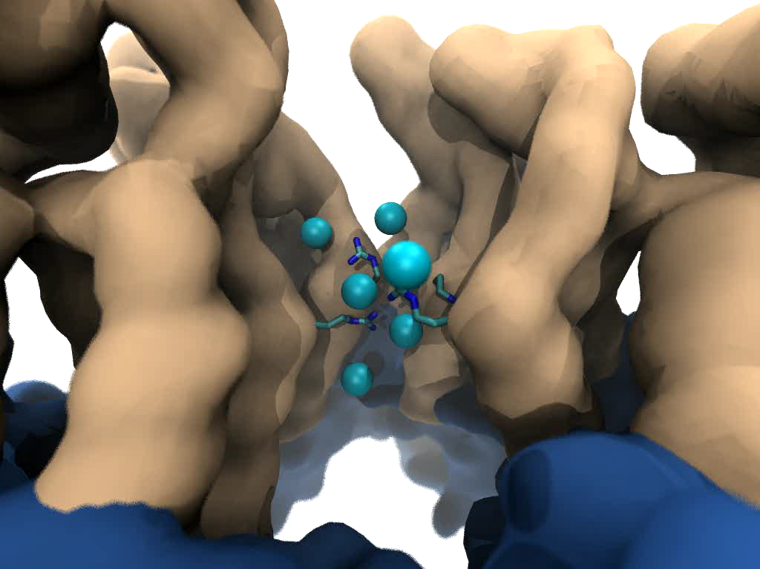
Goal: Intuitive interactive viz. in crowded molecular complexes
Results from 64 M atom, 1 μs sim!
Close-up view of chloride ions permeating through HIV-1 capsid hexameric centers

Slide 41
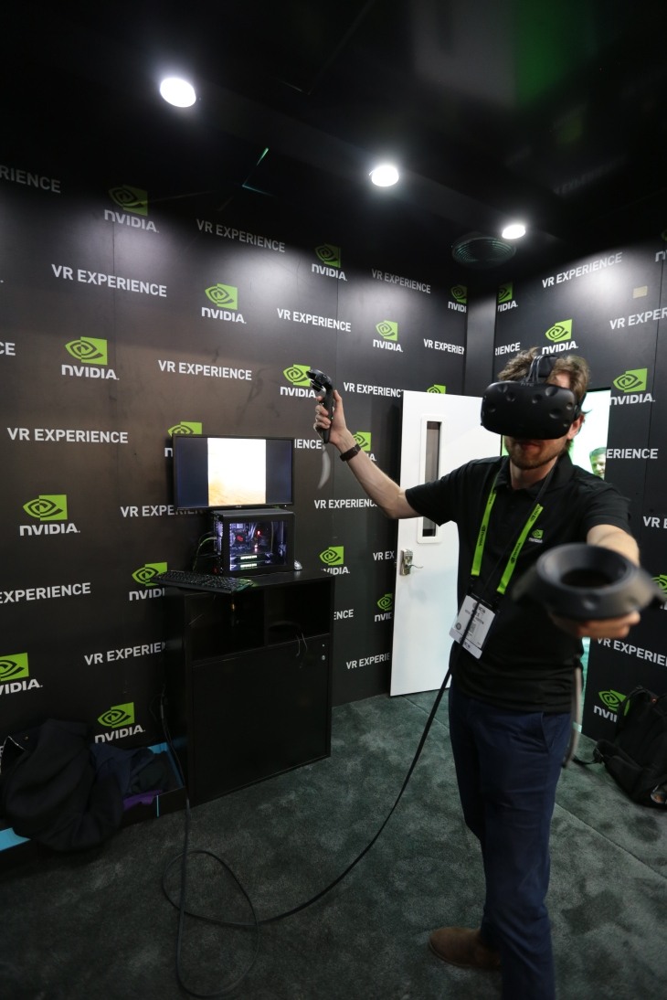
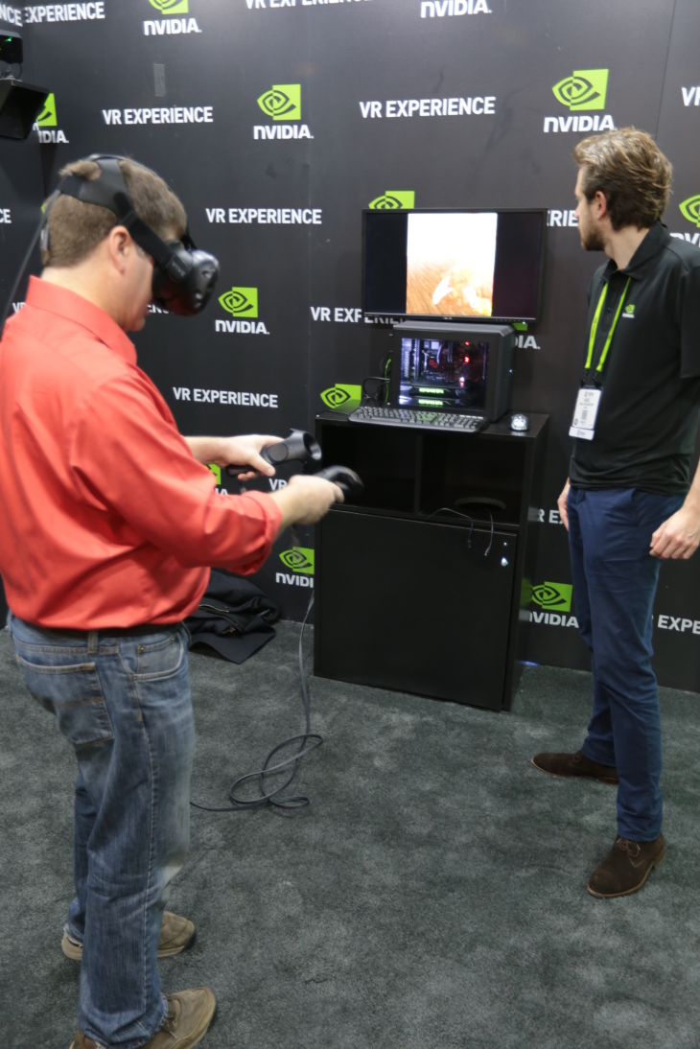
In-Progress VMD VR Development, Demos
VMD VR ray tracing:
Google Cardboard [1]
Demo w/ Indiana U., SC’15 [2]
Prototype of VR user interaction with VMD models in room-scale VR with NVIDIA @ SC’16
[1] Atomic Detail Visualization of Photosynthetic Membranes with GPU-Accelerated Ray Tracing. Stone et al., J. Parallel Computing, 55:17-27, 2016.
[2] Immersive Molecular Visualization with Omnidirectional Stereoscopic Ray Tracing and Remote Rendering. J.E. Stone, W.R. Sherman, K. Schulten. IEEE HPDAV (IPDPSW), pp. 1048-1057, 2016.
VMD Chromatophore Demo, NVIDIA VR Room at SC‘16

Slide 42
HMD Ray Tracing Challenges
HMDs require high frame rates (90Hz or more) and minimum latency between IMU sensor reads and presentation on the display
Multi-GPU workstations fast enough to direct-drive HMDs at required frame rates for simple scenes with direct lighting, hard shadows
Advanced RT effects such as AO lighting, depth of field require much larger sample counts, impractical for direct-driving HMDs
Remote viz. required for many HPC problems due to large data
Remote viz. latencies too high for direct-drive of HMD
Our two-phase approach: moderate-FPS remote RT combined with local high-FPS view-dependent HMD reprojection w/ OpenGL

Slide 43
VMD Molecular Structure Data and Global State
Scene Graph
Graphical Representations
User Interface Subsystem
DrawMolecule
Tcl/Python Scripting
Non-Molecular
Geometry
Mouse + Windows
VR Input “Tools”
Display Subsystem
Windowed OpenGL GPU
VMDDisplayList
OpenGL Pbuffer GPU
OpenGLDisplayDevice
Tachyon CPU RT
DisplayDevice
FileRenderer
TachyonL-OptiX GPU RT
Batch + Interactive

Slide 44
VMD TachyonL-OptiX: Multi-GPU on NVIDIA VCA Cluster
VMD Scene
Scene Data Replicated, Image Space + Sample Space Parallel Decomposition onto GPUs
VCA 0:
8 K6000 GPUs
VCA N:
8 K6000 GPUs

Slide 45
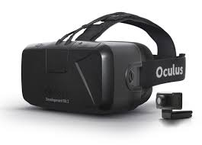
Progressive
Ray Tracing Engine Ray tracing loop runs
continuously in new thread
Decodes H.264 video
stream from remote
VCA GPU cluster
Omnistereo
Image Stream
HMD Display Loop HMD loop runs in main
VMD application thread
at max OpenGL draw rate
View-dependent
stereo reprojection for
current HMD head pose
HMD distortion correction
Camera
+ Scene
RT Code
+ Camera
+ Scene
Omnistereo
H.264 Video
HMD Video
HMD Pose
VMD
15Mbps Internet Link
HMD
Remote VCA GPU Cluster
Ray tracing runs continuously,
streams H.264 video to VMD client

Slide 46
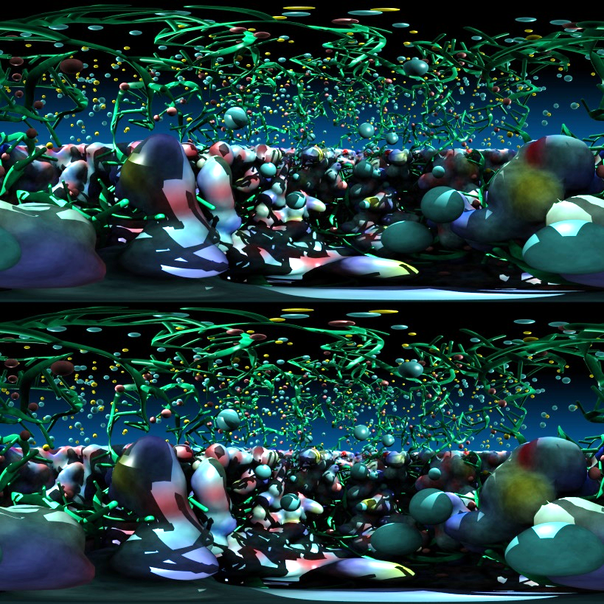
Stereoscopic Panorama Ray Tracing w/ OptiX
Render 360° images and movies for VR headsets such as Oculus Rift, Google Cardboard
Ray trace panoramic stereo spheremaps or cubemaps for very high-frame-rate display via OpenGL texturing onto simple geometry
Stereo requires spherical camera projections poorly suited to rasterization
Benefits from OptiX multi-GPU rendering and load balancing, remote visualization

Slide 47
A) Monoscopic circular projection.
Eye at center of projection (COP).
B) Left eye stereo circular projection.
Eye offset from COP by half of interocular distance.
Polar Axis
Zero Eye Sep
C) Stereo eye separation smoothly decreased to zero at zenith and nadir points on the polar axis to prevent incorrect stereo when HMD sees the poles.
Decreasing Eye Sep
Full Eye Separation
Decreasing Eye Sep
Zero Eye Sep

Slide 48
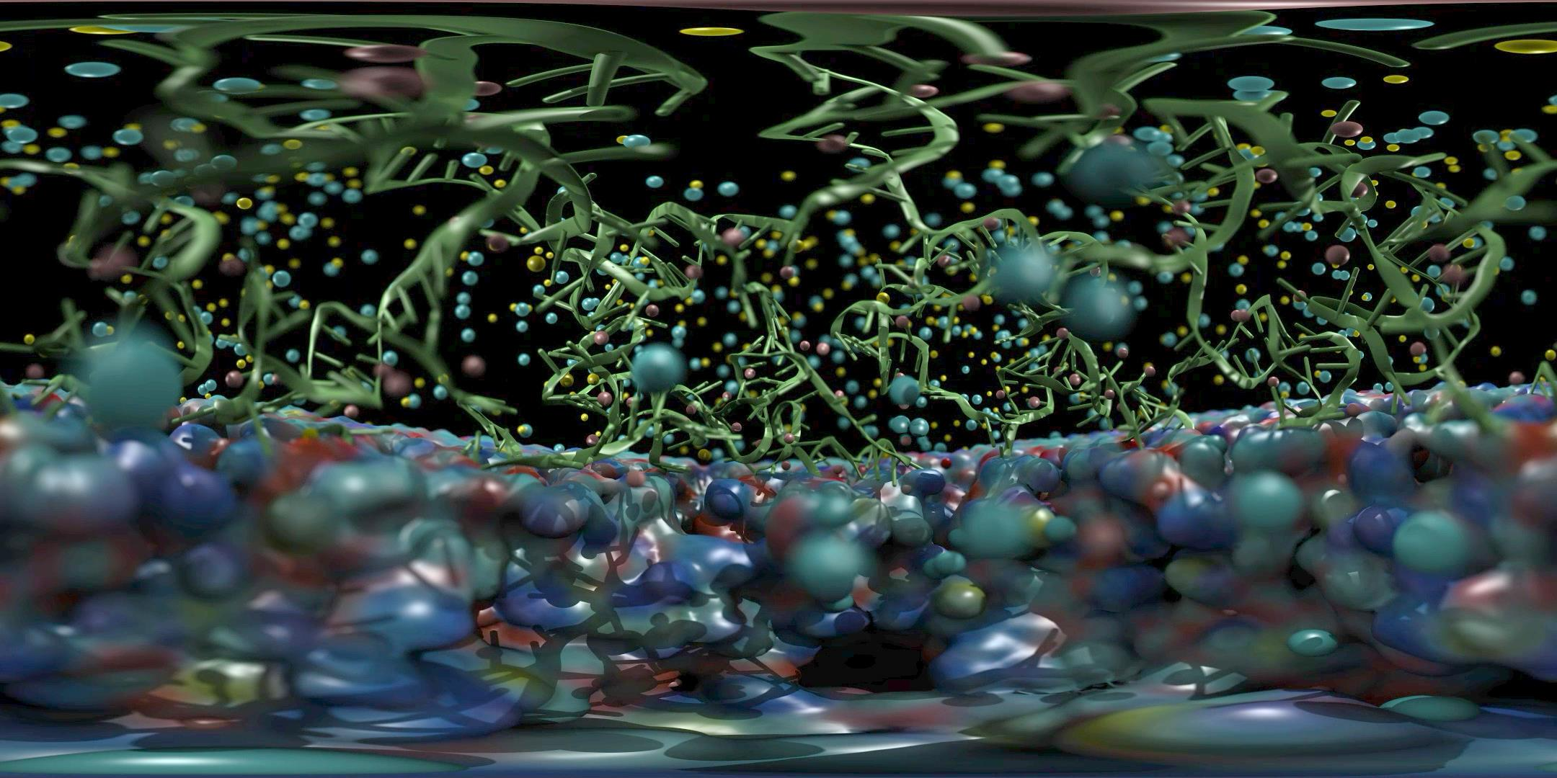

Slide 49
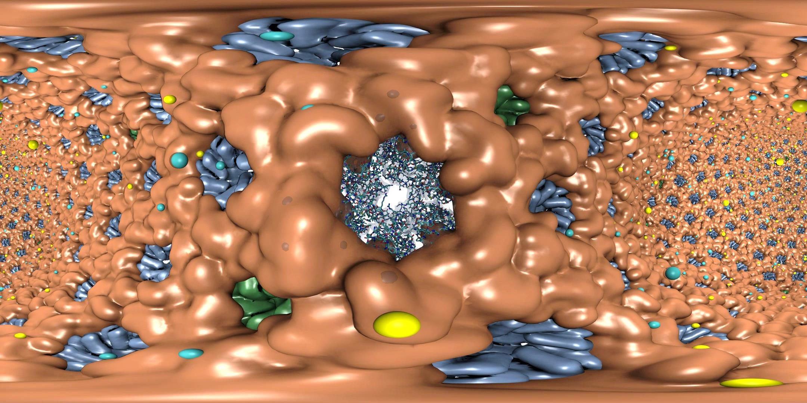

Slide 50
Remote Omnidirectional Stereoscopic RT Performance @ 3072x1536 w/ 2-subframes
Scene | Per-subframe samples AA : AO (AO per-hit) | RT update rate (FPS)
STMV shadows | 1:0 2:0 4:0 | 22.2 18.1 10.3
STMV Shadows+AO | 1:1 1:2 1:4 | 18.2 16.1 12.4
STMV Shadows+AO+DoF | 1:1 2:1 2:2 | 16.1 11.1 8.5
HIV-1 Shadows | 1:0 2:0 4:0 | 20.1 18.1 10.2
HIV-1 Shadows+AO | 1:1 1:2 1:4 | 17.4 12.2 8.1

Slide 51
HMD View-Dependent Reprojection with OpenGL
Texture map panoramic image onto reprojection geometry that matches the original RT image formation surface (sphere for equirectangular, cube for cube map)
HMD sees standard perspective frustum view of the textured surface
Commodity HMD optics require software lens distortion and chromatic aberration correction prior to display, implemented with multi-pass FBO rendering
Enables low-latency, high-frame-rate redraw as HMD head pose changes (150Hz or more)

Slide 52
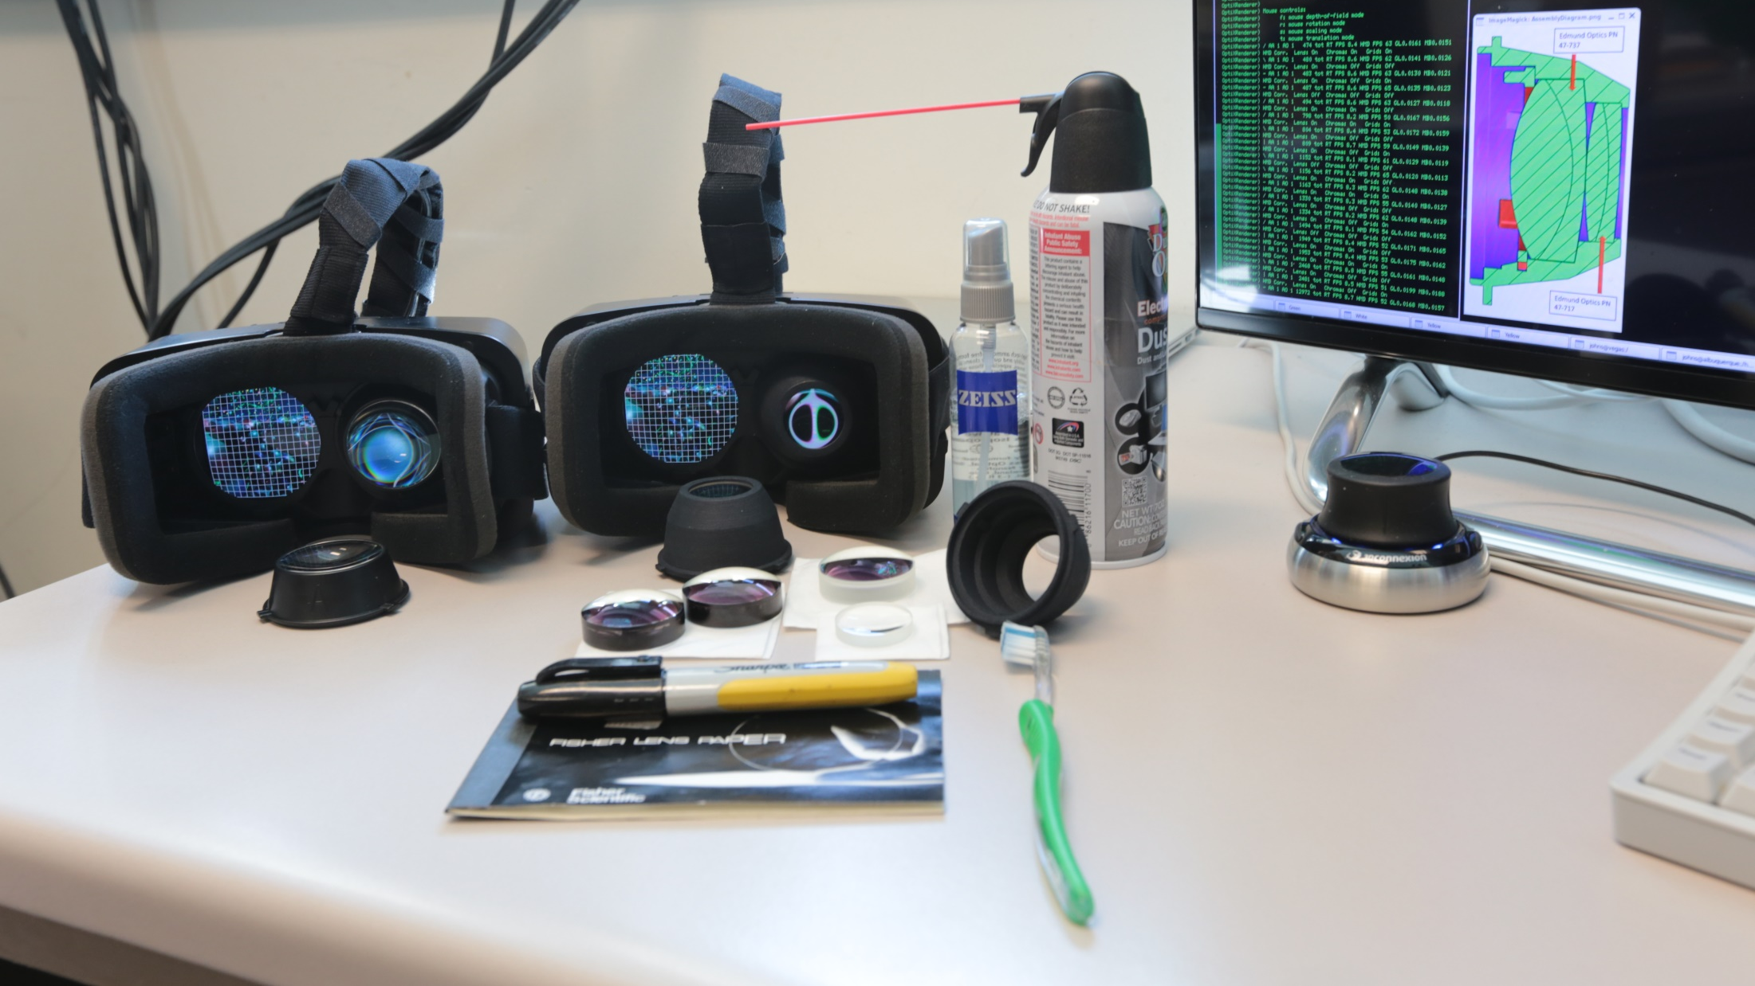
VMD can support a variety of HMD lens designs, e.g.
http://research.microsoft.com/en-us/um/redmond/projects/lensfactory/oculus/

Slide 53
Immersive Molecular Visualization with Omnidirectional Stereoscopic Ray Tracing and Remote Rendering. J. E. Stone, W. R. Sherman, and K. Schulten. High Performance Data Analysis and Visualization Workshop, IEEE International Parallel and Distributed Processing Symposium Workshops (IPDPSW), pp. 1048-1057, 2016.

Slide 54
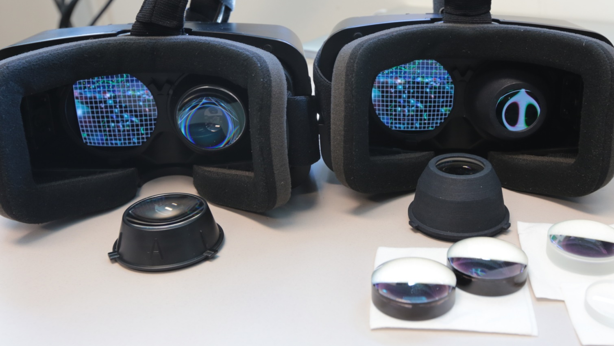

Slide 55
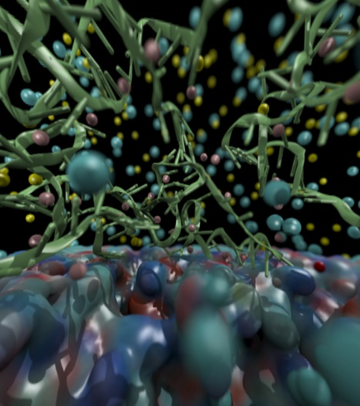
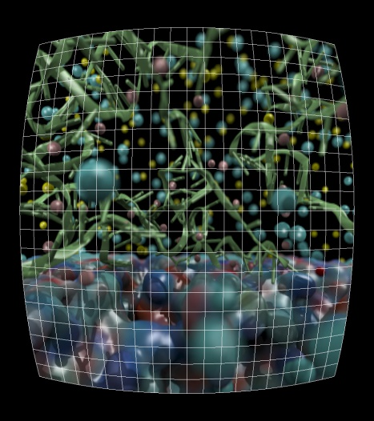
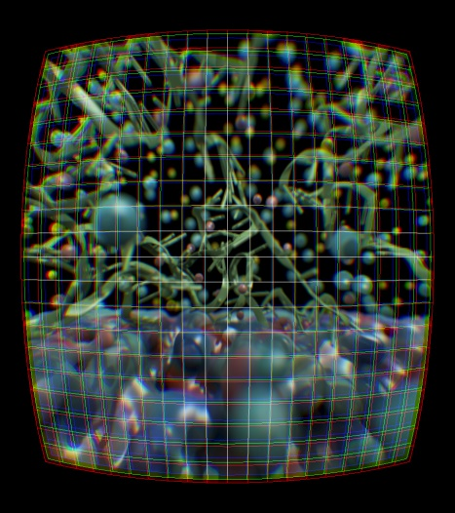
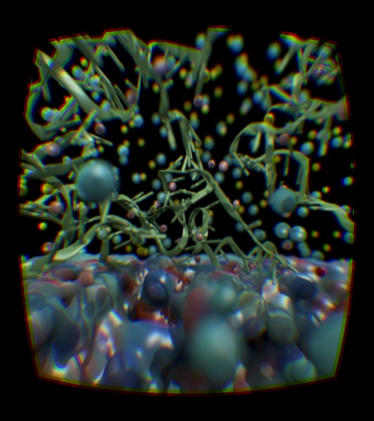
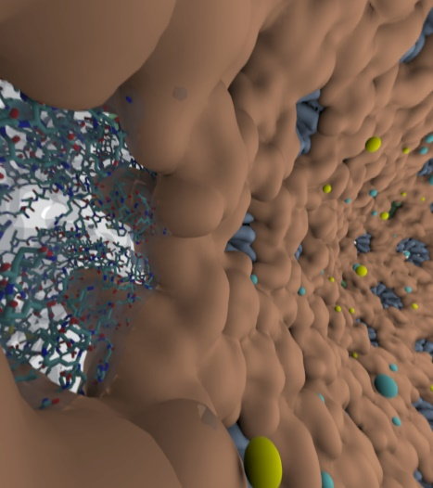
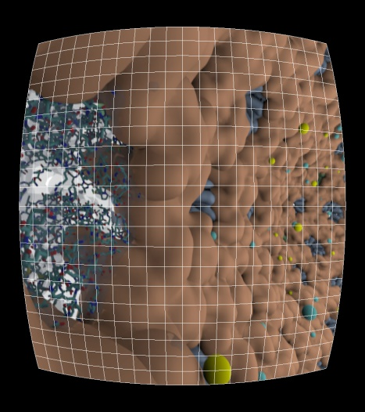
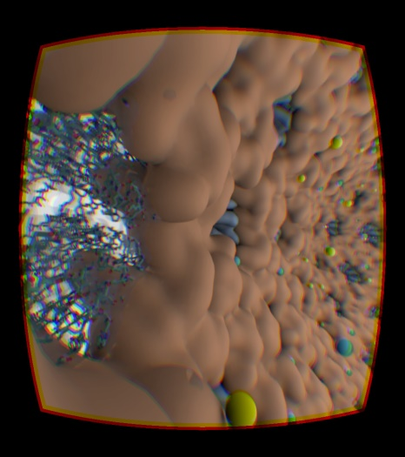

Slide 56
Ongoing VR Work
OpenXR – cross platform muti-vendor HMD support
Ray tracing engine and optimizations:
AI denoising for better average quality
Interactive RT stochastic sampling strategies to improve interactivity
Improved omnidirectional cubemap/spheremap sampling approaches
AI multi-view warping to allow rapid in-between view generation amid multiple HMD head locations
H.265 for high-res omnidirectional video streaming
Multi-node parallel RT and remote viz. on general clusters and supercomputers, e.g. NCSA Blue Waters, ORNL Titan
Tons of work to do on VR user interfaces, multi-user collaborative visualization, …

Slide 57
Please See These Other Talks:
S8727 - Improving NAMD Performance on Volta GPUs
S8718 - Optimizing HPC Simulation and Visualization Codes using Nsight Systems
S8747 - ORNL Summit: Petascale Molecular Dynamics Simulations on the Summit POWER9/Volta Supercomputer
SE150572 - OpenACC User Group Meeting
S8665: VMD: Biomolecular Visualization from Atoms to Cells Using Ray Tracing, Rasterization, and VR

Slide 58
Acknowledgements
Theoretical and Computational Biophysics Group, University of Illinois at Urbana-Champaign
NVIDIA CUDA and OptiX teams
Funding:
NIH support: P41GM104601
DOE INCITE, ORNL Titan: DE-AC05-00OR22725
NSF Blue Waters: NSF OCI 07-25070, PRAC “The Computational Microscope”, ACI-1238993, ACI-1440026
Notes:
58

Slide 59
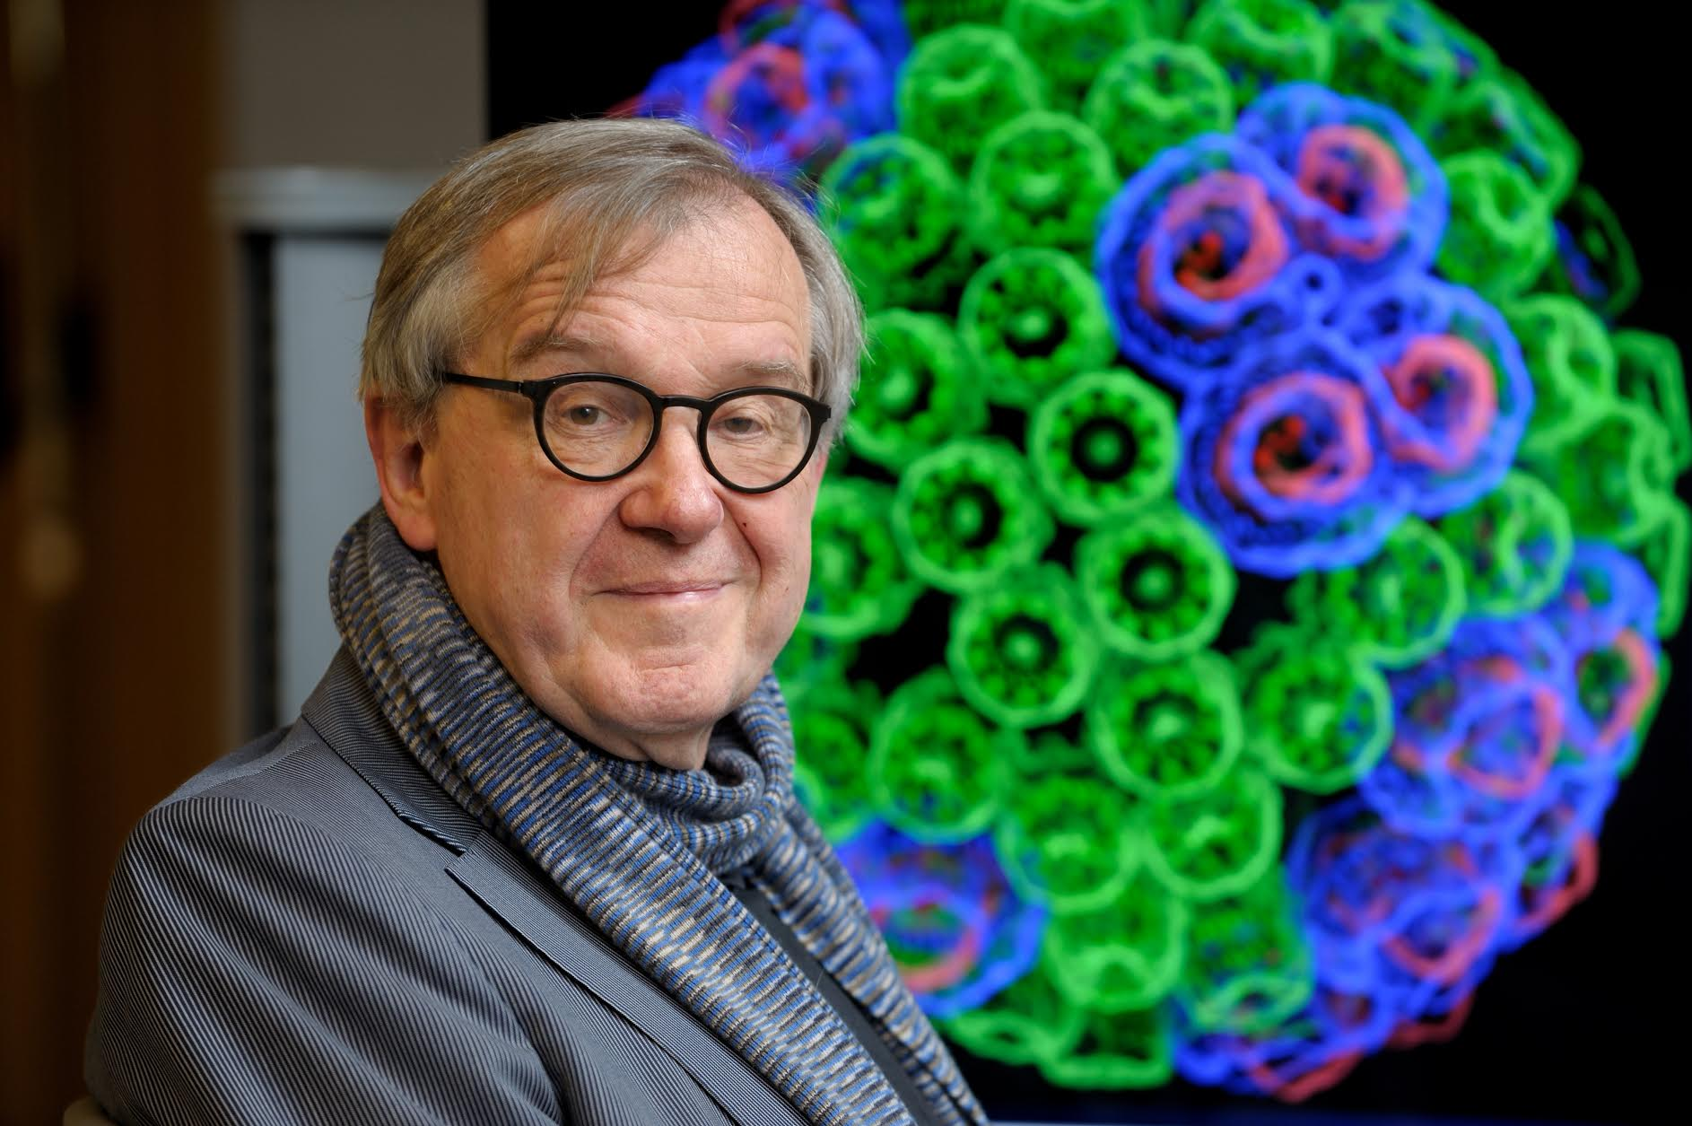
“When I was a young man, my goal was to look with mathematical and computational means at the inside of cells, one atom at a time, to decipher how living systems work. That is what I strived for and I never deflected from this goal.” – Klaus Schulten

Slide 60
Related Publications http://www.ks.uiuc.edu/Research/gpu/
NAMD goes quantum: An integrative suite for hybrid simulations. Melo, M. C. R.; Bernardi, R. C.; Rudack T.; Scheurer, M.; Riplinger, C.; Phillips, J. C.; Maia, J. D. C.; Rocha, G. D.; Ribeiro, J. V.; Stone, J. E.; Neese, F.; Schulten, K.; Luthey-Schulten, Z.; Nature Methods, 2018. (In press)
Challenges of Integrating Stochastic Dynamics and Cryo-electron Tomograms in Whole-cell Simulations. T. M. Earnest, R. Watanabe, J. E. Stone, J. Mahamid, W. Baumeister, E. Villa, and Z. Luthey-Schulten. J. Physical Chemistry B, 121(15): 3871-3881, 2017.
Early Experiences Porting the NAMD and VMD Molecular Simulation and Analysis Software to GPU-Accelerated OpenPOWER Platforms. J. E. Stone, A.-P. Hynninen, J. C. Phillips, and K. Schulten. International Workshop on OpenPOWER for HPC (IWOPH'16), LNCS 9945, pp. 188-206, 2016.
Immersive Molecular Visualization with Omnidirectional Stereoscopic Ray Tracing and Remote Rendering. J. E. Stone, W. R. Sherman, and K. Schulten. High Performance Data Analysis and Visualization Workshop, IEEE International Parallel and Distributed Processing Symposium Workshop (IPDPSW), pp. 1048-1057, 2016.
High Performance Molecular Visualization: In-Situ and Parallel Rendering with EGL. J. E. Stone, P. Messmer, R. Sisneros, and K. Schulten. High Performance Data Analysis and Visualization Workshop, IEEE International Parallel and Distributed Processing Symposium Workshop (IPDPSW), pp. 1014-1023, 2016.
Evaluation of Emerging Energy-Efficient Heterogeneous Computing Platforms for Biomolecular and Cellular Simulation Workloads. J. E. Stone, M. J. Hallock, J. C. Phillips, J. R. Peterson, Z. Luthey-Schulten, and K. Schulten.25th International Heterogeneity in Computing Workshop, IEEE International Parallel and Distributed Processing Symposium Workshop (IPDPSW), pp. 89-100, 2016.

Slide 61
Related Publications http://www.ks.uiuc.edu/Research/gpu/
Atomic Detail Visualization of Photosynthetic Membranes with GPU-Accelerated Ray Tracing. J. E. Stone, M. Sener, K. L. Vandivort, A. Barragan, A. Singharoy, I. Teo, J. V. Ribeiro, B. Isralewitz, B. Liu, B.-C. Goh, J. C. Phillips, C. MacGregor-Chatwin, M. P. Johnson, L. F. Kourkoutis, C. Neil Hunter, and K. Schulten. J. Parallel Computing, 55:17-27, 2016.
Chemical Visualization of Human Pathogens: the Retroviral Capsids. Juan R. Perilla, Boon Chong Goh, John E. Stone, and Klaus Schulten. SC'15 Visualization and Data Analytics Showcase, 2015.
Visualization of Energy Conversion Processes in a Light Harvesting Organelle at Atomic Detail. M. Sener, J. E. Stone, A. Barragan, A. Singharoy, I. Teo, K. L. Vandivort, B. Isralewitz, B. Liu, B. Goh, J. C. Phillips, L. F. Kourkoutis, C. N. Hunter, and K. Schulten. SC'14 Visualization and Data Analytics Showcase, 2014. ***Winner of the SC'14 Visualization and Data Analytics Showcase
Runtime and Architecture Support for Efficient Data Exchange in Multi-Accelerator Applications. J. Cabezas, I. Gelado, J. E. Stone, N. Navarro, D. B. Kirk, and W. Hwu. IEEE Transactions on Parallel and Distributed Systems, 26(5):1405-1418, 2015.
Unlocking the Full Potential of the Cray XK7 Accelerator. M. D. Klein and J. E. Stone. Cray Users Group, Lugano Switzerland, May 2014.
GPU-Accelerated Analysis and Visualization of Large Structures Solved by Molecular Dynamics Flexible Fitting. J. E. Stone, R. McGreevy, B. Isralewitz, and K. Schulten. Faraday Discussions, 169:265-283, 2014.
Simulation of reaction diffusion processes over biologically relevant size and time scales using multi-GPU workstations. M. J. Hallock, J. E. Stone, E. Roberts, C. Fry, and Z. Luthey-Schulten. Journal of Parallel Computing, 40:86-99, 2014.

Slide 62
Related Publications http://www.ks.uiuc.edu/Research/gpu/
GPU-Accelerated Molecular Visualization on Petascale Supercomputing Platforms. J. Stone, K. L. Vandivort, and K. Schulten. UltraVis'13: Proceedings of the 8th International Workshop on Ultrascale Visualization, pp. 6:1-6:8, 2013.
Early Experiences Scaling VMD Molecular Visualization and Analysis Jobs on Blue Waters. J. Stone, B. Isralewitz, and K. Schulten. In proceedings, Extreme Scaling Workshop, 2013.
Lattice Microbes: High‐performance stochastic simulation method for the reaction‐diffusion master equation. E. Roberts, J. Stone, and Z. Luthey‐Schulten. J. Computational Chemistry 34 (3), 245-255, 2013.
Fast Visualization of Gaussian Density Surfaces for Molecular Dynamics and Particle System Trajectories. M. Krone, J. Stone, T. Ertl, and K. Schulten. EuroVis Short Papers, pp. 67-71, 2012.
Immersive Out-of-Core Visualization of Large-Size and Long-Timescale Molecular Dynamics Trajectories. J. Stone, K. L. Vandivort, and K. Schulten. G. Bebis et al. (Eds.): 7th International Symposium on Visual Computing (ISVC 2011), LNCS 6939, pp. 1-12, 2011.
Fast Analysis of Molecular Dynamics Trajectories with Graphics Processing Units – Radial Distribution Functions. B. Levine, J. Stone, and A. Kohlmeyer. J. Comp. Physics, 230(9):3556-3569, 2011.

Slide 63
Related Publications http://www.ks.uiuc.edu/Research/gpu/
Quantifying the Impact of GPUs on Performance and Energy Efficiency in HPC Clusters. J. Enos, C. Steffen, J. Fullop, M. Showerman, G. Shi, K. Esler, V. Kindratenko, J. Stone, J Phillips. International Conference on Green Computing, pp. 317-324, 2010.
GPU-accelerated molecular modeling coming of age. J. Stone, D. Hardy, I. Ufimtsev, K. Schulten. J. Molecular Graphics and Modeling, 29:116-125, 2010.
OpenCL: A Parallel Programming Standard for Heterogeneous Computing. J. Stone, D. Gohara, G. Shi. Computing in Science and Engineering, 12(3):66-73, 2010.
An Asymmetric Distributed Shared Memory Model for Heterogeneous Computing Systems. I. Gelado, J. Stone, J. Cabezas, S. Patel, N. Navarro, W. Hwu. ASPLOS ’10: Proceedings of the 15th International Conference on Architectural Support for Programming Languages and Operating Systems, pp. 347-358, 2010.

Slide 64
Related Publications http://www.ks.uiuc.edu/Research/gpu/
GPU Clusters for High Performance Computing. V. Kindratenko, J. Enos, G. Shi, M. Showerman, G. Arnold, J. Stone, J. Phillips, W. Hwu. Workshop on Parallel Programming on Accelerator Clusters (PPAC), In Proceedings IEEE Cluster 2009, pp. 1-8, Aug. 2009.
Long time-scale simulations of in vivo diffusion using GPU hardware. E. Roberts, J. Stone, L. Sepulveda, W. Hwu, Z. Luthey-Schulten. In IPDPS’09: Proceedings of the 2009 IEEE International Symposium on Parallel & Distributed Computing, pp. 1-8, 2009.
High Performance Computation and Interactive Display of Molecular Orbitals on GPUs and Multi-core CPUs. J. E. Stone, J. Saam, D. Hardy, K. Vandivort, W. Hwu, K. Schulten, 2nd Workshop on General-Purpose Computation on Graphics Pricessing Units (GPGPU-2), ACM International Conference Proceeding Series, volume 383, pp. 9-18, 2009.
Probing Biomolecular Machines with Graphics Processors. J. Phillips, J. Stone. Communications of the ACM, 52(10):34-41, 2009.
Multilevel summation of electrostatic potentials using graphics processing units. D. Hardy, J. Stone, K. Schulten. J. Parallel Computing, 35:164-177, 2009.

Slide 65
Related Publications http://www.ks.uiuc.edu/Research/gpu/
Adapting a message-driven parallel application to GPU-accelerated clusters. J. Phillips, J. Stone, K. Schulten. Proceedings of the 2008 ACM/IEEE Conference on Supercomputing, IEEE Press, 2008.
GPU acceleration of cutoff pair potentials for molecular modeling applications. C. Rodrigues, D. Hardy, J. Stone, K. Schulten, and W. Hwu. Proceedings of the 2008 Conference On Computing Frontiers, pp. 273-282, 2008.
GPU computing. J. Owens, M. Houston, D. Luebke, S. Green, J. Stone, J. Phillips. Proceedings of the IEEE, 96:879-899, 2008.
Accelerating molecular modeling applications with graphics processors. J. Stone, J. Phillips, P. Freddolino, D. Hardy, L. Trabuco, K. Schulten. J. Comp. Chem., 28:2618-2640, 2007.
Continuous fluorescence microphotolysis and correlation spectroscopy. A. Arkhipov, J. Hüve, M. Kahms, R. Peters, K. Schulten. Biophysical Journal, 93:4006-4017, 2007.

Slide 66
Related Publications http://www.ks.uiuc.edu/Research/gpu/
GPU Clusters for High Performance Computing. V. Kindratenko, J. Enos, G. Shi, M. Showerman, G. Arnold, J. Stone, J. Phillips, W. Hwu. Workshop on Parallel Programming on Accelerator Clusters (PPAC), In Proceedings IEEE Cluster 2009, pp. 1-8, Aug. 2009.
Long time-scale simulations of in vivo diffusion using GPU hardware. E. Roberts, J. Stone, L. Sepulveda, W. Hwu, Z. Luthey-Schulten. In IPDPS’09: Proceedings of the 2009 IEEE International Symposium on Parallel & Distributed Computing, pp. 1-8, 2009.
High Performance Computation and Interactive Display of Molecular Orbitals on GPUs and Multi-core CPUs. J. E. Stone, J. Saam, D. Hardy, K. Vandivort, W. Hwu, K. Schulten, 2nd Workshop on General-Purpose Computation on Graphics Pricessing Units (GPGPU-2), ACM International Conference Proceeding Series, volume 383, pp. 9-18, 2009.
Probing Biomolecular Machines with Graphics Processors. J. Phillips, J. Stone. Communications of the ACM, 52(10):34-41, 2009.
Multilevel summation of electrostatic potentials using graphics processing units. D. Hardy, J. Stone, K. Schulten. J. Parallel Computing, 35:164-177, 2009.

Slide 67
Related Publications http://www.ks.uiuc.edu/Research/gpu/
Adapting a message-driven parallel application to GPU-accelerated clusters. J. Phillips, J. Stone, K. Schulten. Proceedings of the 2008 ACM/IEEE Conference on Supercomputing, IEEE Press, 2008.
GPU acceleration of cutoff pair potentials for molecular modeling applications. C. Rodrigues, D. Hardy, J. Stone, K. Schulten, and W. Hwu. Proceedings of the 2008 Conference On Computing Frontiers, pp. 273-282, 2008.
GPU computing. J. Owens, M. Houston, D. Luebke, S. Green, J. Stone, J. Phillips. Proceedings of the IEEE, 96:879-899, 2008.
Accelerating molecular modeling applications with graphics processors. J. Stone, J. Phillips, P. Freddolino, D. Hardy, L. Trabuco, K. Schulten. J. Comp. Chem., 28:2618-2640, 2007.
Continuous fluorescence microphotolysis and correlation spectroscopy. A. Arkhipov, J. Hüve, M. Kahms, R. Peters, K. Schulten. Biophysical Journal, 93:4006-4017, 2007.

