Slide 1
S7391—Turbocharging VMD Molecular Visualizations with State-of-the-Art Rendering and VR Technologies
John E. Stone
Theoretical and Computational Biophysics Group
Beckman Institute for Advanced Science and Technology
University of Illinois at Urbana-Champaign
http://www.ks.uiuc.edu/Research/gpu/
S7391, GPU Technology Conference
14:00-14:50, Room 212B, San Jose Convention Center,
San Jose, CA, Tuesday May 9th, 2017

Slide 2
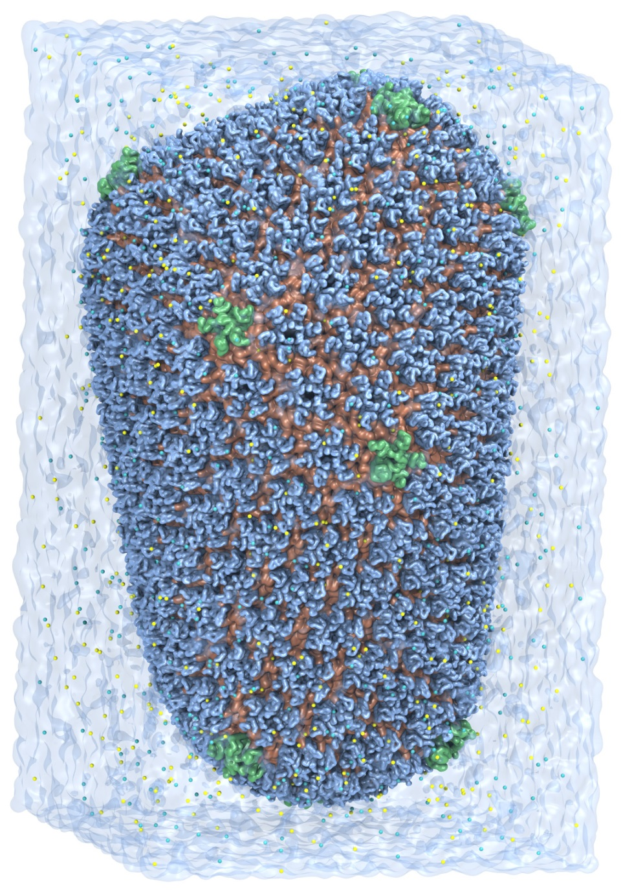
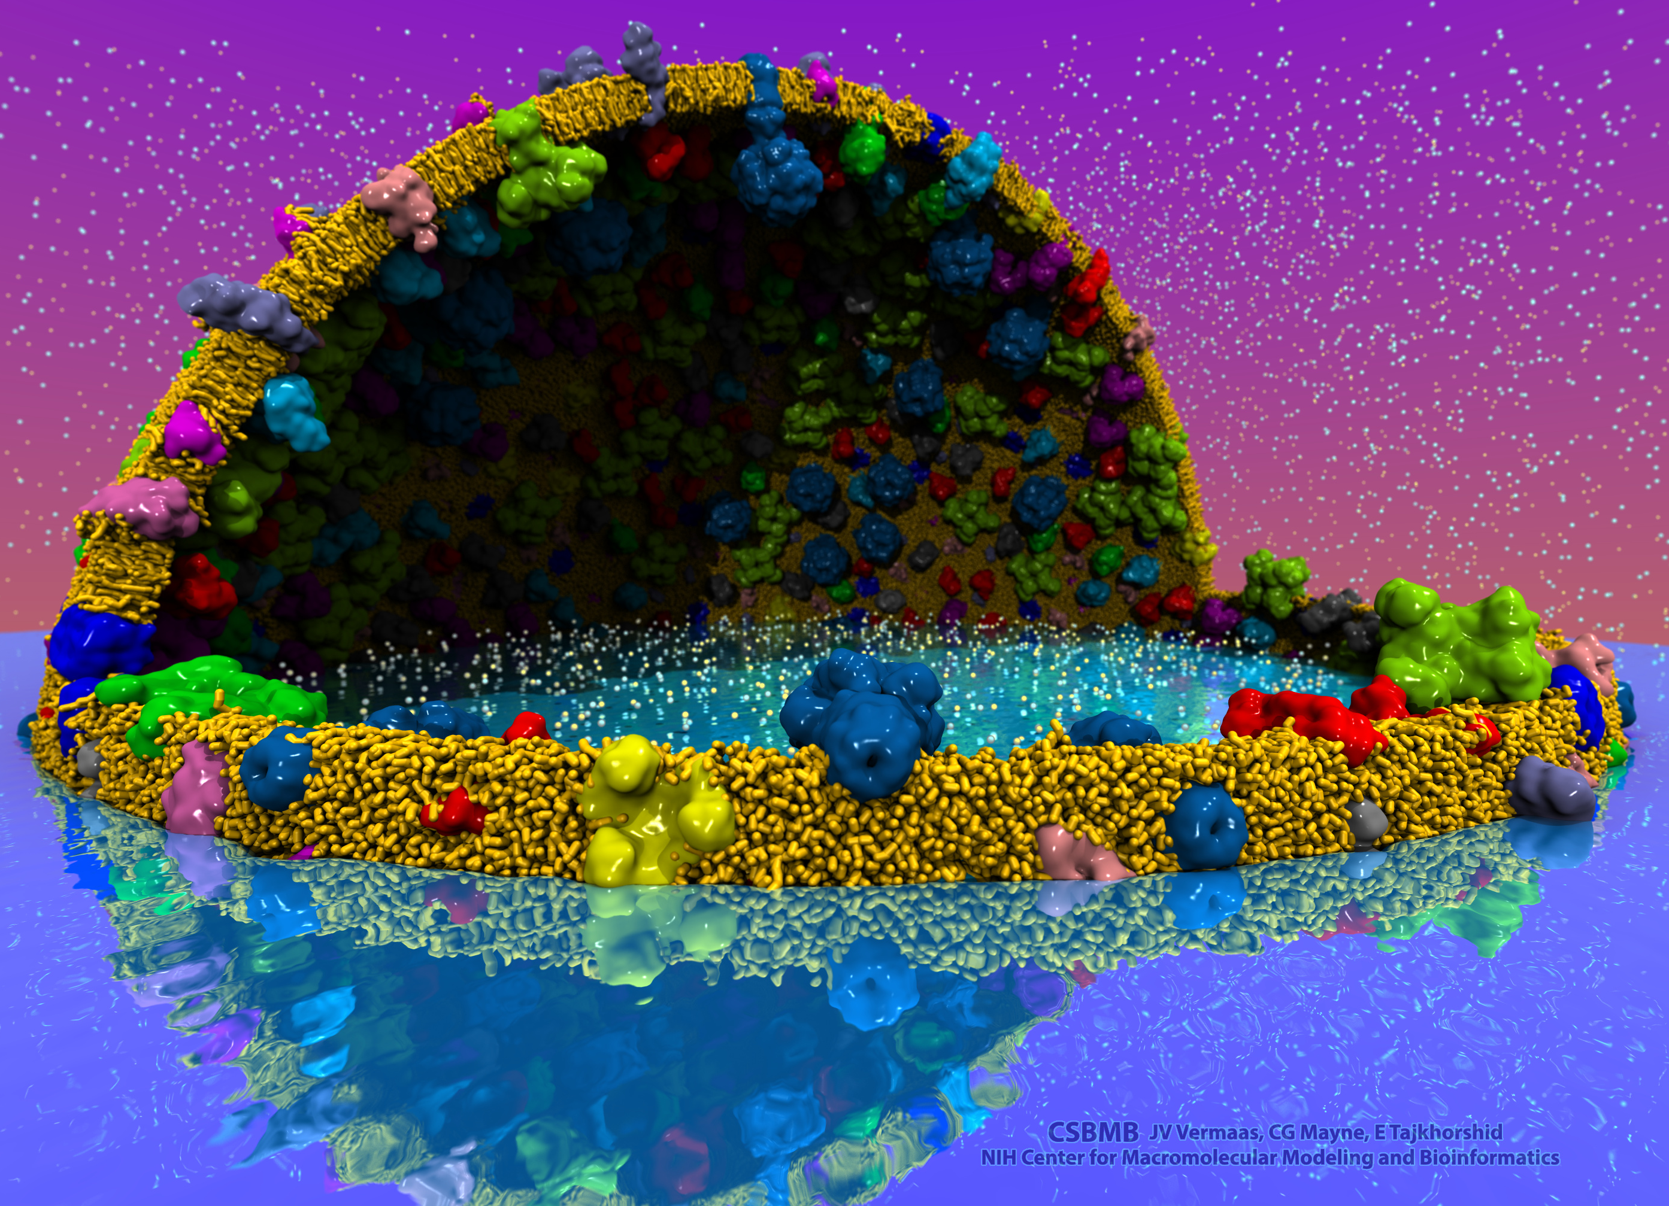
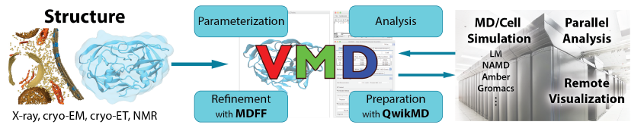
VMD – “Visual Molecular Dynamics”
Visualization and analysis of:
  Molecular dynamics simulations
  Lattice cell simulations
  Quantum chemistry calculations
  Cryo-EM densities, volumetric data
  Sequence information
User extensible scripting and plugins
http://www.ks.uiuc.edu/Research/vmd/
Cell-Scale Modeling
MD Simulation

Slide 3
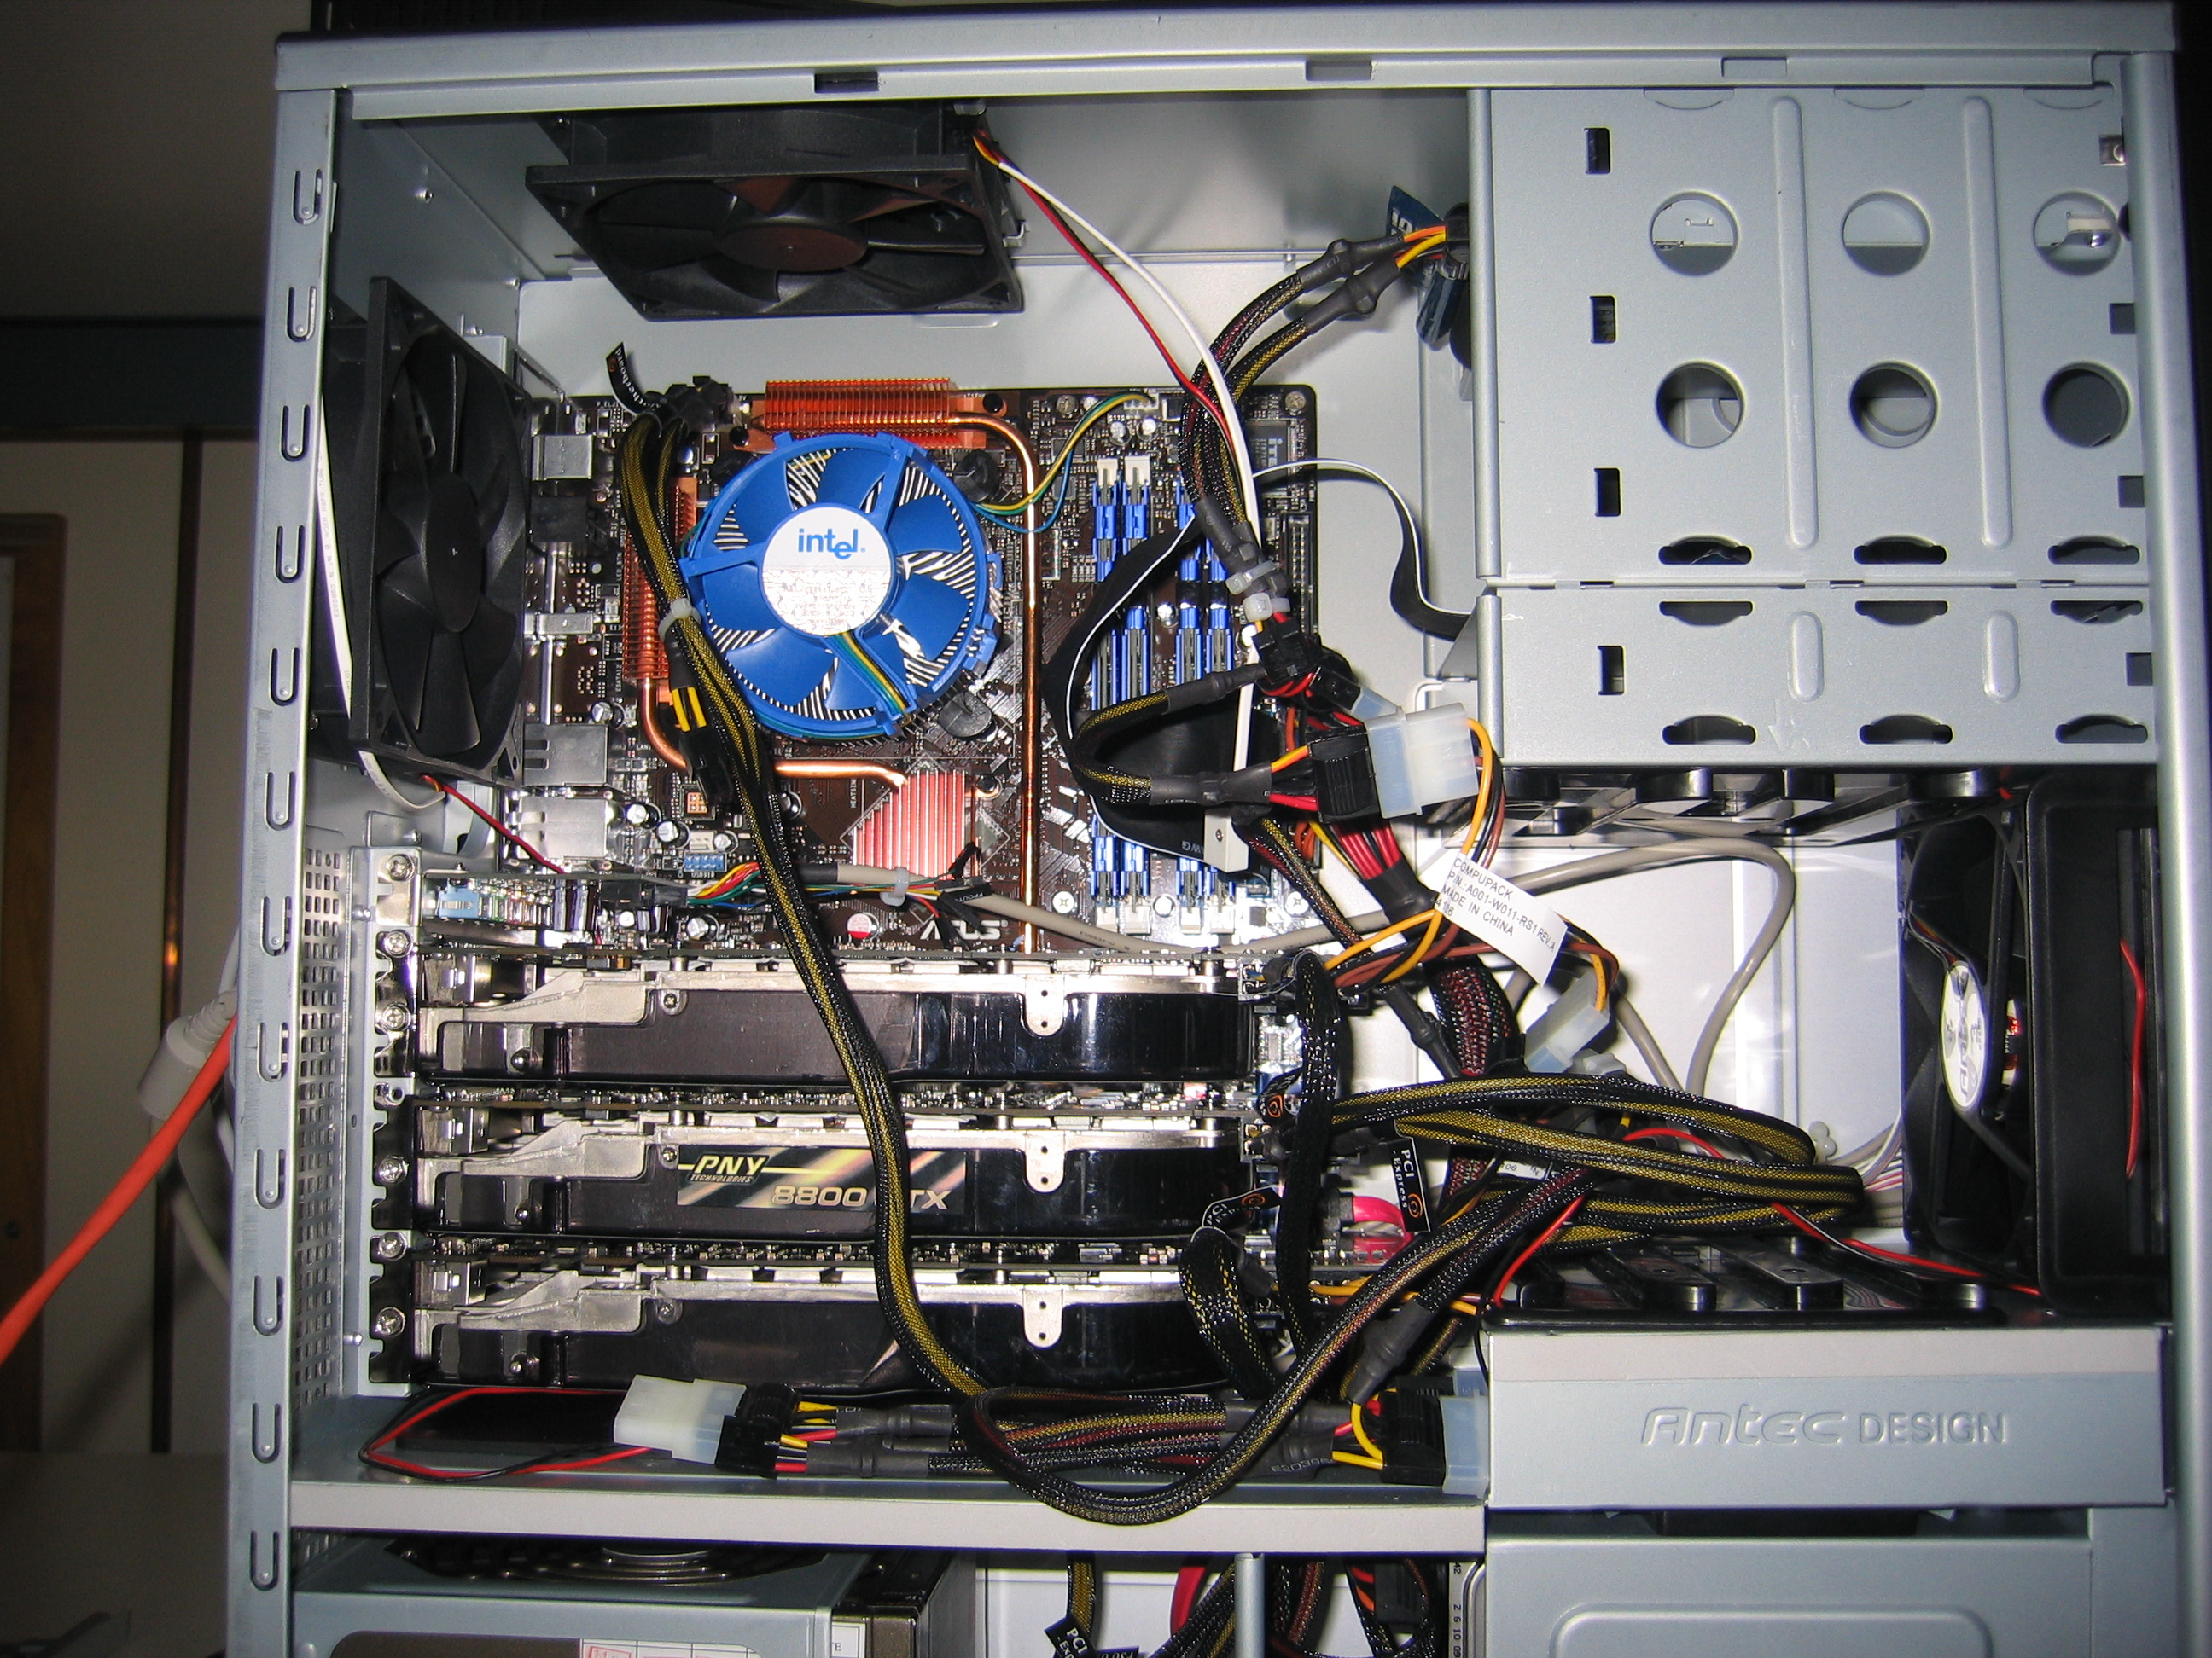
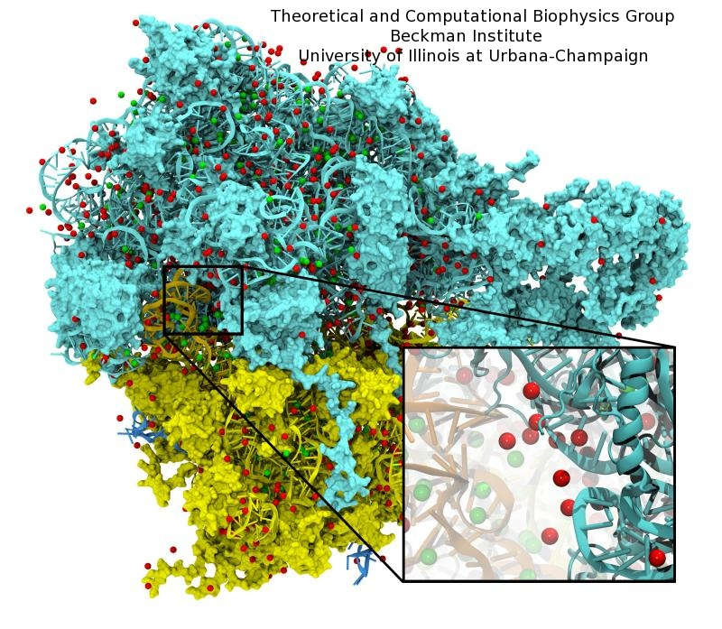
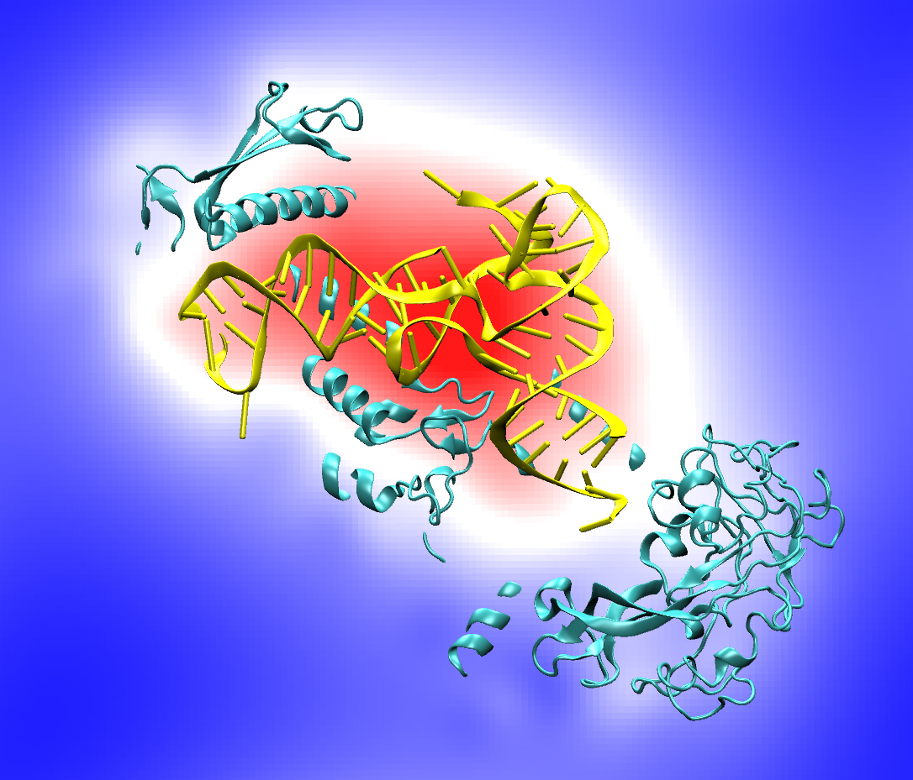
10 Years of GPU Computing in VMD
Has stood the test of time
Modeling, Visualization, Rendering, and Analysis
Blast from the past:
CUDA starting with version 0.7 !!!
Quad core Intel QX6700, three NVIDIA GeForce 8800GTX GPUs, RHEL4 Linux
Accelerating molecular modeling applications with graphics processors. J. Stone, J. Phillips, P. Freddolino, D. Hardy, L. Trabuco, K. Schulten. J. Comp. Chem., 28:2618-2640, 2007.

Slide 4
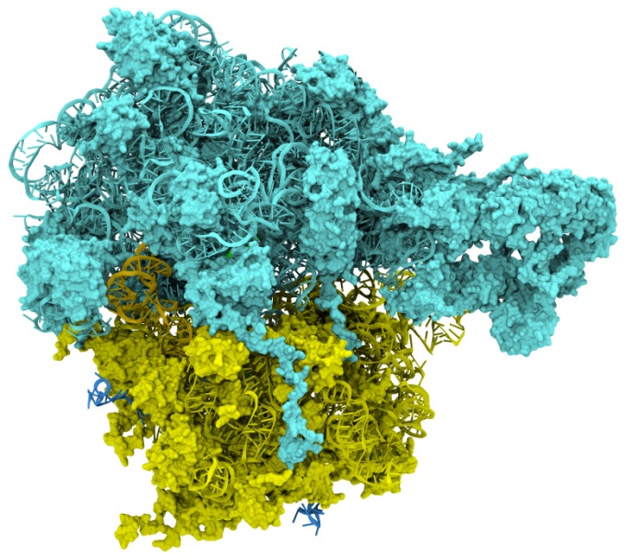
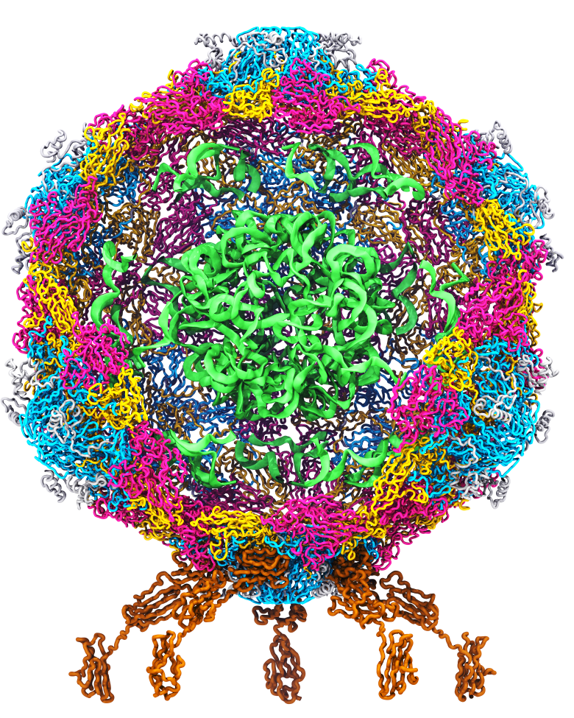
Goal: A Computational Microscope
Study the molecular machines in living cells
Ribosome: target for antibiotics
Poliovirus
Notes:
Ribosomes synthesize new proteins from genetic information
Bacterial ribosome is a target for antibiotics, which interfere with its ability to function by binding to sites on the structure, preventing proteins from being synthesized
Ribosome simulations are extremely computationally challenging due to the size of the structure and its natural environment (solvent, ions, etc, large box, 3 million atoms or so)
Bionanodevice for sequencing DNA efficiently
Knowledge of an individual’s genetic makeup can lead to the prediction and treatment of many diseases by the means of personal genomic medicine and pharmacogenomics. In order for genome sequencing to become practical for common medical use, an inexpensive high throughput genome sequencing technique is required. NIH has set a goal of reducing the cost of genome sequencing by a factor of 10,000, to less than $1,000 within ten years.
The computer is the best microscope to guide the development of bionanodevices, for example to sequence DNA. While experiments can measure DNA electrostatic potentials, they cannot visualize the DNA’s location and conformation at the time of measurement.

Slide 5
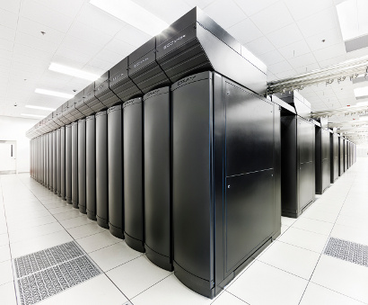
VMD Petascale Visualization and Analysis
Analyze/visualize large trajectories too large to transfer off-site:
  User-defined parallel analysis operations, data types
  Parallel rendering, movie making
Supports GPU-accelerated Cray XK7 nodes for both visualization and analysis:
  GPU accelerated trajectory analysis w/ CUDA
  OpenGL and GPU ray tracing for visualization and movie rendering
Parallel I/O rates up to 275 GB/sec on 8192 Cray XE6 nodes – can read in 231 TB in 15 minutes!
Parallel VMD currently available on:
ORNL Titan, NCSA Blue Waters, Indiana Big Red II, CSCS Piz Daint, and similar systems
NCSA Blue Waters Hybrid Cray XE6 / XK7
22,640 XE6 dual-Opteron CPU nodes
4,224 XK7 nodes w/ Telsa K20X GPUs

Slide 6

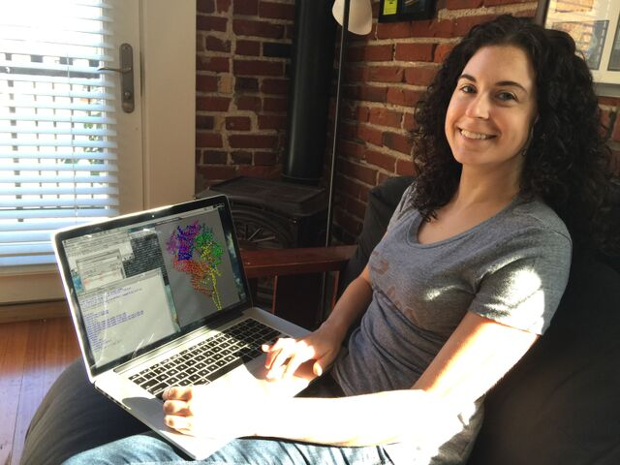
Interactive Remote Visualization and Analysis
Enabled by hardware H.264/H.265 video encode/decode
Enable visualization and analyses not possible with conventional workstations
Access data located anywhere in the world
  Same VMD session available to any device
Linux prototype in-development using NVIDIA Video Codec SDK, easy-to-use NvPipe wrapper library
Notes:
Use a schematic that’s generic rather than titan
1-12 viz machines, never such an immediate impact, tell the story, but brief strong points
Maybe show jodi here
Shrink supercomputer, grow the person figure

Slide 7
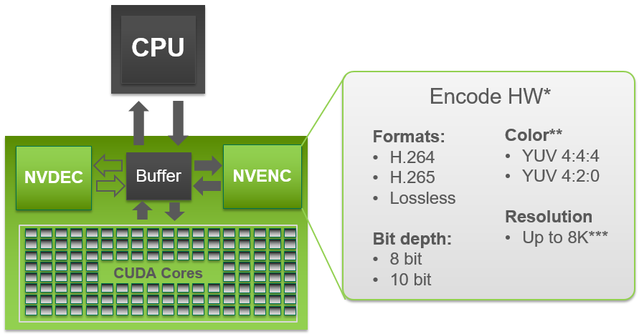
NVIDIA Video CODEC SDK and NvPipe
GPUs (Kepler-on) include NVENC and NVDEC video codec acceleration hardware
Independent of GPU compute hardware
Hardware-accelerated codecs can overlap with interactive rendering, and computation
NvPipe provides an easy to use API for interactive video streaming, abstracting many low level codec details, ideal for basic remote visualization implementations: https://github.com/NVIDIA/NvPipe

Slide 8
NvPipe https://github.com/NVIDIA/NvPipe
Simplified API for producing a basic encoder/decoder system.
Roughly 100 lines of code for basic encode/decode “Hello World” loops with minimal error handling logic
Encode/decode ends up being simpler than your networking code ☺
Encode loop structure:
  User selects encoder type, e.g. NVPIPE_H264_NV, and target encoder bitrate parameter
  User provides uncompressed RGB or RGBA image buffer, image dimensions, and size of the output memory buffer
  NvPipe compresses the frame using the NVENC hardware encoder, and returns the number of bytes of output written to the output buffer
Symmetric decode loop structure:
  Provide decoder with compressed buffer, buffer size in bytes, and image dimensions as input
  Decoder produces uncompressed output image
Optionally supports FFMPEG back-ends (but I haven’t tried those yet)

Slide 9

https://www.khronos.org/vulkan/
In-progress: Vulkan-based rasterization path for VMD
  Modern API, reduced dependence on extensions for modern functionality
  Significantly reduced API overheads relative to OpenGL, some other apps have seen ~2x performance gains vs. OpenGL
  Shaders (e.g. GLSL) compiled to SPIR-V intermediate code
  Compile-time rather than runtime verification of rendering pipelines
  Integration with windowing system is handled by Vulkan extensions
  Multi-GPU rendering wasn’t part of Vulkan 1.0 spec, but is in development

Slide 10
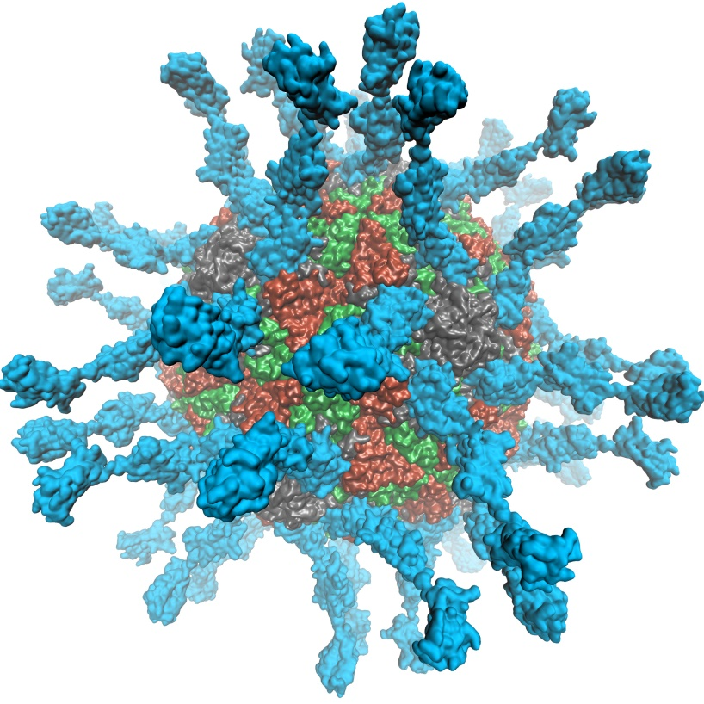
VMD 1.9.3 supports EGL for in-situ and parallel rendering on clouds, clusters, and supercomputers
Eliminate dependency on windowing systems
Simplified deployment of parallel VMD builds supporting off-screen rendering
Maintains 100% of VMD OpenGL shaders and rendering features
Support high-quality vendor-supported commercial OpenGL implementations in HPC systems that were previously limited to Mesa
Poliovirus

Slide 11
OpenGL: GLX vs. EGL
Viz Application
(user)
Viz Application
(user)
OpenGL
GLX
OpenGL
X server
(root)
OpenGL
EGL
Driver
Driver
GPU
GPU

Slide 12
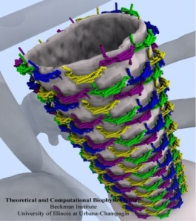
Molecular Structure Data and Global VMD State
Scene Graph
Graphical Representations
User Interface Subsystem
DrawMolecule
Tcl/Python Scripting
Non-Molecular
Geometry
Mouse + Windows
6DoF Input “Tools”
VMDDisplayList
Display
Subsystem
GLX+X11+Drv
OpenGL Pbuffer/FBO
DisplayDevice
Windowed OpenGL
EGL+Drv
OpenGLRenderer
OpenGL Pbuffer/FBO

Slide 13
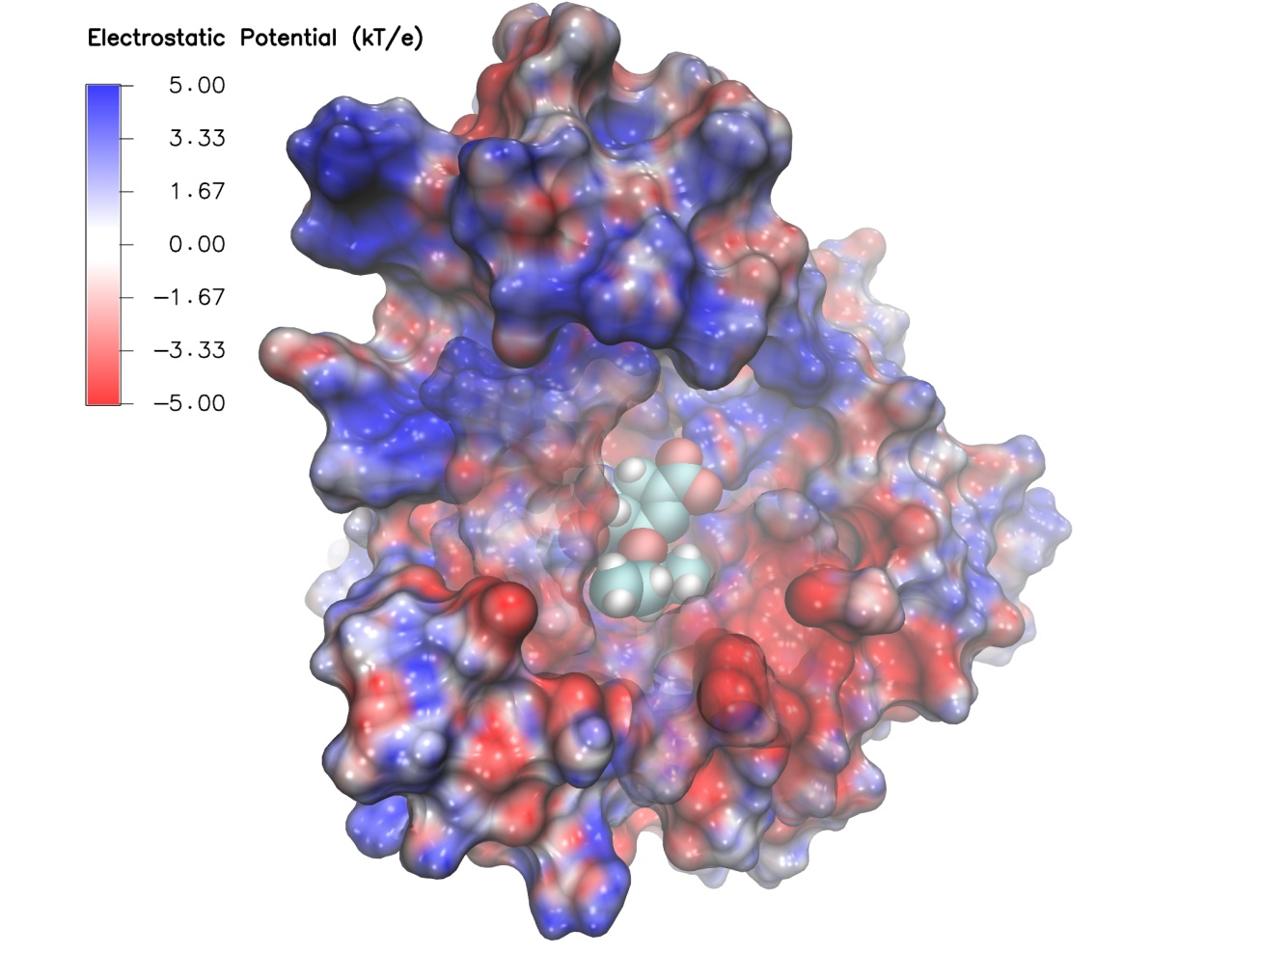
Swine Flu A/H1N1 neuraminidase bound to Tamiflu: VMD EGL rendering demonstrating full support for all VMD shaders and OpenGL features, multisample antialiasing, ray cast spheres, 3-D texture mapping, ...

Slide 14
Benefits of EGL Platform Interfaces
Enumerate and select among available platforms, potentially supporting multiple vendors in the same host/node
  Allows specific target implementation to be bound, e.g. GPU, CPU-integrated GPU, software rasterizer
EGL interfaces make it EASY to bind a GPU to a thread with optimal CPU affinity with respect to NUMA topology, NVLink GPU topology
  High-perf. multi-GPU image compositing, video streaming
  EGL plays nicely with MPI, CUDA/OpenCL, OptiX, NVENC, etc
  NVIDIA EGL supports multiple GPU indexing schemes, e.g. PCIe ordering
  Exploit NVLink interconnect topology on IBM OpenPOWER platforms, e.g. “Minsky”, upcoming DOE/ORNL “Summit” system

Slide 15
Example Node NUMA Topology
DRAM
GPU 1
QPI/HT
IOH 1
PCIe 3.0 x16
CPU 1
GPU 2
PCIe 3.0 x16
CPU Bus 25GB/sec
QuickPath (QPI)
HyperTransport (HT)
NET
QPI/
HT
PCIe 3.0 x4/x8/x16
PCIe 3.0 x16 12GB/sec
GPU 3
CPU 2
IOH 2
PCIe 3.0 x16
QPI/HT
GPU 4
DRAM
PCIe 3.0 x16

Slide 16
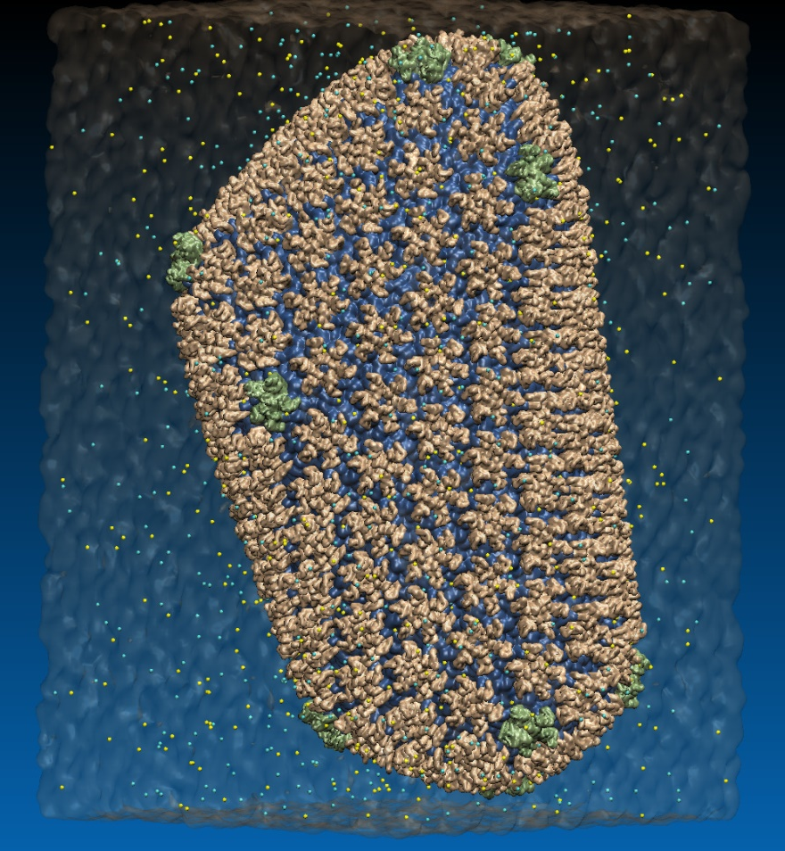
VMD EGL Performance on Amazon EC2 Cloud
MPI Ranks | EC2 “G2.8xlarge” GPU Instances | HIV-1 movie rendering time (sec), (I/O %) 3840x2160 resolution
1 | 1 | 626s (10% I/O)
2 | 1 | 347s (19% I/O)
4 | 1 | 221s (31% I/O)
8 | 2 | 141s (46% I/O)
16 | 4 | 107s (64% I/O)
32 | 8 | 90s (76% I/O)
Performance at 32 nodes reaches ~48 frames per second
High Performance Molecular Visualization: In-Situ and Parallel Rendering with EGL. J. E. Stone, P. Messmer, R. Sisneros, and K. Schulten. High Performance Data Analysis and Visualization Workshop, IEEE IPDPSW, pp. 1014-1023, 2016.
64M atom HIV-1 capsid simulation rendered via EGL

Slide 17
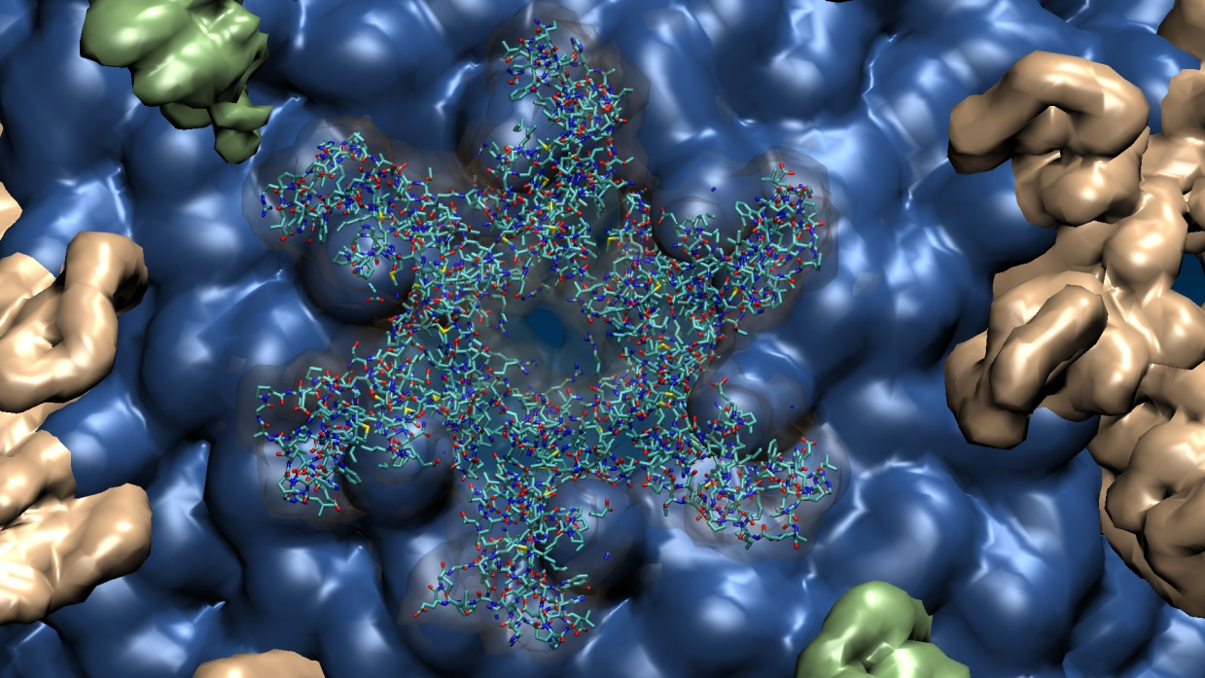
Close-up view of HIV-1 hexamer rendered via EGL
64M atom HIV-1 capsid simulation rendered via EGL

Slide 18
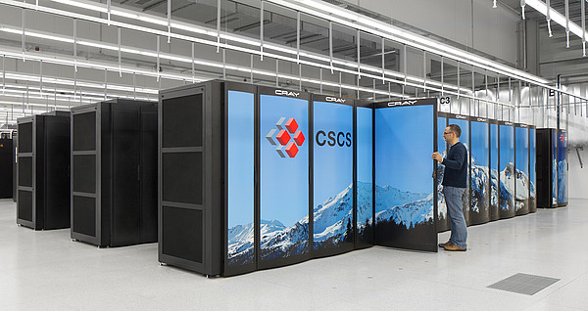
EGL Is Supported Now!
Cloud+Workstations with most recent NVIDIA drivers
VMD on HPC systems w/ latest Tesla P100 GPUs:
  Cray XC50, CSCS Piz Daint, driver 375.39
  IBM OpenPOWER, drivers 375.66 and later support both GLX and EGL

Slide 19
Info) VMD for OPENPOWER, version 1.9.3 (April 27, 2017)
Info) http://www.ks.uiuc.edu/Research/vmd/
[…]
Info) Multithreading available, 160 CPUs detected.
Info) Free system memory: 501GB (98%)
Info) Creating CUDA device pool and initializing hardware...
Info) Detected 4 available CUDA accelerators:
Info) [0] Tesla P100-SXM2-16GB 56 SM_6.0 @ 1.48 GHz, 16GB RAM, AE3, ZCP
[…]
Info) EGL: node[0] bound to display[0], 4 displays total
Info) EGL version 1.4
Info) OpenGL Pbuffer size: 4096x2400
Info) OpenGL renderer: Tesla P100-SXM2-16GB/PCIe
Info) Features: STENCIL MSAA(4) MDE CVA MTX NPOT PP PS GLSL(OVFGS)
Info) Full GLSL rendering mode is available.
Info) Textures: 2-D (32768x32768), 3-D (16384x16384x16384), Multitexture (4)
Info) Created EGL OpenGL Pbuffer for off-screen rendering

Slide 20
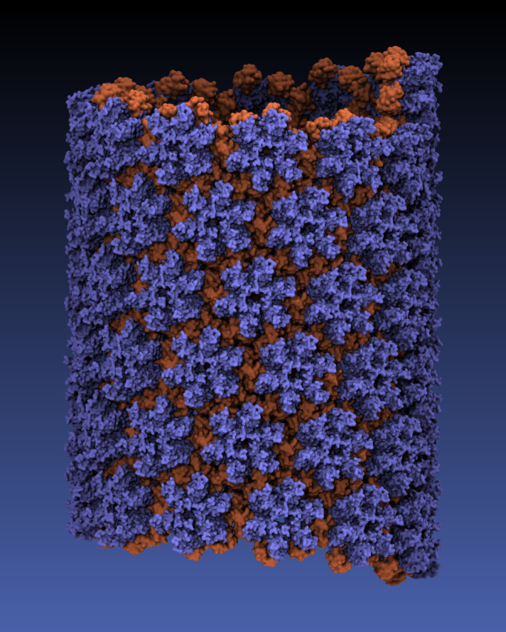

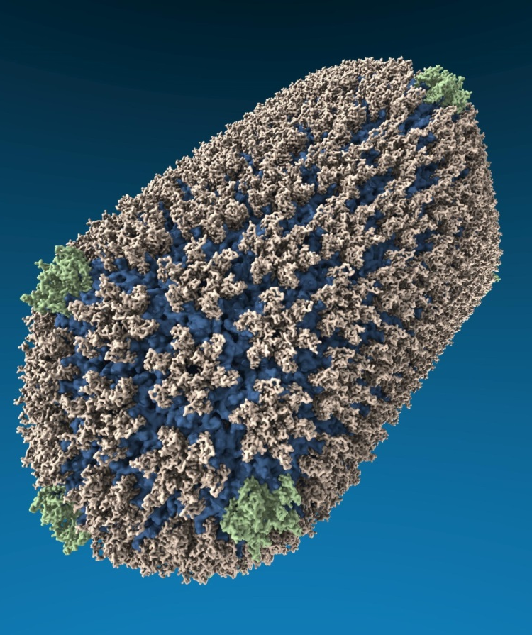
VMD “QuickSurf” Representation, Ray Tracing
All-atom HIV capsid simulations w/ up to 64M atoms on Blue Waters

Slide 21
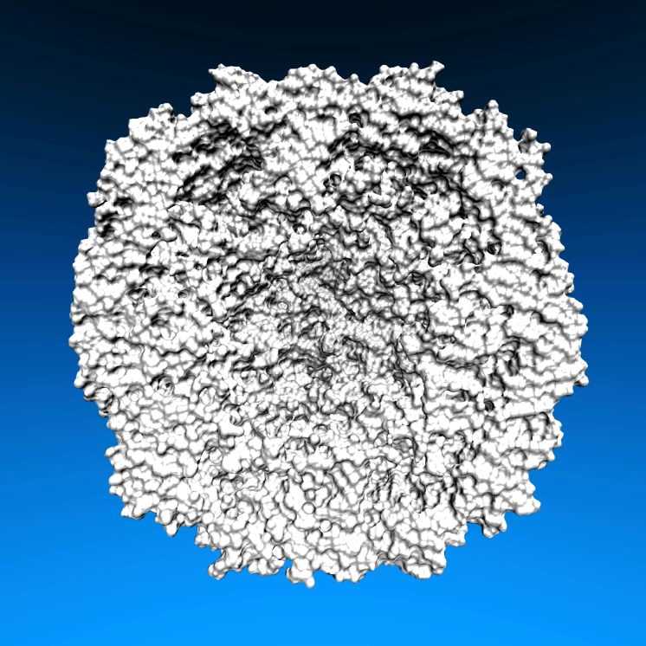
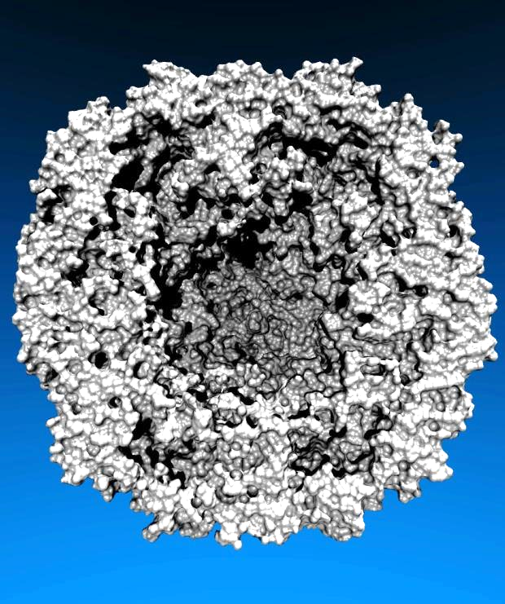
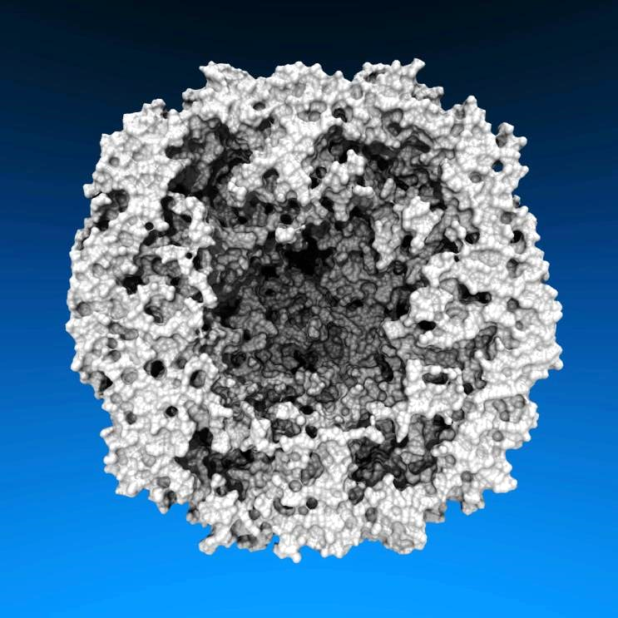
Lighting Comparison, STMV Capsid
Two lights, no shadows
Two lights, hard shadows, 1 shadow ray per light
Ambient occlusion + two lights, 144 AO rays/hit

Slide 22
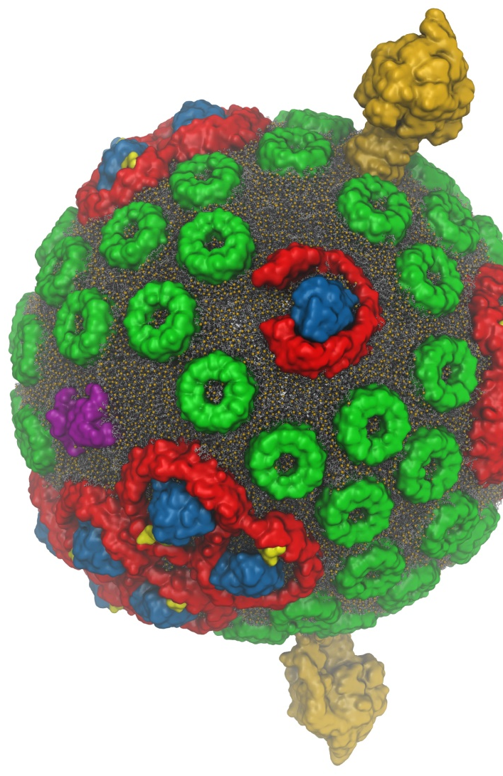
VMD w/ OptiX 4.1
Interactive RT on laptops, desktops, and cloud
Large-scale parallel rendering: in situ or post hoc visualization tasks
Remote RT on NVIDIA VCA clusters
Stereoscopic panoramic and full-dome projections
Omnidirectional VR for YouTube, VR HMDs
Top-end Pascal Tesla GPUs roughly 2x faster than Kepler
GPU memory sharing via NVLink on Quadro GP100, Tesla P100
GPU-Accelerated Molecular Visualization on Petascale Supercomputing Platforms. J. E. Stone, K. L. Vandivort, and K. Schulten. UltraVis’13, pp. 6:1-6:8, 2013.
Visualization of Energy Conversion Processes in a Light Harvesting Organelle at Atomic Detail. M. Sener, et al. SC'14 Visualization and Data Analytics Showcase, 2014.
Chemical Visualization of Human Pathogens: the Retroviral Capsids. J. R. Perilla, B.-C. Goh, J. E. Stone, and K. Schulten. SC'15 Visualization and Data Analytics Showcase, 2015.
Atomic Detail Visualization of Photosynthetic Membranes with GPU-Accelerated Ray Tracing. J. E. Stone et al., J. Parallel Computing, 55:17-27, 2016.
Immersive Molecular Visualization with Omnidirectional Stereoscopic Ray Tracing and Remote Rendering J. E. Stone, W. R. Sherman, and K. HPDAV, IPDPSW, pp. 1048-1057, 2016.
VMD/OptiX GPU Ray Tracing of all-atom Chromatophore w/ lipids.

Slide 23
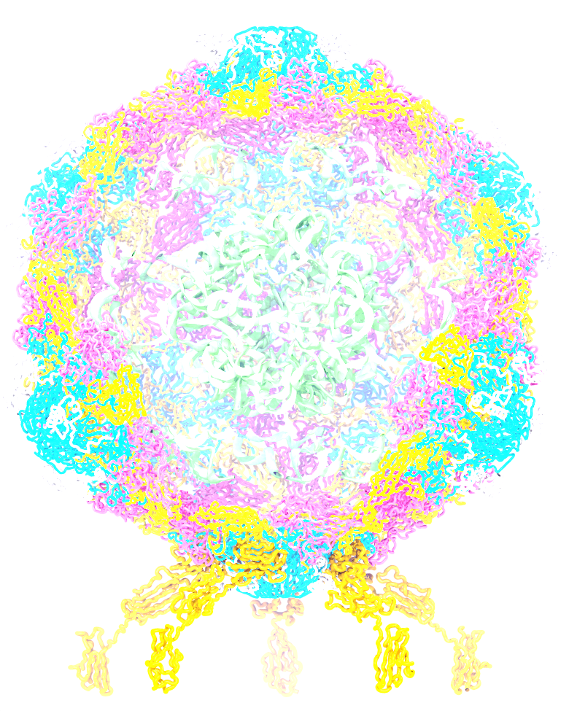
VMD TachyonL-OptiX Interactive Ray Tracing Engine
Scene Graph
RT Rendering Pass
Seed RNGs
Accumulate RT samples
Accum. Buf
Normalize+copy accum. buf
TrBvh RT Acceleration Structure
Compute ave. FPS,
adjust RT samples per pass
Output Framebuffer

Slide 24
VMD TachyonL-OptiX Interactive RT w/ OptiX Progressive RT API
Scene Graph
RT Progressive Subframe
rtContextLaunchProgressive2D()
Check for User Interface Inputs,
Update OptiX Variables
TrBvh RT Acceleration Structure
rtBufferGetProgressiveUpdateReady()
rtContextStopProgressive()
Draw Output Framebuffer

Slide 25
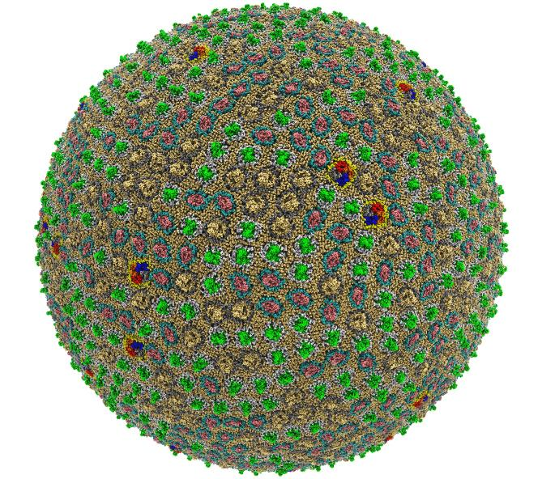
Preparation, Visualization, Analysis of All-Atom Cell-Scale Simulations
Interactive rasterization w/ OpenGL/EGL now, Vulkan in future releases of VMD
Interactive ray tracing on CPUs and GPUs
Support for large host memory (TB), up to 2 billion atoms per “molecule” now
Parallel analysis, visualization w/ MPI
200 nm spherical envelope
Membrane with ~50% occupancy by proteins
63M atoms in envelope model
Atomic Detail Visualization of Photosynthetic Membranes with GPU-Accelerated Ray Tracing. J.E. Stone, …, K. Schulten, J. Parallel Computing, 55:17-27, 2016.
High Performance Molecular Visualization: In-Situ and Parallel Rendering with EGL. J.E. Stone, ..., K. Schulten. IEEE High Performance Data Analysis and Visualization, IPDPSW, pp. 1014-1023, 2016.

Slide 26

Proto-Cell Rendered with VMD+OptiX
113M particles
1,397 copies of 14 different membrane proteins
Preparing for simulations on pre-exascale computers

Slide 27
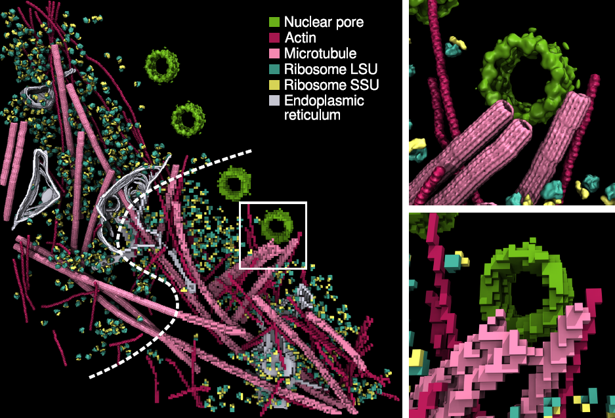
Interactive Ray Tracing of Cells
High resolution cellular tomograms, billions of voxels
Even isosurface or lattice site graphical representations involve ~100M geometric primitives
24GB Quadro M6000s used for interactive RT of cellular tomograms of this size
Latest Quadro GP100 GPUs benefit from OptiX 4.1 support for NVLink and distribution of scene data across multiple GPUs
Earnest, et al. J. Physical Chemistry B, 121(15): 3871-3881, 2017.

Slide 28
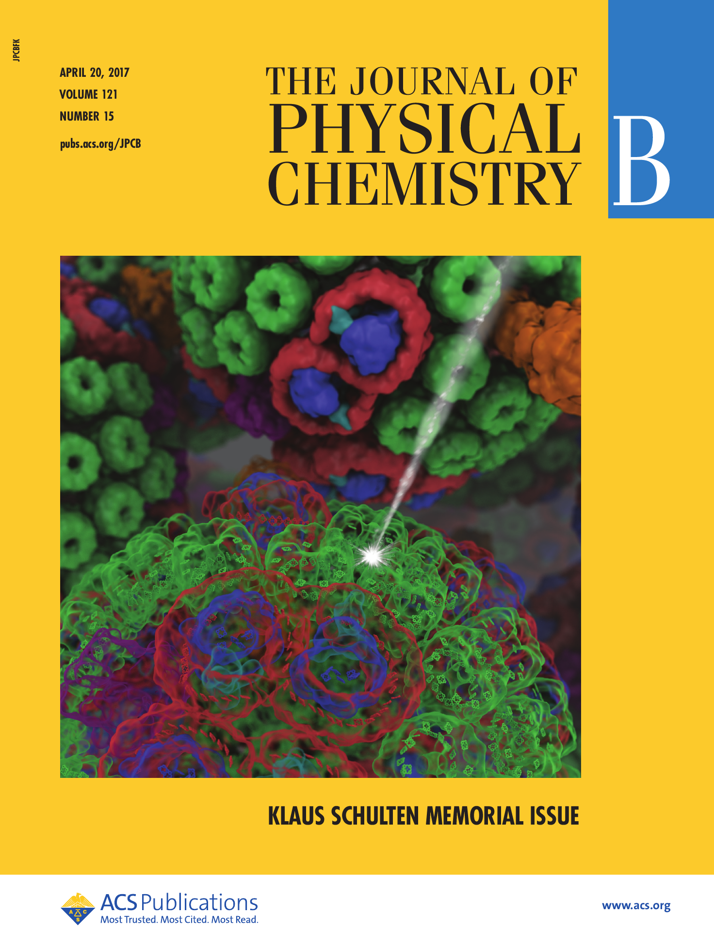
VMD Molecule Instancing: In-Progress Development
VMD 1.9.4 supports instancing of graphical representations associated with molecules
Will exploit VBO caching in OpenGL to eliminate host-GPU geometry transfers
OptiX instancing of geometry buffers to eliminate GPU memory consumption for instances

Slide 29
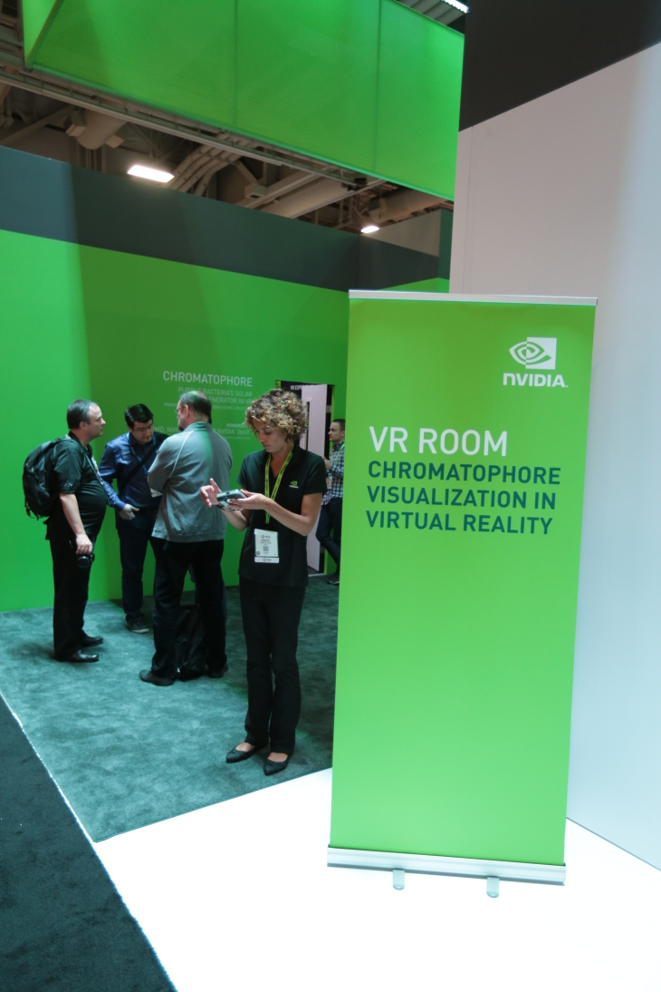
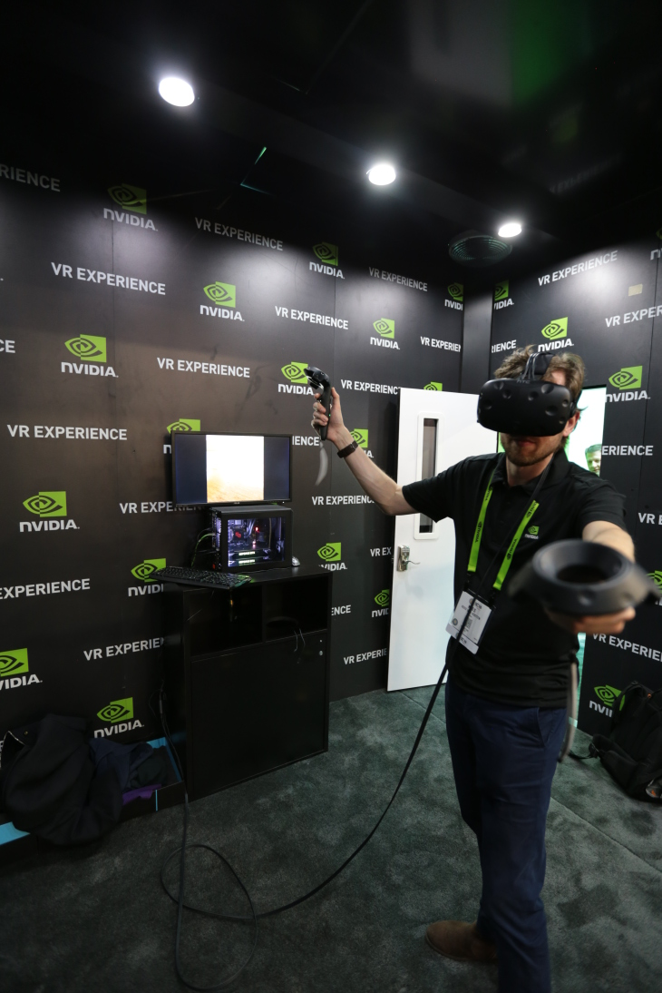
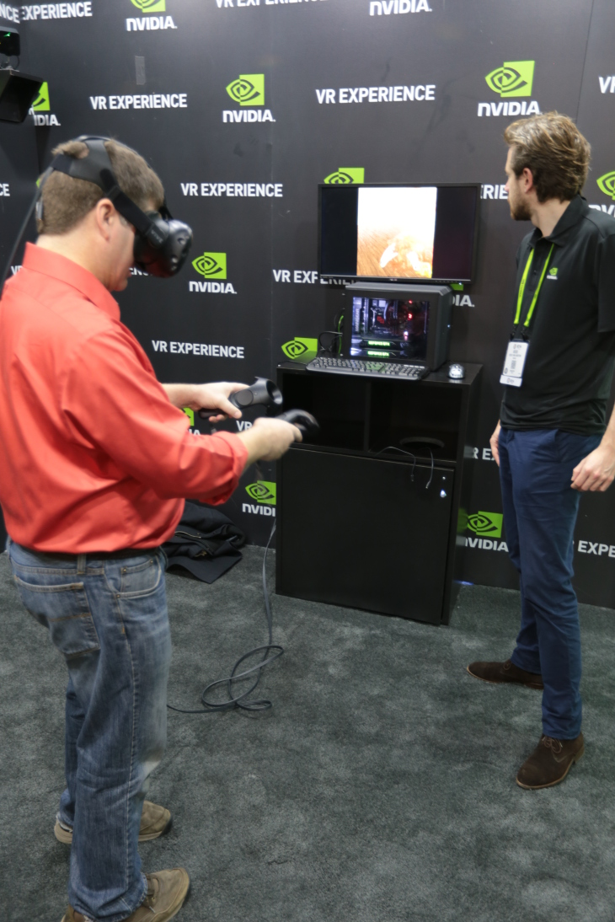
In-Progress VMD VR Development, Demos
VMD VR ray tracing:
Google Cardboard [1]
Demo w/ Indiana U., SC’15 [2]
Prototype of VR user interaction with VMD models in room-scale VR with NVIDIA @ SC’16
[1] Atomic Detail Visualization of Photosynthetic Membranes with GPU-Accelerated Ray Tracing. Stone et al., J. Parallel Computing, 55:17-27, 2016.
[2] Immersive Molecular Visualization with Omnidirectional Stereoscopic Ray Tracing and Remote Rendering. J.E. Stone, W.R. Sherman, K. Schulten. IEEE HPDAV (IPDPSW), pp. 1048-1057, 2016.
VMD Chromatophore Demo, NVIDIA VR Room at SC‘16

Slide 30
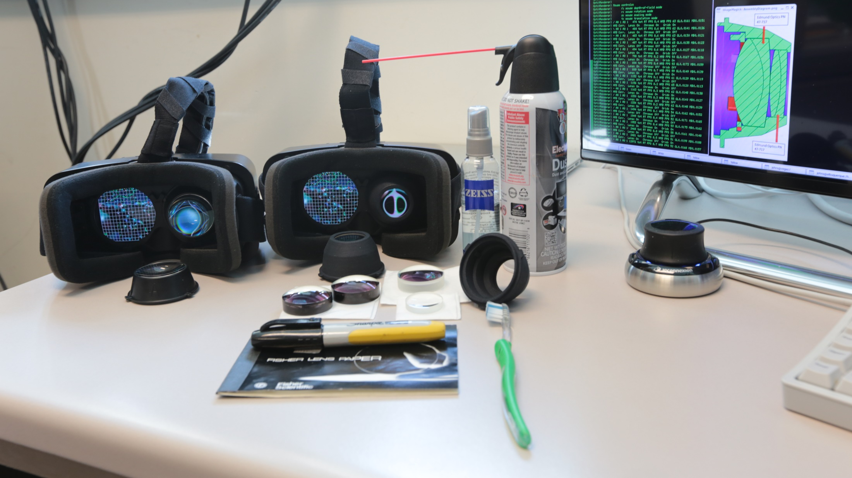
Immersive Molecular Visualization with Omnidirectional Stereoscopic Ray Tracing and Remote Rendering. J. E. Stone, W. R. Sherman, and K. Schulten. High Performance Data Analysis and Visualization Workshop, IEEE International Parallel and Distributed Processing Symposium Workshops (IPDPSW), pp. 1048-1057, 2016.

Slide 31
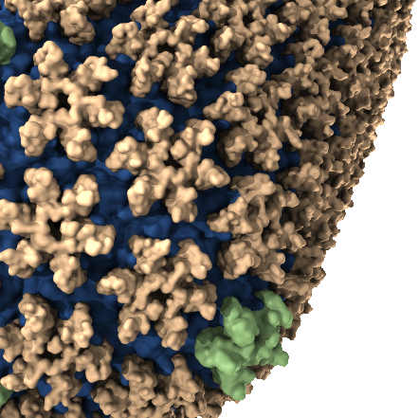
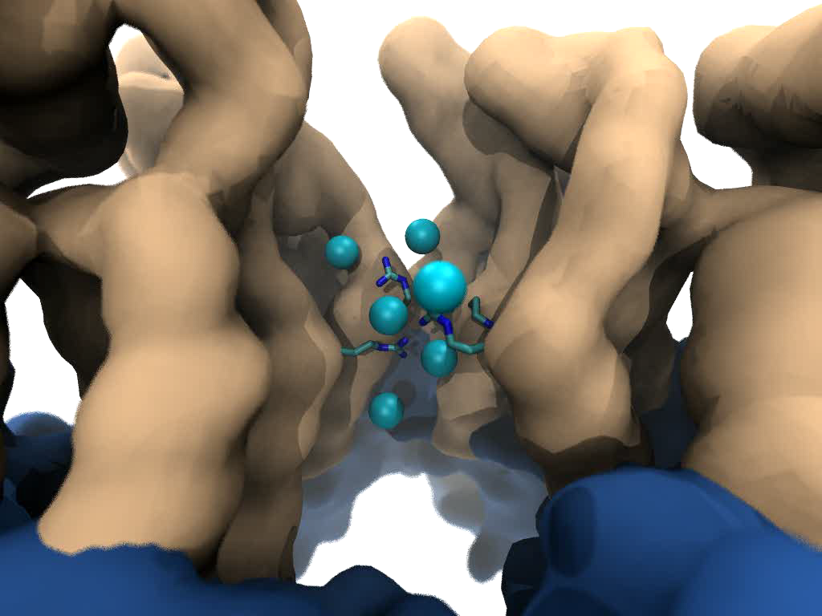


Goal: Intuitive interactive viz. in crowded molecular complexes
Results from 64 M atom, 1 μs sim!
Close-up view of chloride ions permeating through HIV-1 capsid hexameric centers

Slide 32
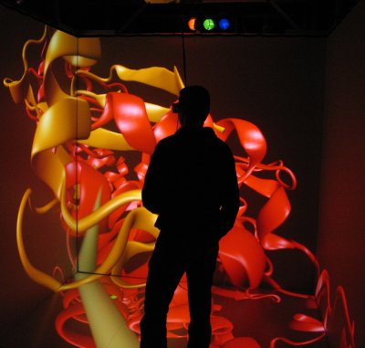
Immersive Viz. w/ VMD
VMD began as a CAVE app (1993)
Use of immersive viz by molecular scientists limited due to cost, complexity, lack of local availability, convenience
Commoditization of HMDs excellent opportunity to overcome cost/availability
This leaves many challenges still to solve:
  Incorporate support for remote visualization
  UIs, multi-user collaboration/interaction
  Rendering perf for large molecular systems
  Accomodating limitations idiosynchracies of commercial HMDs
VMD running in a CAVE w/ VR Juggler

Slide 33
HMD Ray Tracing Challenges
HMDs require high frame rates (90Hz or more) and minimum latency between IMU sensor reads and presentation on the display
Multi-GPU workstations fast enough to direct-drive HMDs at required frame rates for simple scenes with direct lighting, hard shadows
Advanced RT effects such as AO lighting, depth of field require much larger sample counts, impractical for direct-driving HMDs
Remote viz. required for many HPC problems due to large data
Remote viz. latencies too high for direct-drive of HMD
Our two-phase approach: moderate-FPS remote RT combined with local high-FPS view-dependent HMD reprojection w/ OpenGL

Slide 34
VMD Molecular Structure Data and Global State
Scene Graph
Graphical Representations
User Interface Subsystem
DrawMolecule
Tcl/Python Scripting
Non-Molecular
Geometry
Mouse + Windows
VR Input “Tools”
Display Subsystem
Windowed OpenGL GPU
VMDDisplayList
OpenGL Pbuffer GPU
OpenGLDisplayDevice
Tachyon CPU RT
DisplayDevice
FileRenderer
TachyonL-OptiX GPU RT
Batch + Interactive

Slide 35
VMD TachyonL-OptiX: Multi-GPU on NVIDIA VCA Cluster
VMD Scene
Scene Data Replicated, Image Space + Sample Space Parallel Decomposition onto GPUs
VCA 0:
8 K6000 GPUs
VCA N:
8 K6000 GPUs

Slide 36
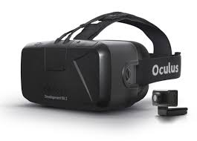
Progressive
Ray Tracing Engine
Ray tracing loop runs
continuously in new thread
Decodes H.264 video
stream from remote
VCA GPU cluster
Omnistereo
Image Stream
HMD Display Loop
HMD loop runs in main
VMD application thread
at max OpenGL draw rate
View-dependent
stereo reprojection for
current HMD head pose
HMD distortion correction
Camera
+ Scene
RT Code
+ Camera
+ Scene
Omnistereo
H.264 Video
HMD Video
HMD Pose
VMD
15Mbps Internet Link
HMD
Remote VCA GPU Cluster
Ray tracing runs continuously,
streams H.264 video to VMD client

Slide 37
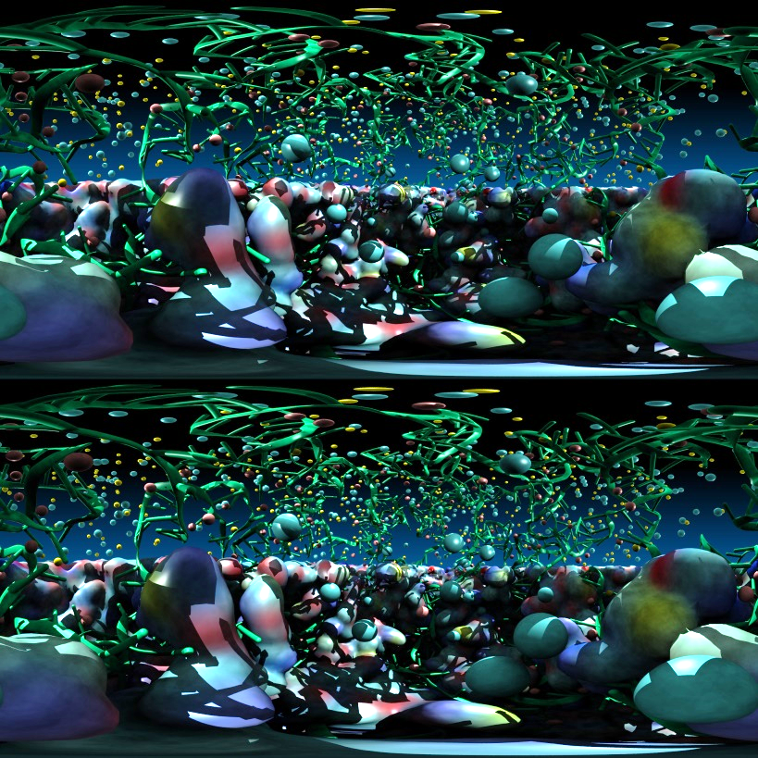
Stereoscopic Panorama Ray Tracing w/ OptiX
Render 360° images and movies for VR headsets such as Oculus Rift, Google Cardboard
Ray trace panoramic stereo spheremaps or cubemaps for very high-frame-rate display via OpenGL texturing onto simple geometry
Stereo requires spherical camera projections poorly suited to rasterization
Benefits from OptiX multi-GPU rendering and load balancing, remote visualization

Slide 38
A) Monoscopic circular projection.
Eye at center of projection (COP).
B) Left eye stereo circular projection.
Eye offset from COP by half of interocular distance.
Polar Axis
Zero Eye Sep
C) Stereo eye separation smoothly decreased to zero at zenith and nadir points on the polar axis to prevent incorrect stereo when HMD sees the poles.
Decreasing Eye Sep
Full Eye Separation
Decreasing Eye Sep
Zero Eye Sep

Slide 39
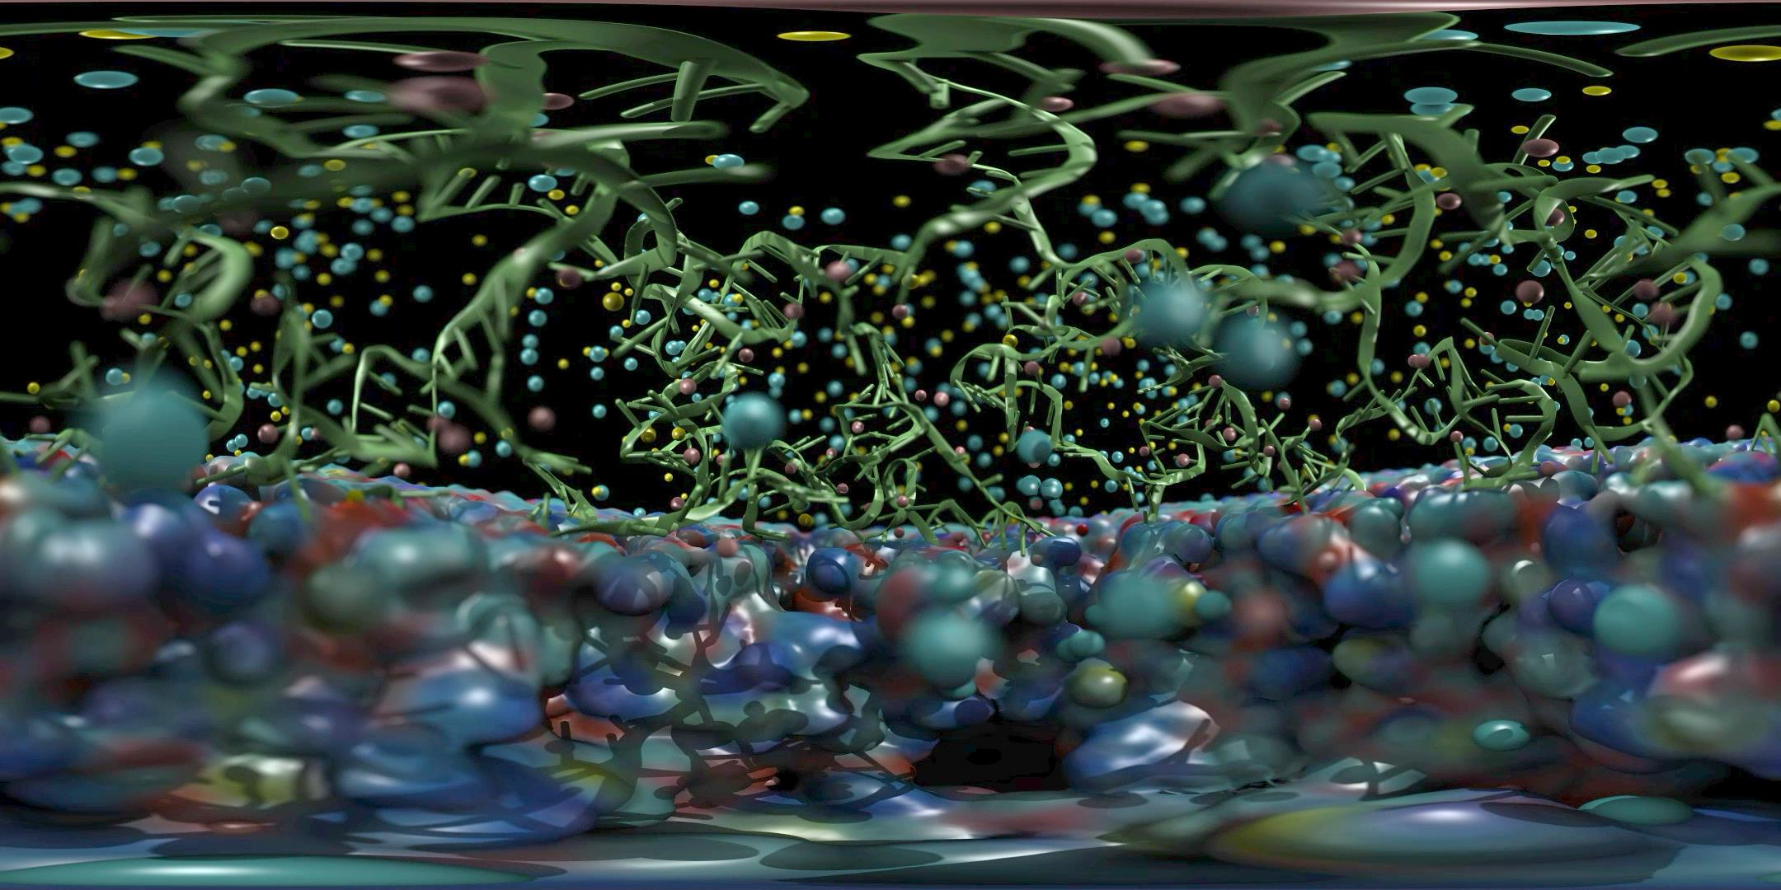

Slide 40
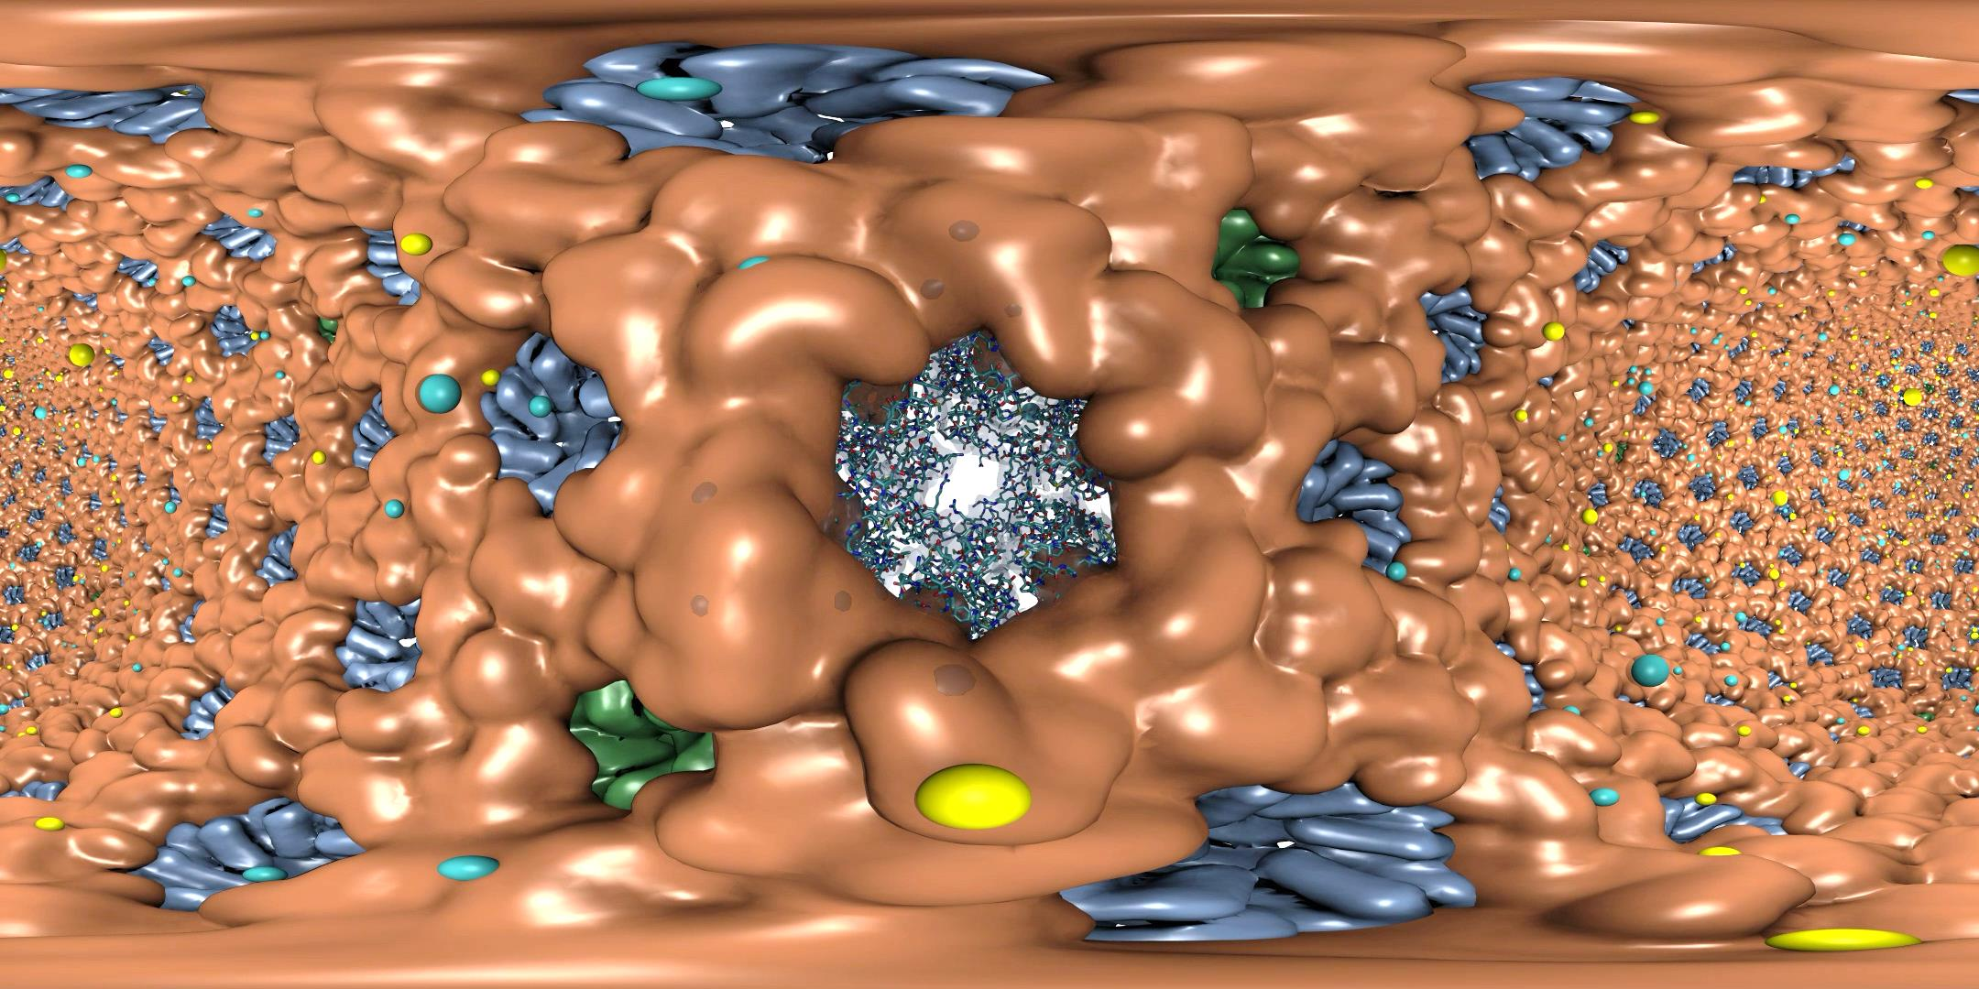

Slide 41
Remote Omnidirectional Stereoscopic
RT Performance @ 3072x1536 w/ 2-subframes
Scene | Per-subframe samples AA : AO (AO per-hit) | RT update rate (FPS)
STMV shadows | 1:0 2:0 4:0 | 22.2 18.1 10.3
STMV Shadows+AO | 1:1 1:2 1:4 | 18.2 16.1 12.4
STMV Shadows+AO+DoF | 1:1 2:1 2:2 | 16.1 11.1 8.5
HIV-1 Shadows | 1:0 2:0 4:0 | 20.1 18.1 10.2
HIV-1 Shadows+AO | 1:1 1:2 1:4 | 17.4 12.2 8.1

Slide 42
HMD View-Dependent Reprojection with OpenGL
Texture map panoramic image onto reprojection geometry that matches the original RT image formation surface (sphere for equirectangular, cube for cube map)
HMD sees standard perspective frustum view of the textured surface
Commodity HMD optics require software lens distortion and chromatic aberration correction prior to display, implemented with multi-pass FBO rendering
Enables low-latency, high-frame-rate redraw as HMD head pose changes (150Hz or more)

Slide 43
VMD can support a variety of HMD lens designs, e.g.
http://research.microsoft.com/en-us/um/redmond/projects/lensfactory/oculus/

Slide 44
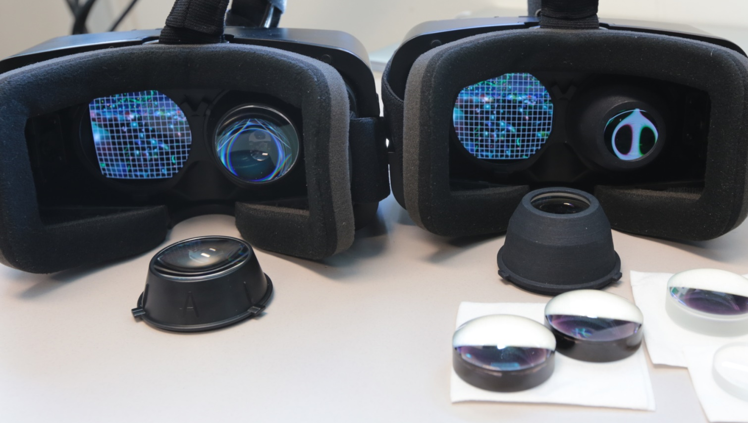

Slide 45
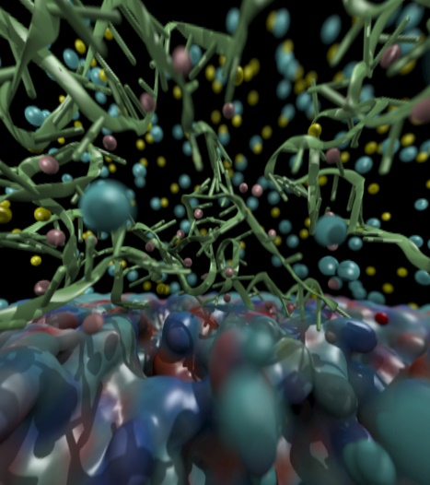
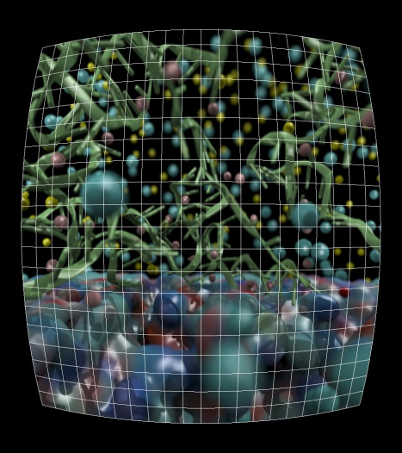
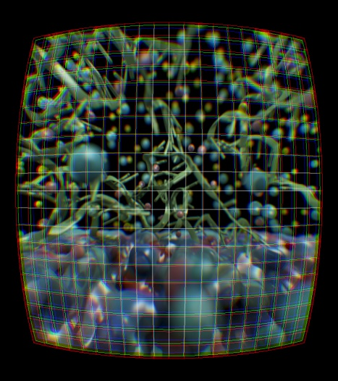
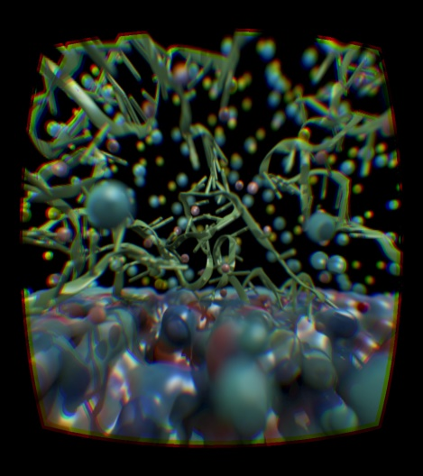
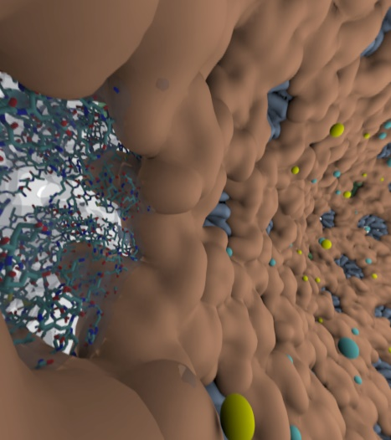
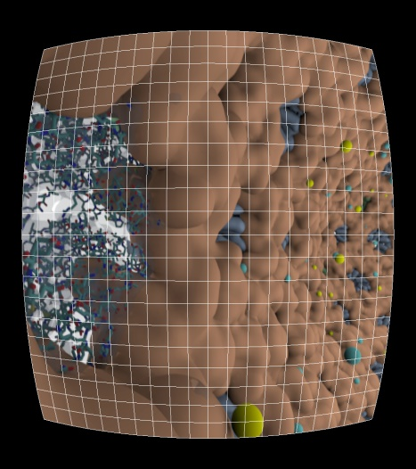
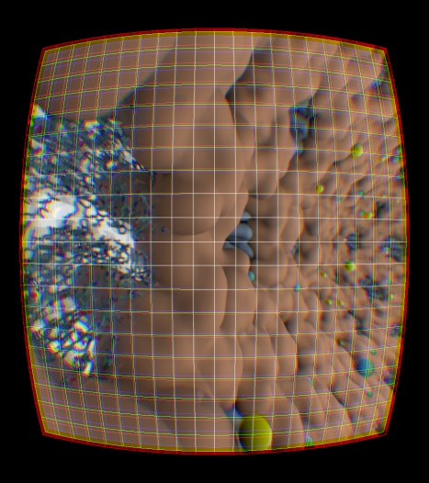
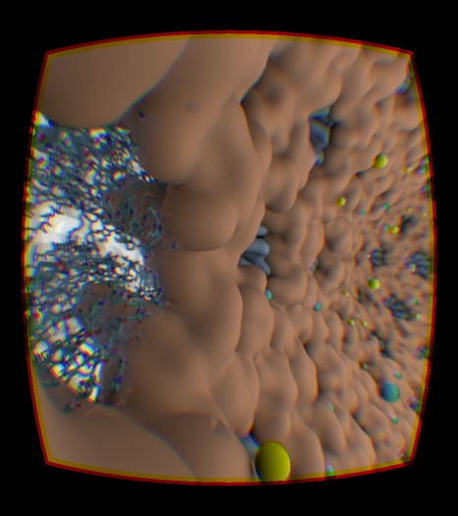

Slide 46
Future Work
Support for more commodity HMDs as they become generally available
Support for OSes besides Linux
Ray tracing engine and optimizations:
  Multi-node parallel RT and remote viz. on general clusters and supercomputers, e.g. NCSA Blue Waters, ORNL Titan
  Interactive RT stochastic sampling strategies to improve interactivity
  Improved omnidirectional cubemap/spheremap sampling approaches
Tons of work to do on VR user interfaces, multi-user collaborative visualization, …

Slide 47
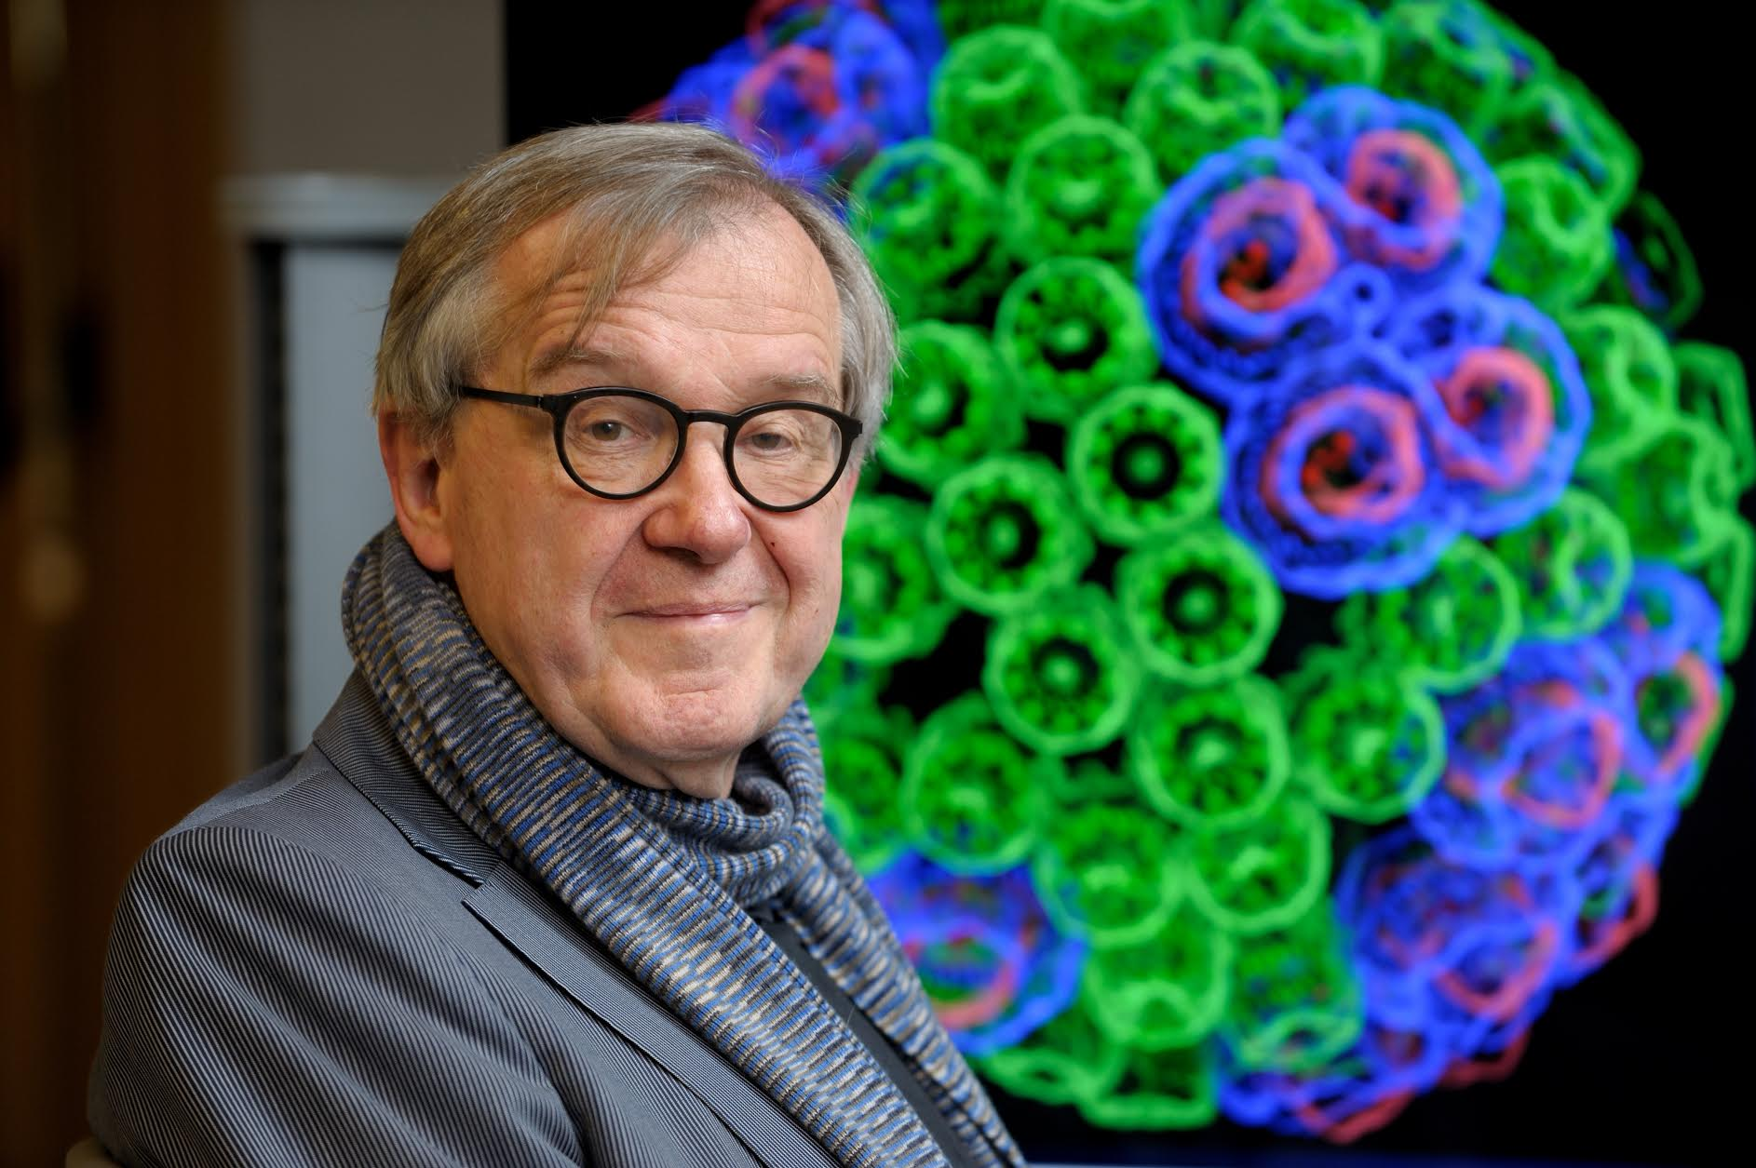
“When I was a young man, my goal was to look with mathematical and computational means at the inside of cells, one atom at a time, to decipher how living systems work. That is what I strived for and I never deflected from this goal.” – Klaus Schulten

Slide 48
Acknowledgements
Theoretical and Computational Biophysics Group, University of Illinois at Urbana-Champaign
CUDA Center of Excellence, University of Illinois at Urbana-Champaign
NVIDIA CUDA and OptiX teams
Funding:
  DOE INCITE, ORNL Titan: DE-AC05-00OR22725
  NSF Blue Waters: NSF OCI 07-25070, PRAC “The Computational Microscope”, ACI-1238993, ACI-1440026
  NIH support: 9P41GM104601, 5R01GM098243-02
Notes:
48

Slide 49
Related Publications http://www.ks.uiuc.edu/Research/gpu/
Challenges of Integrating Stochastic Dynamics and Cryo-electron Tomograms in Whole-cell Simulations. T. M. Earnest, R. Watanabe, J. E. Stone, J. Mahamid, W. Baumeister, E. Villa, and Z. Luthey-Schulten. J. Physical Chemistry B, 121(15): 3871-3881, 2017.
Early Experiences Porting the NAMD and VMD Molecular Simulation and Analysis Software to GPU-Accelerated OpenPOWER Platforms. J. E. Stone, A.-P. Hynninen, J. C. Phillips, and K. Schulten. International Workshop on OpenPOWER for HPC (IWOPH'16), LNCS 9945, pp. 188-206, 2016.
Immersive Molecular Visualization with Omnidirectional Stereoscopic Ray Tracing and Remote Rendering. J. E. Stone, W. R. Sherman, and K. Schulten. High Performance Data Analysis and Visualization Workshop, IEEE International Parallel and Distributed Processing Symposium Workshop (IPDPSW), pp. 1048-1057, 2016.
High Performance Molecular Visualization: In-Situ and Parallel Rendering with EGL. J. E. Stone, P. Messmer, R. Sisneros, and K. Schulten. High Performance Data Analysis and Visualization Workshop, IEEE International Parallel and Distributed Processing Symposium Workshop (IPDPSW), pp. 1014-1023, 2016.
Evaluation of Emerging Energy-Efficient Heterogeneous Computing Platforms for Biomolecular and Cellular Simulation Workloads. J. E. Stone, M. J. Hallock, J. C. Phillips, J. R. Peterson, Z. Luthey-Schulten, and K. Schulten.25th International Heterogeneity in Computing Workshop, IEEE International Parallel and Distributed Processing Symposium Workshop (IPDPSW), pp. 89-100, 2016.
Atomic Detail Visualization of Photosynthetic Membranes with GPU-Accelerated Ray Tracing. J. E. Stone, M. Sener, K. L. Vandivort, A. Barragan, A. Singharoy, I. Teo, J. V. Ribeiro, B. Isralewitz, B. Liu, B.-C. Goh, J. C. Phillips, C. MacGregor-Chatwin, M. P. Johnson, L. F. Kourkoutis, C. Neil Hunter, and K. Schulten. J. Parallel Computing, 55:17-27, 2016.

Slide 50
Related Publications http://www.ks.uiuc.edu/Research/gpu/
Chemical Visualization of Human Pathogens: the Retroviral Capsids. Juan R. Perilla, Boon Chong Goh, John E. Stone, and Klaus Schulten. SC'15 Visualization and Data Analytics Showcase, 2015.
Visualization of Energy Conversion Processes in a Light Harvesting Organelle at Atomic Detail. M. Sener, J. E. Stone, A. Barragan, A. Singharoy, I. Teo, K. L. Vandivort, B. Isralewitz, B. Liu, B. Goh, J. C. Phillips, L. F. Kourkoutis, C. N. Hunter, and K. Schulten. SC'14 Visualization and Data Analytics Showcase, 2014. ***Winner of the SC'14 Visualization and Data Analytics Showcase
Runtime and Architecture Support for Efficient Data Exchange in Multi-Accelerator Applications. J. Cabezas, I. Gelado, J. E. Stone, N. Navarro, D. B. Kirk, and W. Hwu. IEEE Transactions on Parallel and Distributed Systems, 26(5):1405-1418, 2015.
Unlocking the Full Potential of the Cray XK7 Accelerator. M. D. Klein and J. E. Stone. Cray Users Group, Lugano Switzerland, May 2014.
GPU-Accelerated Analysis and Visualization of Large Structures Solved by Molecular Dynamics Flexible Fitting. J. E. Stone, R. McGreevy, B. Isralewitz, and K. Schulten. Faraday Discussions, 169:265-283, 2014.
Simulation of reaction diffusion processes over biologically relevant size and time scales using multi-GPU workstations. M. J. Hallock, J. E. Stone, E. Roberts, C. Fry, and Z. Luthey-Schulten. Journal of Parallel Computing, 40:86-99, 2014.

Slide 51
Related Publications http://www.ks.uiuc.edu/Research/gpu/
GPU-Accelerated Molecular Visualization on Petascale Supercomputing Platforms. J. Stone, K. L. Vandivort, and K. Schulten. UltraVis'13: Proceedings of the 8th International Workshop on Ultrascale Visualization, pp. 6:1-6:8, 2013.
Early Experiences Scaling VMD Molecular Visualization and Analysis Jobs on Blue Waters. J. Stone, B. Isralewitz, and K. Schulten. In proceedings, Extreme Scaling Workshop, 2013.
Lattice Microbes: High‐performance stochastic simulation method for the reaction‐diffusion master equation. E. Roberts, J. Stone, and Z. Luthey‐Schulten.
J. Computational Chemistry 34 (3), 245-255, 2013.
Fast Visualization of Gaussian Density Surfaces for Molecular Dynamics and Particle System Trajectories. M. Krone, J. Stone, T. Ertl, and K. Schulten. EuroVis Short Papers, pp. 67-71, 2012.
Immersive Out-of-Core Visualization of Large-Size and Long-Timescale Molecular Dynamics Trajectories. J. Stone, K. L. Vandivort, and K. Schulten. G. Bebis et al. (Eds.): 7th International Symposium on Visual Computing (ISVC 2011), LNCS 6939, pp. 1-12, 2011.
Fast Analysis of Molecular Dynamics Trajectories with Graphics Processing Units – Radial Distribution Functions. B. Levine, J. Stone, and A. Kohlmeyer. J. Comp. Physics, 230(9):3556-3569, 2011.

Slide 52
Related Publications http://www.ks.uiuc.edu/Research/gpu/
Quantifying the Impact of GPUs on Performance and Energy Efficiency in HPC Clusters. J. Enos, C. Steffen, J. Fullop, M. Showerman, G. Shi, K. Esler, V. Kindratenko, J. Stone, J Phillips. International Conference on Green Computing, pp. 317-324, 2010.
GPU-accelerated molecular modeling coming of age. J. Stone, D. Hardy, I. Ufimtsev, K. Schulten. J. Molecular Graphics and Modeling, 29:116-125, 2010.
OpenCL: A Parallel Programming Standard for Heterogeneous Computing. J. Stone, D. Gohara, G. Shi. Computing in Science and Engineering, 12(3):66-73, 2010.
An Asymmetric Distributed Shared Memory Model for Heterogeneous Computing Systems. I. Gelado, J. Stone, J. Cabezas, S. Patel, N. Navarro, W. Hwu. ASPLOS ’10: Proceedings of the 15th International Conference on Architectural Support for Programming Languages and Operating Systems, pp. 347-358, 2010.

Slide 53
Related Publications http://www.ks.uiuc.edu/Research/gpu/
GPU Clusters for High Performance Computing. V. Kindratenko, J. Enos, G. Shi, M. Showerman, G. Arnold, J. Stone, J. Phillips, W. Hwu. Workshop on Parallel Programming on Accelerator Clusters (PPAC), In Proceedings IEEE Cluster 2009, pp. 1-8, Aug. 2009.
Long time-scale simulations of in vivo diffusion using GPU hardware. E. Roberts, J. Stone, L. Sepulveda, W. Hwu, Z. Luthey-Schulten. In IPDPS’09: Proceedings of the 2009 IEEE International Symposium on Parallel & Distributed Computing, pp. 1-8, 2009.
High Performance Computation and Interactive Display of Molecular Orbitals on GPUs and Multi-core CPUs. J. E. Stone, J. Saam, D. Hardy, K. Vandivort, W. Hwu, K. Schulten, 2nd Workshop on General-Purpose Computation on Graphics Pricessing Units (GPGPU-2), ACM International Conference Proceeding Series, volume 383, pp. 9-18, 2009.
Probing Biomolecular Machines with Graphics Processors. J. Phillips, J. Stone. Communications of the ACM, 52(10):34-41, 2009.
Multilevel summation of electrostatic potentials using graphics processing units. D. Hardy, J. Stone, K. Schulten. J. Parallel Computing, 35:164-177, 2009.

Slide 54
Related Publications http://www.ks.uiuc.edu/Research/gpu/
Adapting a message-driven parallel application to GPU-accelerated clusters. J. Phillips, J. Stone, K. Schulten. Proceedings of the 2008 ACM/IEEE Conference on Supercomputing, IEEE Press, 2008.
GPU acceleration of cutoff pair potentials for molecular modeling applications. C. Rodrigues, D. Hardy, J. Stone, K. Schulten, and W. Hwu. Proceedings of the 2008 Conference On Computing Frontiers, pp. 273-282, 2008.
GPU computing. J. Owens, M. Houston, D. Luebke, S. Green, J. Stone, J. Phillips. Proceedings of the IEEE, 96:879-899, 2008.
Accelerating molecular modeling applications with graphics processors. J. Stone, J. Phillips, P. Freddolino, D. Hardy, L. Trabuco, K. Schulten. J. Comp. Chem., 28:2618-2640, 2007.
Continuous fluorescence microphotolysis and correlation spectroscopy. A. Arkhipov, J. Hüve, M. Kahms, R. Peters, K. Schulten. Biophysical Journal, 93:4006-4017, 2007.

