Slide 1
S6253—VMD: Petascale Molecular Visualization and Analysis with Remote Video Streaming
John E. Stone
Theoretical and Computational Biophysics Group
Beckman Institute for Advanced Science and Technology
University of Illinois at Urbana-Champaign
http://www.ks.uiuc.edu/Research/gpu/
S6253, GPU Technology Conference
1:00pm-1:50pm, Room LL21D, San Jose Convention Center,
San Jose, CA, Tuesday April 5th, 2016

Slide 2
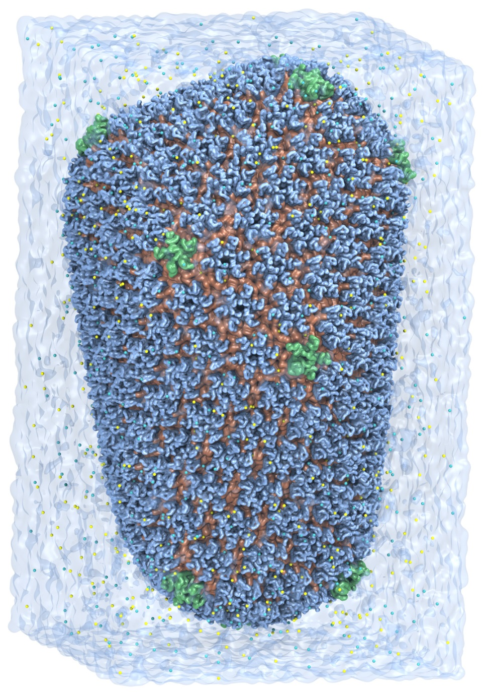
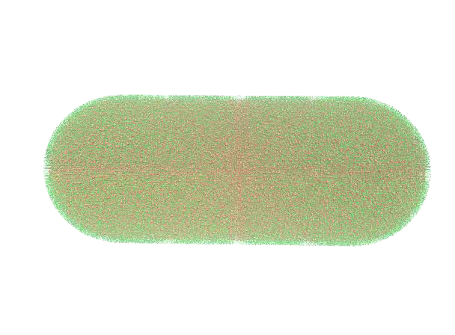
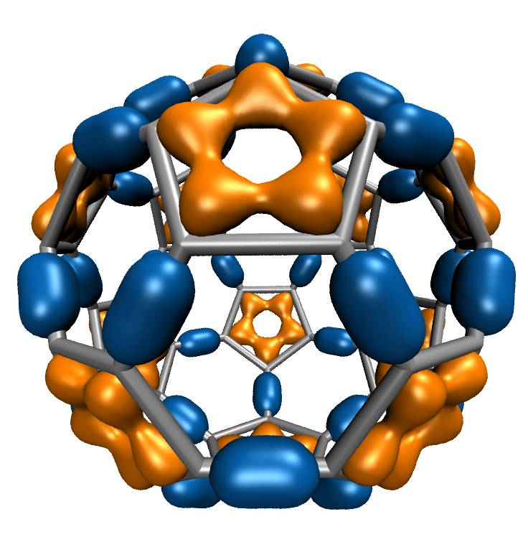
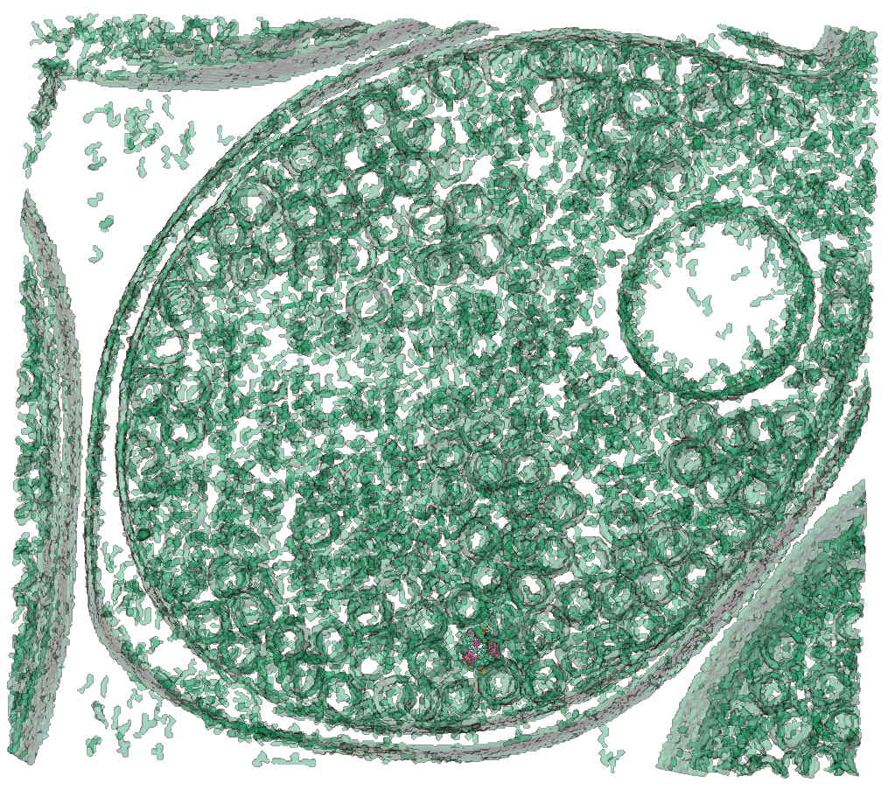
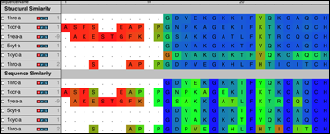
VMD – “Visual Molecular Dynamics”
Visualization and analysis of:
  molecular dynamics simulations
  particle systems and whole cells
  cryoEM densities, volumetric data
  quantum chemistry calculations
  sequence information
User extensible w/ scripting and plugins
http://www.ks.uiuc.edu/Research/vmd/
Whole Cell Simulation
MD Simulations
CryoEM, Cellular Tomography
Sequence Data
Quantum Chemistry

Slide 3
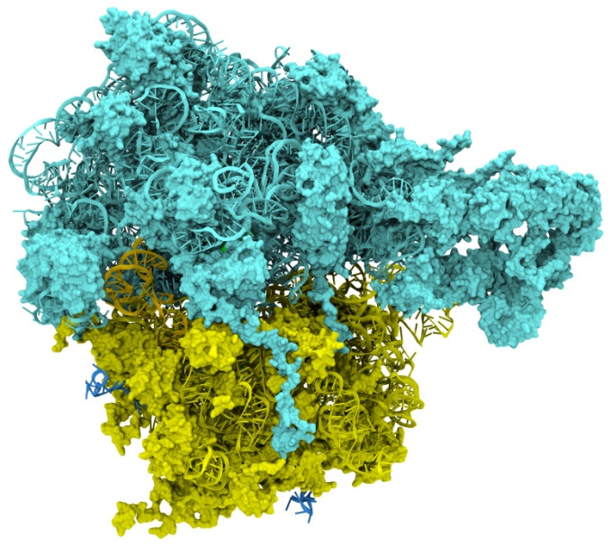
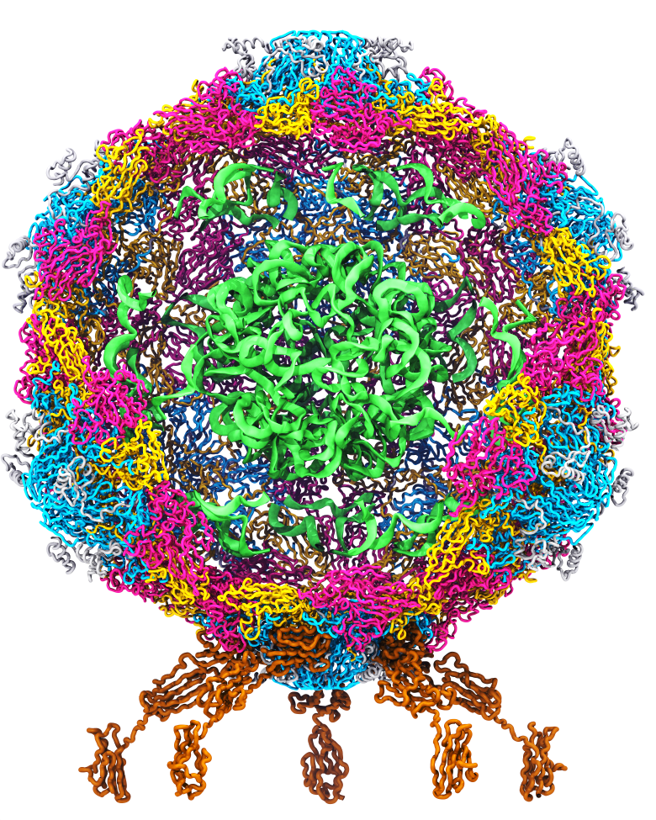
Goal: A Computational Microscope
Study the molecular machines in living cells
Ribosome: target for antibiotics
Poliovirus
Notes:
Ribosomes synthesize new proteins from genetic information
Bacterial ribosome is a target for antibiotics, which interfere with its ability to function by binding to sites on the structure, preventing proteins from being synthesized
Ribosome simulations are extremely computationally challenging due to the size of the structure and its natural environment (solvent, ions, etc, large box, 3 million atoms or so)
Bionanodevice for sequencing DNA efficiently
Knowledge of an individual’s genetic makeup can lead to the prediction and treatment of many diseases by the means of personal genomic medicine and pharmacogenomics. In order for genome sequencing to become practical for common medical use, an inexpensive high throughput genome sequencing technique is required. NIH has set a goal of reducing the cost of genome sequencing by a factor of 10,000, to less than $1,000 within ten years.
The computer is the best microscope to guide the development of bionanodevices, for example to sequence DNA. While experiments can measure DNA electrostatic potentials, they cannot visualize the DNA’s location and conformation at the time of measurement.

Slide 4
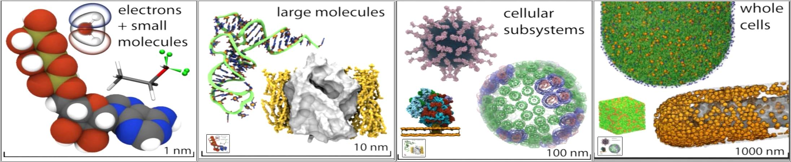
VMD Interoperability Serves Many Communities
Uniquely interoperable with a broad range of tools:
  AMBER, CHARMM, CPMD, DL_POLY, GAMESS, GROMACS, HOOMD, LAMMPS, NAMD, and many more …
Supports key data types, file formats, and databases
Incorporates tools for simulation preparation, visualization, and analysis

Slide 5
NAMD and VMD Use GPUs and Petascale Computing to Meet
Computational Biology’s Insatiable Demand for Processing Power

Slide 6
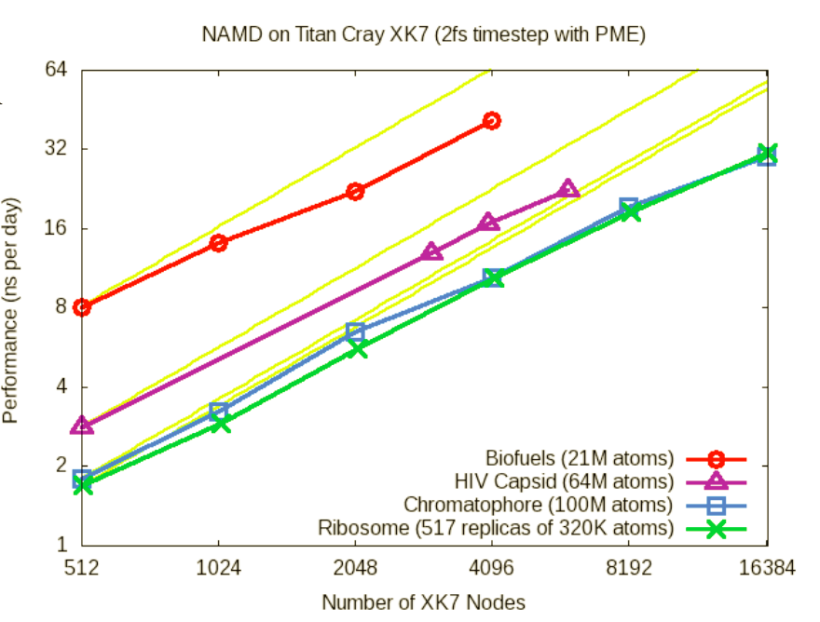
NAMD Titan XK7 Performance August 2013
NAMD XK7 vs. XE6
GPU Speedup: 2x-4x
HIV-1 Trajectory: ~1.2 TB/day @ 4096 XK7 nodes

Slide 7
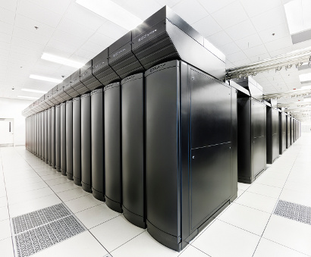
VMD Petascale Visualization and Analysis
Analyze/visualize large trajectories too large to transfer off-site:
  User-defined parallel analysis operations, data types
  Parallel rendering, movie making
Supports GPU-accelerated Cray XK7 nodes for both visualization and analysis:
  GPU accelerated trajectory analysis w/ CUDA
  OpenGL and GPU ray tracing for visualization and movie rendering
Parallel I/O rates up to 275 GB/sec on 8192 Cray XE6 nodes – can read in 231 TB in 15 minutes!
Parallel VMD currently available on:
ORNL Titan, NCSA Blue Waters, Indiana Big Red II, CSCS Piz Daint, and similar systems
NCSA Blue Waters Hybrid Cray XE6 / XK7
22,640 XE6 dual-Opteron CPU nodes
4,224 XK7 nodes w/ Telsa K20X GPUs

Slide 8

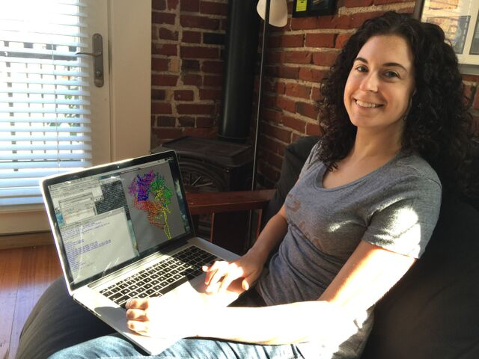
Interactive Remote Visualization and Analysis
Enabled by hardware H.264/H.265 video encode/decode
Enable visualization and analyses not possible with conventional workstations
Access data located anywhere in the world
  Same VMD session available to any device
Notes:
Use a schematic that’s generic rather than titan
1-12 viz machines, never such an immediate impact, tell the story, but brief strong points
Maybe show jodi here
Shrink supercomputer, grow the person figure

Slide 9

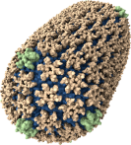
Interactive Collaboration
Enable interactive VMD sessions with multiple-endpoints
Enable collaboration features that were previously impractical:
  Remote viz. overcomes local computing and visualization limitations for interactive display
Experimentalist Collaborators
Pittsburgh, PA
Supercomputer, MD Simulation
Urbana, IL
Notes:
Add cities by the laptops…

Slide 10
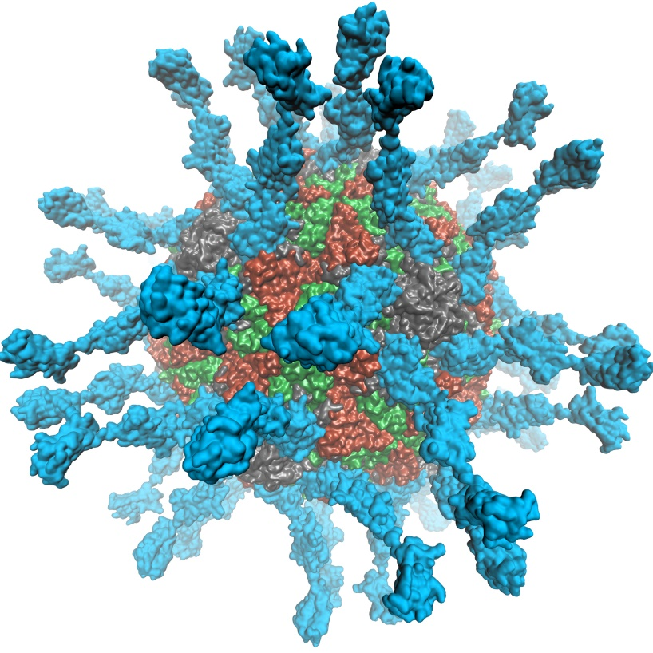
Adaptation of VMD to EGL for in-situ and parallel rendering on clouds, clusters, and supercomputers
Eliminate dependency on windowing systems
Simplified deployment of parallel VMD builds supporting off-screen rendering
Maintains 100% of VMD OpenGL shaders and rendering features
Support high-quality vendor-supported commercial OpenGL implementations in HPC systems that were previously limited to Mesa
Poliovirus

Slide 11
OpenGL: GLX vs. EGL
Viz Application
(user)
Viz Application
(user)
OpenGL
GLX
OpenGL
X server
(root)
OpenGL
EGL
Driver
Driver
GPU
GPU

Slide 12
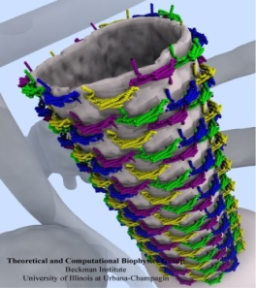
Molecular Structure Data and Global VMD State
Scene Graph
Graphical Representations
User Interface Subsystem
DrawMolecule
Tcl/Python Scripting
Non-Molecular
Geometry
Mouse + Windows
6DoF Input “Tools”
VMDDisplayList
Display
Subsystem
GLX+X11+Drv
OpenGL Pbuffer/FBO
DisplayDevice
Windowed OpenGL
EGL+Drv
OpenGLRenderer
OpenGL Pbuffer/FBO

Slide 13
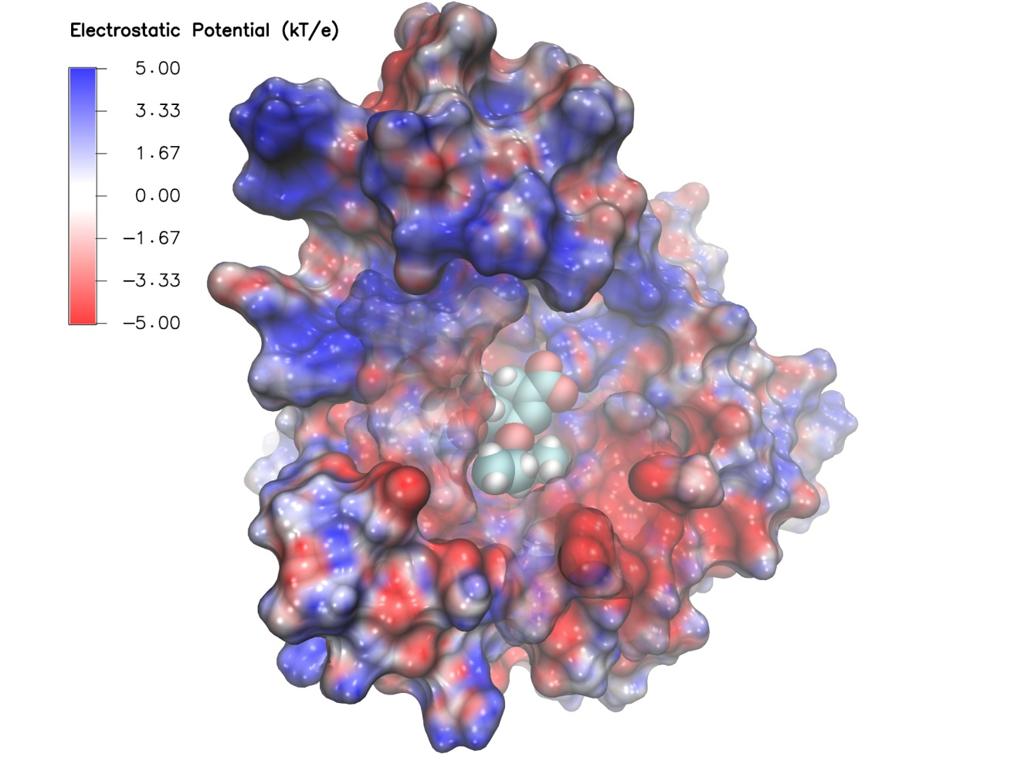
Swine Flu A/H1N1 neuraminidase bound to Tamiflu: VMD EGL rendering demonstrating full support for all VMD shaders and OpenGL features, multisample antialiasing, ray cast spheres, 3-D texture mapping, ...

Slide 14
Benefits of EGL Platform Interfaces
Minor similarity to OpenCL’s platform interfaces
Enumerate and select among available implementations, potentially supporting multiple vendors in the same node
Allows specific target implementation to be bound, e.g. GPU, CPU-integrated GPU, software rasterizer
EGL interfaces make it EASY to bind a GPU to a thread with optimal CPU affinity with respect to NUMA topology
  High-perf. multi-GPU image compositing, video
  NVIDIA EGL implementation supports multiple indexing schemes, e.g. PCIe ordering
  EGL plays nicely with MPI, CUDA/OpenCL, OptiX, NVENC, etc

Slide 15
Example Node NUMA Topology
DRAM
GPU 1
QPI/HT
IOH 1
PCIe 3.0 x16
CPU 1
GPU 2
PCIe 3.0 x16
CPU Bus 25GB/sec
QuickPath (QPI)
HyperTransport (HT)
NET
QPI/
HT
PCIe 3.0 x4/x8/x16
PCIe 3.0 x16 12GB/sec
GPU 3
CPU 2
IOH 2
PCIe 3.0 x16
QPI/HT
GPU 4
DRAM
PCIe 3.0 x16

Slide 16
Example Cloud Node NUMA Topology
DRAM
vGPU 1
QPI/HT
IOH 1
PCIe 3.0 x16
CPU 1
vGPU 2
CPU Bus 25GB/sec
QuickPath (QPI)
HyperTransport (HT)
Board 1
QPI/
HT
PCIe 3.0 x8/x16
NET
PCIe 3.0 x16 12GB/sec
vGPU 3
CPU 2
IOH 2
vGPU 4
QPI/HT
DRAM
PCIe 3.0 x16
Board 2

Slide 17
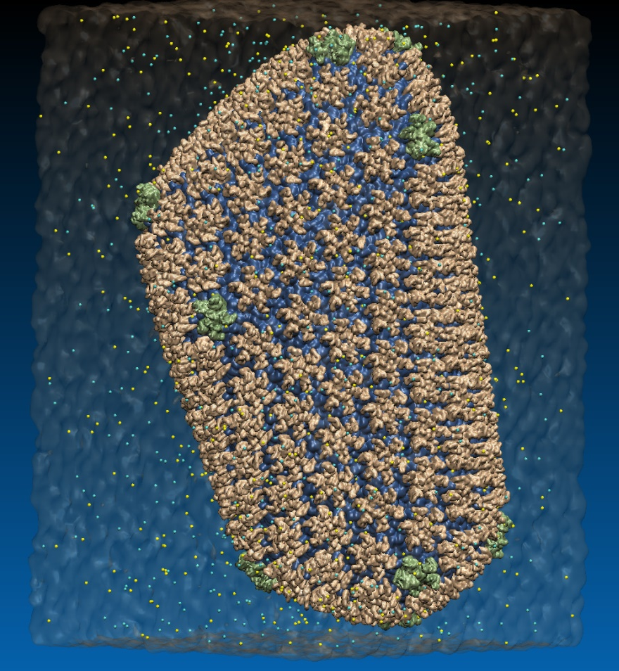
VMD EGL Performance on Amazon EC2 Cloud
MPI Ranks | EC2 “G2.8xlarge” GPU Instances | HIV-1 movie rendering time (sec), (I/O %) 3840x2160 resolution
1 | 1 | 626s (10% I/O)
2 | 1 | 347s (19% I/O)
4 | 1 | 221s (31% I/O)
8 | 2 | 141s (46% I/O)
16 | 4 | 107s (64% I/O)
32 | 8 | 90s (76% I/O)
Performance at 32 nodes reaches ~48 frames per second
High Performance Molecular Visualization: In-Situ and Parallel Rendering with EGL. J. E. Stone, P. Messmer, R. Sisneros, and K. Schulten. High Performance Data Analysis and Visualization Workshop, IEEE IPDPSW, 2016.
64M atom HIV-1 capsid simulation rendered via EGL

Slide 18
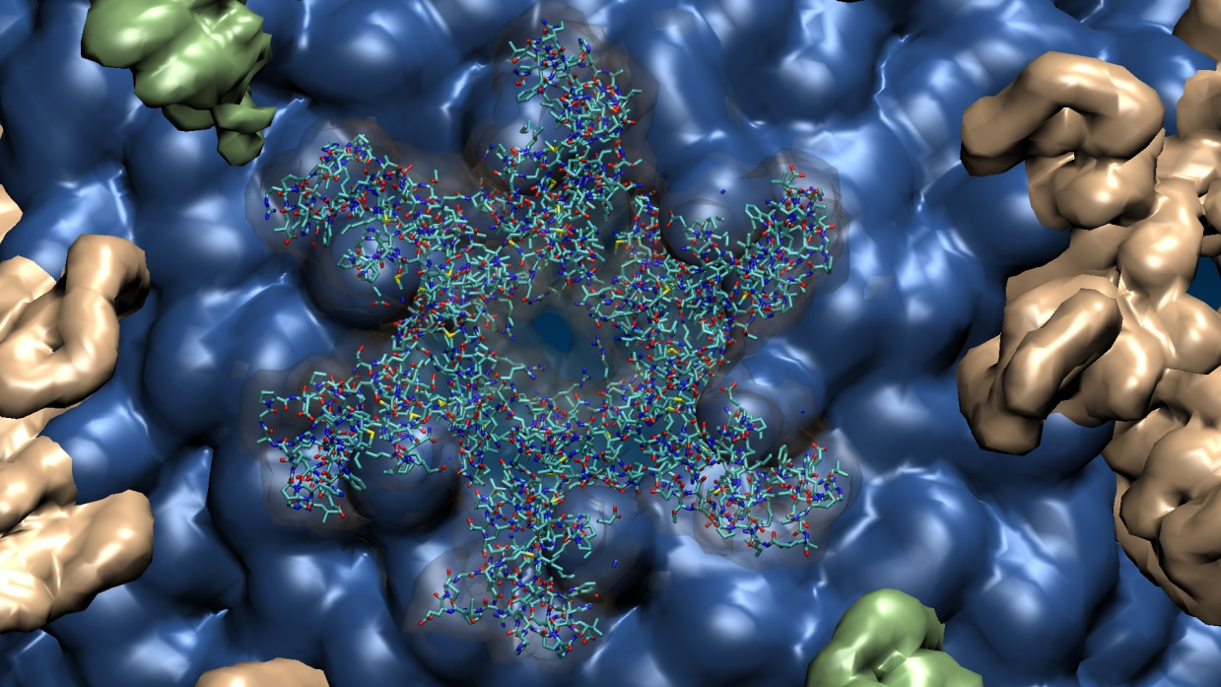
Close-up view of HIV-1 hexamer rendered via EGL
64M atom HIV-1 capsid simulation rendered via EGL

Slide 19
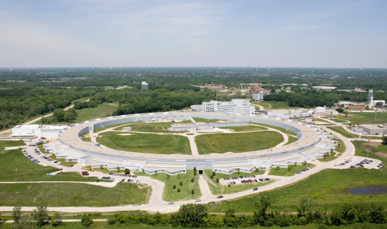
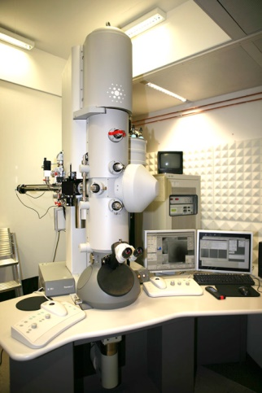
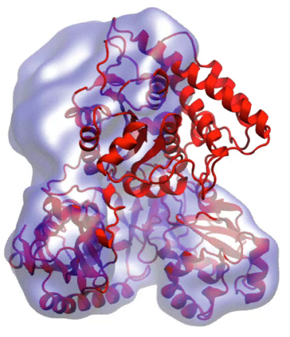
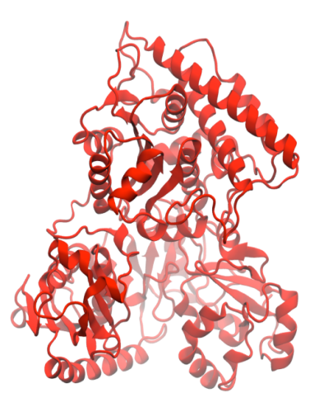
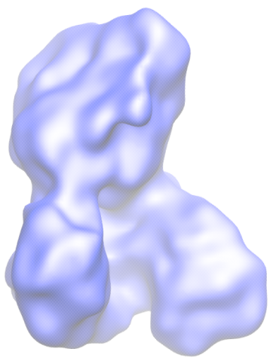
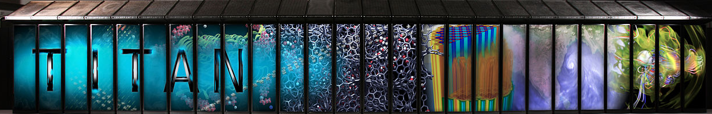
Molecular Dynamics Flexible Fitting (MDFF)
X-ray crystallography
MDFF
Electron microscopy
APS at Argonne
FEI microscope
ORNL Titan
Flexible fitting of atomic structures into electron microscopy maps using molecular dynamics.
L. Trabuco, E. Villa, K. Mitra, J. Frank, and K. Schulten. Structure, 16:673-683, 2008.
Acetyl - CoA Synthase

Slide 20
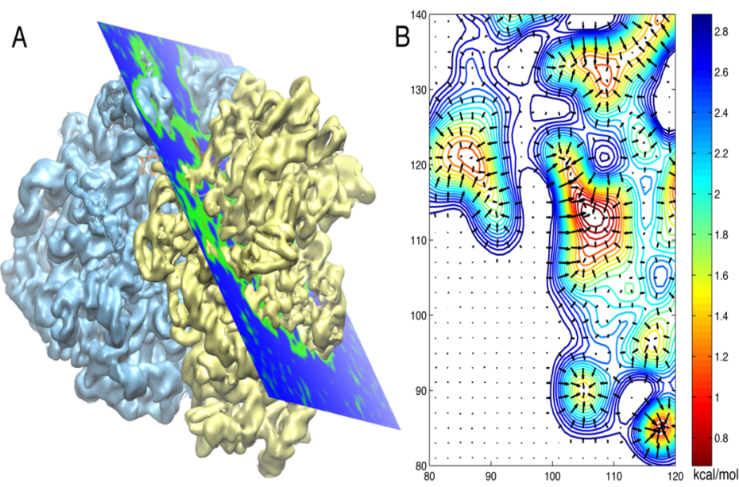

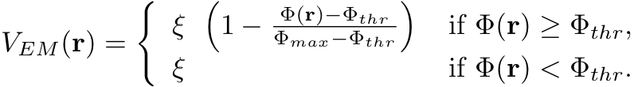
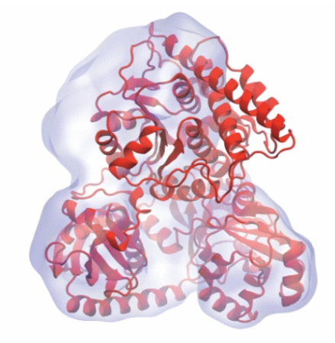
Molecular Dynamics Flexible Fitting - Theory
Two terms are added to the MD potential
An external potential derived from the EM map is defined on a grid as
A mass-weighted force is then applied to each atom

Slide 21
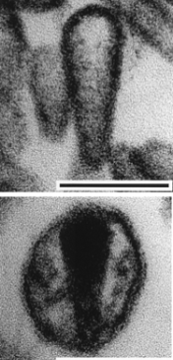
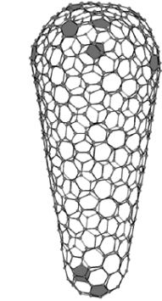
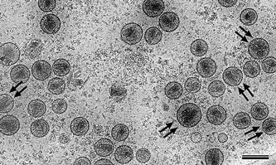
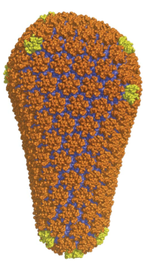
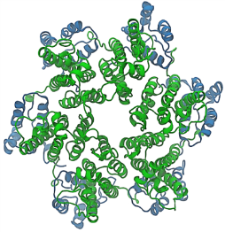
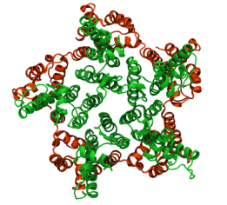
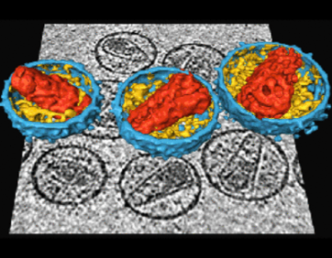
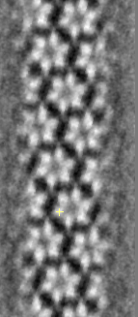
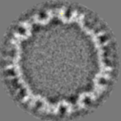
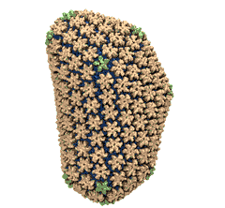
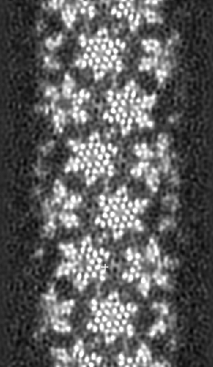
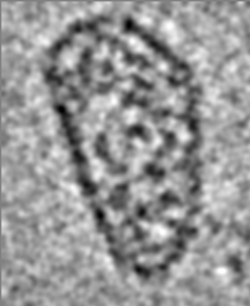
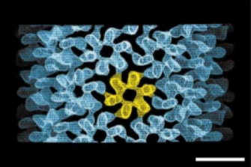
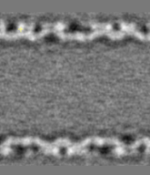
Structural Route to the all-atom HIV-1 Capsid
1st TEM (1999)
1st tomography (2003)
Crystal structures of separated hexamer and pentamer
Ganser et al. Science, 1999
Pornillos et al. , Cell 2009, Nature 2011
Briggs et al. EMBO J, 2003
High res. EM of hexameric tubule, tomography of capsid, all-atom model of capsid by MDFF w/ NAMD & VMD, NSF/NCSA Blue Waters computer at Illinois
Briggs et al. Structure, 2006
cryo-ET (2006)
hexameric tubule
Li et al., Nature, 2000
Byeon et al., Cell 2009
Zhao et al. , Nature 497: 643-646 (2013)

Slide 22
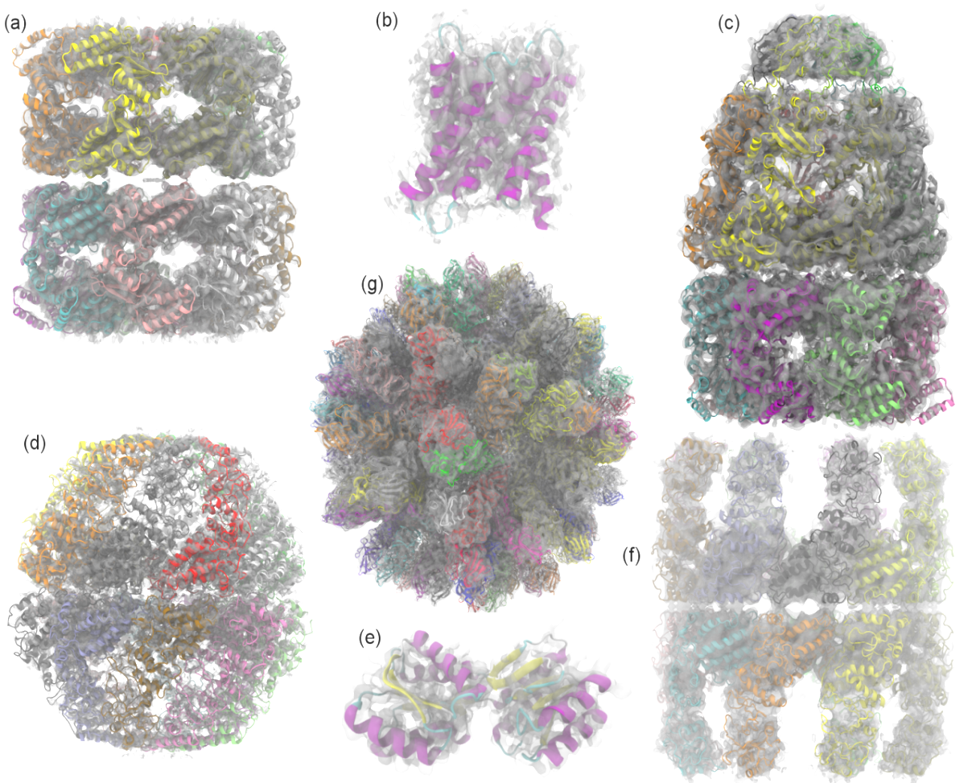
Evaluating Quality-of-Fit for Structures Solved by Hybrid Fitting Methods
Compute Pearson correlation to evaluate the fit of a reference cryo-EM density map with a simulated density map produced from an all-atom structure.

Slide 23
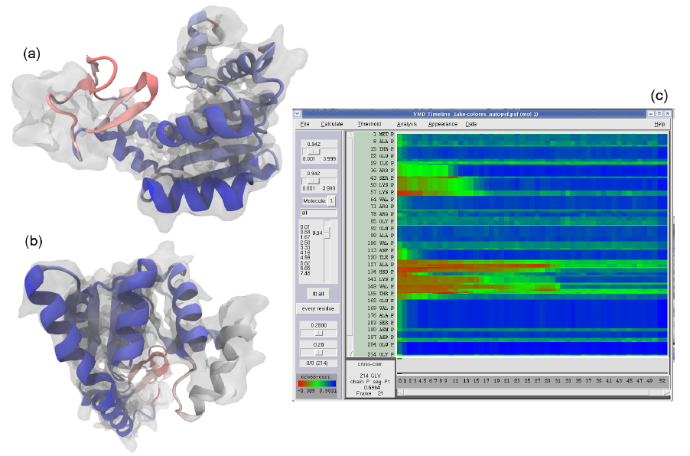
GPUs Can Reduce MDFF Trajectory Analysis Runtimes from Hours to Minutes
GPUs enable laptops and desktop workstations to handle tasks that would have previously required a cluster, or a very long wait…
GPU-accelerated petascale supercomputers enable analyses that were previously impractical, allowing detailed study of very large structures such as viruses
GPU-accelerated MDFF Cross Correlation Timeline
Regions with poor fit Regions with good fit

Slide 24
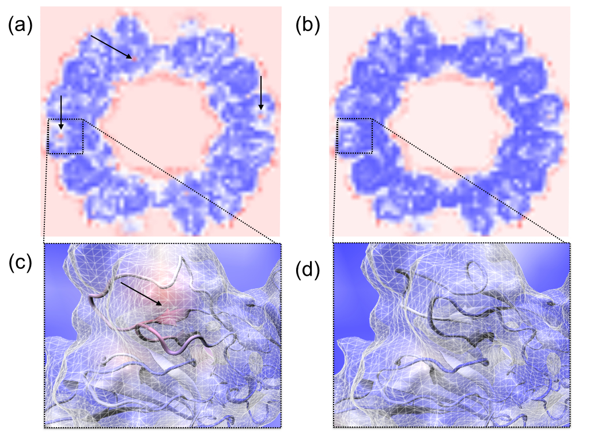

Slide 25
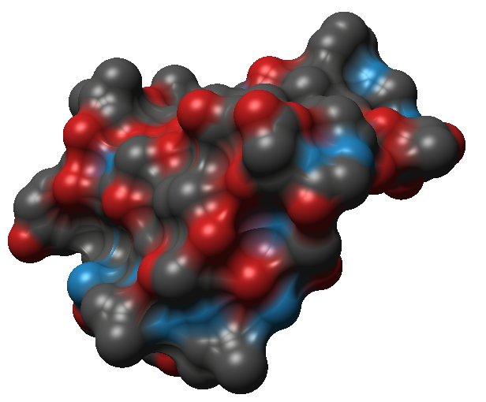
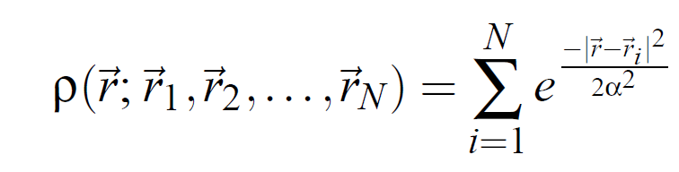
MDFF Density Map Algorithm
Build spatial acceleration data structures, optimize data for GPU
Compute 3-D density map:
Truncated Gaussian and spatial acceleration grid ensure linear time-complexity
3-D density map lattice point and the neighboring spatial acceleration cells it references

Slide 26
Single-Pass MDFF GPU Cross-Correlation
3-D density map decomposes into 3-D grid of 8x8x8 tiles containing CC partial sums and local CC values
Fusion of density and CC calculations into a single CUDA kernel!!!
Spatial CC map and overall CC value computed in a single pass
Small 8x8x2 CUDA thread blocks afford large
per-thread register count, shared memory
Each thread computes 4 z-axis density map lattice points and associated CC partial sums
0,0
0,1
…
Threads producing results that are used
1,0
1,1
…
…
…
…
Inactive threads, region of discarded output
Padding optimizes global memory performance, guaranteeing coalesced global memory accesses
Grid of thread blocks
Notes:
Threads in a thread block (potentially) execute in parallel
Threads in a block can communicate via fast shared memory
Global memory reads are slow
Constant memory is fast, but can only be written by host at kernel startup.

Slide 27
VMD GPU Cross Correlation Performance
 | RHDV | Mm-cpn open | GroEL | Aquaporin
Resolution (Å) | 6.5 | 8 | 4 | 3
Atoms | 702K | 61K | 54K | 1.6K
VMD-CUDA Quadro K6000 | 0.458s 34.6x | 0.06s 25.7x | 0.034s 36.8x | 0.007s 55.7x
VMD-CPU-SSE 32-threads, 2x Xeon E5-2687W | 0.779s 20.3x | 0.085s 18.1x | 0.159s 7.9x | 0.033s 11.8x
Chimera 1-thread Xeon E5-2687W | 15.86s 1.0x | 1.54s 1.0x | 1.25s 1.0x | 0.39s 1.0x
GPU-Accelerated Analysis and Visualization of Large Structures Solved by Molecular Dynamics Flexible Fitting. J. E. Stone, R. McGreevy, B. Isralewitz, and K. Schulten. Faraday Discussions 169:265-283, 2014.

Slide 28
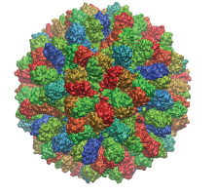
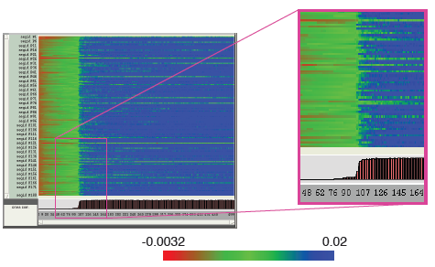
VMD RHDV Cross Correlation Timeline on Cray XK7
 | RHDV
Atoms | 702K
Traj. Frames | 10,000
Component Selections | 720
Single-node XK7 (projected) | 336 hours (14 days)
128-node XK7 | 3.2 hours 105x speedup
2048-node XK7 | 19.5 minutes 1035x speedup
RHDV
Group-relative CC Timeline
Calculation would take 5 years using original serial CC calculation on a workstation!

Slide 29
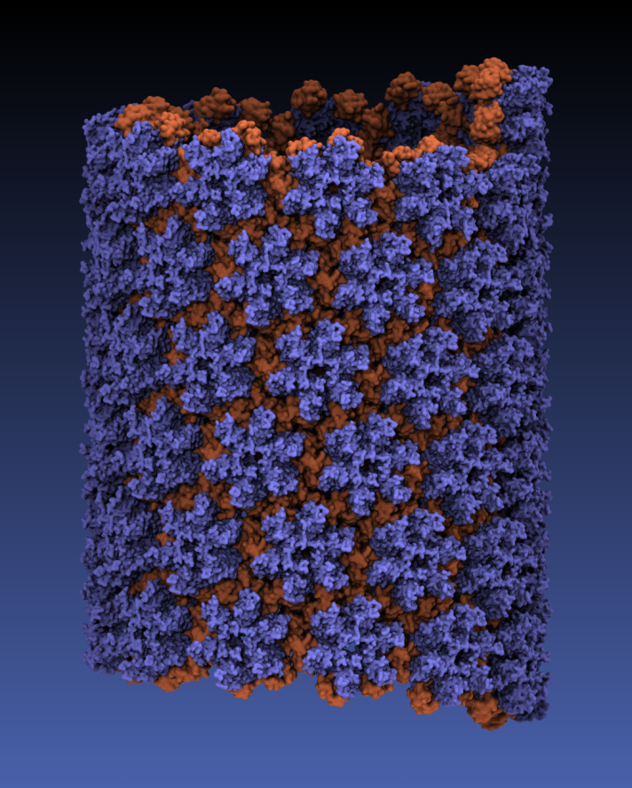

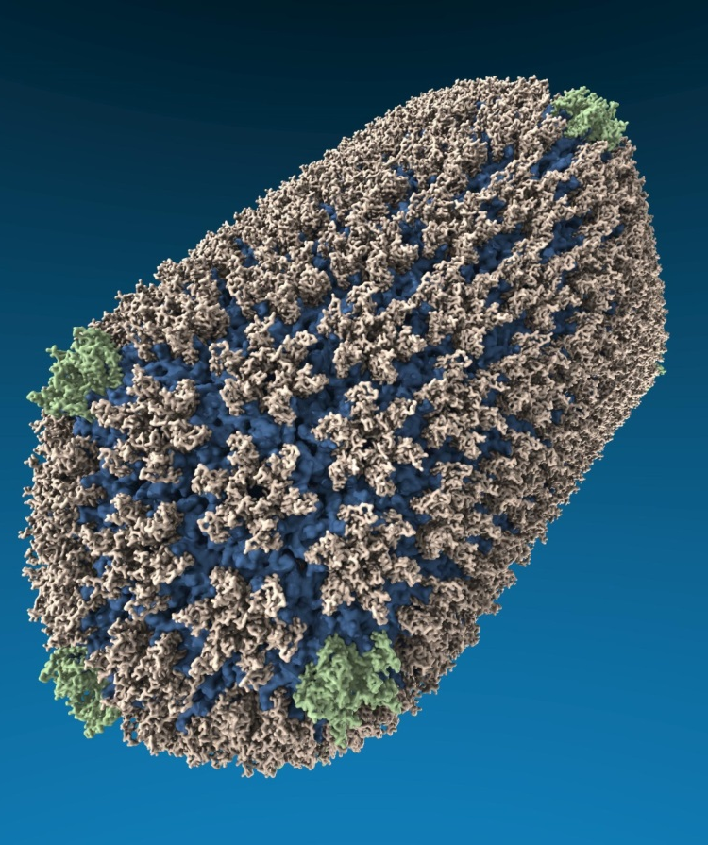
VMD “QuickSurf” Representation, Ray Tracing
All-atom HIV capsid simulations w/ up to 64M atoms on Blue Waters

Slide 30
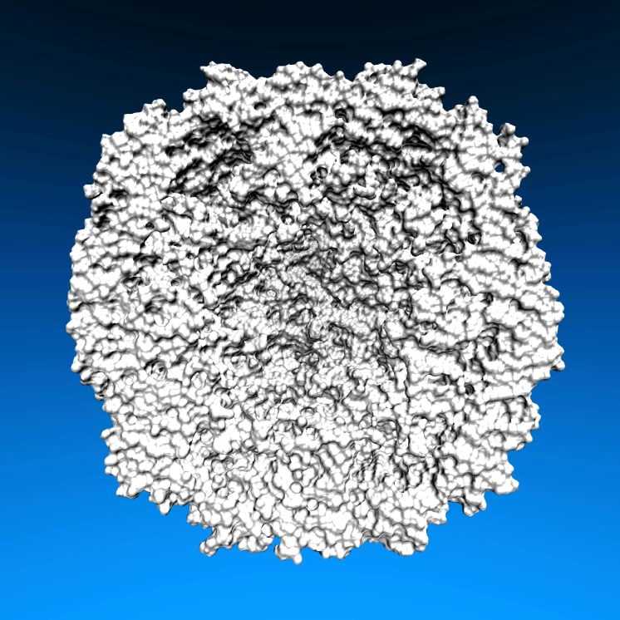


Lighting Comparison, STMV Capsid
Two lights, no shadows
Two lights, hard shadows, 1 shadow ray per light
Ambient occlusion + two lights, 144 AO rays/hit

Slide 31

VMD Chromatophore Rendering on Blue Waters
New representations, GPU-accelerated molecular surface calculations, memory-efficient algorithms for huge complexes
VMD GPU-accelerated ray tracing engine w/ OptiX+CUDA+MPI+Pthreads
Each revision: 7,500 frames render on ~96 Cray XK7 nodes in 290 node-hours, 45GB of images prior to editing
GPU-Accelerated Molecular Visualization on Petascale Supercomputing Platforms. J. E. Stone, K. L. Vandivort, and K. Schulten. UltraVis’13, 2013.
Visualization of Energy Conversion Processes in a Light Harvesting Organelle at Atomic Detail. M. Sener, et al. SC'14 Visualization and Data Analytics Showcase, 2014. ***Winner of the SC'14 Visualization and Data Analytics Showcase

Slide 32

VMD 1.9.3+OptiX 3.9 –
~1.5x Performance Increase on Blue Waters Supercomputer
OptiX GPU-native “Trbvh” acceleration structure builder yields substantial perf increase vs. CPU builders running on Opteron 6276 CPUs
New optimizations in VMD TachyonL-OptiX RT engine:
  CUDA C++ Template specialization of RT kernels
    Combinatorial expansion of ray-gen and shading kernels at compile-time: stereo on/off, AO on/off, depth-of-field on/off, reflections on/off, etc…
    Optimal kernels selected from expansions at runtime
  Streamlined OptiX context and state management
  Optimization of GPU-specific RT intersection routines, memory layout
Atomic Detail Visualization of Photosynthetic Membranes with GPU-Accelerated Ray Tracing. J. E. Stone et al., J. Parallel Computing, 2016.
VMD/OptiX GPU Ray Tracing of chromatophore w/ lipids.

Slide 33

VMD 1.9.3
HIV-1 Parallel Movie Rendering on Blue Waters Cray XE6/XK7
New VMD 1.9.3: TachyonL-OptiX on XK7 vs. Tachyon on XE6, K20X GPUs yield up to twelve times geom+ray tracing speedup
Ray Tracer Version | Node Type and Count | Script Load | State Load | Geometry + Ray Tracing | Total Time
New TachyonL-OptiX [2] | 64 XK7 Tesla K20X GPUs | 2 s | 39 s | 435 s | 476 s
New TachyonL-OptiX [2] | 128 XK7 Tesla K20X GPUs | 3 s | 62 s | 230 s | 295 s
TachyonL-OptiX [1] | 64 XK7 Tesla K20X GPUs | 2 s | 38 s | 655 s | 695 s
TachyonL-OptiX [1] | 128 XK7 Tesla K20X GPUs | 4 s | 74 s | 331 s | 410 s
TachyonL-OptiX [1] | 256 XK7 Tesla K20X GPUs | 7 s | 110 s | 171 s | 288 s
Tachyon [1] | 256 XE6 CPUs | 7 s | 160 s | 1,374 s | 1,541 s
Tachyon [1] | 512 XE6 CPUs | 13 s | 211 s | 808 s | 1,032 s
[1] GPU-Accelerated Molecular Visualization on Petascale Supercomputing Platforms. J. E. Stone, K. L. Vandivort, and K. Schulten. UltraVis'13: Proceedings of the 8th International Workshop on Ultrascale Visualization, pp. 6:1-6:8, 2013.
[2] Atomic Detail Visualization of Photosynthetic Membranes with GPU-Accelerated Ray Tracing. J. E. Stone et al., J. Parallel Computing, 2016 (in-press)

Slide 34

VMD TachyonL-OptiX Interactive Ray Tracing Engine
Scene Graph
RT Rendering Pass
Seed RNGs
Accumulate RT samples
Accum. Buf
Normalize+copy accum. buf
TrBvh RT Acceleration Structure
Compute ave. FPS,
adjust RT samples per pass
Output Framebuffer

Slide 35

Interactive RT of All-Atom
Minimal Cell Envelope
200 nm spherical envelope
Membrane with ~50% occupancy by proteins (2000x Aquaporin channels)
42M atoms in membrane
Interactive RT w/ 2 dir. lights and AO on GeForce Titan X @ ~12 FPS
Complete model with correct proteins, solvent, etc, will contain billions of atoms

Slide 36

Immersive Molecular Visualization with Omnidirectional Stereoscopic Ray Tracing and Remote Rendering. J. E. Stone, W. R. Sherman, and K. Schulten. High Performance Data Analysis and Visualization Workshop, IEEE International Parallel and Distributed Processing Symposium Workshops (IPDPSW), 2016. (In-press)

Slide 37

Optimizing VMD for Speed+Power Consumption

Slide 38
Molecular Orbitals w/ JIT Kernel Generation
Visualization of MOs aids in understanding the chemistry of molecular system
MO spatial distribution is correlated with probability density for an electron(s)
Animation of (classical mechanics) molecular dynamics trajectories provides insight into simulation results
  To do the same for QM or QM/MM simulations MOs must be computed at 10 FPS or more
  Large GPU speedups (up to 30x vs. 4-core CPU) over existing tools makes this possible!
Run-time code generation (JIT) and compilation via CUDA 7.0 NVRTC enable further optimizations and the highest performance to date: 1.8x faster than previous best result
C₆₀
High Performance Computation and Interactive Display of Molecular Orbitals on GPUs and Multi-core CPUs. J. E. Stone, J. Saam, D. Hardy, K. Vandivort, W. Hwu, K. Schulten, 2nd Workshop on General-Purpose Computation on Graphics Processing Units (GPGPU-2), ACM International Conference Proceeding Series, volume 383, pp. 9-18, 2009.
Notes:
38
CBH – we should probably write “electron(s)”. Most people are used to closed shell calcs in which the MO contains 2 electrons; but open shell calcs are definitely on the rise in which each MO contains only 1 electron.

Slide 39
for (shell=0; shell < maxshell; shell++) {
float contracted_gto = 0.0f;
// Loop over the Gaussian primitives of CGTO
int maxprim = const_num_prim_per_shell[shell_counter];
int shell_type = const_shell_symmetry[shell_counter];
for (prim=0; prim < maxprim; prim++) {
float exponent = const_basis_array[prim_counter ];
float contract_coeff = const_basis_array[prim_counter + 1];
contracted_gto += contract_coeff * expf(-exponent*dist2);
prim_counter += 2;
}
General loop-based data-dependent MO CUDA kernel
Runtime-generated data-specific MO CUDA kernel compiled via CUDA 7.x NVRTC JIT…
contracted_gto = 1.832937 * expf(-7.868272*dist2);
contracted_gto += 1.405380 * expf(-1.881289*dist2);
contracted_gto += 0.701383 * expf(-0.544249*dist2);
1.8x Faster

Slide 40

VMD-Next: Coming Soon
Improved structure building tools
Many new and updated user-contributed plugins
Further integration of interactive ray tracing into VMD
  Seamless interactive RT in main VMD display window
  Support trajectory playback in interactive RT
  Enable multi-node interactive RT on HPC systems
  Improved movie making tools, off-screen OpenGL movie rendering, parallel movie rendering:
  EGL for parallel graphics w/o X11 server
  Built-in (basic) interactive remote visualization on HPC clusters and supercomputers
  Much work to do on VR user interfaces, multi-user collaborative visualization, …
GPU Ray Tracing of
HIV-1 Capsid Detail

Slide 41
Acknowledgements
Theoretical and Computational Biophysics Group, University of Illinois at Urbana-Champaign
NVIDIA CUDA Center of Excellence, University of Illinois at Urbana-Champaign
NVIDIA CUDA team
NVIDIA OptiX team
NCSA Blue Waters Team
Funding:
  DOE INCITE, ORNL Titan: DE-AC05-00OR22725
  NSF Blue Waters: NSF OCI 07-25070, PRAC “The Computational Microscope”, ACI-1238993, ACI-1440026
  NIH support: 9P41GM104601, 5R01GM098243-02
Notes:
41

Slide 42


Slide 43
Related Publications http://www.ks.uiuc.edu/Research/gpu/
Immersive Molecular Visualization with Omnidirectional Stereoscopic Ray Tracing and Remote Rendering. John E. Stone, William R. Sherman, and Klaus Schulten.High Performance Data Analysis and Visualization Workshop, IEEE International Parallel and Distributed Processing Symposium Workshop (IPDPSW), 2016. (In-press)
High Performance Molecular Visualization: In-Situ and Parallel Rendering with EGL. John E. Stone, Peter Messmer, Robert Sisneros, and Klaus Schulten.High Performance Data Analysis and Visualization Workshop, IEEE International Parallel and Distributed Processing Symposium Workshop (IPDPSW), 2016. (In-press)
Evaluation of Emerging Energy-Efficient Heterogeneous Computing Platforms for Biomolecular and Cellular Simulation Workloads. John E. Stone, Michael J. Hallock, James C. Phillips, Joseph R. Peterson, Zaida Luthey-Schulten, and Klaus Schulten.25th International Heterogeneity in Computing Workshop, IEEE International Parallel and Distributed Processing Symposium Workshop (IPDPSW), 2016. (In-press)
Atomic Detail Visualization of Photosynthetic Membranes with GPU-Accelerated Ray Tracing. J. E. Stone, M. Sener, K. L. Vandivort, A. Barragan, A. Singharoy, I. Teo, J. V. Ribeiro, B. Isralewitz, B. Liu, B.-C. Goh, J. C. Phillips, C. MacGregor-Chatwin, M. P. Johnson, L. F. Kourkoutis, C. Neil Hunter, and K. Schulten. J. Parallel Computing, 2016. (In-press)
Chemical Visualization of Human Pathogens: the Retroviral Capsids. Juan R. Perilla, Boon Chong Goh, John E. Stone, and Klaus SchultenSC'15 Visualization and Data Analytics Showcase, 2015.

Slide 44
Related Publications http://www.ks.uiuc.edu/Research/gpu/
Visualization of Energy Conversion Processes in a Light Harvesting Organelle at Atomic Detail. M. Sener, J. E. Stone, A. Barragan, A. Singharoy, I. Teo, K. L. Vandivort, B. Isralewitz, B. Liu, B. Goh, J. C. Phillips, L. F. Kourkoutis, C. N. Hunter, and K. Schulten. SC'14 Visualization and Data Analytics Showcase, 2014. ***Winner of the SC'14 Visualization and Data Analytics Showcase
Runtime and Architecture Support for Efficient Data Exchange in Multi-Accelerator Applications. J. Cabezas, I. Gelado, J. E. Stone, N. Navarro, D. B. Kirk, and W. Hwu. IEEE Transactions on Parallel and Distributed Systems, 2014. (In press)
Unlocking the Full Potential of the Cray XK7 Accelerator. M. D. Klein and J. E. Stone. Cray Users Group, Lugano Switzerland, May 2014.
GPU-Accelerated Analysis and Visualization of Large Structures Solved by Molecular Dynamics Flexible Fitting. J. E. Stone, R. McGreevy, B. Isralewitz, and K. Schulten. Faraday Discussions, 169:265-283, 2014.
Simulation of reaction diffusion processes over biologically relevant size and time scales using multi-GPU workstations. M. J. Hallock, J. E. Stone, E. Roberts, C. Fry, and Z. Luthey-Schulten. Journal of Parallel Computing, 40:86-99, 2014.

Slide 45
Related Publications http://www.ks.uiuc.edu/Research/gpu/
GPU-Accelerated Molecular Visualization on Petascale Supercomputing Platforms. J. Stone, K. L. Vandivort, and K. Schulten. UltraVis'13: Proceedings of the 8th International Workshop on Ultrascale Visualization, pp. 6:1-6:8, 2013.
Early Experiences Scaling VMD Molecular Visualization and Analysis Jobs on Blue Waters. J. Stone, B. Isralewitz, and K. Schulten. In proceedings, Extreme Scaling Workshop, 2013.
Lattice Microbes: High‐performance stochastic simulation method for the reaction‐diffusion master equation. E. Roberts, J. Stone, and Z. Luthey‐Schulten.
J. Computational Chemistry 34 (3), 245-255, 2013.
Fast Visualization of Gaussian Density Surfaces for Molecular Dynamics and Particle System Trajectories. M. Krone, J. Stone, T. Ertl, and K. Schulten. EuroVis Short Papers, pp. 67-71, 2012.
Immersive Out-of-Core Visualization of Large-Size and Long-Timescale Molecular Dynamics Trajectories. J. Stone, K. L. Vandivort, and K. Schulten. G. Bebis et al. (Eds.): 7th International Symposium on Visual Computing (ISVC 2011), LNCS 6939, pp. 1-12, 2011.
Fast Analysis of Molecular Dynamics Trajectories with Graphics Processing Units – Radial Distribution Functions. B. Levine, J. Stone, and A. Kohlmeyer. J. Comp. Physics, 230(9):3556-3569, 2011.

Slide 46
Related Publications http://www.ks.uiuc.edu/Research/gpu/
Quantifying the Impact of GPUs on Performance and Energy Efficiency in HPC Clusters. J. Enos, C. Steffen, J. Fullop, M. Showerman, G. Shi, K. Esler, V. Kindratenko, J. Stone, J Phillips. International Conference on Green Computing, pp. 317-324, 2010.
GPU-accelerated molecular modeling coming of age. J. Stone, D. Hardy, I. Ufimtsev, K. Schulten. J. Molecular Graphics and Modeling, 29:116-125, 2010.
OpenCL: A Parallel Programming Standard for Heterogeneous Computing. J. Stone, D. Gohara, G. Shi. Computing in Science and Engineering, 12(3):66-73, 2010.
An Asymmetric Distributed Shared Memory Model for Heterogeneous Computing Systems. I. Gelado, J. Stone, J. Cabezas, S. Patel, N. Navarro, W. Hwu. ASPLOS ’10: Proceedings of the 15th International Conference on Architectural Support for Programming Languages and Operating Systems, pp. 347-358, 2010.

Slide 47
Related Publications http://www.ks.uiuc.edu/Research/gpu/
GPU Clusters for High Performance Computing. V. Kindratenko, J. Enos, G. Shi, M. Showerman, G. Arnold, J. Stone, J. Phillips, W. Hwu. Workshop on Parallel Programming on Accelerator Clusters (PPAC), In Proceedings IEEE Cluster 2009, pp. 1-8, Aug. 2009.
Long time-scale simulations of in vivo diffusion using GPU hardware. E. Roberts, J. Stone, L. Sepulveda, W. Hwu, Z. Luthey-Schulten. In IPDPS’09: Proceedings of the 2009 IEEE International Symposium on Parallel & Distributed Computing, pp. 1-8, 2009.
High Performance Computation and Interactive Display of Molecular Orbitals on GPUs and Multi-core CPUs. J. Stone, J. Saam, D. Hardy, K. Vandivort, W. Hwu, K. Schulten, 2nd Workshop on General-Purpose Computation on Graphics Pricessing Units (GPGPU-2), ACM International Conference Proceeding Series, volume 383, pp. 9-18, 2009.
Probing Biomolecular Machines with Graphics Processors. J. Phillips, J. Stone. Communications of the ACM, 52(10):34-41, 2009.
Multilevel summation of electrostatic potentials using graphics processing units. D. Hardy, J. Stone, K. Schulten. J. Parallel Computing, 35:164-177, 2009.

Slide 48
Related Publications http://www.ks.uiuc.edu/Research/gpu/
Adapting a message-driven parallel application to GPU-accelerated clusters. J. Phillips, J. Stone, K. Schulten. Proceedings of the 2008 ACM/IEEE Conference on Supercomputing, IEEE Press, 2008.
GPU acceleration of cutoff pair potentials for molecular modeling applications. C. Rodrigues, D. Hardy, J. Stone, K. Schulten, and W. Hwu. Proceedings of the 2008 Conference On Computing Frontiers, pp. 273-282, 2008.
GPU computing. J. Owens, M. Houston, D. Luebke, S. Green, J. Stone, J. Phillips. Proceedings of the IEEE, 96:879-899, 2008.
Accelerating molecular modeling applications with graphics processors. J. Stone, J. Phillips, P. Freddolino, D. Hardy, L. Trabuco, K. Schulten. J. Comp. Chem., 28:2618-2640, 2007.
Continuous fluorescence microphotolysis and correlation spectroscopy. A. Arkhipov, J. Hüve, M. Kahms, R. Peters, K. Schulten. Biophysical Journal, 93:4006-4017, 2007.

