Slide 1
S5371—VMD: Visualization and Analysis of Biomolecular Complexes with GPU Computing
John E. Stone
Theoretical and Computational Biophysics Group
Beckman Institute for Advanced Science and Technology
University of Illinois at Urbana-Champaign
http://www.ks.uiuc.edu/Research/gpu/
S5371, GPU Technology Conference
9:00-9:50, Room LL21C, San Jose Convention Center,
San Jose, CA, Wednesday March 18, 2015

Slide 2
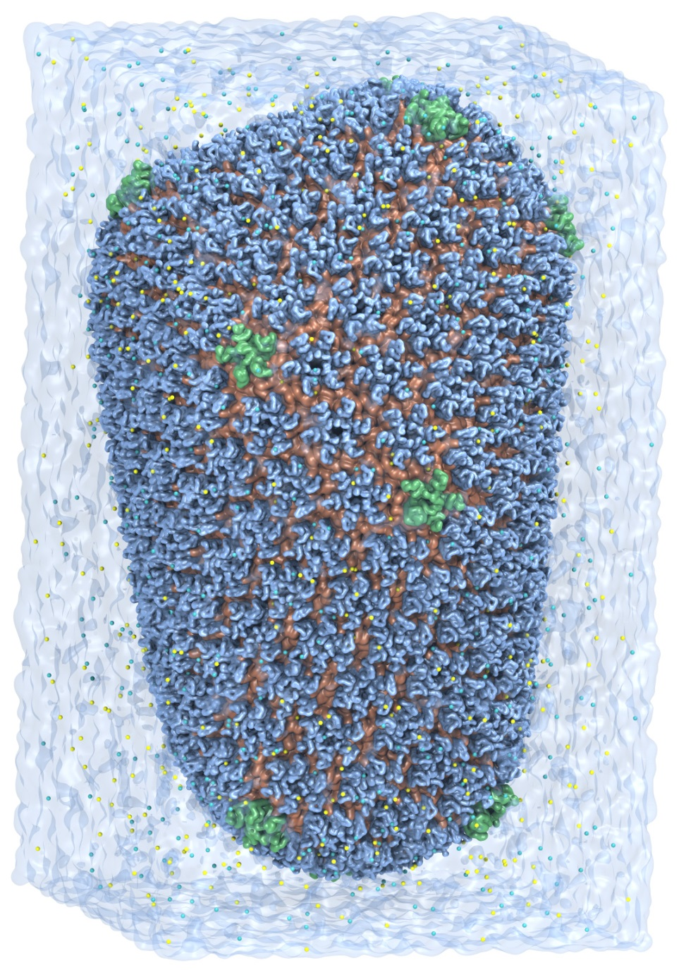
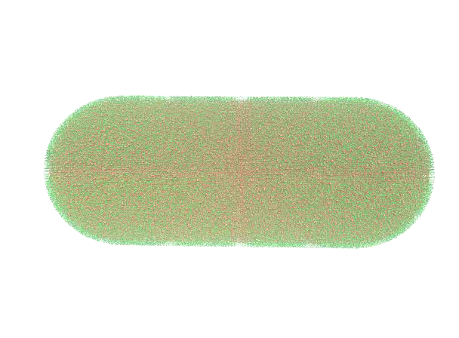
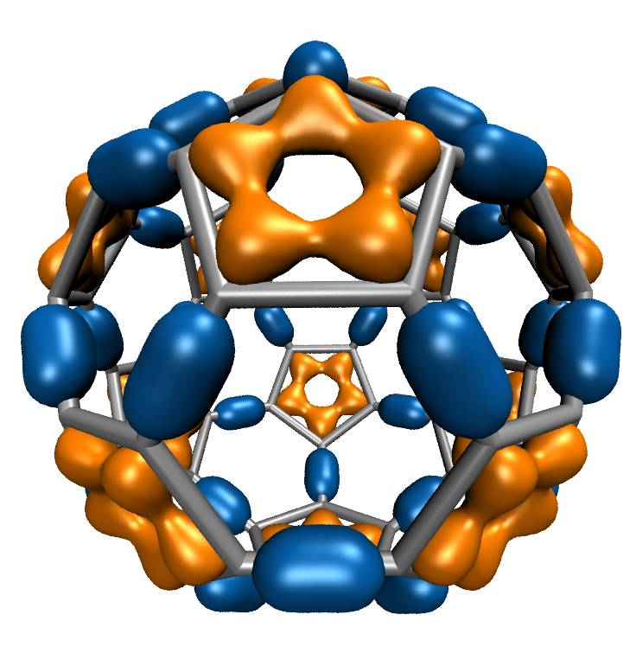
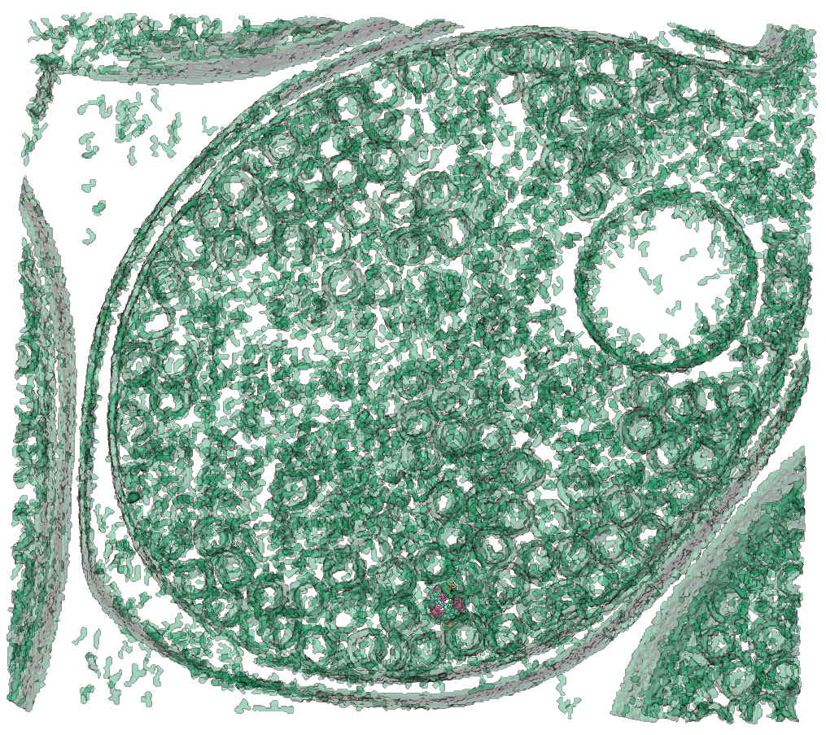
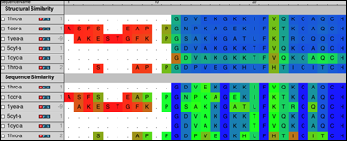
VMD – “Visual Molecular Dynamics”
Visualization and analysis of:
molecular dynamics simulations
particle systems and whole cells
cryoEM densities, volumetric data
quantum chemistry calculations
sequence information
User extensible w/ scripting and plugins
http://www.ks.uiuc.edu/Research/vmd/
Whole Cell Simulation
MD Simulations
CryoEM, Cellular Tomography
Sequence Data
Quantum Chemistry

Slide 3
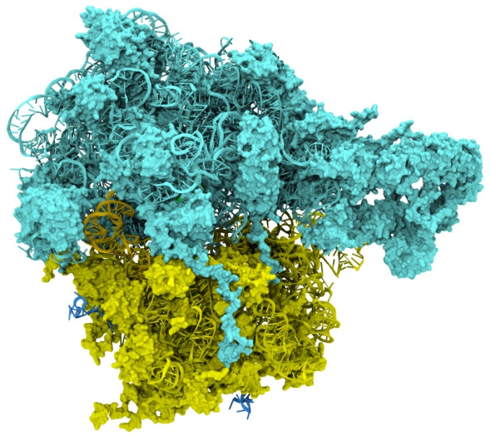
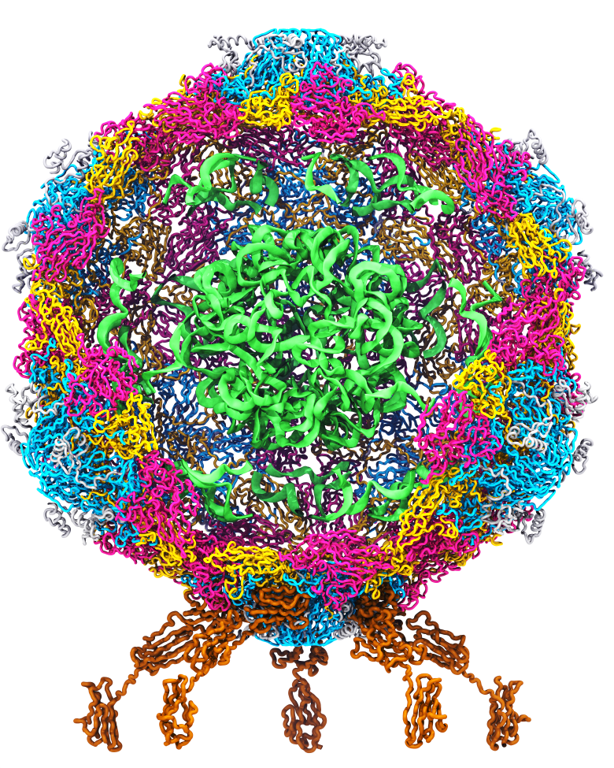
Goal: A Computational Microscope
Study the molecular machines in living cells
Ribosome: target for antibiotics
Poliovirus
Notes:
Ribosomes synthesize new proteins from genetic information
Bacterial ribosome is a target for antibiotics, which interfere with its ability to function by binding to sites on the structure, preventing proteins from being synthesized
Ribosome simulations are extremely computationally challenging due to the size of the structure and its natural environment (solvent, ions, etc, large box, 3 million atoms or so)
Bionanodevice for sequencing DNA efficiently
Knowledge of an individual’s genetic makeup can lead to the prediction and treatment of many diseases by the means of personal genomic medicine and pharmacogenomics. In order for genome sequencing to become practical for common medical use, an inexpensive high throughput genome sequencing technique is required. NIH has set a goal of reducing the cost of genome sequencing by a factor of 10,000, to less than $1,000 within ten years.
The computer is the best microscope to guide the development of bionanodevices, for example to sequence DNA. While experiments can measure DNA electrostatic potentials, they cannot visualize the DNA’s location and conformation at the time of measurement.

Slide 4
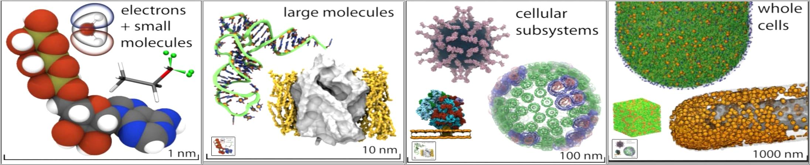
VMD Interoperability Serves Many Communities
VMD 1.9.1 user statistics:
100,000 unique registered users from all over the world
Uniquely interoperable with a broad range of tools: AMBER, CHARMM, CPMD, DL_POLY, GAMESS, GROMACS, HOOMD, LAMMPS, NAMD, and many more …
Supports key data types, file formats, and databases, e.g. electron microscopy, quantum chemistry, MD trajectories, sequence alignments, super resolution light microscopy
Incorporates tools for simulation preparation, visualization, and analysis

Slide 5
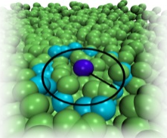
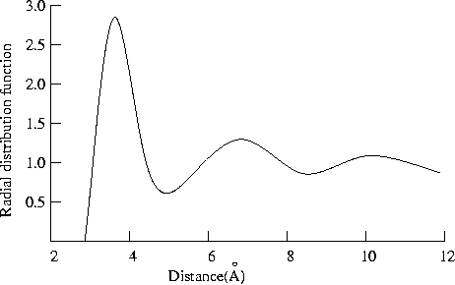
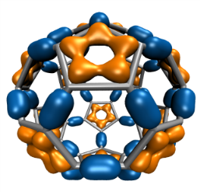
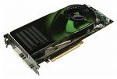
CUDA GPU-Accelerated Trajectory Analysis and Visualization in VMD
VMD GPU-Accelerated Feature or GPU Kernel | Exemplary speedup vs. contemporary 4-core CPU
Molecular orbital display | 30x
Radial distribution function | 23x
Molecular surface display | 15x
Electrostatic field calculation | 11x
Ray tracing w/ shadows, AO lighting | 7x
cryoEM cross correlation quality-of-fit | 7x
Ion placement | 6x
MDFF density map synthesis | 6x
Implicit ligand sampling | 6x
Root mean squared fluctuation | 6x
Radius of gyration | 5x
Close contact determination | 5x
Dipole moment calculation | 4x

Slide 6
Molecular Orbitals w/ NVRTC JIT
Visualization of MOs aids in understanding the chemistry of molecular system
MO spatial distribution is correlated with probability density for an electron(s)
Animation of (classical mechanics) molecular dynamics trajectories provides insight into simulation results
To do the same for QM or QM/MM simulations MOs must be computed at 10 FPS or more
Large GPU speedups (up to 30x vs. 4-core CPU) over existing tools makes this possible!
Run-time code generation (JIT) and compilation via CUDA 7.0 NVRTC enable further optimizations and the highest performance to date: 1.8x faster than previous best result
C₆₀
High Performance Computation and Interactive Display of Molecular Orbitals on GPUs and Multi-core CPUs. J. E. Stone, J. Saam, D. Hardy, K. Vandivort, W. Hwu, K. Schulten, 2nd Workshop on General-Purpose Computation on Graphics Processing Units (GPGPU-2), ACM International Conference Proceeding Series, volume 383, pp. 9-18, 2009.
Notes:
6
CBH – we should probably write “electron(s)”. Most people are used to closed shell calcs in which the MO contains 2 electrons; but open shell calcs are definitely on the rise in which each MO contains only 1 electron.

Slide 7
MO GPU Parallel Decomposition
MO 3-D lattice decomposes into 2-D slices (CUDA grids)
…
GPU 2
GPU 1
GPU 0
Small 8x8 thread blocks afford large
per-thread register count, shared memory
Lattice computed using multiple GPUs
0,0
0,1
…
Threads producing results that are used
Each thread computes one MO lattice point.
1,0
1,1
…
…
…
…
Padding optimizes global memory performance, guaranteeing coalesced global memory accesses
Threads producing results that are discarded
Grid of thread blocks
Notes:
Threads in a thread block (potentially) execute in parallel
Threads in a block can communicate via fast shared memory
Global memory reads are slow
Constant memory is fast, but can only be written by host at kernel startup.

Slide 8
MO Kernel for One Grid Point (Naive C)
…
for (at=0; at<numatoms; at++) {
int prim_counter = atom_basis[at];
calc_distances_to_atom(&atompos[at], &xdist, &ydist, &zdist, &dist2, &xdiv);
for (contracted_gto=0.0f, shell=0; shell < num_shells_per_atom[at]; shell++) {
int shell_type = shell_symmetry[shell_counter];
for (prim=0; prim < num_prim_per_shell[shell_counter]; prim++) {
float exponent = basis_array[prim_counter ];
float contract_coeff = basis_array[prim_counter + 1];
contracted_gto += contract_coeff * expf(-exponent*dist2);
prim_counter += 2;
}
for (tmpshell=0.0f, j=0, zdp=1.0f; j<=shell_type; j++, zdp*=zdist) {
int imax = shell_type - j;
for (i=0, ydp=1.0f, xdp=pow(xdist, imax); i<=imax; i++, ydp*=ydist, xdp*=xdiv)
tmpshell += wave_f[ifunc++] * xdp * ydp * zdp;
}
value += tmpshell * contracted_gto;
shell_counter++;
}
} …..
Loop over atoms
Loop over shells
Loop over primitives: largest component of runtime, due to expf()
Loop over angular momenta
(unrolled in real code)

Slide 9
MO Kernel Structure, Opportunity for NRTC JIT… Data-driven execution, but representative loop trip counts in (…)
Loop over atoms (1 to ~200) {
Loop over electron shells for this atom type (1 to ~6) {
Loop over primitive functions for this shell type (1 to ~6) {
}
Small loop trip counts result in significant loop overhead. Runtime kernel generation and NVRTC JIT compilation can achieve in a large (1.8x!) speed boost via loop unrolling, constant folding, elimination of array accesses, …
Loop over angular momenta for this shell type (1 to ~15) {}
}
}
Notes:
9
expf() is very costly on the CPU, often several hundred clock cycles
On GPUs expf() is implemented as a native machine instruction executing in just tens of clock cycles which gives us a huge performance boost all by itself, but the other large component of GPU performance comes from the massive parallelism.
We can launch a calculation on tens of thousands of grid points at once on the GPU, fully utilizing all of its hardware.
CBH – much better. I modifited “shells” to “electron shells” and “primitives” to “primitive functions”

Slide 10
Molecular Orbital Computation and Display Process Runtime Kernel Generation, NVRTC Just-In-Time (JIT) Compilation
One-time initialization
Read QM simulation log file, trajectory
Preprocess MO coefficient data
eliminate duplicates, sort by type, etc…
Initialize Pool of GPU
Worker Threads
Generate/compile basis set-specific CUDA kernel
For current frame and MO index,
retrieve MO wavefunction coefficients
Compute 3-D grid of MO wavefunction amplitudes
using basis set-specific CUDA kernel
For each trj frame, for each MO shown
Extract isosurface mesh from 3-D MO grid
Render the resulting surface

Slide 11
for (shell=0; shell < maxshell; shell++) {
float contracted_gto = 0.0f;
// Loop over the Gaussian primitives of CGTO
int maxprim = const_num_prim_per_shell[shell_counter];
int shell_type = const_shell_symmetry[shell_counter];
for (prim=0; prim < maxprim; prim++) {
float exponent = const_basis_array[prim_counter ];
float contract_coeff = const_basis_array[prim_counter + 1];
contracted_gto += contract_coeff * expf(-exponent*dist2);
prim_counter += 2;
}
General loop-based data-dependent MO CUDA kernel
Runtime-generated data-specific MO CUDA kernel compiled via CUDA 7.0 NVRTC JIT…
contracted_gto = 1.832937 * expf(-7.868272*dist2);
contracted_gto += 1.405380 * expf(-1.881289*dist2);
contracted_gto += 0.701383 * expf(-0.544249*dist2);
1.8x Faster

Slide 12
for (shell=0; shell < maxshell; shell++) {
float contracted_gto = 0.0f;
// Loop over the Gaussian primitives of CGTO
int maxprim = const_num_prim_per_shell[shell_counter];
int shell_type = const_shell_symmetry[shell_counter];
for (prim=0; prim < maxprim; prim++) {
float exponent = const_basis_array[prim_counter ];
float contract_coeff = const_basis_array[prim_counter + 1];
contracted_gto += contract_coeff * expf(-exponent*dist2);
prim_counter += 2;
}
float tmpshell=0;
switch (shell_type) {
case S_SHELL:
value += const_wave_f[ifunc++] * contracted_gto;
break;
[…..]
case D_SHELL:
tmpshell += const_wave_f[ifunc++] * xdist2;
tmpshell += const_wave_f[ifunc++] * ydist2;
tmpshell += const_wave_f[ifunc++] * zdist2;
tmpshell += const_wave_f[ifunc++] * xdist * ydist;
tmpshell += const_wave_f[ifunc++] * xdist * zdist;
tmpshell += const_wave_f[ifunc++] * ydist * zdist;
value += tmpshell * contracted_gto;
break;
contracted_gto = 1.832937 * expf(-7.868272*dist2);
contracted_gto += 1.405380 * expf(-1.881289*dist2);
contracted_gto += 0.701383 * expf(-0.544249*dist2);
// P_SHELL
tmpshell = const_wave_f[ifunc++] * xdist;
tmpshell += const_wave_f[ifunc++] * ydist;
tmpshell += const_wave_f[ifunc++] * zdist;
value += tmpshell * contracted_gto;
contracted_gto = 0.187618 * expf(-0.168714*dist2);
// S_SHELL
value += const_wave_f[ifunc++] * contracted_gto;
contracted_gto = 0.217969 * expf(-0.168714*dist2);
// P_SHELL
tmpshell = const_wave_f[ifunc++] * xdist;
tmpshell += const_wave_f[ifunc++] * ydist;
tmpshell += const_wave_f[ifunc++] * zdist;
value += tmpshell * contracted_gto;
contracted_gto = 3.858403 * expf(-0.800000*dist2);
// D_SHELL
tmpshell = const_wave_f[ifunc++] * xdist2;
tmpshell += const_wave_f[ifunc++] * ydist2;
tmpshell += const_wave_f[ifunc++] * zdist2;
tmpshell += const_wave_f[ifunc++] * xdist * ydist;
tmpshell += const_wave_f[ifunc++] * xdist * zdist;
tmpshell += const_wave_f[ifunc++] * ydist * zdist;
value += tmpshell * contracted_gto;
General loop-based data-dependent MO CUDA kernel
Runtime-generated data-specific MO CUDA kernel compiled via CUDA 7.0 NVRTC JIT…
1.8x Faster

Slide 13
NAMD and VMD Use GPUs and Petascale Computing to Meet
Computational Biology’s Insatiable Demand for Processing Power

Slide 14
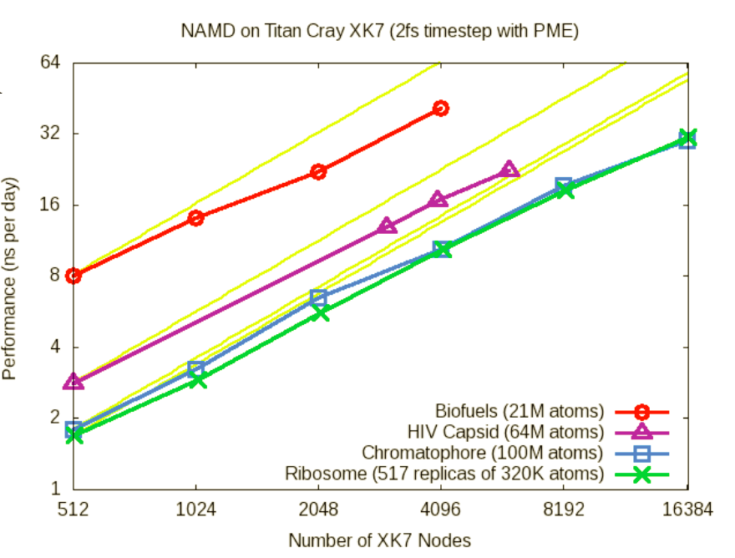
NAMD Titan XK7 Performance August 2013
NAMD XK7 vs. XE6
GPU Speedup: 2x-4x
HIV-1 Trajectory: ~1.2 TB/day @ 4096 XK7 nodes

Slide 15
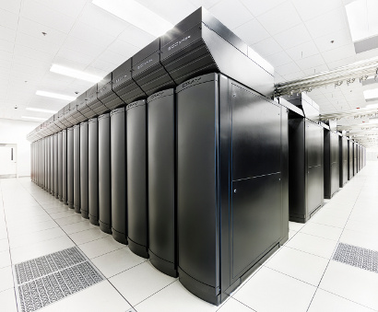
VMD Petascale Visualization and Analysis
Analyze/visualize large trajectories too large to transfer off-site:
User-defined parallel analysis operations, data types
Parallel rendering, movie making
Supports GPU-accelerated Cray XK7 nodes for both visualization and analysis:
GPU accelerated trajectory analysis w/ CUDA
OpenGL and GPU ray tracing for visualization and movie rendering
Parallel I/O rates up to 275 GB/sec on 8192 Cray XE6 nodes – can read in 231 TB in 15 minutes!
Parallel VMD currently available on:
ORNL Titan, NCSA Blue Waters, Indiana Big Red II, CSCS Piz Daint, and similar systems
NCSA Blue Waters Hybrid Cray XE6 / XK7
22,640 XE6 dual-Opteron CPU nodes
4,224 XK7 nodes w/ Telsa K20X GPUs

Slide 16
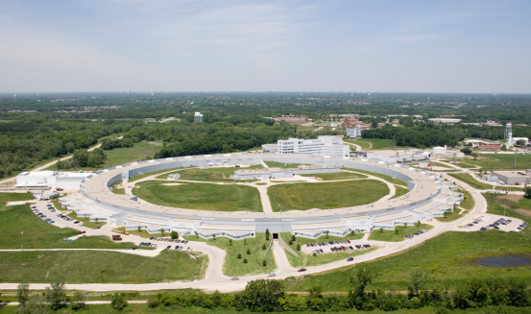
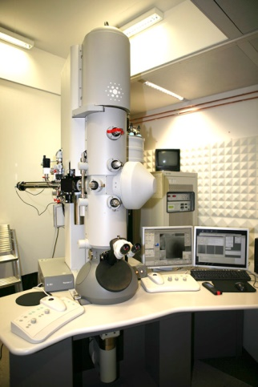
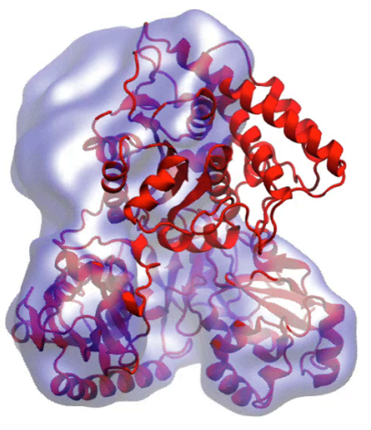
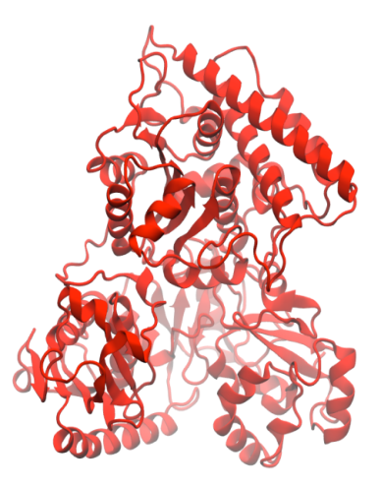
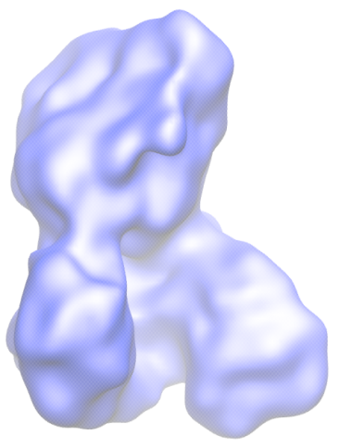
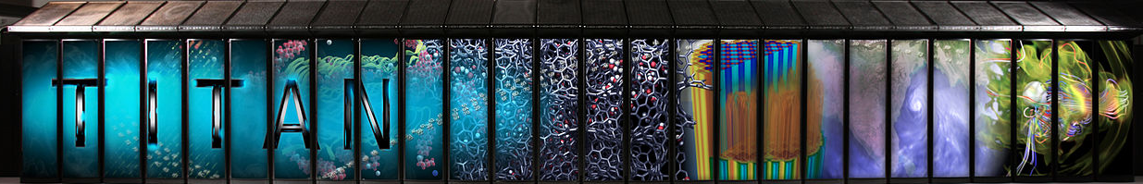
Molecular Dynamics Flexible Fitting (MDFF)
X-ray crystallography
MDFF
Electron microscopy
APS at Argonne
FEI microscope
ORNL Titan
Flexible fitting of atomic structures into electron microscopy maps using molecular dynamics.
L. Trabuco, E. Villa, K. Mitra, J. Frank, and K. Schulten. Structure, 16:673-683, 2008.
Acetyl - CoA Synthase

Slide 17
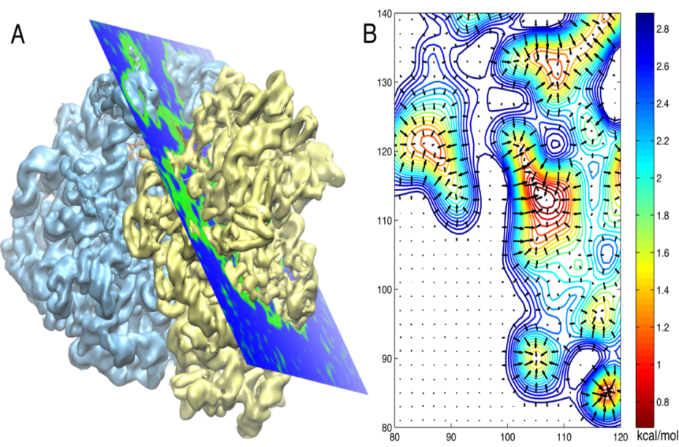

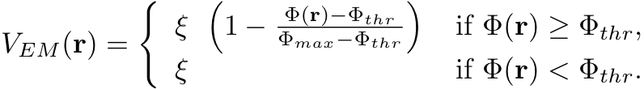
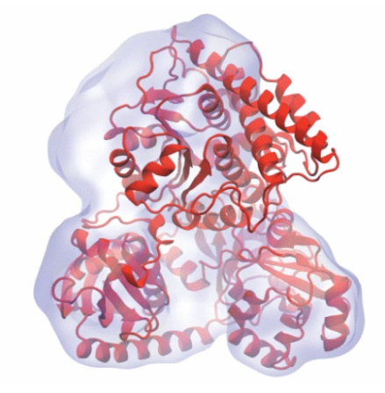
Molecular Dynamics Flexible Fitting - Theory
Two terms are added to the MD potential
An external potential derived from the EM map is defined on a grid as
A mass-weighted force is then applied to each atom

Slide 18
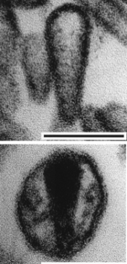
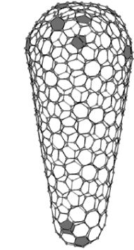
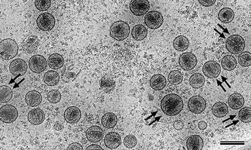
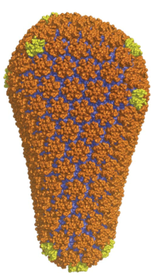
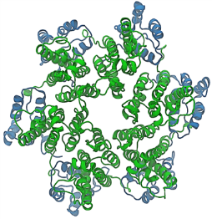
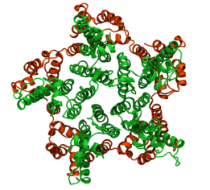
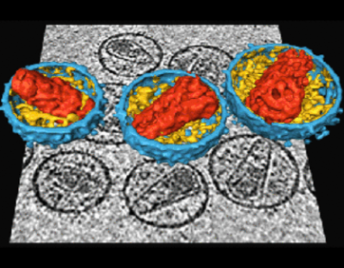
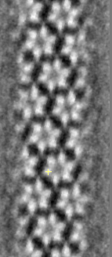
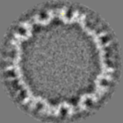
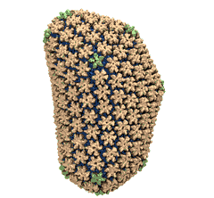
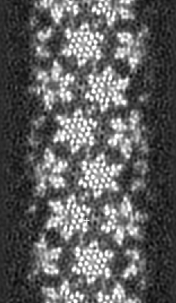
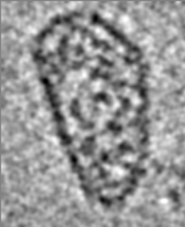
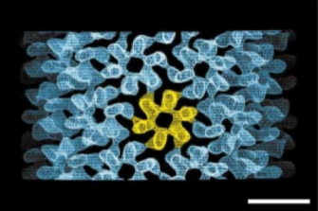
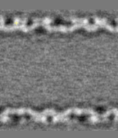
Structural Route to the all-atom HIV-1 Capsid
1st TEM (1999)
1st tomography (2003)
Crystal structures of separated hexamer and pentamer
Ganser et al. Science, 1999
Pornillos et al. , Cell 2009, Nature 2011
Briggs et al. EMBO J, 2003
High res. EM of hexameric tubule, tomography of capsid, all-atom model of capsid by MDFF w/ NAMD & VMD, NSF/NCSA Blue Waters computer at Illinois
Briggs et al. Structure, 2006
cryo-ET (2006)
hexameric tubule
Li et al., Nature, 2000
Byeon et al., Cell 2009
Zhao et al. , Nature 497: 643-646 (2013)

Slide 19
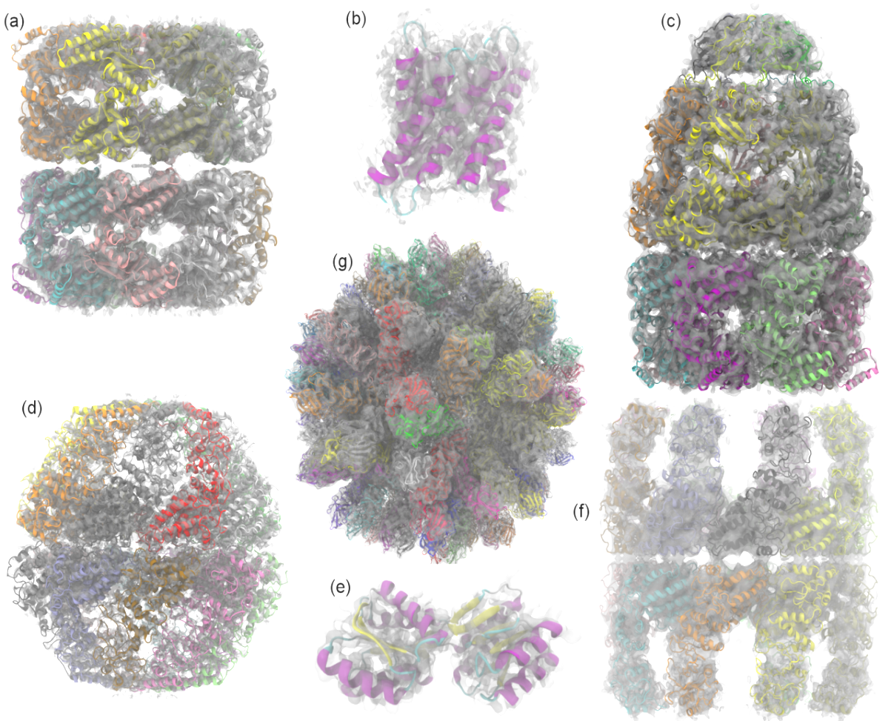
Evaluating Quality-of-Fit for Structures Solved by Hybrid Fitting Methods
Compute Pearson correlation to evaluate the fit of a reference cryo-EM density map with a simulated density map produced from an all-atom structure.

Slide 20
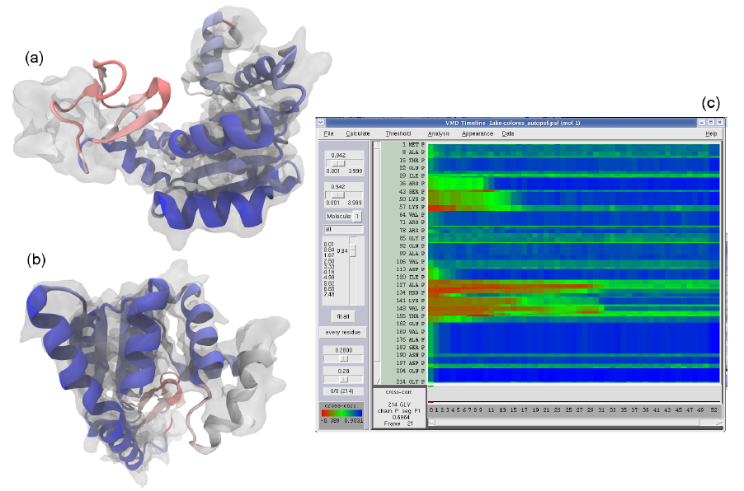
GPUs Can Reduce MDFF Trajectory Analysis Runtimes from Hours to Minutes
GPUs enable laptops and desktop workstations to handle tasks that would have previously required a cluster, or a very long wait…
GPU-accelerated petascale supercomputers enable analyses that were previously impractical, allowing detailed study of very large structures such as viruses
GPU-accelerated MDFF Cross Correlation Timeline
Regions with poor fit Regions with good fit

Slide 21
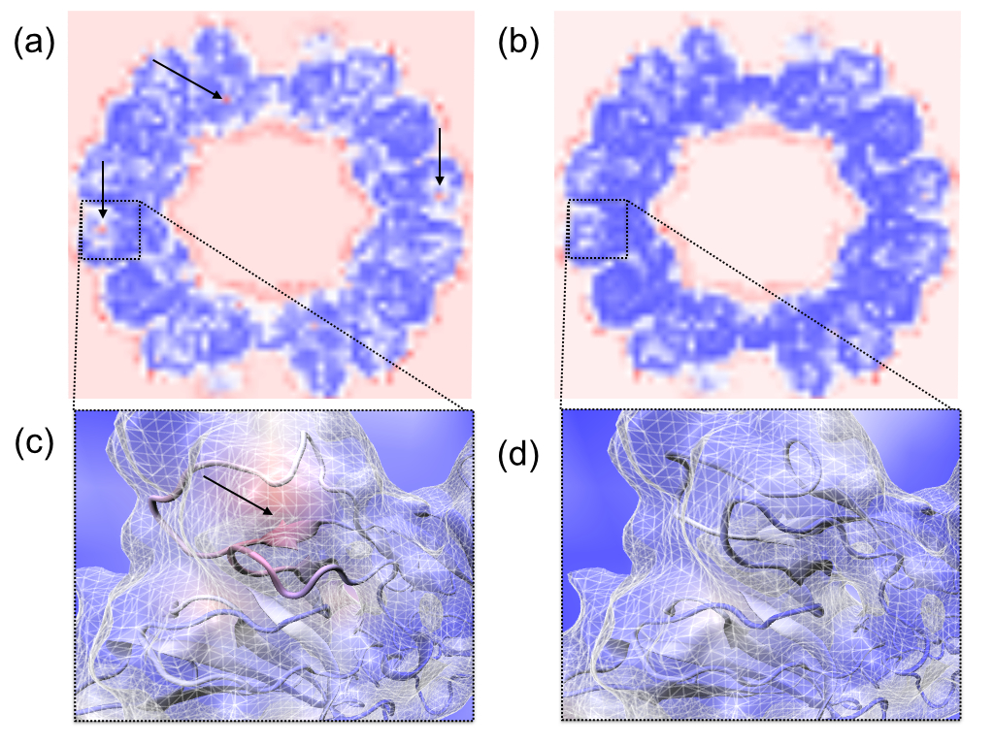

Slide 22
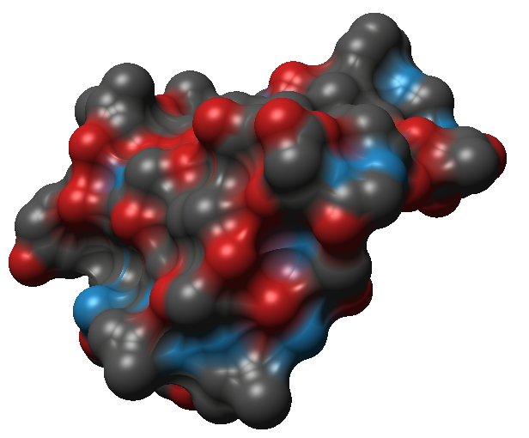
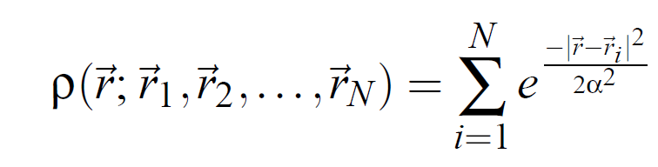
MDFF Density Map Algorithm
Build spatial acceleration data structures, optimize data for GPU
Compute 3-D density map:
Truncated Gaussian and spatial acceleration grid ensure linear time-complexity
3-D density map lattice point and the neighboring spatial acceleration cells it references

Slide 23
Single-Pass MDFF GPU Cross-Correlation
3-D density map decomposes into 3-D grid of 8x8x8 tiles containing CC partial sums and local CC values
Fusion of density and CC calculations into a single CUDA kernel!!!
Spatial CC map and overall CC value computed in a single pass
Small 8x8x2 CUDA thread blocks afford large
per-thread register count, shared memory
Each thread computes 4 z-axis density map lattice points and associated CC partial sums
0,0
0,1
…
Threads producing results that are used
1,0
1,1
…
…
…
…
Inactive threads, region of discarded output
Padding optimizes global memory performance, guaranteeing coalesced global memory accesses
Grid of thread blocks
Notes:
Threads in a thread block (potentially) execute in parallel
Threads in a block can communicate via fast shared memory
Global memory reads are slow
Constant memory is fast, but can only be written by host at kernel startup.

Slide 24
VMD GPU Cross Correlation Performance
 | RHDV | Mm-cpn open | GroEL | Aquaporin
Resolution (Å) | 6.5 | 8 | 4 | 3
Atoms | 702K | 61K | 54K | 1.6K
VMD-CUDA Quadro K6000 | 0.458s 34.6x | 0.06s 25.7x | 0.034s 36.8x | 0.007s 55.7x
VMD-CPU-SSE 32-threads, 2x Xeon E5-2687W | 0.779s 20.3x | 0.085s 18.1x | 0.159s 7.9x | 0.033s 11.8x
Chimera 1-thread Xeon E5-2687W | 15.86s 1.0x | 1.54s 1.0x | 1.25s 1.0x | 0.39s 1.0x
GPU-Accelerated Analysis and Visualization of Large Structures Solved by Molecular Dynamics Flexible Fitting. J. E. Stone, R. McGreevy, B. Isralewitz, and K. Schulten. Faraday Discussions 169:265-283, 2014.

Slide 25
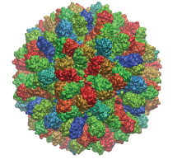
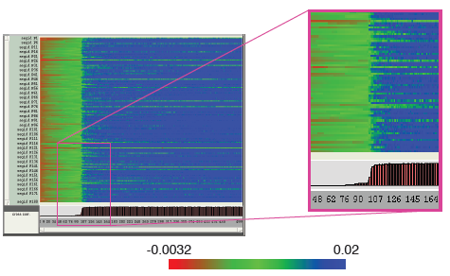
VMD RHDV Cross Correlation Timeline on Cray XK7
 | RHDV
Atoms | 702K
Traj. Frames | 10,000
Component Selections | 720
Single-node XK7 (projected) | 336 hours (14 days)
128-node XK7 | 3.2 hours 105x speedup
2048-node XK7 | 19.5 minutes 1035x speedup
RHDV
Group-relative CC Timeline
Calculation would take 5 years using original serial CC calculation on a workstation!

Slide 26
Visualization Goals, Challenges
Increased GPU acceleration for visualization of petascale molecular dynamics trajectories
Overcome GPU memory capacity limits, enable high quality visualization of >100M atom systems
Use GPU to accelerate not only interactive-rate visualizations, but also photorealistic ray tracing with artifact-free ambient occlusion lighting, etc.
Maintain ease-of-use, intimate link to VMD analytical features, atom selection language, etc.

Slide 27
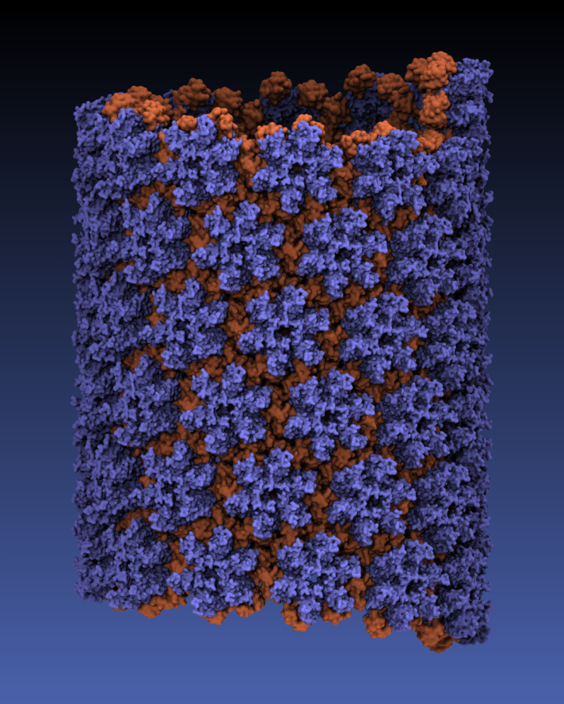

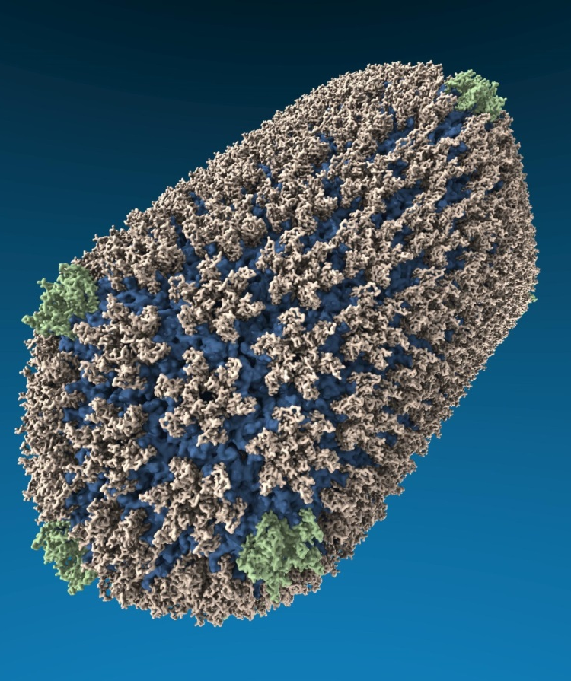
VMD “QuickSurf” Representation, Ray Tracing
All-atom HIV capsid simulations w/ up to 64M atoms on Blue Waters

Slide 28
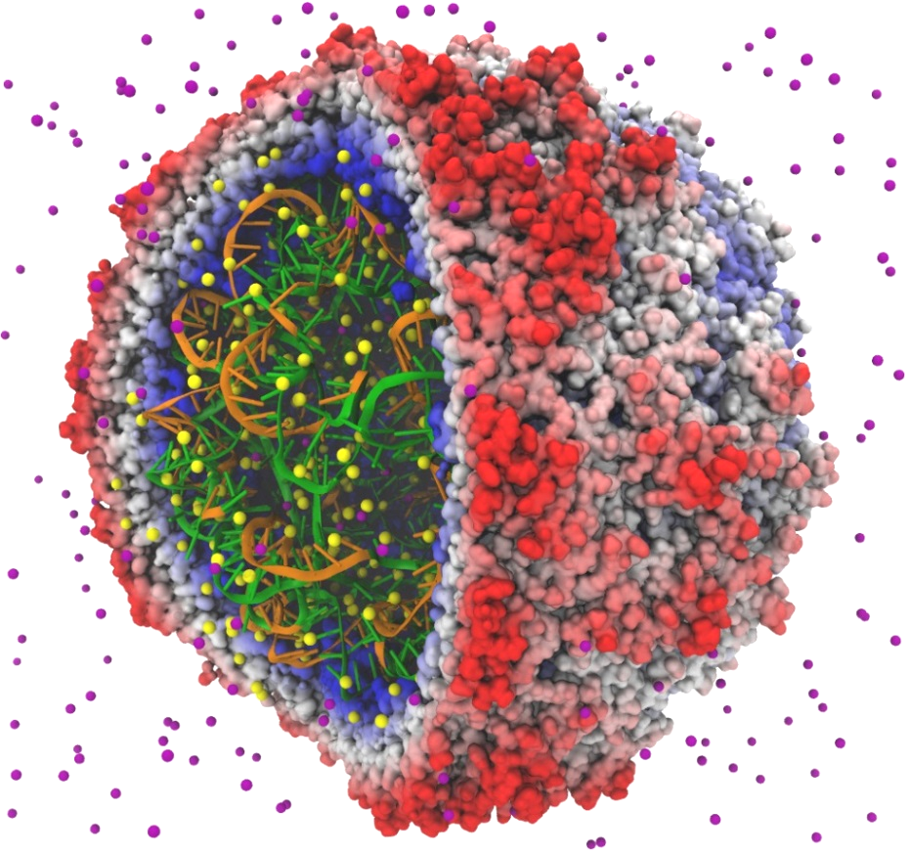
VMD “QuickSurf” Representation
Displays continuum of structural detail:
All-atom, coarse-grained, cellular models
Smoothly variable detail controls
Linear-time algorithm, scales to millions of particles, as limited by memory capacity
Uses multi-core CPUs and GPU acceleration to enable smooth interactive animation of molecular dynamics trajectories w/ up to ~1-2 million atoms
GPU acceleration yields 10x-15x speedup vs. multi-core CPUs
Fast Visualization of Gaussian Density Surfaces for Molecular Dynamics and Particle System Trajectories. M. Krone, J. E. Stone, T. Ertl, K. Schulten. EuroVis Short Papers, pp. 67-71, 2012
Satellite Tobacco Mosaic Virus

Slide 29
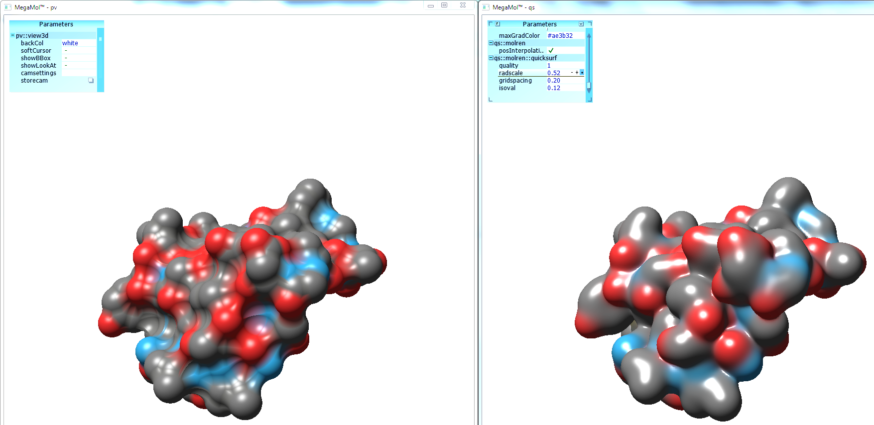
VMD 1.9.2 QuickSurf Algorithm Improvements
50%-66% memory use, 1.5x-2x speedup
Build spatial acceleration data structures, optimize data for GPU
Compute 3-D density map, 3-D color texture map with data-parallel “gather” algorithm:
Normalize, quantize, and compress density, color, surface normal data while in registers, before writing out to GPU global memory
Extract isosurface, maintaining quantized/compressed data representation
Centralized GPU memory management among all molecules+representations: enables graceful eviction of surface data for ray tracing, or other GPU-memory-capacity-constrained operations
3-D density map lattice, spatial acceleration grid, and extracted surface

Slide 30
VMD GPU-Accelerated Ray Tracing Engine
Complementary to VMD OpenGL GLSL renderer that uses fast, low-cost, interactivity-oriented rendering techniques
Key ray tracing benefits:
Ambient occlusion lighting and hard shadows
High quality transparent surfaces
Depth of field focal blur and similar optical effects
Mirror reflection
Single-pass stereoscopic rendering
Special cameras: planetarium dome master format

Slide 31
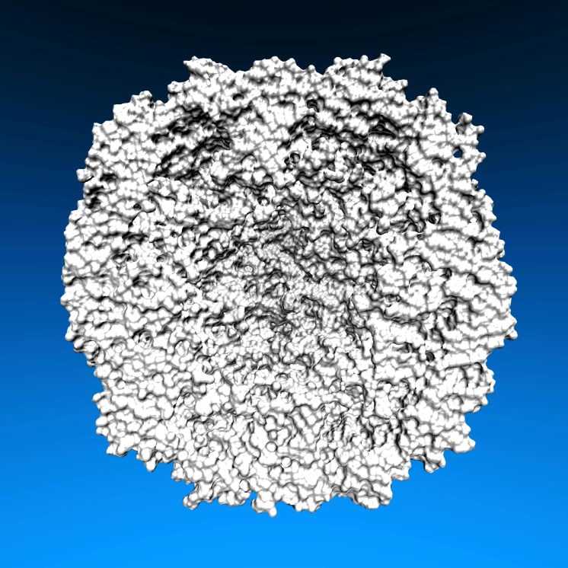
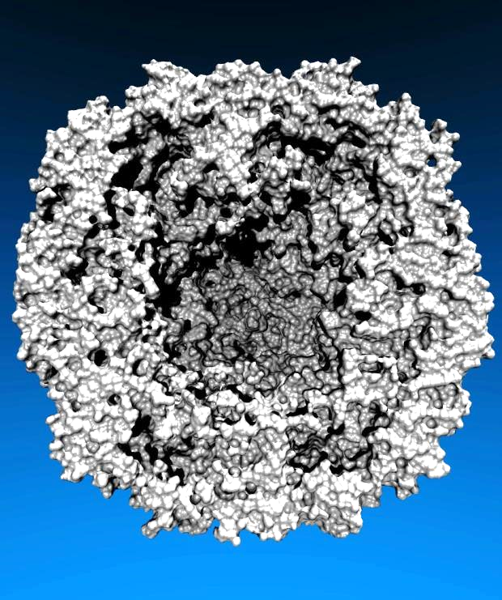

Lighting Comparison, STMV Capsid
Two lights, no shadows
Two lights, hard shadows, 1 shadow ray per light
Ambient occlusion + two lights, 144 AO rays/hit

Slide 32

HIV-1 Parallel Movie Rendering on Blue Waters Cray XE6/XK7
VMD 1.9.2
HIV-1 “HD” 1920x1080 movie rendering: GPUs speed up geom+ray tracing by up to eight times
Node Type and Count | Script Load Time | State Load Time | Geometry + Ray Tracing | Total Time
256 XE6 CPUs | 7 s | 160 s | 1,374 s | 1,541 s
512 XE6 CPUs | 13 s | 211 s | 808 s | 1,032 s
64 XK7 Tesla K20X GPUs | 2 s | 38 s | 655 s | 695 s
128 XK7 Tesla K20X GPUs | 4 s | 74 s | 331 s | 410 s
256 XK7 Tesla K20X GPUs | 7 s | 110 s | 171 s | 288 s
GPU-Accelerated Molecular Visualization on Petascale Supercomputing Platforms,
Stone et al. UltraVis'13: Eighth Workshop on Ultrascale Visualization Proceedings, 2013.

Slide 33

Photosynthetic Chromatophore of Purple Bacteria
Purple bacteria live in light-starved conditions at the bottom of ponds, with ~1% sunlight
Chromatophore system
100M atoms, 700 Å³ volume
Contains over 100 proteins, ~3,000 bacteriochlorophylls for collection of photons
Energy conversion process synthesizes ATP, which fuels cells…

Slide 34

Movie sums up ~40 papers and 37 years of work by Schulten lab and collaborators
Driving NAMD and VMD software design:
Two decades of simulation, analysis, and visualization of individual chromatophore components w/ NAMD+VMD

Slide 35

Role of Visualization
MD simulation, analysis, visualization provide researchers a so-called “Computational Microscope”
Visualization is heavily used at every step of structure building, simulation prep and run, analysis, and publication
1998 VMD rendering of LH-I
SGI Onyx2 InfiniteReality w/ IRIS GL

Slide 36

VMD Chromatophore Rendering on Blue Waters
New representations, GPU-accelerated molecular surface calculations, memory-efficient algorithms for huge complexes
VMD GPU-accelerated ray tracing engine w/ OptiX+CUDA+MPI+Pthreads
Each revision: 7,500 frames render on ~96 Cray XK7 nodes in 290 node-hours, 45GB of images prior to editing
GPU-Accelerated Molecular Visualization on Petascale Supercomputing Platforms. J. E. Stone, K. L. Vandivort, and K. Schulten. UltraVis’13, 2013.
Visualization of Energy Conversion Processes in a Light Harvesting Organelle at Atomic Detail. M. Sener, et al. SC'14 Visualization and Data Analytics Showcase, 2014. ***Winner of the SC'14 Visualization and Data Analytics Showcase

Slide 37

VMD 1.9.2 Interactive GPU Ray Tracing
Ray tracing heavily used for VMD publication-quality images/movies
High quality lighting, shadows, transparency, depth-of-field focal blur, etc.
VMD now provides –interactive– ray tracing on laptops, desktops, and remote visual supercomputers

Slide 38

VMD TachyonL-OptiX Interactive Ray Tracing Engine
Scene Graph
RT Rendering Pass
Seed RNGs
Accumulate RT samples
Accum. Buf
Normalize+copy accum. buf
TrBvh RT Acceleration Structure
Compute ave. FPS,
adjust RT samples per pass
Output Framebuffer

Slide 39

VMD-Next: Coming Soon
Further integration of interactive ray tracing into VMD
Seamless interactive RT in main VMD display window
Support trajectory playback in interactive RT
Enable multi-node interactive RT on HPC systems
Improved movie making tools, off-screen OpenGL movie rendering, parallel movie rendering:
EGL for parallel graphics w/o X11 server
Built-in (basic) interactive remote visualization on HPC clusters and supercomputers
Improved structure building tools
Many new and updated user-contributed plugins:
GPU Ray Tracing of
HIV-1 Capsid Detail

Slide 40
Acknowledgements
Theoretical and Computational Biophysics Group, University of Illinois at Urbana-Champaign
NVIDIA CUDA Center of Excellence, University of Illinois at Urbana-Champaign
NVIDIA CUDA team
NVIDIA OptiX team
NCSA Blue Waters Team
Funding:
DOE INCITE, ORNL Titan: DE-AC05-00OR22725
NSF Blue Waters: NSF OCI 07-25070, PRAC “The Computational Microscope”, ACI-1238993, ACI-1440026
NIH support: 9P41GM104601, 5R01GM098243-02
Notes:
40

Slide 41


Slide 42
GPU Computing Publications http://www.ks.uiuc.edu/Research/gpu/
Visualization of Energy Conversion Processes in a Light Harvesting Organelle at Atomic Detail. M. Sener, J. E. Stone, A. Barragan, A. Singharoy, I. Teo, K. L. Vandivort, B. Isralewitz, B. Liu, B. Goh, J. C. Phillips, L. F. Kourkoutis, C. N. Hunter, and K. Schulten. SC'14 Visualization and Data Analytics Showcase, 2014. ***Winner of the SC'14 Visualization and Data Analytics Showcase
Runtime and Architecture Support for Efficient Data Exchange in Multi-Accelerator Applications. J. Cabezas, I. Gelado, J. E. Stone, N. Navarro, D. B. Kirk, and W. Hwu. IEEE Transactions on Parallel and Distributed Systems, 2014. (In press)
Unlocking the Full Potential of the Cray XK7 Accelerator. M. D. Klein and J. E. Stone. Cray Users Group, Lugano Switzerland, May 2014.
GPU-Accelerated Analysis and Visualization of Large Structures Solved by Molecular Dynamics Flexible Fitting. J. E. Stone, R. McGreevy, B. Isralewitz, and K. Schulten. Faraday Discussions, 169:265-283, 2014.
Simulation of reaction diffusion processes over biologically relevant size and time scales using multi-GPU workstations. M. J. Hallock, J. E. Stone, E. Roberts, C. Fry, and Z. Luthey-Schulten. Journal of Parallel Computing, 40:86-99, 2014.

Slide 43
GPU Computing Publications http://www.ks.uiuc.edu/Research/gpu/
GPU-Accelerated Molecular Visualization on Petascale Supercomputing Platforms. J. Stone, K. L. Vandivort, and K. Schulten. UltraVis'13: Proceedings of the 8th International Workshop on Ultrascale Visualization, pp. 6:1-6:8, 2013.
Early Experiences Scaling VMD Molecular Visualization and Analysis Jobs on Blue Waters. J. Stone, B. Isralewitz, and K. Schulten. In proceedings, Extreme Scaling Workshop, 2013.
Lattice Microbes: High‐performance stochastic simulation method for the reaction‐diffusion master equation. E. Roberts, J. Stone, and Z. Luthey‐Schulten. J. Computational Chemistry 34 (3), 245-255, 2013.
Fast Visualization of Gaussian Density Surfaces for Molecular Dynamics and Particle System Trajectories. M. Krone, J. Stone, T. Ertl, and K. Schulten. EuroVis Short Papers, pp. 67-71, 2012.
Immersive Out-of-Core Visualization of Large-Size and Long-Timescale Molecular Dynamics Trajectories. J. Stone, K. L. Vandivort, and K. Schulten. G. Bebis et al. (Eds.): 7th International Symposium on Visual Computing (ISVC 2011), LNCS 6939, pp. 1-12, 2011.
Fast Analysis of Molecular Dynamics Trajectories with Graphics Processing Units – Radial Distribution Functions. B. Levine, J. Stone, and A. Kohlmeyer. J. Comp. Physics, 230(9):3556-3569, 2011.

Slide 44
GPU Computing Publications http://www.ks.uiuc.edu/Research/gpu/
Quantifying the Impact of GPUs on Performance and Energy Efficiency in HPC Clusters. J. Enos, C. Steffen, J. Fullop, M. Showerman, G. Shi, K. Esler, V. Kindratenko, J. Stone, J Phillips. International Conference on Green Computing, pp. 317-324, 2010.
GPU-accelerated molecular modeling coming of age. J. Stone, D. Hardy, I. Ufimtsev, K. Schulten. J. Molecular Graphics and Modeling, 29:116-125, 2010.
OpenCL: A Parallel Programming Standard for Heterogeneous Computing. J. Stone, D. Gohara, G. Shi. Computing in Science and Engineering, 12(3):66-73, 2010.
An Asymmetric Distributed Shared Memory Model for Heterogeneous Computing Systems. I. Gelado, J. Stone, J. Cabezas, S. Patel, N. Navarro, W. Hwu. ASPLOS ’10: Proceedings of the 15th International Conference on Architectural Support for Programming Languages and Operating Systems, pp. 347-358, 2010.

Slide 45
GPU Computing Publications http://www.ks.uiuc.edu/Research/gpu/
GPU Clusters for High Performance Computing. V. Kindratenko, J. Enos, G. Shi, M. Showerman, G. Arnold, J. Stone, J. Phillips, W. Hwu. Workshop on Parallel Programming on Accelerator Clusters (PPAC), In Proceedings IEEE Cluster 2009, pp. 1-8, Aug. 2009.
Long time-scale simulations of in vivo diffusion using GPU hardware. E. Roberts, J. Stone, L. Sepulveda, W. Hwu, Z. Luthey-Schulten. In IPDPS’09: Proceedings of the 2009 IEEE International Symposium on Parallel & Distributed Computing, pp. 1-8, 2009.
High Performance Computation and Interactive Display of Molecular Orbitals on GPUs and Multi-core CPUs. J. Stone, J. Saam, D. Hardy, K. Vandivort, W. Hwu, K. Schulten, 2nd Workshop on General-Purpose Computation on Graphics Pricessing Units (GPGPU-2), ACM International Conference Proceeding Series, volume 383, pp. 9-18, 2009.
Probing Biomolecular Machines with Graphics Processors. J. Phillips, J. Stone. Communications of the ACM, 52(10):34-41, 2009.
Multilevel summation of electrostatic potentials using graphics processing units. D. Hardy, J. Stone, K. Schulten. J. Parallel Computing, 35:164-177, 2009.

Slide 46
GPU Computing Publications http://www.ks.uiuc.edu/Research/gpu/
Adapting a message-driven parallel application to GPU-accelerated clusters. J. Phillips, J. Stone, K. Schulten. Proceedings of the 2008 ACM/IEEE Conference on Supercomputing, IEEE Press, 2008.
GPU acceleration of cutoff pair potentials for molecular modeling applications. C. Rodrigues, D. Hardy, J. Stone, K. Schulten, and W. Hwu. Proceedings of the 2008 Conference On Computing Frontiers, pp. 273-282, 2008.
GPU computing. J. Owens, M. Houston, D. Luebke, S. Green, J. Stone, J. Phillips. Proceedings of the IEEE, 96:879-899, 2008.
Accelerating molecular modeling applications with graphics processors. J. Stone, J. Phillips, P. Freddolino, D. Hardy, L. Trabuco, K. Schulten. J. Comp. Chem., 28:2618-2640, 2007.
Continuous fluorescence microphotolysis and correlation spectroscopy. A. Arkhipov, J. Hüve, M. Kahms, R. Peters, K. Schulten. Biophysical Journal, 93:4006-4017, 2007.

