Slide 1
Optimizing NAMD and VMD for the
IBM Power9 Platform
John E. Stone
Theoretical and Computational Biophysics Group
Beckman Institute for Advanced Science and Technology
University of Illinois at Urbana-Champaign
http://www.ks.uiuc.edu/Research/gpu/
http://www.ks.uiuc.edu/Research/namd/
http://www.ks.uiuc.edu/Research/vmd/
IBM Power User’s Group, Supercomputing 2018,
Omni Hotel 3rd Floor Ballroom, Thursday November 15th, 2018

Slide 2
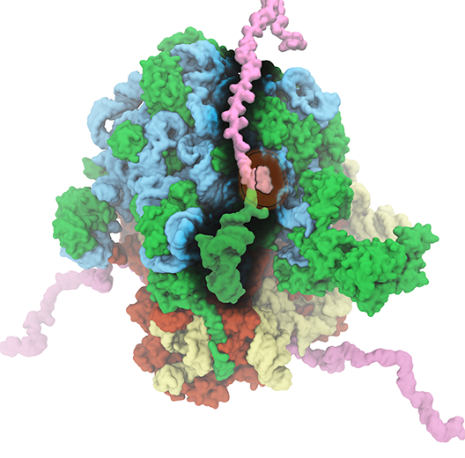
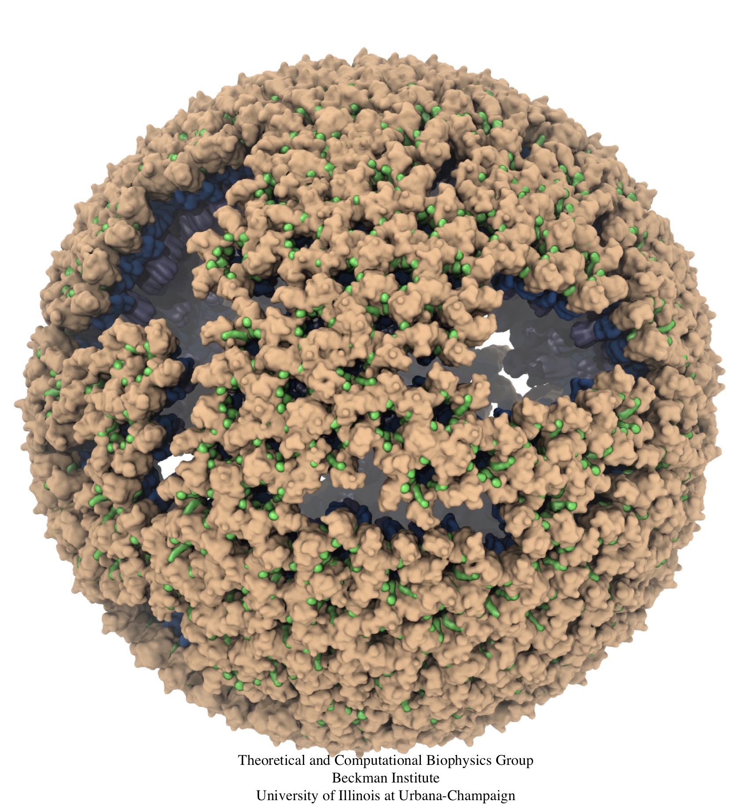
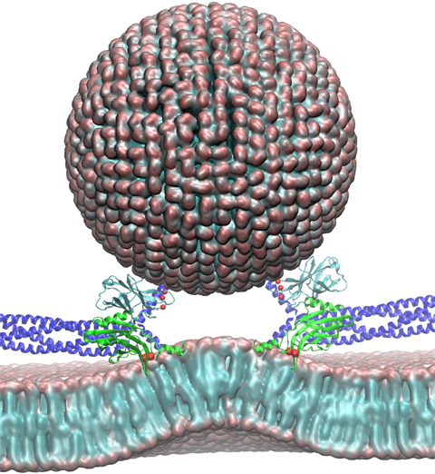
NAMD & VMD: Computational Microscope
Enable researchers to investigate systems described at the atomic scale
NAMD - molecular dynamics simulation
VMD - visualization, system preparation and analysis
Neuron
Ribosome
Virus Capsid

Slide 3
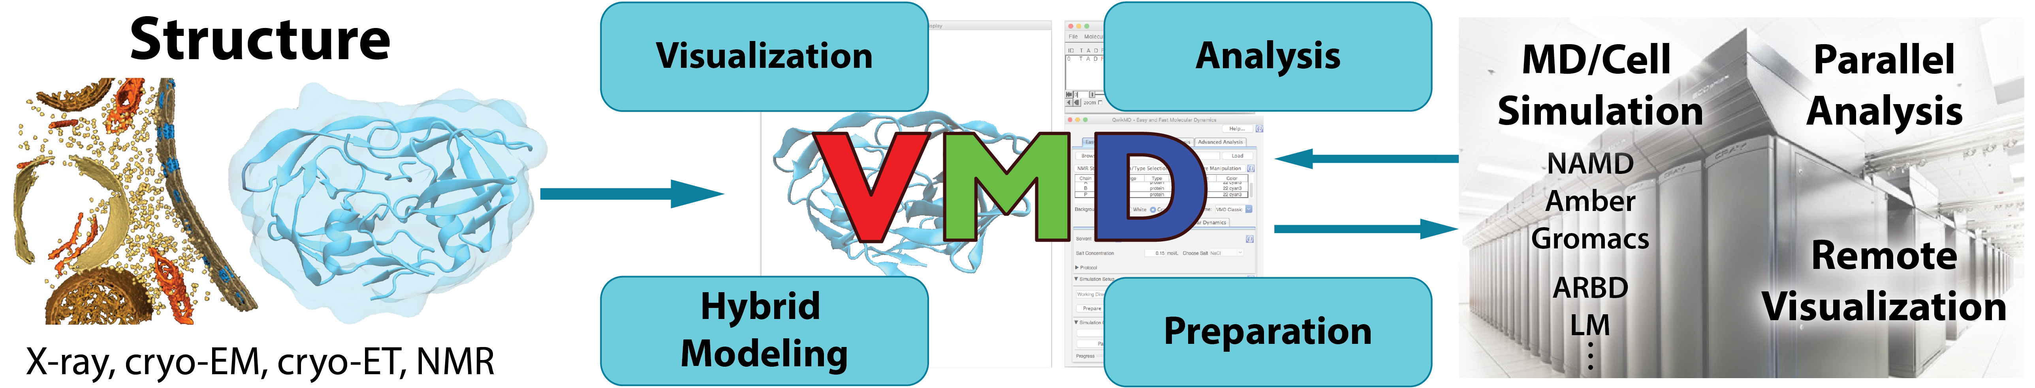
NAMD+VMD: Building A Next Generation Modeling Platform
Provide tools for preparation, simulation, visualization, and analysis
  Reach cell-scale modeling w/ all-atom MD, coarse graining, Lattice Microbes
  Improved performance, visual fidelity, exploit advanced technologies (GPUs, VR HMDs)
Enable hybrid modeling and computational electron microscopy
  Load, filter, process, interpret, visualize multi-modal structural information
Connect key software tools to enable state-of-the-art simulations
  Support new data types, file formats, software interfaces
  Openness, extensibility, and interoperability are our hallmarks
  Reusable algorithms made available in NAMD, for other tools

Slide 4
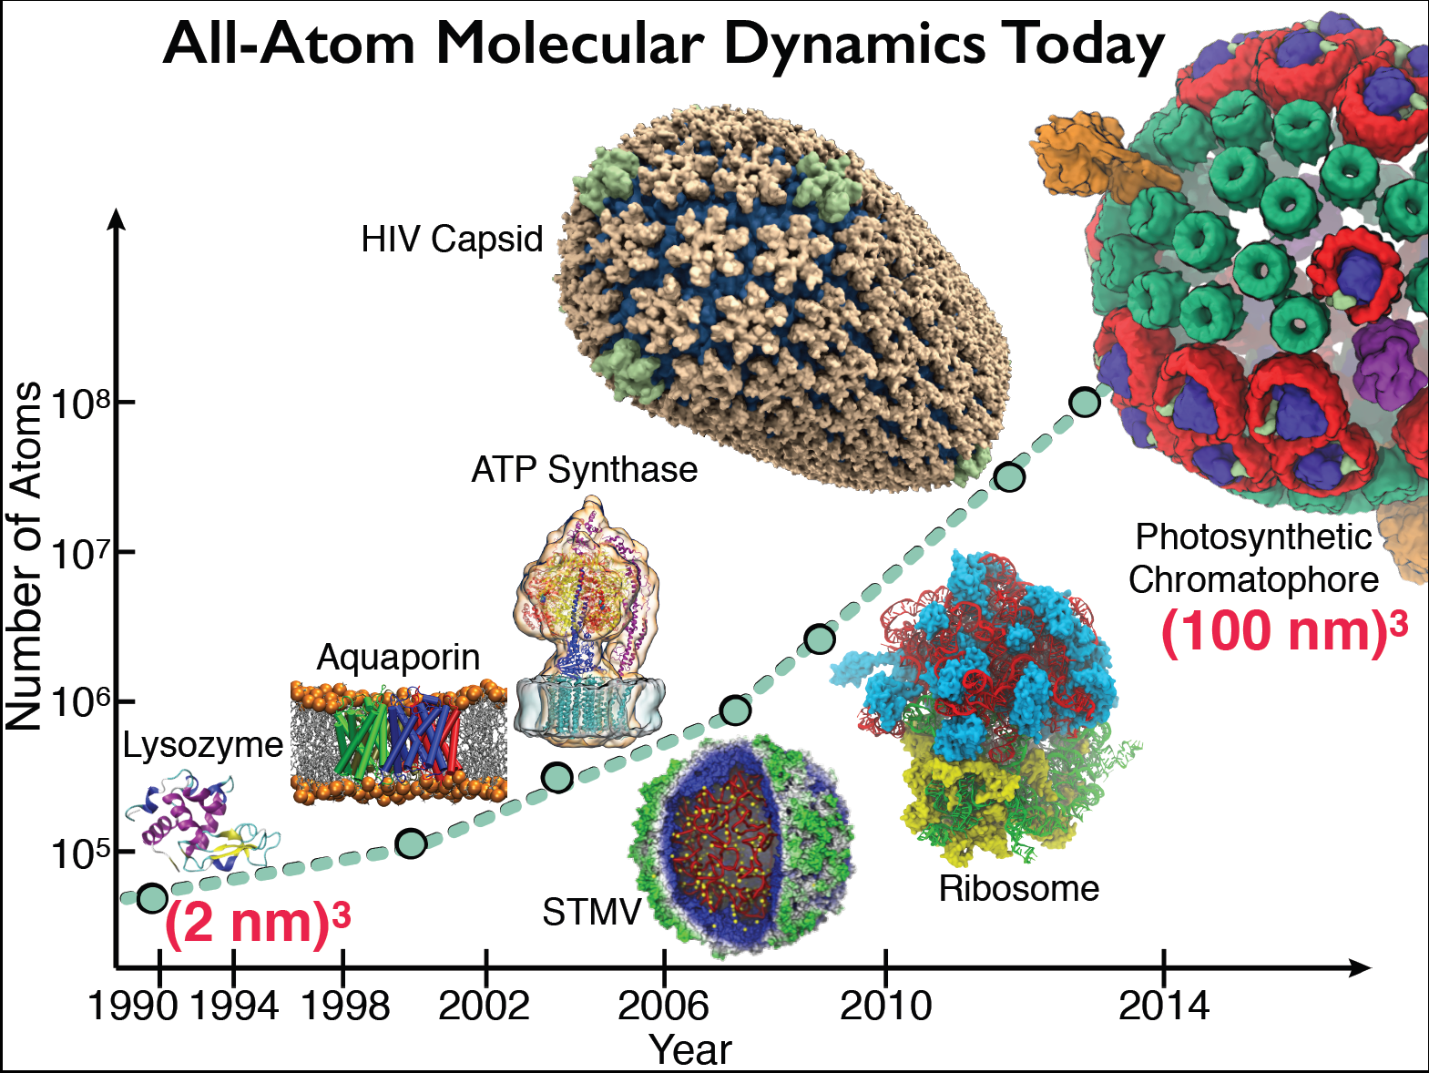

Slide 5
History of NAMD and VMD on POWER
NAMD + VMD have supported IBM POWER hardware since 1998!
  Originally ported in big-endian mode under AIX 4.x
2016: Adapted to POWER8 w/ Linux in little-endian mode w/ P100 GPUs:
  New NAMD GPU kernels improved overall P8+P100 performance [1]
  Used VSX instructions for hand-coded and vectorized kernels [1]
  Supported CUDA 7.x [1], and CUDA 8.x w/ P100 and NVLink
  First VMD support for OpenGL GLX+EGL on POWER ppc64le
[1] Early Experiences Porting the NAMD and VMD Molecular Simulation and Analysis Software to GPU-Accelerated OpenPOWER Platforms. J. E. Stone, A.-P. Hynninen, J. C. Phillips, K. Schulten. International Workshop on OpenPOWER for HPC (IWOPH'16), LNCS 9945, pp. 188-206, 2016.

Slide 6
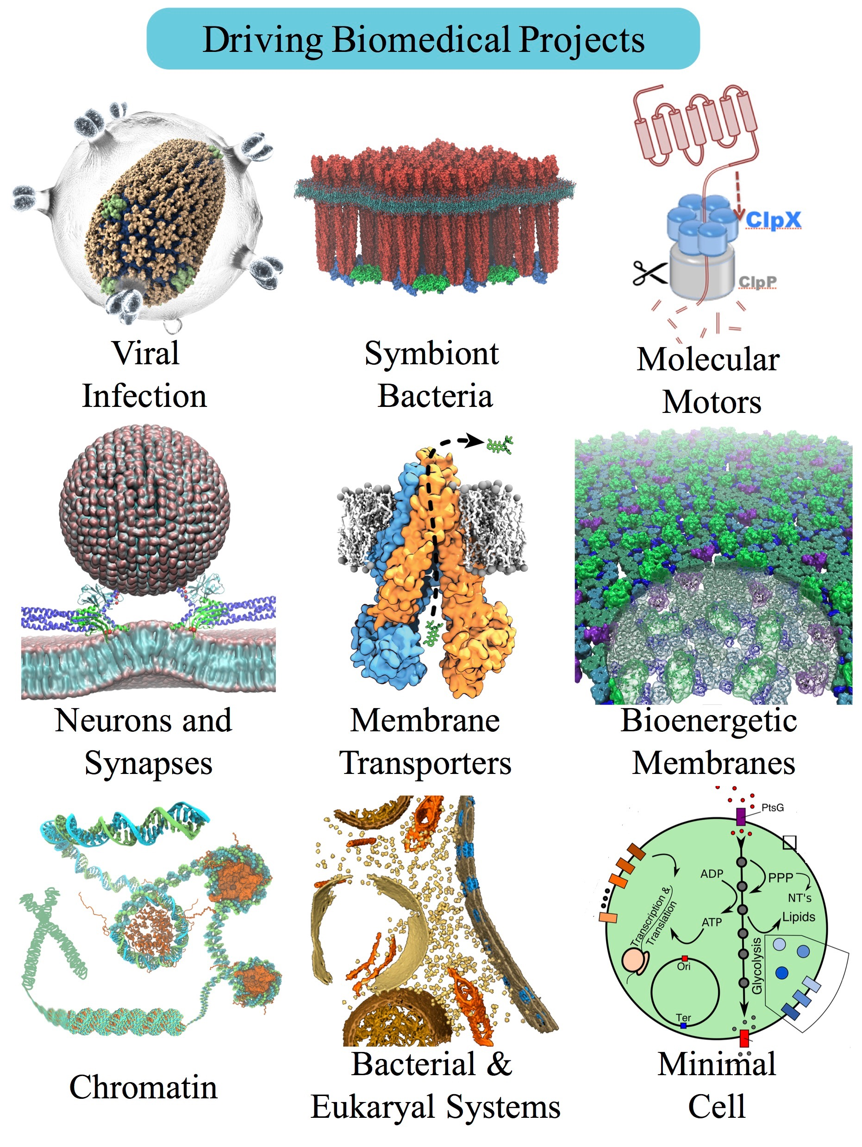
Petascale Simulations Driving NAMD/VMD Development
NCSA ORNL | Blue Waters (4,228 XK7 nodes) Titan (18,688 XK7 nodes) | AMD Opteron + K20X Kepler GPU | 16 CPU cores / GPU
TACC | Stampede 2 (4200 KNL nodes, 1736 Skylake nodes) | Intel Knights Landing Intel Xeon Skylake | 68 CPU cores 48 CPU cores
ORNL | Summit (~4600 nodes) | 2 IBM Power9 + 6 Tesla V100 GPUs | 7 CPU cores / GPU
Notes:
a large number of them drive large-scale simulation and visualization challenges that you will see

Slide 7
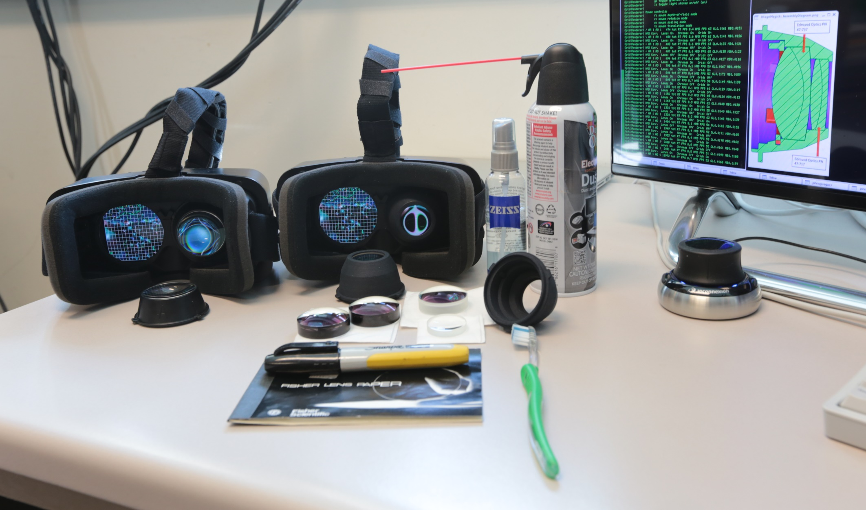
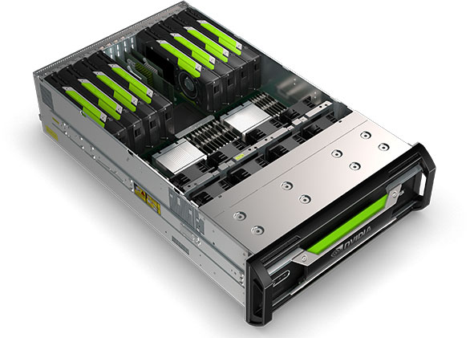
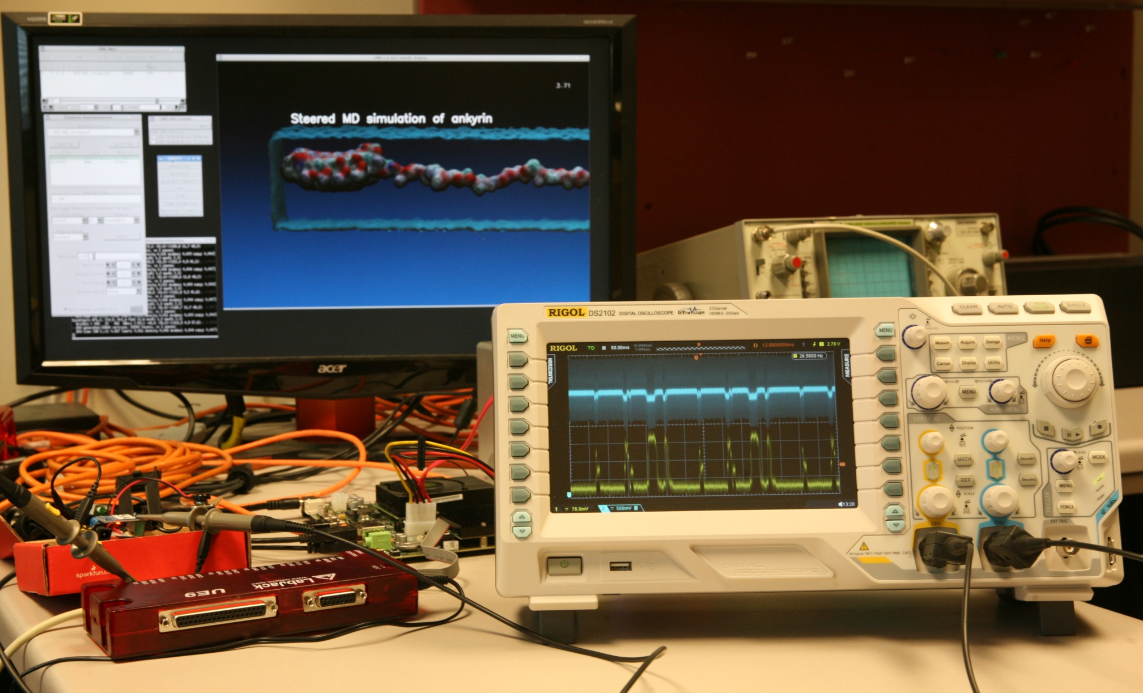
Technology Opportunities and Collaborations
Supercomputer Centers, Cray, IBM
  GPU accelerated supercomputing
  In-situ and remote visualization technologies
NVIDIA
  GPU computing
  Performance profiling and optimization
  Ray tracing
  In-situ and remote visualization
  HPC/AI containers and clouds
Intel
  CPU vectorization and sw optimization
  Ray tracing
  Non-volatile memory systems
Amazon
  Cloud deployment of VMD/NAMD, related tools
Universities:
  T. Ertl, U. Stuttgart: visualization algorithms
  G. Fiorin, J. Henin, Toni Giorgino, collective variables
  W. Sherman, Indiana U.: VR HMDs, visualization
VR HMDs, 6DoF input devices
GPU computing,
Ray tracing,
Remote viz.
Energy efficiency: ARM+GPU

Slide 8
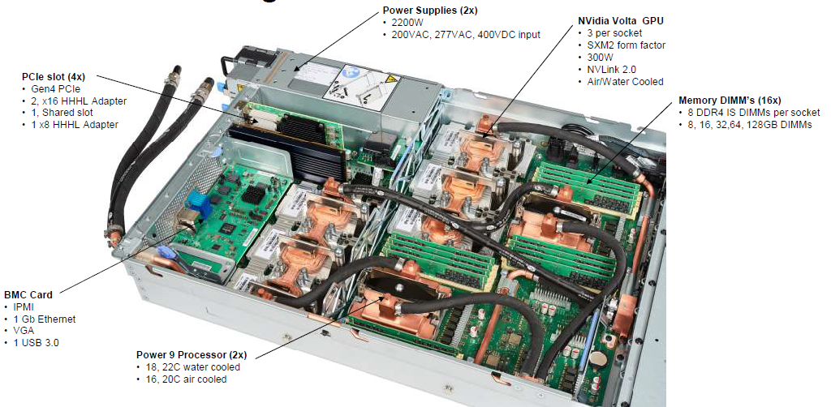
IBM AC922 w/ 6 GPUs

Slide 9
IBM AC922 Summit Node
3 GPUs Per CPU Socket
Tesla V100 GPU
Tesla V100 GPU
Tesla V100 GPU
Tesla V100 GPU
Tesla V100 GPU
Tesla V100 GPU
Nvlink 2.0
2x 50GBps:
100GBps
DDR4 DRAM
DDR4 DRAM
POWER9
CPU
POWER9
CPU
X-Bus
64GBps
120GBps
120GBps
InfiniBand
12GBps
InfiniBand
12GBps

Slide 10
IBM AC922 Summit Node
3 GPUs Per CPU Socket
Tesla V100 GPU
Tesla V100 GPU
Tesla V100 GPU
Tesla V100 GPU
Tesla V100 GPU
Tesla V100 GPU
Nvlink 2.0
2x 50GBps:
100GBps
DDR4 DRAM
DDR4 DRAM
POWER9
CPU
POWER9
CPU
X-Bus
64GBps
120GBps
120GBps
InfiniBand
12GBps
InfiniBand
12GBps
1.6TB SSD
“Burst Buffer”

Slide 11
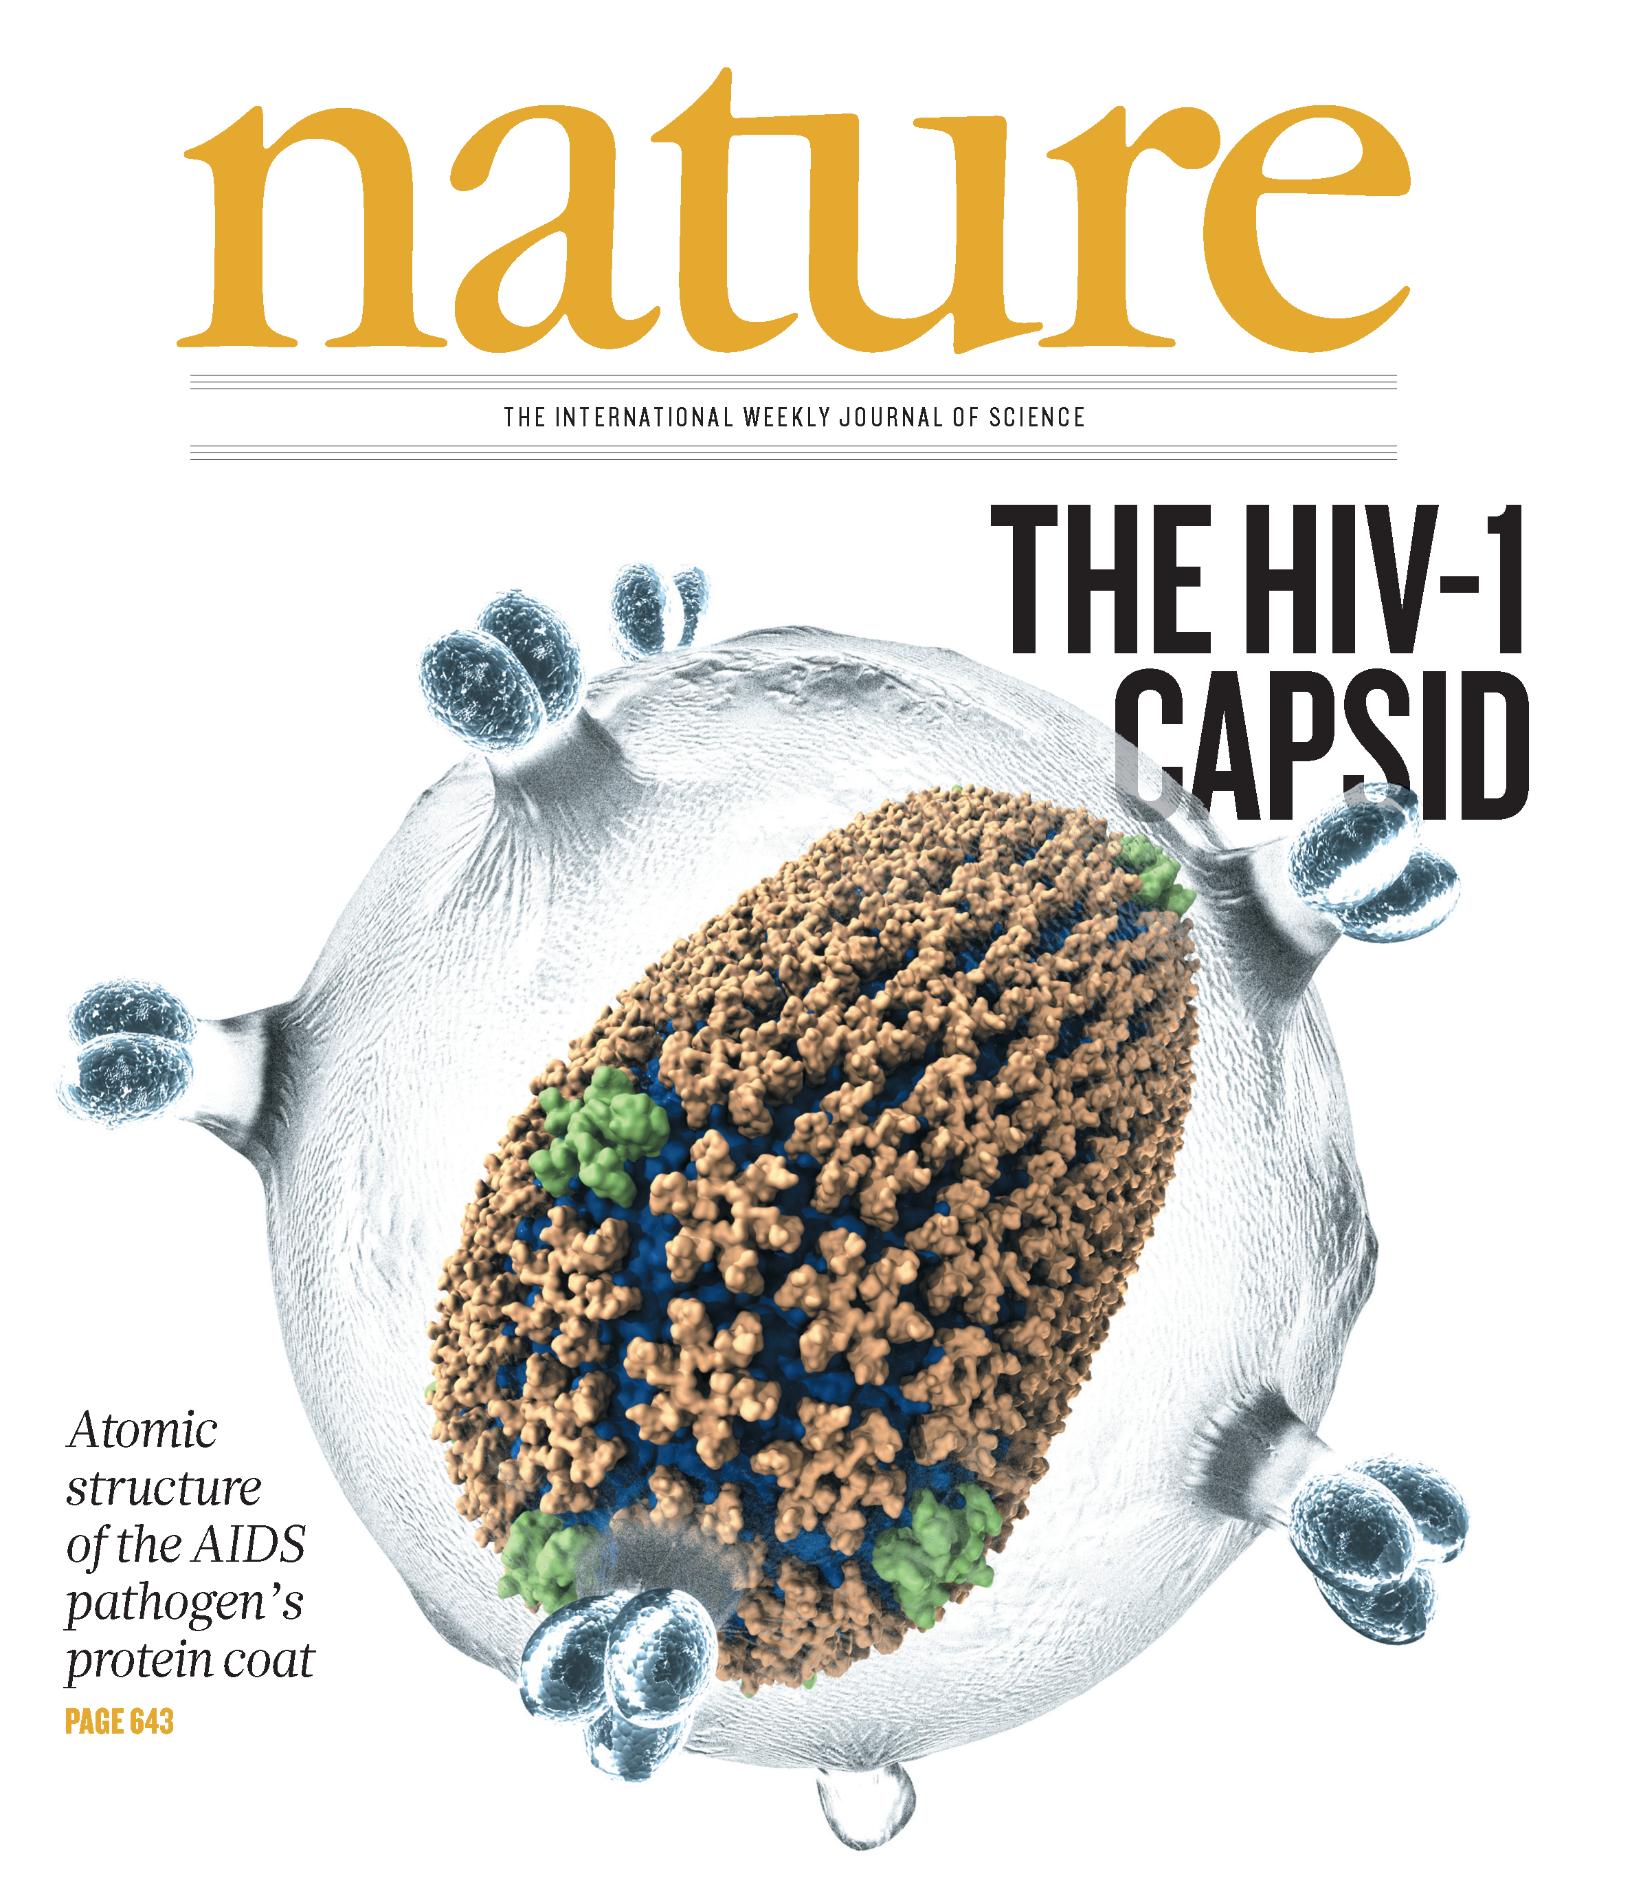
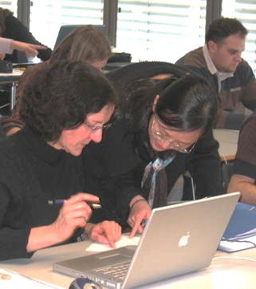
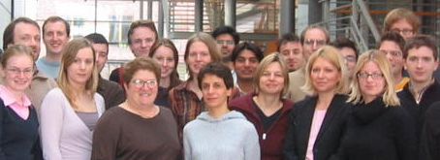
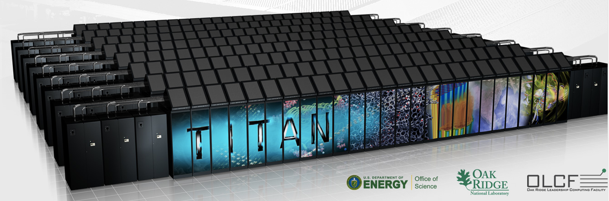
NAMD Highlights
Over 12,600 citations of NAMD
One program available on all platforms.
  Desktops and laptops – setup and testing
  Linux clusters – affordable local workhorses
  Supercomputers – free allocations on XSEDE
  Blue Waters – sustained petaflop/s performance
  GPUs – from desktop to supercomputer
User knowledge is preserved across platforms.
  No change in input or output files.
  Run any simulation on any number of cores.
Available free of charge to all.
Hands-On Workshops
Oak Ridge TITAN

Slide 12
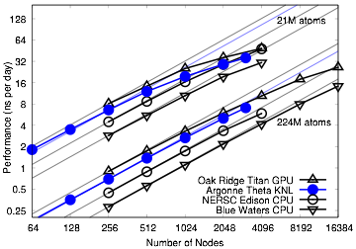
Earliest NAMD Runs on Summit

Slide 13
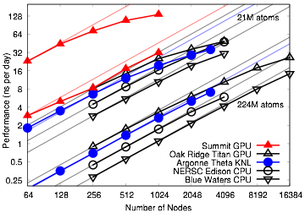
Earliest NAMD Runs on Summit

Slide 14
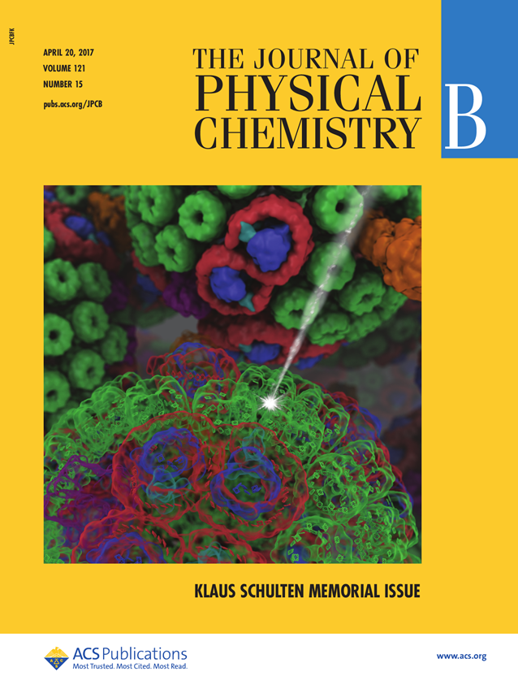
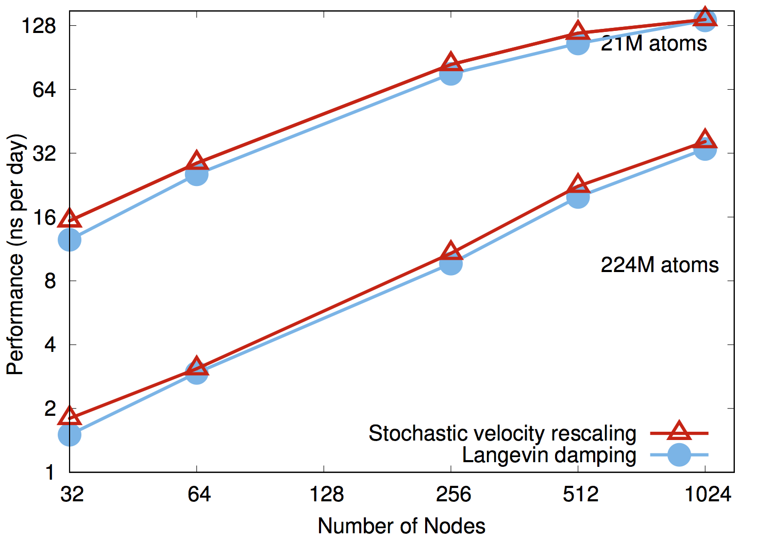
NAMD on Summit, May 2018:
~20% Performance Increase
NAMD simulations can generate up to 10TB of output per day on 20% of Summit

Slide 15
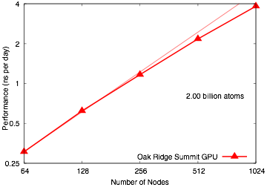
NAMD 2 Billion Atom Benchmark on 20% of Summit
“Scalable Molecular Dynamics with NAMD on the Summit System”
IBM Journal of Research and Development, 2018. (In press)

Slide 16
Upcoming NAMD 2.13 Release
NAMD 2.13 beta will soon be released
Improved GPU support
  Introducing CUDA kernels for offloading (almost) entire force calculation
    Bonds, angles, dihedrals, impropers, crossterms, exclusions
  Better GPU device management, especially for multiple GPUs per node
Support for system sizes up to 2 billion atoms
  Internal fixes for data structure setup and file I/O
  Extend system preparation tools (combine Psfgen with substructure assembly)
  Enables simulation of initial protocell model

Slide 17
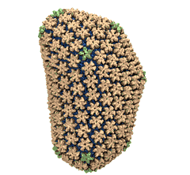
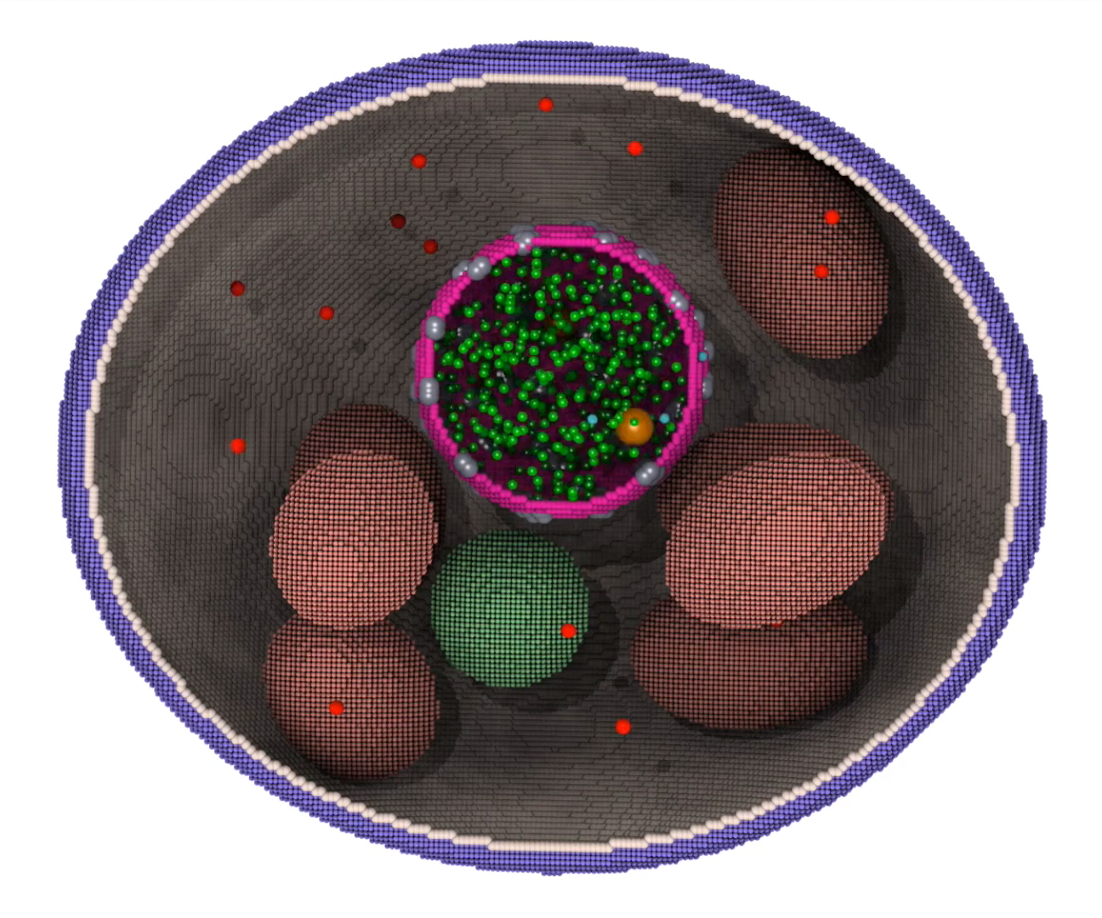
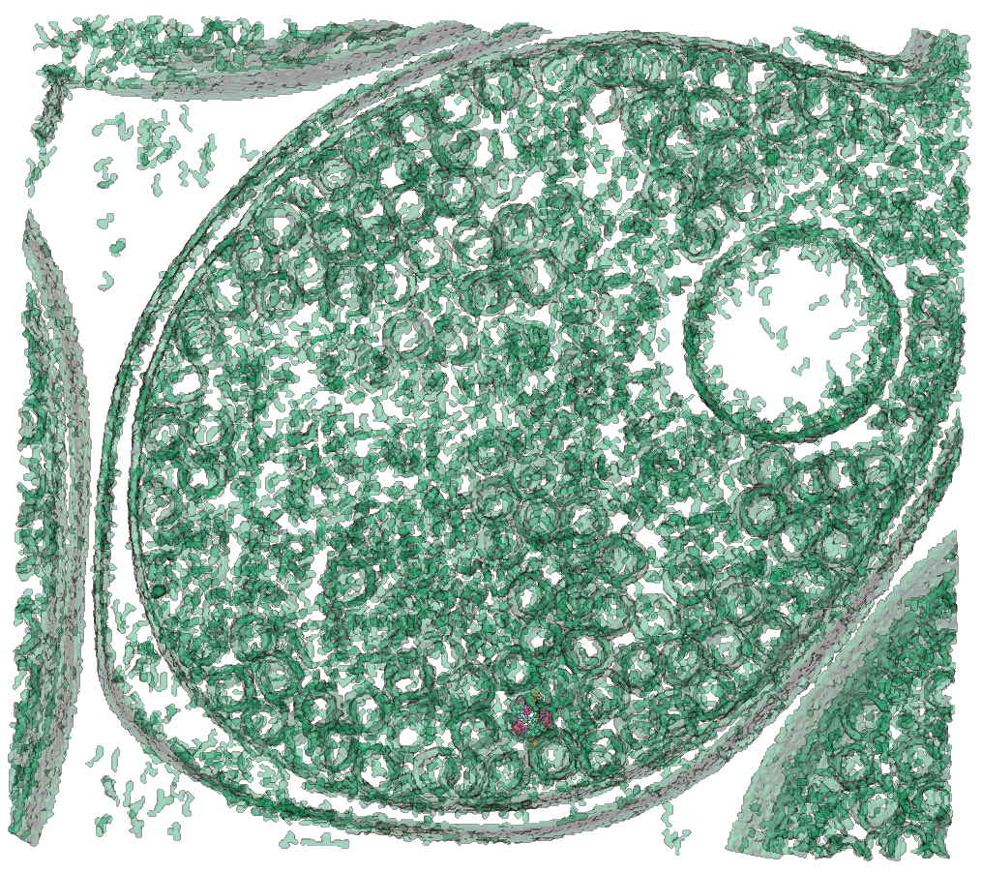
VMD – “Visual Molecular Dynamics”
Unique capabilities:
  Trajectories are fundamental to VMD
  Support for very large systems, now reaching billions of particles
  Extensive GPU acceleration
  Parallel analysis/visualization with MPI
Visualization and analysis of:
  Molecular dynamics simulations
  “Particle” systems and whole cells
  Cryo-EM densities, volumetric data
  Quantum chemistry calculations
  Sequence information
MD Simulations
Cell-Scale Simulation
Integrate w/ Cryo-EM/ET

Slide 18
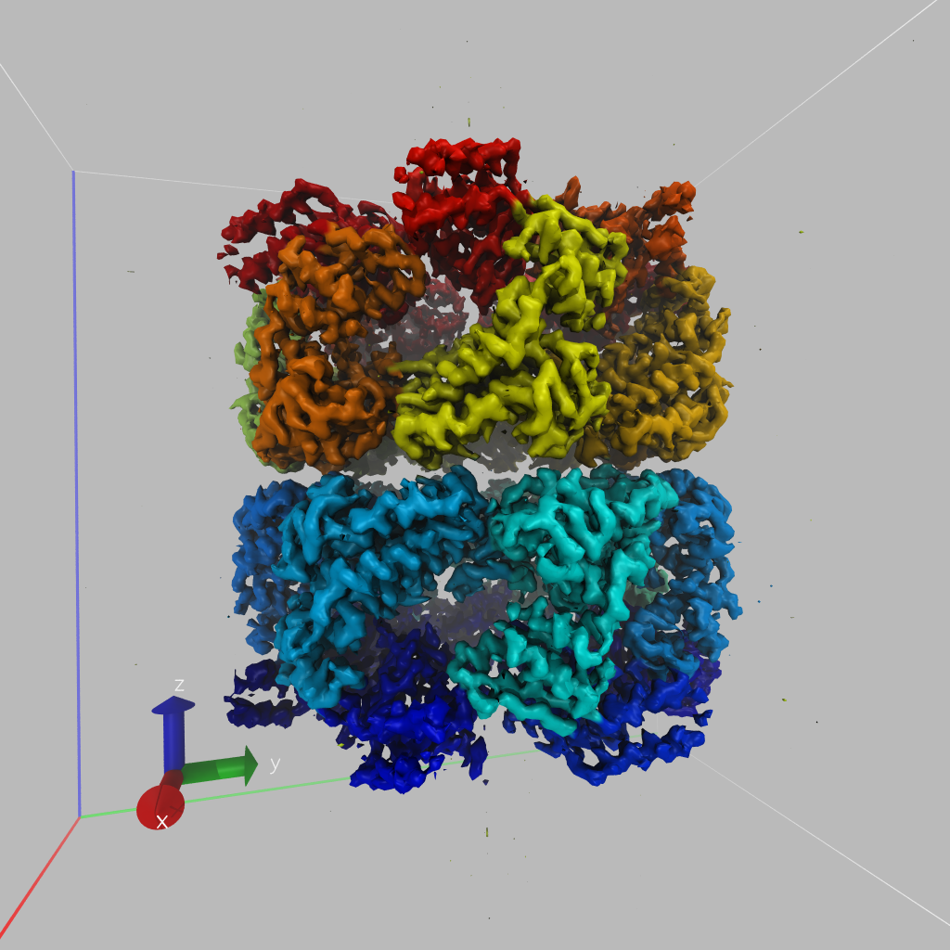
Upcoming VMD 1.9.4 Release, Foundation for Future
24,600 VMD Citations
1.9.3: 63,000 users, 9,965 NIH (Nov’16)
1.9.4 pre-releases: 12,500 users (Jul’17)
  VMD 1.9.4 beta release next month
  Support for ORNL Summit
  Many visualization and analytical advances:
    GPU-accelerated density map segmentation
    Multi-billion voxel tomograms and density maps
    QM/MM visualization improvements
    NanoShaper: molecular surfaces, cavity calc.
    Many ray tracing advances
  New, updated, user-contributed plugins:
    QwikMD simulation prep/analysis: QM/MM
    ffTK force field parameterization: RESP calcs
    BFEE– Binding free energy estimator
    ParseFEP – Analyze NAMD free energy calculations
Show segmentation here
GPU Density Map Segmentation
Recent Publications:
NAMD goes quantum: An integrative suite for hybrid simulations. Nature Methods, 2018.
Challenges of Integrating Stochastic Dynamics and Cryo-Electron Tomograms in Whole-Cell Simulations. JPCB, 2017
Notes:
Pick items to highlight, and go from this to movie or other slides

Slide 19
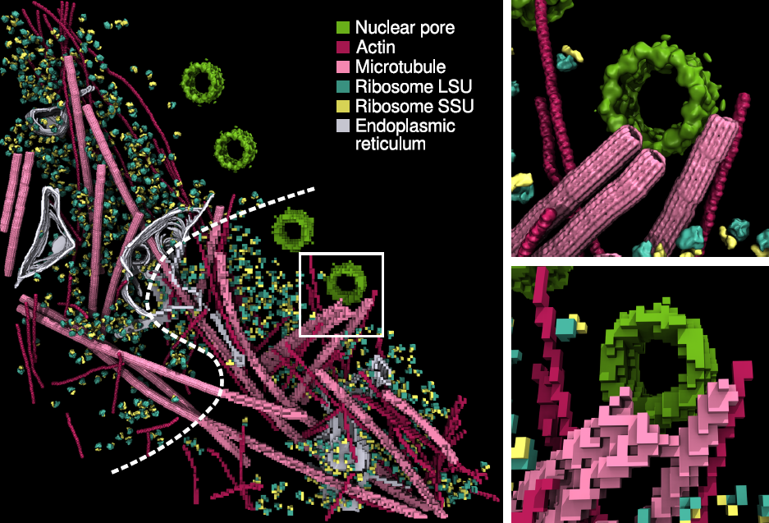
Density Map Segmentation
VMD GPU-accelerated density map segmentation of GroEL
Earnest, et al. J. Physical Chemistry B, 121(15): 3871-3881, 2017.

Slide 20
VMD Tesla V100 Cross Correlation Performance
Rabbit Hemorrhagic Disease Virus: 702K atoms, 6.5Å resolution
VMD on Volta GPUs now ~9x faster than Kepler GPUs
Application and Hardware platform | Runtime, Speedup vs. Chimera, VMD+GPU
Chimera Xeon E5-2687W (2 socket) [1] | 15.860s, 1x
VMD-CUDA IBM Power8 + 1x Tesla K40 [2] | 0.488s, 32x 0.9x
VMD-CUDA Intel Xeon E5-2687W + 1x Quadro K6000 [1,2] | 0.458s, 35x 1.0x
VMD-CUDA Intel Xeon E5-2698v3 + 1x Tesla P100 | 0.090s, 176x 5.1x
VMD-CUDA IBM Power8 “Minsky” + 1x Tesla P100 | 0.080s, 198x 5.7x
VMD-CUDA Intel Xeon E5-2697Av4 + 1x Tesla V100 | 0.050s, 317x 9.2x
VMD-CUDA IBM Power9 “Newell” + 1x Tesla V100 | 0.049s, 323x 9.3x
[1] GPU-Accelerated Analysis and Visualization of Large Structures Solved by Molecular Dynamics Flexible Fitting. J. E. Stone, R. McGreevy, B. Isralewitz, and K. Schulten. Faraday Discussions 169:265-283, 2014.
[2] Early Experiences Porting the NAMD and VMD Molecular Simulation and Analysis Software to GPU-Accelerated OpenPOWER Platforms. J. E. Stone, A.-P. Hynninen, J. C. Phillips, K. Schulten. International Workshop on OpenPOWER for HPC (IWOPH'16), LNCS 9945, pp. 188-206, 2016.

Slide 21
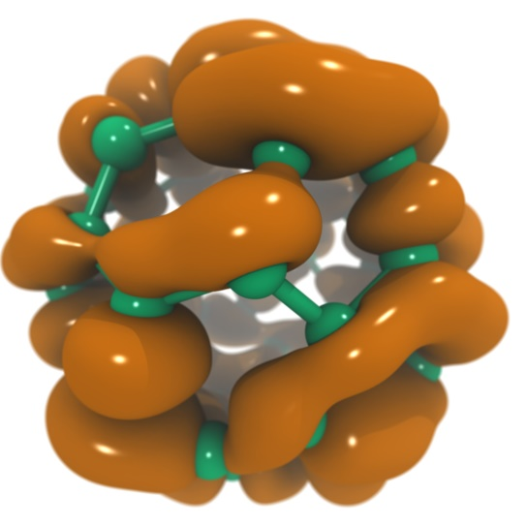
VMD Tesla V100 Performance for
C₆₀ Molecular Orbitals, 516x519x507 grid
Hardware platform | Runtime, Speedup
IBM Power8 (ORNL ‘crest’) + 1x Tesla K40 [1] | 3.49s, 1.0x
Intel Xeon E5-2697Av4 + 1x Tesla V100 [2] | 0.610s, 5.7x
Intel Xeon E5-2697Av4 + 2x Tesla V100 [2] | 0.294s, 11.8x
Intel Xeon E5-2697Av4 + 3x Tesla V100 [2] | 0.220s, 15.9x
IBM Power9 “Newell” + 1x Tesla V100 | 0.394s, 8.8x
IBM Power9 “Newell” + 2x Tesla V100 | 0.207s, 16.8x
IBM Power9 “Newell” + 3x Tesla V100 | 0.151s, 23.1x
IBM Power9 “Newell” + 4x Tesla V100 | 0.130s, 26.8x
NVLink perf. boost
[1] Early Experiences Porting the NAMD and VMD Molecular Simulation and Analysis Software to GPU-Accelerated OpenPOWER Platforms. J. E. Stone, A.-P. Hynninen, J. C. Phillips, K. Schulten. International Workshop on OpenPOWER for HPC (IWOPH'16), LNCS 9945, pp. 188-206, 2016.
[2] NAMD goes quantum: An integrative suite for hybrid simulations. Melo et al., Nature Methods, 2018.

Slide 22
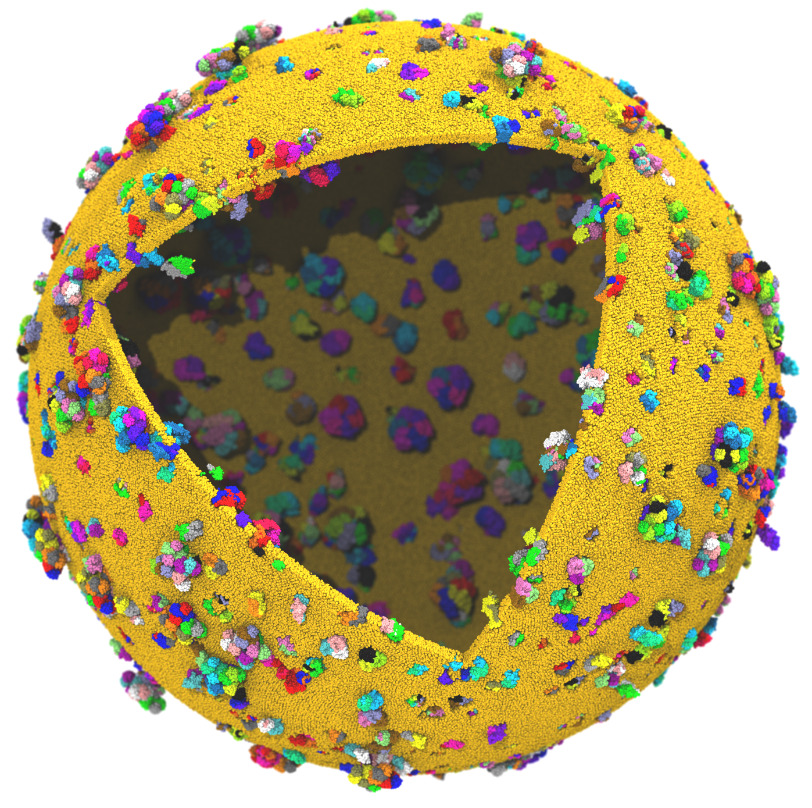
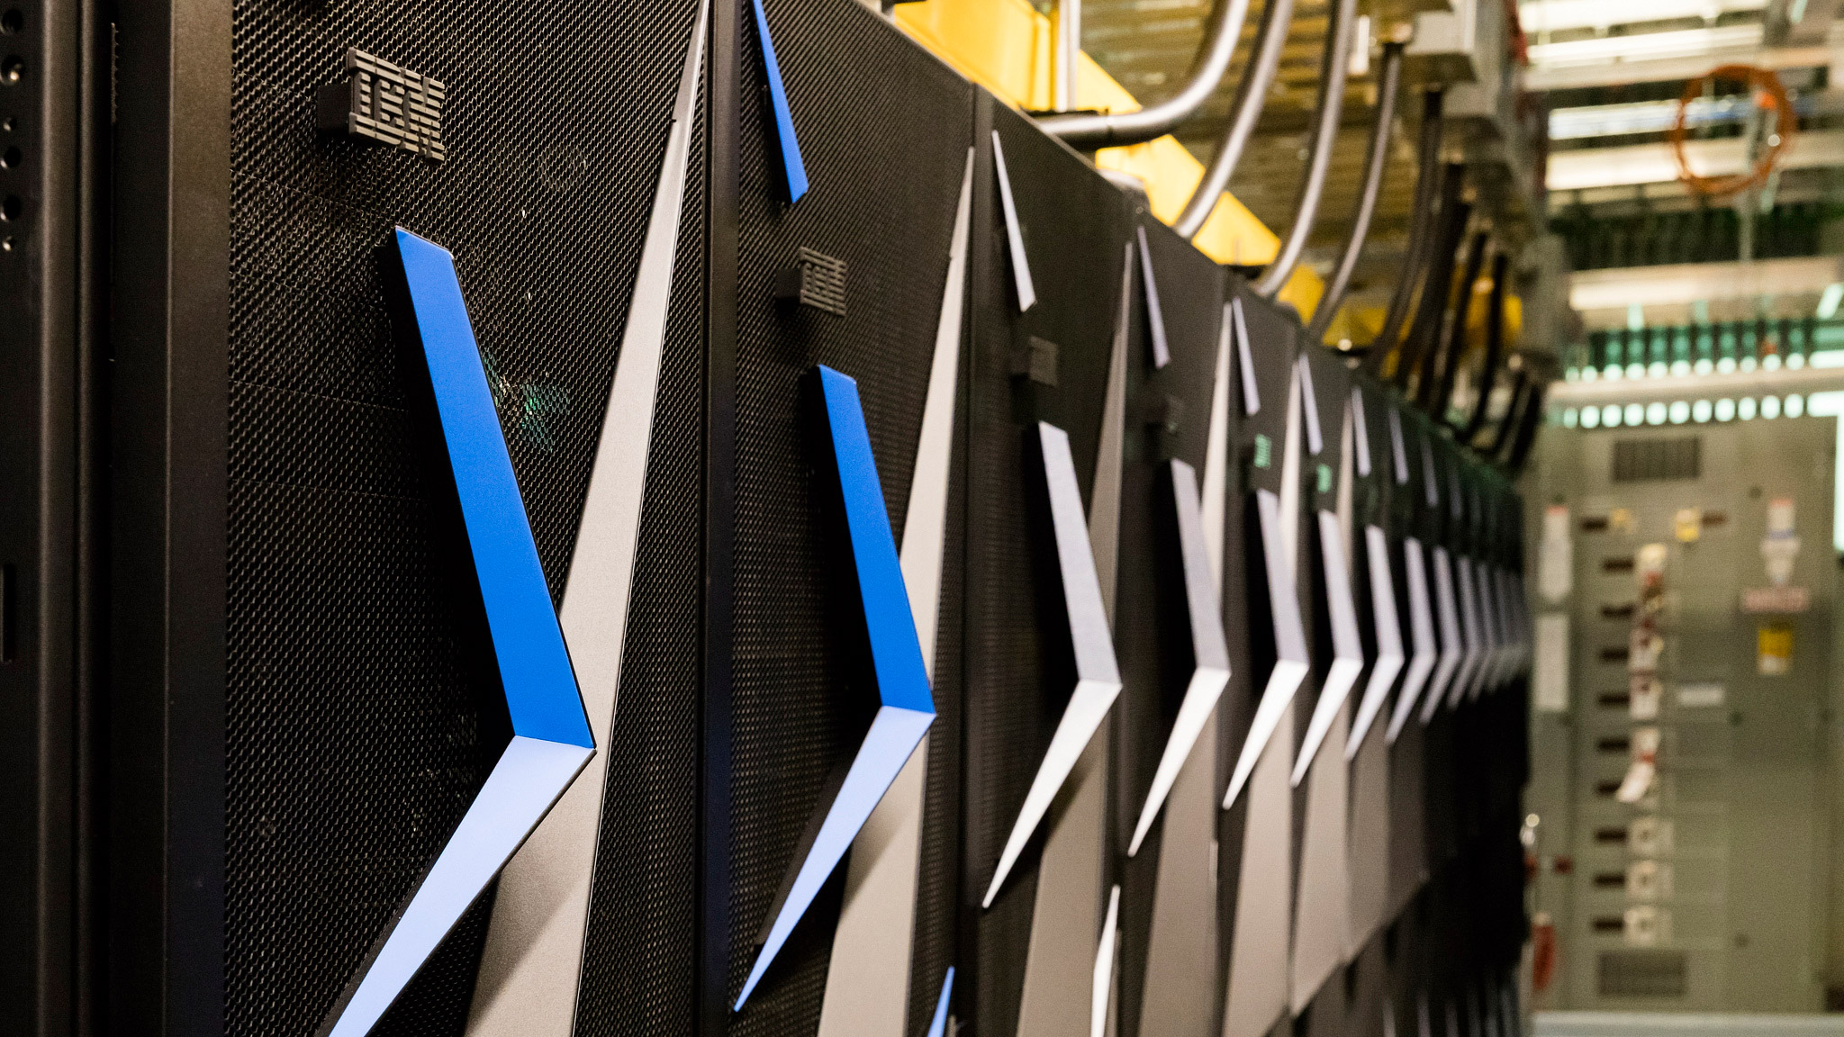
Next Generation: Simulating a Proto-Cell
ORNL Summit: NVLink-connected Tesla V100 GPUs enable next-gen visualizations
200nm diameter
~1 billion atoms w/ solvent
~1400 proteins in membrane

Slide 23
Proto-Cell Data Challenges
1B-atom proto-cell requires nodes with more than TB RAM to build complete model…
1B-atom proto-cell binary structure file: 63GB
Trajectory frame atomic coordinates: 12GB, 1.2TB/ns of simulation (1 frame per 10ps)
Routine modeling and visualization tasks are a big challenge at this scale
  Models contain thousands of atomic-detail components that must work together in harmony
  Exploit persistent memory technologies to enable “instant on” operation on massive cell-scale models – eliminate several minutes of startup during analysis/visualization of known structure
  Sparse output of results at multiple timescales will help ameliorate visualization and analysis I/O
  Data quantization, compression, APIs like ZFP

Slide 24


NEW: Power9+V100 Interactive Remote Visualization
Built-into VMD itself
Enable access to massive data sets
Uses GPU H.264 / HEVC hardware accelerated video encode/decode
Supports interactive remote visualizations (both rasterization and ray tracing)
Development ongoing, expected in next major VMD release, in 1H 2019…

Slide 25
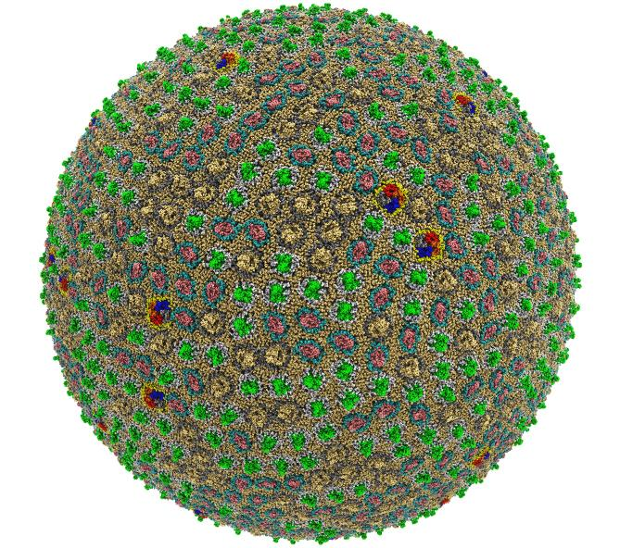
Preparation, Visualization, Analysis of Cell-Scale Simulations
Support for large memory (TB), up to 2 billion atoms per “molecule” now
Interactive viz. w/ OpenGL/EGL, Vulkan
Interactive ray tracing on CPUs and GPUs
Remote visualization w/ video streaming
New file formats, compression, out-of-core, and non-volatile memory technologies
Parallel analysis, visualization w/ MPI
200 nm spherical envelope
Membrane with ~50% occupancy by proteins
63M atoms in envelope model
Challenges of Integrating Stochastic Dynamics and Cryo-electron Tomograms in Whole-cell Simulations. Earnest, et al. J. Physical Chemistry B, 121(15): 3871-3881, 2017.
Atomic Detail Visualization of Photosynthetic Membranes with GPU-Accelerated Ray Tracing. J.E. Stone, …, K. Schulten, J. Parallel Computing, 55:17-27, 2016.
High Performance Molecular Visualization: In-Situ and Parallel Rendering with EGL. J.E. Stone, ..., K. Schulten. IEEE High Performance Data Analysis and Visualization, IPDPSW, pp. 1014-1023, 2016.

Slide 26
Acknowledgements
Theoretical and Computational Biophysics Group, University of Illinois at Urbana-Champaign
NVIDIA CUDA and OptiX teams
Funding:
  NIH support: P41GM104601
  ORNL Center for Advanced Application Readiness (CAAR)
  IBM POWER team, IBM Poughkeepsie Customer Center
  NVIDIA CUDA, OptiX, Devtech teams
  UIUC/IBM C3SR
  NCSA ISL
Notes:
26

Slide 27
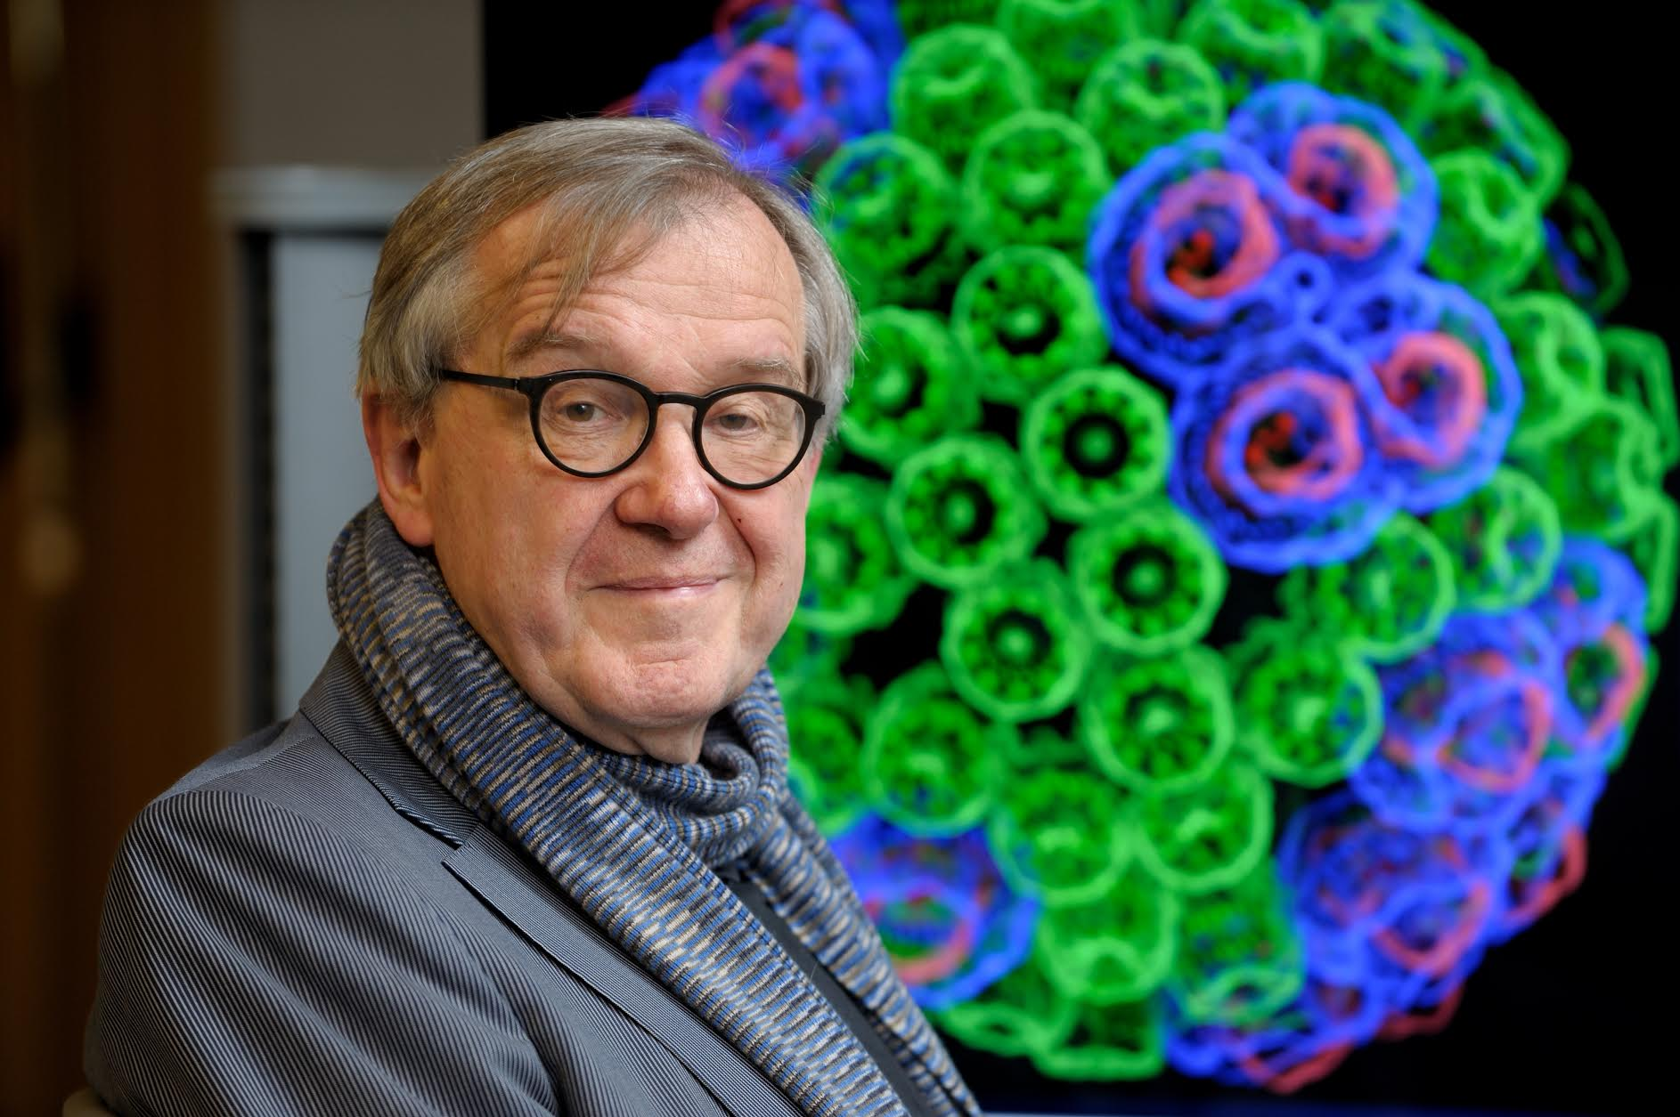
“When I was a young man, my goal was to look with mathematical and computational means at the inside of cells, one atom at a time, to decipher how living systems work. That is what I strived for and I never deflected from this goal.” – Klaus Schulten

