Slide 1
Molecular Visualization and Simulation in VR
John E. Stone
Theoretical and Computational Biophysics Group
Beckman Institute for Advanced Science and Technology
University of Illinois at Urbana-Champaign
http://www.ks.uiuc.edu/Research/vmd/
http://www.ks.uiuc.edu/Research/gpu/
Indiana University, Wednesday March 6th, 2019

Slide 2
AVL Virtual Reality Workshop Series – Spring 2019
Wednesdays @ 4:00pm – Franklin Hall Reality Lab (052)
Bonus: VR Expeditions select Mondays (FH 052 @4:00pm)
Date | Topic | Presenter
Jan. 16 | The Medium of Virtual Reality | Bill Sherman
Jan. 23 | A Survey of VR Experiences | Chauncey Frend
Jan. 30 | (no talk – cancelled for weather)
Feb. 6 | VR for Simulation and Training | Chauncey Frend
Feb. 11 | VR Expedition: Experiential Gaming | Jeff Rogers
Feb. 13 | VR for Architectural review | Jeff Rogers
Jeb. 18 | VR Expedition: Cultural Heritage | Tassie Gniady
Feb. 20 | Developing Mobile VR Experiences | Jeff Rogers
Feb. 25 | VR Expedition: Creative Tools in VR | Chauncey Frend
Feb. 27 | Scientific Visualization with VR | Bill Sherman
Mar. 6 | Molecular Visualization and Simulation with VR | John Stone
Mar. 13 | (no talk – Spring Break) | N/A
Mar. 20 | Virtual Tourism | Tassie Gniady
Mar. 25 | VR Expedition: Science Education | Bill Sherman
Mar. 27 | (no talk – IEEE VR Conference) | N/A
Apr. 3 | Archaeology Training with VR | Laura Shackelford / Cam Merrill / Alan Craig
Apr. 10 | VR-Unity Extravaganza | Bill Sherman
✧

Slide 3
Services for Digital Humanities and Creative Activities Workshop Series – Spring 2019
Thursdays @ 4:00pm – Wells Library Scholars’ Commons
Date | Topic | Presenter
Jan. 17 | Introduction to Text Analysis | Tassie Gniady and David Kloster
Jan. 24 | Introduction to Topic Modeling | Tassie Gniady and David Kloster
Jan. 31 | Introduction to Sentiment Analysis | David Kloster and Tassie Gniady
Feb. 7 | Introduction to Document Similarity | David Kloster and Tassie Gniady
Feb. 14 | Hands-on Text Extravaganza | Tassie Gniady and David Kloster
Feb. 21 | Rome Reborn: Visiting Rome in A.D. 320 | Bernie Frischer
Feb. 28 | Virtual Reality in the Art History Classroom | Matthew Brennan
Mar. 7 | Painting Virtual Art: An Artists’s History through VR | Margaret Dolinsky
Mar. 13 | (no talk – Spring Break) | N/A
Mar. 21 | Augmented Reality / Virtual Reality | Chauncey Frend
Mar. 28 | 3D Digitization | Jeff Rogers and Tassie Gniady
Apr. 4 | Advanced Media | Chris Eller
Apr. 11 | Create your own VR Tour | Matt Mercer and Tassie Gniady
APr. 18 | XR Extravaganza | Jeff Rogers
✧
Notes:
Companion series in the midst of several VR related topics as well.

Slide 4
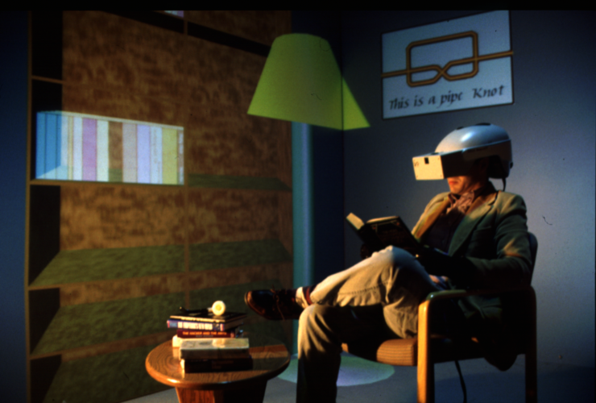
Molecular Visualization and Simulation in VR
Presented by John E. Stone, Senior Research Programmer, U. Illinois
Impact of Virtual Reality Workshop Series

Slide 5
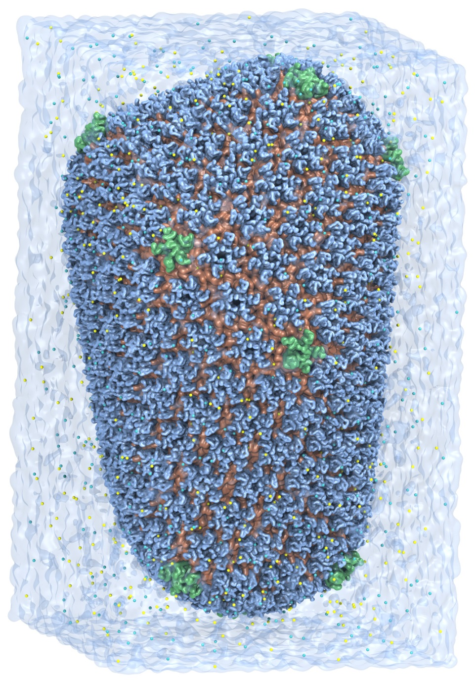
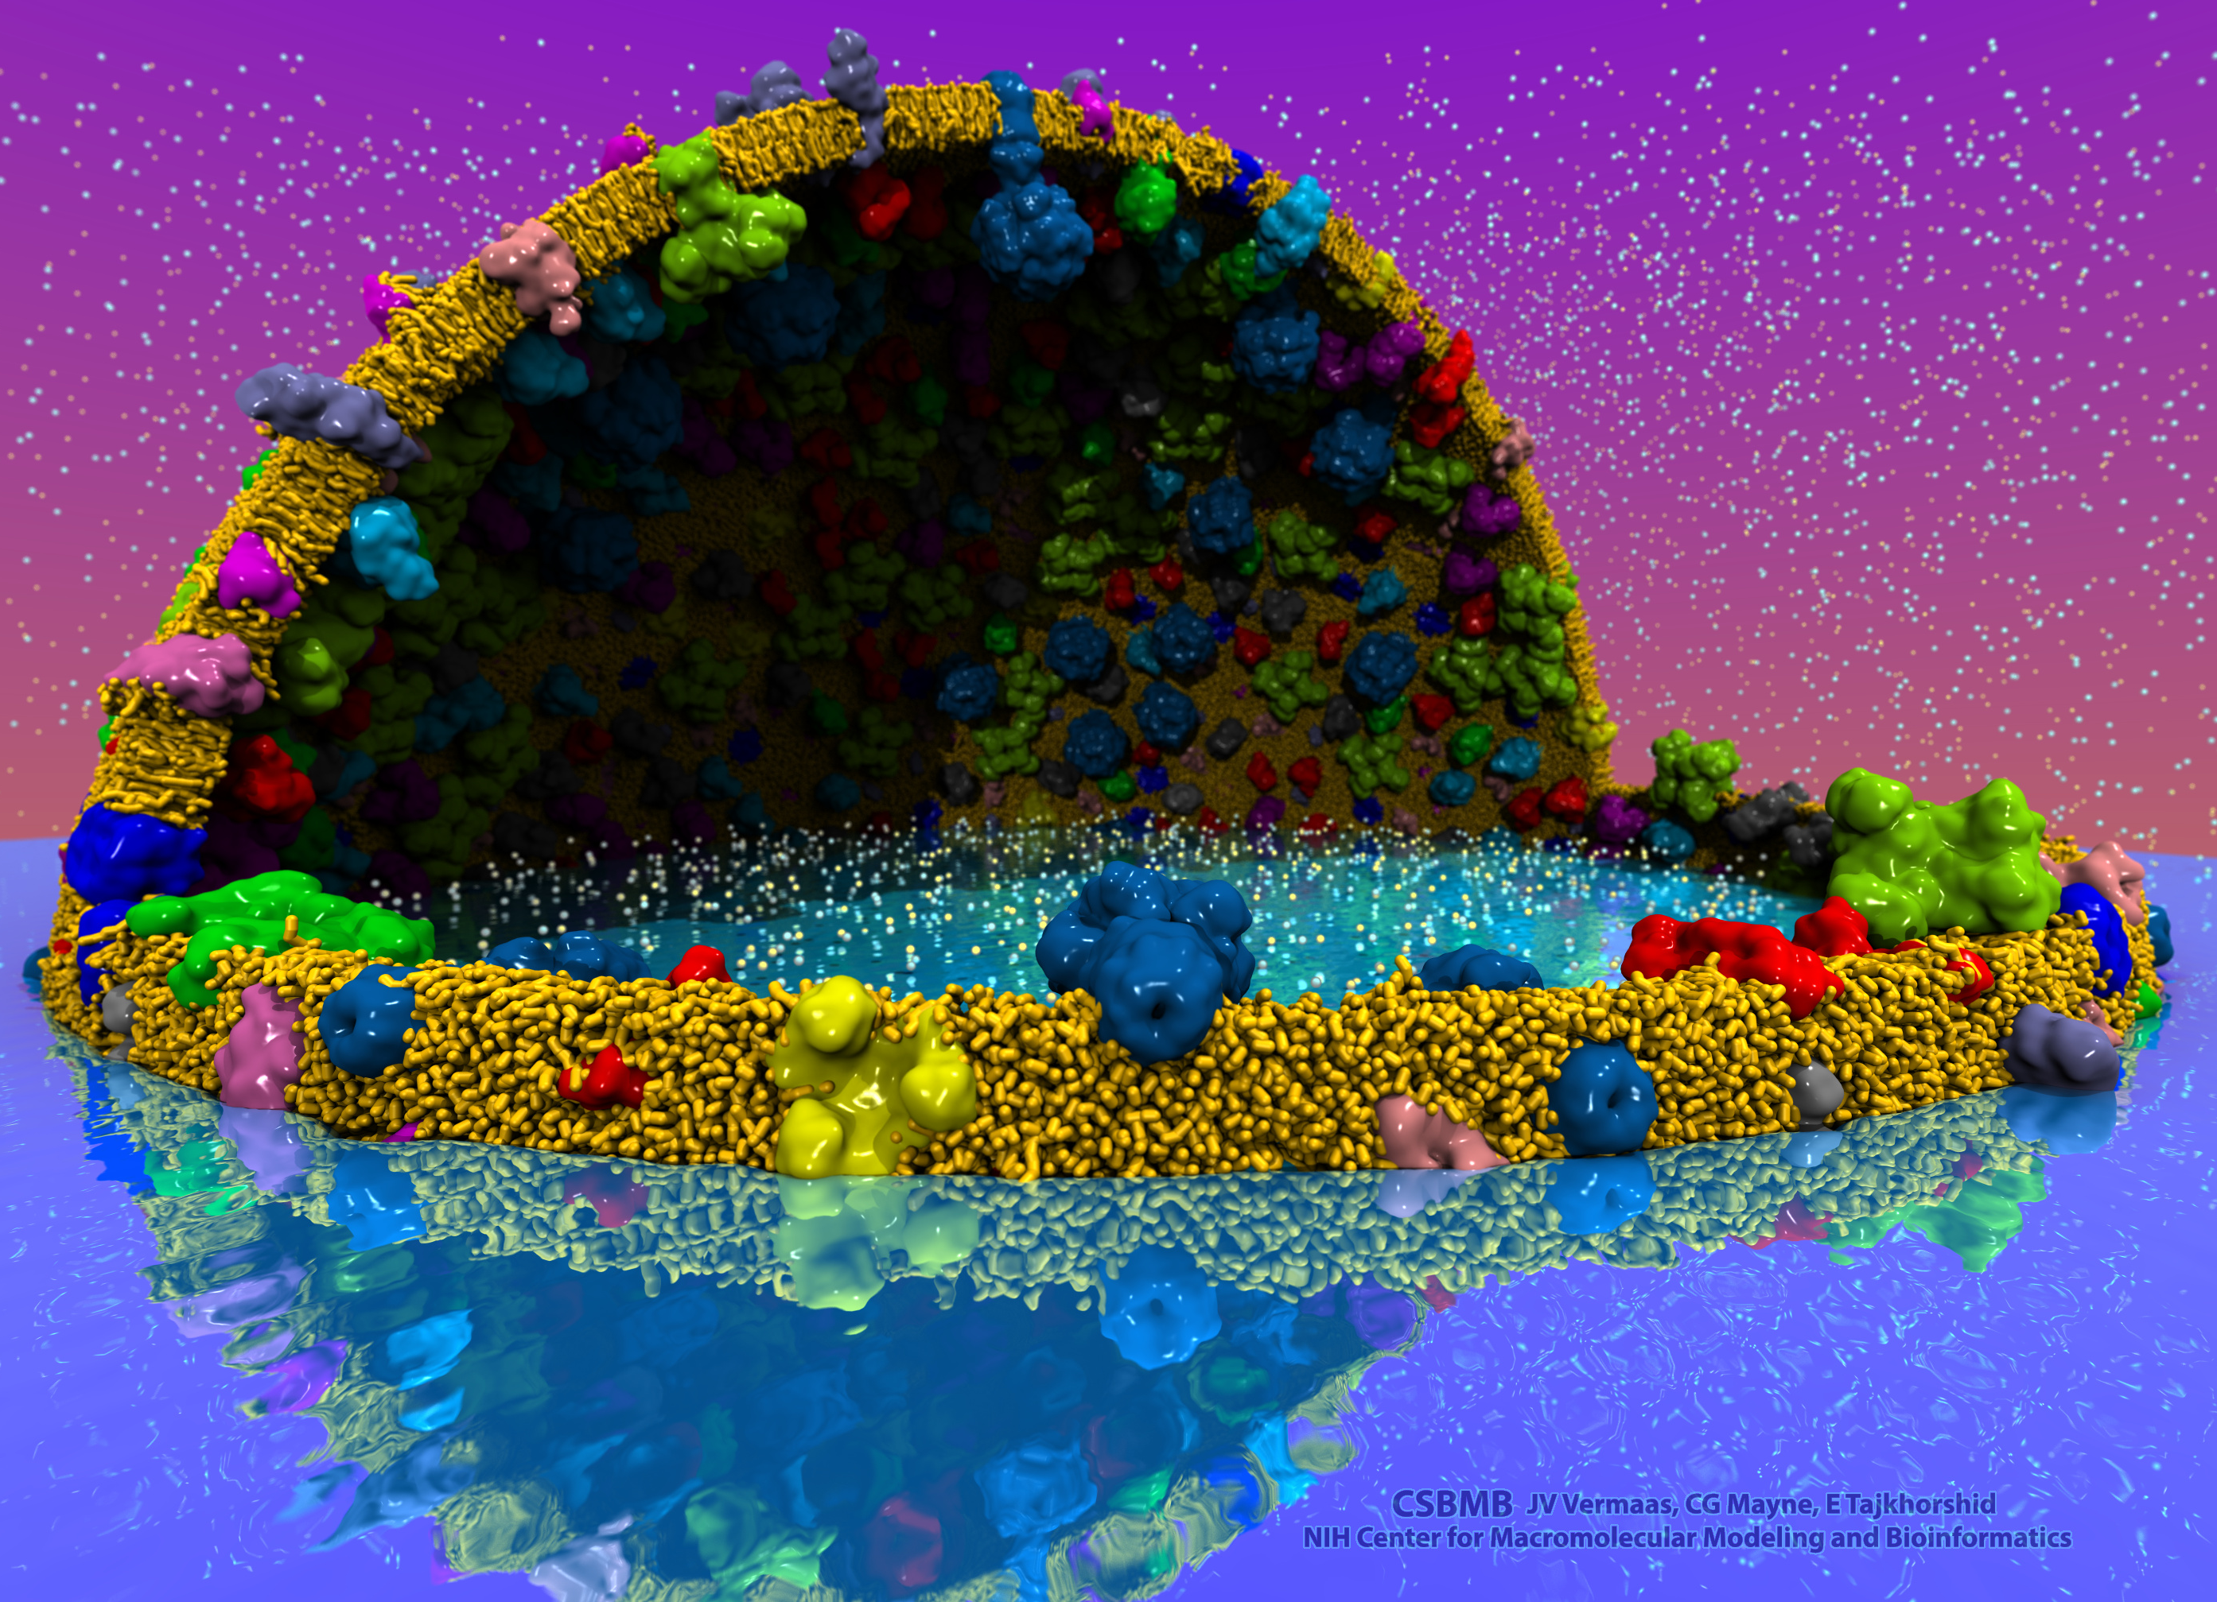
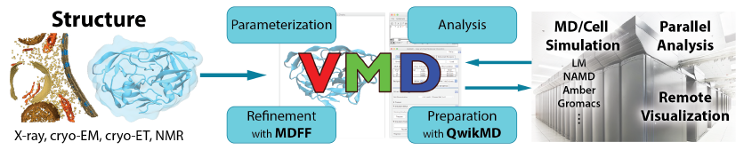
VMD – “Visual Molecular Dynamics”
Visualization and analysis of:
  Molecular dynamics simulations
  Lattice cell simulations
  Quantum chemistry calculations
  Cryo-EM densities, volumetric data
  Sequence information
User extensible scripting and plugins
http://www.ks.uiuc.edu/Research/vmd/
Cell-Scale Modeling
MD Simulation

Slide 6
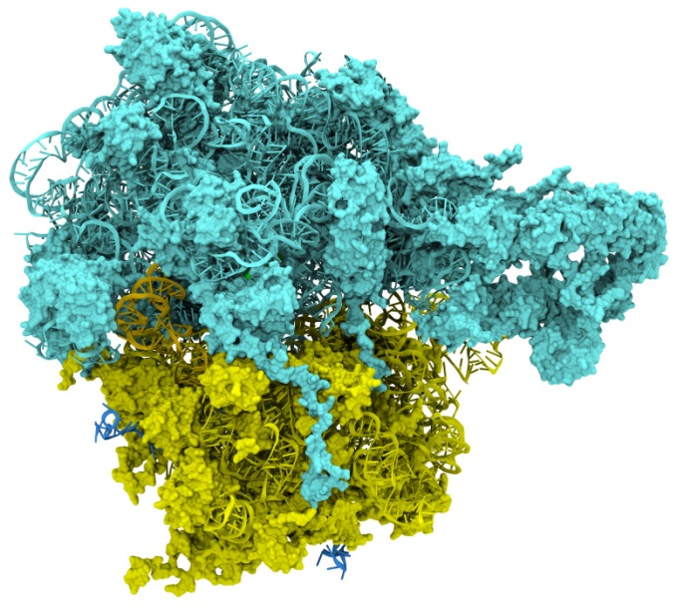
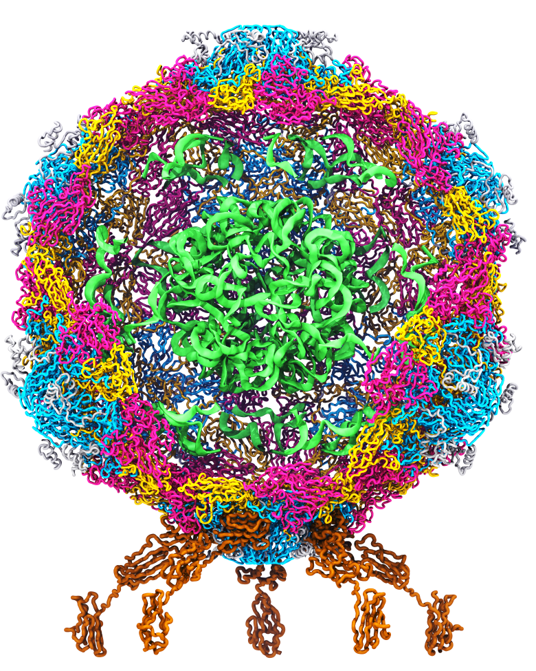
Goal: A Computational Microscope
Study the molecular machines in living cells
Ribosome: target for antibiotics
Poliovirus
Notes:
Ribosomes synthesize new proteins from genetic information
Bacterial ribosome is a target for antibiotics, which interfere with its ability to function by binding to sites on the structure, preventing proteins from being synthesized
Ribosome simulations are extremely computationally challenging due to the size of the structure and its natural environment (solvent, ions, etc, large box, 3 million atoms or so)
Bionanodevice for sequencing DNA efficiently
Knowledge of an individual’s genetic makeup can lead to the prediction and treatment of many diseases by the means of personal genomic medicine and pharmacogenomics. In order for genome sequencing to become practical for common medical use, an inexpensive high throughput genome sequencing technique is required. NIH has set a goal of reducing the cost of genome sequencing by a factor of 10,000, to less than $1,000 within ten years.
The computer is the best microscope to guide the development of bionanodevices, for example to sequence DNA. While experiments can measure DNA electrostatic potentials, they cannot visualize the DNA’s location and conformation at the time of measurement.

Slide 7
VMD Visualization Concepts

Slide 8
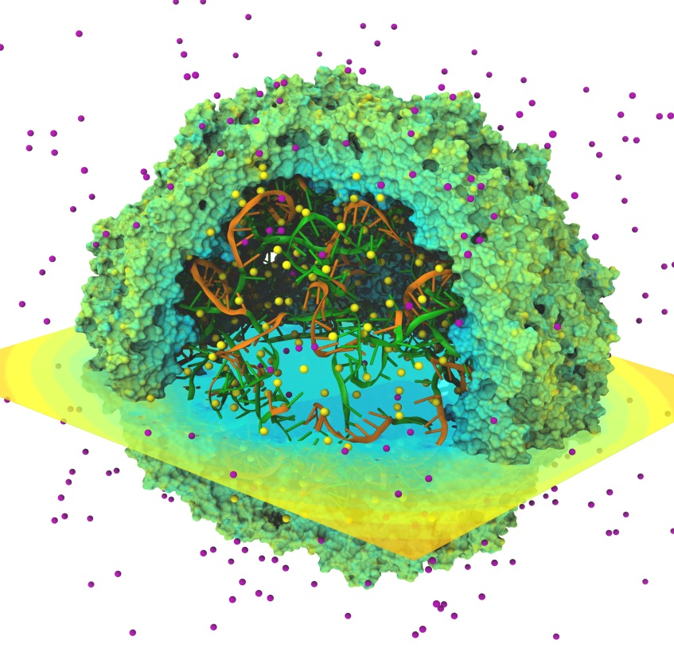
Biomolecular Visualization Challenges
Geometrically complex scenes
Spatial relationships important to see clearly: fog, shadows, AO helpful
Often show a mix of structural and spatial properties
Time varying!

Slide 9
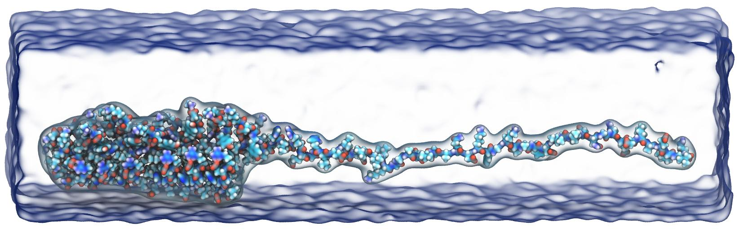
Structure Visualization
Molecular representations provide different levels of abstraction, atomic detail vs. higher level organizational information
Atoms, VdW spheres, bonds, ball-stick, …
Molecular orbitals (quantum chemistry)
Molecular surfaces
Coarse-grained “beads”
Ribbons, secondary structure, “cartoon” reps, RNA/DNA

Slide 10
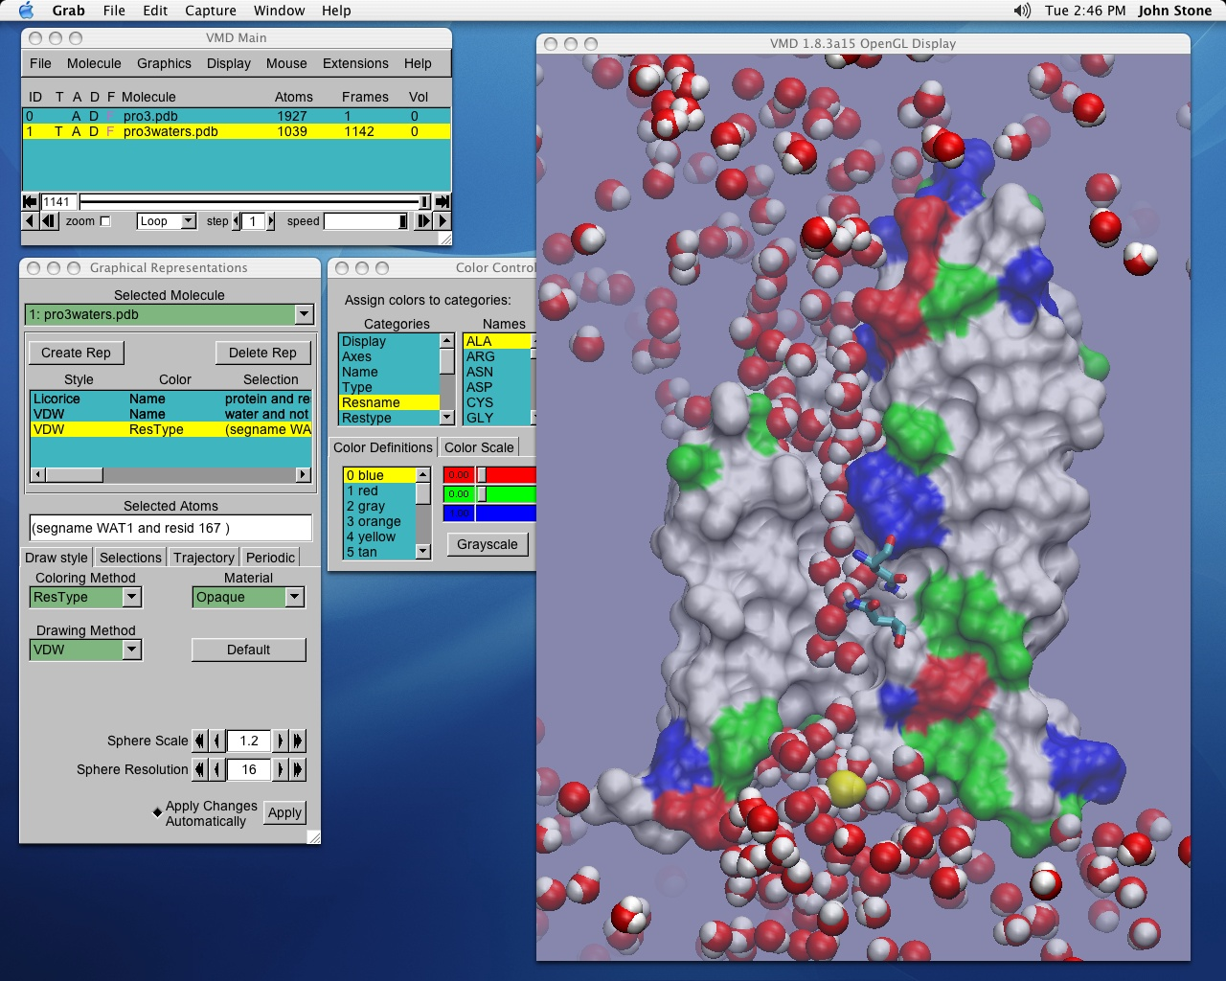
Selection, Filtering
Most viz tools allow interactive visual picking, menu-driven selections of structure components to display or operate on
VMD also extensively uses a text-based selection language (think google):
  “water within 10 of protein and z > 0”
  Allows selection on user-defined fields
  Promotes synergy between interactive and scripting interfaces
  Works very well when dealing with huge time-varying structures

Slide 11
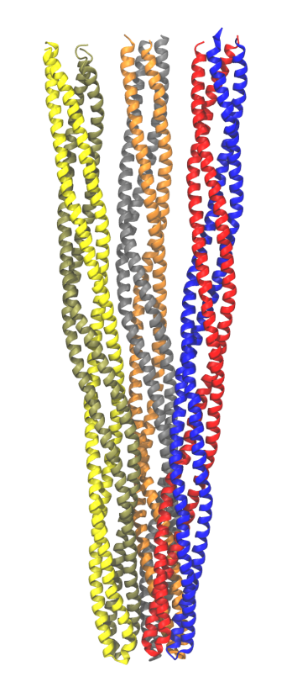
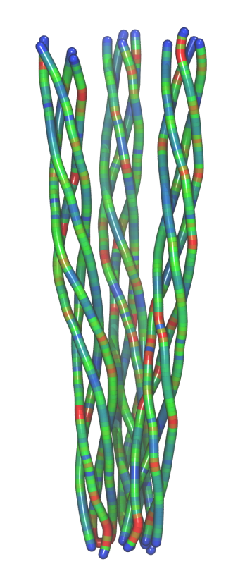
Computed Properties
Smoothing of thermal noise
Secondary structure
Hydrogen bonds, salt bridges
Forces, energies, stress, strain
Time averaging of electrostatic fields, occupancy maps
Quality-of-fit cross correlation with cryo-EM density maps
Normal modes, principal component analysis, essential dynamics
Cluster simulation trajectory timesteps by structural similarity
Chemoreceptor trimer-of-dimers analysis with Bendix plugin in VMD

Slide 12
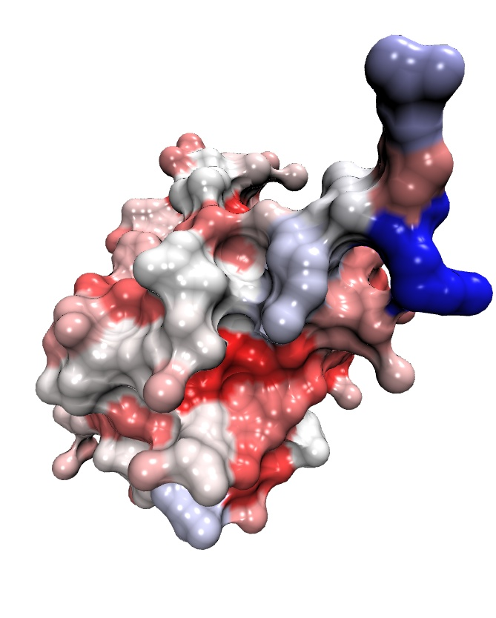
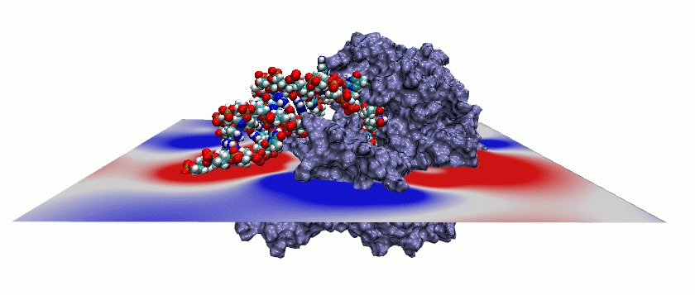
Display of Computed Properties on Structures
PME electrostatic potential contour for a helicase on a volumetric slice plane
Per-residue solvent-accessible
surface area of Ubiquitin

Slide 13
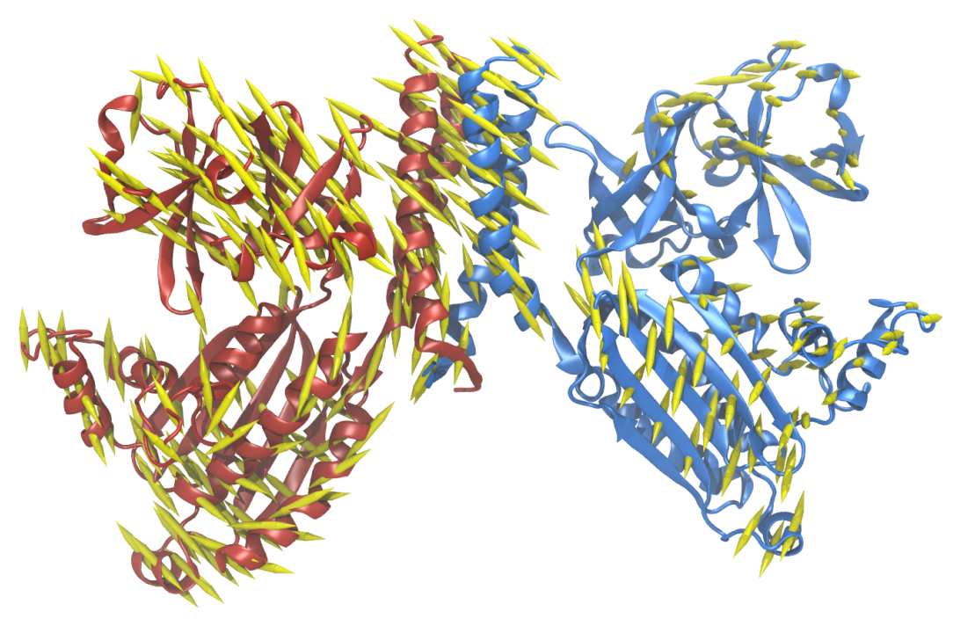
CheA kinase PCA: first principal component porcupine plot

Slide 14
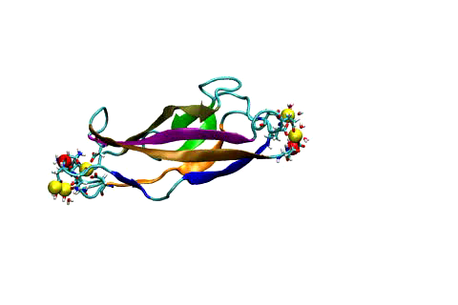
Visualization of Molecular Dynamics
Molecular dynamics simulations save trajectories of atomic coordinates as simulated time progresses
Researchers study trajectories by analyzing force profiles, energies, structural changes, etc.
Visualization selections, graphics, structure properties recomputed for each trajectory timestep!

Slide 15
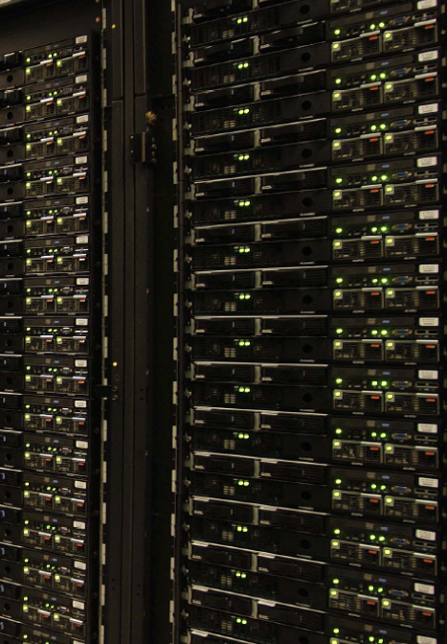
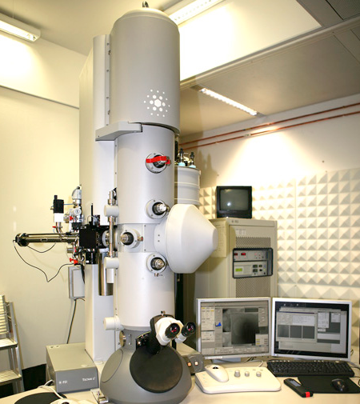
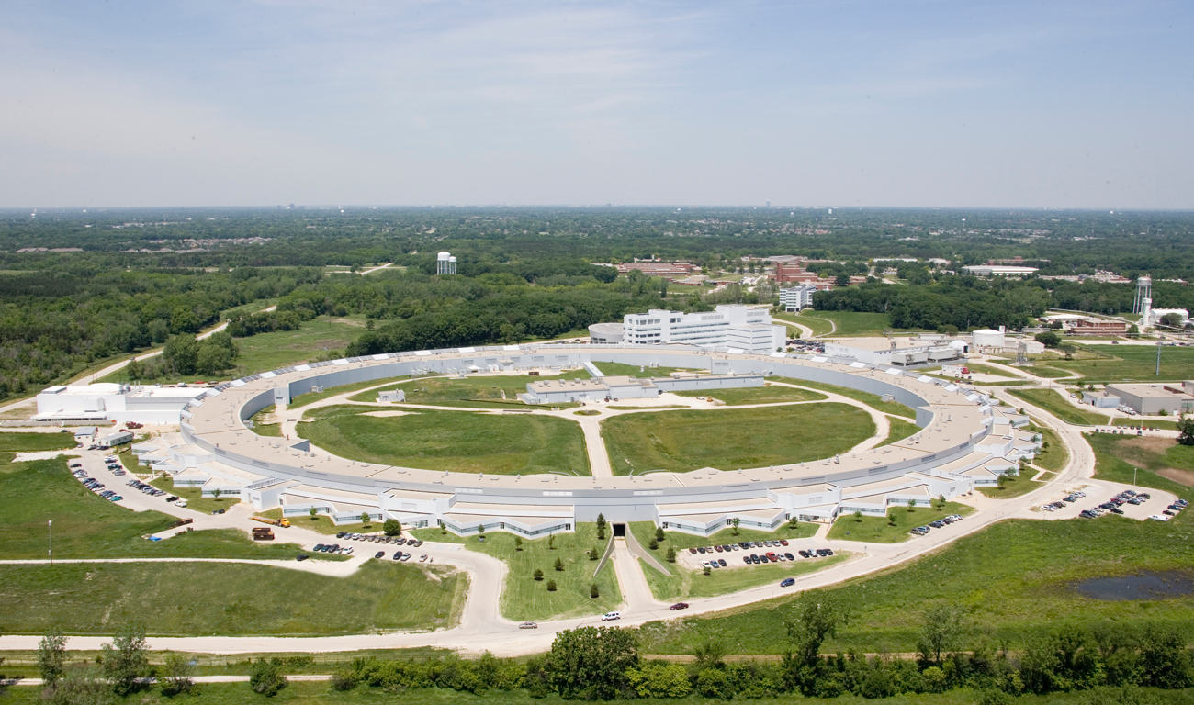
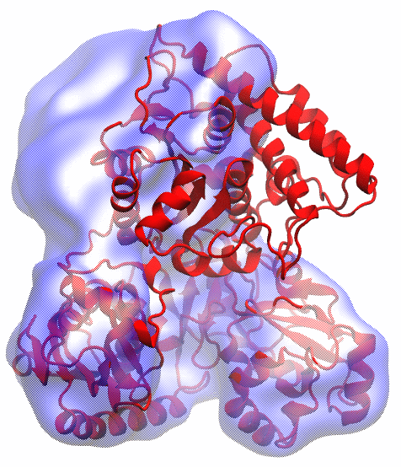
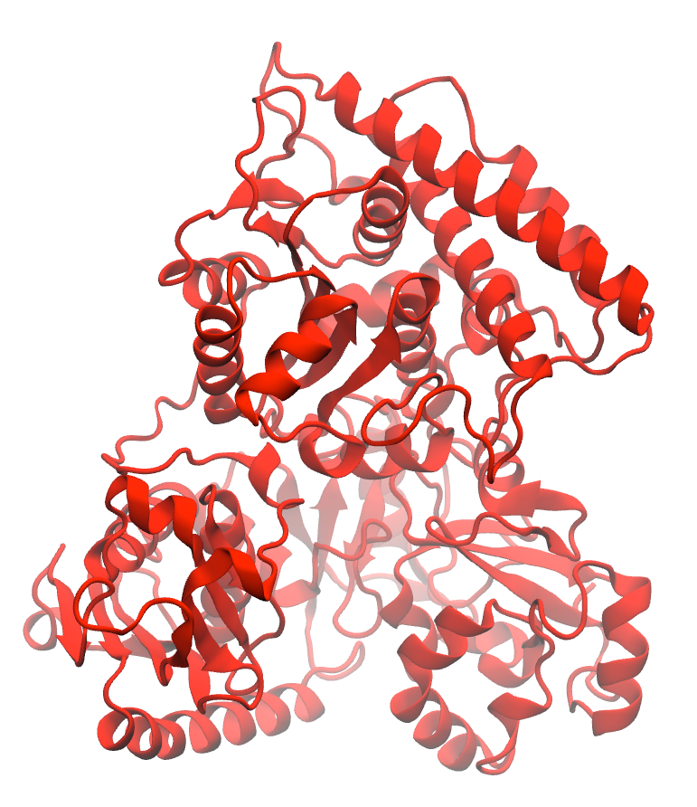
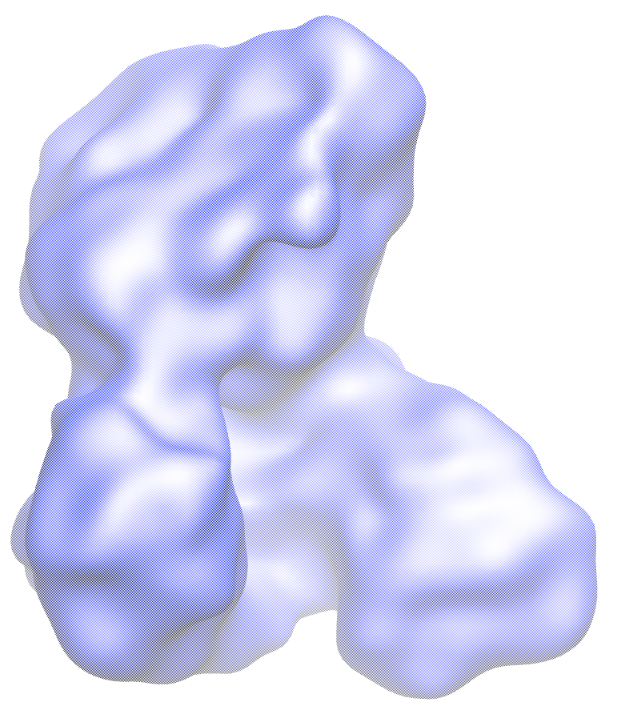
Petascale Computing - A Key Instrument for Life Science
MDFF Solves Structures from X-ray Crystallography and Cryo-EM
Electron microscopy
X-ray crystallography
APS at Argonne
FEI microscope
Electron density of protein in action at low resolution
Ideal protein structure at high resolution
Acetyl – CoA Synthase

Slide 16
Immersive Visualization and VR for Structural Biology

Slide 17
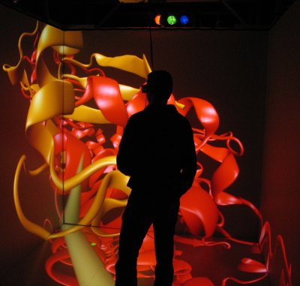
Immersive Viz. w/ VMD
VMD began as a CAVE app (1993)
Use of immersive viz by molecular scientists limited due to cost, complexity, lack of local availability, convenience
Commoditization of HMDs excellent opportunity to overcome cost/availability
This leaves many challenges still to solve:
  Incorporate support for remote visualization
  UIs, multi-user collaboration/interaction
  Rendering perf for large molecular systems
  Accomodate limitations idiosyncracies of commercial HMDs
VMD running in a CAVE w/ VR Juggler

Slide 18
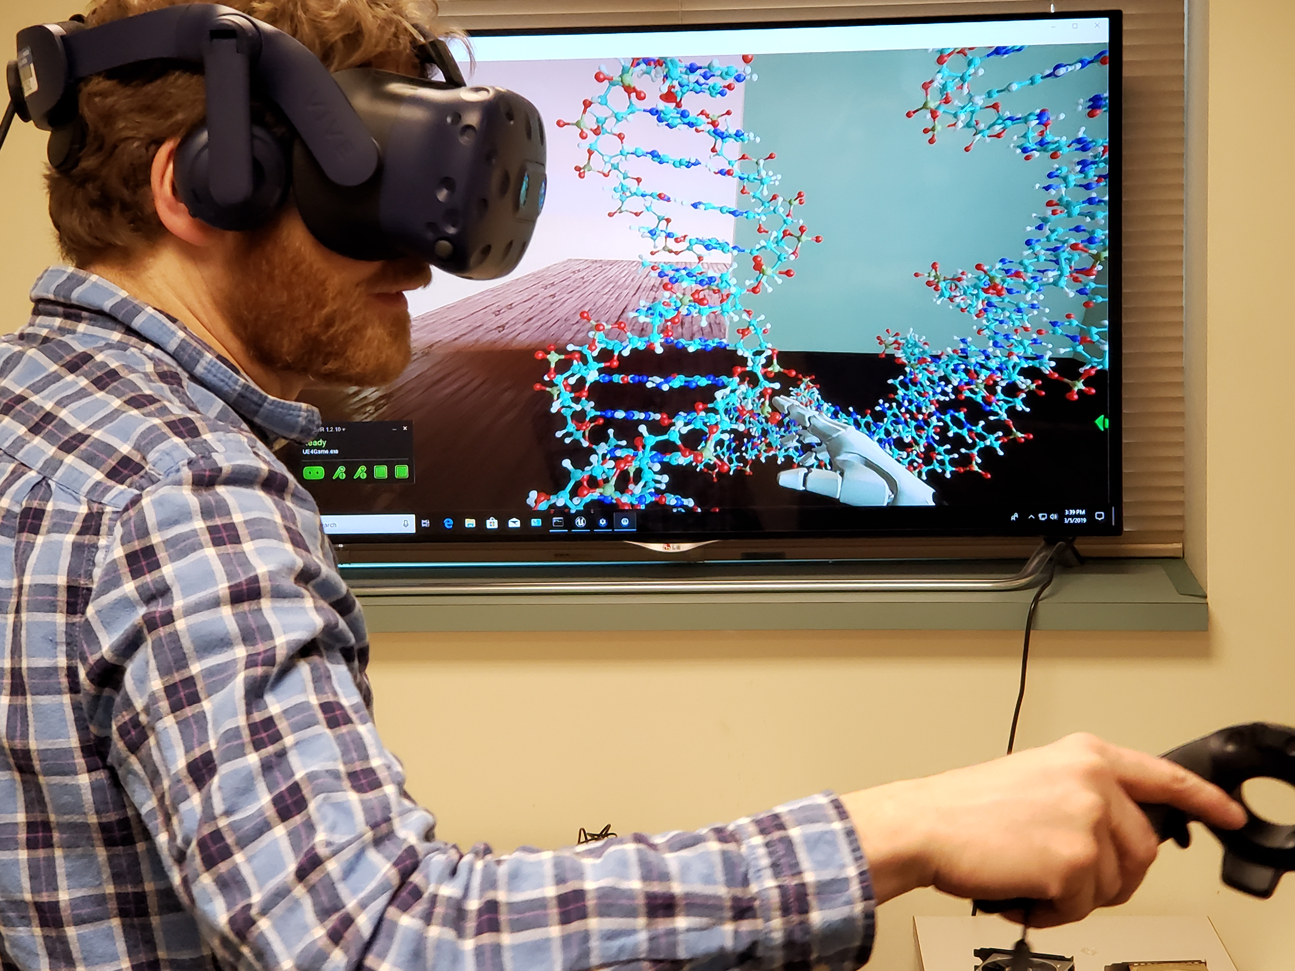
Benefits of VR for Structural Biology
By far the easiest structure exploration and navigation experience
Well designed VR “tools” easier to use than conventional windowed visualization interfaces

Slide 19
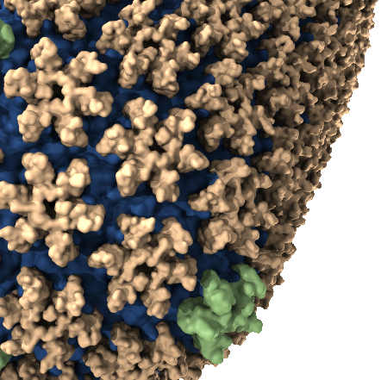
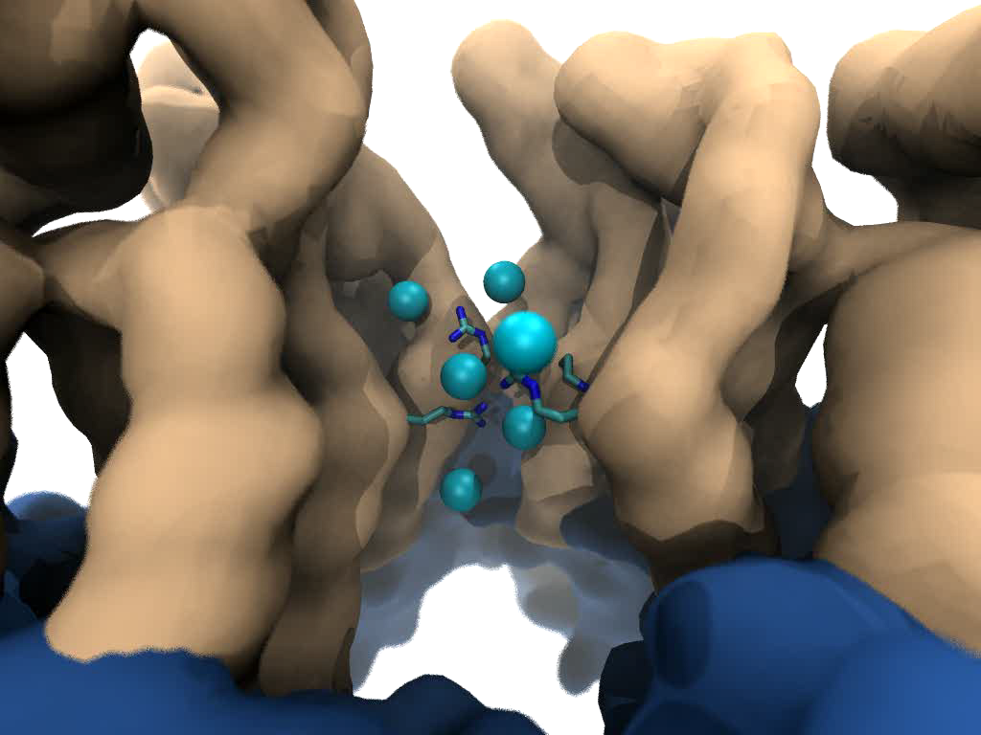


Goal: Intuitive interactive viz. in crowded molecular complexes
Results from 64 M atom, 1 μs sim!
Close-up view of chloride ions permeating through HIV-1 capsid hexameric centers

Slide 20
What Sorts of Tasks Do Researchers
Need to Perform in VR
Heavily skewed toward 3-D atomic structure visualization, analysis, dynamics
Prime Example: Superposition and direct comparison of multiple modalities of structure information arising from different experimental and computational structure determination methods
  Conventional windowed visualization interactions can be “clunky” until user uses 6DoF input devices and develops dexterity to use them effectively
  VR HMDs and hand controllers simple to use and understand
  Key interactions contextual with the structure/data being interacted with and the visualization or analysis task at hand

Slide 21
What General “VR UI Tools”
Are Useful in This Area
Navigation, teleportation, scaling, view-reset
Selection
Grabbing, pulling, orientation
Hand-held lighting
Clipping of drawn geometry, to allow peeling away of obscuring layers of atomic structures, density isosurfaces, etc.

Slide 22
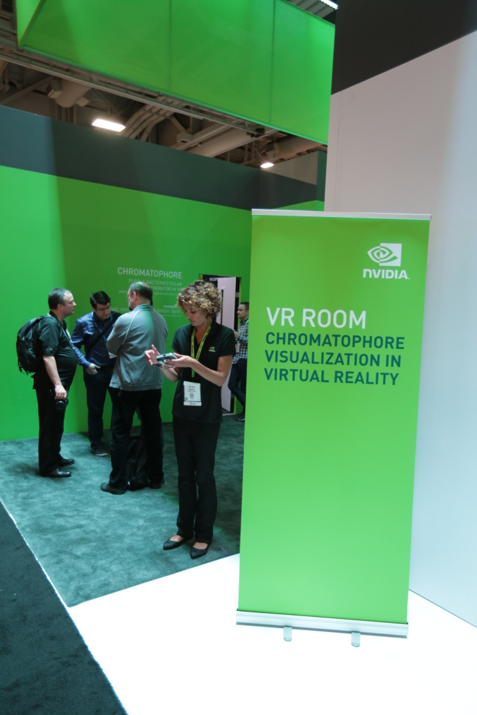
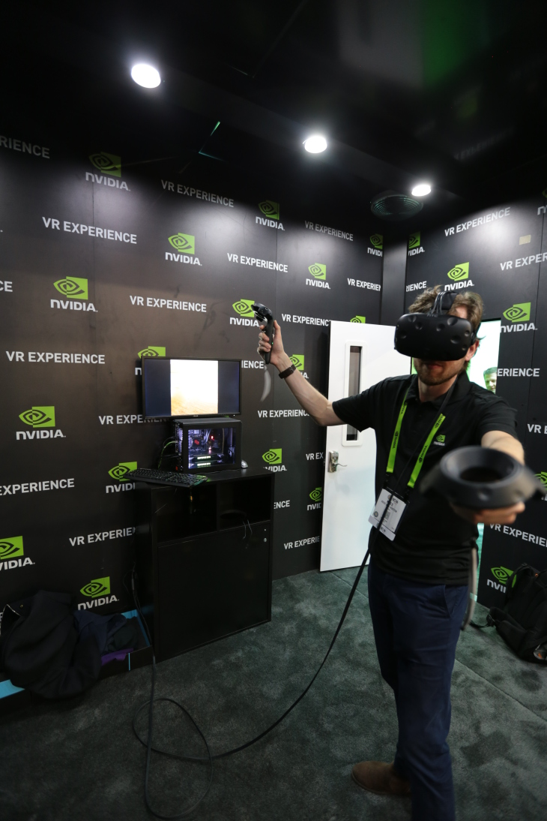
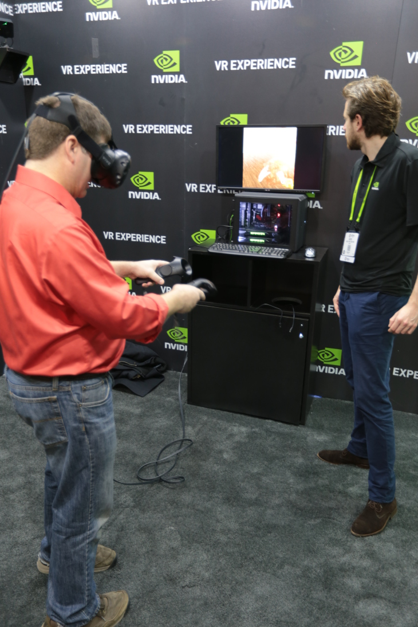
In-Progress VMD VR Development, Demos
VMD VR ray tracing:
Google Cardboard [1]
Demo w/ Indiana U., SC’15 [2]
Prototype of VR user interaction with VMD models in room-scale VR with NVIDIA @ SC’16
[1] Atomic Detail Visualization of Photosynthetic Membranes with GPU-Accelerated Ray Tracing. Stone et al., J. Parallel Computing, 55:17-27, 2016.
[2] Immersive Molecular Visualization with Omnidirectional Stereoscopic Ray Tracing and Remote Rendering. J.E. Stone, W.R. Sherman, K. Schulten. IEEE HPDAV (IPDPSW), pp. 1048-1057, 2016.
VMD Chromatophore Demo, NVIDIA VR Room at SC‘16

Slide 23
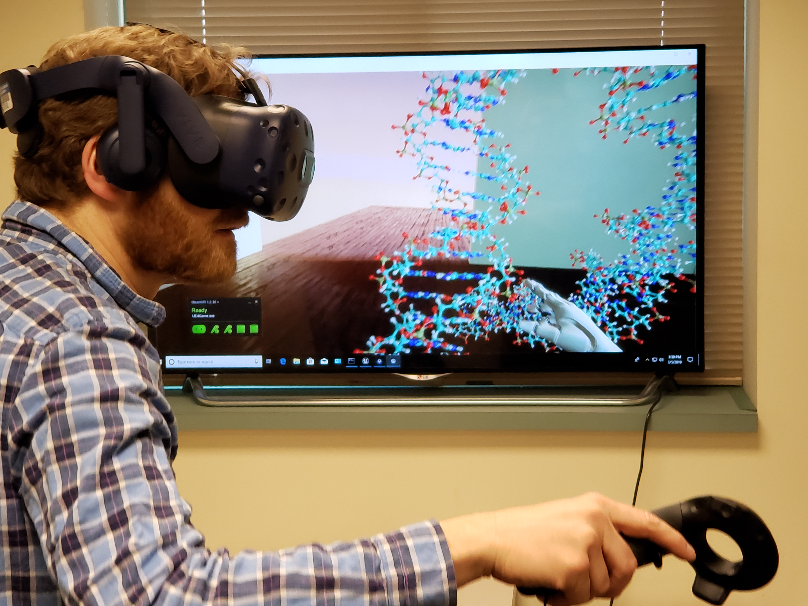
Tool Examples: Grabbing, Moving

Slide 24
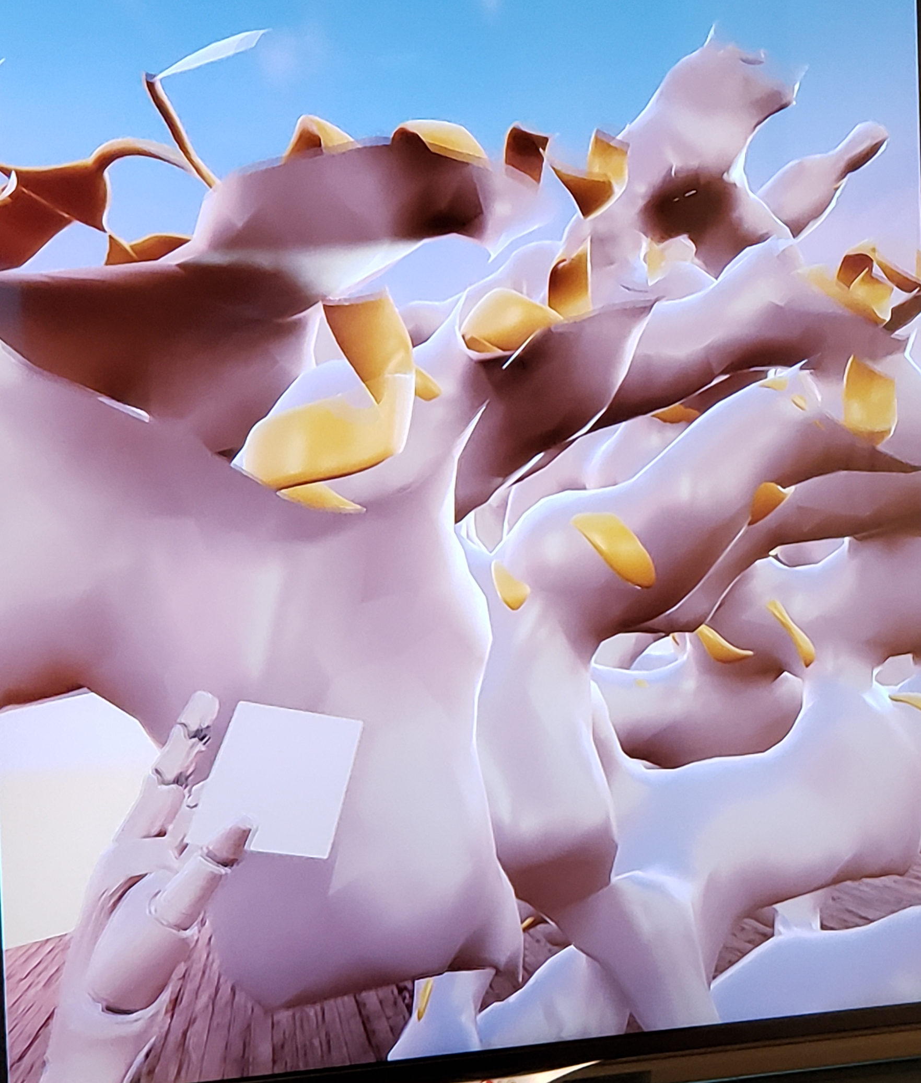
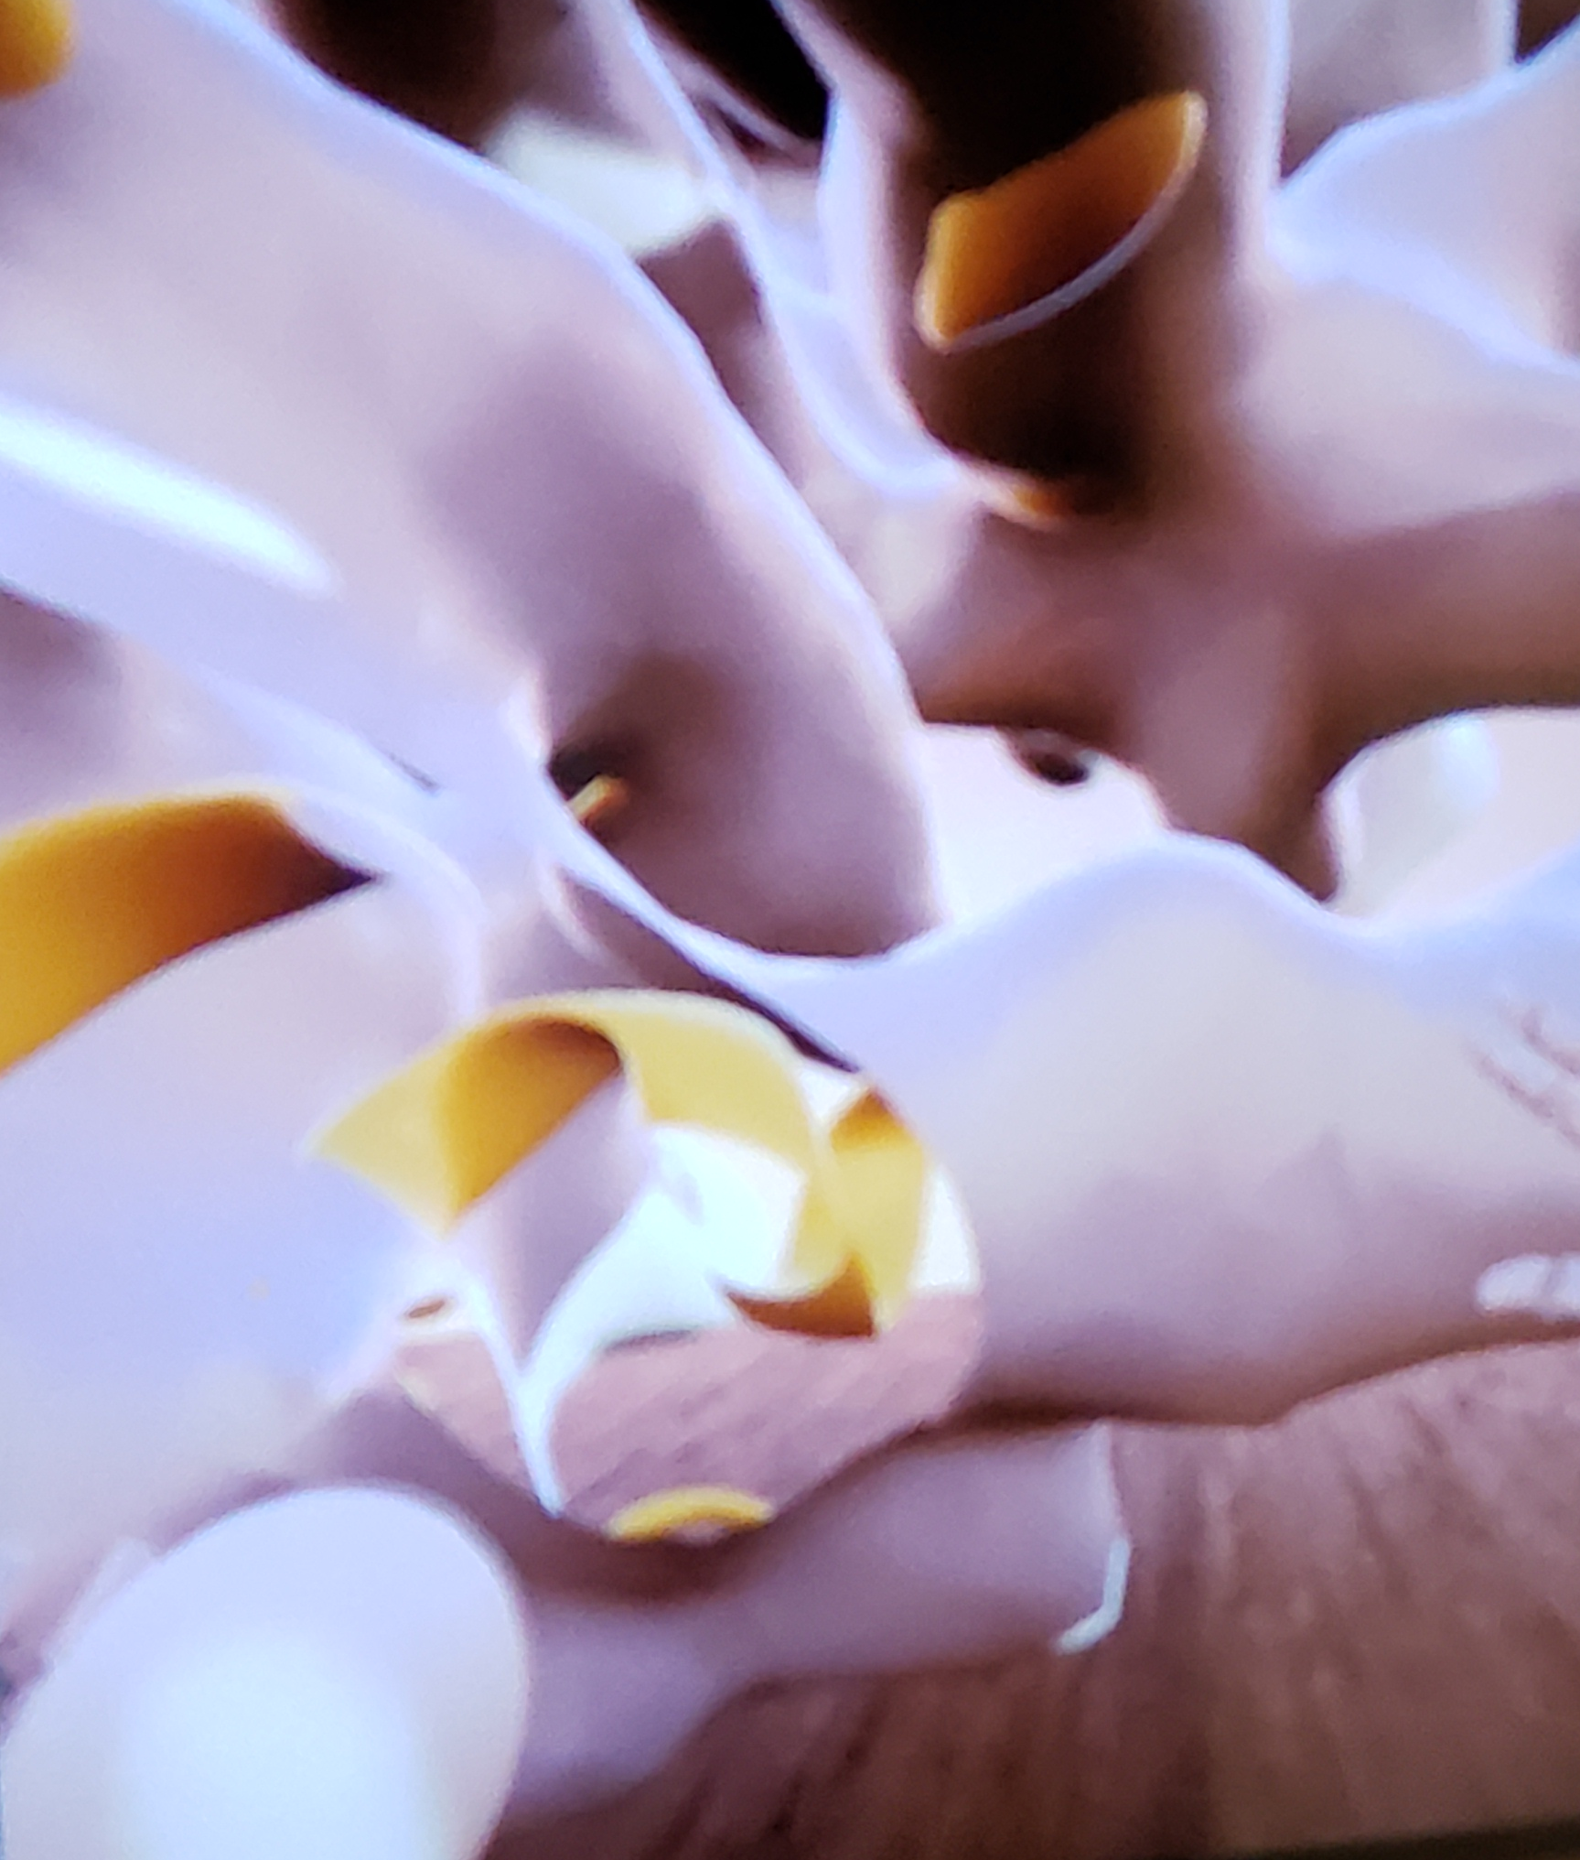
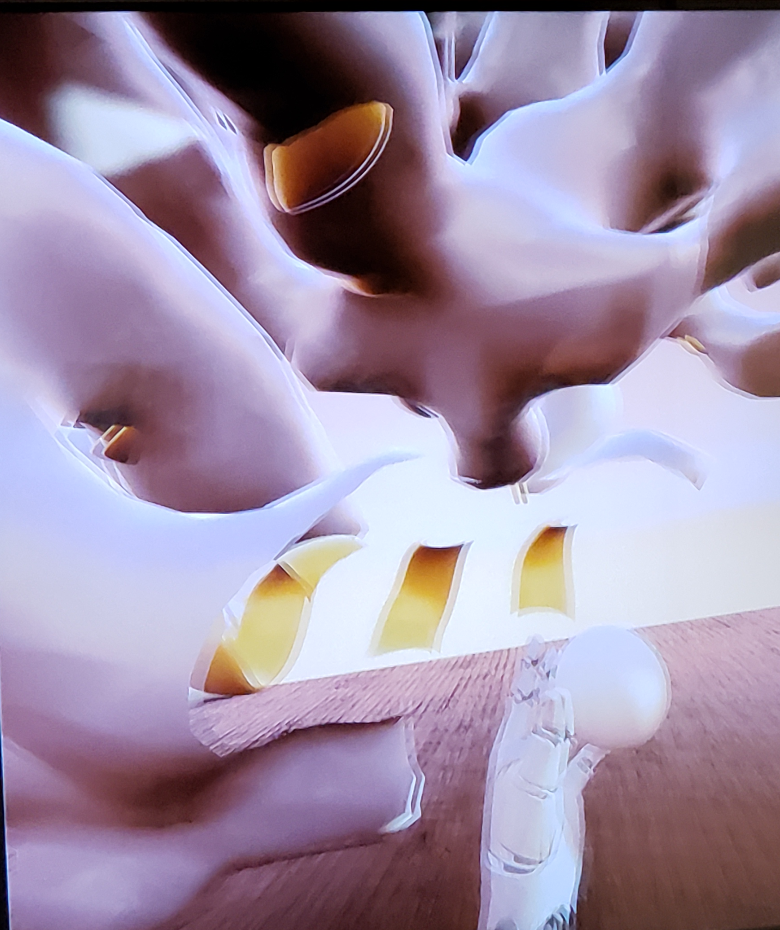
Tool Examples: Clipping Geometry

Slide 25
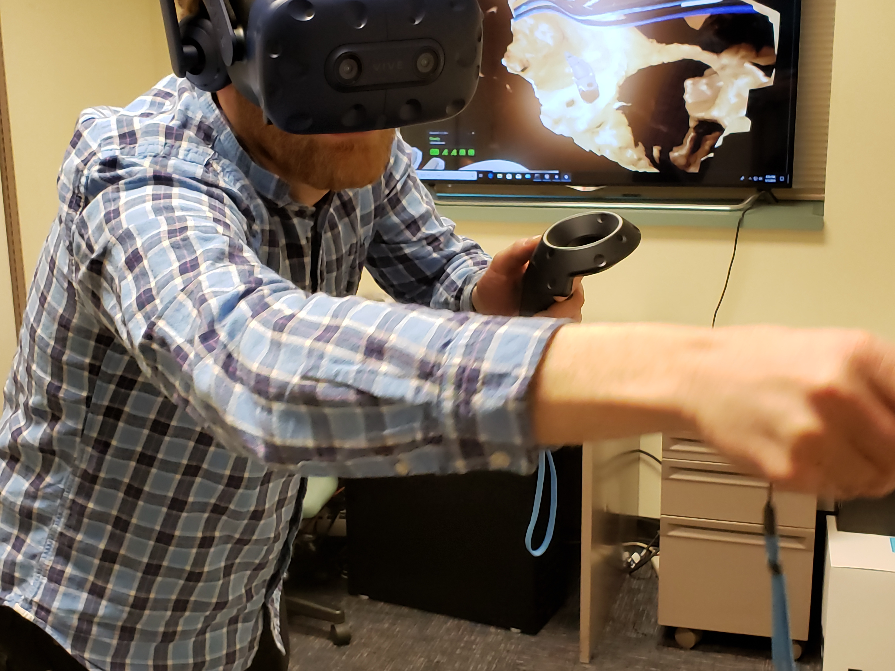
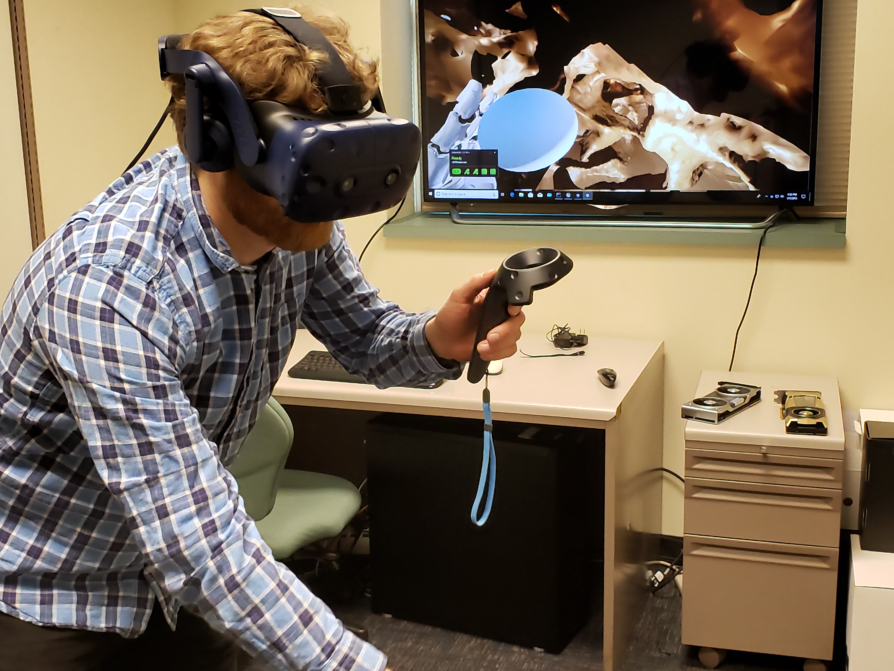
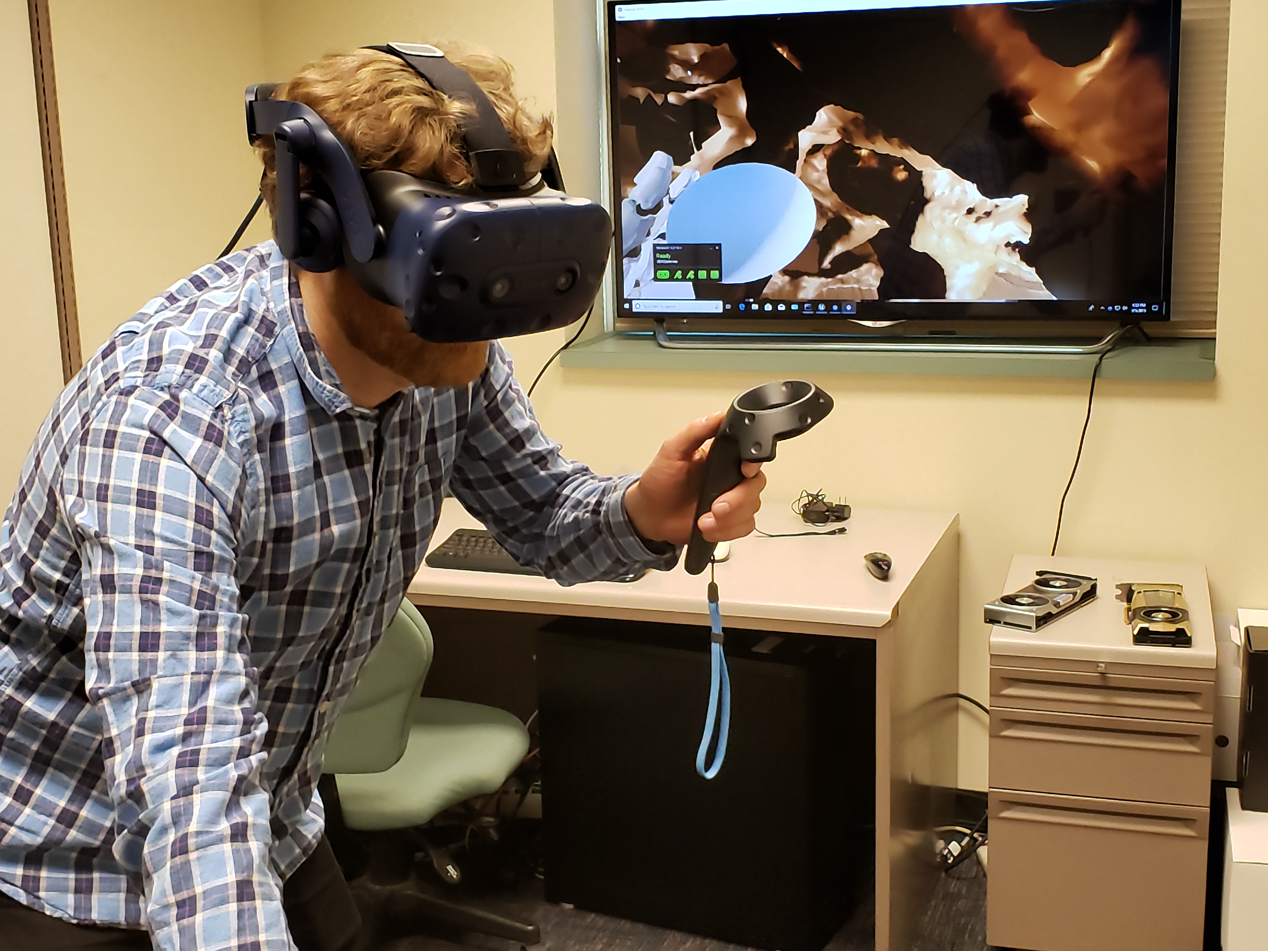
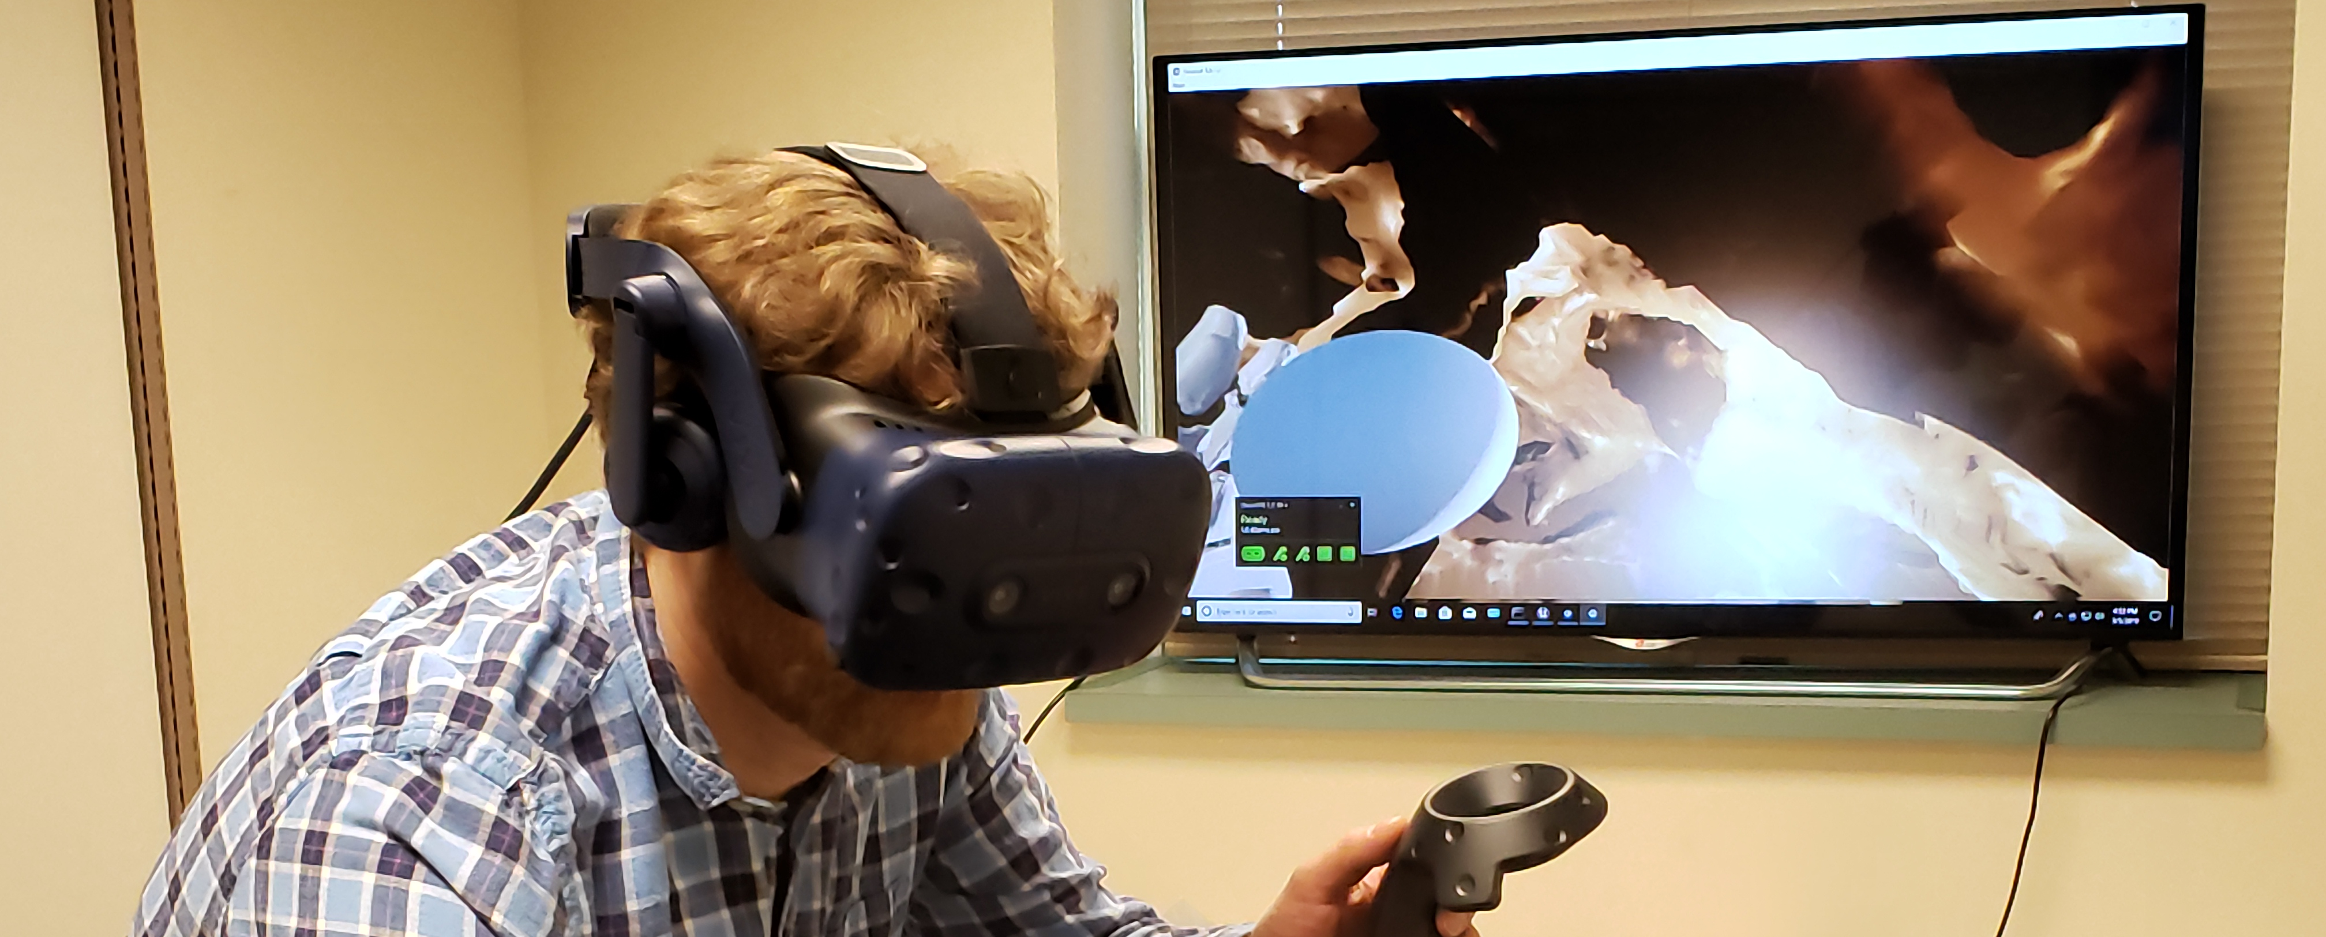
Tool Examples: Hand-Held Lighting

Slide 26
Interactions That are Difficult to
Support Within Conventional VR
Simultaneous interaction between the 3-D atomic structure visualizations and potentially large numbers of other 2-D plots or projections
Large tabulated displays of quantitative properties, e.g., amino acid residue sequences, gene sequences, other 1-D properties
Sometimes a “BIG STEREOSCOPIC TV” wins, although they have become difficult to find now…

Slide 27
Data Size Challenges and The Ultimate Limits on What We Can Visualize Interactively

Slide 28
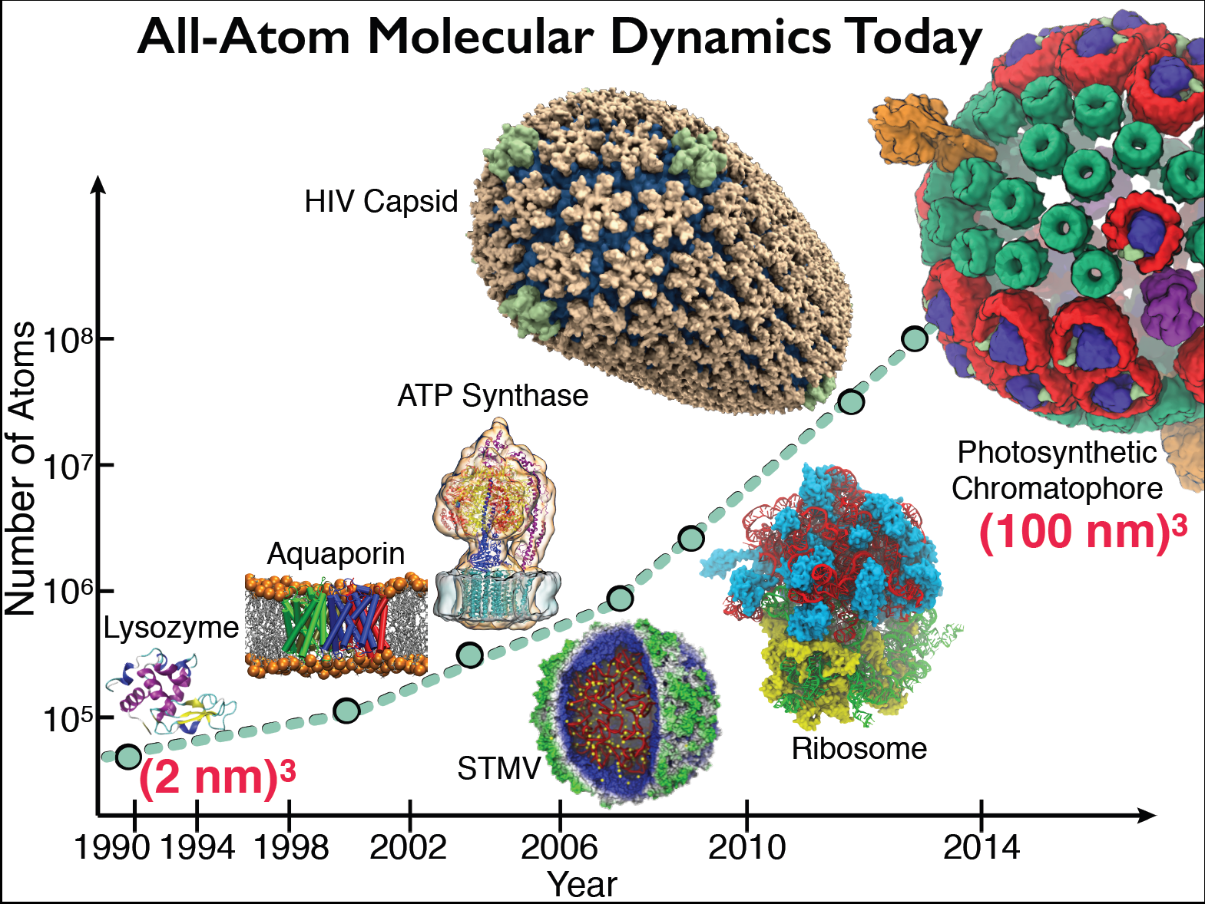

Slide 29
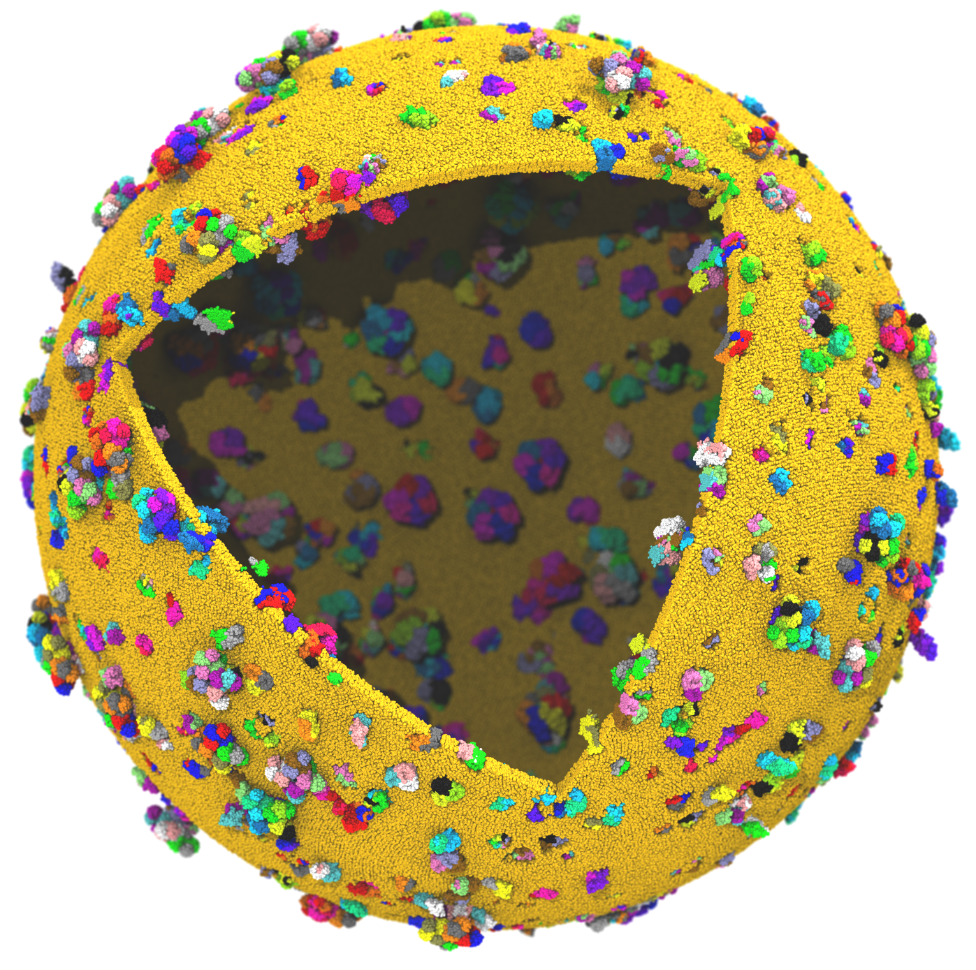
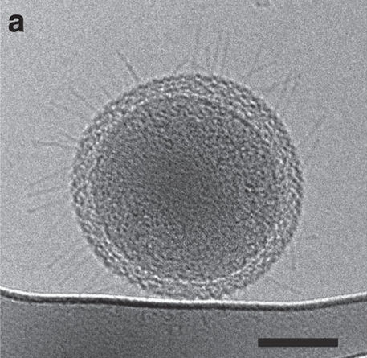
Next Generation: Simulating a Proto-Cell
Emulate aspects of the Mycoplasma mycoides bacterium
200nm diameter
~1 billion atoms w/ solvent
~1400 proteins in membrane
Cryo-ET image of ultra-small bacteria (scale bar 100nm)
Luef et al. Nature Comm., 6:6372, 2015.

Slide 30
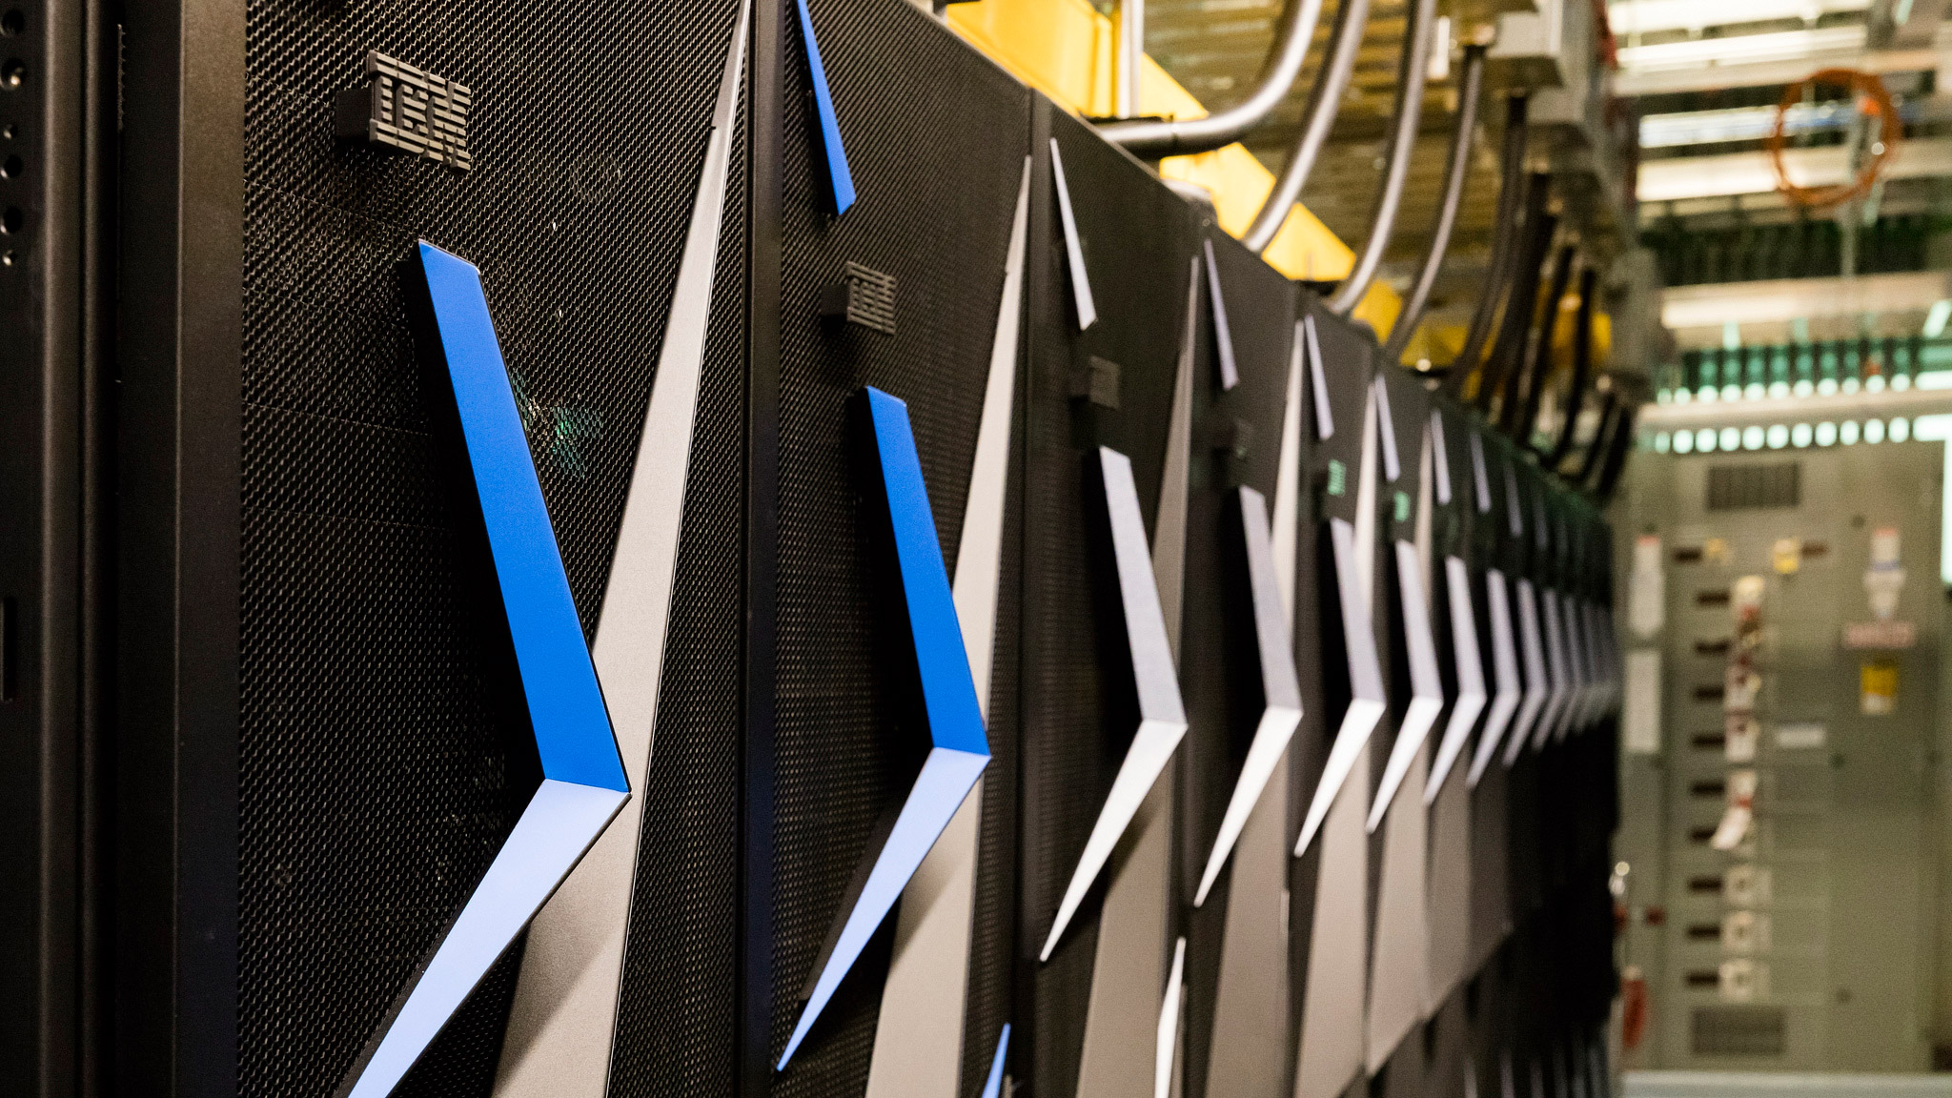
Next Generation: Simulating a Proto-Cell
ORNL Summit: NVLink-connected Tesla V100 GPUs enable next-gen visualizations
200nm diameter
~1 billion atoms w/ solvent
~1400 proteins in membrane

Slide 31
Proto-Cell Data Challenges
1B-atom proto-cell requires nodes with more than TB RAM to build complete model…
1B-atom proto-cell binary structure file: 63GB
Trajectory frame atomic coordinates: 12GB, 1.2TB/ns of simulation (1 frame per 10ps)
Routine modeling and visualization tasks are a big challenge at this scale
  Models contain thousands of atomic-detail components that must work together in harmony
  Exploit persistent memory technologies to enable “instant on” operation on massive cell-scale models – eliminate several minutes of startup during analysis/visualization of known structure
  Sparse output of results at multiple timescales will help ameliorate visualization and analysis I/O
  Data quantization, compression, APIs like ZFP

Slide 32
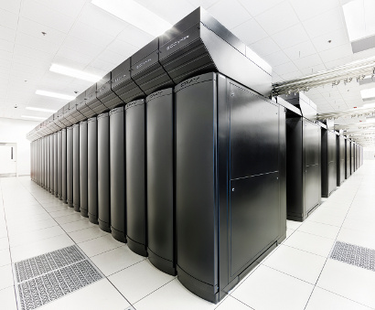
VMD Petascale Visualization and Analysis
Analyze/visualize large trajectories too large to transfer off-site:
  User-defined parallel analysis operations, data types
  Parallel rendering, movie making
Supports GPU-accelerated Cray XK7 nodes for both visualization and analysis:
  GPU accelerated trajectory analysis w/ CUDA
  OpenGL and GPU ray tracing for visualization and movie rendering
Parallel I/O rates up to 275 GB/sec on 8192 Cray XE6 nodes – can read in 231 TB in 15 minutes!
Parallel VMD currently available on:
ORNL Titan, NCSA Blue Waters, Indiana Big Red II, CSCS Piz Daint, and similar systems
NCSA Blue Waters Hybrid Cray XE6 / XK7
22,640 XE6 dual-Opteron CPU nodes
4,224 XK7 nodes w/ Telsa K20X GPUs

Slide 33
IBM AC922 Summit Node
3 GPUs Per CPU Socket
Tesla V100 GPU
Tesla V100 GPU
Tesla V100 GPU
Tesla V100 GPU
Tesla V100 GPU
Tesla V100 GPU
Nvlink 2.0
2x 50GBps:
100GBps
DDR4 DRAM
DDR4 DRAM
POWER9
CPU
POWER9
CPU
X-Bus
64GBps
120GBps
120GBps
InfiniBand
12GBps
InfiniBand
12GBps

Slide 34
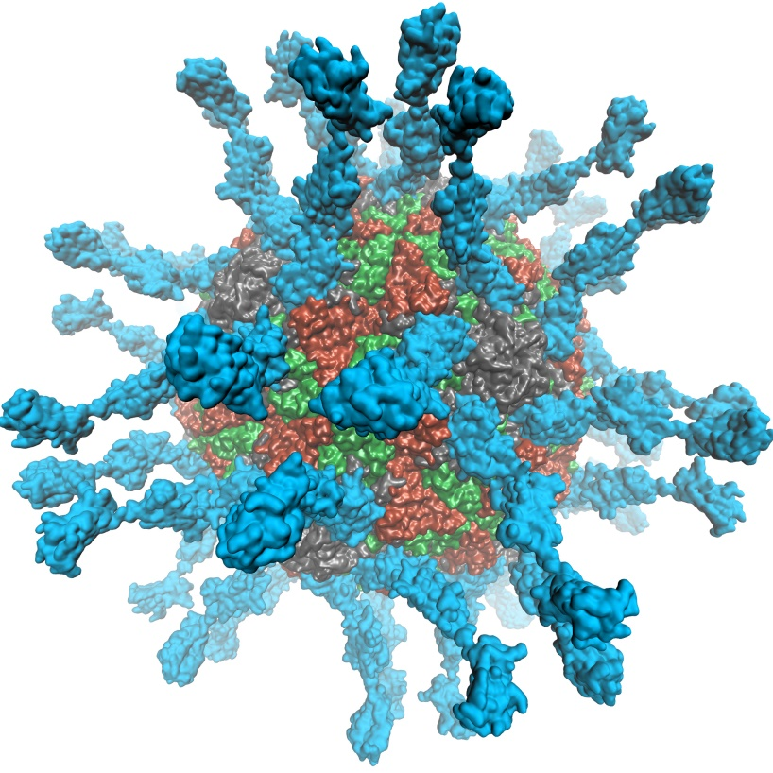
VMD supports EGL for in-situ and parallel rendering on clouds, clusters, and supercomputers
No windowing system dependency
Easily deploy parallel VMD builds supporting off-screen rendering
Maintains 100% of VMD OpenGL shaders and rendering features
Support high-quality vendor-supported commercial OpenGL implementations in HPC systems that were previously limited to Mesa
Poliovirus

Slide 35
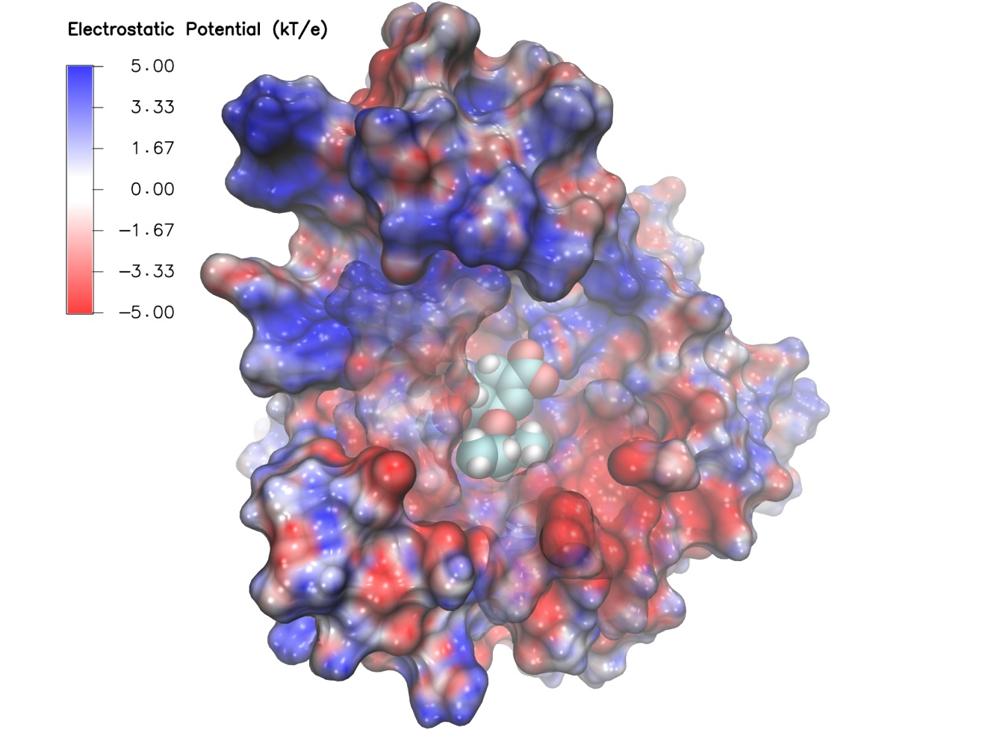
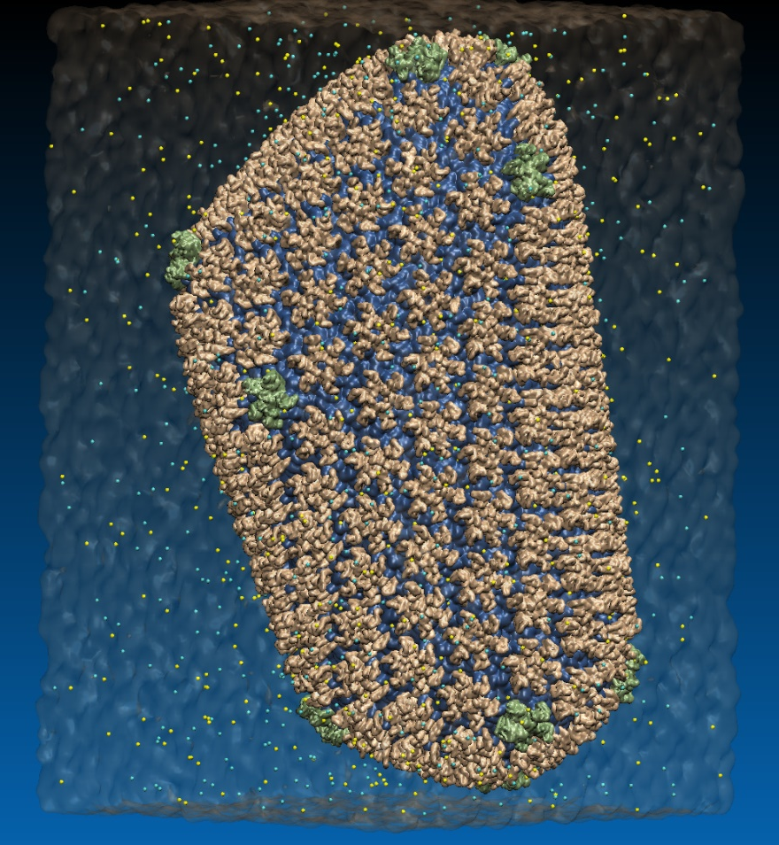
VMD EGL Rendering: Supports full VMD GLSL shading features, multisample antialiasing, ray cast spheres, 3-D tex mapping, ...
Swine Flu A/H1N1 neuraminidase bound to Tamiflu
64M atom HIV-1 capsid simulation
High Performance Molecular Visualization: In-Situ and Parallel Rendering with EGL. J. E. Stone, P. Messmer, R. Sisneros, and K. Schulten. High Performance Data Analysis and Visualization Workshop, IEEE IPDPSW, pp. 1014-1023, 2016.

Slide 36
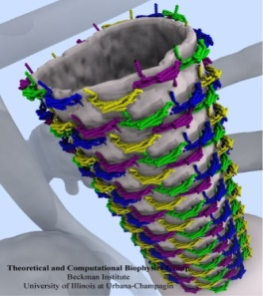
Molecular Structure Data and Global VMD State
Scene Graph
Graphical Representations
User Interface Subsystem
DrawMolecule
Tcl/Python Scripting
Non-Molecular
Geometry
Mouse + Windows
6DoF Input “Tools”
VMDDisplayList
Display
Subsystem
GLX+X11+Drv
OpenGL Pbuffer/FBO
DisplayDevice
Windowed OpenGL
EGL+Drv
OpenGLRenderer
OpenGL Pbuffer/FBO

Slide 37
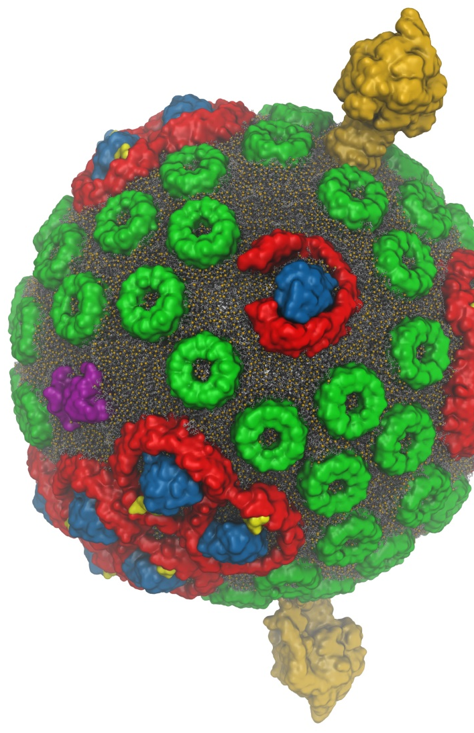
VMD w/ OptiX 5
Interactive RT on laptops, desktops, and cloud
Large-scale parallel rendering: in situ or post hoc visualization
Remote RT on NVIDIA GPU clusters
Stereoscopic panoramic and full-dome projections
Omnidirectional VR for YouTube, VR HMDs
GPU memory sharing via NVLink on Quadro GP100, Tesla P100
  VMD+OptiX 5, NVIDIA NGC container: https://ngc.nvidia.com/registry/
In-progress:
  OptiX denoising support: fast turnaround w/ AO, DoF, etc
  Denoising to enable practical use of path tracing in VMD
GPU-Accelerated Molecular Visualization on Petascale Supercomputing Platforms. J. E. Stone, K. L. Vandivort, and K. Schulten. UltraVis’13, pp. 6:1-6:8, 2013.
Visualization of Energy Conversion Processes in a Light Harvesting Organelle at Atomic Detail. M. Sener, et al. SC'14 Visualization and Data Analytics Showcase, 2014.
Chemical Visualization of Human Pathogens: the Retroviral Capsids. J. R. Perilla, B.-C. Goh, J. E. Stone, and K. Schulten. SC'15 Visualization and Data Analytics Showcase, 2015.
Atomic Detail Visualization of Photosynthetic Membranes with GPU-Accelerated Ray Tracing. J. E. Stone et al., J. Parallel Computing, 55:17-27, 2016.
Immersive Molecular Visualization with Omnidirectional Stereoscopic Ray Tracing and Remote Rendering J. E. Stone, W. R. Sherman, and K. HPDAV, IPDPSW, pp. 1048-1057, 2016.
VMD/OptiX GPU Ray Tracing of all-atom Chromatophore w/ lipids.

Slide 38
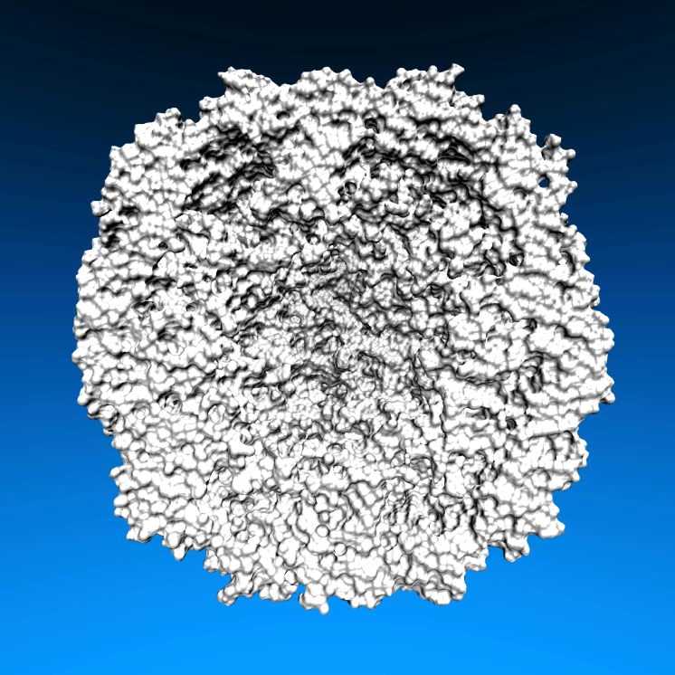
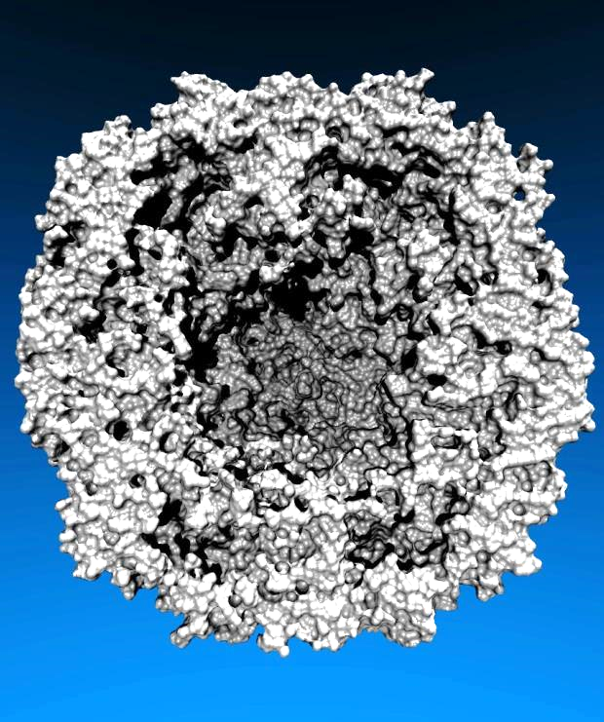
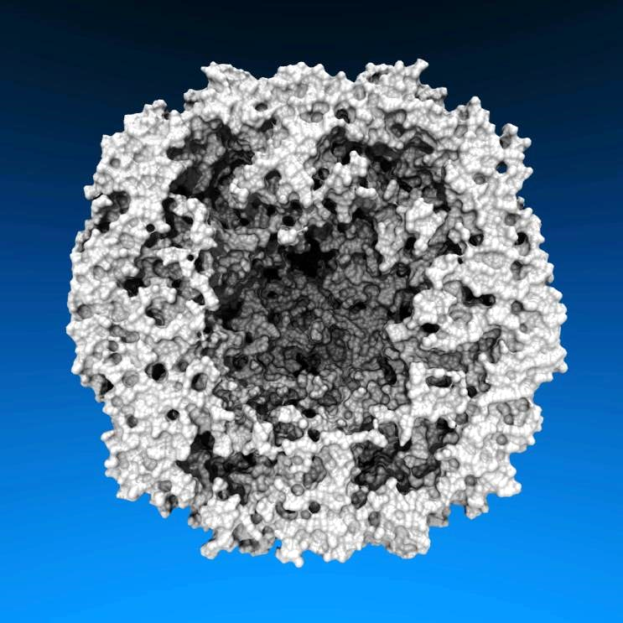
Lighting Comparison, STMV Capsid
Two lights, no shadows
Two lights, hard shadows, 1 shadow ray per light
Ambient occlusion + two lights, 144 AO rays/hit

Slide 39

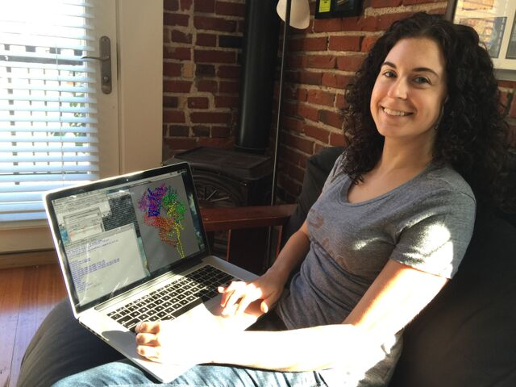
Interactive Remote Visualization and Analysis
Enabled by hardware H.264/H.265 video encode/decode
Enable visualization and analyses not possible with conventional workstations
Access data located anywhere in the world
  Same VMD session available to any device
Linux prototype in-development using NVIDIA Video Codec SDK, easy-to-use NvPipe wrapper library
Notes:
Use a schematic that’s generic rather than titan
1-12 viz machines, never such an immediate impact, tell the story, but brief strong points
Maybe show jodi here
Shrink supercomputer, grow the person figure

Slide 40
Using Omnidirectional Stereoscopic Projections to Permit Remote Ray Tracing for VR HMDs

Slide 41
HMD Ray Tracing Challenges
HMDs require high frame rates (90Hz or more) and minimum latency between IMU sensor reads and presentation on the display
Multi-GPU workstations fast enough to direct-drive HMDs at required frame rates for simple scenes with direct lighting, hard shadows
Advanced RT effects such as AO lighting, depth of field require much larger sample counts, impractical for direct-driving HMDs
Remote viz. required for many HPC problems due to large data
Remote viz. latencies too high for direct-drive of HMD
Our two-phase approach: moderate-FPS remote RT combined with local high-FPS view-dependent HMD reprojection w/ OpenGL

Slide 42
VMD Molecular Structure Data and Global State
Scene Graph
Graphical Representations
User Interface Subsystem
DrawMolecule
Tcl/Python Scripting
Non-Molecular
Geometry
Mouse + Windows
VR Input “Tools”
Display Subsystem
Windowed OpenGL GPU
VMDDisplayList
OpenGL Pbuffer GPU
OpenGLDisplayDevice
Tachyon CPU RT
DisplayDevice
FileRenderer
TachyonL-OptiX GPU RT
Batch + Interactive

Slide 43
VMD TachyonLOptiX: Multi-GPU on NVIDIA VCA Cluster
VMD Scene
Scene Data Replicated, Image Space + Sample Space Parallel Decomposition onto GPUs
VCA 0:
8 K6000 GPUs
VCA N:
8 K6000 GPUs

Slide 44

Progressive
Ray Tracing Engine
Ray tracing loop runs
continuously in new thread
Decodes H.264 video
stream from remote
VCA GPU cluster
Omnistereo
Image Stream
HMD Display Loop
HMD loop runs in main
VMD application thread
at max OpenGL draw rate
View-dependent
stereo reprojection for
current HMD head pose
HMD distortion correction
Camera
+ Scene
RT Code
+ Camera
+ Scene
Omnistereo
H.264 Video
HMD Video
HMD Pose
VMD
15Mbps Internet Link
HMD
Remote VCA GPU Cluster
Ray tracing runs continuously,
streams H.264 video to VMD client

Slide 45

Stereoscopic Panorama Ray Tracing w/ OptiX
Render 360° images and movies for VR headsets such as Oculus Rift, Google Cardboard
Ray trace panoramic stereo spheremaps or cubemaps for very high-frame-rate display via OpenGL texturing onto simple geometry
Stereo requires spherical camera projections poorly suited to rasterization
Benefits from OptiX multi-GPU rendering and load balancing, remote visualization

Slide 46
A) Monoscopic circular projection.
Eye at center of projection (COP).
B) Left eye stereo circular projection.
Eye offset from COP by half of interocular distance.
Polar Axis
Zero Eye Sep
C) Stereo eye separation smoothly decreased to zero at zenith and nadir points on the polar axis to prevent incorrect stereo when HMD sees the poles.
Decreasing Eye Sep
Full Eye Separation
Decreasing Eye Sep
Zero Eye Sep

Slide 47


Slide 48


Slide 49
Remote Omnidirectional Stereoscopic
RT Performance @ 3072x1536 w/ 2-subframes
Scene | Per-subframe samples AA : AO (AO per-hit) | RT update rate (FPS)
STMV shadows | 1:0 2:0 4:0 | 22.2 18.1 10.3
STMV Shadows+AO | 1:1 1:2 1:4 | 18.2 16.1 12.4
STMV Shadows+AO+DoF | 1:1 2:1 2:2 | 16.1 11.1 8.5
HIV-1 Shadows | 1:0 2:0 4:0 | 20.1 18.1 10.2
HIV-1 Shadows+AO | 1:1 1:2 1:4 | 17.4 12.2 8.1

Slide 50
HMD View-Dependent Reprojection with OpenGL
Texture map panoramic image onto reprojection geometry that matches the original RT image formation surface (sphere for equirectangular, cube for cube map)
HMD sees standard perspective frustum view of the textured surface
Commodity HMD optics require software lens distortion and chromatic aberration correction prior to display, implemented with multi-pass FBO rendering
Enables low-latency, high-frame-rate redraw as HMD head pose changes (150Hz or more)

Slide 51

Immersive Molecular Visualization with Omnidirectional Stereoscopic Ray Tracing and Remote Rendering. J. E. Stone, W. R. Sherman, and K. Schulten. High Performance Data Analysis and Visualization Workshop, IEEE International Parallel and Distributed Processing Symposium Workshops (IPDPSW), pp. 1048-1057, 2016.

Slide 52


Slide 53









Slide 54
Ongoing VR Work
OpenXR – cross platform muti-vendor HMD support
Ray tracing engine supports NVIDIA RTX Ray Tracing HW Acceleration
Future:
  AI denoising for better average quality
  Interactive RT stochastic sampling strategies to improve interactivity
  Improved omnidirectional cubemap/spheremap sampling approaches
  AI multi-view warping to allow rapid in-between view generation amid multiple HMD head locations
  H.265 for high-res omnidirectional video streaming
  Multi-node parallel RT and remote viz. on general clusters and supercomputers, e.g. NCSA Blue Waters, ORNL Titan
Tons of work to do on VR user interfaces, multi-user collaborative visualization, …

Slide 55
Acknowledgements
Theoretical and Computational Biophysics Group, University of Illinois at Urbana-Champaign
NVIDIA CUDA and OptiX teams
Funding:
  NIH support: P41GM104601
  DOE INCITE, ORNL Titan: DE-AC05-00OR22725
  NSF Blue Waters: NSF OCI 07-25070, PRAC “The Computational Microscope”, ACI-1238993, ACI-1440026
Notes:
55

Slide 56

“When I was a young man, my goal was to look with mathematical and computational means at the inside of cells, one atom at a time, to decipher how living systems work. That is what I strived for and I never deflected from this goal.” – Klaus Schulten

Slide 57
Related Publications http://www.ks.uiuc.edu/Research/gpu/
NAMD goes quantum: An integrative suite for hybrid simulations. Melo, M. C. R.; Bernardi, R. C.; Rudack T.; Scheurer, M.; Riplinger, C.; Phillips, J. C.; Maia, J. D. C.; Rocha, G. D.; Ribeiro, J. V.; Stone, J. E.; Neese, F.; Schulten, K.; Luthey-Schulten, Z.; Nature Methods, 2018. (In press)
Challenges of Integrating Stochastic Dynamics and Cryo-electron Tomograms in Whole-cell Simulations. T. M. Earnest, R. Watanabe, J. E. Stone, J. Mahamid, W. Baumeister, E. Villa, and Z. Luthey-Schulten. J. Physical Chemistry B, 121(15): 3871-3881, 2017.
Early Experiences Porting the NAMD and VMD Molecular Simulation and Analysis Software to GPU-Accelerated OpenPOWER Platforms. J. E. Stone, A.-P. Hynninen, J. C. Phillips, and K. Schulten. International Workshop on OpenPOWER for HPC (IWOPH'16), LNCS 9945, pp. 188-206, 2016.
Immersive Molecular Visualization with Omnidirectional Stereoscopic Ray Tracing and Remote Rendering. J. E. Stone, W. R. Sherman, and K. Schulten. High Performance Data Analysis and Visualization Workshop, IEEE International Parallel and Distributed Processing Symposium Workshop (IPDPSW), pp. 1048-1057, 2016.
High Performance Molecular Visualization: In-Situ and Parallel Rendering with EGL. J. E. Stone, P. Messmer, R. Sisneros, and K. Schulten. High Performance Data Analysis and Visualization Workshop, IEEE International Parallel and Distributed Processing Symposium Workshop (IPDPSW), pp. 1014-1023, 2016.
Evaluation of Emerging Energy-Efficient Heterogeneous Computing Platforms for Biomolecular and Cellular Simulation Workloads. J. E. Stone, M. J. Hallock, J. C. Phillips, J. R. Peterson, Z. Luthey-Schulten, and K. Schulten.25th International Heterogeneity in Computing Workshop, IEEE International Parallel and Distributed Processing Symposium Workshop (IPDPSW), pp. 89-100, 2016.

Slide 58
Related Publications http://www.ks.uiuc.edu/Research/gpu/
Atomic Detail Visualization of Photosynthetic Membranes with GPU-Accelerated Ray Tracing. J. E. Stone, M. Sener, K. L. Vandivort, A. Barragan, A. Singharoy, I. Teo, J. V. Ribeiro, B. Isralewitz, B. Liu, B.-C. Goh, J. C. Phillips, C. MacGregor-Chatwin, M. P. Johnson, L. F. Kourkoutis, C. Neil Hunter, and K. Schulten. J. Parallel Computing, 55:17-27, 2016.
Chemical Visualization of Human Pathogens: the Retroviral Capsids. Juan R. Perilla, Boon Chong Goh, John E. Stone, and Klaus Schulten. SC'15 Visualization and Data Analytics Showcase, 2015.
Visualization of Energy Conversion Processes in a Light Harvesting Organelle at Atomic Detail. M. Sener, J. E. Stone, A. Barragan, A. Singharoy, I. Teo, K. L. Vandivort, B. Isralewitz, B. Liu, B. Goh, J. C. Phillips, L. F. Kourkoutis, C. N. Hunter, and K. Schulten. SC'14 Visualization and Data Analytics Showcase, 2014. ***Winner of the SC'14 Visualization and Data Analytics Showcase
Runtime and Architecture Support for Efficient Data Exchange in Multi-Accelerator Applications. J. Cabezas, I. Gelado, J. E. Stone, N. Navarro, D. B. Kirk, and W. Hwu. IEEE Transactions on Parallel and Distributed Systems, 26(5):1405-1418, 2015.
Unlocking the Full Potential of the Cray XK7 Accelerator. M. D. Klein and J. E. Stone. Cray Users Group, Lugano Switzerland, May 2014.
GPU-Accelerated Analysis and Visualization of Large Structures Solved by Molecular Dynamics Flexible Fitting. J. E. Stone, R. McGreevy, B. Isralewitz, and K. Schulten. Faraday Discussions, 169:265-283, 2014.
Simulation of reaction diffusion processes over biologically relevant size and time scales using multi-GPU workstations. M. J. Hallock, J. E. Stone, E. Roberts, C. Fry, and Z. Luthey-Schulten. Journal of Parallel Computing, 40:86-99, 2014.

Slide 59
Related Publications http://www.ks.uiuc.edu/Research/gpu/
GPU-Accelerated Molecular Visualization on Petascale Supercomputing Platforms. J. Stone, K. L. Vandivort, and K. Schulten. UltraVis'13: Proceedings of the 8th International Workshop on Ultrascale Visualization, pp. 6:1-6:8, 2013.
Early Experiences Scaling VMD Molecular Visualization and Analysis Jobs on Blue Waters. J. Stone, B. Isralewitz, and K. Schulten. In proceedings, Extreme Scaling Workshop, 2013.
Lattice Microbes: High‐performance stochastic simulation method for the reaction‐diffusion master equation. E. Roberts, J. Stone, and Z. Luthey‐Schulten.
J. Computational Chemistry 34 (3), 245-255, 2013.
Fast Visualization of Gaussian Density Surfaces for Molecular Dynamics and Particle System Trajectories. M. Krone, J. Stone, T. Ertl, and K. Schulten. EuroVis Short Papers, pp. 67-71, 2012.
Immersive Out-of-Core Visualization of Large-Size and Long-Timescale Molecular Dynamics Trajectories. J. Stone, K. L. Vandivort, and K. Schulten. G. Bebis et al. (Eds.): 7th International Symposium on Visual Computing (ISVC 2011), LNCS 6939, pp. 1-12, 2011.
Fast Analysis of Molecular Dynamics Trajectories with Graphics Processing Units – Radial Distribution Functions. B. Levine, J. Stone, and A. Kohlmeyer. J. Comp. Physics, 230(9):3556-3569, 2011.

Slide 60
Related Publications http://www.ks.uiuc.edu/Research/gpu/
Quantifying the Impact of GPUs on Performance and Energy Efficiency in HPC Clusters. J. Enos, C. Steffen, J. Fullop, M. Showerman, G. Shi, K. Esler, V. Kindratenko, J. Stone, J Phillips. International Conference on Green Computing, pp. 317-324, 2010.
GPU-accelerated molecular modeling coming of age. J. Stone, D. Hardy, I. Ufimtsev, K. Schulten. J. Molecular Graphics and Modeling, 29:116-125, 2010.
OpenCL: A Parallel Programming Standard for Heterogeneous Computing. J. Stone, D. Gohara, G. Shi. Computing in Science and Engineering, 12(3):66-73, 2010.
An Asymmetric Distributed Shared Memory Model for Heterogeneous Computing Systems. I. Gelado, J. Stone, J. Cabezas, S. Patel, N. Navarro, W. Hwu. ASPLOS ’10: Proceedings of the 15th International Conference on Architectural Support for Programming Languages and Operating Systems, pp. 347-358, 2010.

Slide 61
Related Publications http://www.ks.uiuc.edu/Research/gpu/
GPU Clusters for High Performance Computing. V. Kindratenko, J. Enos, G. Shi, M. Showerman, G. Arnold, J. Stone, J. Phillips, W. Hwu. Workshop on Parallel Programming on Accelerator Clusters (PPAC), In Proceedings IEEE Cluster 2009, pp. 1-8, Aug. 2009.
Long time-scale simulations of in vivo diffusion using GPU hardware. E. Roberts, J. Stone, L. Sepulveda, W. Hwu, Z. Luthey-Schulten. In IPDPS’09: Proceedings of the 2009 IEEE International Symposium on Parallel & Distributed Computing, pp. 1-8, 2009.
High Performance Computation and Interactive Display of Molecular Orbitals on GPUs and Multi-core CPUs. J. E. Stone, J. Saam, D. Hardy, K. Vandivort, W. Hwu, K. Schulten, 2nd Workshop on General-Purpose Computation on Graphics Pricessing Units (GPGPU-2), ACM International Conference Proceeding Series, volume 383, pp. 9-18, 2009.
Probing Biomolecular Machines with Graphics Processors. J. Phillips, J. Stone. Communications of the ACM, 52(10):34-41, 2009.
Multilevel summation of electrostatic potentials using graphics processing units. D. Hardy, J. Stone, K. Schulten. J. Parallel Computing, 35:164-177, 2009.

Slide 62
Related Publications http://www.ks.uiuc.edu/Research/gpu/
Adapting a message-driven parallel application to GPU-accelerated clusters. J. Phillips, J. Stone, K. Schulten. Proceedings of the 2008 ACM/IEEE Conference on Supercomputing, IEEE Press, 2008.
GPU acceleration of cutoff pair potentials for molecular modeling applications. C. Rodrigues, D. Hardy, J. Stone, K. Schulten, and W. Hwu. Proceedings of the 2008 Conference On Computing Frontiers, pp. 273-282, 2008.
GPU computing. J. Owens, M. Houston, D. Luebke, S. Green, J. Stone, J. Phillips. Proceedings of the IEEE, 96:879-899, 2008.
Accelerating molecular modeling applications with graphics processors. J. Stone, J. Phillips, P. Freddolino, D. Hardy, L. Trabuco, K. Schulten. J. Comp. Chem., 28:2618-2640, 2007.
Continuous fluorescence microphotolysis and correlation spectroscopy. A. Arkhipov, J. Hüve, M. Kahms, R. Peters, K. Schulten. Biophysical Journal, 93:4006-4017, 2007.

Slide 63
Related Publications http://www.ks.uiuc.edu/Research/gpu/
GPU Clusters for High Performance Computing. V. Kindratenko, J. Enos, G. Shi, M. Showerman, G. Arnold, J. Stone, J. Phillips, W. Hwu. Workshop on Parallel Programming on Accelerator Clusters (PPAC), In Proceedings IEEE Cluster 2009, pp. 1-8, Aug. 2009.
Long time-scale simulations of in vivo diffusion using GPU hardware. E. Roberts, J. Stone, L. Sepulveda, W. Hwu, Z. Luthey-Schulten. In IPDPS’09: Proceedings of the 2009 IEEE International Symposium on Parallel & Distributed Computing, pp. 1-8, 2009.
High Performance Computation and Interactive Display of Molecular Orbitals on GPUs and Multi-core CPUs. J. E. Stone, J. Saam, D. Hardy, K. Vandivort, W. Hwu, K. Schulten, 2nd Workshop on General-Purpose Computation on Graphics Pricessing Units (GPGPU-2), ACM International Conference Proceeding Series, volume 383, pp. 9-18, 2009.
Probing Biomolecular Machines with Graphics Processors. J. Phillips, J. Stone. Communications of the ACM, 52(10):34-41, 2009.
Multilevel summation of electrostatic potentials using graphics processing units. D. Hardy, J. Stone, K. Schulten. J. Parallel Computing, 35:164-177, 2009.

Slide 64
Related Publications http://www.ks.uiuc.edu/Research/gpu/
Adapting a message-driven parallel application to GPU-accelerated clusters. J. Phillips, J. Stone, K. Schulten. Proceedings of the 2008 ACM/IEEE Conference on Supercomputing, IEEE Press, 2008.
GPU acceleration of cutoff pair potentials for molecular modeling applications. C. Rodrigues, D. Hardy, J. Stone, K. Schulten, and W. Hwu. Proceedings of the 2008 Conference On Computing Frontiers, pp. 273-282, 2008.
GPU computing. J. Owens, M. Houston, D. Luebke, S. Green, J. Stone, J. Phillips. Proceedings of the IEEE, 96:879-899, 2008.
Accelerating molecular modeling applications with graphics processors. J. Stone, J. Phillips, P. Freddolino, D. Hardy, L. Trabuco, K. Schulten. J. Comp. Chem., 28:2618-2640, 2007.
Continuous fluorescence microphotolysis and correlation spectroscopy. A. Arkhipov, J. Hüve, M. Kahms, R. Peters, K. Schulten. Biophysical Journal, 93:4006-4017, 2007.

