Slide 1
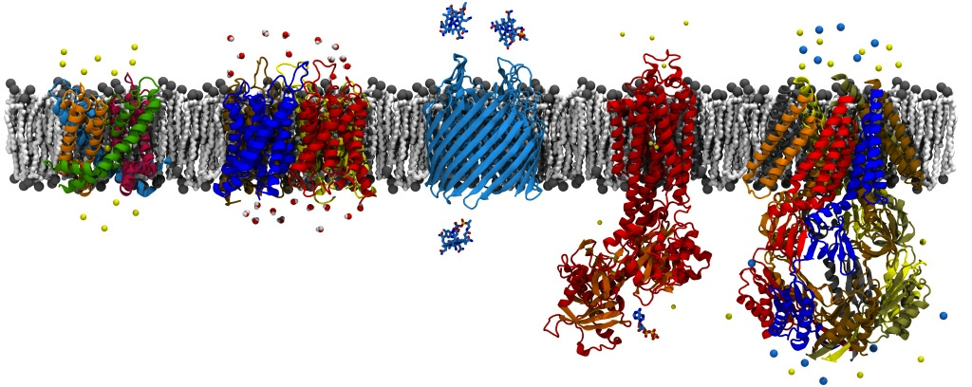
Analysis and Visualization Algorithms in VMD
David Hardy
http://www.ks.uiuc.edu/Research/~dhardy/
NAIS: State-of-the-Art Algorithms for Molecular Dynamics
(Presenting the work of John Stone.)

Slide 2
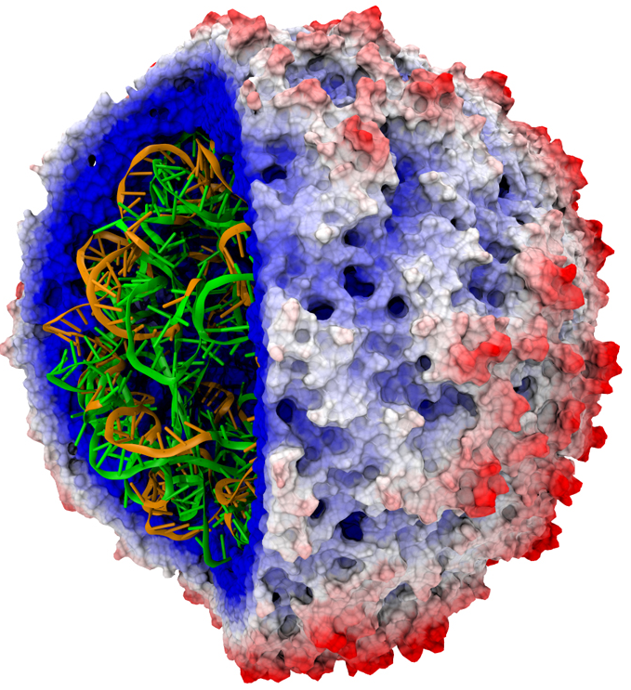
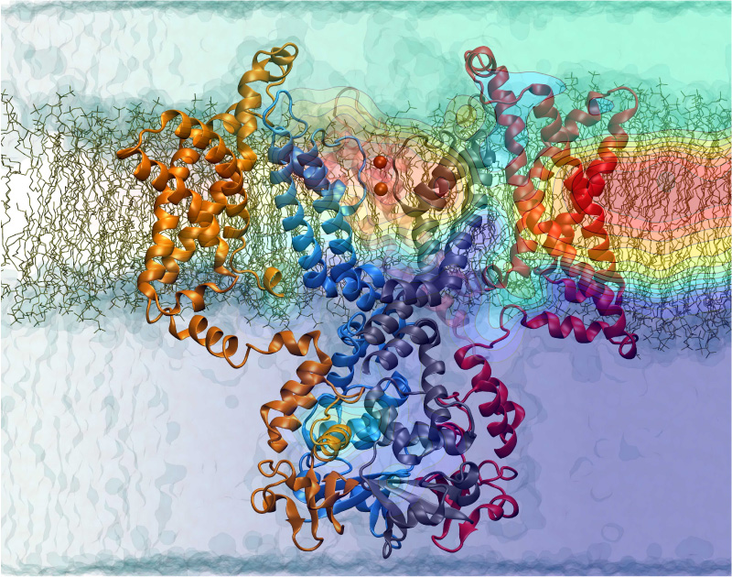
VMD – “Visual Molecular Dynamics”
Visualization and analysis of molecular dynamics simulations, sequence data, volumetric data, quantum chemistry simulations, particle systems, …
User extensible with scripting and plugins
http://www.ks.uiuc.edu/Research/vmd/

Slide 3
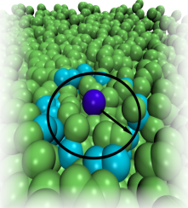
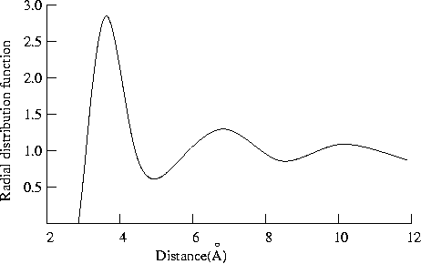
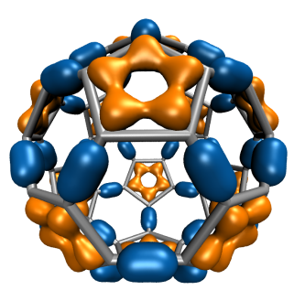
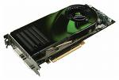
GPU Accelerated Trajectory Analysis and Visualization in VMD
GPU-Accelerated Feature | GPU Speedup
Molecular orbital display | 120x
Radial distribution function | 92x
Electrostatic field calculation | 44x
Molecular surface display | 40x
Ion placement | 26x
MDFF density map synthesis | 26x
Implicit ligand sampling | 25x
Root mean squared fluctuation | 25x
Radius of gyration | 21x
Close contact determination | 20x
Dipole moment calculation | 15x

Slide 4
VMD for Demanding Analysis Tasks Parallel VMD Analysis w/ MPI
Analyze trajectory frames, structures, or sequences in parallel on clusters and supercomputers:
Compute time-averaged electrostatic fields, MDFF quality-of-fit, etc.
Parallel rendering, movie making
Addresses computing requirements beyond desktop
User-defined parallel reduction operations, data types
Dynamic load balancing:
Tested with up to 15,360 CPU cores
Supports GPU-accelerated clusters and supercomputers
Sequence/Structure Data,
Trajectory Frames, etc…
VMD
Data-Parallel
Analysis in VMD
VMD
VMD
Gathered Results

Slide 5
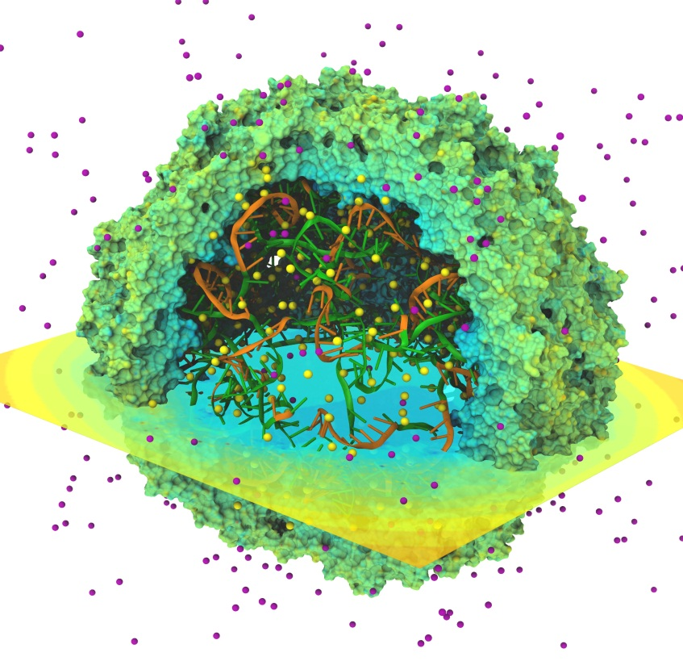
Time-Averaged Electrostatics Analysis on Energy-Efficient GPU Cluster
1.5 hour job (CPUs) reduced to 3 min (CPUs+GPU)
Electrostatics of thousands of trajectory frames averaged
Per-node power consumption on NCSA “AC” GPU cluster:
CPUs-only: 299 watts
CPUs+GPUs: 742 watts
GPU Speedup: 25.5x
Power efficiency gain: 10.5x
Quantifying the Impact of GPUs on Performance and Energy Efficiency in HPC Clusters. J. Enos, C. Steffen, J. Fullop, M. Showerman, G. Shi, K. Esler, V. Kindratenko, J. Stone, J. Phillips. The Work in Progress in Green Computing, pp. 317-324, 2010.

Slide 6
Time-Averaged Electrostatics Analysis on NCSA Blue Waters Early Science System
NCSA Blue Waters Node Type | Seconds per trajectory frame for one compute node
Cray XE6 Compute Node: 32 CPU cores (2xAMD 6200 CPUs) | 9.33
Cray XK6 GPU-accelerated Compute Node: 16 CPU cores + NVIDIA X2090 (Fermi) GPU | 2.25
Speedup for GPU XK6 nodes vs. CPU XE6 nodes | GPU nodes are 4.15x faster overall
Preliminary performance for VMD time-averaged electrostatics w/ Multilevel Summation Method running Blue Waters Early Science System

Slide 7
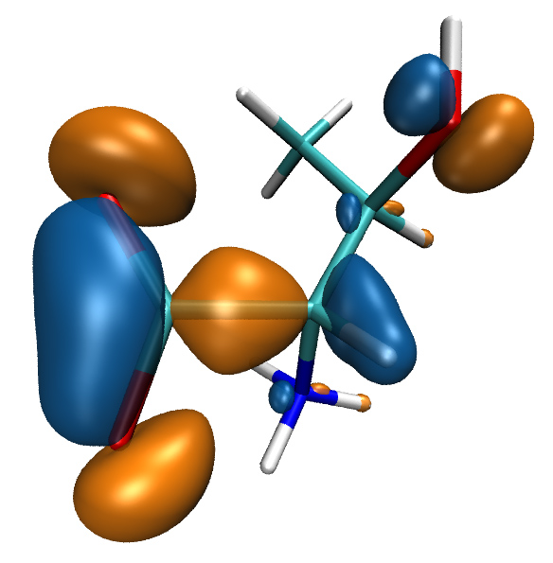
Visualizing Molecular Orbitals
Visualization of MOs aids in understanding the chemistry of molecular system
Display of MOs can require tens to hundreds of seconds on multi-core CPUs, even with hand-coded SSE
GPUs enable MOs to be computed and displayed in a fraction of a second, fully interactively

Slide 8
MO GPU Parallel Decomposition
MO 3-D lattice decomposes into 2-D slices (CUDA grids)
…
GPU 2
GPU 1
GPU 0
Small 8x8 thread blocks afford large
per-thread register count, shared memory
Lattice can be computed using multiple GPUs
0,0
0,1
…
Threads producing results that are used
Each thread computes one MO lattice point.
1,0
1,1
…
…
…
…
Padding optimizes global memory performance, guaranteeing coalesced global memory accesses
Threads producing results that are discarded
Grid of thread blocks
Notes:
Threads in a thread block (potentially) execute in parallel
Threads in a block can communicate via fast shared memory
Global memory reads are slow
Constant memory is fast, but can only be written by host at kernel startup.

Slide 9
VMD MO GPU Kernel Snippet: Loading Tiles Into Shared Memory On-Demand
[… outer loop over atoms …]
if ((prim_counter + (maxprim<<1)) >= SHAREDSIZE) {
prim_counter += sblock_prim_counter;
sblock_prim_counter = prim_counter & MEMCOAMASK;
s_basis_array[sidx ] = basis_array[sblock_prim_counter + sidx ];
s_basis_array[sidx + 64] = basis_array[sblock_prim_counter + sidx + 64];
s_basis_array[sidx + 128] = basis_array[sblock_prim_counter + sidx + 128];
s_basis_array[sidx + 192] = basis_array[sblock_prim_counter + sidx + 192];
prim_counter -= sblock_prim_counter;
__syncthreads();
}
for (prim=0; prim < maxprim; prim++) {
float exponent = s_basis_array[prim_counter ];
float contract_coeff = s_basis_array[prim_counter + 1];
contracted_gto += contract_coeff * __expf(-exponent*dist2);
prim_counter += 2;
}
[… continue on to angular momenta loop …]
Shared memory tiles:
Tiles are checked and loaded, if necessary, immediately prior to entering key arithmetic loops
Adds additional control overhead to loops, even with optimized implementation

Slide 10
VMD MO GPU Kernel Snippet: Fermi kernel based on L1 cache
[… outer loop over atoms …]
// loop over the shells belonging to this atom (or basis function)
for (shell=0; shell < maxshell; shell++) {
float contracted_gto = 0.0f;
int maxprim = shellinfo[(shell_counter<<4) ];
int shell_type = shellinfo[(shell_counter<<4) + 1];
for (prim=0; prim < maxprim; prim++) {
float exponent = basis_array[prim_counter ];
float contract_coeff = basis_array[prim_counter + 1];
contracted_gto += contract_coeff * __expf(-exponent*dist2);
prim_counter += 2;
}
[… continue on to angular momenta loop …]
L1 cache:
Simplifies code!
Reduces control overhead
Gracefully handles arbitrary-sized problems
Matches performance of constant memory

Slide 11
VMD Single-GPU Molecular Orbital Performance Results for C₆₀
Intel X5550 CPU, GeForce GTX 480 GPU
Kernel | Cores/GPUs | Runtime (s) | Speedup
Xeon 5550 ICC-SSE | 1 | 30.64 | 1.0
Xeon 5550 ICC-SSE | 8 | 4.13 | 7.4
CUDA shared mem | 1 | 0.37 | 83
CUDA L1-cache (16KB) | 1 | 0.27 | 113
CUDA const-cache | 1 | 0.26 | 117
CUDA const-cache, zero-copy | 1 | 0.25 | 122
Fermi GPUs have caches: may outperform hand-coded shared memory kernels. Zero-copy memory transfers improve overlap of computation and host-GPU I/Os.

Slide 12
VMD Multi-GPU Molecular Orbital Performance Results for C₆₀
Intel X5550 CPU, 4x GeForce GTX 480 GPUs,
Kernel | Cores/GPUs | Runtime (s) | Speedup
Intel X5550-SSE | 1 | 30.64 | 1.0
Intel X5550-SSE | 8 | 4.13 | 7.4
GeForce GTX 480 | 1 | 0.255 | 120
GeForce GTX 480 | 2 | 0.136 | 225
GeForce GTX 480 | 3 | 0.098 | 312
GeForce GTX 480 | 4 | 0.081 | 378
Uses persistent thread pool to avoid GPU init overhead, dynamic scheduler distributes work to GPUs

Slide 13
Molecular Orbital Computation and Display Process
One-time initialization
Read QM simulation log file, trajectory
Initialize Pool of GPU
Worker Threads
Preprocess MO coefficient data
eliminate duplicates, sort by type, etc…
For current frame and MO index,
retrieve MO wavefunction coefficients
Compute 3-D grid of MO wavefunction amplitudes
Most performance-demanding step, run on GPU…
For each trj frame, for each MO shown
Extract isosurface mesh from 3-D MO grid
Apply user coloring/texturing
and render the resulting surface

Slide 14
Multi-GPU Load Balance
Many early CUDA codes assumed all GPUs were identical
Host machines may contain a diversity of GPUs of varying capability (discrete, IGP, etc)
Different GPU on-chip and global memory capacities may need different problem “tile” sizes
Static decomposition works poorly for non-uniform workload, or diverse GPUs
GPU 1
14 SMs
GPU N
30 SMs
…

Slide 15
Multi-GPU Dynamic Work Distribution
Dynamic work distribution
// Each GPU worker thread loops over
// subset 2-D planes in a 3-D cube…
while (!threadpool_next_tile(&parms, tilesize, &tile){
// Process one plane of work…
// Launch one CUDA kernel for each
// loop iteration taken…
// Shared iterator automatically
// balances load on GPUs
}
GPU 1
GPU N
…

Slide 16
Example Multi-GPU Latencies Relevant to Interactive Sci-Viz, Script-Driven Analyses (4 Tesla C2050 GPUs, Intel Xeon 5550)
6.3us CUDA empty kernel (immediate return)
9.0us Sleeping barrier primitive (non-spinning
barrier that uses POSIX condition variables to prevent
idle CPU consumption while workers wait at the barrier)
14.8us pool wake, host fctn exec, sleep cycle (no CUDA)
30.6us pool wake, 1x(tile fetch, simple CUDA kernel launch), sleep
1817.0us pool wake, 100x(tile fetch, simple CUDA kernel launch), sleep

Slide 17
Multi-GPU Dynamic Scheduling Performance with Heterogeneous GPUs
Kernel | Cores/GPUs | Runtime (s) | Speedup
Intel X5550-SSE | 1 | 30.64 | 1.0
Quadro 5800 | 1 | 0.384 | 79
Tesla C2050 | 1 | 0.325 | 94
GeForce GTX 480 | 1 | 0.255 | 120
GeForce GTX 480 + Tesla C2050 + Quadro 5800 | 3 | 0.114 | 268 (91% of ideal perf)
Dynamic load balancing enables mixture of GPU generations, SM counts, and clock rates to perform well.

Slide 18
Multi-GPU Runtime Error/Exception Handling
Original Workload
Competition for resources from other applications can cause runtime failures, e.g. GPU out of memory half way through an algorithm
Handle exceptions, e.g. convergence failure, NaN result, insufficient compute capability/features
Handle and/or reschedule failed tiles of work
Retry Stack
GPU 1
SM 1.1
128MB
GPU N
SM 2.0
3072MB
…

Slide 19
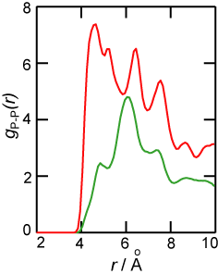
Radial Distribution Functions
RDFs describes how atom density varies with distance
Can be compared with experiments
Shape indicates phase of matter: sharp peaks appear for solids, smoother for liquids
Quadratic time complexity O(N²)
Solid
Liquid

Slide 20
Computing RDFs
Compute distances for all pairs of atoms between two groups of atoms A and B
A and B may be the same, or different
Use nearest image convention for periodic systems
Each pair distance is inserted into a histogram
Histogram is normalized one of several ways depending on use, but usually according to the volume of the spherical shells associated with each histogram bin

Slide 21
Multi-GPU RDF Performance
4 NVIDIA GTX480 GPUs 30 to 92x faster than 4-core Intel X5550 CPU
Fermi GPUs ~3x faster than GT200 GPUs: larger on-chip shared memory
Solid
Fast Analysis of Molecular Dynamics Trajectories with Graphics Processing Units – Radial Distribution Functions. B. Levine, J. Stone, and A. Kohlmeyer. 2010. (submitted)
Liquid

Slide 22
Molecular Surface Display: “QuickSurf” Representation
Displays continuum of structural detail:
All-atom models
Coarse-grained models
Cellular scale models
Multi-scale models: All-atom + CG, Brownian + Whole Cell
Smoothly variable between full detail, and reduced resolution representations of very large complexes
Uses multi-core CPUs and GPU acceleration to enable smooth real-time animation of MD trajectories
Linear-time algorithm, scales to hundreds of millions of particles, as limited by memory capacity
Fast Visualization of Gaussian Density Surfaces for Molecular Dynamics and Particle System Trajectories.
M. Krone, J. Stone, T. Ertl, K. Schulten. EuroVis 2012. (Submitted)

Slide 23
Recurring Algorithm Design Principles (1)
Extensive use of on-chip shared memory and constant memory to further amplify memory bandwidth
Pre-processing and sorting of operands to organize computation for peak efficiency on the GPU, particularly for best use of L1 cache and shared mem
Tiled/blocked data structures in GPU global memory for peak bandwidth utilization
Use of CPU to “regularize” the work done by the GPU, handle exceptions & unusual work units
Asynchronous operation of CPU/GPU enabling overlapping of computation and I/O on both ends

Slide 24
Recurring Algorithm Design Principles (2)
Take advantage of special features of the GPU memory systems
Broadcasts, wide loads/stores (float4, double2), texture interpolation, write combining, etc.
Avoid doing complex array indexing arithmetic within the GPU threads, pre-compute as much as possible outside of the GPU kernel so the GPU is doing what it’s best at: floating point arithmetic

