Slide 1
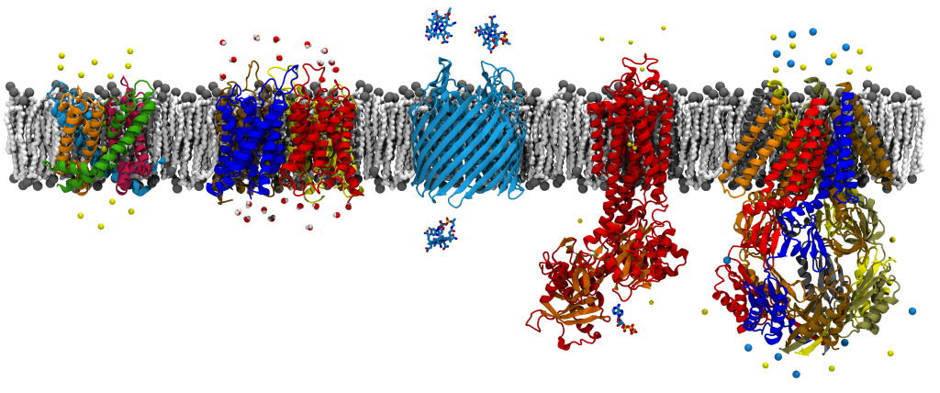
Short-range (Non-bonded) Interactions in NAMD
David Hardy
http://www.ks.uiuc.edu/Research/~dhardy/
NAIS: State-of-the-Art Algorithms for Molecular Dynamics
(Presenting the work of James Phillips.)

Slide 2
Molecular Dynamics
Integrate for 1 billion time steps
Non-bonded interactions
require most computation
van der Waals
electrostatics

Slide 3
Short-range Non-bonded Interactions
Sum interactions within cutoff distance a:
Perform spatial hashing of atoms into grid cells
For every grid cell, for each atom:
Loop over atoms in each neighboring cell
If r_{ij}² < a², sum potential energy, virial, and atomic forces
Use Newton’s 3rd Law: f_{ij} = −f_{ji}
If cutoff distance is no bigger than cell,
then loop over nearest neighbors
cutoff
NAMD: grid cells are “patches”
NAMD: spatial hashing is “migration”

Slide 4
Excluded Pairs
Self interactions are excluded
Typically exclude pairs of atoms that are covalently bonded to each other or to a common atom
Possible approaches:
Ignore and correct later
But this can cause large numerical errors
Detect during evaluation and skip

Slide 5
Algorithmic Enhancements (1)
Maintain pair lists
For each atom i, keep list of atoms j within cutoff
Extend cutoff distance (a+δ), no update needed until an atom moves distance δ/2
Maintain “hydrogen groups”
Reduce amount of pairwise testing between atoms
Let ε be upper bound on hydrogen bond length
Test distance between “parent” atoms
If r_{ij}² < (a − 2ε)², then all atoms interact
If r_{ij}² > (a + 2ε)², then no atoms interact
Otherwise have to test all pairs

Slide 6
Algorithmic Enhancements (2)
Combine pair lists and hydrogen groups
Use hydrogen groups to shortcut pair list generation
Check exclusions only when generating pair lists
During force computation, just need to test cutoff
Interpolation tables for interactions
Avoid erfc and exp functions needed for PME
Avoid rsqrt (on x86)
Avoid additional branching and calculation for van der Waals switching function

Slide 7
Short-range Parallelization
Spatial decomposition
Assign grid cells to PEs
Maps naturally to 3D mesh topology
Communication with nearest neighbors
NAMD
sends
positions
downstream,
then sends
forces
upstream.

Slide 8
NAMD Hybrid Decomposition
Kale et al., J. Comp. Phys. 151:283-312, 1999.
Spatially decompose data and communication.
Separate but related work decomposition.
“Compute objects” facilitate iterative, measurement-based load balancing system.

Slide 9
NAMD Code is Message-Driven
No receive calls as in “message passing”
Messages sent to object “entry points”
Incoming messages placed in queue
Priorities are necessary for performance
Execution generates new messages
Implemented in Charm++
Can be emulated in MPI
Charm++ provides tools and idioms
Parallel Programming Lab: http://charm.cs.uiuc.edu/

Slide 10
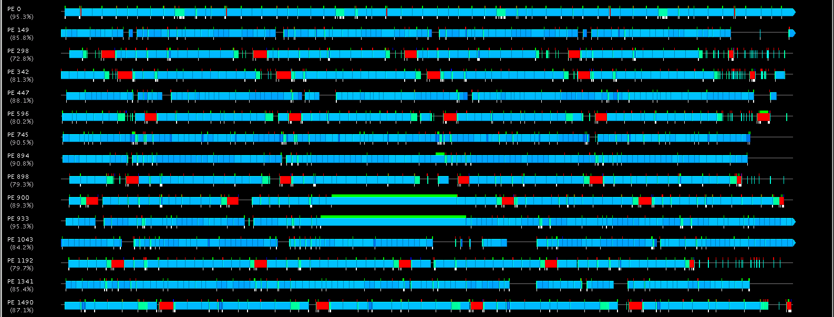
System Noise Example Timeline from Charm++ tool “Projections” http://charm.cs.uiuc.edu/

Slide 11
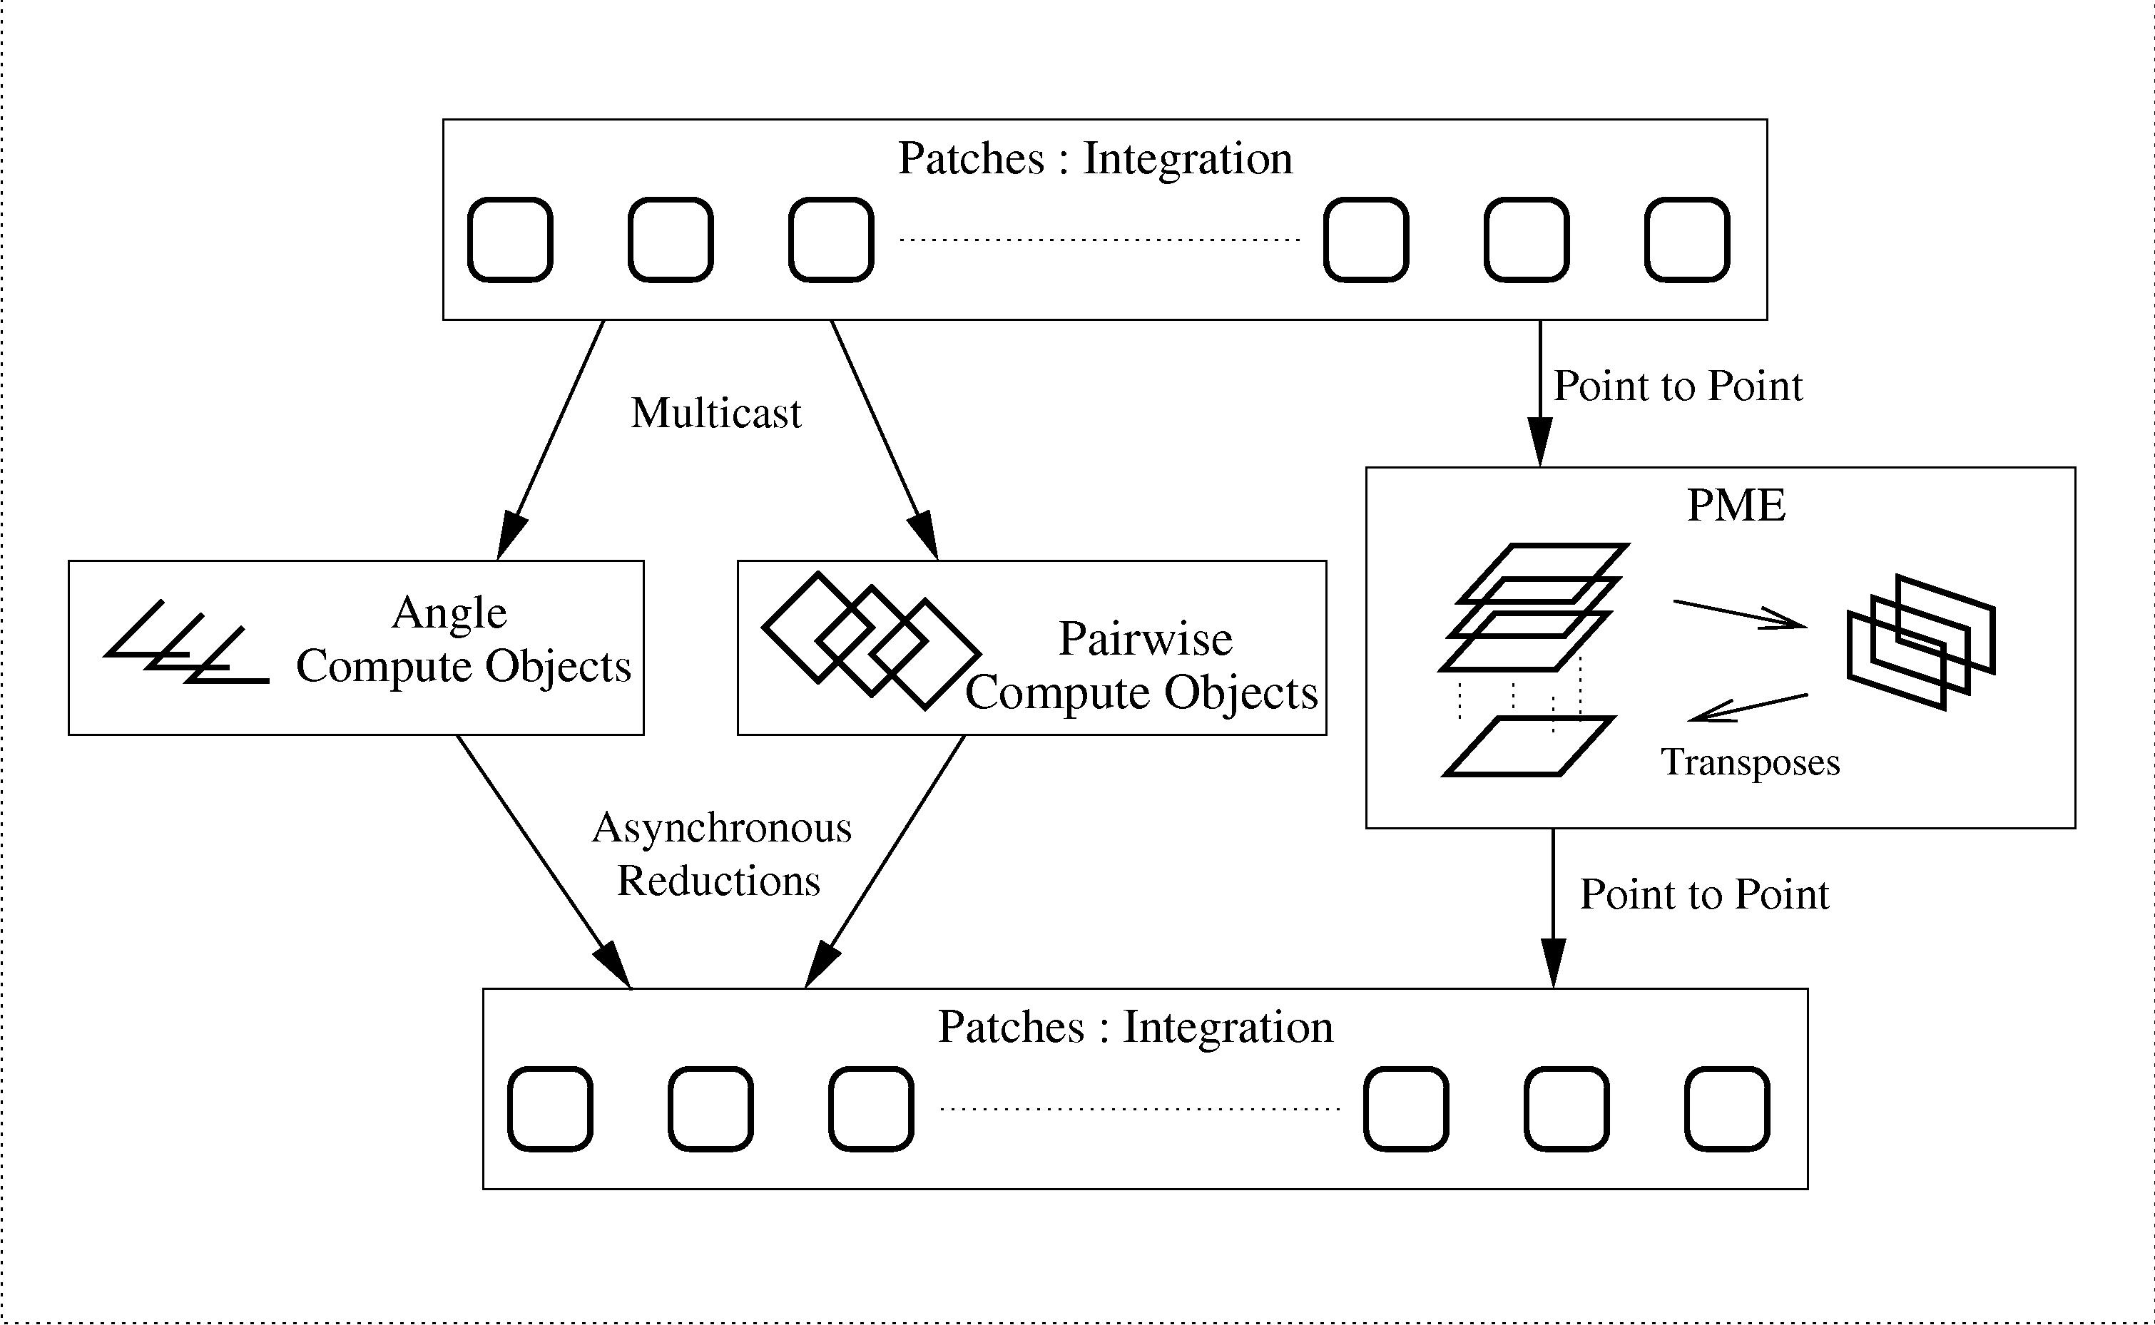
NAMD Overlapping Execution
Phillips et al., SC2002.
Offload to GPU
Objects are assigned to processors and queued as data arrives.
Notes:
Just declare, don’t explain

Slide 12
Message-Driven CUDA?
No, CUDA is too coarse-grained.
CPU needs fine-grained work to interleave and pipeline.
GPU needs large numbers of tasks submitted all at once.
No, CUDA lacks priorities.
FIFO isn’t enough.
Perhaps in a future interface:
Stream data to GPU.
Append blocks to a running kernel invocation.
Stream data out as blocks complete.

Slide 13
Short-range Forces on CUDA GPU
Start with most expensive calculation: direct nonbonded interactions.
Decompose work into pairs of patches, identical to NAMD structure.
GPU hardware assigns patch-pairs to multiprocessors dynamically.
Force computation on single multiprocessor (GeForce 8800 GTX has 16)
16kB Shared Memory
Patch A Coordinates & Parameters
Texture Unit
Force Table
Interpolation
32-way SIMD Multiprocessor
32-256 multiplexed threads
Constants
Exclusions
32kB Registers
Patch B Coords, Params, & Forces
8kB cache
8kB cache
768 MB Main Memory, no cache, 300+ cycle latency
Stone et al., J. Comp. Chem. 28:2618-2640, 2007.

Slide 14
texture<float4> force_table;
__constant__ unsigned int exclusions[];
__shared__ atom jatom[];
atom iatom; // per-thread atom, stored in registers
float4 iforce; // per-thread force, stored in registers
for ( int j = 0; j < jatom_count; ++j ) {
float dx = jatom[j].x - iatom.x; float dy = jatom[j].y - iatom.y; float dz = jatom[j].z - iatom.z;
float r2 = dx*dx + dy*dy + dz*dz;
if ( r2 < cutoff2 ) {
float4 ft = texfetch(force_table, 1.f/sqrt(r2));
bool excluded = false;
int indexdiff = iatom.index - jatom[j].index;
if ( abs(indexdiff) <= (int) jatom[j].excl_maxdiff ) {
indexdiff += jatom[j].excl_index;
excluded = ((exclusions[indexdiff>>5] & (1<<(indexdiff&31))) != 0);
}
float f = iatom.half_sigma + jatom[j].half_sigma; // sigma
f *= f*f; // sigma^3
f *= f; // sigma^6
f *= ( f * ft.x + ft.y ); // sigma^12 * fi.x - sigma^6 * fi.y
f *= iatom.sqrt_epsilon * jatom[j].sqrt_epsilon;
float qq = iatom.charge * jatom[j].charge;
if ( excluded ) { f = qq * ft.w; } // PME correction
else { f += qq * ft.z; } // Coulomb
iforce.x += dx * f; iforce.y += dy * f; iforce.z += dz * f;
iforce.w += 1.f; // interaction count or energy
}
}
Short-range Forces
CUDA Code
Force Interpolation
Exclusions
Parameters
Accumulation
Stone et al., J. Comp. Chem. 28:2618-2640, 2007.
Notes:
Add callouts, emphasize only illustration

Slide 15
CUDA Kernel Evolution
Original - minimize main memory access
Enough threads to load all atoms in patch
Needed two atoms per thread to fit
Swap atoms between shared and registers
Revised - multiple blocks for concurrency
64 threads/atoms per block (now 128 for Fermi)
Loop over shared memory atoms in sets of 16
Two blocks for each patch pair

Slide 16
Initial GPU Performance (2007)
ApoA1 Performance
Full NAMD, not test harness
Useful performance boost
8x speedup for nonbonded
5x speedup overall w/o PME
3.5x speedup overall w/ PME
GPU = quad-core CPU
Plans for better performance
Overlap GPU and CPU work.
Tune or port remaining work.
PME, bonded, integration, etc.
faster
2.67 GHz Core 2 Quad Extreme + GeForce 8800 GTX

Slide 17
2007 GPU Cluster Performance
ApoA1 Performance
Poor scaling unsurprising
2x speedup on 4 GPUs
Gigabit ethernet
Load balancer disabled
Plans for better scaling
InfiniBand network
Tune parallel overhead
Load balancer changes
Balance GPU load.
Minimize communication.
faster
2.2 GHz Opteron + GeForce 8800 GTX

Slide 18
Overlapping GPU and CPU with Communication
GPU
x
Remote Force
f
Local Force
f
x
CPU
Remote
Local
f
Local
Update
x
f
x
Other Nodes/Processes
One Timestep

Slide 19
“Remote Forces”
Remote
Patch
Remote
Patch
Forces on atoms in a local patch are “local”
Forces on atoms in a remote patch are “remote”
Calculate remote forces first to overlap force communication with local force calculation
Not enough local work to overlap it with position communication
Local
Patch
Remote
Patch
Local
Patch
Remote
Patch
Work done by one processor

Slide 20
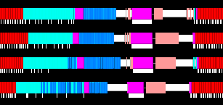
Actual Timelines from NAMD Generated using Charm++ tool “Projections” http://charm.cs.uiuc.edu/
GPU
x
Remote Force
f
Local Force
f
x
CPU
x
f
x
f

Slide 21
NCSA “4+4” QP Cluster
STMV (1M atoms) s/step
6.76
3.33
faster
2.4 GHz Opteron + Quadro FX 5600

Slide 22
NCSA “8+2” Lincoln Cluster
CPU: 2 Intel E5410 Quad-Core 2.33 GHz
GPU: 2 NVIDIA C1060
Actually S1070 shared by two nodes
How to share a GPU among 4 CPU cores?
Send all GPU work to one process?
Coordinate via messages to avoid conflict?
Or just hope for the best?

Slide 23
NCSA Lincoln Cluster Performance (8 Intel cores and 2 NVIDIA Telsa GPUs per node)
STMV (1M atoms) s/step
~2.8
2 GPUs = 24 cores
4 GPUs
8 GPUs
16 GPUs
CPU cores

Slide 24
No GPU Sharing (Ideal World)
GPU 1
x
Remote Force
f
Local Force
f
x
GPU 2
x
Remote Force
f
Local Force
f
x

Slide 25
GPU Sharing (Desired)
x
Remote Force
f
Local Force
f
x
Client 1
x
Remote Force
f
Local Force
f
x
Client 2

Slide 26
GPU Sharing (Feared)
x
Remote Force
f
Local Force
f
x
Client 1
x
Remote Force
f
Local Force
f
x
Client 2

Slide 27
GPU Sharing (Observed)
x
Remote Force
f
Local Force
f
x
Client 1
x
Remote Force
f
Local Force
f
x
Client 2

Slide 28
GPU Sharing (Explained)
CUDA is behaving reasonably, but
Force calculation is actually two kernels
Longer kernel writes to multiple arrays
Shorter kernel combines output
Possible solutions:
Modify CUDA to be less “fair” (please!)
Use locks (atomics) to merge kernels (not G80)
Explicit inter-client coordination

Slide 29
Inter-client Communication
First identify which processes share a GPU
Need to know physical node for each process
GPU-assignment must reveal real device ID
Threads don’t eliminate the problem
Production code can’t make assumptions
Token-passing is simple and predictable
Rotate clients in fixed order
High-priority, yield, low-priority, yield, …

Slide 30
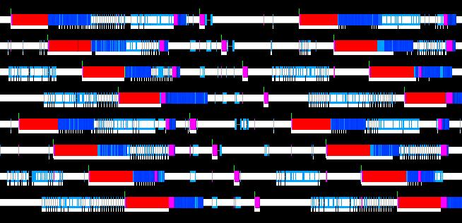
Token-Passing GPU-Sharing
GPU1
GPU2
Local
Remote
Local
Remote

Slide 31
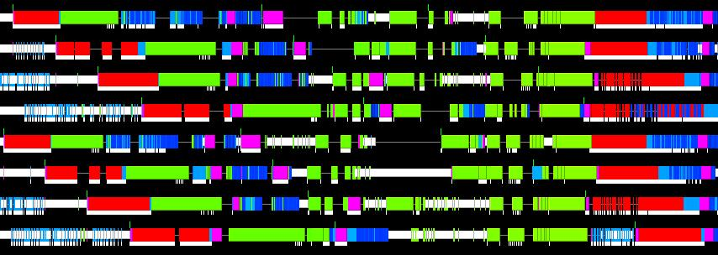
GPU-Sharing with PME
Local
Remote
Local
Remote

Slide 32
Weakness of Token-Passing
GPU is idle while token is being passed
Busy client delays itself and others
Next strategy requires threads:
One process per GPU, one thread per core
Funnel CUDA calls through a single stream
No local work until all remote work is queued
Typically funnels MPI as well

Slide 33
Current Compromise
Use Fermi to overlap multiple streams
If GPU is shared:
Submit remote work
Wait for remote work to complete
Gives other processes a chance to submit theirs
Submit local work
If GPU is not shared:
Submit remote and local work immediately

Slide 34
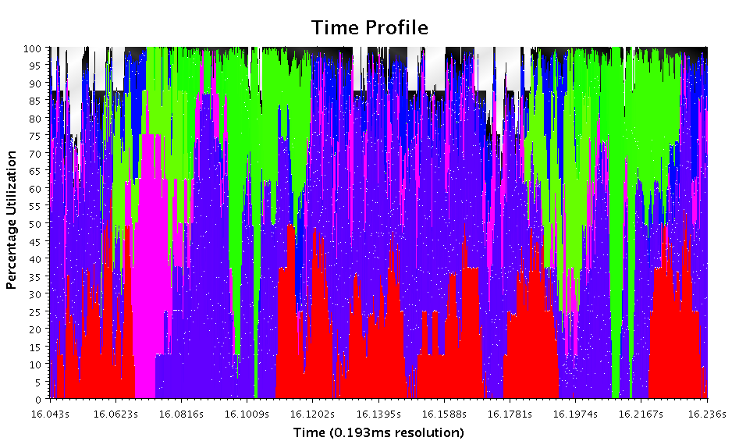
8 GPUs + 8 CPU Cores

Slide 35
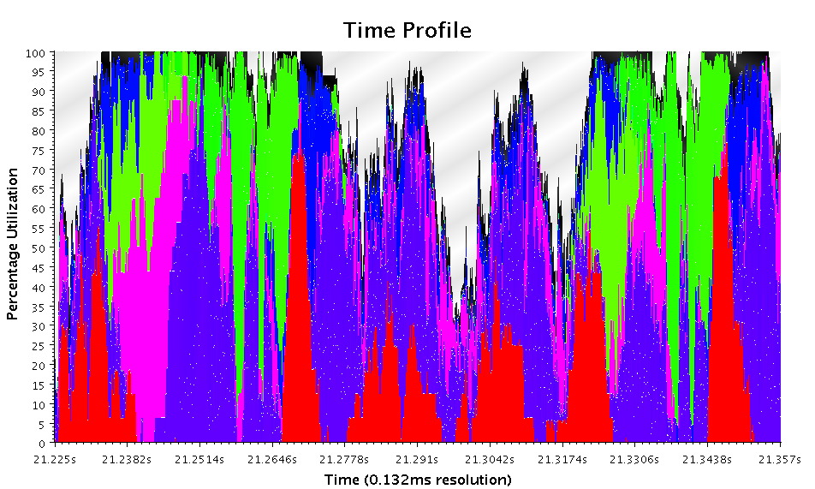
8 GPUs + 16 CPU Cores

Slide 36
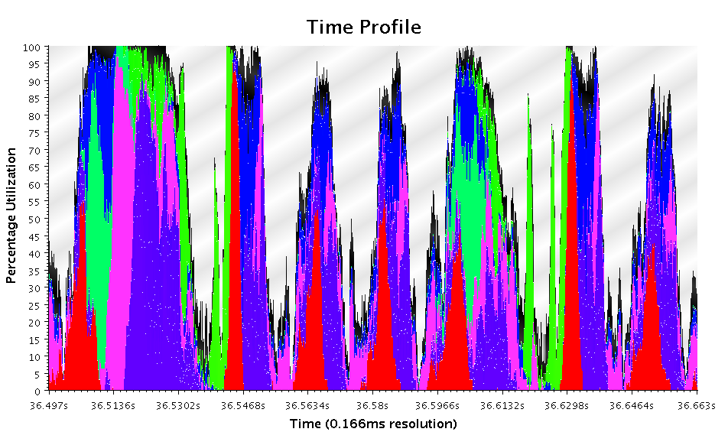
8 GPUs + 32 CPU Cores

Slide 37
Further NAMD GPU Developments
Production features in 2.7b3 release (7/6/2010):
Full electrostatics with PME
1-4 exclusions
Constant-pressure simulation
Improved force accuracy:
Patch-centered atom coordinates
Increased precision of force interpolation
Performance enhancements in 2.7b4 release (9/17/2010):
Sort blocks in order of decreasing work
Recursive bisection within patch on 32-atom boundaries
Warp-based pair lists based on sorted atoms

Slide 38
Sorting Blocks
Sort patch pairs by increasing distance.
Equivalent to sort by decreasing work.
Slower blocks start first, fast blocks last.
Reduces idle time, total runtime of grid.

Slide 39
Sorting Atoms
Reduce warp divergence on cutoff tests
Group nearby atoms in the same warp
One option is space-filling curve
Used recursive bisection instead
Split only on 32-atom boundaries
Find major axis, sort, split, repeat…

Slide 40
Warp-based Pairlists
List generation
Load 16 atoms into shared memory
Any atoms in this warp within pairlist distance?
Combine all (4) warps as bits in char and save.
List use
Load set of 16 atoms if any bit is set in list
Only calculate if this warp’s bit is set
Cuts kernel runtime by 50%

Slide 41
Lincoln and Longhorn Performance (8 Intel cores and 2 NVIDIA Telsa GPUs per node)
STMV (1M atoms) s/step
~2.8
32 GPUs
CPU cores

Slide 42
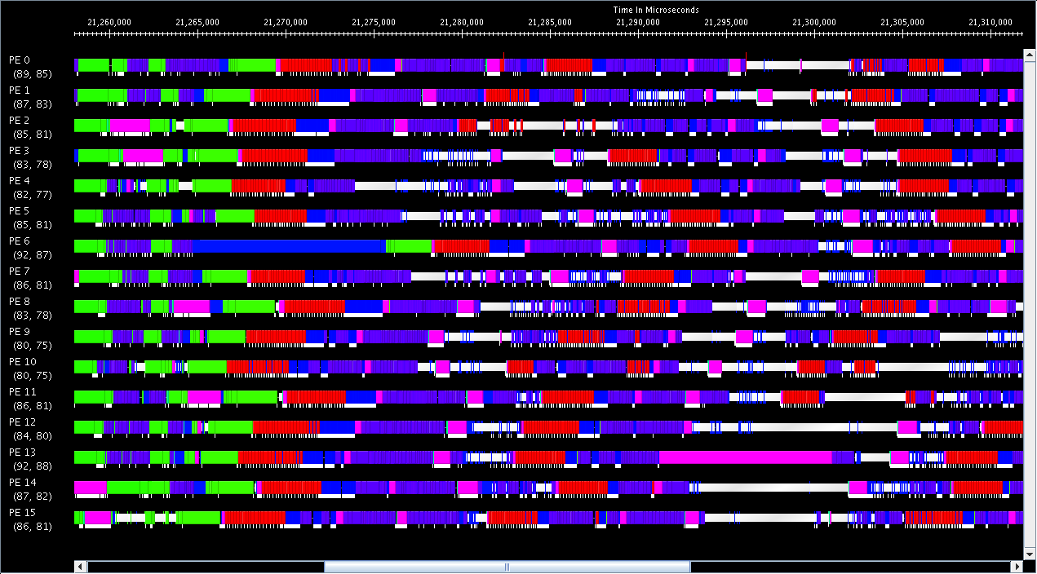
System Noise Still Present

