Slide 1
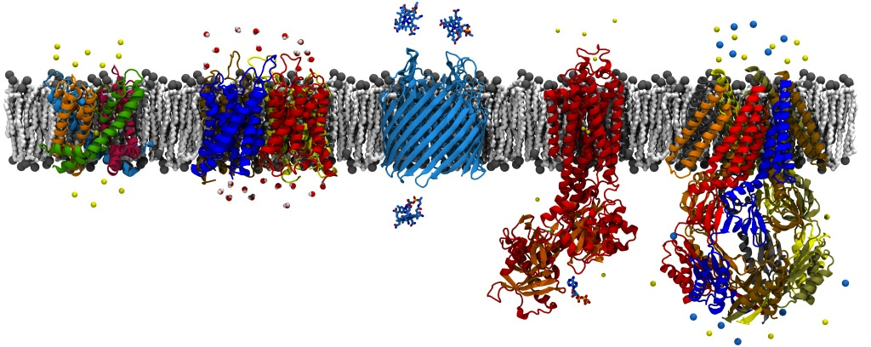
NAMD Algorithms and HPC Functionality
David Hardy
http://www.ks.uiuc.edu/Research/~dhardy/
NAIS: State-of-the-Art Algorithms for Molecular Dynamics

Slide 2
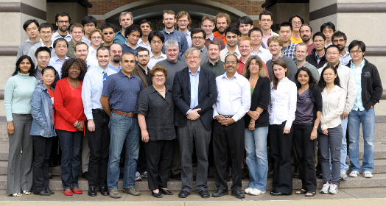
Beckman Institute University of Illinois at Urbana-Champaign
Theoretical and Computational
Biophysics Group

Slide 3
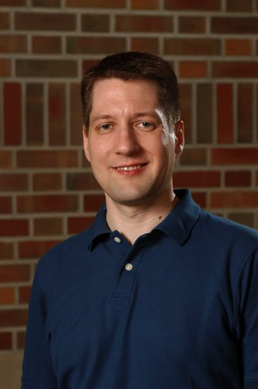
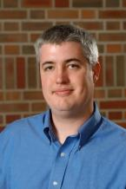
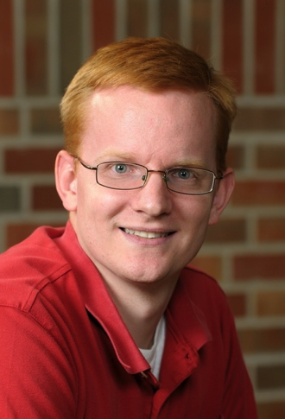
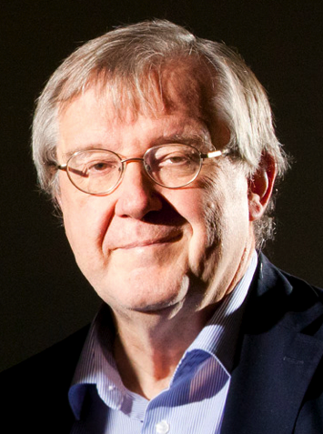
Acknowledgments
Jim Phillips
Lead NAMD
developer
John Stone
Lead VMD
developer
David Tanner
Implemented GBIS
Klaus Schulten
Director of TCB group

Slide 4
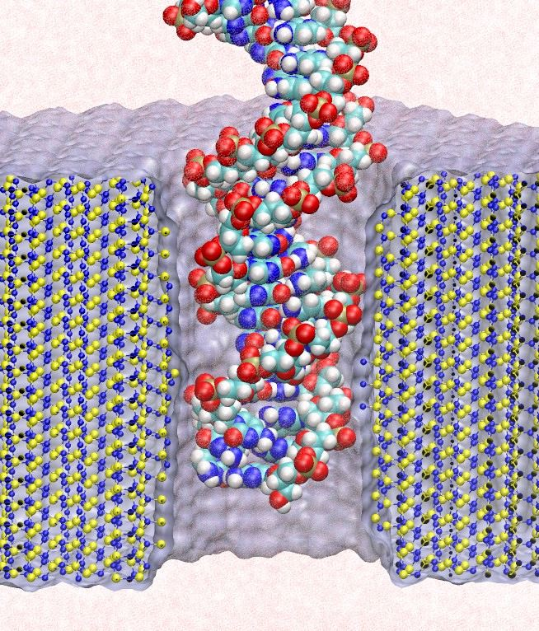
NAMD and VMD: The Computational Microscope
Study the molecular machines in living cells
Ribosome: synthesizes proteins from genetic information, target for antibiotics
Silicon nanopore: bionanodevice for sequencing DNA efficiently
Notes:
Ribosomes synthesize new proteins from genetic information
Bacterial ribosome is a target for antibiotics, which interfere with its ability to function by binding to sites on the structure, preventing proteins from being synthesized
Ribosome simulations are extremely computationally challenging due to the size of the structure and its natural environment (solvent, ions, etc, large box, 3 million atoms or so)
Bionanodevice for sequencing DNA efficiently
Knowledge of an individual’s genetic makeup can lead to the prediction and treatment of many diseases by the means of personal genomic medicine and pharmacogenomics. In order for genome sequencing to become practical for common medical use, an inexpensive high throughput genome sequencing technique is required. NIH has set a goal of reducing the cost of genome sequencing by a factor of 10,000, to less than $1,000 within ten years.
The computer is the best microscope to guide the development of bionanodevices, for example to sequence DNA. While experiments can measure DNA electrostatic potentials, they cannot visualize the DNA’s location and conformation at the time of measurement.

Slide 5
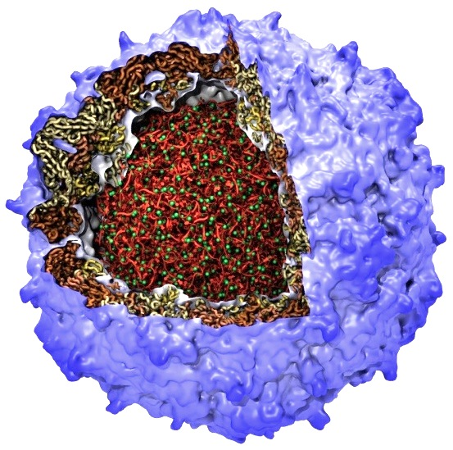
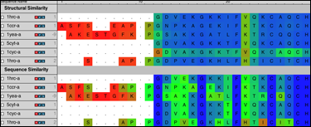
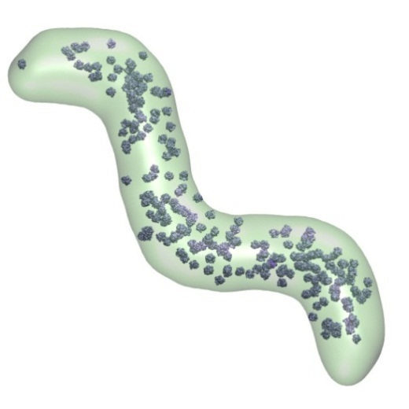
VMD – “Visual Molecular Dynamics”
Visualization and analysis of:
molecular dynamics simulations
quantum chemistry calculations
particle systems and whole cells
sequence data
volumetric data
User extensible w/ scripting and plugins
Poliovirus
Ribosome Sequences
Electrons in Vibrating Buckyball
Cellular Tomography,
Cryo-electron Microscopy
Whole Cell Simulations

Slide 6
VMD Interoperability – Linked to Today’s Key Research Areas
Unique in its interoperability with a broad range of modeling tools: AMBER, CHARMM, CPMD, DL_POLY, GAMESS, GROMACS, HOOMD, LAMMPS, NAMD, and many more …
Supports key data types, file formats, and databases, e.g. electron microscopy, quantum chemistry, MD trajectories, sequence alignments, super resolution light microscopy
Incorporates tools for simulation preparation, visualization, and analysis

Slide 7
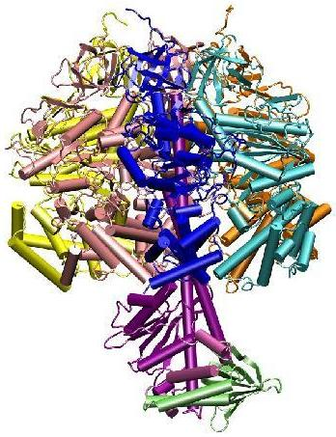
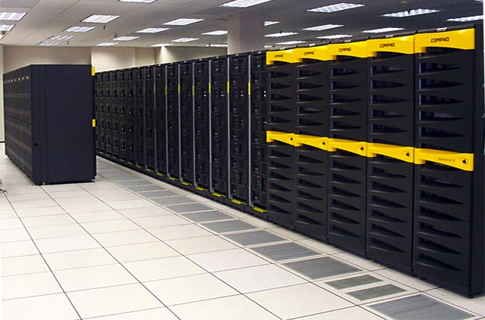
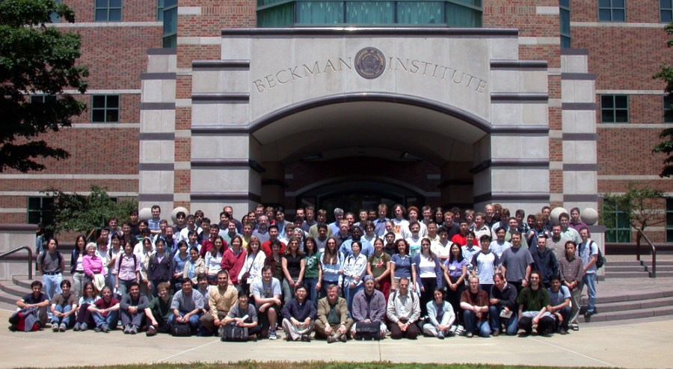
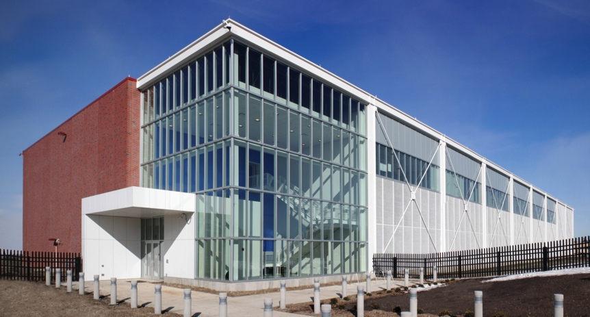
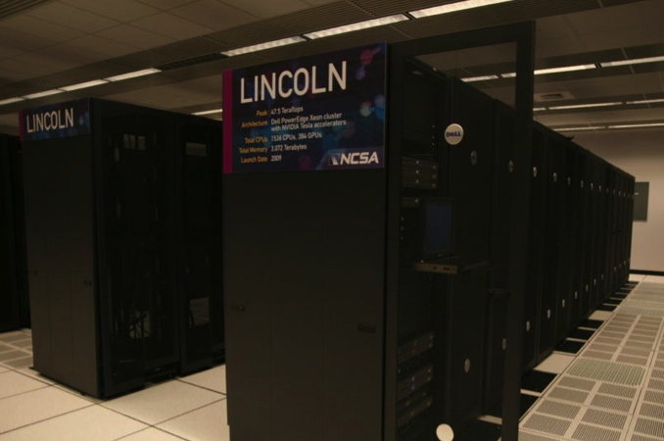
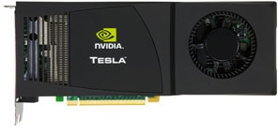
NAMD: Scalable Molecular Dynamics
2002 Gordon Bell Award
51,000 Users, 2900 Citations
ATP synthase
PSC Lemieux
Computational Biophysics Summer School
Blue Waters Target Application
GPU Acceleration
Illinois Petascale Computing Facility
NVIDIA Tesla
NCSA Lincoln

Slide 8
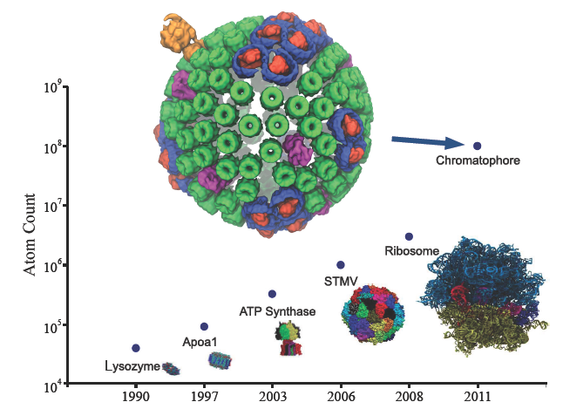
Larger machines enable larger simulations
Notes:
Put in a machine connection for one of the smaller system and a machine connection to chromatophore (BWs)
Move “Larger machines….” and make it a title.
Discuss “In the past, simulations ran on a single core, and while we still tune for single processor speed, now we are also running over 300K cores on BW and 1M cores on BG/Q….running a simulation and maintiaining execution over this massive number of cores is a challenging task”

Slide 9
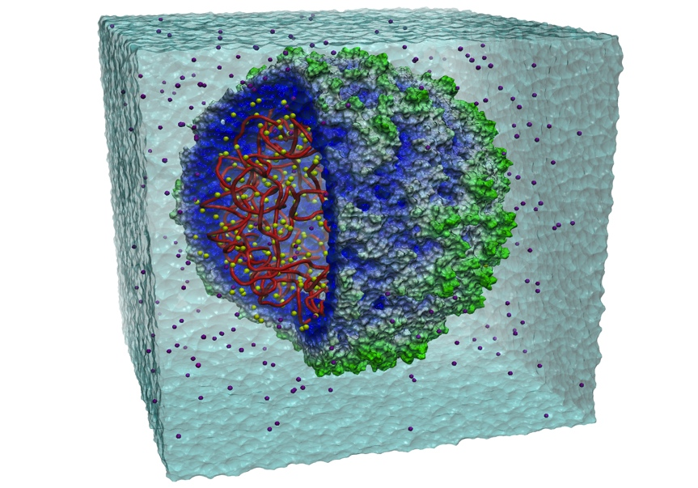
NAMD features are chosen for scalability
CHARMM, AMBER, OPLS force fields
Multiple time stepping
Hydrogen bond constraints
Efficient PME full electrostatics
Conjugate-gradient minimization
Temperature and pressure controls
Steered molecular dynamics (many methods)
Interactive molecular dynamics (with VMD)
Locally enhanced sampling
Alchemical free energy perturbation
Adaptive biasing force potential of mean force
User-extendable in Tcl for forces and algorithms
All features run in parallel and scale to millions of atoms!

Slide 10
NAMD 2.9 Release
Public beta released March 19, final version in May
Capabilities:
New scalable replica-exchange implementation
QM/MM interface to OpenAtom plane-wave QM code
Knowledge-based Go potentials to drive folding and assembly
Multilevel Summation Method electrostatics (serial prototype)
Performance:
Cray XE6/XK6 native multi-threaded network layer
Communication optimizations for wider multicore nodes
GPU acceleration of energy minimization
GPU-oriented shared-memory optimizations
GPU Generalized Born (OBC) implicit solvent
Faster grid force calculation for MDFF maps
Enables
Desktop
MDFF
Notes:
Add several images that relate to the new features.
Add scaling figure for GB ISM?
From Klaus: “Must mention somewhere in presentation that our best speed is 160ns/day and on conventional hardware it is the best there is unless you take 4fs timesteps and other tricks on other softwares …. and now we try to improve that further to XXX ns/day” Eric, an idea of what’s reasonable as target for next few years?
----- Meeting Notes (3/9/12 10:49) -----
needs updating
state NAMD 2.9 DONE
highlight replica exchange; say ahead of schedule DONE
"Enabling" Desktop MDFF DONE
----- Meeting Notes (3/16/12 11:41) -----
Repeat title slide before this one w/ box around Jims name
PUT NAMD 2.9s in different color. Red

Slide 11
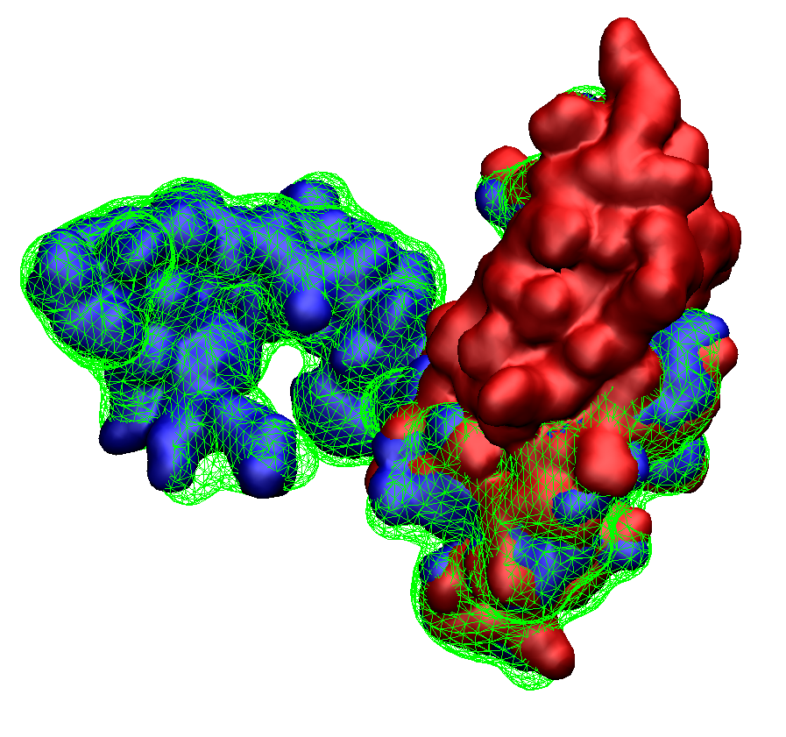
NAMD 2.9 Desktop MDFF
with GPU-Accelerated Implicit Solvent and CPU-Optimized Cryo-EM Forces
Fast: 2 ns/day
Explicit Solvent
8 cores (1X)
Initial
Structure
PDB 2EZM
Fitted
Structure
Faster: 12 ns/day
Implicit Solvent
8 cores (6X)
Fastest: 40 ns/day
Cyanovirin-N
1,500 atoms
1 Å final RMSD
Implicit Solvent
1 GPU (20X)
Simulated EM Map from PDB 3EZM
Notes:
----- Meeting Notes (3/9/12 10:49) -----
New:
get molecule info from Yan TODO
Crystal structure PDB ID
say what CryoEM map is looking at DONE
Take live demo away DONE
say green mesh is simulated CryoEM density for PDB ID DONE
take bottom away DONE

Slide 12
NAMD 2.9 Scalable Replica Exchange
Easier to use and more efficient:
Eliminates complex, machine-specific launch scripts
Scalable pair-wise communication between replicas
Fast communication via high-speed network
Basis for many enhanced sampling methods:
Parallel tempering (temperature exchange)
Umbrella sampling for free-energy calculations
Hamiltonian exchange (alchemical or conformational)
Finite Temperature String method
Nudged elastic band
Great power and flexibility:
Enables petascale simulations of modestly sized systems
Leverages features of Collective Variables module
Tcl scripts can be highly customized and extended
Released in
NAMD 2.9
Enabled for
Roux group
Notes:
----- Meeting Notes (3/9/12 10:49) -----
New:
use image from proposal
replace etc with list of features in proposal which require this
move text up DONE

Slide 13
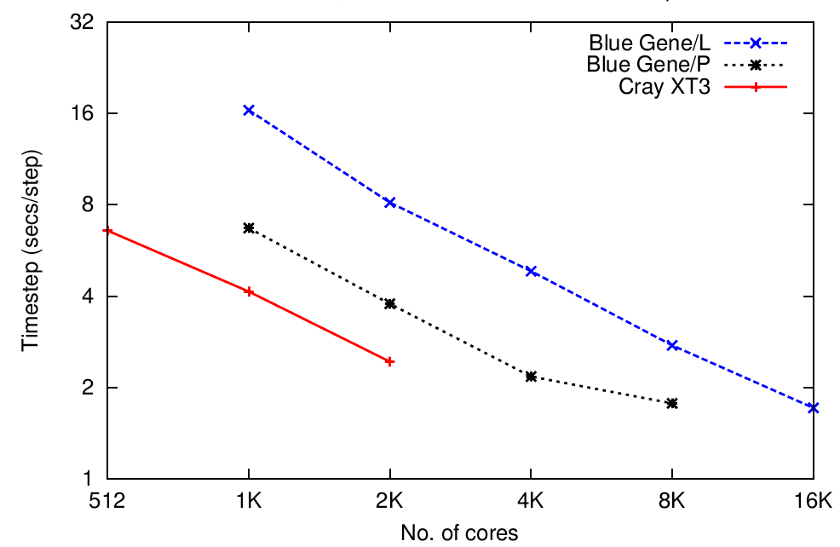
NAMD 2.9 QM/MM Calculations
Car-Parrinello MD (OpenAtom) and NAMD in one software
OpenAtom (100 atoms, 70Ry, on 1K cores): 120 ms / step
NAMD: (50,000 atoms on 512 cores): 2.5 ms / step
Permits 1000+ atom QM regions
Parallel Car-Parrinello MD
DOE and NSF Funded 10 yrs
Martyna/Kale Collaboration
Synchronous load-balancing of QM and MD maximizes processor utilization
OpenAtom
BG/L
BG/P
Cray XT3
Faster
NAMD
OPENATOM
Timestep (sec/step)
Parallel Electrostatic Embedding
Charm++
Method combining OpenAtom and NAMD
# Cores
Harrison & Schulten, Quantum and classical dynamics of ATP hydrolysis in solvent. Submitted
Notes:
Add Martyna name
----- Meeting Notes (3/9/12 10:49) -----
needs font revision to many fonts
----- Meeting Notes (3/16/12 11:59) -----
Fix Parinello spellings!!! ALL OF THEM.
Mv 10 yrs to front of DOE and NSF line

Slide 14
NAMD impact is broad and deep
Comprehensive, industrial-quality software
Integrated with VMD for simulation setup and analysis
Portable extensibility through Tcl scripts (also used in VMD)
Consistent user experience from laptop to supercomputer
Large user base – 51,000 users
9,100 (18%) are NIH-funded; many in other countries
14,100 have downloaded more than one version
Leading-edge simulations
“most-used software” on NICS Cray XT5 (largest NSF machine)
“by far the most used MD package” at TACC (2nd and 3rd largest)
NCSA Blue Waters early science projects and acceptance test
Argonne Blue Gene/Q early science project
Notes:
Move 50K users to same line as “Large user base”
Use absolute # along with 18%
“18% are NIH funded, ie 10,000; many also in other countries”

Slide 15
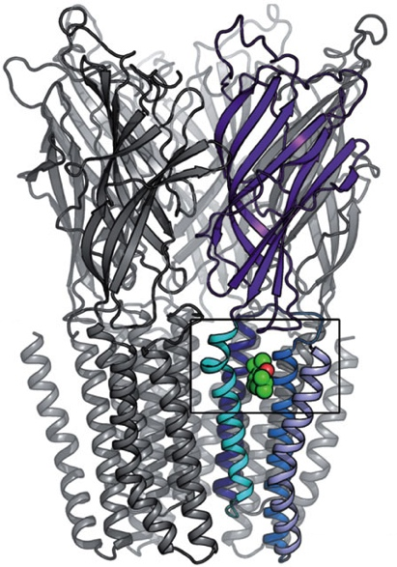
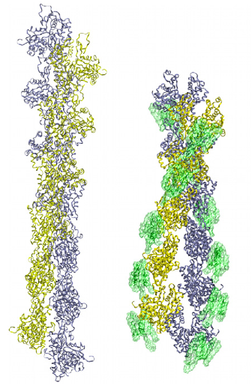
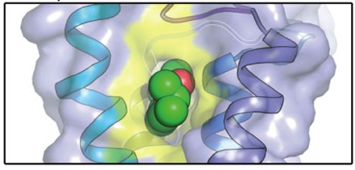
Outside researchers choose NAMD and succeed
Corringer, et al., Nature, 2011
2100 external citations since 2007
Voth, et al., PNAS, 2010
180K-atom 30 ns study of anesthetic binding to bacterial ligand-gated ion channel provided “complementary interpretations…that could not have been deduced from the static structure alone.”
Bound Propofol Anesthetic
500K-atom 500 ns investigation of effect of actin depolymerization factor/cofilin on mechanical properties and conformational dynamics of actin filament.
Recent NAMD Simulations in Nature
Bare actin
Cofilactin
M. Koeksal, et al., Taxadiene synthase structure and evolution of modular architecture in terpene biosynthesis. (2011)
C.-C. Su, et al., Crystal structure of the CusBA heavy-metal efflux complex of Escherichia coli. (2011)
D. Slade, et al., The structure and catalytic mechanism of a poly(ADP-ribose) glycohydrolase. (2011)
F. Rose, et al., Mechanism of copper(II)-induced misfolding of Parkinson’s disease protein. (2011)
L. G. Cuello, et al., Structural basis for the coupling between activation and inactivation gates in K(+) channels. (2010)
S. Dang, et al.,, Structure of a fucose transporter in an outward-open conformation. (2010)
F. Long, et al., Crystal structures of the CusA efflux pump suggest methionine-mediated metal transport. (2010)
R. H. P. Law, et al., The structural basis for membrane binding and pore formation by lymphocyte perforin. (2010)
P. Dalhaimer and T. D. Pollard, Molecular Dynamics Simulations of Arp2/3 Complex Activation. (2010)
J. A. Tainer, et al., Recognition of the Ring-Opened State of Proliferating Cell Nuclear Antigen by Replication Factor C Promotes Eukaryotic Clamp-Loading. (2010)
D. Krepkiy, et al.,, Structure and hydration of membranes embedded with voltage-sensing domains. (2009)
N. Yeung, et al.,, Rational design of a structural and functional nitric oxide reductase. (2009)
Z. Xia, et al., Recognition Mechanism of siRNA by Viral p19 Suppressor of RNA Silencing: A Molecular Dynamics Study. (2009)

Slide 16
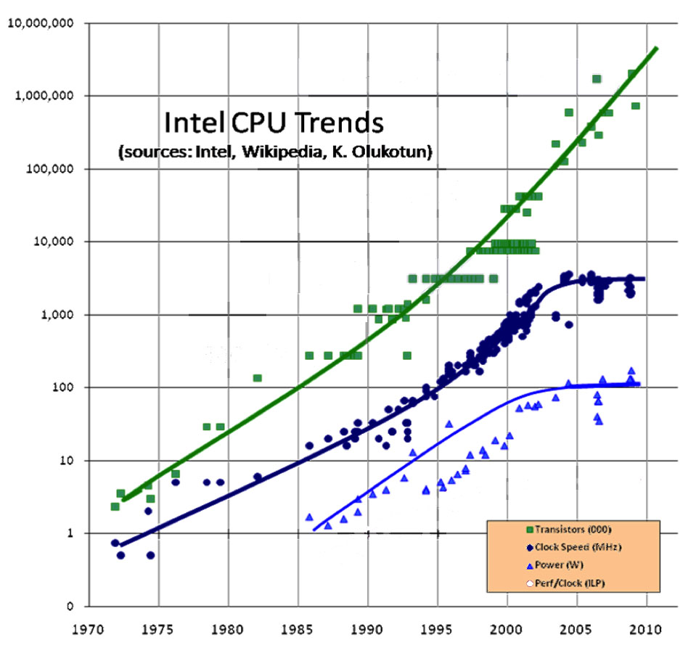
Challenges of New Hardware
The number of transistors on a chip keeps increasing
(and will, for 10 years)
BUT the frequency has stopped increasing (since 2003 or so)
count
Due to power limits
Transistors (1000s)
Clock Speed (MHz)
Power (W)
Year
Notes:
----- Meeting Notes (3/9/12 10:05) -----
remove foot note DONE
repair legend
remove red labels
make y axis "Number"
make x axis "Year"
perhaps remove 4th curve
make text on right more reader friendly; text can have arrows to curves
rephrase last sentance, heterogeneous
make titles higher

Slide 17
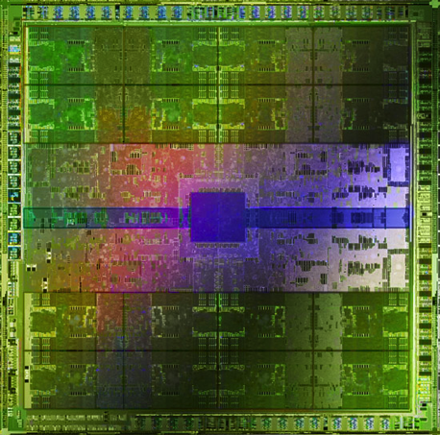
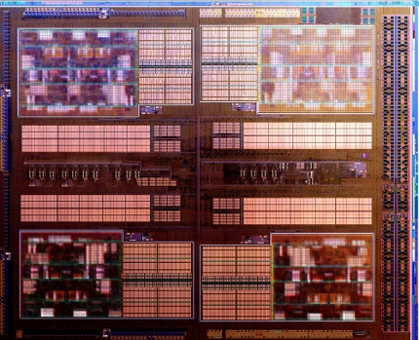
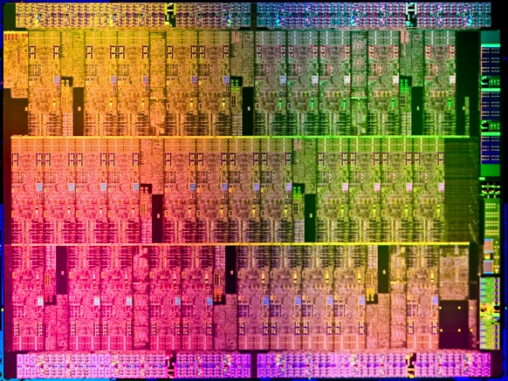
Harnessing Future Hardware
Challenge: a panoply of complex and powerful hardware
Complex multicore chips, accelerators
Kepler GPU
(Blue Waters)
AMD Interlagos
(Blue Waters)
Intel MIC
(TACC Stampede)
Solution: BTRC computer science expertise
Parallel Programming Lab: leading research group in scalable parallel computing
Notes:
----- Meeting Notes (3/9/12 10:05) -----
put transition from previous slide, useing Complex or Future on both slides; make transition in first bullet
remove "resource has"? us BTRC
----- Meeting Notes (3/16/12 11:25) -----
cpaita

Slide 18
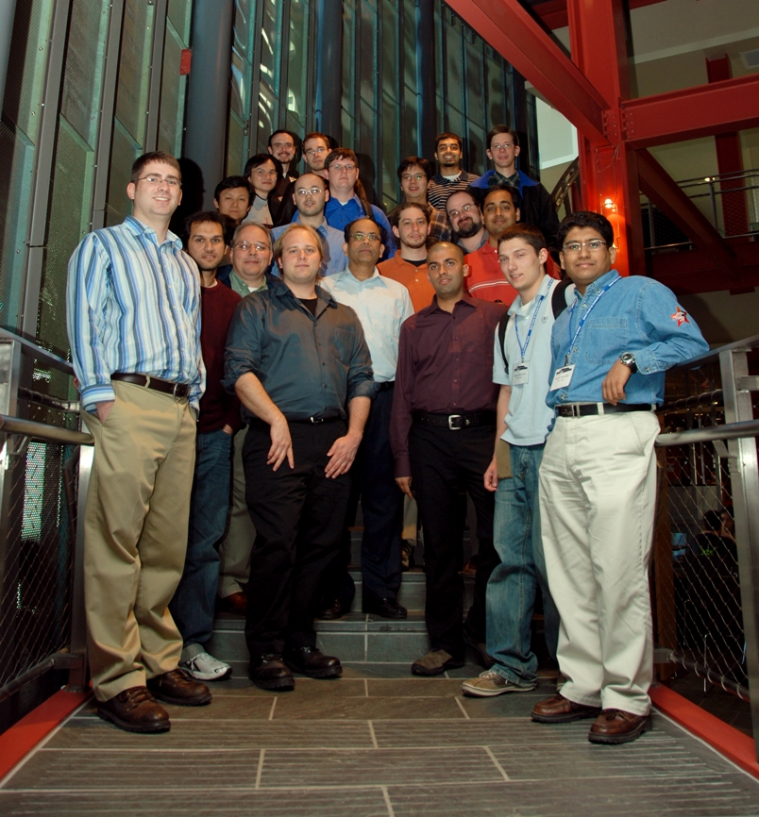
Parallel Programming Lab University of Illinois at Urbana-Champaign
Siebel Center for Computer Science
http://charm.cs.illinois.edu/

Slide 19
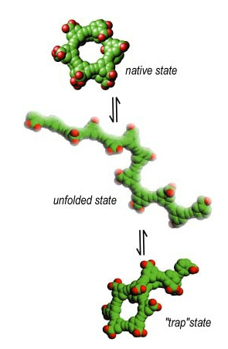
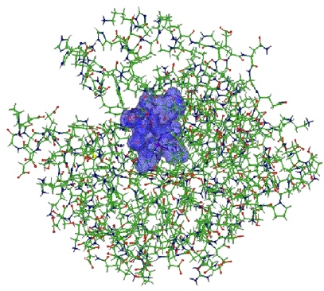
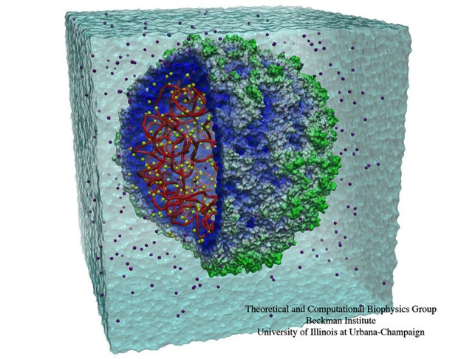
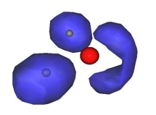
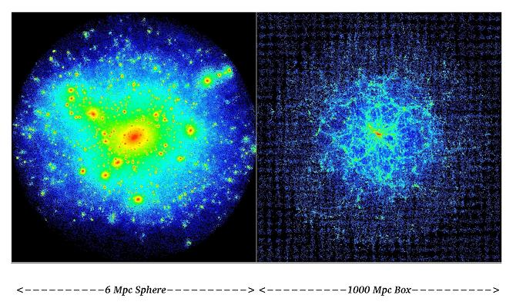
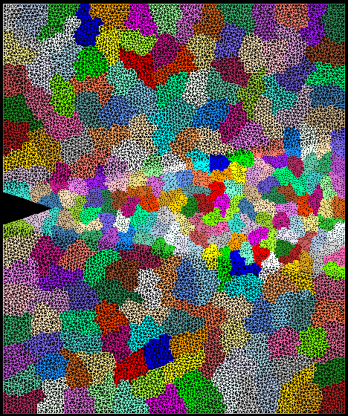
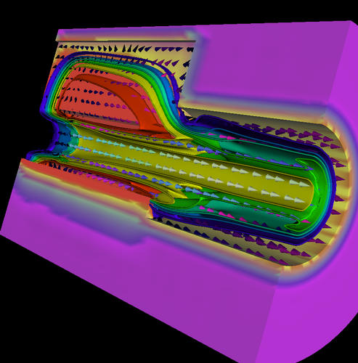
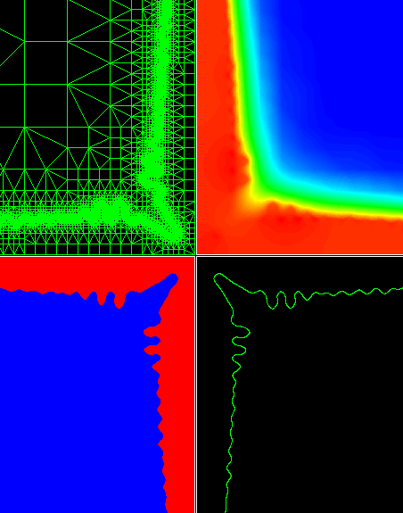
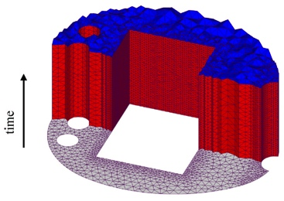
Develop abstractions in context of full-scale applications
Protein Folding
Quantum Chemistry (QM/MM)
NAMD: Molecular Dynamics
STM virus simulation
Computational Cosmology
Parallel Objects,
Adaptive Runtime System
Libraries and Tools
Crack Propagation
Rocket Simulation
Dendritic Growth
Space-time meshes
The enabling CS technology of parallel objects and intelligent Runtime systems has led to several collaborative applications in CSE

Slide 20
Computing research drives NAMD
Parallel Programming Lab – directed by Prof Laxmikant Kale
Charm++ is an Adaptive Parallel Runtime System
Gordon Bell Prize 2002
Three publications at Supercomputing 2011
Four panels discussing the future necessity of our ideas
20 years of co-design for NAMD performance, portability, and productivity, adaptivity
Recent example: Implicit Solvent deployed in NAMD by 1 RA in 6 months. 4x more scalable than similar codes
Yesterday’s supercomputer is tomorrow’s desktop
Notes:
----- Meeting Notes (3/9/12 10:05) -----
make text same font; use the larger font
use better work than "Support"
Co-Development with PPL
make "For example" "Recent Example"
(NAMD/Charm++) for Gordon Bell
Don't make panels sub bullet DONE
make blue black DONE

Slide 21
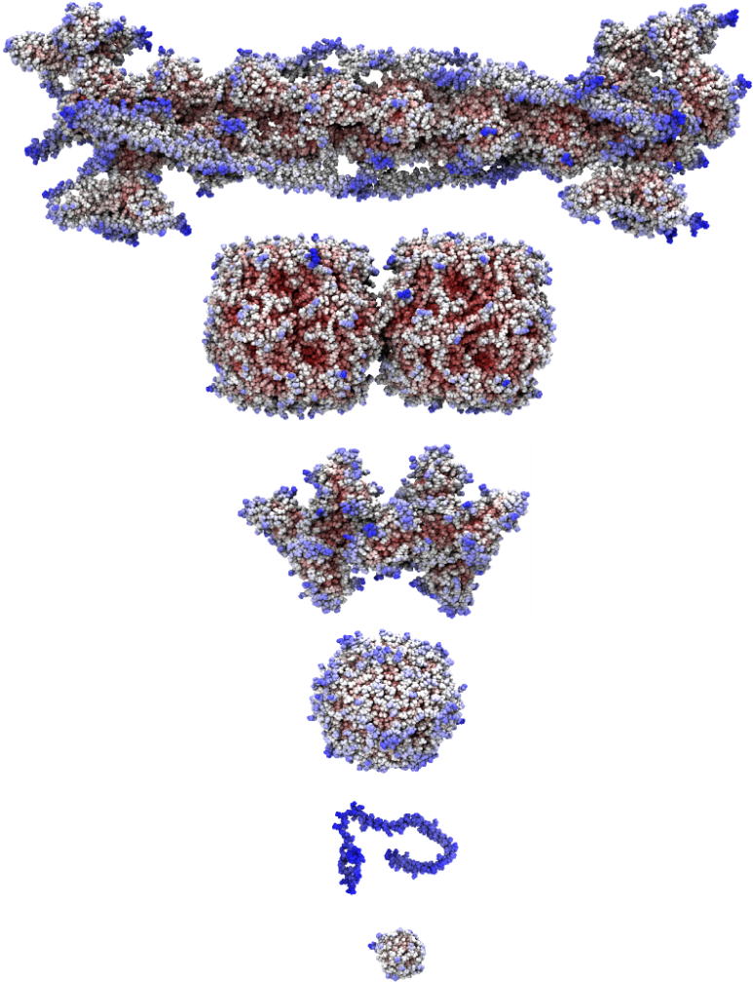
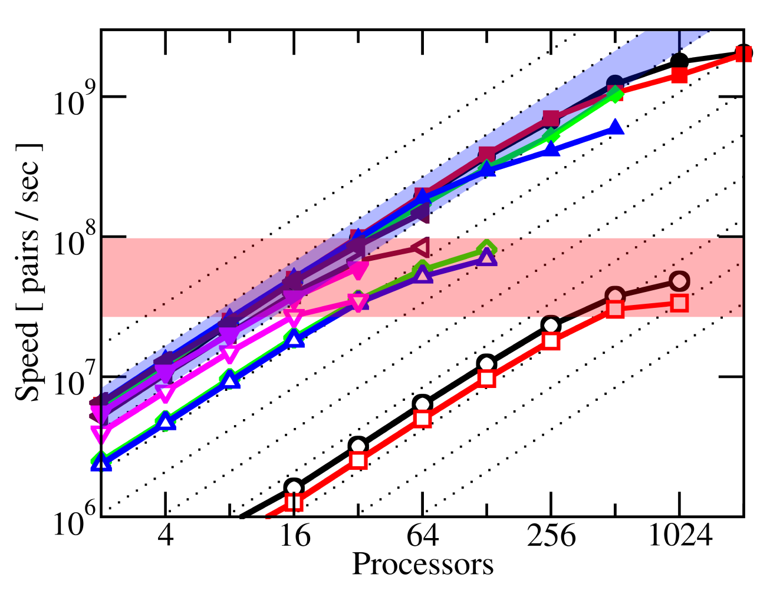
NAMD 2.8 Highly Scalable Implicit Solvent Model
NAMD Implicit Solvent is 4x more scalable than Traditional Implicit Solvent for all system sizes, implemented by one GRA in 6 months.
138,000 Atoms
65M Interactions
NAMD
149,000 Atoms
Speed [pairs/sec]
27,600 Atoms
29,500 Atoms
traditional
2,016 Atoms
2,412 Atoms
Processors
Tanner et al., J. Chem. Theory and Comp., 7:3635-3642, 2011
Notes:
----- Meeting Notes (3/9/12 10:05) -----
make textbox smaller font DONE
lower case T Traditional DONE
make squares, and grayer DONE
make atoms paired with; remove pairs DONE
atoms per molecule DONE

Slide 22
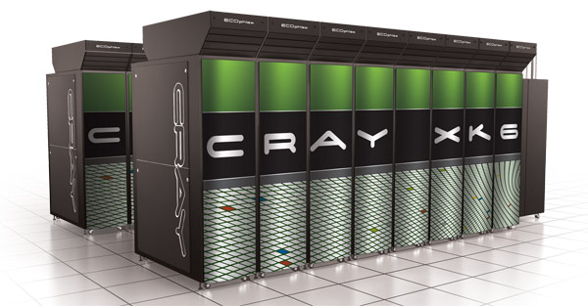
Cray Gemini Optimization
The new Cray machine has a better network (called Gemini)
MPI-based NAMD scaled poorly
BTRC implemented direct port of Charm++ to Cray
uGNI is the lowest level interface for the Cray Gemini network
Removes MPI from NAMD call stack
ApoA1 (92,000 atoms) on Cray Blue Waters prototype
Gemini provides at least 2x increase in usable nodes for strong scaling
ns/day
nodes
Notes:
Title: Recent Progress with uGNI (subtitle: This will enable XX atoms YY ns/day)
Explain what uGNI is (not how it works) just what it is …. Cray’s proprietary communication API
Put a simple statement under title that directly says what this slide means for the user
----- Meeting Notes (3/9/12 10:49) -----
Title: Performance on Cray's new Blue Waters System
Subtitle: Cray, Month installed, Jan 2012 to show recent
----- Meeting Notes (3/16/12 11:25) -----
green bracket hard to see
border around graph needs deleted

Slide 23
100M-atom Benchmark Performance
100M-atom performance on Jaguar and Blue Waters
Cray
Jaguar XT5 (ORNL)
224,000 cores
BlueWaters ESS XE6 (UIUC)
Final: 380,000 cores, 3000 GPUs
ns/day
Number of “Cores”
Tsubame
Tokyo Institute of Tech.
4224 GPUs
ns/day
Number of Nodes
Notes:
Add Tsubame mention. Add Tsubame performance?
Add Tianhe mention?

Slide 24
100M Atoms on Titan vs Jaguar
5x5x4 STMV grid
PME every 4 steps
New Optimizations
Charm++ uGNI port
Node-aware optimizations
Priority messages in critical path
Persistent FFT messages for PME
Shared-memory parallelism for PME
Paper to be submitted to SC12

Slide 25
1M Atom Virus on TitanDev GPU
Single STMV
PME every 4 steps

Slide 26
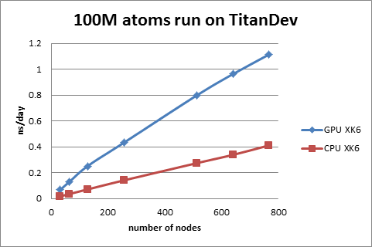
100M Atoms on TitanDev

Slide 27
TitanDev Cray XK6 Results
 | 100 stmv s/step 32 nodes | 100 stmv s/step 768 nodes
XK6, Fermi | 1.23065 s | 0.07657 s
XK6, without Fermi | 4.62633 s | 0.19688 s
XE6 | 2.318 s | 0.10602 s
XK6 Fermi vs XK6 without Fermi | 3.8 x | 2.6 x
XK6 Fermi vs XE6 | 1.8 x | 1.4 x
Notes:
XK6 results on Titandev
XE6 results on Monte Rosa
All 100stmv results are with Langvin controls turned off, and with PME once every 4 steps

Slide 28
TitanDev Cray XK6 Results
 | time step | non PME step | PME step | sum PME computation | kernel
GPU, 100 stmv, 32 nodes | 1.249 s | 1.009 s | 1.833 s | 0.796 s | 0.964 s
GPU, 4 stmv, 30 nodes | 0.057 s | 0.049 s | 0.065 s | 0.028 s | 0.042 s
GPU, 100 stmv, 768 nodes | 0.085 s | 0.046 s | 0.176 s | 0.034 s | 0.042 s
strong scaling | 0.616 | 0.905 | 0.435 | 0.988 | 0.966
weak scaling | 0.680 | 1.061 | 0.368 | 0.845 | 1.004

Slide 29
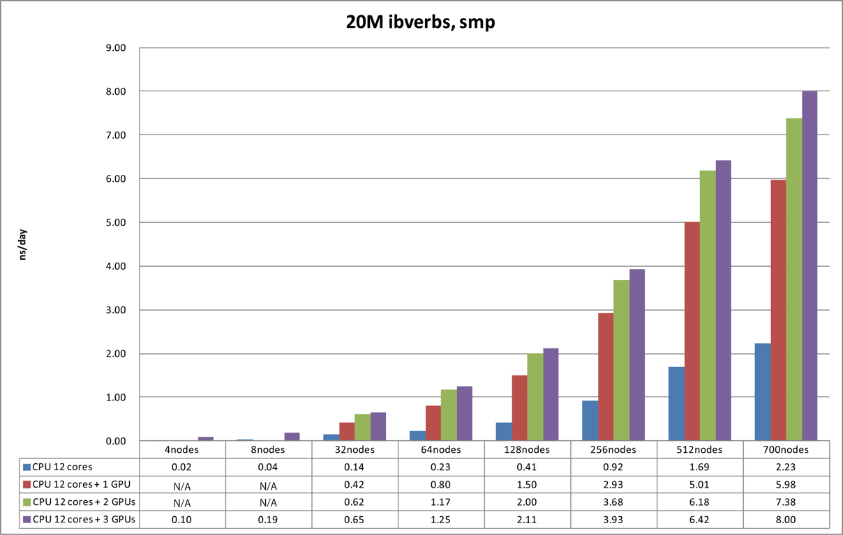
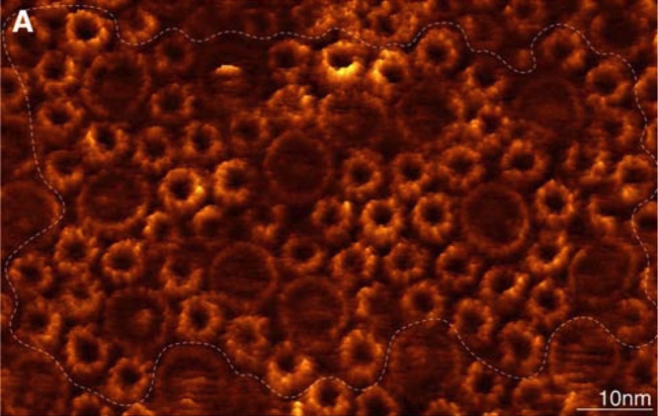
Tsubame (Tokyo) Application of GPU Accelerated NAMD
20 million atom proteins + membrane
8400 cores
AFM image of flat chromatophore membrane (Scheuring 2009)

Slide 30
GPU Computing in NAMD and VMD
NAMD algorithms to be discussed:
Short-range non-bonded interactions
Generalized Born Implicit Solvent
Multilevel Summation Method
VMD algorithms to be discussed:
Electrostatic potential maps
Visualizing molecular orbitals
Radial distribution functions
“QuickSurf” representation

