Slide 1
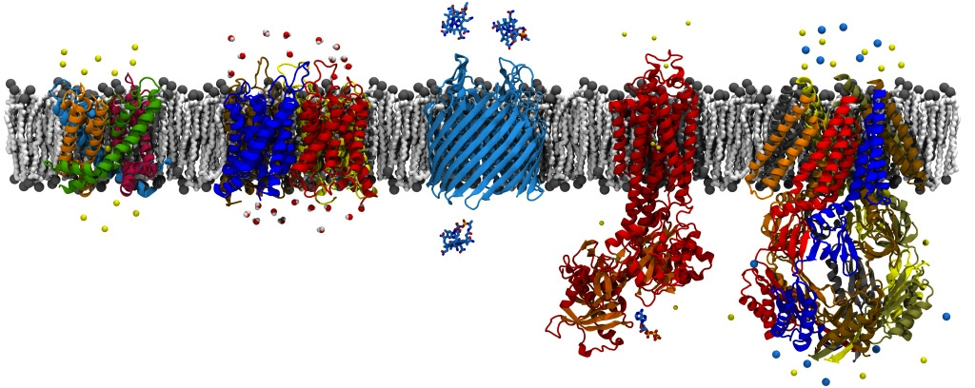
Future Direction with NAMD
David Hardy
http://www.ks.uiuc.edu/Research/~dhardy/
NAIS: State-of-the-Art Algorithms for Molecular Dynamics

Slide 2
Short-term Outlook
Important for our software to support GPUs
GPU acceleration is being incorporated into new supercomputers
GPU-accelerated desktop workstations to replace cluster computing
Easier maintenance
Improved power consumption
Both NAMD and GROMACS are in good shape for using GPU computing

Slide 3
Trends in Computing Hardware
Computing hardware will continue to get “wider”
Moore’s Law is still in effect
Core clock speeds have plateaued
Memory hierarchies likely to get “deeper”
Memory bandwidth not increasing at the same rate as compute cores and FLOP/s
High performance software increasingly more difficult to develop

Slide 4
NAMD and Performance
Could benefit from single core level performance improvements
SSE intrinsics within key computational kernels
Could make better use of GPUs
Asynchronous message-driven design is advantageous for large scale parallelization
Dynamic load balancing helps with hardware issues (e.g. system noise, recovery from failed nodes)

Slide 5
Molecular Dynamics Challenges
Extending timescales of simulations
NAMD has high performance replica exchange, basis for other enhanced sampling methods
Improving force fields
NAMD supports leading polarizable force field efforts (Drude, FlucQ)
Plans to support AMOEBA polarizable force field
Better scaling methods
Multilevel summation method has promise

