Slide 1
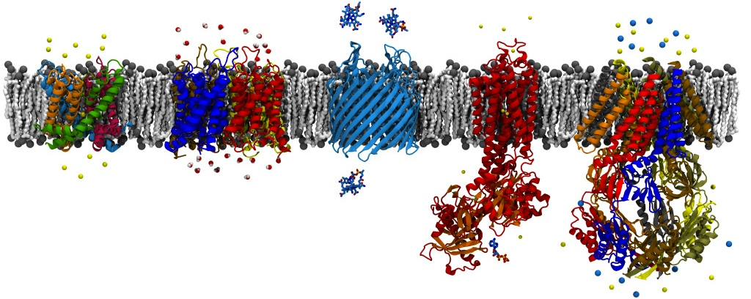
Demonstration: Using NAMD
David Hardy
http://www.ks.uiuc.edu/Research/~dhardy/
NAIS: State-of-the-Art Algorithms for Molecular Dynamics

Slide 2
Obtaining NAMD
Download pre-built binary (recommended)
Build it yourself (not too hard, but tedious)
  Dependencies
    Charm++ (http://charm.cs.uiuc.edu/software/)
    FFTW (http://www.fftw.org/download.html)
    TCL (http://www.tcl.tk/software/tcltk/)
    Optionally: CUDA Toolkit
  Recommended: Download source tar ball for that release, has Charm++ version in “charm” directory
  Windows building requires “cygwin”

Slide 3
Building NAMD
Recommended: For modern multi-core CPUs, use multicore builds of Charm++ and NAMD
CAUTION: Charm++ and NAMD do not use identical names to describe the same architecture
  ./build charm++ multicore-darwin-x86_64
  ./config MacOSX-x86_64-g++ \
  --with-tcl --tcl-prefix /opt/local \
  --with-fftw --fftw-prefix /opt/local \
  --with-cuda --cuda-prefix /usr/local/cuda
PROBLEM: NAMD CUDA supported on Linux only! It won’t build on Windows or Mac.
  Issue will be addressed after NAMD 2.9 is released

Slide 4
Running NAMD
Recommended: Read NAMD tutorial (and VMD).
  URL: http://www.ks.uiuc.edu/Training/Tutorials/
  “Using VMD” and “NAMD Tutorial”
Using NAMD CUDA:
  Some capabilities are missing from CUDA build
    E.g., alchemical free energy methods, coarse-grained models
  Most of NAMD’s capabilities work with CUDA build
  Performance concern:
    Calculating potential energy slows performance
    Solution: Use “outputEnergies = 100” in configuration file

Slide 5
Executing NAMD
Multicore workstation:
  “namd2 +p4 mysim.conf”
Multicore workstation with 2 GPUs:
  “namd2 +p4 +devices 0,1 mysim.conf”
Or use “charmrun namd2 …” (cluster build)
Or use “mpiexec namd2 …” (MPI build)

Slide 6
NAMD Parallel Performance (1)
Benchmark performance within 500 steps
  Grep for “Benchmark time:” lines
  Use “outputTiming = nsteps”
Multicore builds might need a thread dedicated to communication (> 32 cores):
  “namd2 +p47 +commthread”
Maintain standard (UDP), TCP, ibverbs (InfiniBand) for Linux clusters
Other high-speed network, use MPI
  SMP builds don’t scale as well due to communication thread bottleneck

Slide 7
NAMD Parallel Performance (2)
Short cycle lengths (< 10 steps) hurts scaling since atom migration sends so many messages
  Keep cycle length at 20 steps
  Pairlist distance will adjust automatically
  One pairlist every 10 steps is good ratio
Good performance when (#patches) ≥ (#PEs)
  Otherwise increase (#patches) with “twoAwayX yes”
Additional tuning advice on NAMD wiki:
  http://www.ks.uiuc.edu/Research/namd/wiki/?NamdPerformanceTuning

Slide 8
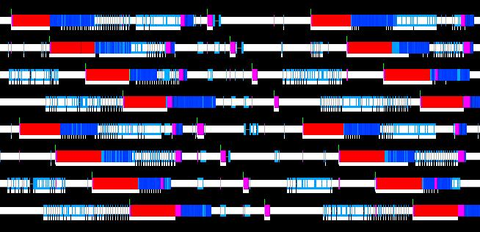
NAMD Profiling
Use “Projections” Charm++ analysis tools
  Charm++ runtime automatically records pertinent performance data
  Rebuild NAMD, rerun benchmark, run projections on results
  http://www.ks.uiuc.edu/Research/namd/wiki/?NamdPerformanceTuning

Slide 9
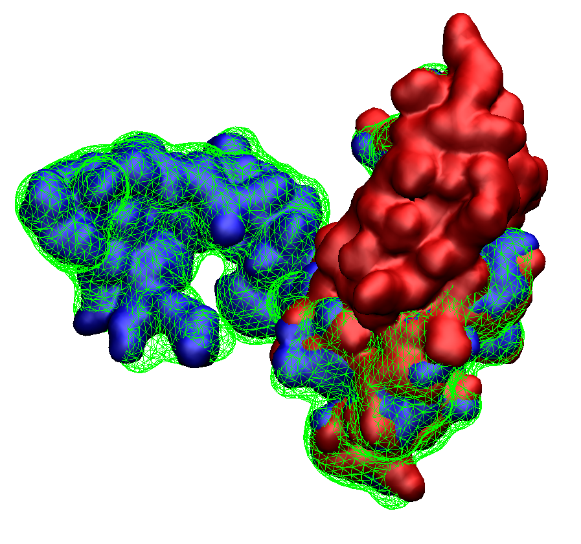
NAMD 2.9 Desktop MDFF
with GPU-Accelerated Implicit Solvent
and CPU-Optimized Cryo-EM Forces
Fast: 2 ns/day
Explicit Solvent
8 cores (1X)
Initial
Structure
PDB 2EZM
Fitted
Structure
Faster: 12 ns/day
Implicit Solvent
8 cores (6X)
Fastest: 40 ns/day
Cyanovirin-N
1,500 atoms
1 Å final RMSD
Implicit Solvent
1 GPU (20X)
Simulated EM Map from PDB 3EZM

Slide 10
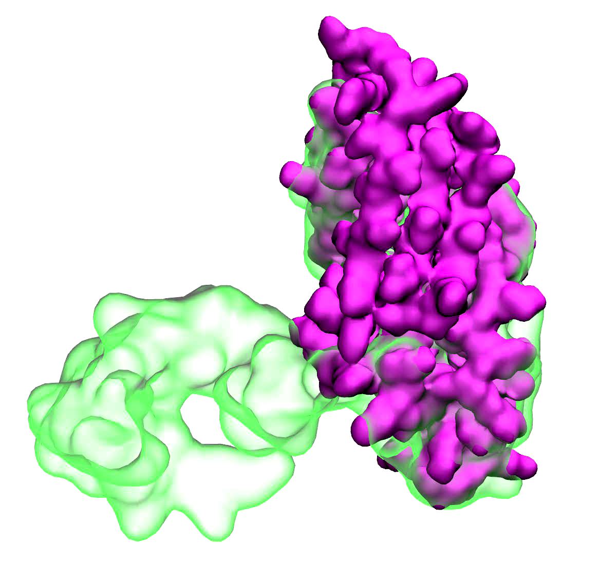

Slide 11
Small IMD Demo
Since HectorGPU configuration does not allow streaming results to the laptop:
  Demonstration with decalanine

