Slide 1
VMD: GPU-Accelerated Analysis of Biomolecular and Cellular Simulations
John E. Stone
Theoretical and Computational Biophysics Group
Beckman Institute for Advanced Science and Technology
University of Illinois at Urbana-Champaign
http://www.ks.uiuc.edu/Research/vmd/
Cray Analytics Symposium, Friday May 26th, 2017

Slide 2
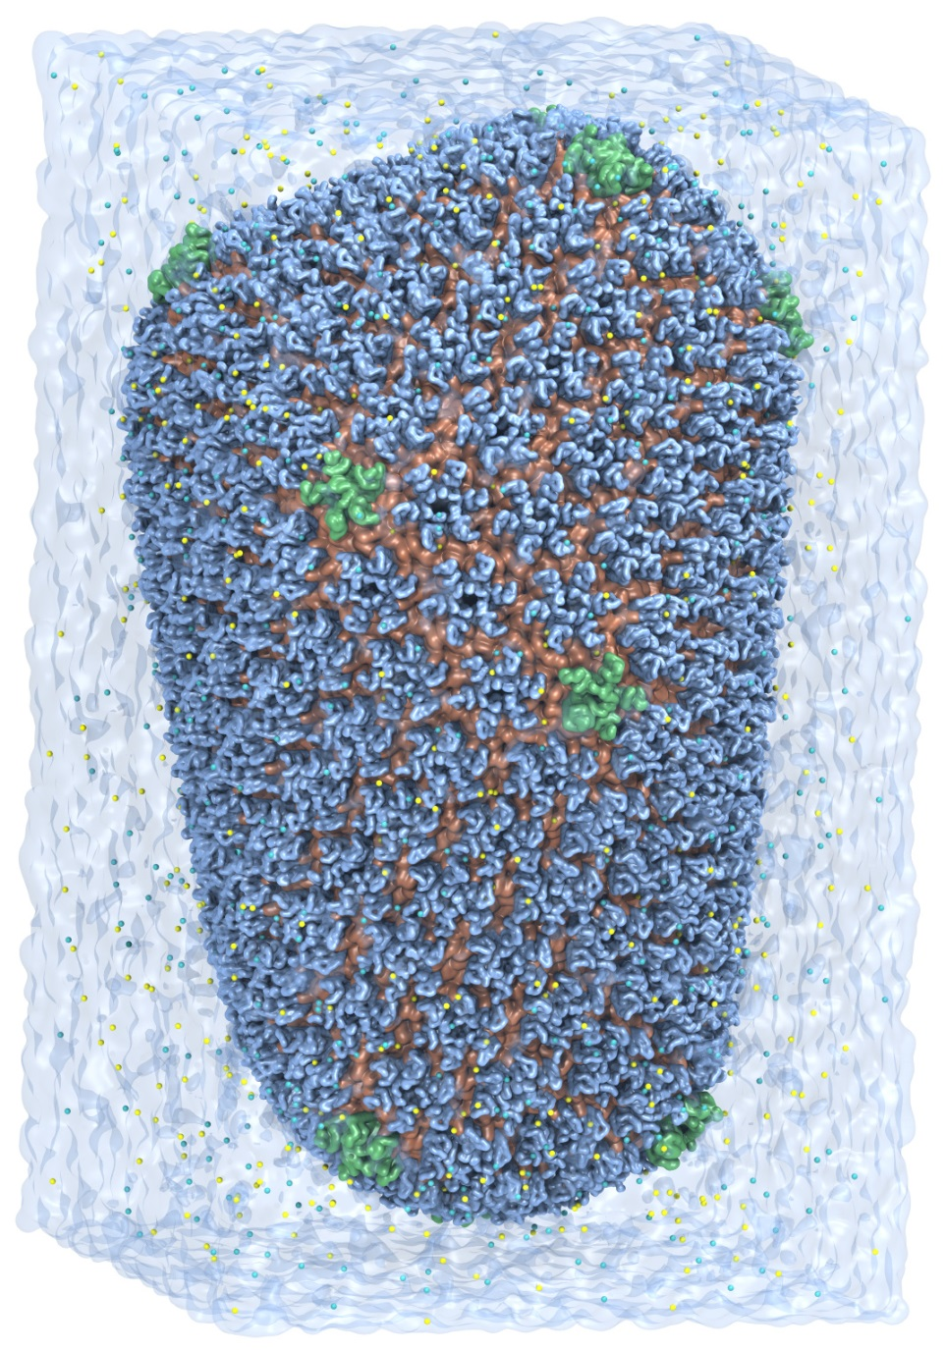
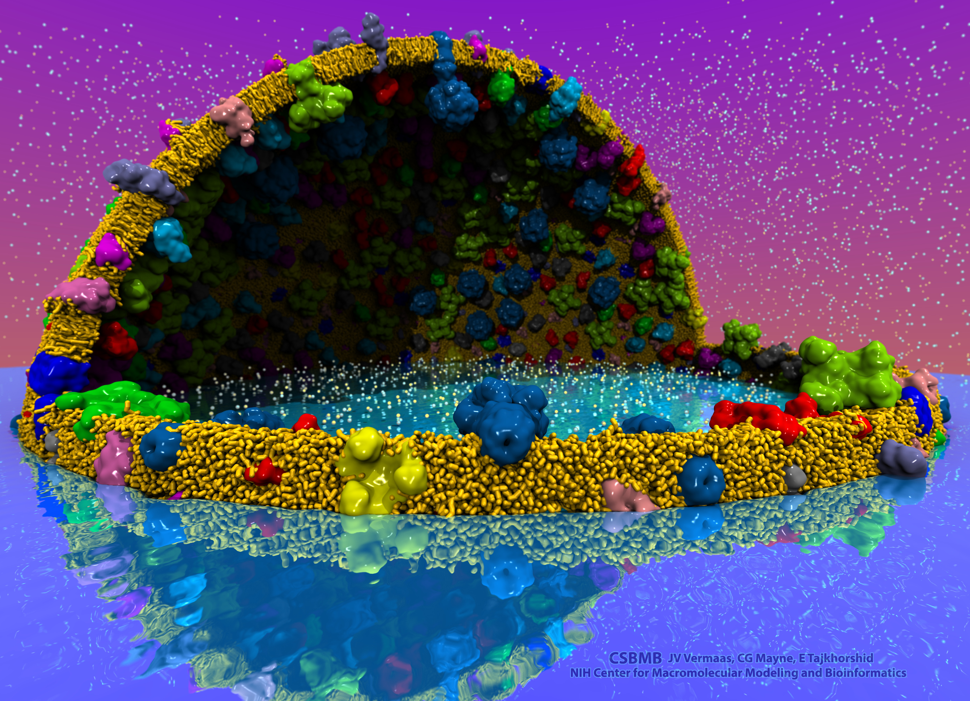
VMD – “Visual Molecular Dynamics”
Visualization and analysis of:
Molecular dynamics simulations
Lattice cell simulations
Quantum chemistry calculations
Sequence information
User extensible scripting and plugins
http://www.ks.uiuc.edu/Research/vmd/
Cell-Scale Modeling
MD Simulation

Slide 3
VMD Interoperability Serves Many Communities
Uniquely interoperable with a broad range of tools:
AMBER, CHARMM, CPMD, DL_POLY, GAMESS, GROMACS, HOOMD, LAMMPS, NAMD, and many more …
Supports key data types, file formats, and databases
Incorporates tools for simulation preparation, visualization, and analysis

Slide 4
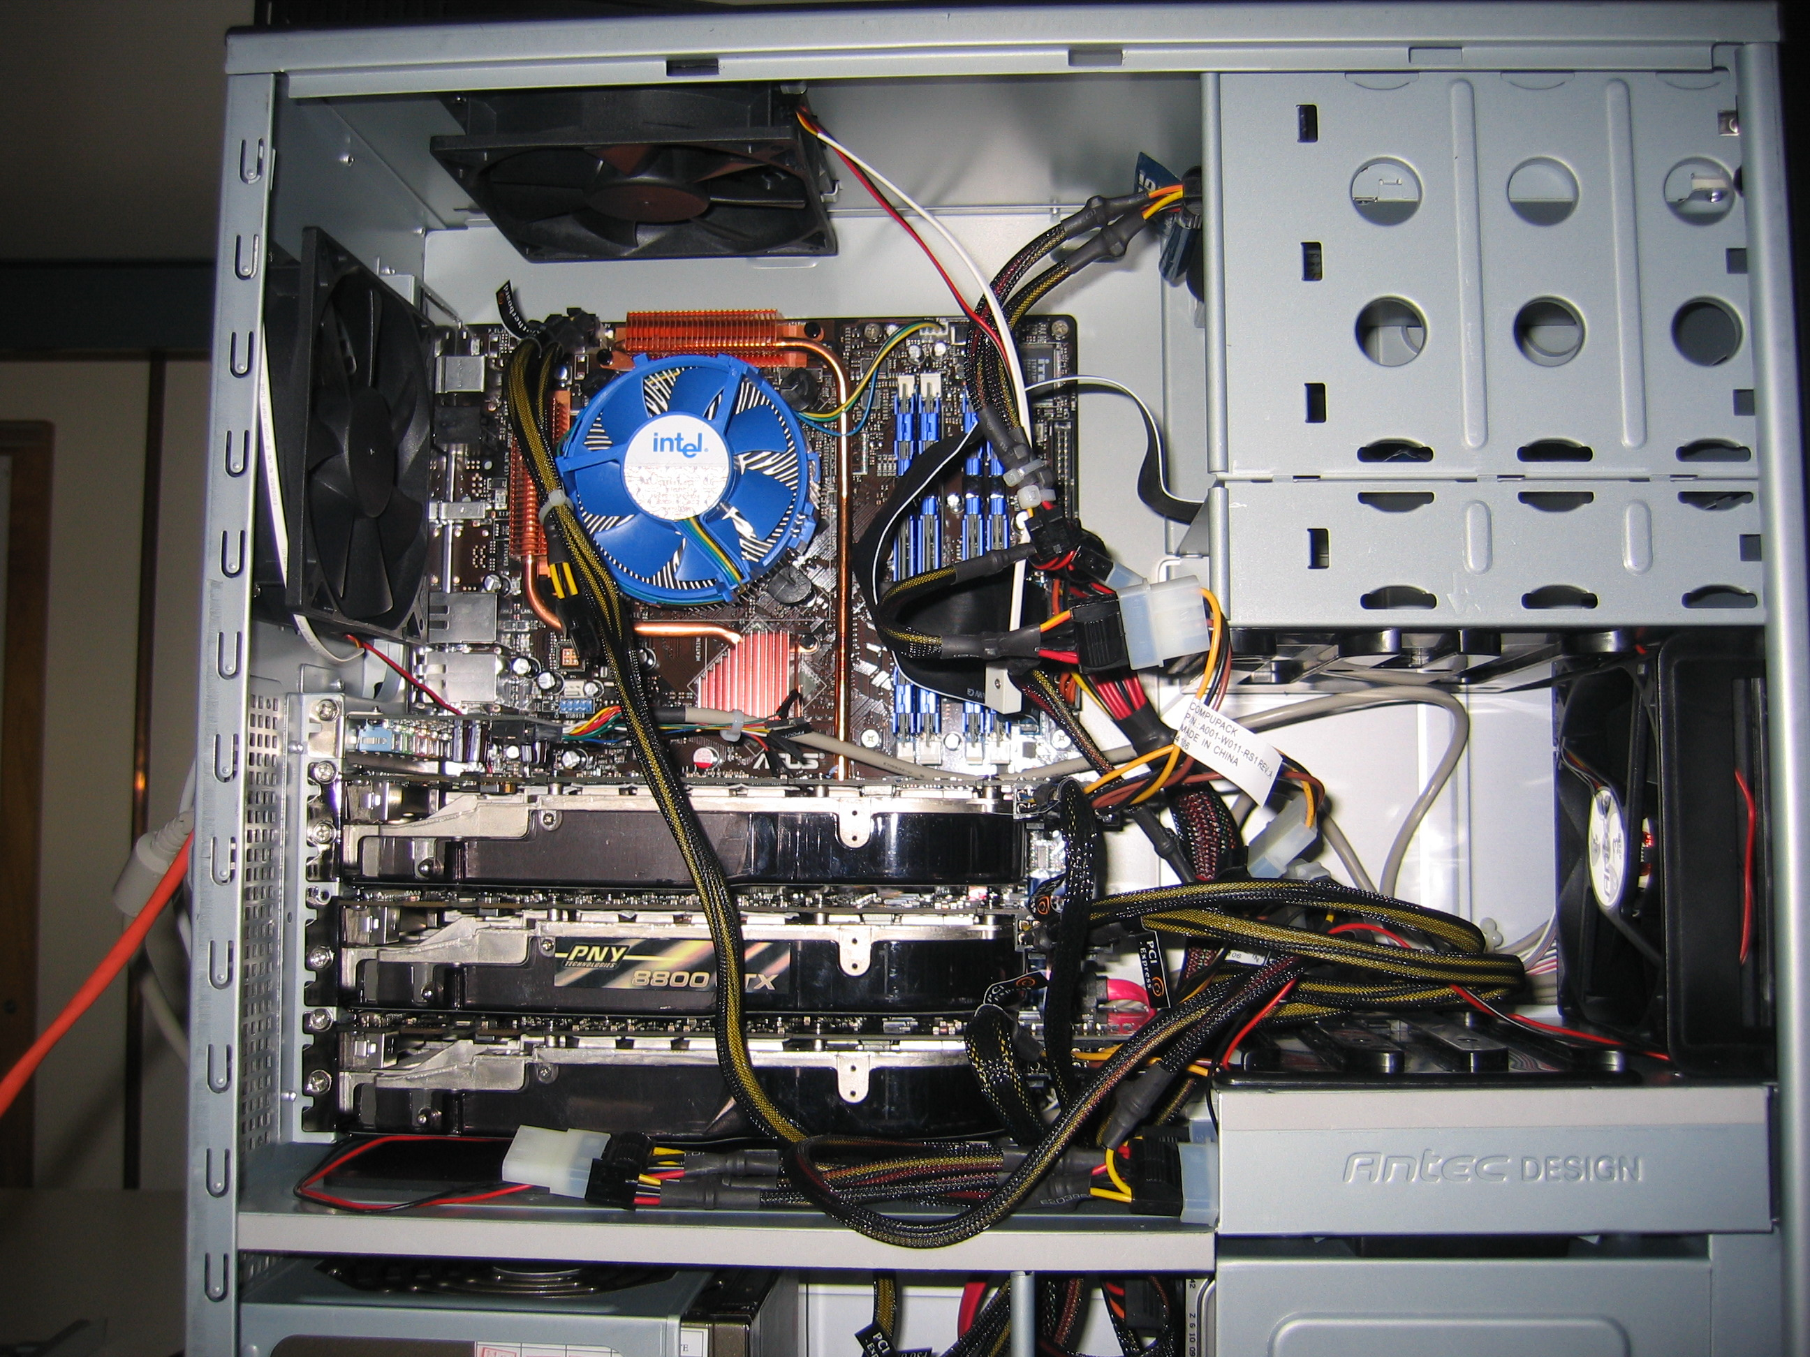
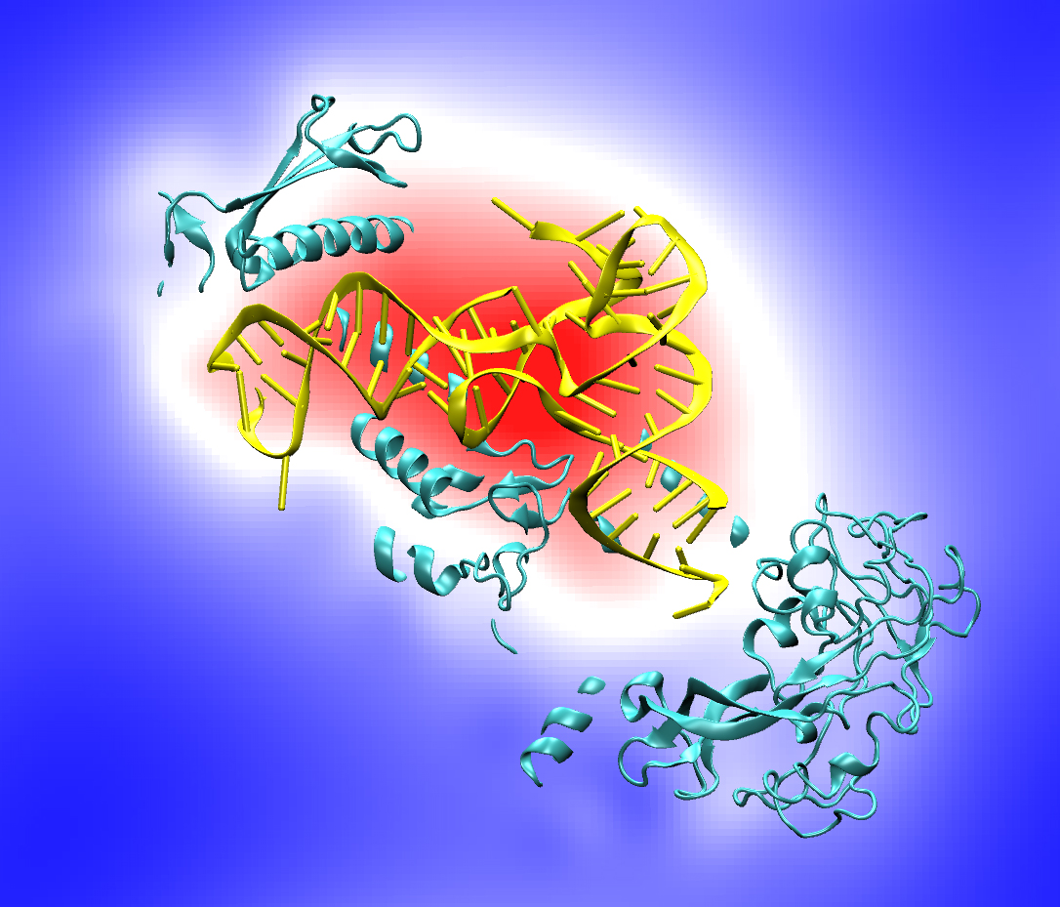
10 Years of GPU Computing in VMD
Has stood the test of time
Modeling, Visualization, Rendering, and Analysis
Blast from the past:
CUDA starting with version 0.7 !!!
Quad core Intel QX6700, three NVIDIA GeForce 8800GTX GPUs, RHEL4 Linux
Accelerating molecular modeling applications with graphics processors. J. Stone, J. Phillips, P. Freddolino, D. Hardy, L. Trabuco, K. Schulten. J. Comp. Chem., 28:2618-2640, 2007.

Slide 5
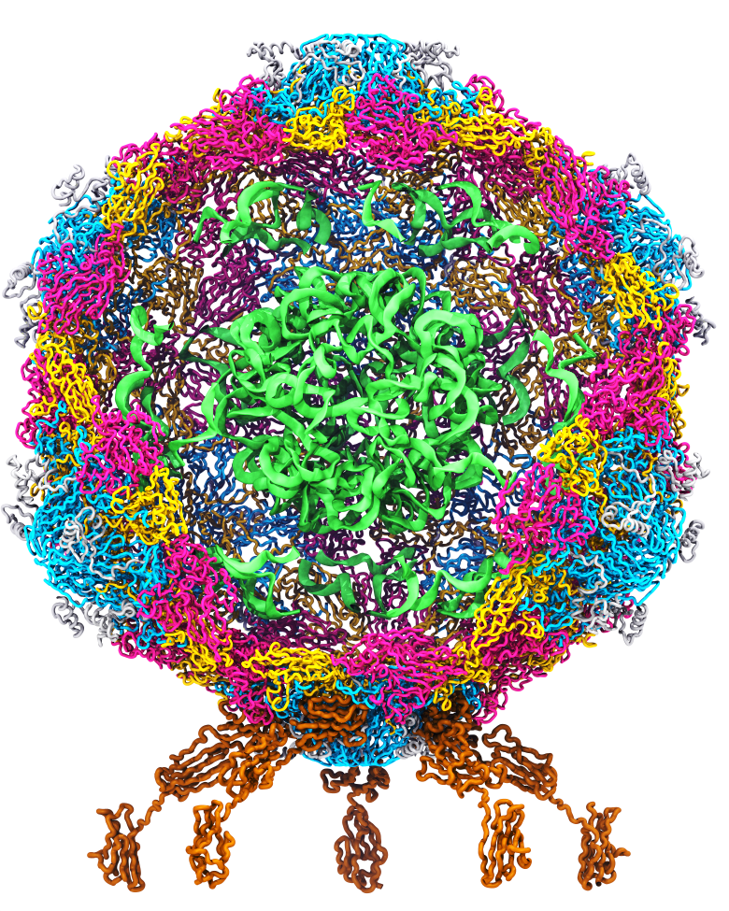
Goal: A Computational Microscope
Study the molecular machines in living cells
Ribosome: target for antibiotics
Poliovirus
Notes:
Ribosomes synthesize new proteins from genetic information
Bacterial ribosome is a target for antibiotics, which interfere with its ability to function by binding to sites on the structure, preventing proteins from being synthesized
Ribosome simulations are extremely computationally challenging due to the size of the structure and its natural environment (solvent, ions, etc, large box, 3 million atoms or so)
Bionanodevice for sequencing DNA efficiently
Knowledge of an individual’s genetic makeup can lead to the prediction and treatment of many diseases by the means of personal genomic medicine and pharmacogenomics. In order for genome sequencing to become practical for common medical use, an inexpensive high throughput genome sequencing technique is required. NIH has set a goal of reducing the cost of genome sequencing by a factor of 10,000, to less than $1,000 within ten years.
The computer is the best microscope to guide the development of bionanodevices, for example to sequence DNA. While experiments can measure DNA electrostatic potentials, they cannot visualize the DNA’s location and conformation at the time of measurement.

Slide 6
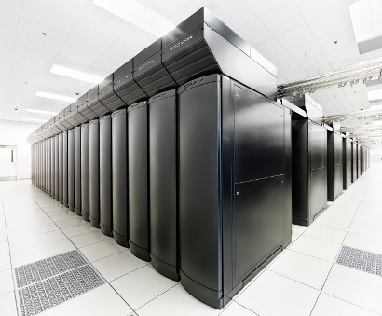
VMD Petascale Visualization and Analysis
Analyze/visualize large trajectories too large to transfer off-site:
User-defined parallel analysis operations, data types
Parallel rendering, movie making
Supports GPU-accelerated Cray XK7 nodes for both visualization and analysis:
GPU accelerated trajectory analysis w/ CUDA
OpenGL and GPU ray tracing for visualization and movie rendering
Parallel I/O rates up to 275 GB/sec on 8192 Cray XE6 nodes – can read in 231 TB in 15 minutes!
Parallel VMD currently available on:
ORNL Titan, NCSA Blue Waters, Indiana Big Red II, CSCS Piz Daint, and similar systems
NCSA Blue Waters Hybrid Cray XE6 / XK7
22,640 XE6 dual-Opteron CPU nodes
4,224 XK7 nodes w/ Telsa K20X GPUs

Slide 7
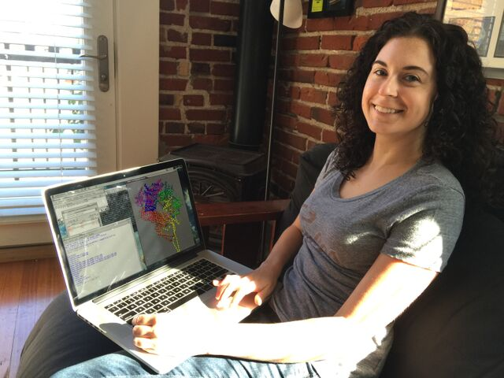
Interactive Remote Visualization and Analysis
Enabled by hardware H.264/H.265 video encode/decode
Enable visualization and analyses not possible with conventional workstations
Access data located anywhere in the world
Same VMD session available to any device
Linux prototype in-development using NVIDIA Video Codec SDK, easy-to-use NvPipe wrapper library
Notes:
Use a schematic that’s generic rather than titan
1-12 viz machines, never such an immediate impact, tell the story, but brief strong points
Maybe show jodi here
Shrink supercomputer, grow the person figure

Slide 8
NVIDIA Video CODEC SDK and NvPipe
GPUs (Kepler-on) include NVENC and NVDEC video codec acceleration hardware
Independent of GPU compute hardware
Hardware-accelerated codecs can overlap with interactive rendering, and computation
NvPipe provides an easy to use API for interactive video streaming, abstracting many low level codec details, ideal for basic remote visualization implementations: https://github.com/NVIDIA/NvPipe

Slide 9
NvPipe https://github.com/NVIDIA/NvPipe
Simplified API for producing a basic encoder/decoder system.
Roughly 100 lines of code for basic encode/decode “Hello World” loops with minimal error handling logic
Encode/decode ends up being simpler than your networking code ☺
Encode loop structure:
User selects encoder type, e.g. NVPIPE_H264_NV, and target encoder bitrate parameter
User provides uncompressed RGB or RGBA image buffer, image dimensions, and size of the output memory buffer
NvPipe compresses the frame using the NVENC hardware encoder, and returns the number of bytes of output written to the output buffer
Symmetric decode loop structure:
Provide decoder with compressed buffer, buffer size in bytes, and image dimensions as input
Decoder produces uncompressed output image
Optionally supports FFMPEG back-ends (but I haven’t tried those yet)

Slide 10
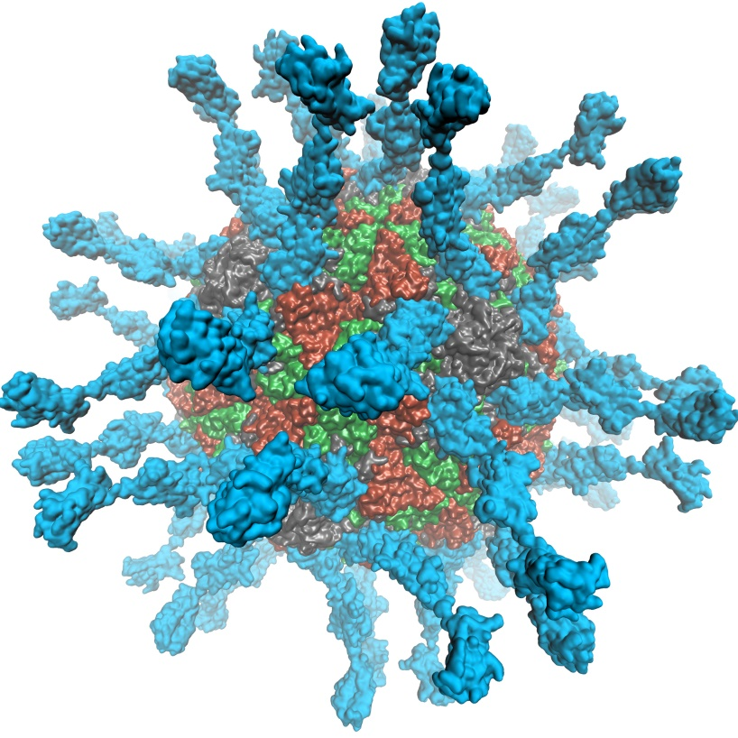
VMD 1.9.3 supports EGL for in-situ and parallel rendering on clouds, clusters, and supercomputers
Eliminate dependency on windowing systems
Simplified deployment of parallel VMD builds supporting off-screen rendering
Maintains 100% of VMD OpenGL shaders and rendering features
Support high-quality vendor-supported commercial OpenGL implementations in HPC systems that were previously limited to Mesa
Poliovirus

Slide 11
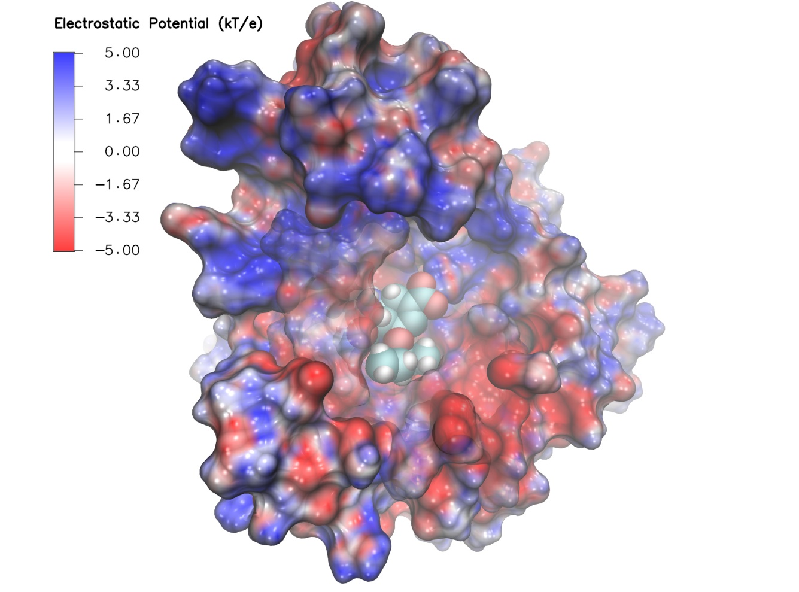
Swine Flu A/H1N1 neuraminidase bound to Tamiflu: VMD EGL rendering demonstrating full support for all VMD shaders and OpenGL features, multisample antialiasing, ray cast spheres, 3-D texture mapping, ...

Slide 12
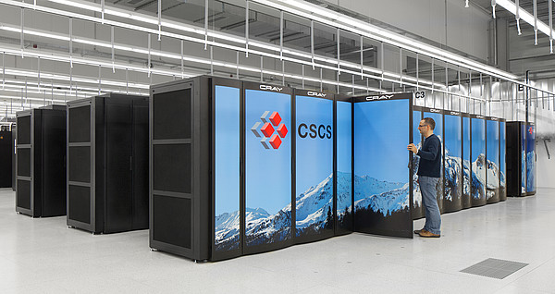
EGL Is Supported Now!
Cloud+Workstations with most recent NVIDIA drivers
VMD on HPC systems w/ latest Tesla P100 GPUs:
Cray XC50, CSCS Piz Daint, driver 375.39
High Performance Molecular Visualization: In-Situ and Parallel Rendering with EGL. J. E. Stone, P. Messmer, R. Sisneros, and K. Schulten. High Performance Data Analysis and Visualization Workshop, IEEE International Parallel and Distributed Processing Symposium Workshop (IPDPSW), pp. 1014-1023, 2016.

Slide 13
https://www.khronos.org/vulkan/
In-progress: Vulkan-based rasterization path for VMD
Modern API, reduced dependence on extensions for modern functionality
Significantly reduced API overheads relative to OpenGL, some other apps have seen ~2x performance gains vs. OpenGL
Shaders (e.g. GLSL) compiled to SPIR-V intermediate code
Compile-time rather than runtime verification of rendering pipelines
Integration with windowing system is handled by Vulkan extensions
Multi-GPU rendering wasn’t part of Vulkan 1.0 spec, but is in development

Slide 14
Benefits of CS Storm NVLink Peer-to-Peer GPU Communication for VMD
Rapid peer-to-peer GPU data transfers:
Use aggregate GPU memory to collectively cache/share large host-side data
Rapid access to large data structures too large to fit entirely in single-GPU memory
Bypass host whenever possible, perform nearest-neighbor exchanges for pairwise calculations, e.g. those that arise in algorithms for simulation trajectory clustering
Well suited for high-fidelity ray tracing of scenes containing massive amounts of geometry

Slide 15
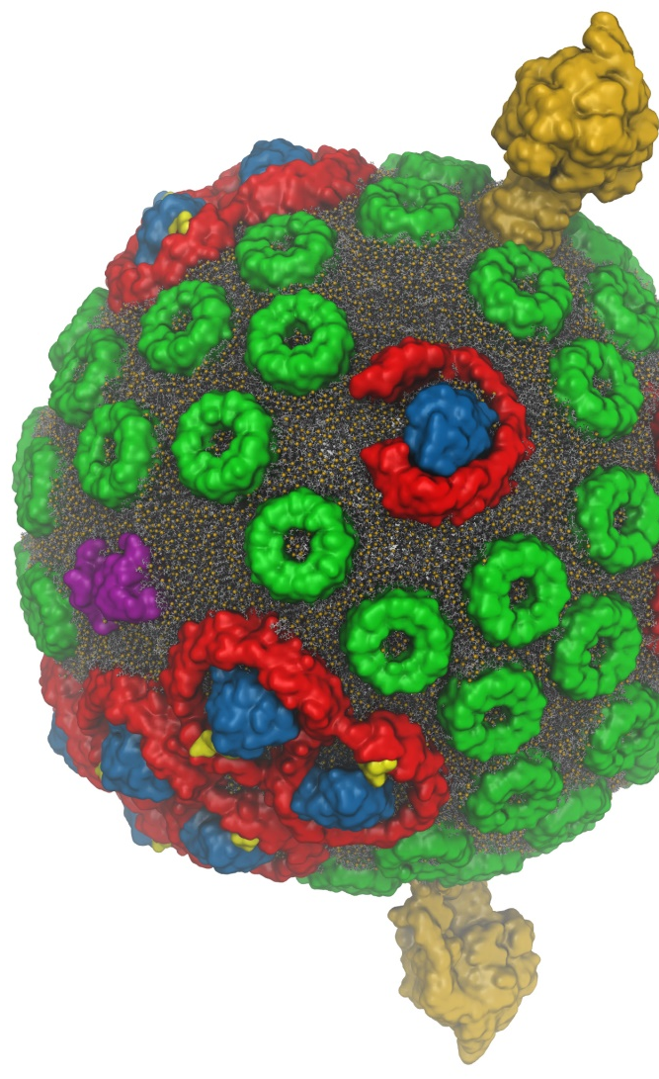
VMD w/ OptiX 4.1
Interactive RT on laptops, desktops, and cloud
Large-scale parallel rendering: in situ or post hoc visualization tasks
Remote RT on NVIDIA VCA clusters
Stereoscopic panoramic and full-dome projections
Omnidirectional VR for YouTube, VR HMDs
Top-end Pascal Tesla GPUs roughly 2x faster than Kepler
GPU memory sharing via NVLink on Quadro GP100, Tesla P100
GPU-Accelerated Molecular Visualization on Petascale Supercomputing Platforms. J. E. Stone, K. L. Vandivort, and K. Schulten. UltraVis’13, pp. 6:1-6:8, 2013.
Visualization of Energy Conversion Processes in a Light Harvesting Organelle at Atomic Detail. M. Sener, et al. SC'14 Visualization and Data Analytics Showcase, 2014.
Chemical Visualization of Human Pathogens: the Retroviral Capsids. J. R. Perilla, B.-C. Goh, J. E. Stone, and K. Schulten. SC'15 Visualization and Data Analytics Showcase, 2015.
Atomic Detail Visualization of Photosynthetic Membranes with GPU-Accelerated Ray Tracing. J. E. Stone et al., J. Parallel Computing, 55:17-27, 2016.
Immersive Molecular Visualization with Omnidirectional Stereoscopic Ray Tracing and Remote Rendering J. E. Stone, W. R. Sherman, and K. HPDAV, IPDPSW, pp. 1048-1057, 2016.
VMD/OptiX GPU Ray Tracing of all-atom Chromatophore w/ lipids.

Slide 16
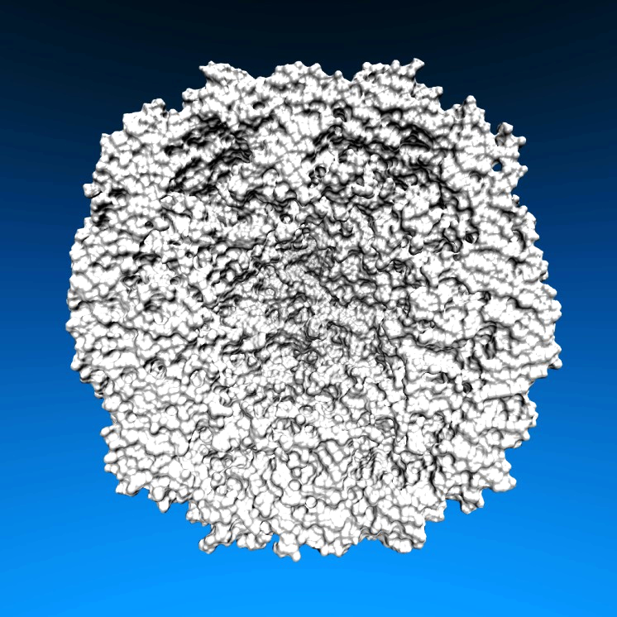
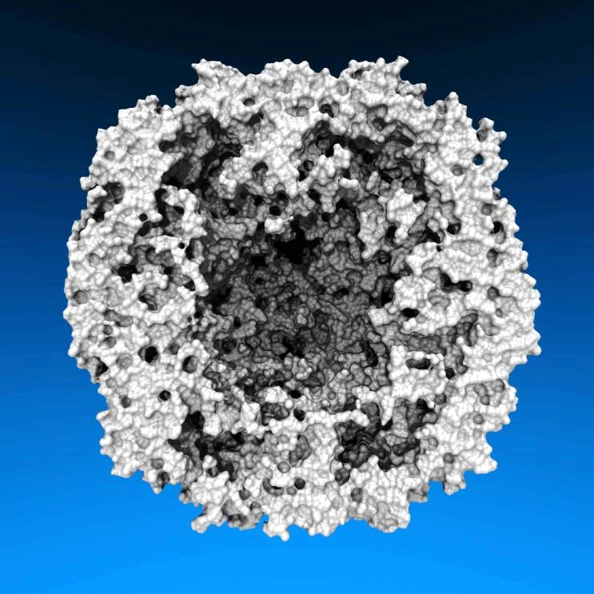
Lighting Comparison, STMV Capsid
Two lights, no shadows
Two lights, hard shadows, 1 shadow ray per light
Ambient occlusion + two lights, 144 AO rays/hit

Slide 17
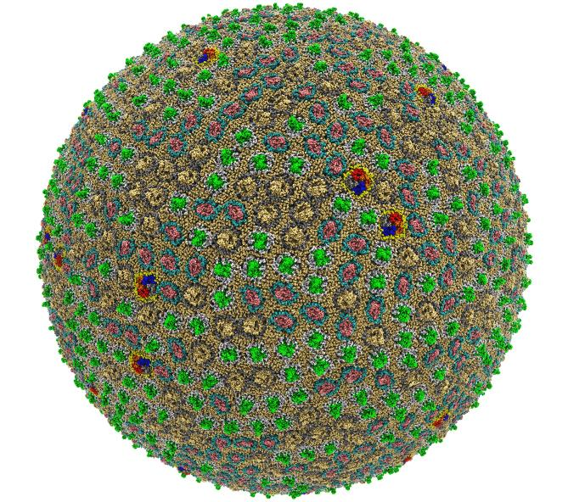
Preparation, Visualization, Analysis of All-Atom Cell-Scale Simulations
Interactive rasterization w/ OpenGL/EGL now, Vulkan in future releases of VMD
Interactive ray tracing on CPUs and GPUs
Support for large host memory (TB), up to 2 billion atoms per “molecule” now
Parallel analysis, visualization w/ MPI
200 nm spherical envelope
Membrane with ~50% occupancy by proteins
63M atoms in envelope model
Atomic Detail Visualization of Photosynthetic Membranes with GPU-Accelerated Ray Tracing. J.E. Stone, …, K. Schulten, J. Parallel Computing, 55:17-27, 2016.
High Performance Molecular Visualization: In-Situ and Parallel Rendering with EGL. J.E. Stone, ..., K. Schulten. IEEE High Performance Data Analysis and Visualization, IPDPSW, pp. 1014-1023, 2016.

Slide 18
Proto-Cell Rendered with VMD+OptiX
113M particles
1,397 copies of 14 different membrane proteins
Preparing for simulations on pre-exascale computers

Slide 19
Interactive Ray Tracing of Cells
High resolution cellular tomograms, billions of voxels
Even isosurface or lattice site graphical representations involve ~100M geometric primitives
24GB Quadro M6000s used for interactive RT of cellular tomograms of this size
Latest Quadro GP100 GPUs benefit from OptiX 4.1 support for NVLink and distribution of scene data across multiple GPUs
Earnest, et al. J. Physical Chemistry B, 121(15): 3871-3881, 2017.

Slide 20
VMD Molecule Instancing: In-Progress Development
VMD 1.9.4 supports instancing of graphical representations associated with molecules
Will exploit VBO caching in OpenGL to eliminate host-GPU geometry transfers
OptiX instancing of geometry buffers to eliminate GPU memory consumption for instances

Slide 21
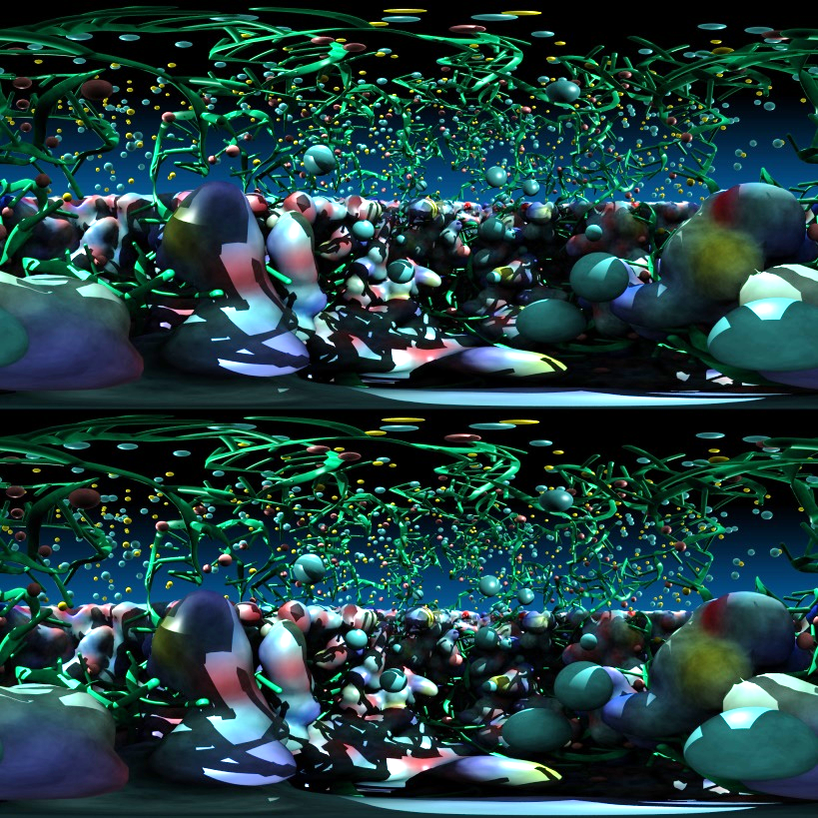
Stereoscopic Panorama Ray Tracing w/ OptiX
Render 360° images and movies for VR headsets such as Oculus Rift, Google Cardboard
Ray trace panoramic stereo spheremaps or cubemaps for very high-frame-rate display via OpenGL texturing onto simple geometry
Stereo requires spherical camera projections poorly suited to rasterization
Benefits from OptiX multi-GPU rendering and load balancing, VCA remote rendering

Slide 22
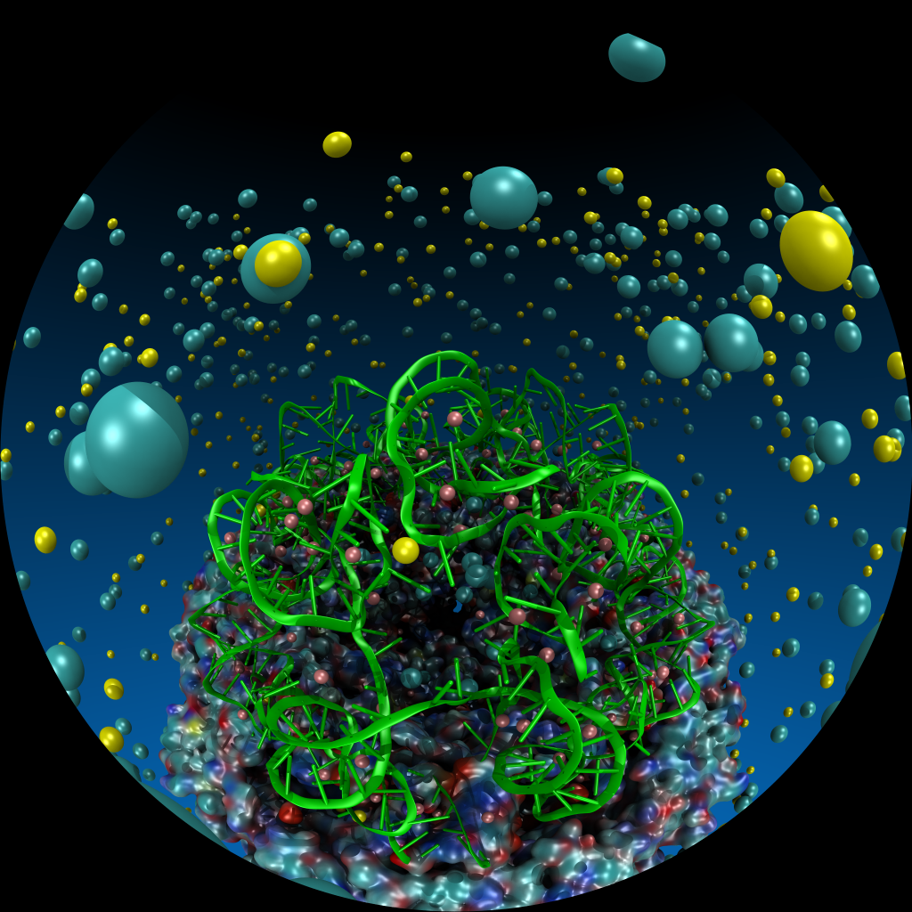
VMD Planetarium Dome Master Camera
Trivial to implement in OptiX
40 lines of CUDA code including antialiasing and handling corner cases for transcendental fctns
Try implementing this in OpenGL . . . (yuck)
Stereoscopic cameras and other special purpose projections are similarly easy

Slide 23
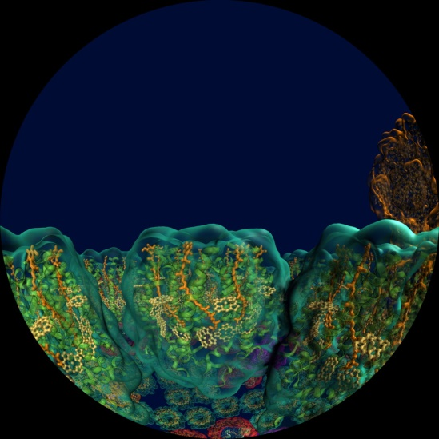
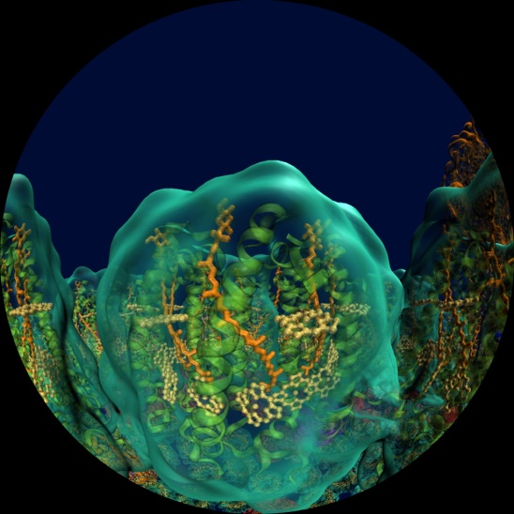
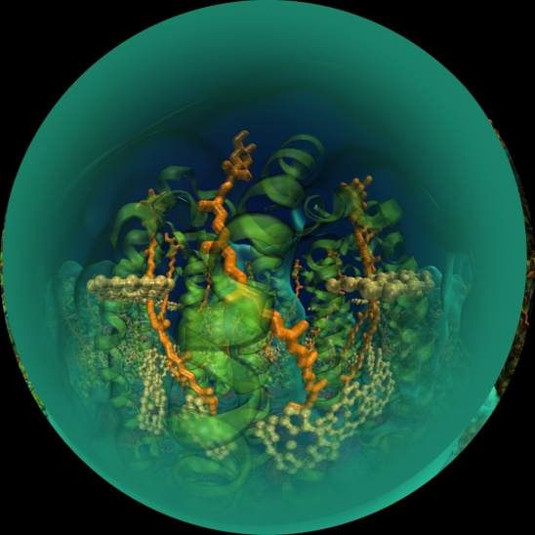
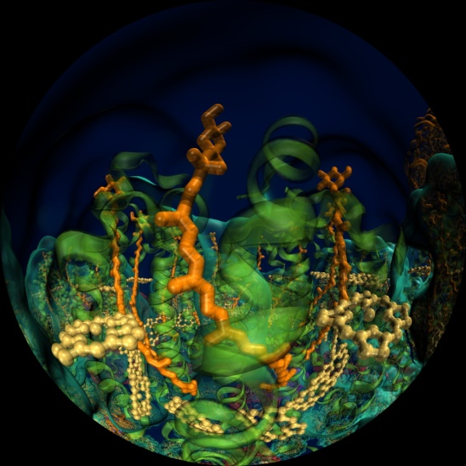
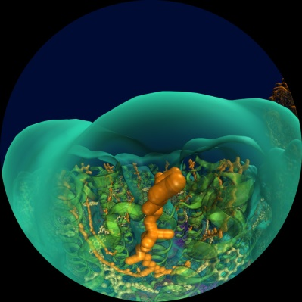
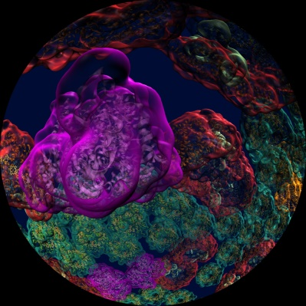
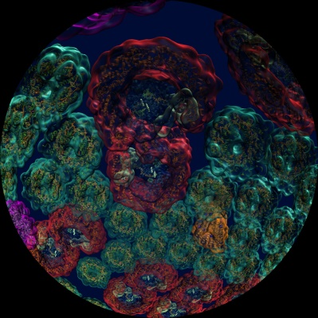
CADENS “Birth of Planet Earth” Planetarium Dome Master Test Frames

Slide 24
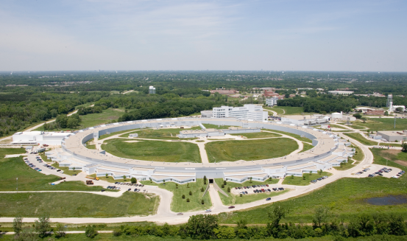
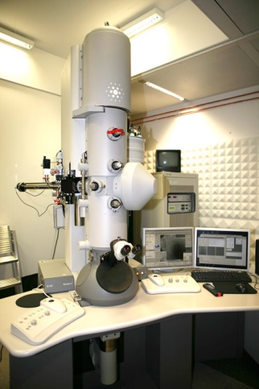
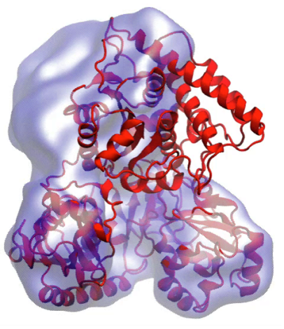
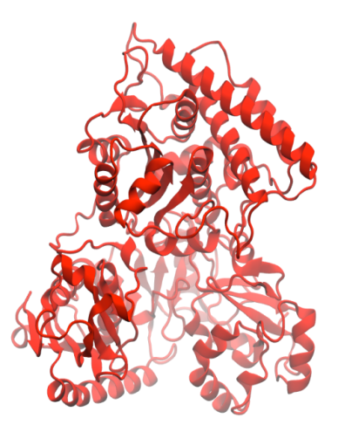
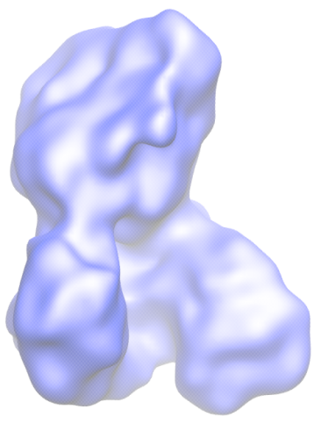
Molecular Dynamics Flexible Fitting (MDFF)
X-ray crystallography
MDFF
Electron microscopy
APS at Argonne
FEI microscope
ORNL Titan
Molecular dynamics-based refinement and validation for sub-5Å cryo-electron microscopy maps. A. Singharoy, I. Teo, R. McGreevy, J. E. Stone, J. Zhao, and K. Schulten. eLife 2016;10.7554/eLife.16105
Acetyl - CoA Synthase

Slide 25
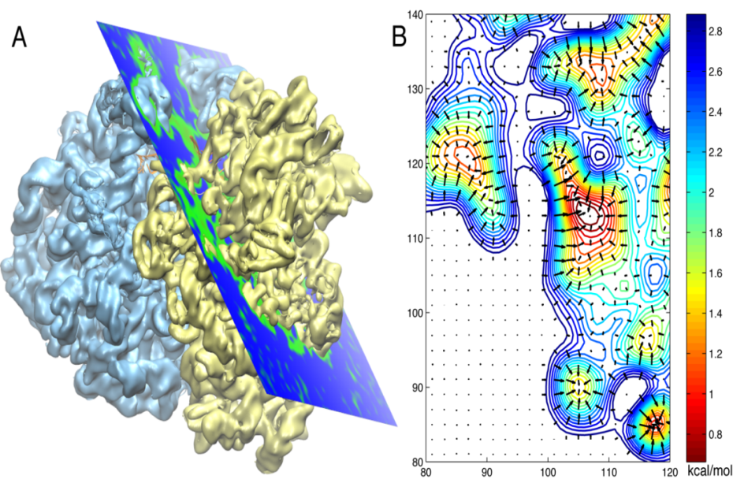
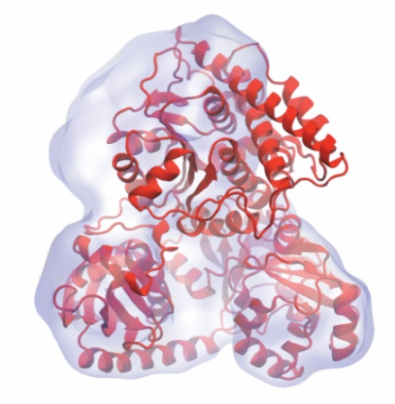
Molecular Dynamics Flexible Fitting - Theory
Two terms are added to the MD potential
An external potential derived from the EM map is defined on a grid as
A mass-weighted force is then applied to each atom

Slide 26
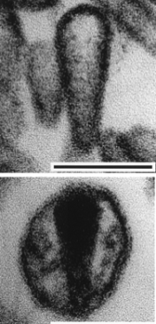
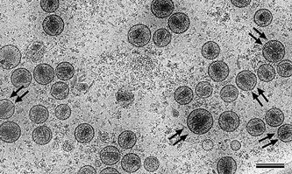
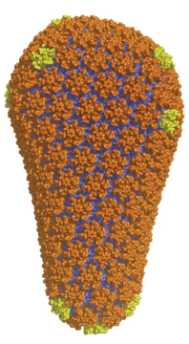
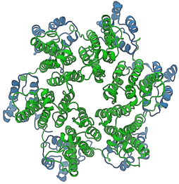
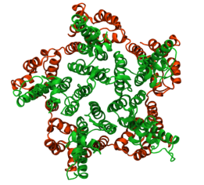
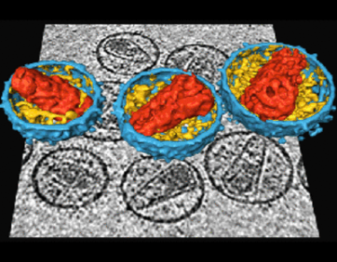
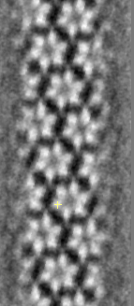
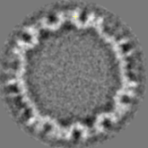
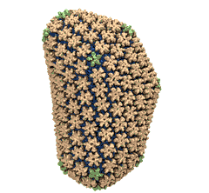
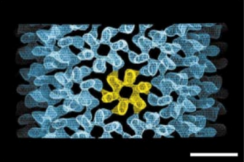
Structural Route to the all-atom HIV-1 Capsid
1st TEM (1999)
1st tomography (2003)
Crystal structures of separated hexamer and pentamer
Ganser et al. Science, 1999
Pornillos et al. , Cell 2009, Nature 2011
Briggs et al. EMBO J, 2003
High res. EM of hexameric tubule, tomography of capsid, all-atom model of capsid by MDFF w/ NAMD & VMD, NSF/NCSA Blue Waters computer at Illinois
Briggs et al. Structure, 2006
cryo-ET (2006)
hexameric tubule
Li et al., Nature, 2000
Byeon et al., Cell 2009
Zhao et al. , Nature 497: 643-646 (2013)

Slide 27
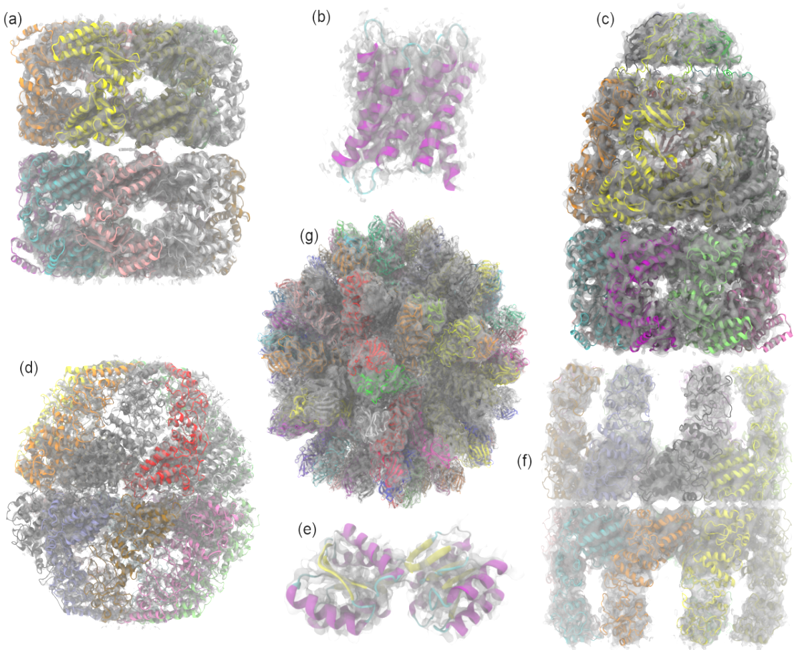
Evaluating Quality-of-Fit for Structures Solved by Hybrid Fitting Methods
Compute Pearson correlation to evaluate the fit of a reference cryo-EM density map with a simulated density map produced from an all-atom structure.

Slide 28
Evaluating Quality-of-Fit for Structures Solved by Hybrid Fitting Methods
Compute Pearson correlation to evaluate quality-of-fit between a reference cryo-EM density map and a simulated density map produced from an all-atom structure.

Slide 29
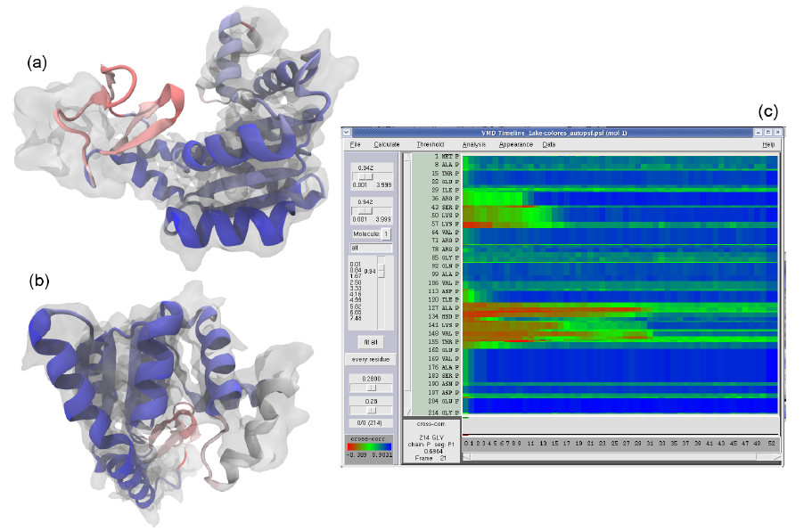
GPUs Can Reduce MDFF Trajectory Analysis Runtimes from Hours to Minutes
GPUs enable laptops and desktop workstations to handle tasks that would have previously required a cluster, or a very long wait…
GPU-accelerated petascale supercomputers enable analyses that were previously impractical, allowing detailed study of very large structures such as viruses
GPU-accelerated MDFF Cross Correlation Timeline
Regions with poor fit Regions with good fit

Slide 30
MDFF Density Map Algorithm
Build spatial acceleration data structures, optimize data for GPU
Compute 3-D density map:
Truncated Gaussian and spatial acceleration grid ensure linear time-complexity
3-D density map lattice point and the neighboring spatial acceleration cells it references

Slide 31
Single-Pass MDFF GPU Cross-Correlation
3-D density map decomposes into 3-D grid of 8x8x8 tiles containing CC partial sums and local CC values
Fusion of density and CC calculations into a single CUDA kernel!!!
Spatial CC map and overall CC value computed in a single pass
Small 8x8x2 CUDA thread blocks afford large
per-thread register count, shared memory
Each thread computes 4 z-axis density map lattice points and associated CC partial sums
0,0
0,1
…
Threads producing results that are used
1,0
1,1
…
…
…
…
Inactive threads, region of discarded output
Padding optimizes global memory performance, guaranteeing coalesced global memory accesses
Grid of thread blocks
Notes:
Threads in a thread block (potentially) execute in parallel
Threads in a block can communicate via fast shared memory
Global memory reads are slow
Constant memory is fast, but can only be written by host at kernel startup.

Slide 32
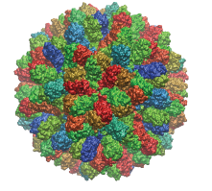
Parallel MDFF Cross Correlation Analysis on Cray XK7
Relative CC
Rabbit Hemorrhagic Disease Virus (RHDV)
Traj. frames | 10,000
Structure component selections | 720
Single-node XK7 (projected) | 336 hours (14 days)
128-node XK7 | 3.2 hours 105x speedup
2048-node XK7 | 19.5 minutes 1035x speedup
Structure
RHDV colored by relative CC
Time
Calculation of 7M CCs would take 5 years using serial CPU algorithm!
Stone et al., Faraday Discuss., 169:265-283, 2014.

Slide 33
VMD Tesla P100 Cross Correlation Performance Rabbit Hemorrhagic Disease Virus: 702K atoms, 6.5Å resolution P100 Die-Stacked Mem Accelerates Bandwidth Intensive Calculation
Hardware platform | Runtime, Speedup vs. Chimera, VMD+GPU
Chimera Xeon E5-2687W (2 socket) [1] | 15.860s, 1x
VMD-CPU IBM Power8 VSX SIMD (2 socket) [2] | 1.334s, 12x
VMD-CPU Intel Xeon E5-2660v3 SIMD (2 socket) [2] | 0.905s, 17x
VMD-CUDA IBM Power8 + 1x Tesla K40 [2] | 0.488s, 32x 0.9x
VMD-CUDA Intel Xeon E5-2687W + 1x Quadro K6000 [1,2] | 0.458s, 35x 1.0x
VMD-CUDA Intel Xeon E5-2698v3 + 1x Tesla P100 | 0.090s, 176x 5.1x
VMD-CUDA IBM Power8 “Minsky” + 1x Tesla P100 | 0.080s, 198x 5.7x
[1] GPU-Accelerated Analysis and Visualization of Large Structures Solved by Molecular Dynamics Flexible Fitting. J. E. Stone, R. McGreevy, B. Isralewitz, and K. Schulten. Faraday Discussions 169:265-283, 2014.
[2] Early Experiences Porting the NAMD and VMD Molecular Simulation and Analysis Software to GPU-Accelerated OpenPOWER Platforms. J. E. Stone, A.-P. Hynninen, J. C. Phillips, K. Schulten. International Workshop on OpenPOWER for HPC (IWOPH'16), LNCS 9945, pp. 188-206, 2016.

Slide 34
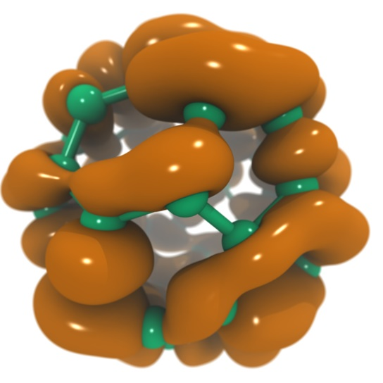
VMD Tesla P100 Performance for C₆₀ Molecular Orbitals, 516x519x507 grid
Hardware platform | Runtime, Speedup
IBM Power8 (2 socket) (ORNL ‘crest’) [1] | 8.03s, 0.4x
Intel Xeon E5-2660v3 (2 socket) [1] | 7.14s, 0.5x
IBM Power8 (ORNL ‘crest’) + 1x Tesla K40 [1] | 3.49s, 1.0x
Intel Xeon E5-2698v3 + 1x Tesla P100 | 1.35s, 2.5x
IBM Power8 “Minsky” + 1x Tesla P100 | 1.09s, 3.3x
IBM Power8 (ORNL ‘crest’) + 4x Tesla K40 [1] | 0.91s, 3.8x
Intel Xeon E5-2698v3 + 4x Tesla P100 | 0.37s, 9.4x
IBM Power8 “Minsky” + 4x Tesla P100 | 0.30s, 11.6x
NVLink perf. boost w/ no code tuning
(YET)
[1] Early Experiences Porting the NAMD and VMD Molecular Simulation and Analysis Software to GPU-Accelerated OpenPOWER Platforms. J. E. Stone, A.-P. Hynninen, J. C. Phillips, K. Schulten. International Workshop on OpenPOWER for HPC (IWOPH'16), LNCS 9945, pp. 188-206, 2016.

Slide 35
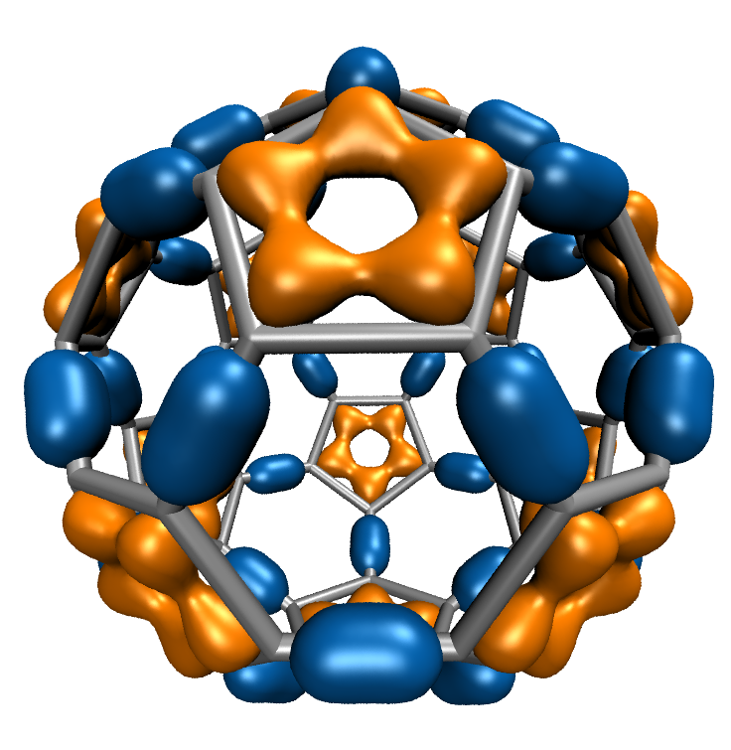
Molecular Orbitals w/ NVRTC JIT
Visualization of MOs aids in understanding the chemistry of molecular system
MO spatial distribution is correlated with probability density for an electron(s)
Animation of (classical mechanics) molecular dynamics trajectories provides insight into simulation results
To do the same for QM or QM/MM simulations MOs must be computed at 10 FPS or more
Large GPU speedups (up to 30x vs. current generation 4-core CPUs) over existing tools makes this possible!
Run-time code generation (JIT) and compilation via CUDA NVRTC enable further optimizations and the highest performance to date: 1.8x faster than fully-general data-driven loops
C₆₀
High Performance Computation and Interactive Display of Molecular Orbitals on GPUs and Multi-core CPUs. J. E. Stone, J. Saam, D. Hardy, K. Vandivort, W. Hwu, K. Schulten, 2nd Workshop on General-Purpose Computation on Graphics Processing Units (GPGPU-2), ACM International Conference Proceeding Series, volume 383, pp. 9-18, 2009.
Notes:
35
CBH – we should probably write “electron(s)”. Most people are used to closed shell calcs in which the MO contains 2 electrons; but open shell calcs are definitely on the rise in which each MO contains only 1 electron.

Slide 36
MO GPU Parallel Decomposition
MO 3-D lattice decomposes into 2-D slices (CUDA grids)
…
GPU 2
GPU 1
GPU 0
Small 8x8 thread blocks afford large
per-thread register count, shared memory
Lattice computed using multiple GPUs
0,0
0,1
…
Threads producing results that are used
Each thread computes one MO lattice point.
1,0
1,1
…
…
…
…
Padding optimizes global memory performance, guaranteeing coalesced global memory accesses
Threads producing results that are discarded
Grid of thread blocks
Notes:
Threads in a thread block (potentially) execute in parallel
Threads in a block can communicate via fast shared memory
Global memory reads are slow
Constant memory is fast, but can only be written by host at kernel startup.

Slide 37
MO Kernel for One Grid Point (Naive C)
…
for (at=0; at<numatoms; at++) {
int prim_counter = atom_basis[at];
calc_distances_to_atom(&atompos[at], &xdist, &ydist, &zdist, &dist2, &xdiv);
for (contracted_gto=0.0f, shell=0; shell < num_shells_per_atom[at]; shell++) {
int shell_type = shell_symmetry[shell_counter];
for (prim=0; prim < num_prim_per_shell[shell_counter]; prim++) {
float exponent = basis_array[prim_counter ];
float contract_coeff = basis_array[prim_counter + 1];
contracted_gto += contract_coeff * expf(-exponent*dist2);
prim_counter += 2;
}
for (tmpshell=0.0f, j=0, zdp=1.0f; j<=shell_type; j++, zdp*=zdist) {
int imax = shell_type - j;
for (i=0, ydp=1.0f, xdp=pow(xdist, imax); i<=imax; i++, ydp*=ydist, xdp*=xdiv)
tmpshell += wave_f[ifunc++] * xdp * ydp * zdp;
}
value += tmpshell * contracted_gto;
shell_counter++;
}
} …..
Loop over atoms
Loop over shells
Loop over primitives: largest component of runtime, due to expf()
Loop over angular momenta
(unrolled in real code)

Slide 38
MO Kernel Structure, Opportunity for NRTC JIT… Data-driven execution, but representative loop trip counts in (…)
Loop over atoms (1 to ~200) {
Loop over electron shells for this atom type (1 to ~6) {
Loop over primitive functions for this shell type (1 to ~6) {
}
Small loop trip counts result in significant loop overhead. Runtime kernel generation and NVRTC JIT compilation can achieve in a large (1.8x!) speed boost via loop unrolling, constant folding, elimination of array accesses, …
Loop over angular momenta for this shell type (1 to ~15) {}
}
}
Notes:
38
expf() is very costly on the CPU, often several hundred clock cycles
On GPUs expf() is implemented as a native machine instruction executing in just tens of clock cycles which gives us a huge performance boost all by itself, but the other large component of GPU performance comes from the massive parallelism.
We can launch a calculation on tens of thousands of grid points at once on the GPU, fully utilizing all of its hardware.
CBH – much better. I modifited “shells” to “electron shells” and “primitives” to “primitive functions”

Slide 39
Molecular Orbital Computation and Display Process Runtime Kernel Generation, NVRTC Just-In-Time (JIT) Compilation
One-time initialization
Read QM simulation log file, trajectory
Preprocess MO coefficient data
eliminate duplicates, sort by type, etc…
Initialize Pool of GPU
Worker Threads
Generate/compile basis set-specific CUDA kernel
For current frame and MO index,
retrieve MO wavefunction coefficients
Compute 3-D grid of MO wavefunction amplitudes
using basis set-specific CUDA kernel
For each trj frame, for each MO shown
Extract isosurface mesh from 3-D MO grid
Render the resulting surface

Slide 40
for (shell=0; shell < maxshell; shell++) {
float contracted_gto = 0.0f;
// Loop over the Gaussian primitives of CGTO
int maxprim = const_num_prim_per_shell[shell_counter];
int shell_type = const_shell_symmetry[shell_counter];
for (prim=0; prim < maxprim; prim++) {
float exponent = const_basis_array[prim_counter ];
float contract_coeff = const_basis_array[prim_counter + 1];
contracted_gto += contract_coeff * expf(-exponent*dist2);
prim_counter += 2;
}
General loop-based data-dependent MO CUDA kernel
Runtime-generated data-specific MO CUDA kernel compiled via CUDA NVRTC JIT…
contracted_gto = 1.832937 * expf(-7.868272*dist2);
contracted_gto += 1.405380 * expf(-1.881289*dist2);
contracted_gto += 0.701383 * expf(-0.544249*dist2);
1.8x Faster

Slide 41
for (shell=0; shell < maxshell; shell++) {
float contracted_gto = 0.0f;
// Loop over the Gaussian primitives of CGTO
int maxprim = const_num_prim_per_shell[shell_counter];
int shell_type = const_shell_symmetry[shell_counter];
for (prim=0; prim < maxprim; prim++) {
float exponent = const_basis_array[prim_counter ];
float contract_coeff = const_basis_array[prim_counter + 1];
contracted_gto += contract_coeff * expf(-exponent*dist2);
prim_counter += 2;
}
float tmpshell=0;
switch (shell_type) {
case S_SHELL:
value += const_wave_f[ifunc++] * contracted_gto;
break;
[…..]
case D_SHELL:
tmpshell += const_wave_f[ifunc++] * xdist2;
tmpshell += const_wave_f[ifunc++] * ydist2;
tmpshell += const_wave_f[ifunc++] * zdist2;
tmpshell += const_wave_f[ifunc++] * xdist * ydist;
tmpshell += const_wave_f[ifunc++] * xdist * zdist;
tmpshell += const_wave_f[ifunc++] * ydist * zdist;
value += tmpshell * contracted_gto;
break;
contracted_gto = 1.832937 * expf(-7.868272*dist2);
contracted_gto += 1.405380 * expf(-1.881289*dist2);
contracted_gto += 0.701383 * expf(-0.544249*dist2);
// P_SHELL
tmpshell = const_wave_f[ifunc++] * xdist;
tmpshell += const_wave_f[ifunc++] * ydist;
tmpshell += const_wave_f[ifunc++] * zdist;
value += tmpshell * contracted_gto;
contracted_gto = 0.187618 * expf(-0.168714*dist2);
// S_SHELL
value += const_wave_f[ifunc++] * contracted_gto;
contracted_gto = 0.217969 * expf(-0.168714*dist2);
// P_SHELL
tmpshell = const_wave_f[ifunc++] * xdist;
tmpshell += const_wave_f[ifunc++] * ydist;
tmpshell += const_wave_f[ifunc++] * zdist;
value += tmpshell * contracted_gto;
contracted_gto = 3.858403 * expf(-0.800000*dist2);
// D_SHELL
tmpshell = const_wave_f[ifunc++] * xdist2;
tmpshell += const_wave_f[ifunc++] * ydist2;
tmpshell += const_wave_f[ifunc++] * zdist2;
tmpshell += const_wave_f[ifunc++] * xdist * ydist;
tmpshell += const_wave_f[ifunc++] * xdist * zdist;
tmpshell += const_wave_f[ifunc++] * ydist * zdist;
value += tmpshell * contracted_gto;
General loop-based data-dependent MO CUDA kernel
Runtime-generated data-specific MO CUDA kernel compiled via CUDA NVRTC JIT…
1.8x Faster

Slide 42
Challenges Adapting Large Software Systems for State-of-the-Art Hardware Platforms
Initial focus on key computational kernels eventually gives way to the need to optimize an ocean of less critical routines, due to observance of Amdahl’s Law
Even though these less critical routines might be easily ported to CUDA or similar, the sheer number of routines often poses a challenge
Need a low-cost approach for getting “some” speedup out of these second-tier routines
In many cases, it is completely sufficient to achieve memory-bandwidth-bound GPU performance with an existing algorithm

Slide 43
Directive-Based Parallel Programming with OpenACC
Annotate loop nests in existing code with #pragma compiler directives:
Annotate opportunities for parallelism
Annotate points where host-GPU memory transfers are best performed, indicate propagation of data
Evolve original code structure to improve efficacy of parallelization
Eliminate false dependencies between loop iterations
Revise algorithms or constructs that create excess data movement

Slide 44
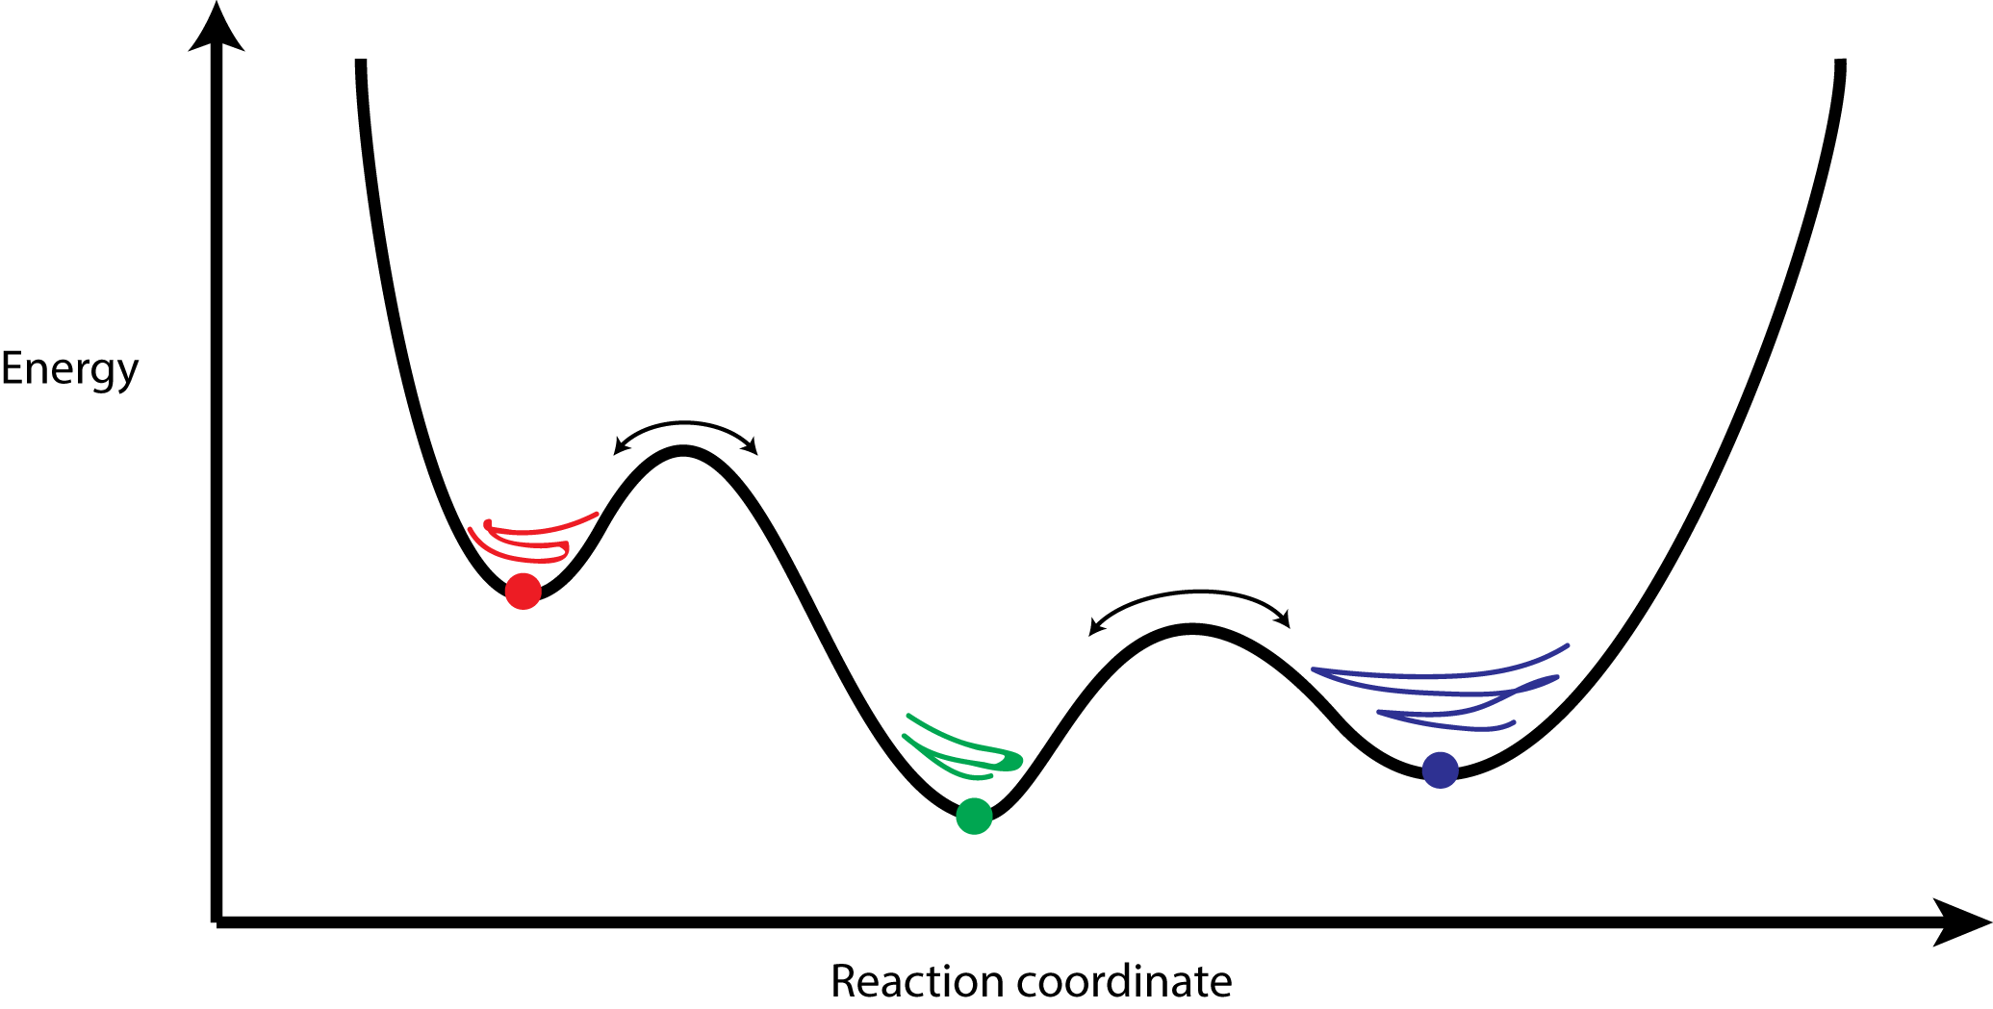
Clustering Analysis of Molecular Dynamics Trajectories
GPU-Accelerated Molecular Dynamics Clustering Analysis with OpenACC. J.E. Stone, J.R. Perilla, C. K. Cassidy, and K. Schulten. In, Robert Farber, ed., Parallel Programming with OpenACC, Morgan Kaufmann, Chapter 11, pp. 215-240, 2016.

Slide 45
Serial QCP RMSD Inner Product Loop
for (int l=0; l<cnt; l++) {
double x1, x2, y1, y2, z1, z2;
x1 = crdx1[l];
y1 = crdy1[l];
z1 = crdz1[l];
G1 += x1*x1 + y1*y1 + z1*z1;
x2 = crdx2[l];
y2 = crdy2[l];
z2 = crdz2[l];
G2 += x2*x2 + y2*y2 + z2*z2;
a0 += x1 * x2;
a1 += x1 * y2;
a2 += x1 * z2;
a3 += y1 * x2;
a4 += y1 * y2;
a5 += y1 * z2;
a6 += z1 * x2;
a7 += z1 * y2;
a8 += z1 * z2;
}
Simple example where directive based parallelism can be applied easily and effectively
Such a loop is inherently a memory-bandwidth-bound algorithm, so that’s the goal for acceleration

Slide 46
OpenACC QCP RMSD Inner Product Loop
Simple example where directive based parallelism can be applied easily and effectively
Such a loop is inherently a memory-bandwidth-bound algorithm, so that’s the goal for acceleration
// excerpted code that has been abridged for brevity…
void rmsdmat_qcp_acc(int cnt, int padcnt, int framecrdsz,
int framecount, const float * restrict crds,
long i, j, k;
#pragma acc kernels copyin(crds[0:tsz]), copy(rmsdmat[0:msz])
for (k=0; k<(framecount*(framecount-1))/2; k++) {
// compute triangular matrix index ‘k’ in a helper function
// to ensure that the compiler doesn’t think that we have
// conflicts or dependencies between loop iterations
acc_idx2sub_tril(long(framecount-1), k, &i, &j);
long x1addr = j * 3L * framecrdsz;
long x2addr = i * 3L * framecrdsz;
#pragma acc loop vector(256)
for (long l=0; l<cnt; l++) {
// abridged for brevity ...
rmsdmat[k]=rmsd; // store linearized triangular matrix
}
}

Slide 47
OpenACC QCP RMSD Inner Product Loop Performance Results
Xeon 2687W v3, w/ hand-coded AVX and FMA intrinsics: 20.7s
Tesla K80 w/ OpenACC: 6.5s (3.2x speedup)
OpenACC on K80 achieved 65% of theoretical peak memory bandwidth, with 2016 compiler and just a few lines of #pragma directives. Excellent speedup for minimal changes to code.
Future OpenACC compiler revs should provide higher performance yet

Slide 48
Acknowledgements
Theoretical and Computational Biophysics Group, University of Illinois at Urbana-Champaign
CUDA Center of Excellence, University of Illinois at Urbana-Champaign
NVIDIA CUDA and OptiX teams
Funding:
DOE INCITE, ORNL Titan: DE-AC05-00OR22725
NSF Blue Waters: NSF OCI 07-25070, PRAC “The Computational Microscope”, ACI-1238993, ACI-1440026
NIH support: 9P41GM104601, 5R01GM098243-02
Notes:
48

Slide 49
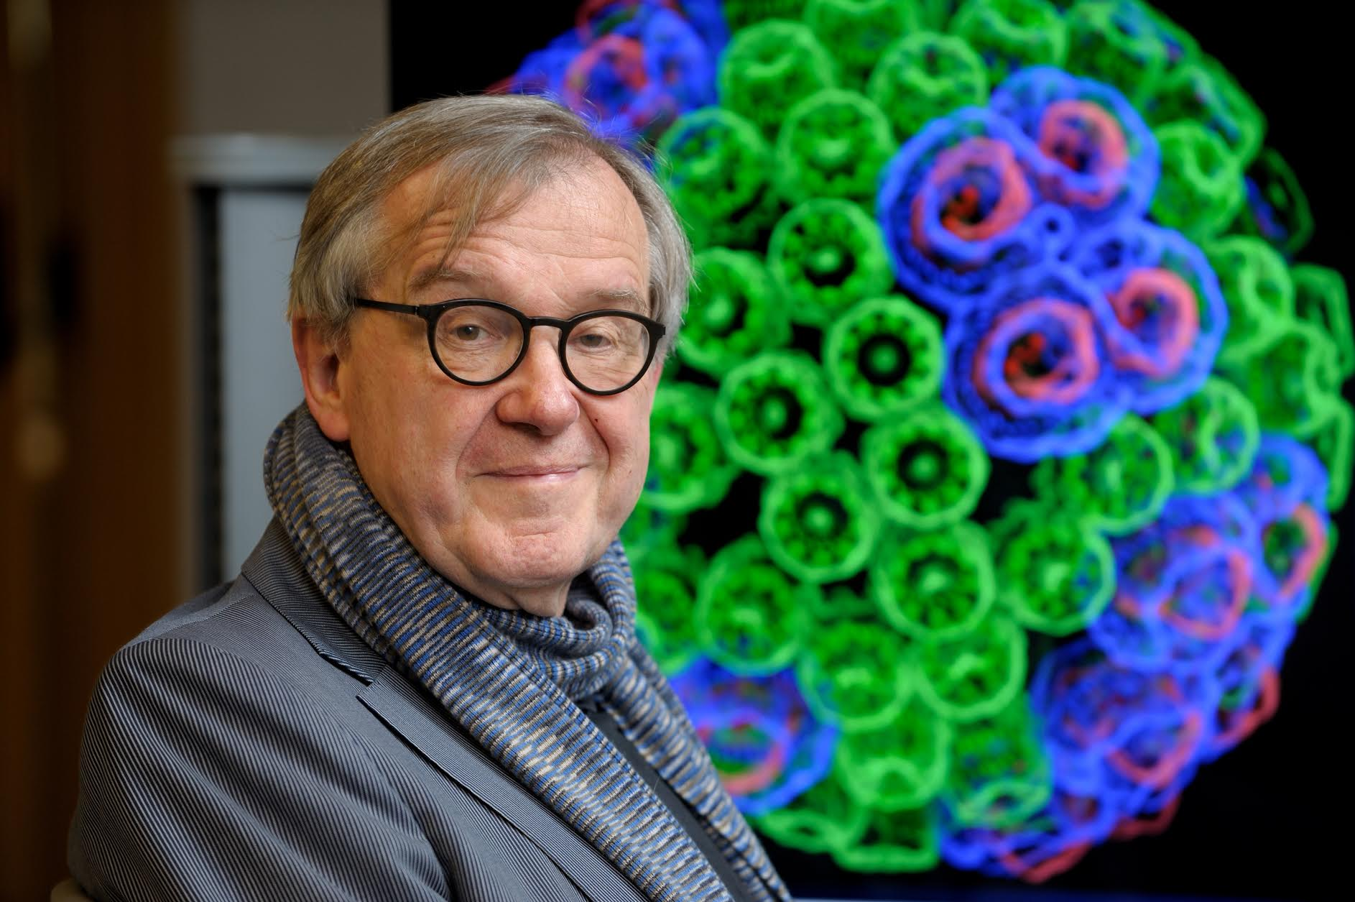
“When I was a young man, my goal was to look with mathematical and computational means at the inside of cells, one atom at a time, to decipher how living systems work. That is what I strived for and I never deflected from this goal.” – Klaus Schulten

Slide 50
Related Publications http://www.ks.uiuc.edu/Research/gpu/
Challenges of Integrating Stochastic Dynamics and Cryo-electron Tomograms in Whole-cell Simulations. T. M. Earnest, R. Watanabe, J. E. Stone, J. Mahamid, W. Baumeister, E. Villa, and Z. Luthey-Schulten. J. Physical Chemistry B, 121(15): 3871-3881, 2017.
Early Experiences Porting the NAMD and VMD Molecular Simulation and Analysis Software to GPU-Accelerated OpenPOWER Platforms. J. E. Stone, A.-P. Hynninen, J. C. Phillips, and K. Schulten. International Workshop on OpenPOWER for HPC (IWOPH'16), LNCS 9945, pp. 188-206, 2016.
Immersive Molecular Visualization with Omnidirectional Stereoscopic Ray Tracing and Remote Rendering. J. E. Stone, W. R. Sherman, and K. Schulten. High Performance Data Analysis and Visualization Workshop, IEEE International Parallel and Distributed Processing Symposium Workshop (IPDPSW), pp. 1048-1057, 2016.
High Performance Molecular Visualization: In-Situ and Parallel Rendering with EGL. J. E. Stone, P. Messmer, R. Sisneros, and K. Schulten. High Performance Data Analysis and Visualization Workshop, IEEE International Parallel and Distributed Processing Symposium Workshop (IPDPSW), pp. 1014-1023, 2016.
Evaluation of Emerging Energy-Efficient Heterogeneous Computing Platforms for Biomolecular and Cellular Simulation Workloads. J. E. Stone, M. J. Hallock, J. C. Phillips, J. R. Peterson, Z. Luthey-Schulten, and K. Schulten.25th International Heterogeneity in Computing Workshop, IEEE International Parallel and Distributed Processing Symposium Workshop (IPDPSW), pp. 89-100, 2016.
Atomic Detail Visualization of Photosynthetic Membranes with GPU-Accelerated Ray Tracing. J. E. Stone, M. Sener, K. L. Vandivort, A. Barragan, A. Singharoy, I. Teo, J. V. Ribeiro, B. Isralewitz, B. Liu, B.-C. Goh, J. C. Phillips, C. MacGregor-Chatwin, M. P. Johnson, L. F. Kourkoutis, C. Neil Hunter, and K. Schulten. J. Parallel Computing, 55:17-27, 2016.

Slide 51
Related Publications http://www.ks.uiuc.edu/Research/gpu/
Chemical Visualization of Human Pathogens: the Retroviral Capsids. Juan R. Perilla, Boon Chong Goh, John E. Stone, and Klaus Schulten. SC'15 Visualization and Data Analytics Showcase, 2015.
Visualization of Energy Conversion Processes in a Light Harvesting Organelle at Atomic Detail. M. Sener, J. E. Stone, A. Barragan, A. Singharoy, I. Teo, K. L. Vandivort, B. Isralewitz, B. Liu, B. Goh, J. C. Phillips, L. F. Kourkoutis, C. N. Hunter, and K. Schulten. SC'14 Visualization and Data Analytics Showcase, 2014. ***Winner of the SC'14 Visualization and Data Analytics Showcase
Runtime and Architecture Support for Efficient Data Exchange in Multi-Accelerator Applications. J. Cabezas, I. Gelado, J. E. Stone, N. Navarro, D. B. Kirk, and W. Hwu. IEEE Transactions on Parallel and Distributed Systems, 26(5):1405-1418, 2015.
Unlocking the Full Potential of the Cray XK7 Accelerator. M. D. Klein and J. E. Stone. Cray Users Group, Lugano Switzerland, May 2014.
GPU-Accelerated Analysis and Visualization of Large Structures Solved by Molecular Dynamics Flexible Fitting. J. E. Stone, R. McGreevy, B. Isralewitz, and K. Schulten. Faraday Discussions, 169:265-283, 2014.
Simulation of reaction diffusion processes over biologically relevant size and time scales using multi-GPU workstations. M. J. Hallock, J. E. Stone, E. Roberts, C. Fry, and Z. Luthey-Schulten. Journal of Parallel Computing, 40:86-99, 2014.

Slide 52
Related Publications http://www.ks.uiuc.edu/Research/gpu/
GPU-Accelerated Molecular Visualization on Petascale Supercomputing Platforms. J. Stone, K. L. Vandivort, and K. Schulten. UltraVis'13: Proceedings of the 8th International Workshop on Ultrascale Visualization, pp. 6:1-6:8, 2013.
Early Experiences Scaling VMD Molecular Visualization and Analysis Jobs on Blue Waters. J. Stone, B. Isralewitz, and K. Schulten. In proceedings, Extreme Scaling Workshop, 2013.
Lattice Microbes: High‐performance stochastic simulation method for the reaction‐diffusion master equation. E. Roberts, J. Stone, and Z. Luthey‐Schulten. J. Computational Chemistry 34 (3), 245-255, 2013.
Fast Visualization of Gaussian Density Surfaces for Molecular Dynamics and Particle System Trajectories. M. Krone, J. Stone, T. Ertl, and K. Schulten. EuroVis Short Papers, pp. 67-71, 2012.
Immersive Out-of-Core Visualization of Large-Size and Long-Timescale Molecular Dynamics Trajectories. J. Stone, K. L. Vandivort, and K. Schulten. G. Bebis et al. (Eds.): 7th International Symposium on Visual Computing (ISVC 2011), LNCS 6939, pp. 1-12, 2011.
Fast Analysis of Molecular Dynamics Trajectories with Graphics Processing Units – Radial Distribution Functions. B. Levine, J. Stone, and A. Kohlmeyer. J. Comp. Physics, 230(9):3556-3569, 2011.

Slide 53
Related Publications http://www.ks.uiuc.edu/Research/gpu/
Quantifying the Impact of GPUs on Performance and Energy Efficiency in HPC Clusters. J. Enos, C. Steffen, J. Fullop, M. Showerman, G. Shi, K. Esler, V. Kindratenko, J. Stone, J Phillips. International Conference on Green Computing, pp. 317-324, 2010.
GPU-accelerated molecular modeling coming of age. J. Stone, D. Hardy, I. Ufimtsev, K. Schulten. J. Molecular Graphics and Modeling, 29:116-125, 2010.
OpenCL: A Parallel Programming Standard for Heterogeneous Computing. J. Stone, D. Gohara, G. Shi. Computing in Science and Engineering, 12(3):66-73, 2010.
An Asymmetric Distributed Shared Memory Model for Heterogeneous Computing Systems. I. Gelado, J. Stone, J. Cabezas, S. Patel, N. Navarro, W. Hwu. ASPLOS ’10: Proceedings of the 15th International Conference on Architectural Support for Programming Languages and Operating Systems, pp. 347-358, 2010.

Slide 54
Related Publications http://www.ks.uiuc.edu/Research/gpu/
GPU Clusters for High Performance Computing. V. Kindratenko, J. Enos, G. Shi, M. Showerman, G. Arnold, J. Stone, J. Phillips, W. Hwu. Workshop on Parallel Programming on Accelerator Clusters (PPAC), In Proceedings IEEE Cluster 2009, pp. 1-8, Aug. 2009.
Long time-scale simulations of in vivo diffusion using GPU hardware. E. Roberts, J. Stone, L. Sepulveda, W. Hwu, Z. Luthey-Schulten. In IPDPS’09: Proceedings of the 2009 IEEE International Symposium on Parallel & Distributed Computing, pp. 1-8, 2009.
High Performance Computation and Interactive Display of Molecular Orbitals on GPUs and Multi-core CPUs. J. E. Stone, J. Saam, D. Hardy, K. Vandivort, W. Hwu, K. Schulten, 2nd Workshop on General-Purpose Computation on Graphics Pricessing Units (GPGPU-2), ACM International Conference Proceeding Series, volume 383, pp. 9-18, 2009.
Probing Biomolecular Machines with Graphics Processors. J. Phillips, J. Stone. Communications of the ACM, 52(10):34-41, 2009.
Multilevel summation of electrostatic potentials using graphics processing units. D. Hardy, J. Stone, K. Schulten. J. Parallel Computing, 35:164-177, 2009.

Slide 55
Related Publications http://www.ks.uiuc.edu/Research/gpu/
Adapting a message-driven parallel application to GPU-accelerated clusters. J. Phillips, J. Stone, K. Schulten. Proceedings of the 2008 ACM/IEEE Conference on Supercomputing, IEEE Press, 2008.
GPU acceleration of cutoff pair potentials for molecular modeling applications. C. Rodrigues, D. Hardy, J. Stone, K. Schulten, and W. Hwu. Proceedings of the 2008 Conference On Computing Frontiers, pp. 273-282, 2008.
GPU computing. J. Owens, M. Houston, D. Luebke, S. Green, J. Stone, J. Phillips. Proceedings of the IEEE, 96:879-899, 2008.
Accelerating molecular modeling applications with graphics processors. J. Stone, J. Phillips, P. Freddolino, D. Hardy, L. Trabuco, K. Schulten. J. Comp. Chem., 28:2618-2640, 2007.
Continuous fluorescence microphotolysis and correlation spectroscopy. A. Arkhipov, J. Hüve, M. Kahms, R. Peters, K. Schulten. Biophysical Journal, 93:4006-4017, 2007.

